Slide 1

Notes:
Script: Before class. Lab open at #/day/9, Console panel open, the TVmaze tab with /shows/169?embed[]=cast&embed[]=seasons ready. Today the app gets bigger, not harder: state, render(), loops.

Slide 2
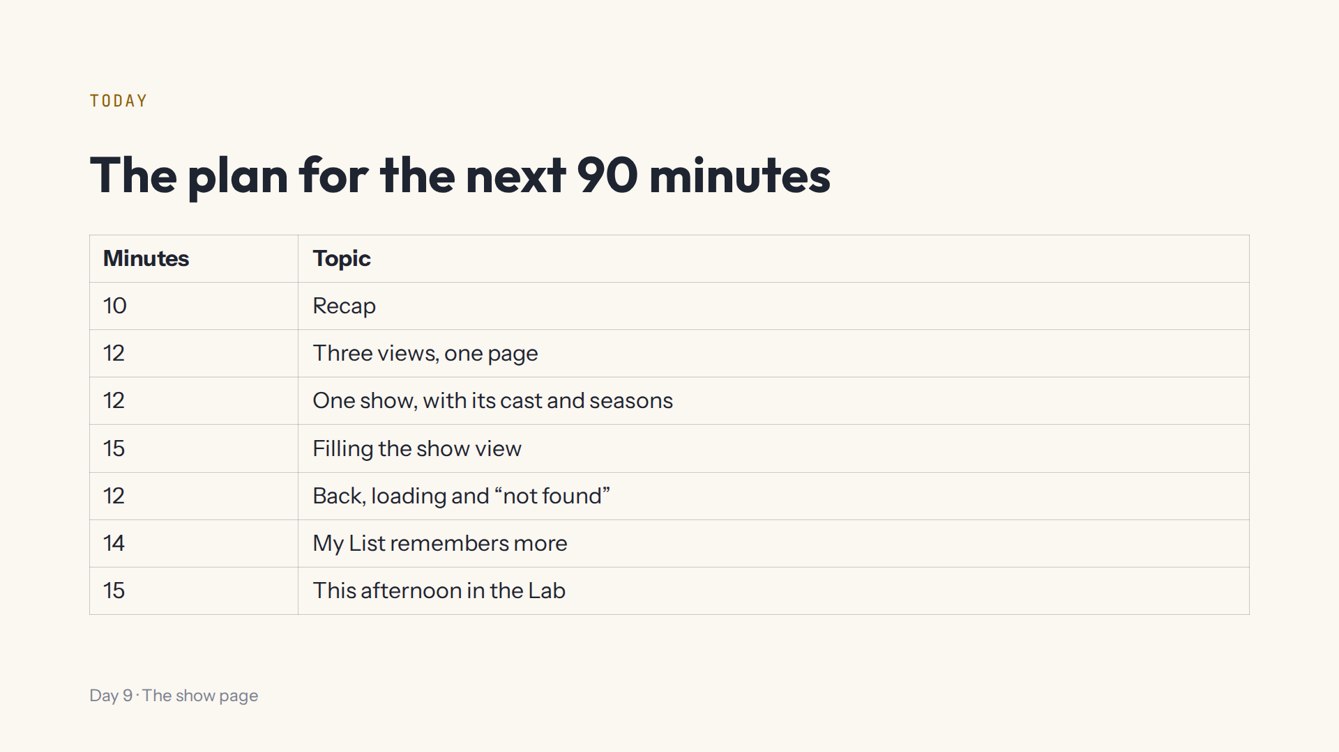
Notes:
Script 0:00. Ideas from 0:10 to 1:15; the last 15 minutes prepare the afternoon.

Slide 3
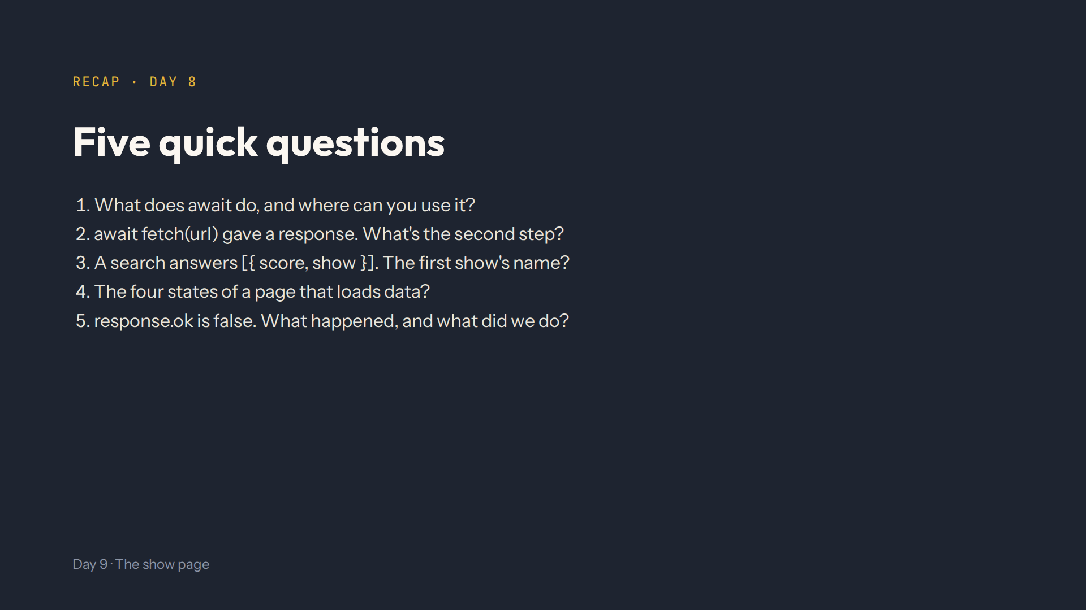
Notes:
Answers in quiz.md. Waits for the answer, only inside an async function. await response.json(). results[0].show.name. Loading, error, empty, success. TVmaze answered an error status; searchShows throws, and catch shows a friendly red message.

Slide 4
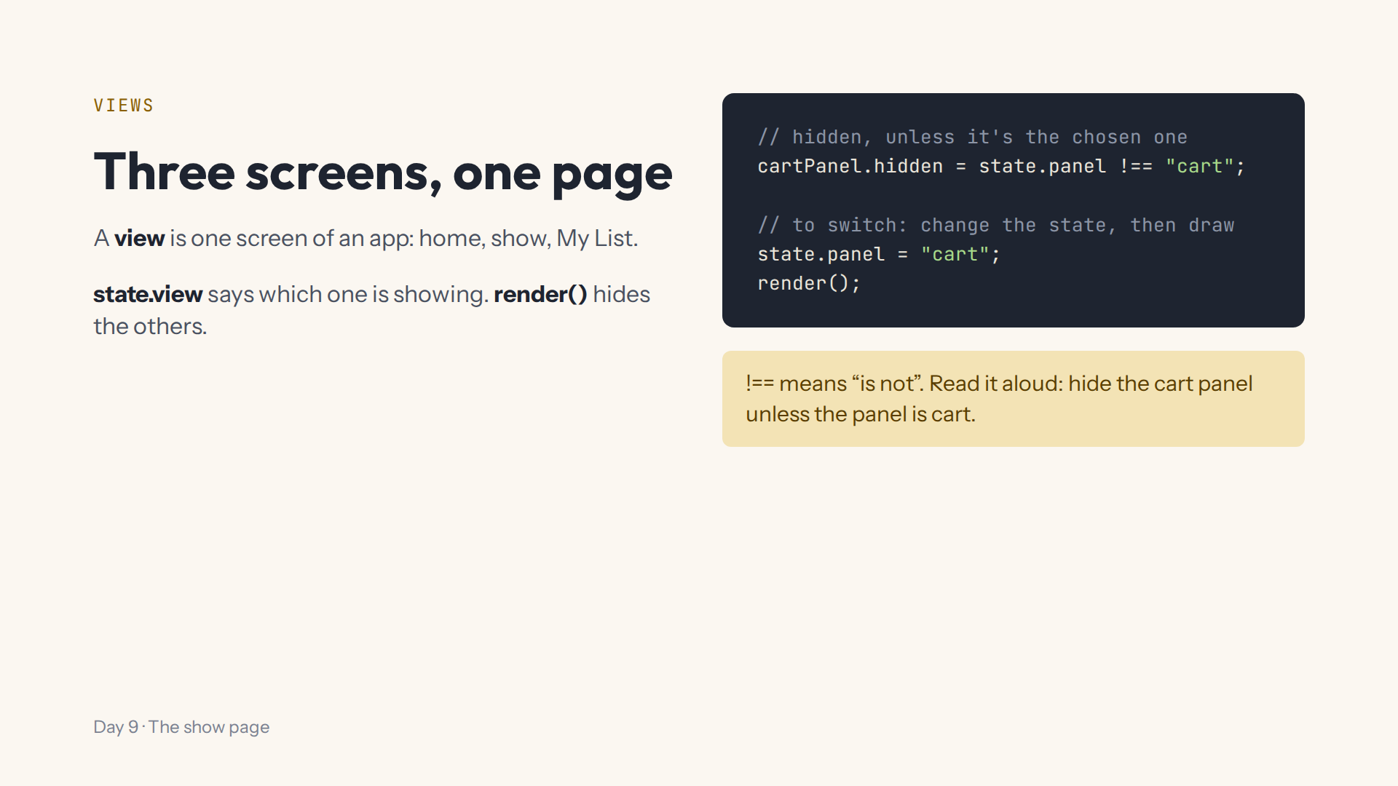
Notes:
Script 0:10. Step 1, whole-page tab: three sections. Type homeView.hidden = true; and showView.hidden = false; at the bottom. Mistake on purpose: hidden = "false" in quotes still hides. Start again afterwards.

Slide 5
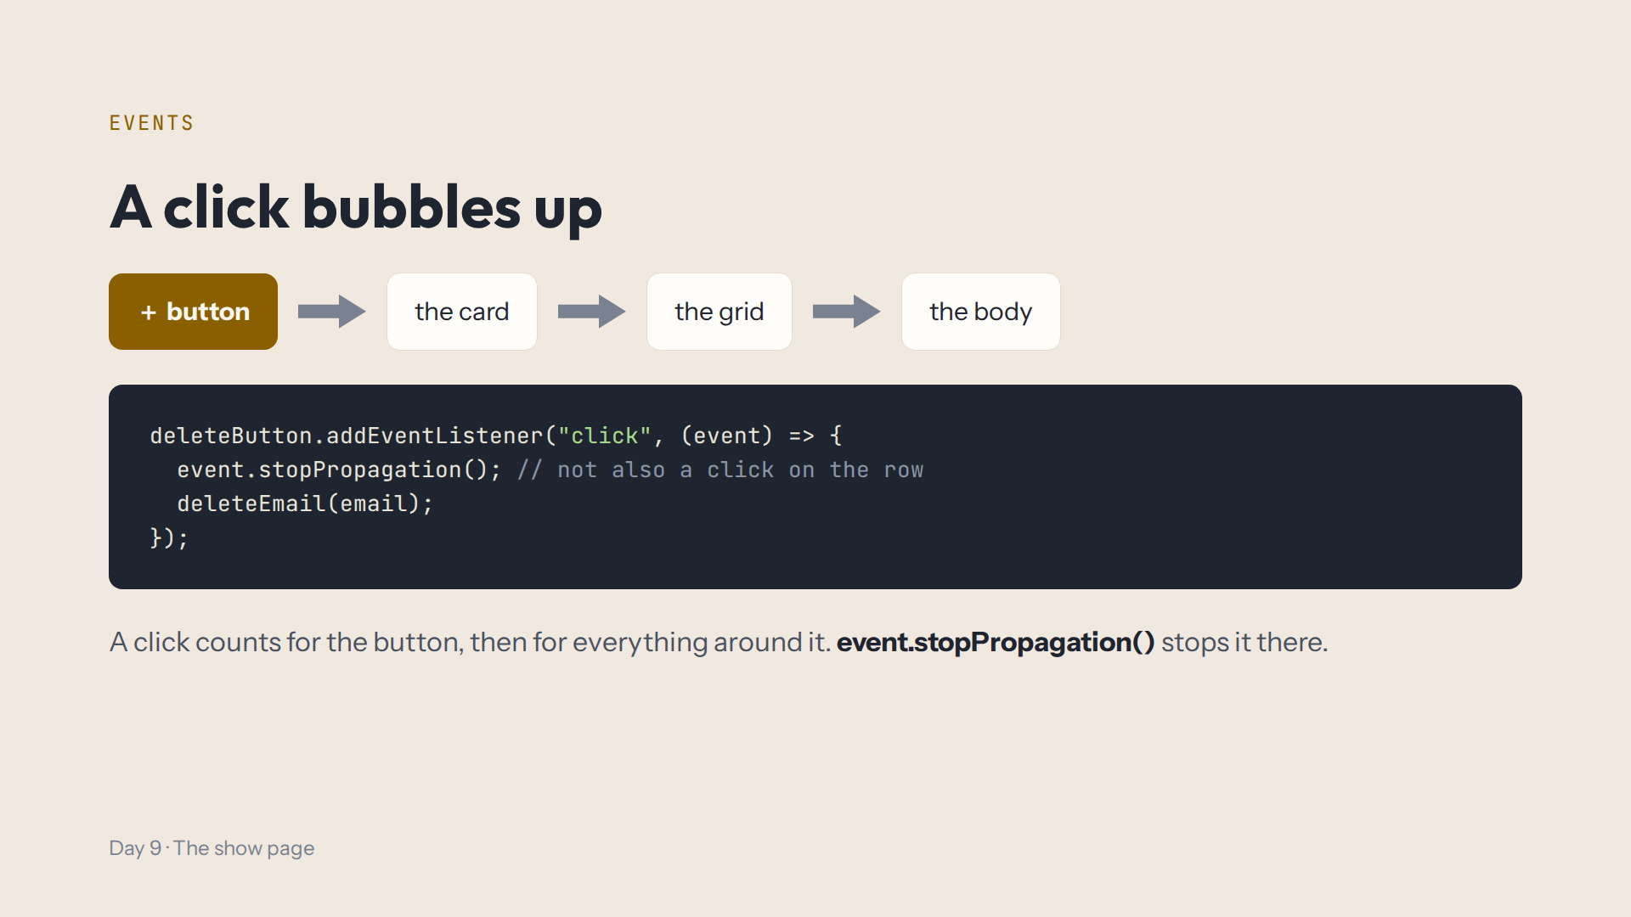
Notes:
Script 0:10, Clicks bubble. Demo: a click listener on document.body that logs, then click a + button: the counter changes and the Console logs too. Ask: stopPropagation on the card or on the button? Start again.

Slide 6
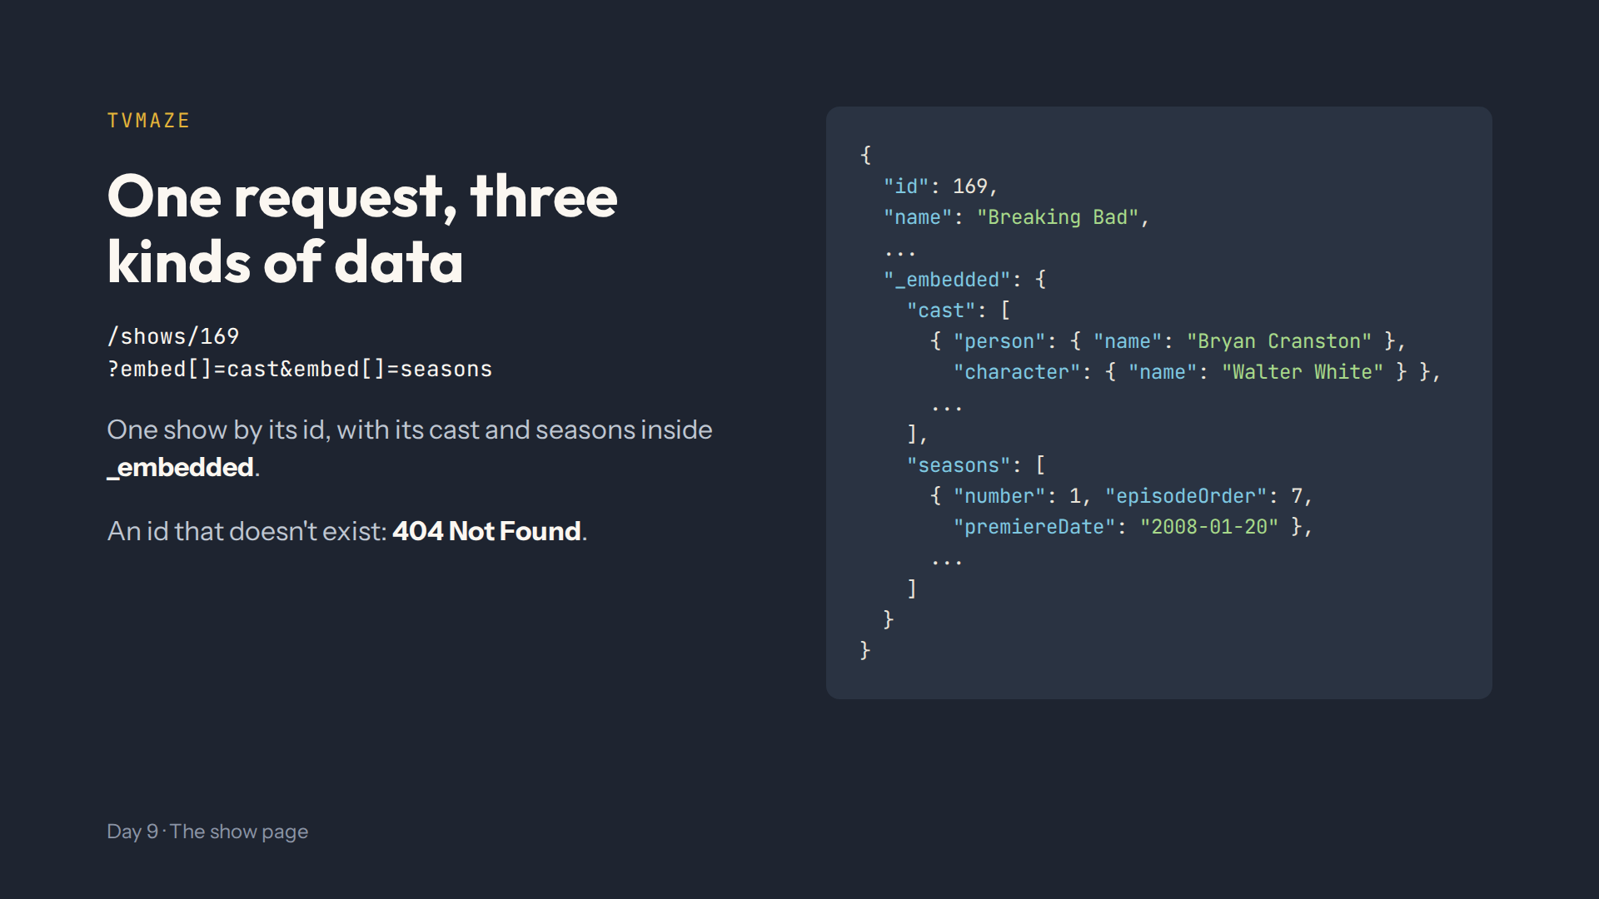
Notes:
Script 0:22. Open the tab with the real answer and scroll to _embedded. Then id 999999999: 404, remember it for step 8. Then step 2: the tonight() demo, a function that returns an object; plan.Show gives undefined.

Slide 7
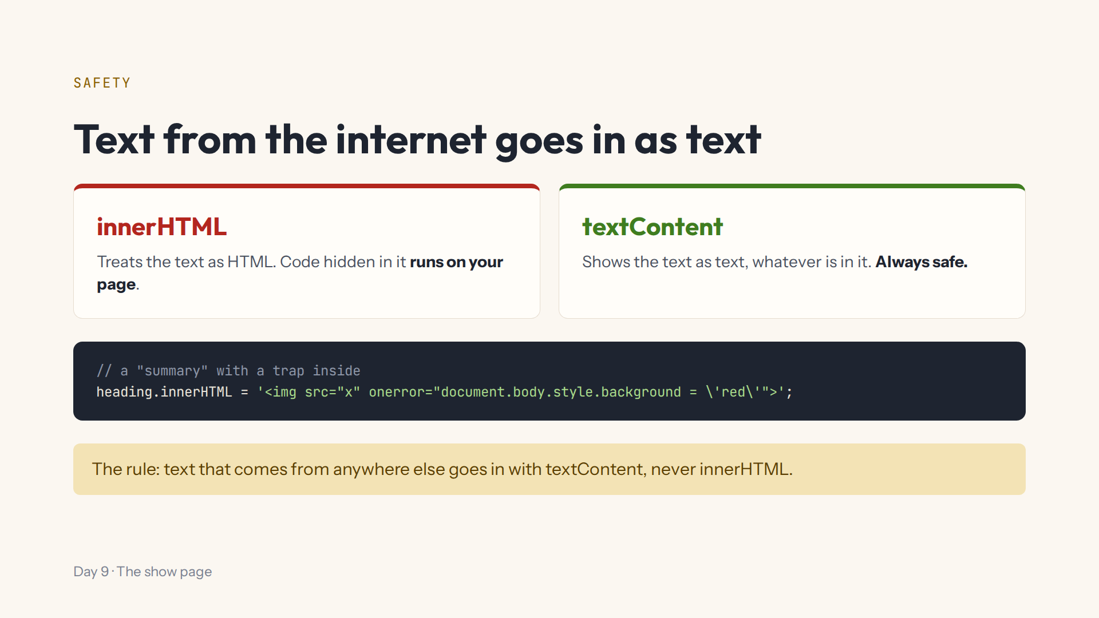
Notes:
Script 0:34. Step 3, at the bottom: const heading = document.querySelector("h1"), then this line: the page turns red. Change innerHTML to textContent: the strange text shows, nothing runs. Start again.

Slide 8
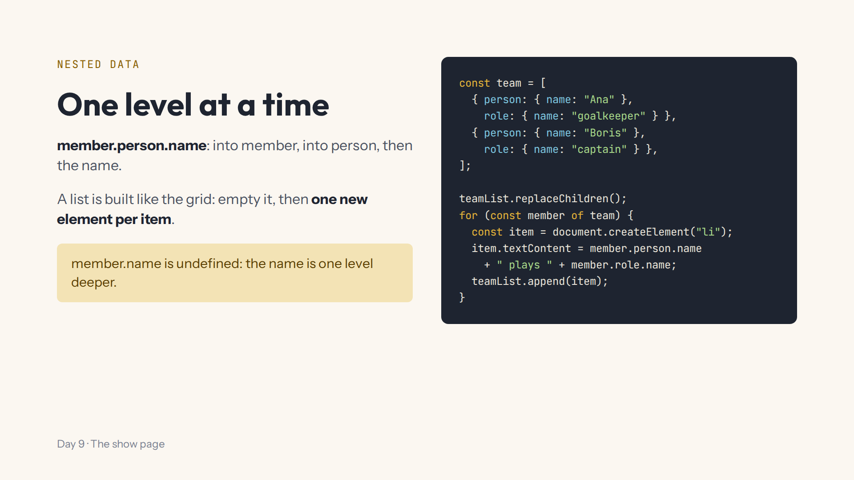
Notes:
Script 0:34, Nested data. Demo in step 4 with the console.log version of this team loop, then member.name on purpose: undefined. The cast has the same shape: member.person.name and member.character.name. Start again.

Slide 9
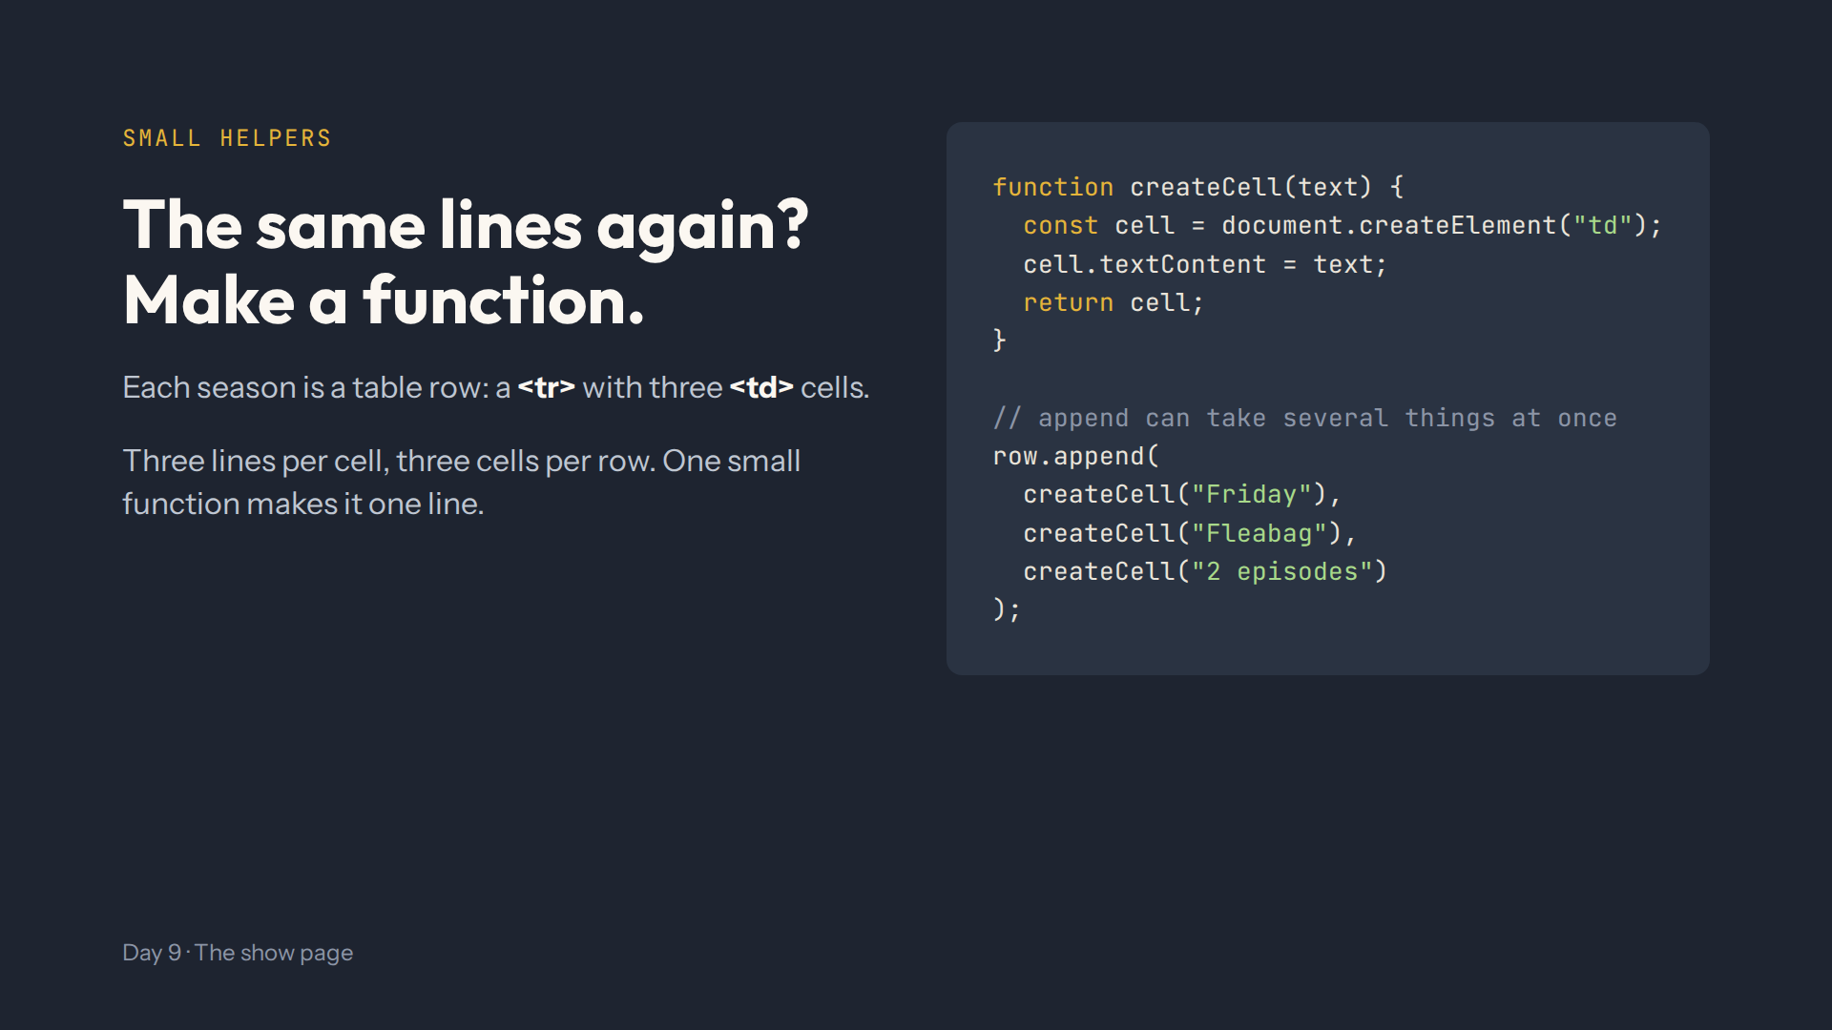
Notes:
Script 0:34, A small function. createCell is ready in step 5: students write one row.append line, and yearOf(season.premiereDate) keeps only the year.

Slide 10
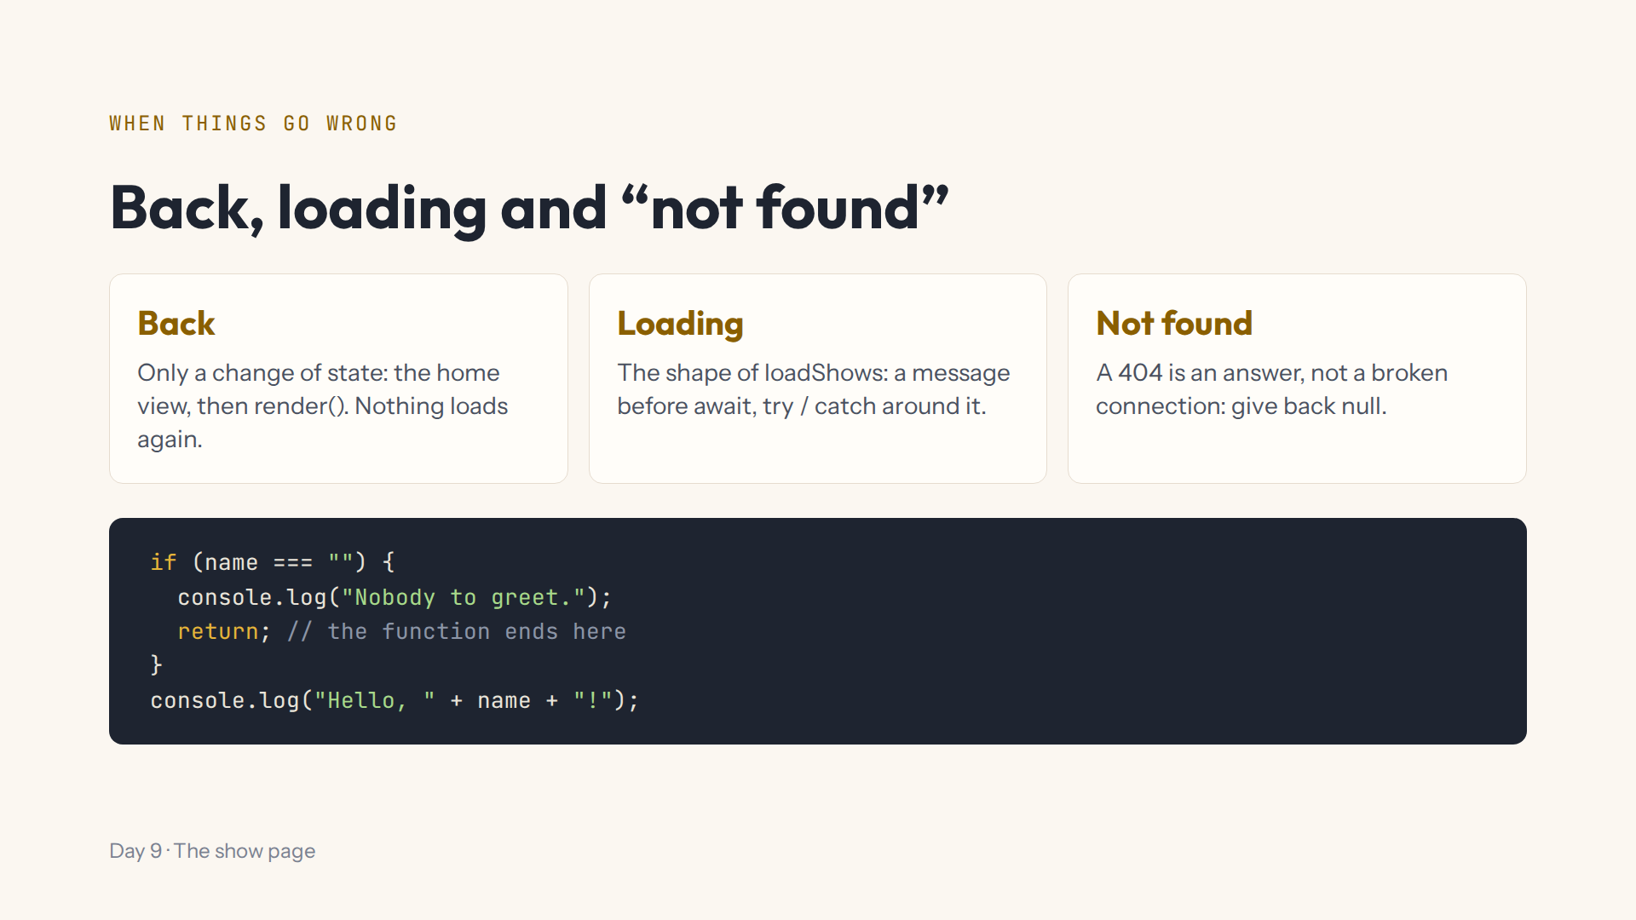
Notes:
Script 0:49. Ask: does the back button need TVmaze? No. Scroll up to loadShows in step 7 and read its shape. Then the greet demo in step 8; delete return on purpose and both lines print.

Slide 11
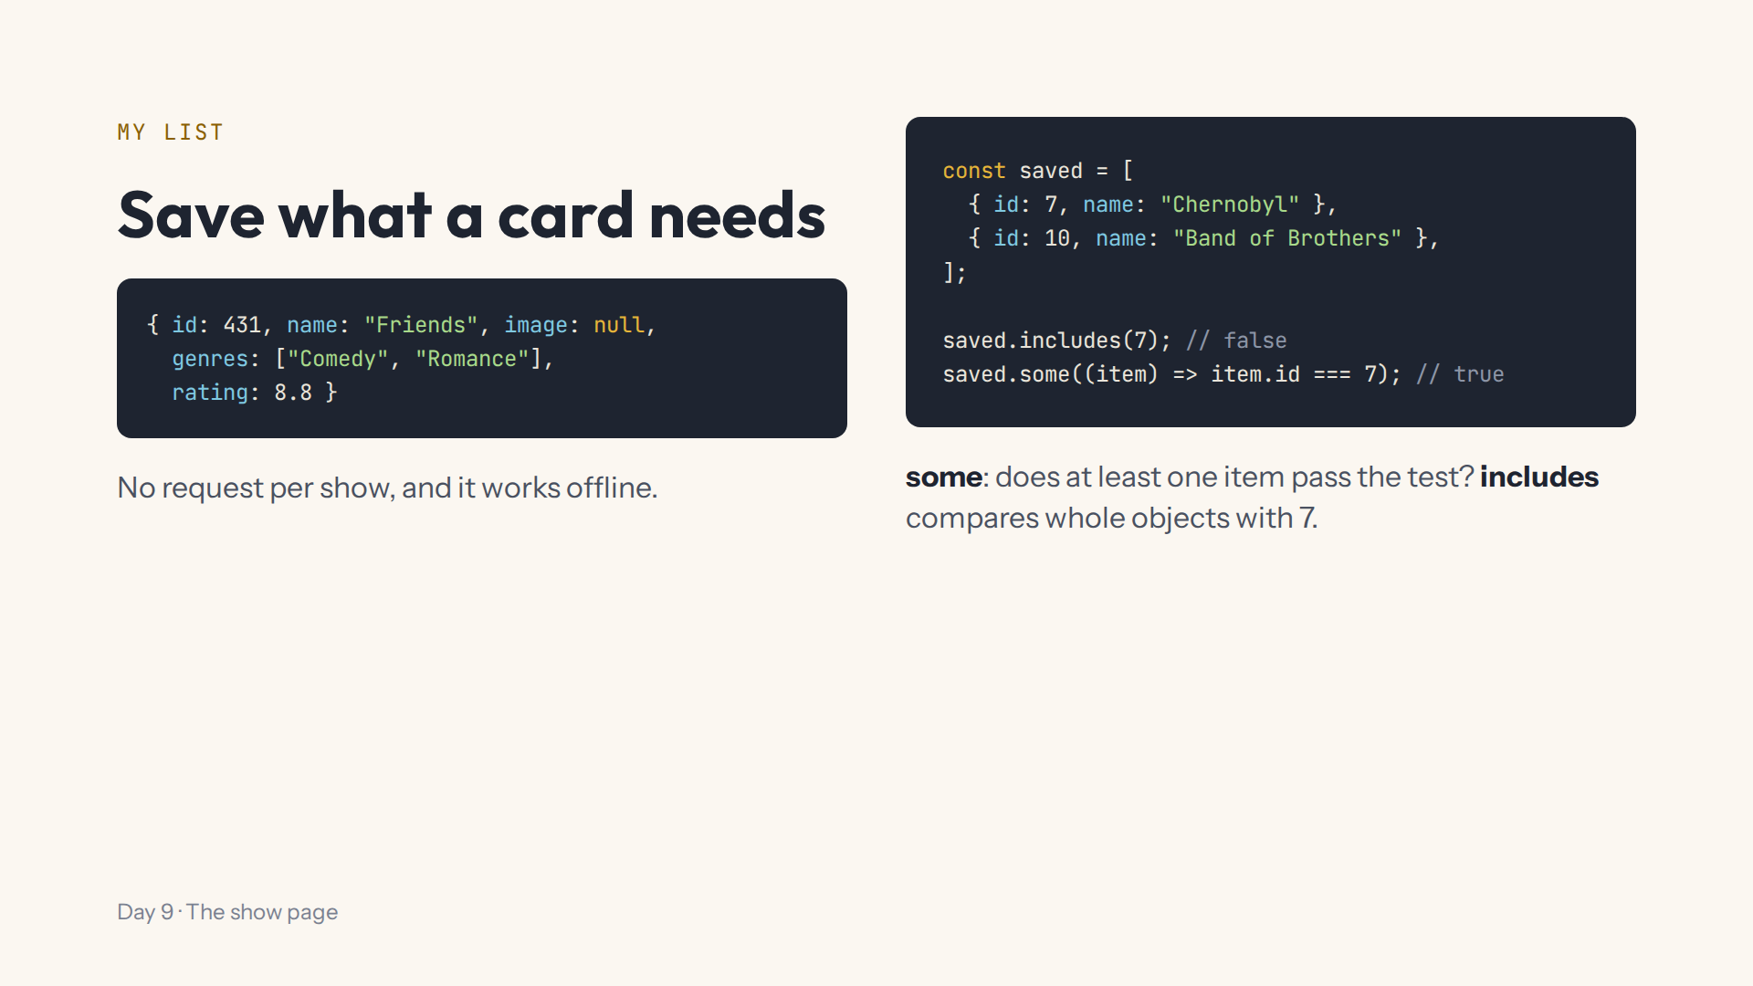
Notes:
Script 1:01. Step 9: add a show, log localStorage.getItem("myListIds"): only ids. Then the includes / some demo. My List goes back to the key "myList"; loadMyList is given and drops the old Day 7 ids.

Slide 12
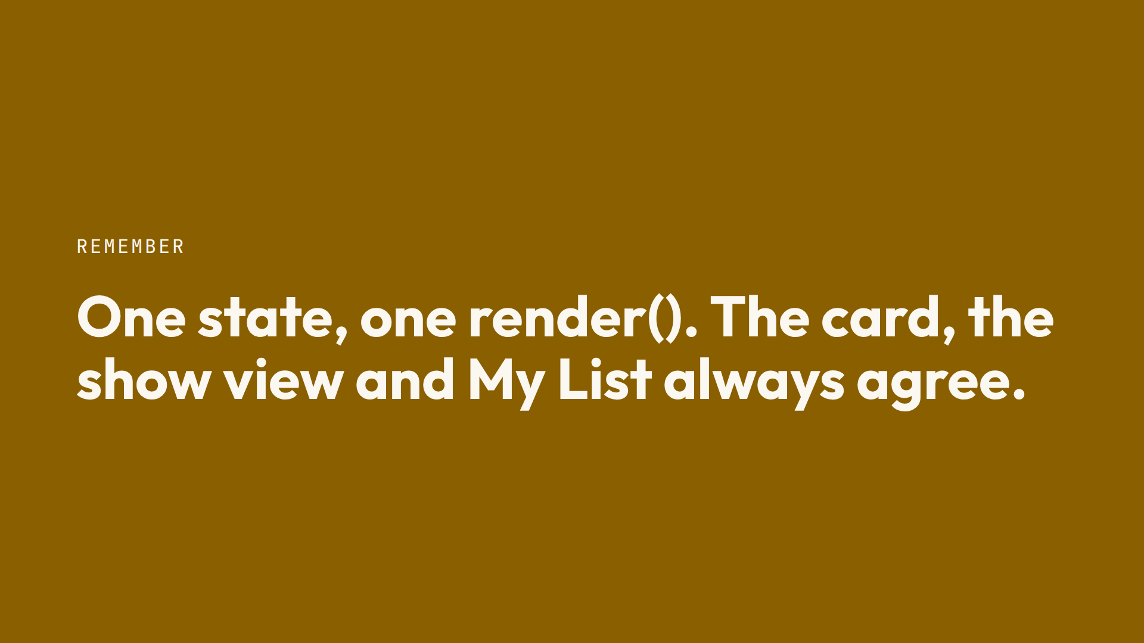
Notes:
Script 1:01, One render. The My List view reuses createCard; header links need preventDefault; the show view's button reads state.currentShow. Ask: you add a show from the show view, which places must show it? How many do you update by hand? None.

Slide 13
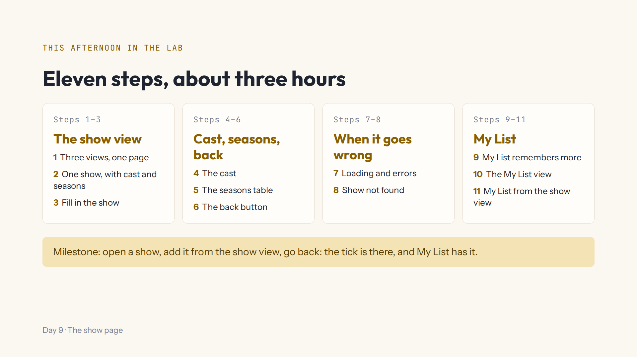
Notes:
Script 1:15. Open #/day/9, read the steps, do step 1 together with Teacher view off. Show Hint, Answer, the Console. Progress saves by itself; Help, Save progress to a file to change computers. Extras B1 to B3 for fast finishers.

Slide 14
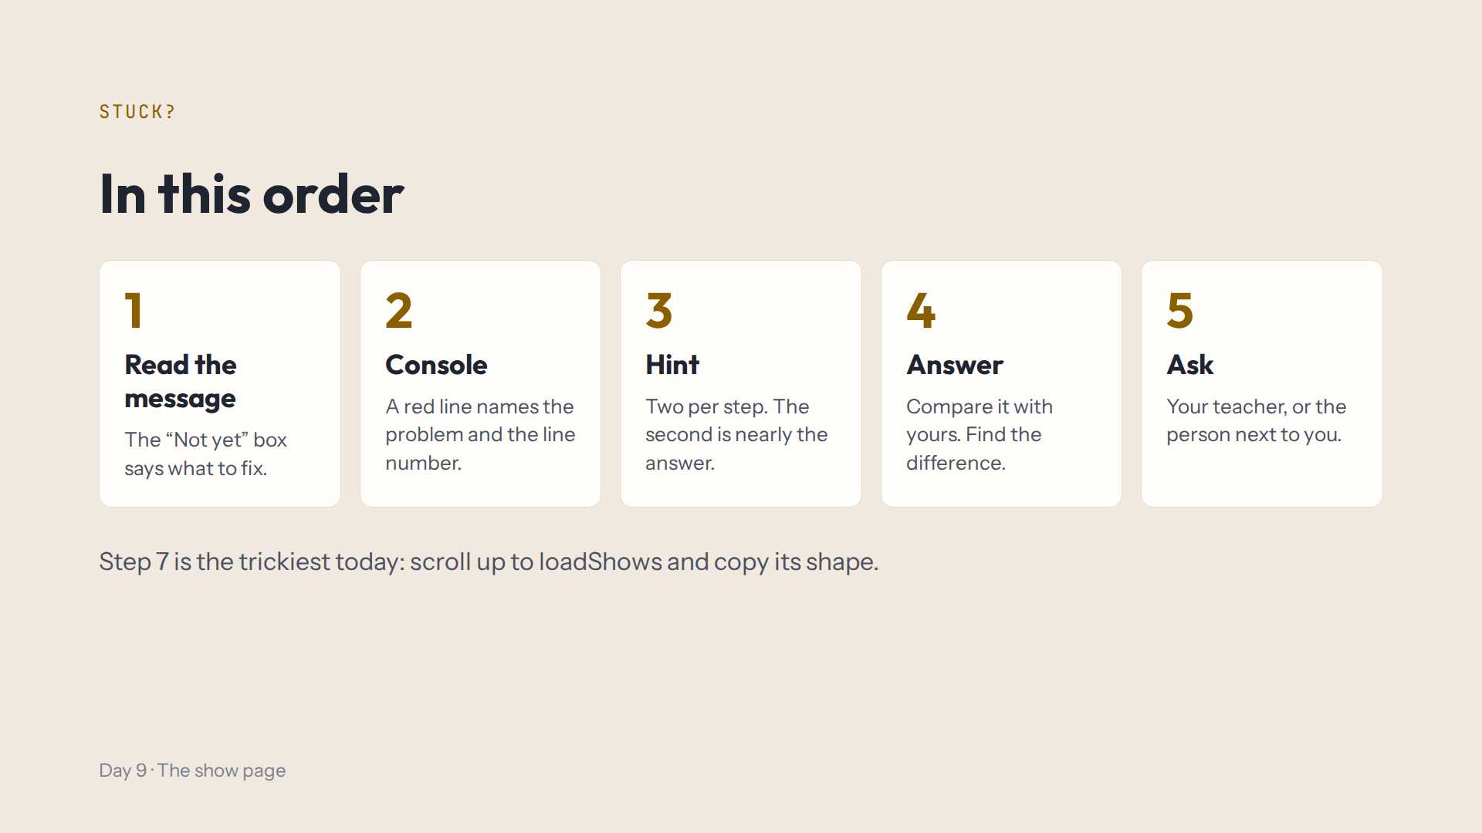
Notes:
Script 1:15. Today the Console also says when the Lab used sample data: that's fine, every check works offline.

Slide 15
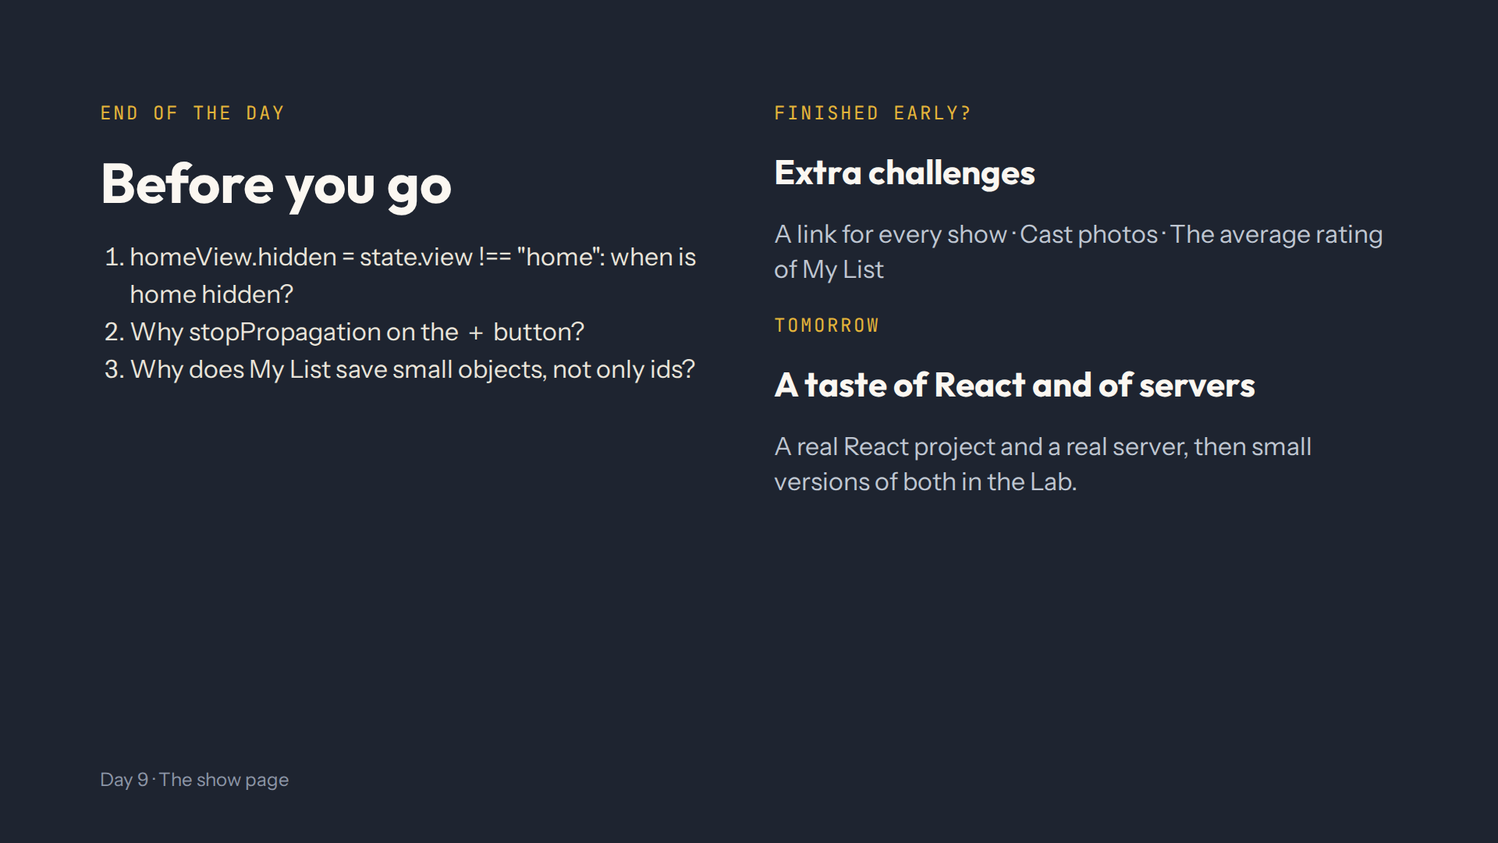
Notes:
For the afternoon teacher at the end of the day. Answers in quiz.md, End-of-day check. Ask them to show you: a show added from the show view, its tick on the card, and My List.

