Slide 1
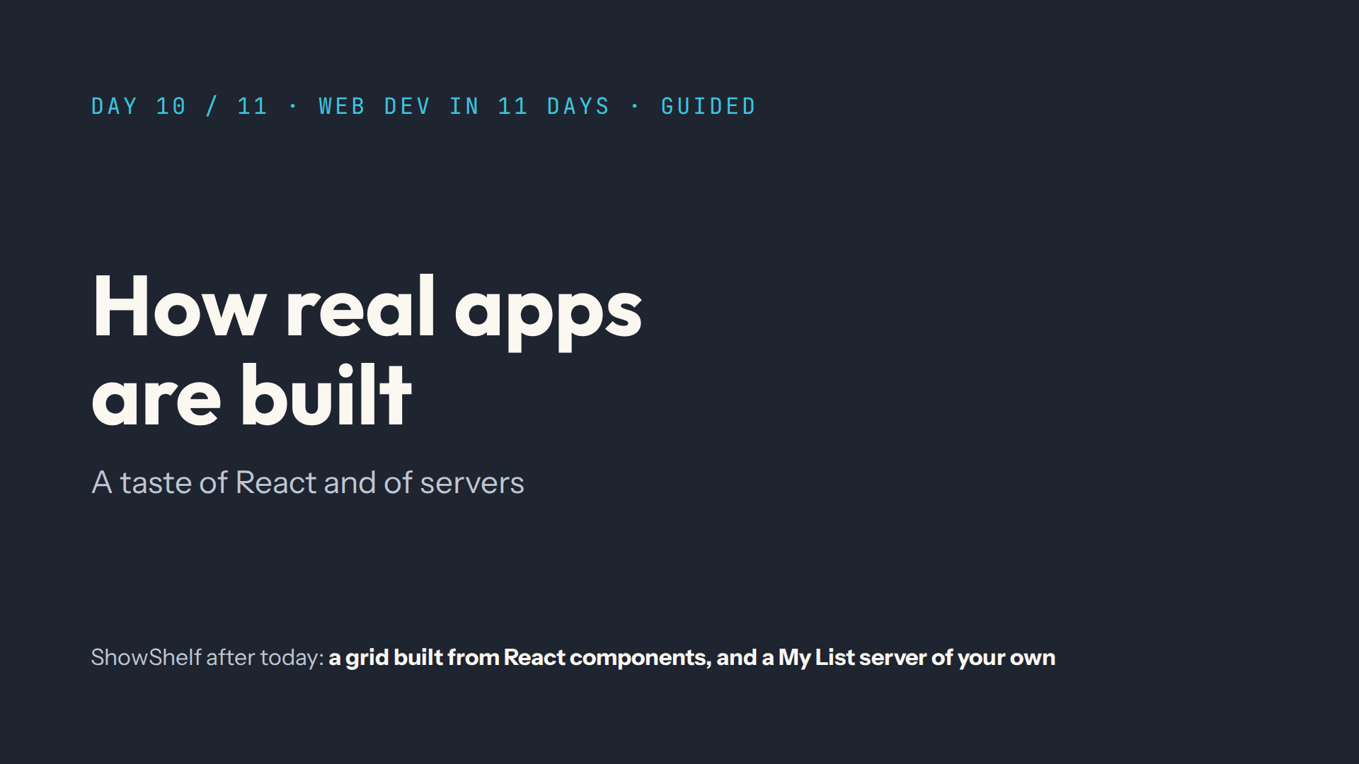
Notes:
Script: Before class. Both projects installed the day before (npm install), Node 20.19 or newer, two terminals open in the course folder. A taste, not a course.

Slide 2
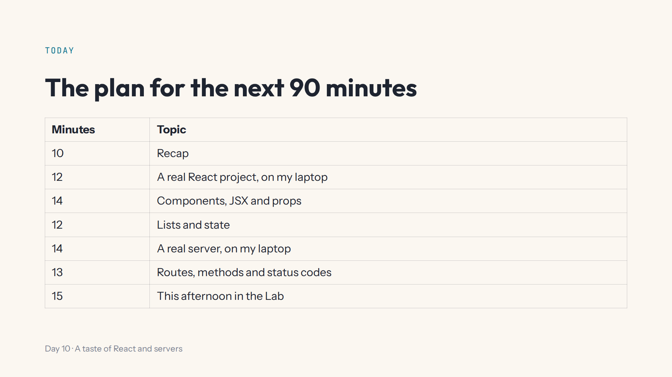
Notes:
Script 0:00. First React (0:10 to 0:48), then the server (0:48 to 1:15), like the two parts of the afternoon.

Slide 3
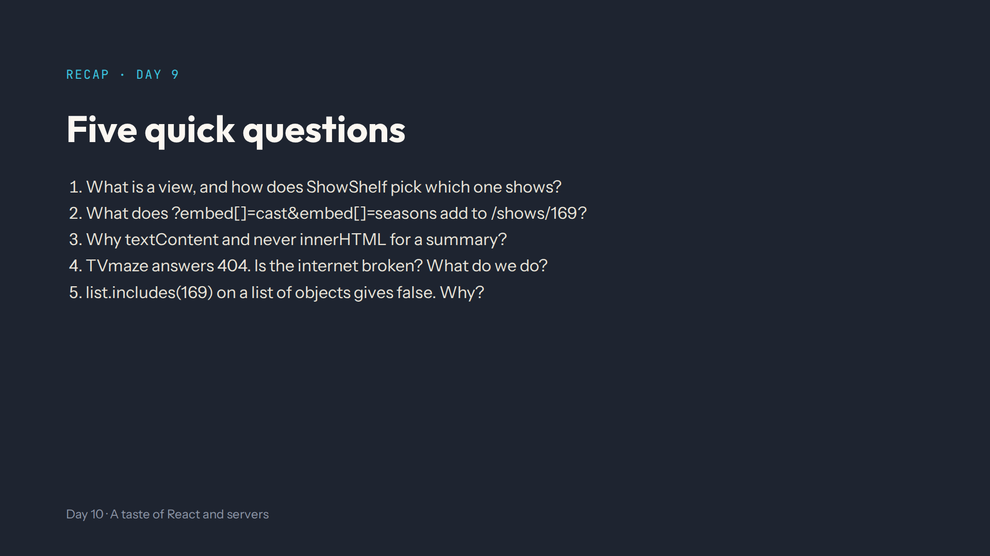
Notes:
Answers in quiz.md. One screen; state.view and hidden in render(). The cast and seasons in _embedded. Code hidden in the text would run. No: return null and say Show not found. includes compares whole objects; use some.

Slide 4
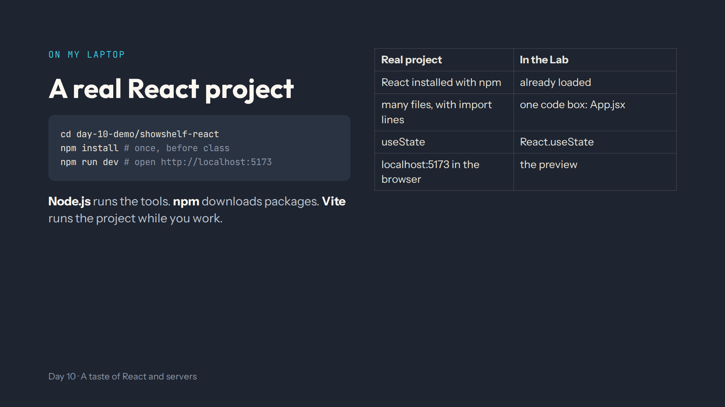
Notes:
Script 0:10. Start it live in terminal 1. Tour: index.html (one div id root), src/main.jsx (createRoot render App), src/components/ShowCard.jsx. Change the heading in src/pages/HomePage.jsx, save, watch it update, change it back. Leave it running.

Slide 5
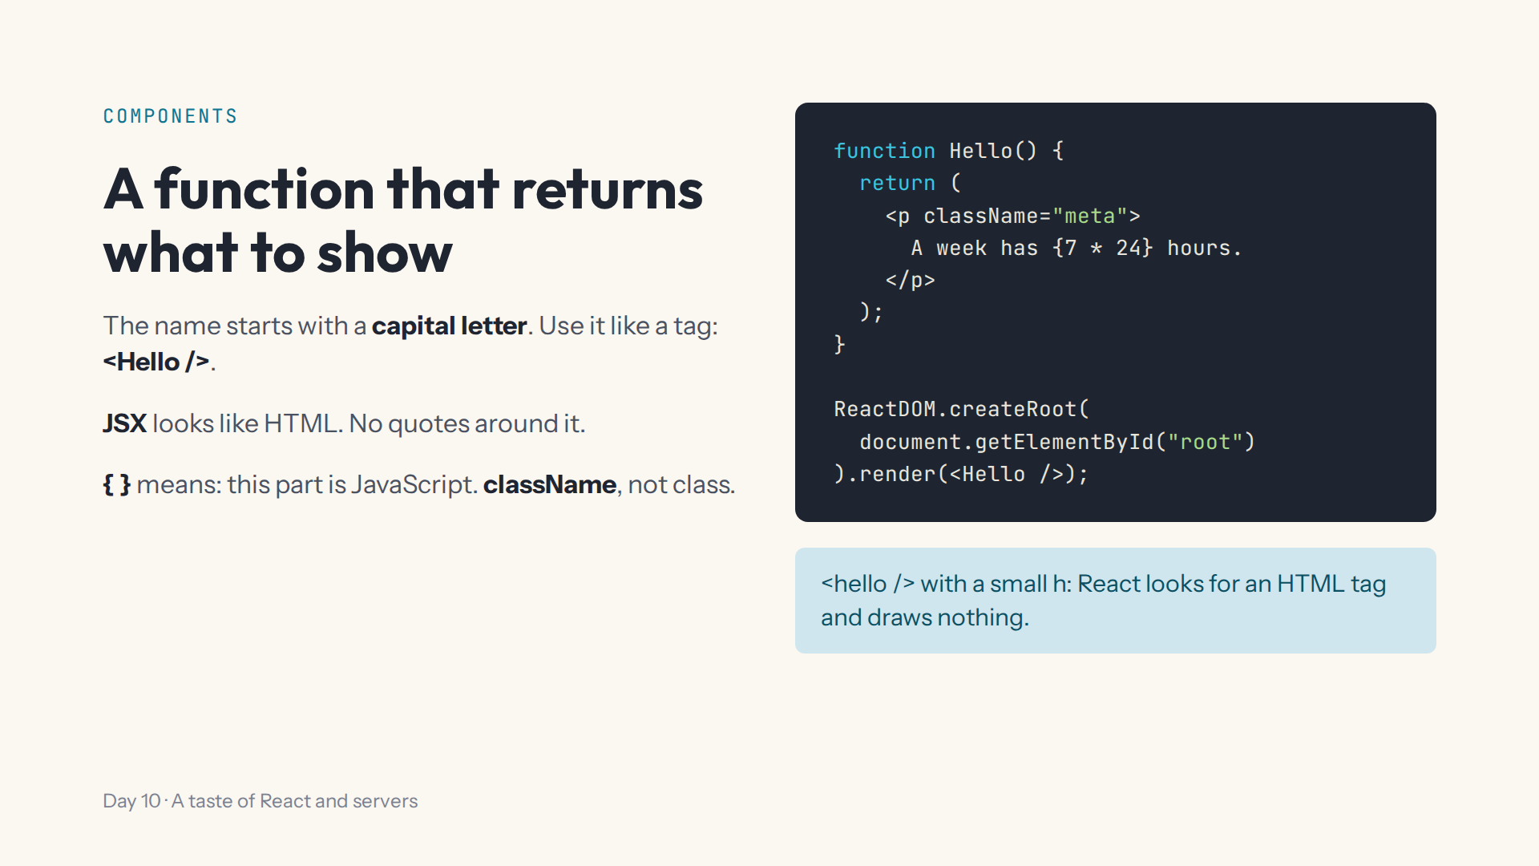
Notes:
Script 0:22. Type it in step 1 with Teacher view off. Mistake on purpose: hello and <hello />, read the Console. A week has 168 hours.

Slide 6
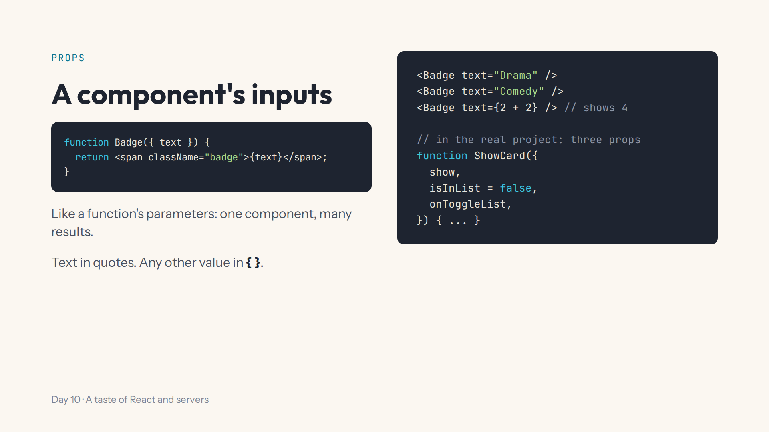
Notes:
Script 0:22, Props. Add Badge above Hello and use it twice inside a p. Ask what text={2 + 2} shows. Then open ShowCard.jsx in the editor. Start again.

Slide 7
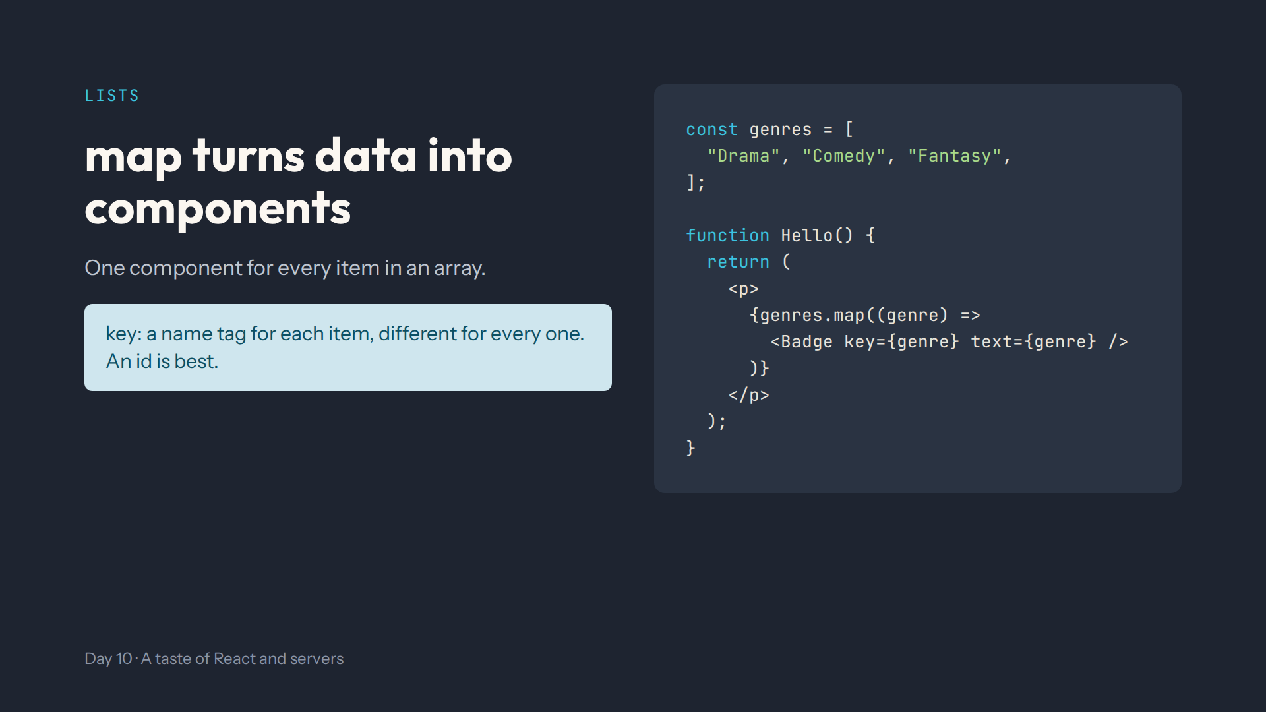
Notes:
Script 0:36. Same code box. Mistake on purpose: remove key and read the warning in the Console, then put it back.

Slide 8
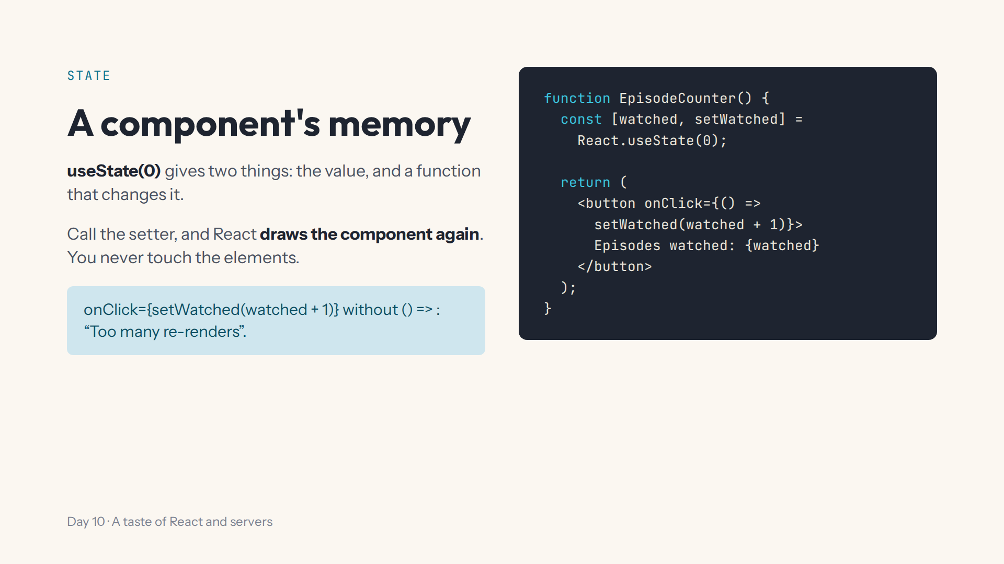
Notes:
Script 0:36, State. Start again, type it, click a few times. Mistake on purpose: no arrow, read the Console. In the real project, point at useState in App.jsx and value plus onChange in SearchBar.jsx. Start again.

Slide 9
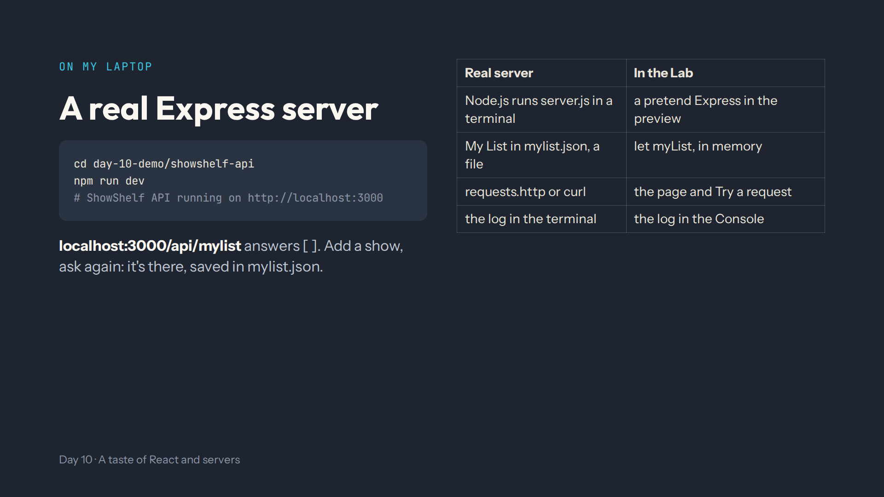
Notes:
Script 0:48. Terminal 2. Browser: localhost:3000, then /api/mylist. requests.http: Add a show (201), Missing name (400). Read the log line. Restart: the show is still there. Say: these two projects don't talk to each other yet. Then stop both servers with Ctrl + C.

Slide 10
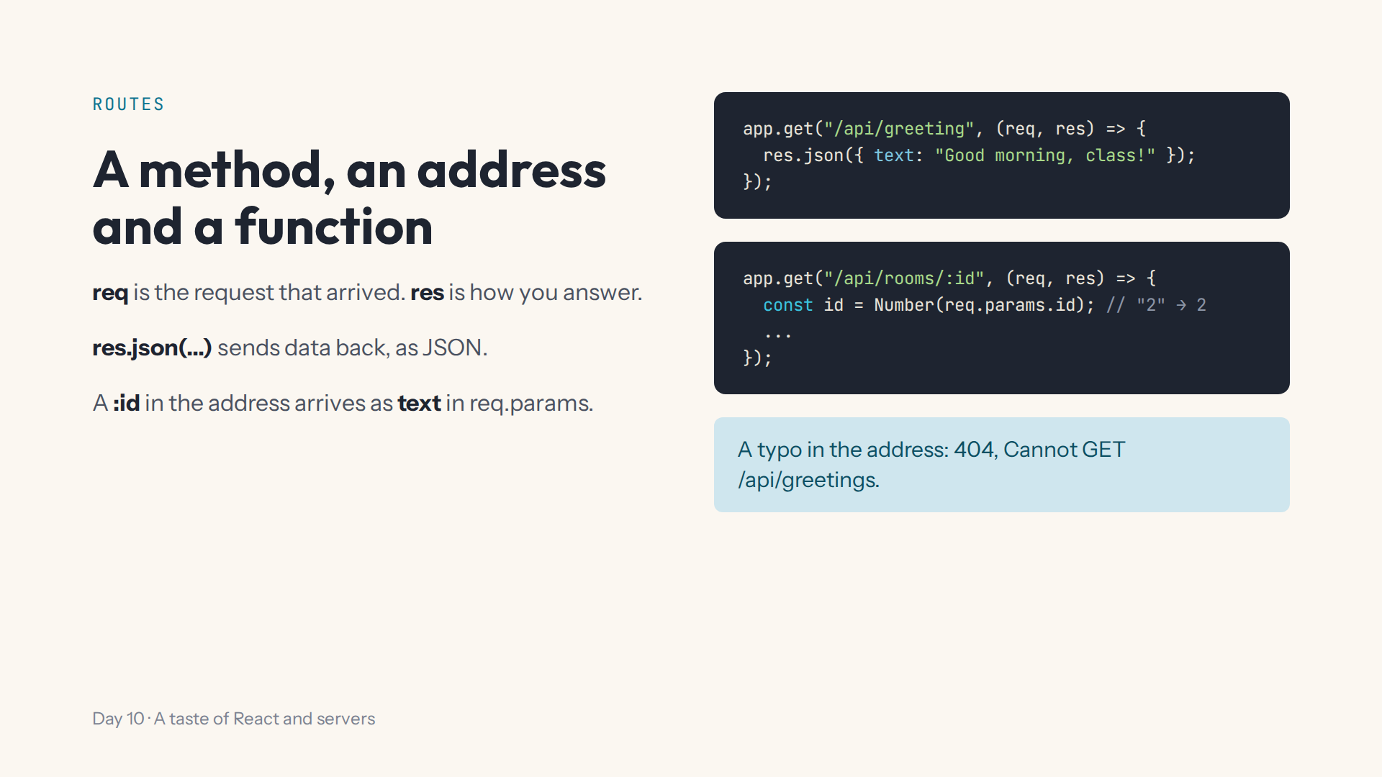
Notes:
Script 1:02. Step 7, under Your routes go here. Try a request: GET /api/greeting, then /api/greetings for the 404, then throw new Error("Oops") inside the route for a 500. Start again.

Slide 11
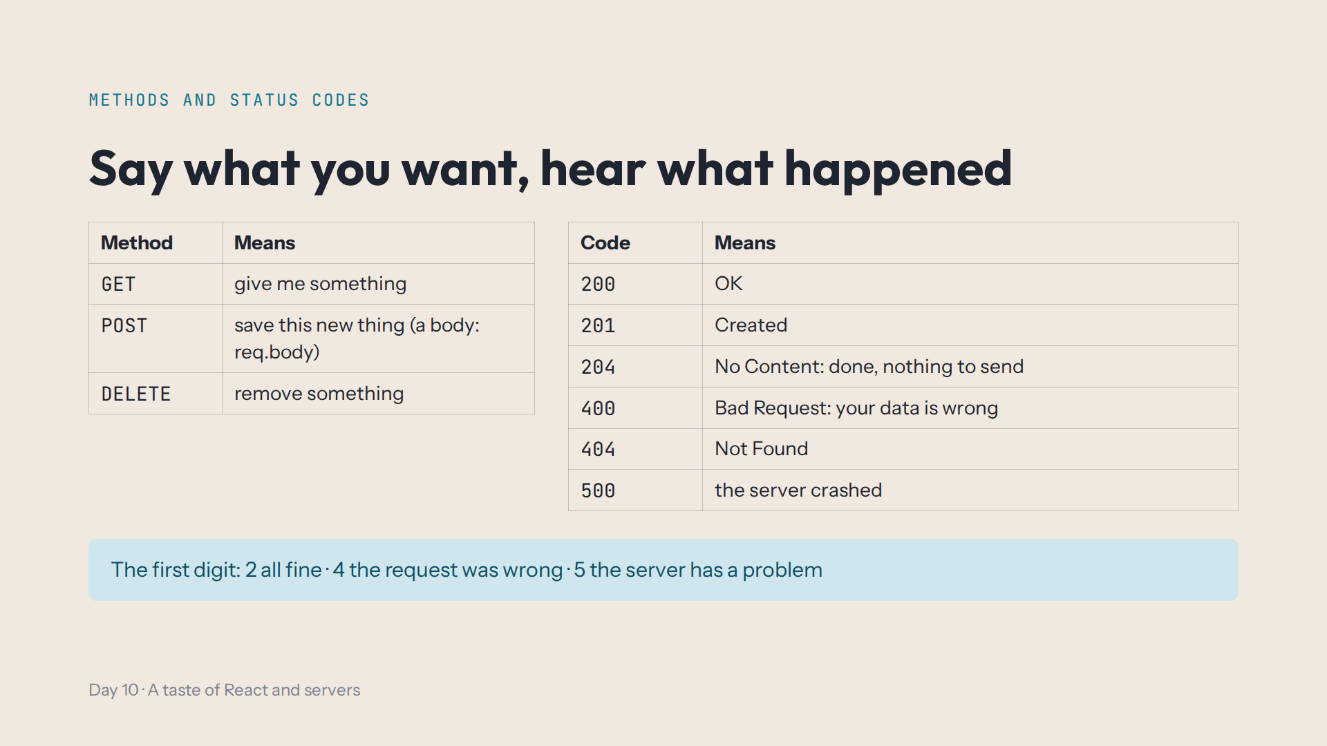
Notes:
Script 1:02, second half. A POST carries a body, read as req.body. To say which show: the id in the address, :id in the route, Number(req.params.id).

Slide 12
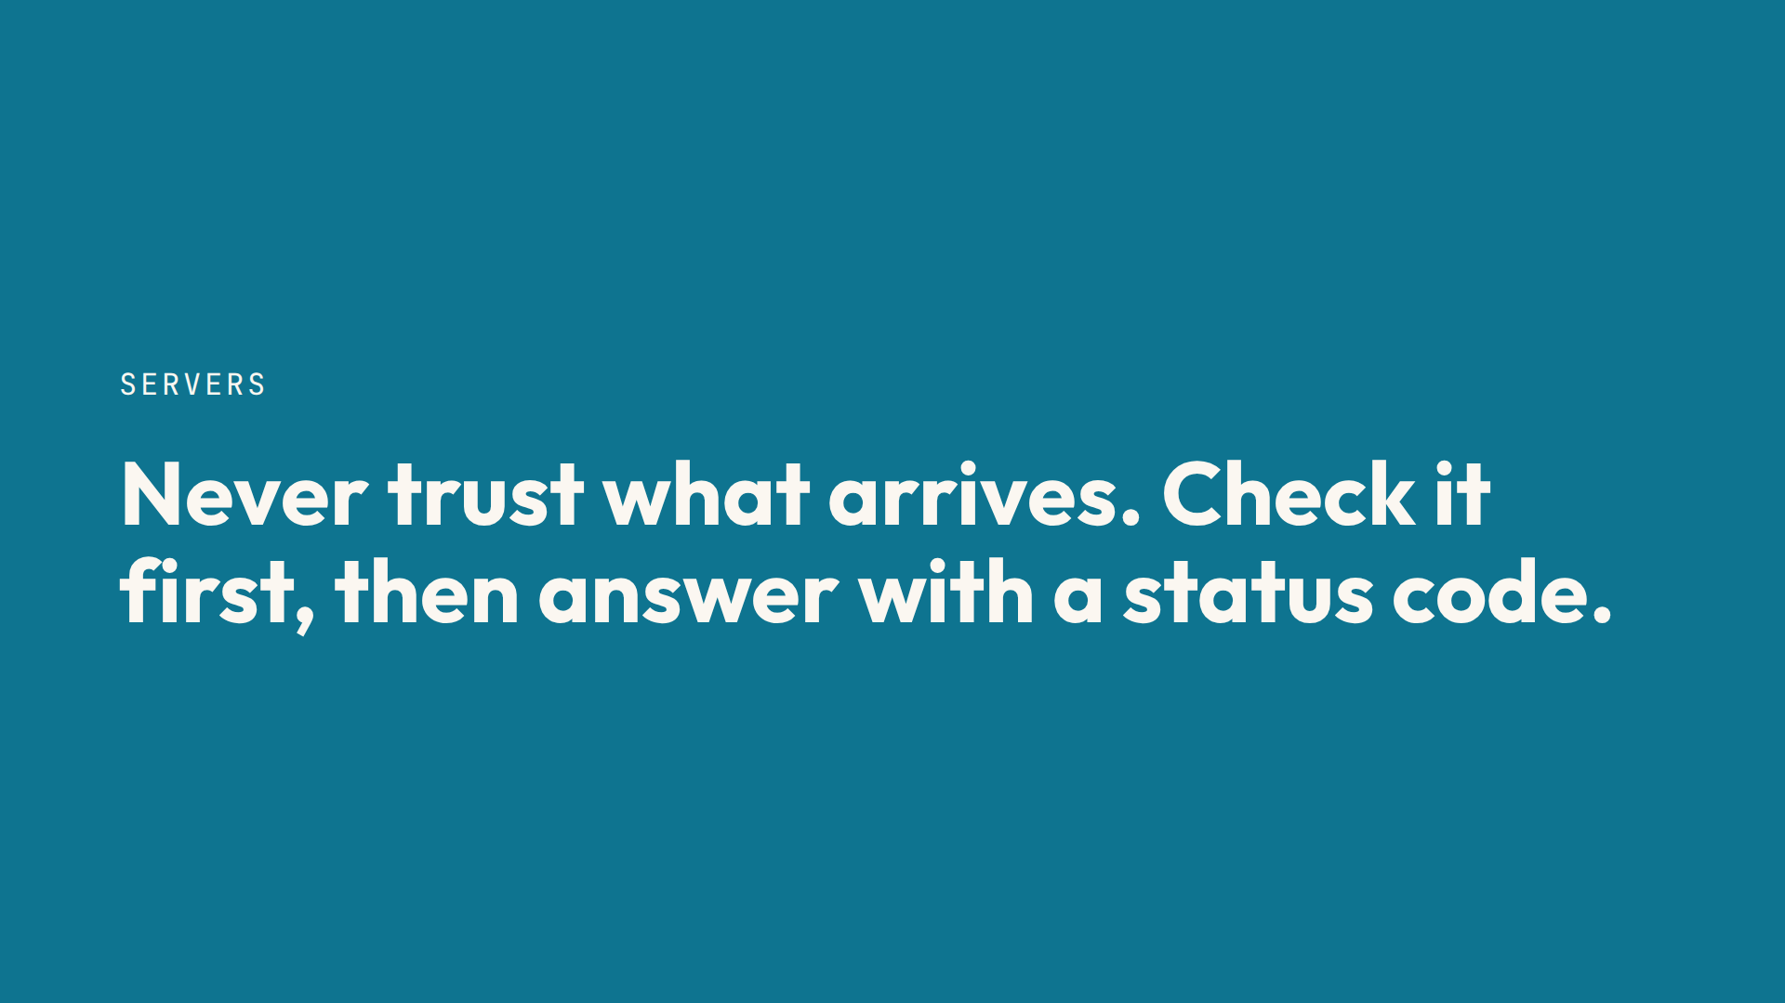
Notes:
Script 1:02, end. Anyone can send anything to a server, not only your page. Step 10 refuses an empty name with return res.status(400).json({ error }).

Slide 13
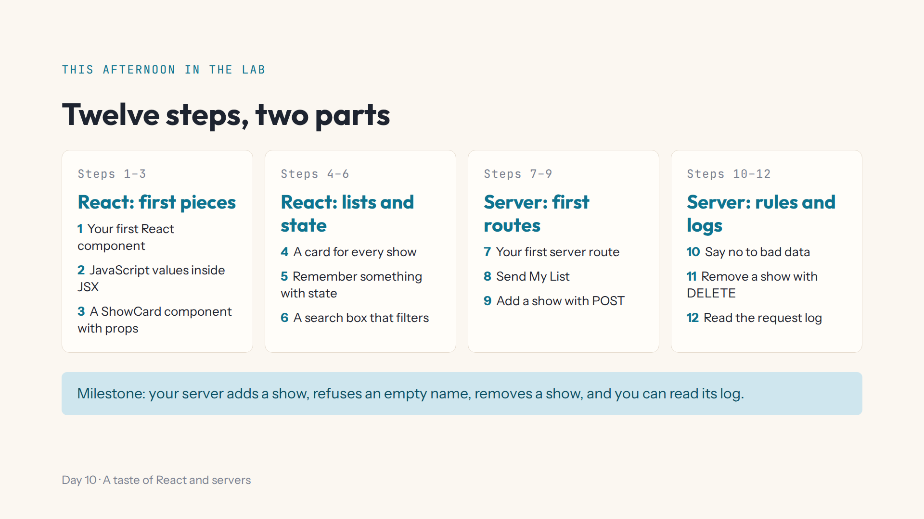
Notes:
Script 1:15. Open #/day/10, read the steps, do step 1 together with Teacher view off. Aim to start step 7 around the middle of the afternoon. Tomorrow: an email address for a free account.

Slide 14
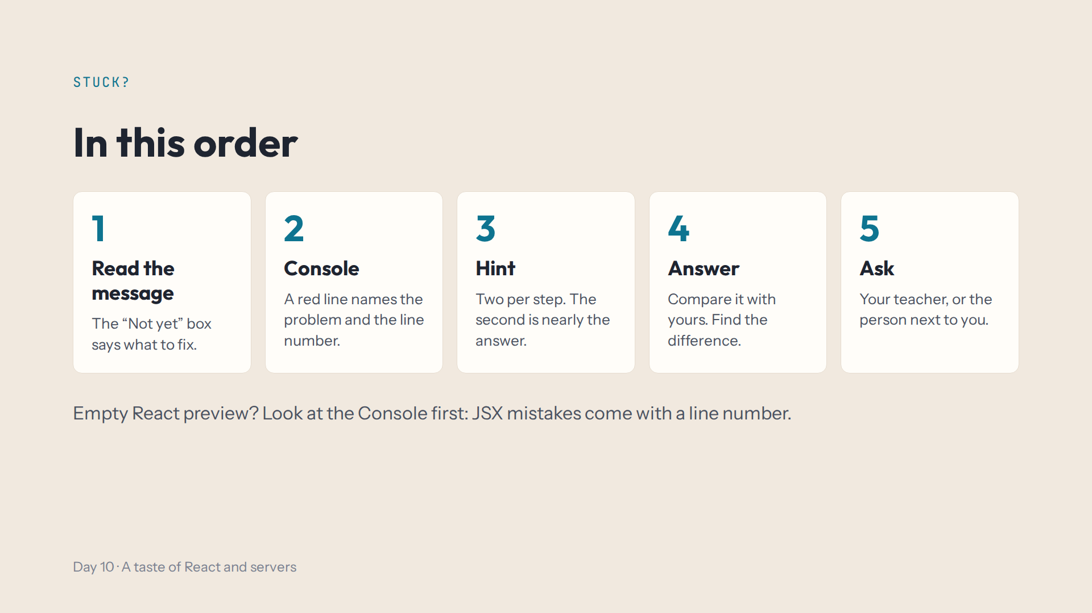
Notes:
Script 1:15. import lines don't work in the Lab and aren't needed. The server's list starts fresh every time the preview runs: that's expected.

Slide 15
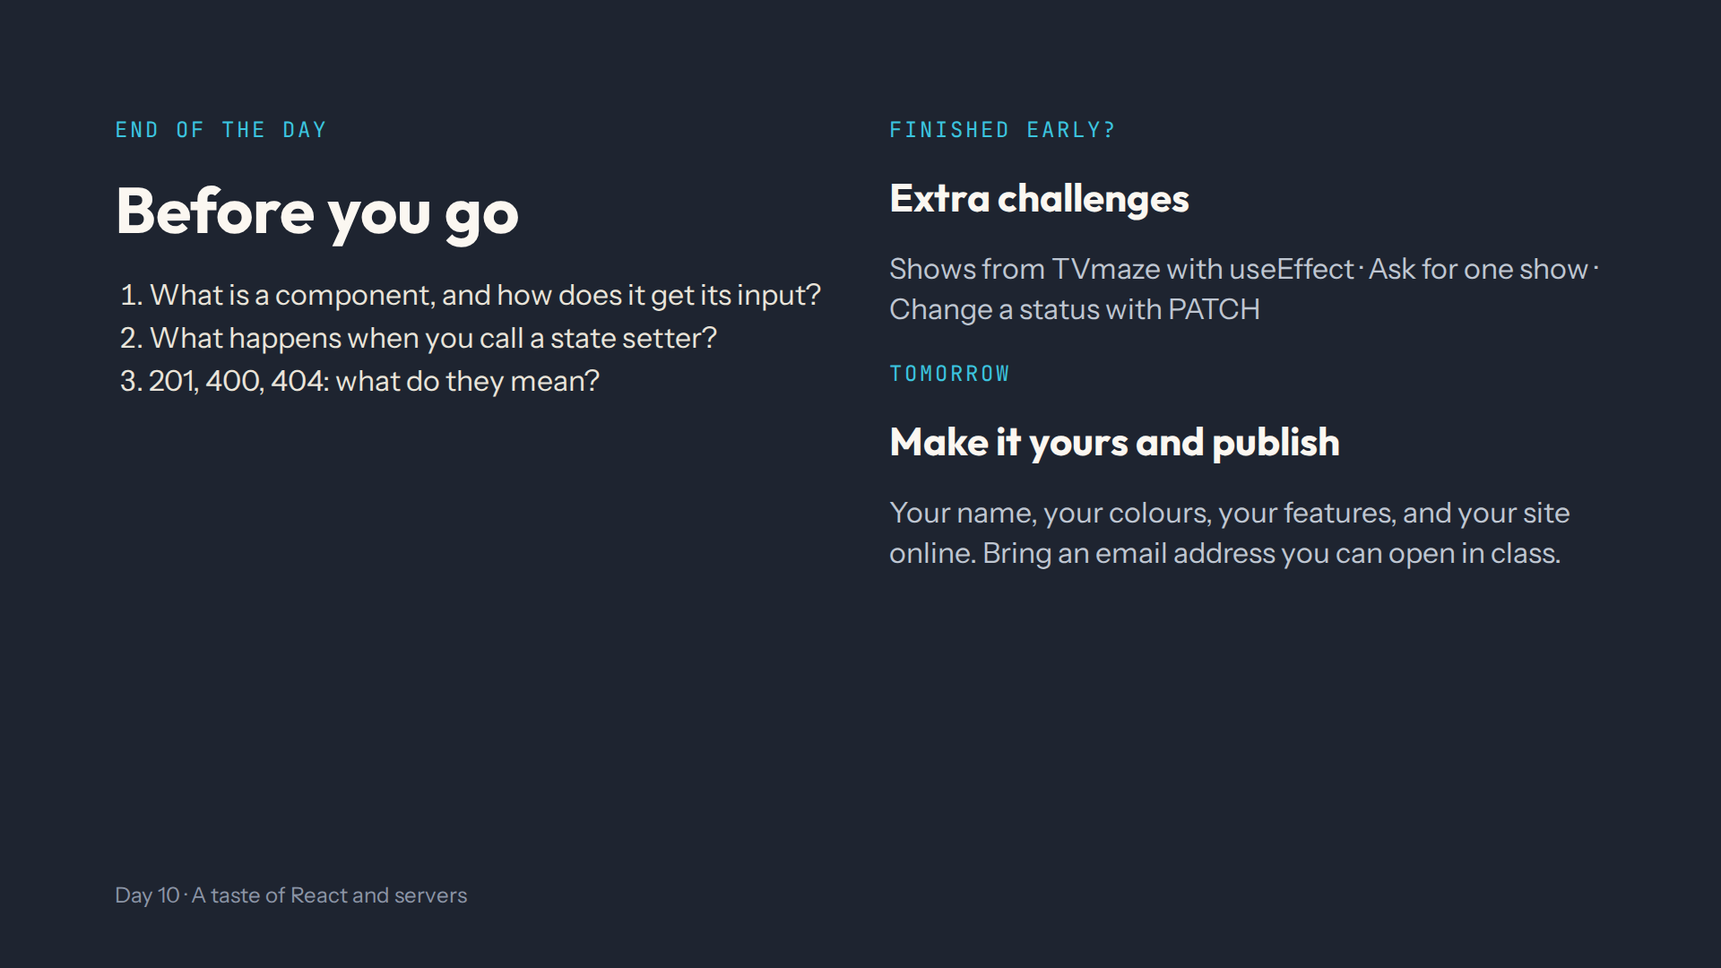
Notes:
For the afternoon teacher at the end of the day. Answers in quiz.md, End-of-day check. Ask them to show you step 11's page: add, an empty name, remove, and the log in the Console.

