Slide 1
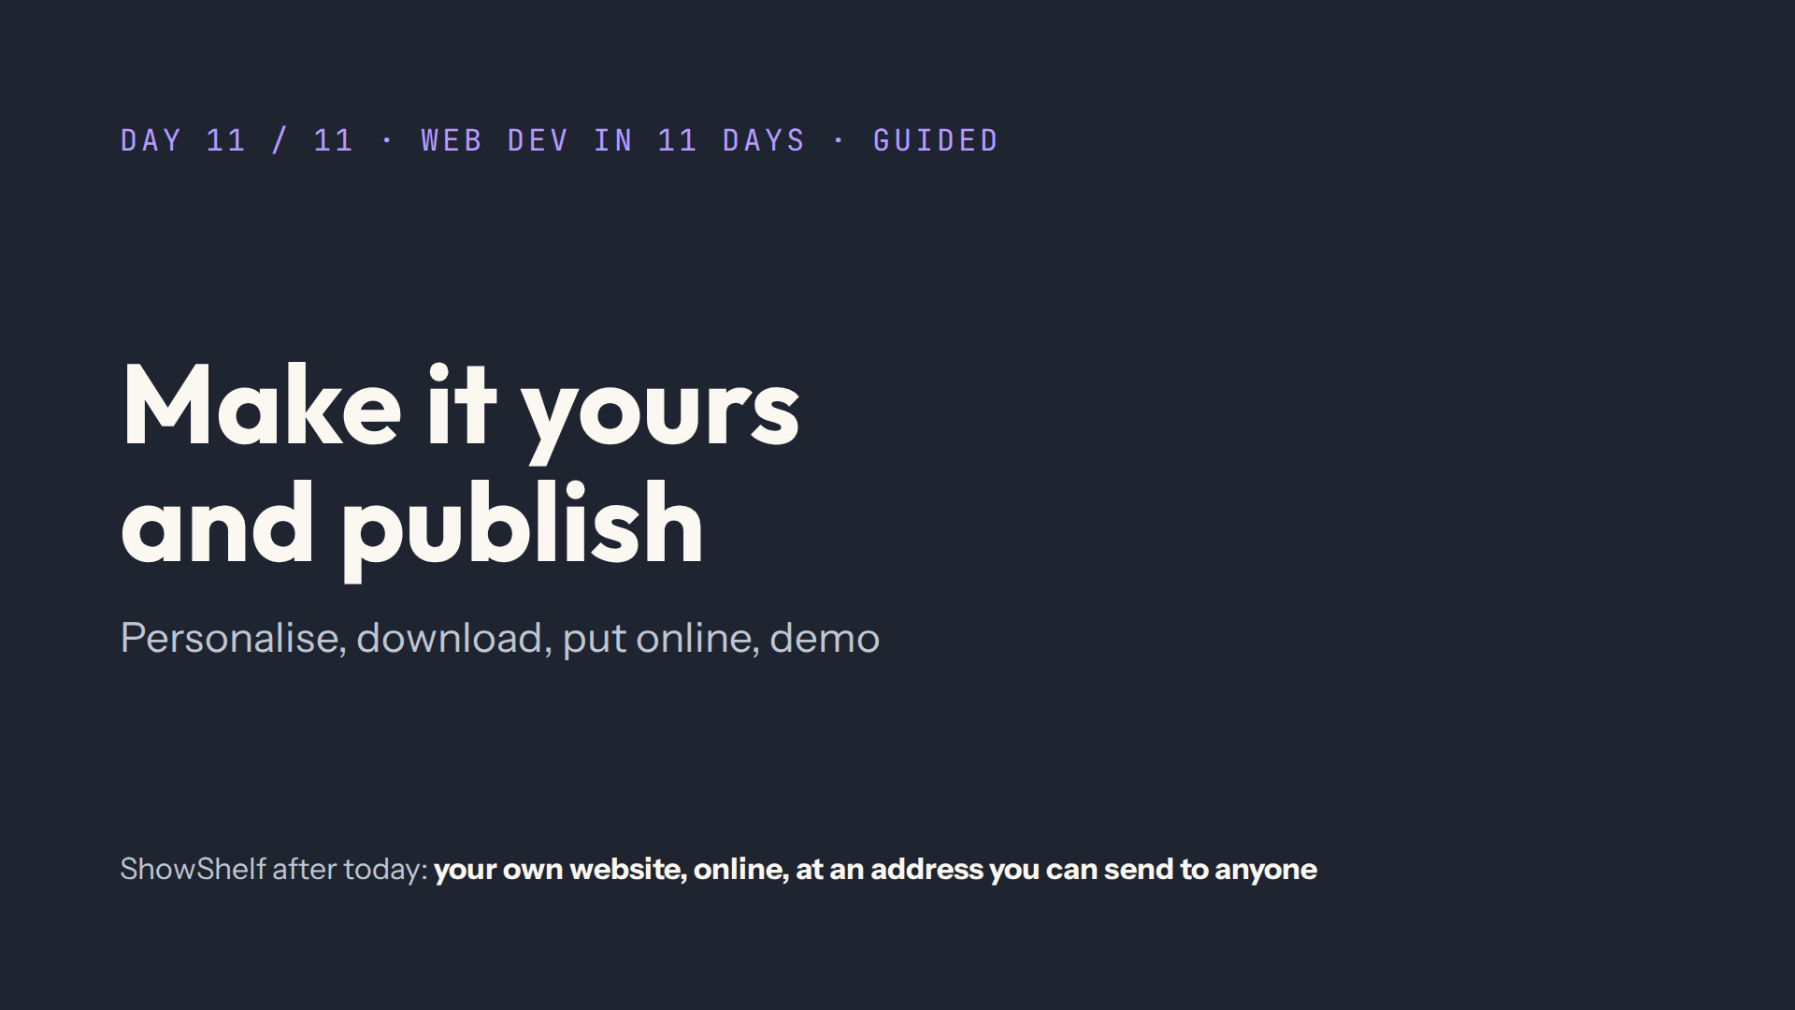
Notes:
Script: Before class. Your own ShowShelf published the day before, on Netlify Drop and GitHub Pages, open in tabs and on your phone. Demo timer ready.

Slide 2
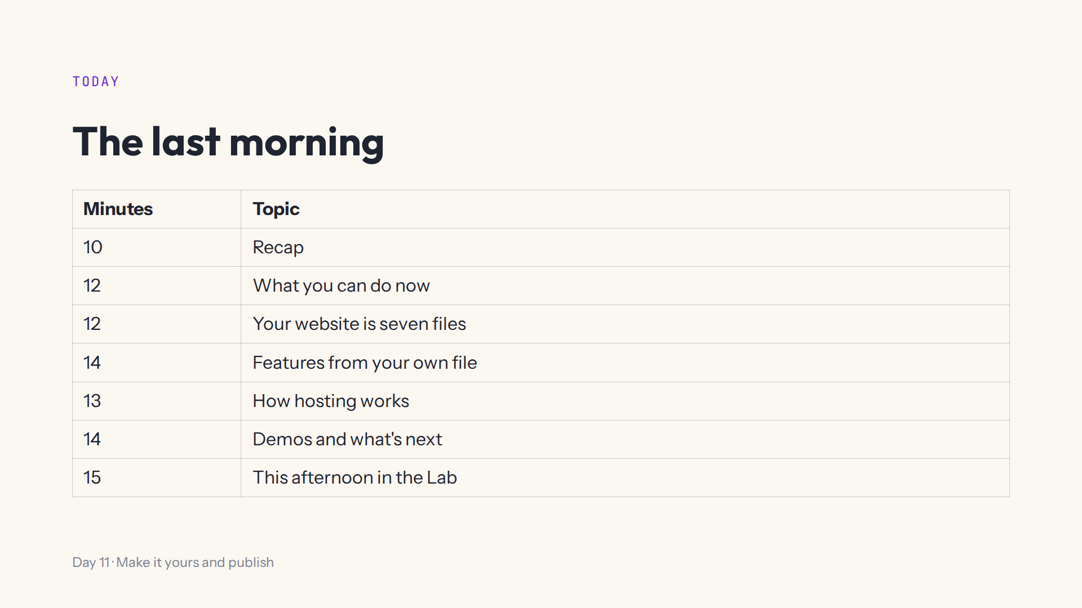
Notes:
Script 0:00. Demos at the end of the afternoon: say when they start.

Slide 3
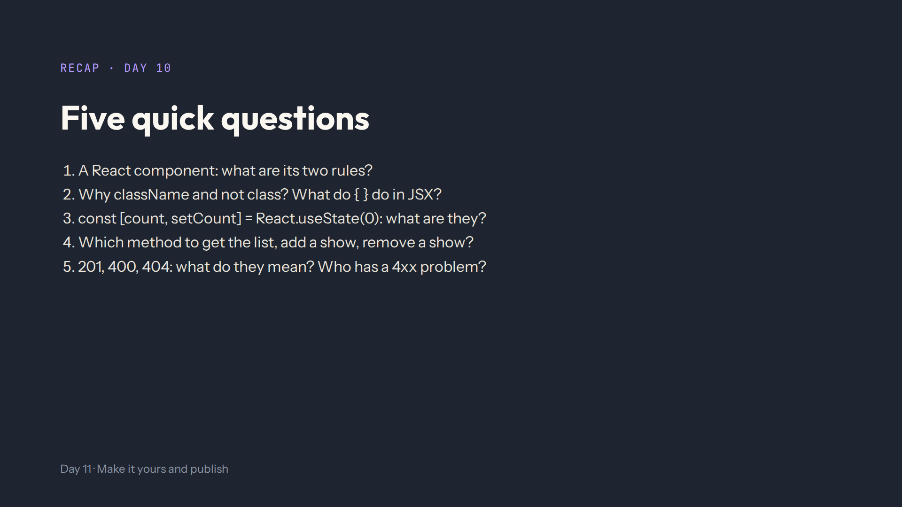
Notes:
Answers in quiz.md. Capital letter, returns JSX with one outer element. class is a JavaScript word; { } shows the result of JavaScript. The value and its setter, which redraws. GET, POST, DELETE. Created, Bad Request, Not Found; 4 means the request was wrong.

Slide 4
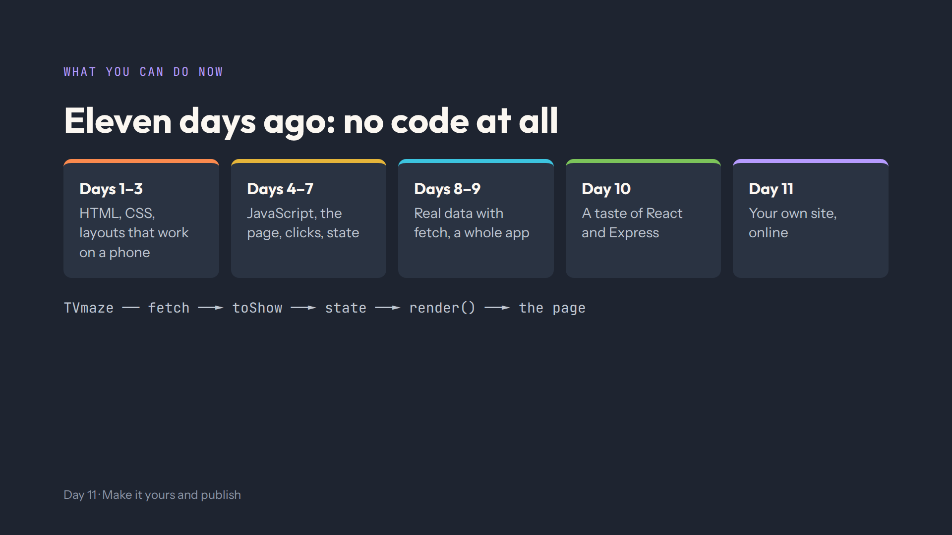
Notes:
Script 0:10. Let students say what they remember from each group of days. Ask: where does a card's data come from, step by step? What runs in the visitor's browser, what on a server? Then the Day 11 overview: the finished site of the day.

Slide 5
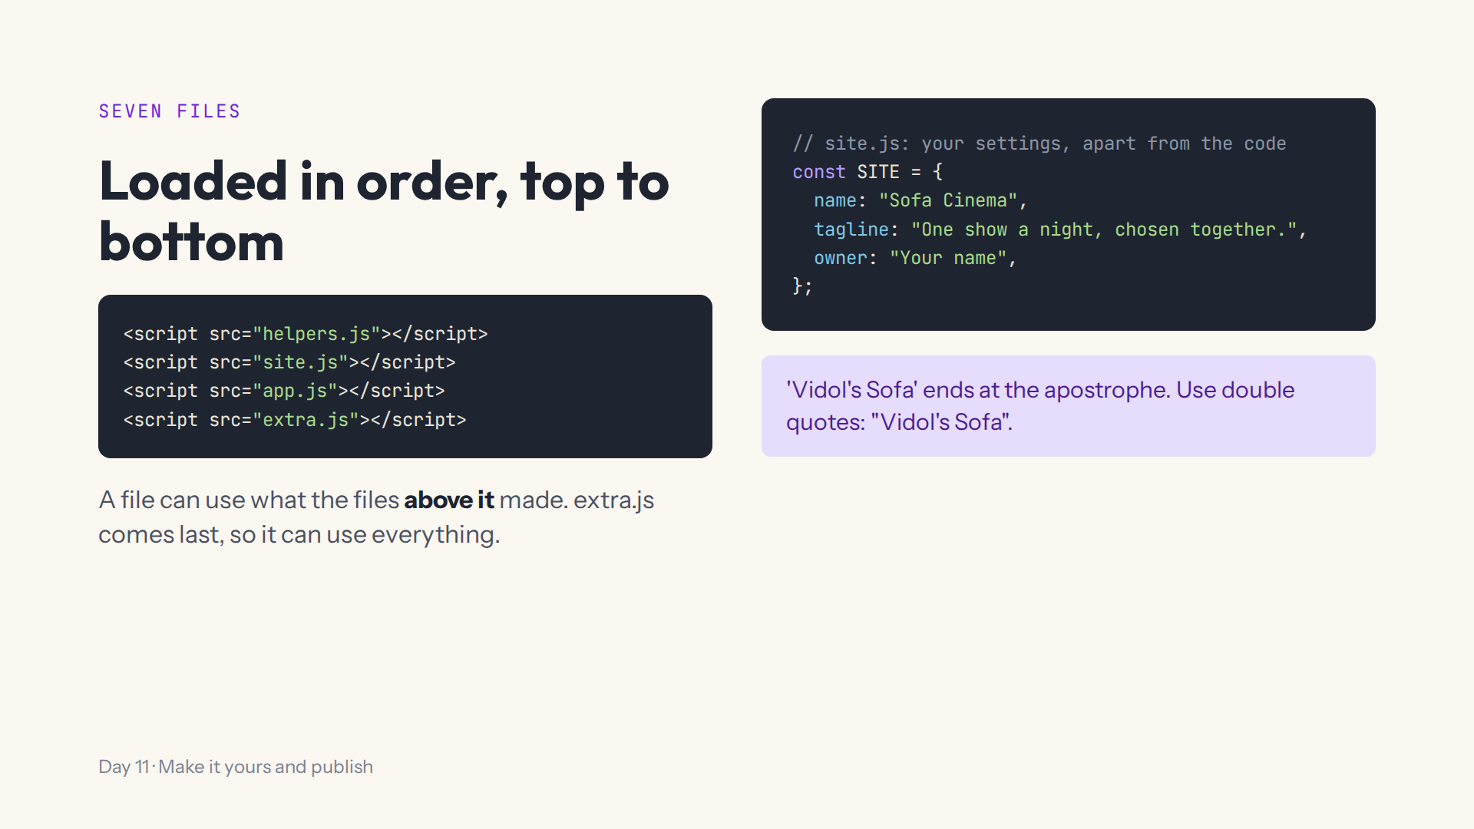
Notes:
Script 0:22. Step 1, whole-page tab, the four script lines. Change name in site.js and watch the logo. Mistake on purpose: single quotes with an apostrophe, read the Console. Start again.

Slide 6
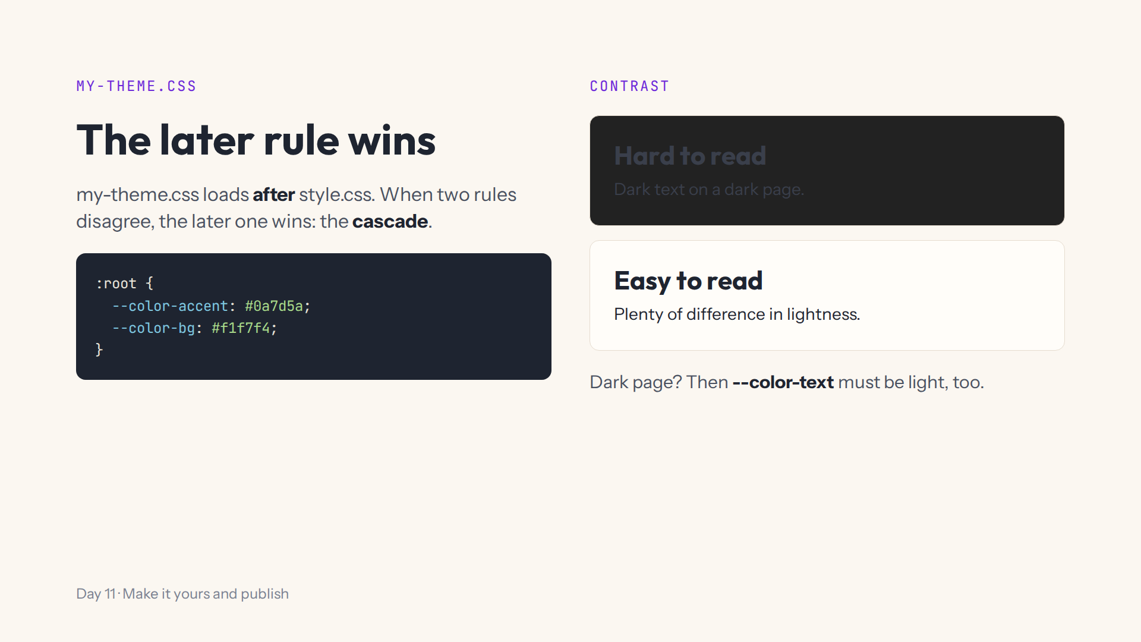
Notes:
Script 0:22, second half. Step 3: --color-bg: #222222 and the heading disappears. Ask what else must change for a dark page. Step 4 adds --radius and a font-family on body. Start again.

Slide 7
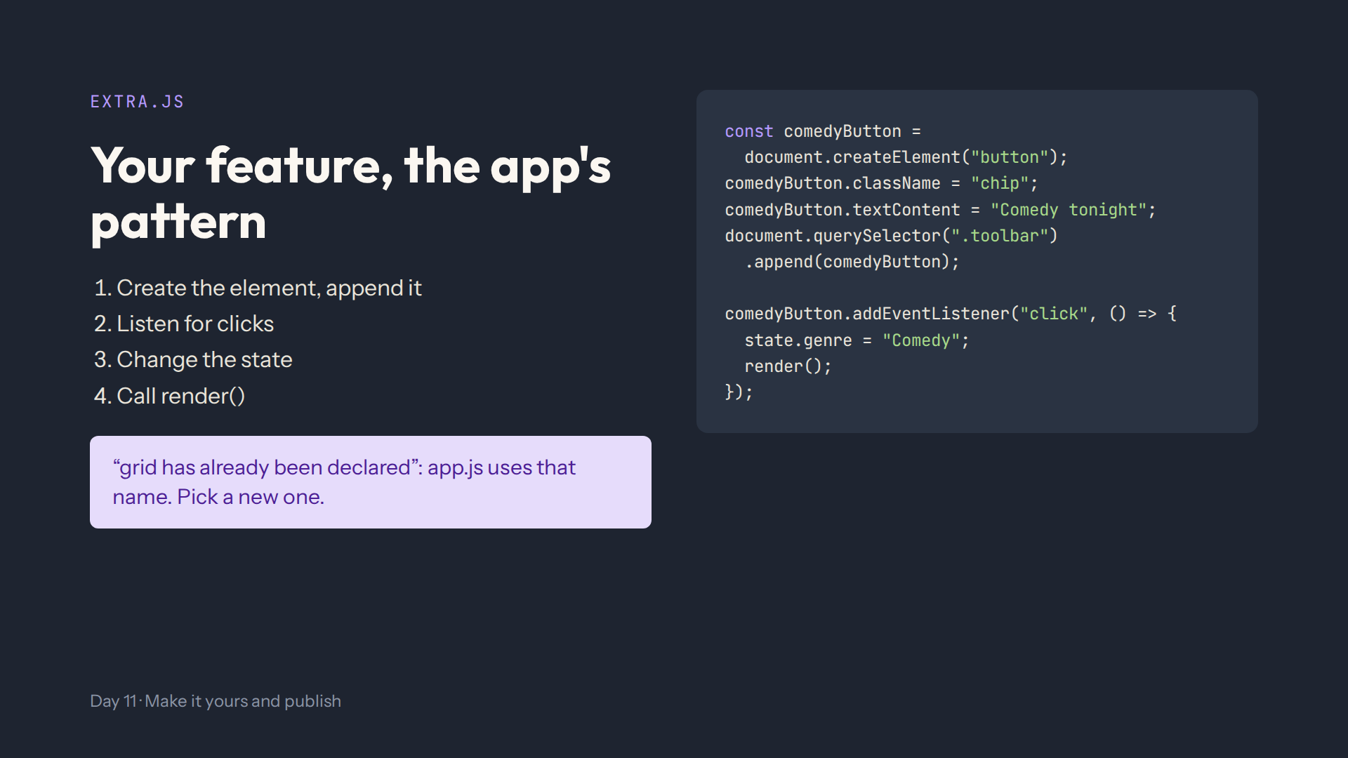
Notes:
Script 0:34. Step 5, below the comments. Click it: only comedies, and the Comedy chip lights up. Mistake on purpose: call it grid. Mention the random pick (Math.floor(Math.random() * list.length)) and sort for steps 5 and 6.

Slide 8
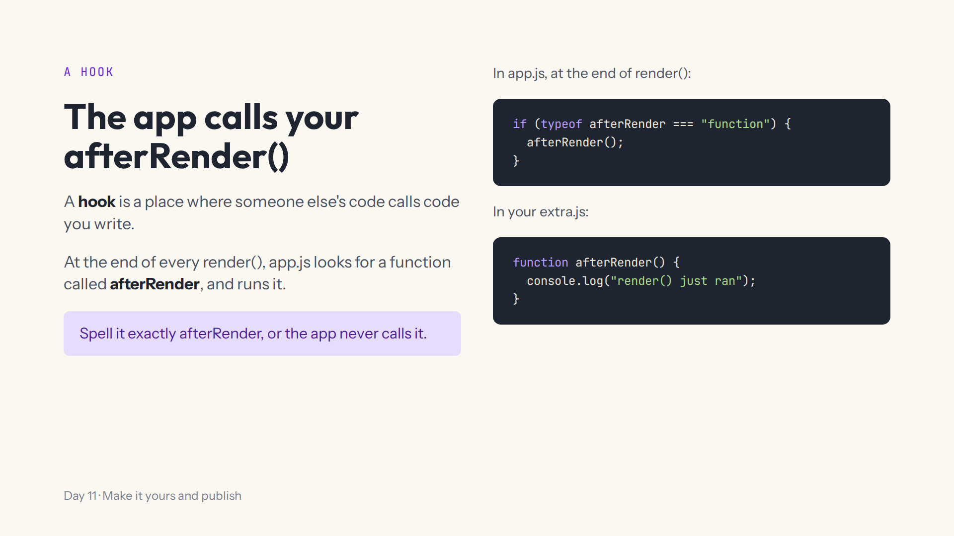
Notes:
Script 0:34, A hook. Add it below the Comedy button, click a few genre chips: one Console line each time. Step 7 uses it to keep a line or a badge up to date. Start again.

Slide 9
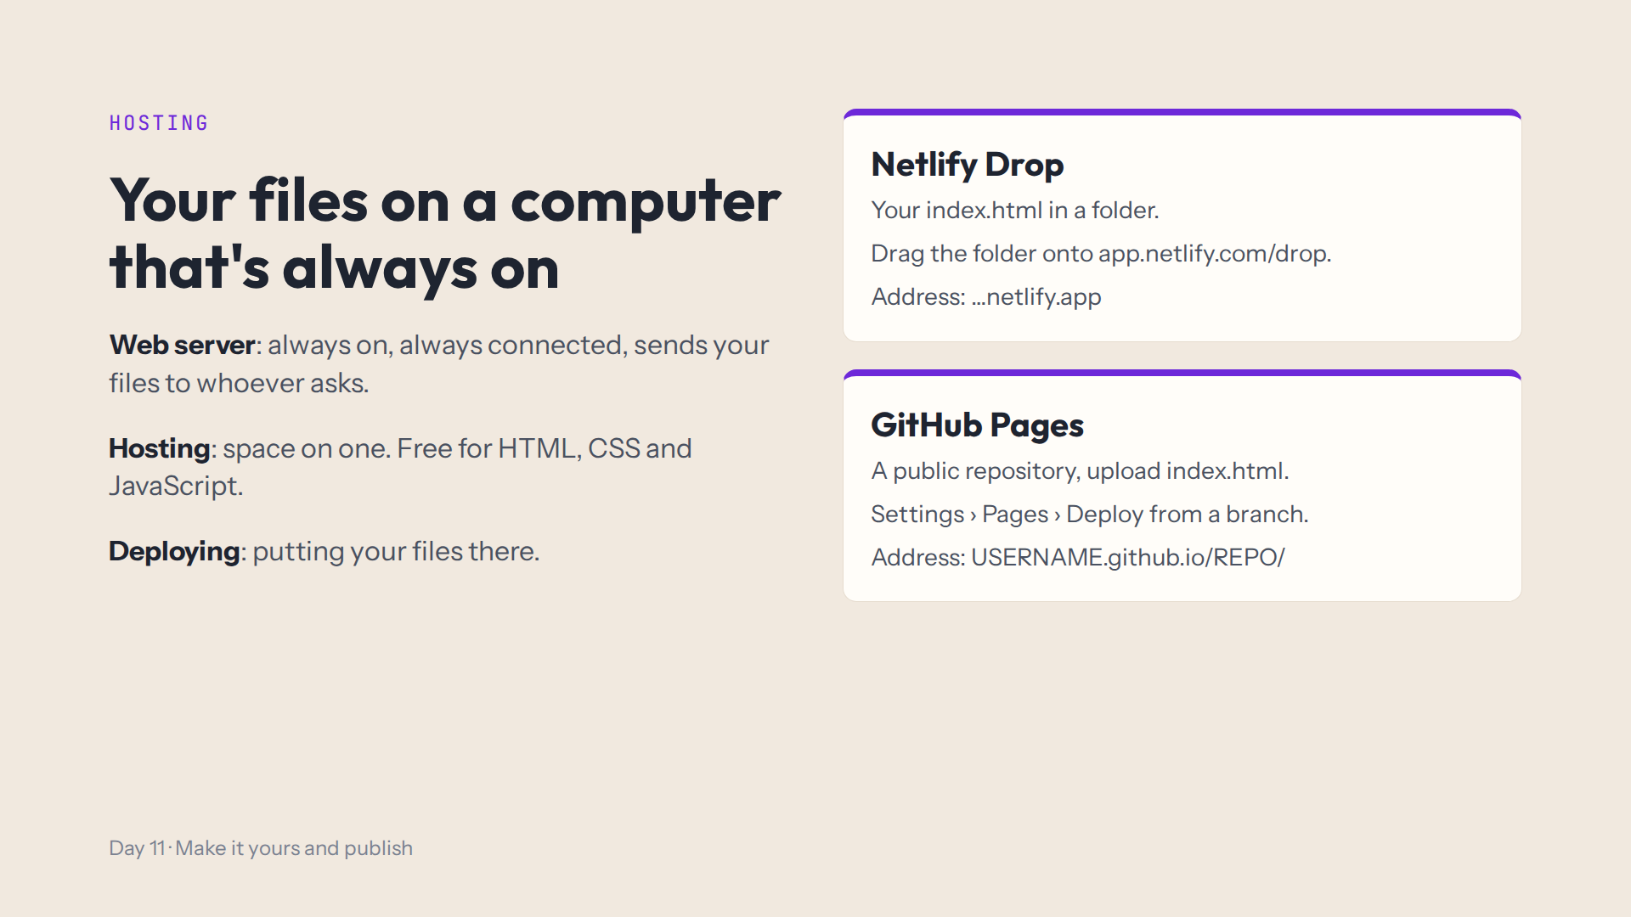
Notes:
Script 0:48. Draw the three boxes on the board: your computer, the web server, a visitor's phone. Show your own site on your phone. The address is public; My List stays in each visitor's browser. To change it later: download and upload again.

Slide 10
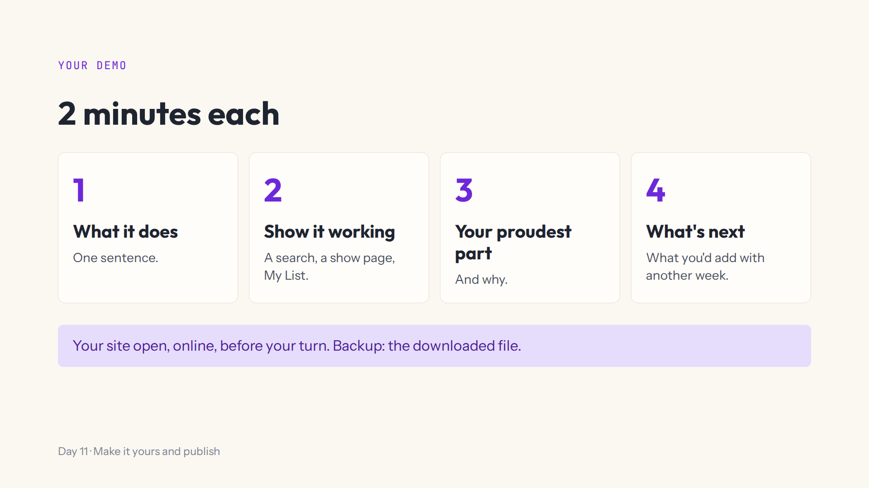
Notes:
Script 1:01. Model it: give your own 2-minute demo now, with the timer running. Step 10 is writing the three sentences down.

Slide 11
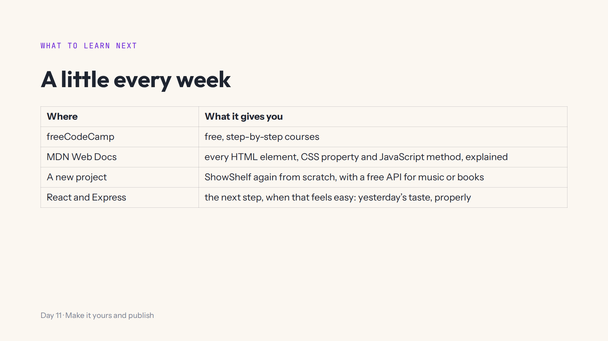
Notes:
Script 1:01, What next. Ask: what would you build for yourself? Take two or three answers.

Slide 12

Notes:
Script 1:01, end. Then straight into the afternoon.

Slide 13
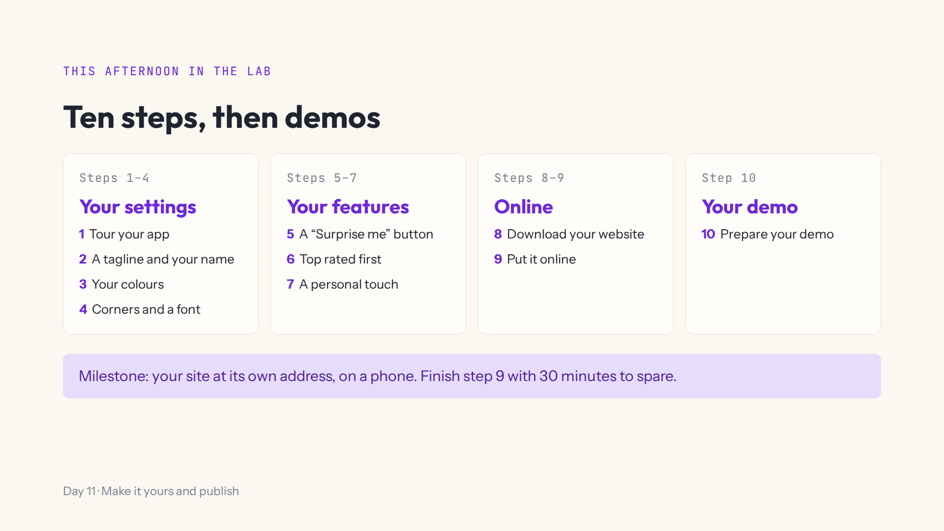
Notes:
Script 1:15. Open #/day/11, read the steps, do step 1 together with Teacher view off. Extras B1 to B3 each have their own Download button. Say when the demos start.

Slide 14
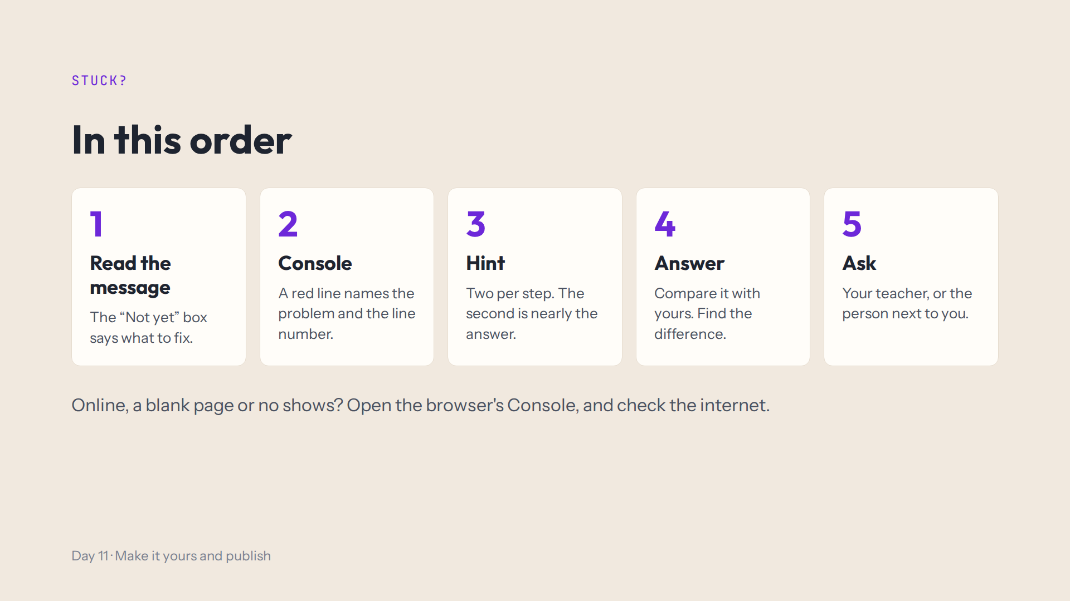
Notes:
Script 1:15. For step 9: drop the folder, not the file; paste the site's address, not the repository's.

Slide 15
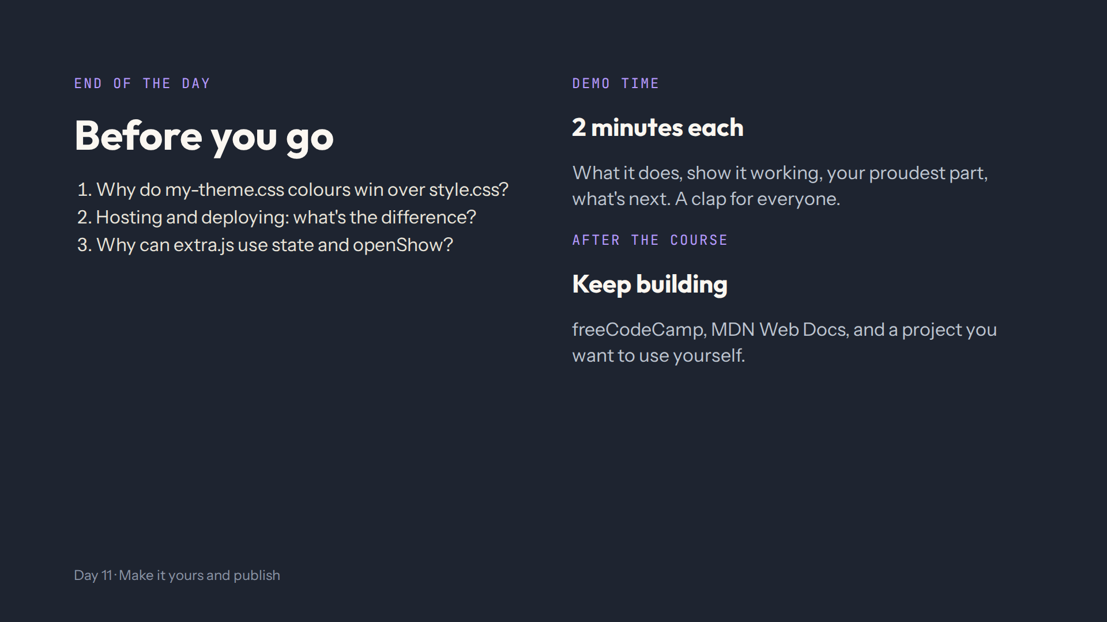
Notes:
For the afternoon teacher at the end of the day. Answers in quiz.md, End-of-day check. Ask them to show you their site at its own address on a phone, and their three demo sentences.

