Slide 1



Motoaid
HELP WHEN YOU NEED IT THE MOST
GET QUICK ROADSIDE ASSISTANCE WHEN YOU'RE STUCK!
We keep you moving — wherever you are.
+123-XXX-XXXX
Register on http://motoaid.com
24H SERVICE

Slide 2
Who We Are
We are a vehicle repair and roadside assistance website.
Available 24/7 to help during breakdowns or emergencies.
Provide fast and reliable service when and where you need it.
Offer affordable pricing with no hidden charges.
Connect users to verified and skilled mechanics across locations.
Easy-to-use website and toll-free number for instant support.

Slide 3
THE PROBLEM
In India, vehicle breakdowns, especially on highways, are a significant concern for motorists. While precise daily statistics are limited, industry estimates suggest that over 100,000 vehicle breakdowns occur daily across the country. This figure is inferred from the number of puncture shops and roadside assistance (RSA) calls in major cities .
Despite the high incidence of breakdowns, only about 5% of car owners opt for formal roadside assistance services, with the majority relying on local mechanics . This reliance often leads to delays and inconsistent service quality, particularly in remote areas.
The demand for reliable RSA services is growing, with the Indian RSA market projected to reach USD 731.80 million by 2025, expanding at a compound annual growth rate (CAGR) of 9.0% . This growth is driven by the increasing number of vehicles on the road and the need for dependable support during breakdowns.
Given these challenges and the growing demand, there's a clear need for accessible, efficient, and affordable roadside assistance services across India.

Slide 4
THE SOLUTION – MOTOAID
A web platform that provides instant access to roadside assistance and vehicle repairs.
Connects users to verified mechanics nearby using geolocation.
Offers 24/7 support via website and toll-free number.
Focuses on affordability, speed, and reliability.

Slide 5
VISION
To become the most trusted and accessible roadside assistance platform in India, ensuring no one feels helpless or unsafe when stranded on the road.
MISSION
Our mission is to provide quick, secure, and verified roadside support by connecting users with nearby service providers using real-time location, problem-based filtering, and document verification, so help reaches them when they need it the most.

Slide 6
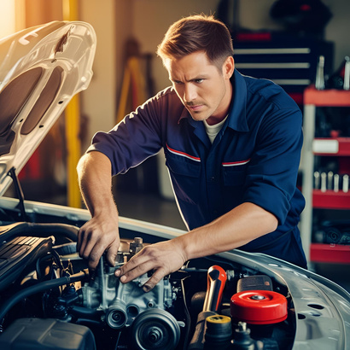

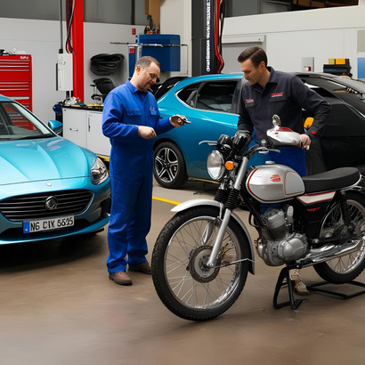
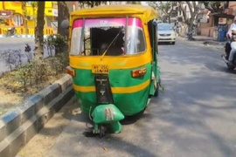
Our Services
All Types of Vehicle Repairs – From minor issues to major breakdowns, we handle it all.
Engine Diagnostics & Repairs
Brake, Clutch & Suspension Work
Battery Jumpstart & Replacement
Flat Tyre Repair & Replacement
Fuel Delivery (Petrol/Diesel)
AC & Electrical Repairs
Towing Services
Regular Servicing for Cars & Bikes
Emergency Roadside Assistance – 24/7 Availability

Slide 7

FAST TURNAROUND TIME
AFFORDABLE & TRANSPARENT QUOTES
GENUINE PARTS & WARRANTY
EMERGENCY REPAIRS AVAILABLE
CUSTOMER-CENTRIC APPROACH

Slide 8


Our Process
Easy 4-Step Service
1. Call Us / Book Online
Reach us via our toll-free number or website
2. Location Pinning
Share your location for faster dispatch
3. Technician Dispatched
Nearest verified mechanic arrives promptly
4. Repair & Pay
Problem solved, pay via card, UPI, or cash

Slide 9

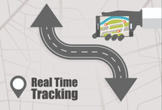

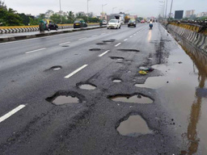
Competitive Advantage
One-click access to verified mechanics
Real-time service tracking
Built specifically for Indian roads & user behavior
Affordable pricing + multilingual support

Slide 10

CONCLUSION
MotoAid is here to ensure no driver is ever stranded.
A simple, scalable solution to a real-world problem.
Join us in making your journey stress free and seamless .

Slide 11

SYNTAX SQUAD

