Slide 1
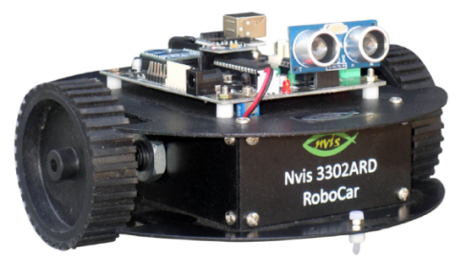
Engineering Design – II
(Buggy) https://sites.google.com/thapar.edu/buggy/home
Introduction to Sensors
Dr. Ashutosh Mishra

Slide 2
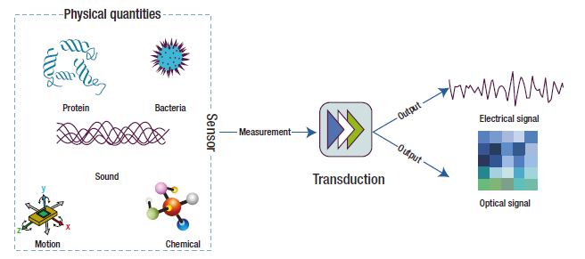
What is a sensor?
A device that receives a stimulus and responds with an electrical signal.
A special type of transducer (device that converts one type of energy into another.
IR-Sensor

Slide 3
Common Sensors
Mechanical
  Accelerometers: measure acceleration forces
  Gyroscopes: useful for measuring or maintaining orientation.
Optical
  Photodetectors: Detect light
  Infrared: emitting and/or detecting infrared radiation
  Gas
  Temperature
  Magnetic
IR-Sensor

Slide 4
Sensors to be used in this course
Infra Red (IR) Sensor
Ultrasonic Sensor
Pulse Receiver
Zig-Bee module (For inter buggy and Command centre communication)
IR-Sensor

Slide 5

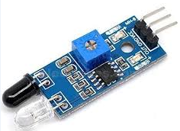
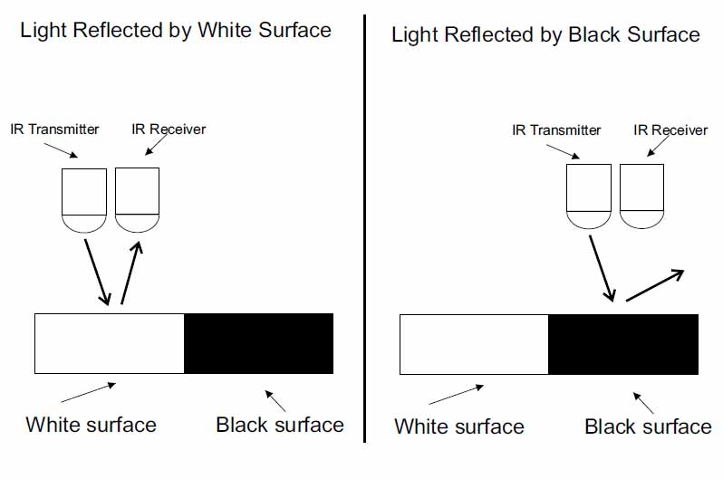
IR sensor basically works on intensity of light
RGB code for white is (255,255,255) and for Black is (O,O,O)
IR-Sensor

Slide 6

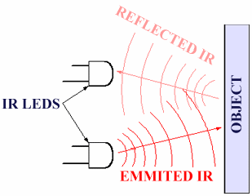
IR-LED –Tx
PD – Rx
IR-Sensor

Slide 7


IR-LED work similar to normal LED
IR-LED transmit infrared light
IR light is not visible to our naked eye
IR light is detected by Photodiode
How PD work ?
PD generate the voltage depending on the intensity of light
IR-Sensor

Slide 8

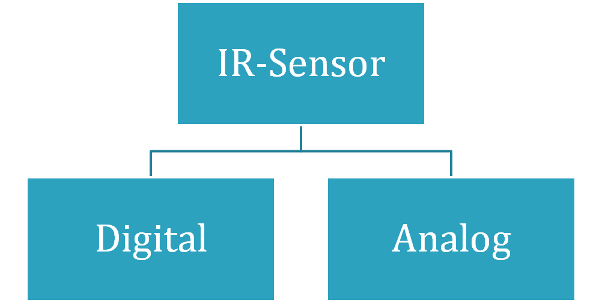
IR-Sensor

Slide 9

Digital – In digital sensor output is digital (High or Low).
Analog – In analog sensor detection depend on intensity of light received.
IR-Sensor

Slide 10

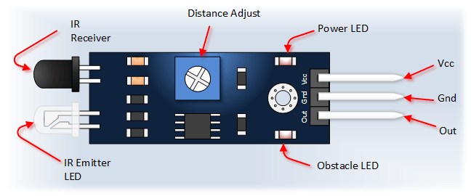
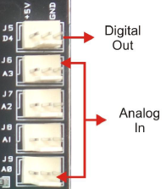
ANALOG INPUT PORT IN BUGGY
In some module output is middle pin while in other its sideline pin.
Extra caution is required to attach these pins to Arduino.
IR-Sensor

Slide 11

void loop() {
r1=analogRead(A1);
r2=analogRead(A3);
r3=digitalRead(A1);
r4=digitalRead(A3);
Serial.println(r1);
Serial.print("\t");
Serial.println(r2);
Serial.print("\t");
Serial.println(r3);
Serial.print("\t");
Serial.println(r4);
}
int r1;
int r2;
int r3;
int r4;
void setup() {
Serial.begin(9600);
pinMode(A1,INPUT);
pinMode(A3,INPUT);
}
IR-Sensor

Slide 12
if(r1==LOW&&r2==LOW)
{
digitalWrite(pin5,HIGH);
digitalWrite(pin6,LOW);
digitalWrite(pin7,LOW);
digitalWrite(pin8,HIGH);
}
if(r1==HIGH&&r2==LOW)
{
digitalWrite(pin5,HIGH);
digitalWrite(pin6,LOW);
digitalWrite(pin7,HIGH);
digitalWrite(pin8,LOW);
}
Forward
Right
IR-Sensor

Slide 13
if(r1==LOW&&r2==HIGH)
{
digitalWrite(pin5,LOW);
digitalWrite(pin6,HIGH);
digitalWrite(pin7,LOW);
digitalWrite(pin8,HIGH);
}
if(r1==HIGH&&r2==HIGH)
{
digitalWrite(pin5,HIGH);
digitalWrite(pin6,LOW);
digitalWrite(pin7,LOW);
digitalWrite(pin8,HIGH);
}
digitalWrite(pin5,LOW);
digitalWrite(pin6,HIGH);
digitalWrite(pin7,HIGH);
digitalWrite(pin8,LOW);
Left
Forward
backward
IR-Sensor

Slide 14


