Slide 1
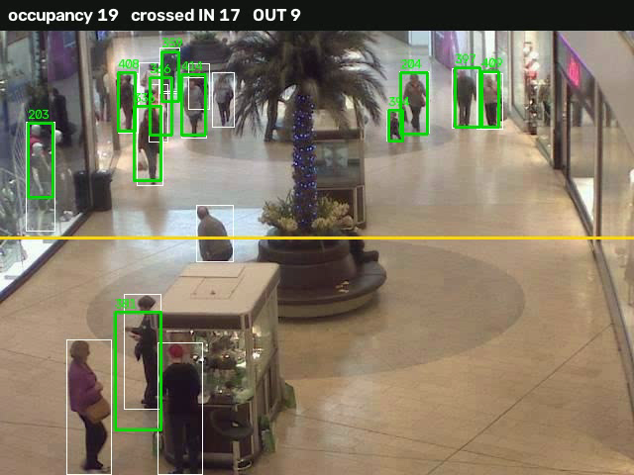
RetailVision
Turning store-camera video into decisions, with AI that runs entirely on your own machine
Real mall CCTV, processed by our pipeline
Detection · Tracking · Forecasting · Local LLM analyst
Notes:
Open with the problem: stores have cameras but nobody turns the footage into numbers. RetailVision does that, and everything runs locally, with no external API and no data leaving the machine.

Slide 2
From a people counter to a store analyst
Where we started
What it does now
Counted every detected object, not only people
Looked at one image, not a video
No memory of who was where, or for how long
No way to ask questions or look ahead
Tracks people through the video (YOLOv8 + ByteTrack)
Measures occupancy, entrance crossings and dwell time
Groups shoppers by behaviour and maps busy zones
Forecasts footfall and answers questions in plain English
100% local: no cloud API, no data leaves the store
Notes:
Be candid about the starting point: the original code counted every object YOLO found in a single image. The rebuild adds tracking, metrics, forecasting and a local analyst.

Slide 3
How it works: one pipeline, all local
1
2
3
4
5
Video
→
Detect
→
Track
→
Measure
→
Store
CCTV clip uploaded in the dashboard
YOLOv8s finds every person in each frame
ByteTrack links detections into paths
Occupancy, line crossings, dwell, zones, segments
SQLite database; background job queue
Everything runs on one laptop.
Models download once, then work offline (tested on Apple GPU, falls back to CPU).
Forecast
Ask
PyTorch LSTM, used only when a backtest shows it beats a simple baseline
Local Qwen model writes SQL over the data and explains the answer
Notes:
Walk left to right. Stress that detection and association are separate: that was one of the bugs we found, because the tracker alone hides most people at low frame rates.

Slide 4
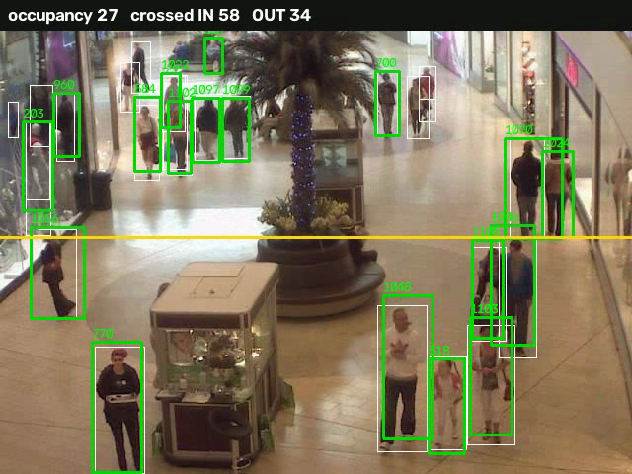
Seeing it work on real mall CCTV
Green box + number
a tracked person and their ID
White box
a raw detection not yet confirmed as a track
Yellow line
the entrance counting line
Top bar
live occupancy and in/out counts
The overlay's 111 in / 66 out matches the pipeline's stored counts exactly.
Notes:
Play demo/annotated_demo.mp4 here. Point at the counter updating as people cross the yellow line.

Slide 5
Measured accuracy against ground truth
27.4
mean occupancy on the full 2,000-frame video (truth: 31.2)
46
peak occupancy (truth: 53)
~90%
of unseen-wording questions answered correctly by the local analyst
Notes:
Dataset: CUHK Mall, 2,000 CCTV frames with per-frame ground-truth counts (research use). Original settings missed about 4 in 10 people; larger input size and a lower confidence threshold fixed most of it. The occupancy fix came from separating detection from tracking.

Slide 6
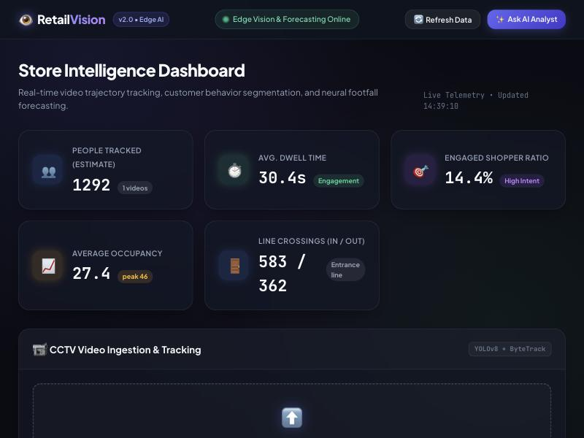
The dashboard
Upload a clip: it runs as a background job that survives restarts
KPIs: people tracked (estimate), dwell time, mean and peak occupancy, entrance in/out
3×3 zone heat-map of where people spend time
Shopper behaviour groups: passer-by, browser, engaged
Draw counting lines per camera, set retention, and delete data
Ask-the-analyst box for plain-English questions
Notes:
Live click-through: upload the clip, watch the progress, show the KPI cards updating. 'People tracked' is labelled an estimate on purpose.

Slide 7
Ask your store a question
Question
Question
Question
How many people crossed the line going in?
What is the average dwell time of engaged shoppers?
Which zone has the most people?
Answer
Answer
Answer
583 people crossed the line going in.
About 100.65 seconds.
Zone r0c0, with 315 people.
SELECT COUNT(*) FROM crossings WHERE direction = 'in'
SELECT AVG(dwell_sec) FROM tracks WHERE segment='engaged-shopper'
SELECT zone, COUNT(*) AS people_count FROM tracks GROUP BY zone ORDER BY people_count DESC LIMIT 1
A small open-source model (Qwen2.5-1.5B) writes the SQL and explains the result. Only read-only SELECT queries are allowed, and nothing is sent outside the machine.
Notes:
These are real outputs from the demo database. We found and fixed two wrong answers while preparing this (it once said '1 person crossed' for 583), so we added examples and re-ran the 30-question benchmark.

Slide 8
What did not work, and what we did about it
Bag and staff labels
Crossings and visitors
Forecast
What we measured
What we measured
What we measured
Bag check: below baseline on small mall crops, but 74% vs 51% on people 180+ px tall (53 crops). Staff vs customer: never validated.
Hand-labelled entrance clip: precision 70%, recall 71%. Reported 57 vs ~52 real, because errors offset. People tracked is inflated by ID switches.
On 17 minutes of data the LSTM only tied 'same as last value'. It needs days of history, which we do not have.
What we did
What we did
What we did
Bag check only for 180+ px crops and opt-in; staff label stays off.
Report crossings as an estimate, cancel flip-flops, keep people tracked labelled an estimate.
Backtests LSTM, last value and same-hour-yesterday and uses the winner; a monitor collects the data.
Notes:
This slide builds trust. Every number on earlier slides has a measurement behind it; these three are the places where the measurement told us to stop claiming something.

Slide 9
Next steps for the team of five
1
2
3
4
5
Tracking
Classification
Forecast
Local LLM
Product
Hand-tracked 30 s window to put a real error on unique visitors and crossings
Higher-resolution footage, or a model trained on a person-attribute dataset
Several days of hourly footfall from one store
Grow the question benchmark; try fine-tuning on question to SQL pairs
Per-user accounts, HTTPS, continuous live streaming on a real camera
Blocked today by data, not by code: identity ground truth, higher-resolution footage, and multi-day history.
Notes:
Each workstream has a different owner. The code, tests and CI are in place so each can be validated independently.

Slide 10
From camera feed to decision, locally
5
workstreams defined
84
automated tests, all passing
Working today: tracking, occupancy, entrance counts, forecasting with an honest backtest, and a local analyst.
0
external APIs
github.com/Vidushi1408/RetailVision
Notes:
Close on the three facts: it works, it is tested, it needs no outside service.

