Slide 1
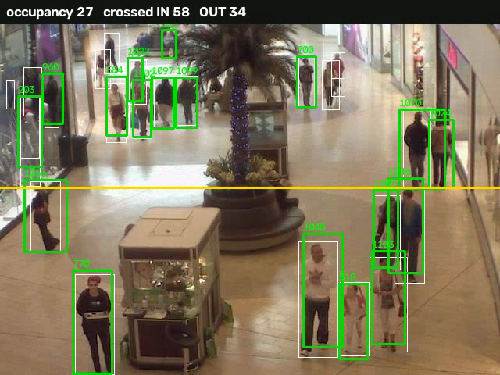
RetailVision
How store-camera video becomes decisions: every algorithm, where it runs, and why we chose it
Output of our own pipeline on public mall CCTV
Detection · Tracking · Clustering · Vision-language · Forecasting · Local LLM
Notes:
Introduce the idea in one sentence: cameras already exist, nobody turns them into numbers. This deck walks through each algorithm in the order the data flows.

Slide 2
What the system produces
1
2
3
4
5
Occupancy
Entrance counts
Behaviour
Forecast
Questions
How many people are in view, every second
People crossing a line you draw, in and out
Dwell time, zones, passer-by / browser / engaged
Footfall for the next hours, once history exists
Plain-English answers from the stored numbers
YOLOv8s
ByteTrack + geometry
KMeans
LSTM + baselines
Local LLM + SQL guard
No cloud AI service is called. Models and data stay on the machine (the web page itself loads Chart.js and fonts from the internet).
Notes:
Five outputs. Stress that everything runs on the user's own machine and uploaded video is deleted after analysis.

Slide 3
The pipeline in one picture
Video
YOLOv8s
ByteTrack
Measure
SQLite
uploaded clip or a camera window
→
finds every person in each frame
→
links boxes into one track per person
→
crossings, merge, trajectory features
→
tracks, crossings, per-second counts
Built on the stored numbers
KMeans
CLIP
LSTM
Qwen + guard
Dashboard
behaviour groups
carrying a bag
footfall forecast
answers questions
charts, line drawing
Neural networks: YOLO, CLIP, LSTM, Qwen. Classical: Kalman filter, Hungarian matching, KMeans. Hand-written rules: crossings, merging, SQL guard.
Notes:
Read left to right, then the second row. Detection and tracking are the expensive part; everything else works on small stored numbers, so it is instant.

Slide 4
Detection: YOLOv8s finds the people
A convolutional network sees one frame and returns boxes with a confidence score
Single pass, no anchors; non-maximum suppression removes duplicate boxes
We keep class 0 (person) only, input 1280 px, confidence 0.15
Pretrained on COCO, used unchanged (no fine-tuning)
13.2
people error per frame with default settings (42%)
4.1
people error with 1280 px and conf 0.15 (13%)
Where: tracker.py, track_video()
Why: fast on a laptop, no training, strong accuracy
Measured on 200 frames of the CUHK Mall dataset (ground-truth counts)
Notes:
Detection has no memory: each frame is independent. We use the pretrained model unchanged; the gain came from input size and threshold, measured on a public dataset.

Slide 5
Tracking: ByteTrack gives each person an ID over time
1 Predict
A Kalman filter moves every track forward using its recent velocity.
Why ByteTrack
Uses box geometry only: no second model
Keeps weak boxes instead of discarding them
Tuned: buffer 60, match 0.9 for crowds at low fps
2 Match strong boxes
Boxes above 0.25 are matched to tracks by overlap (IoU) with the Hungarian algorithm.
3 Match weak boxes
Leftover tracks are matched to low-score boxes (0.10 to 0.25): usually a person who is partly hidden.
Weak spot: IDs jump when people cross or walk as a group, so "people tracked" is an estimate.
4 Create / lose
Unmatched strong boxes start tracks; unmatched tracks wait 60 frames before they are dropped.
Notes:
Kalman filter predicts where each track should be; IoU measures overlap; the Hungarian algorithm assigns one detection to one track. The two-round matching is the idea that makes ByteTrack special.

Slide 6
Counting entrances: line-crossing geometry
1 Signed distance of each track point to line A to B (cross product).
2 Count only a move from beyond the margin on one side to beyond it on the other.
3 The crossing point must lie within the segment.
4 Cancel a cross and its opposite within 3 s: jitter or an ID switch.
left side
margin 0.02
A
B
Entrance clip, hand-labelled: precision 70%, recall 71%. Reported 57 vs about 52 real crossings.
right side = "in"
Notes:
This is our own algorithm. Every rule exists because something went wrong on real footage: the margin stops jitter, the segment test stops walking around the end, the reversal rule removed 17 false events on the entrance clip.

Slide 7
Behaviour: trajectory features and KMeans
4 numbers per person
KMeans, k = 3
Naming the groups
Dwell time (seconds)
Path length
Average speed
Stationary ratio
Standardise the 4 numbers
Group people by nearest centre
No labels needed; fitted per video
Fastest centre: passer-by
Longest dwell of the rest: engaged-shopper
Remaining: browser
Made from the track's points in track_features()
Where: classifier.py, segment_shoppers()
Limit: always exactly 3 groups, and names are relative to that one video.
Notes:
KMeans is unsupervised: it finds three groups in four numbers. The names come from a rule on the cluster centres, which is why they are only meaningful inside one video.

Slide 8
Attributes: CLIP reads a picture with sentences
A network trained on image-text pairs maps pictures and sentences into one space
Score = similarity to "carrying a bag or basket" minus similarity to "carrying nothing"
Runs on each person's largest crop, only if it is 180 px or taller
Optional per upload: loads a 600 MB model
Small mall crops (87 to 188 px)
below the 'no bag' baseline
Entrance crops (188 to 295 px)
74% accuracy vs 51% baseline
Staff vs customer
Where: classifier.py, carrying_bag()
never validated: off
n = 53 labelled crops: about plus or minus 12 points
Notes:
Zero-shot means no training labels: we compare the picture with sentences. The key lesson is that crop size decides whether this works: below baseline on small crops, 74% on large ones.

Slide 9
Forecast: LSTM, chosen only if it wins a backtest
Hourly means
Backtest
Compare
Forecast
per-second occupancy averaged by hour
→
train on first 80%, test on the rest
→
LSTM vs last value vs same hour yesterday
→
lowest error wins; its name is shown
The network
What is and is not proven
1 LSTM layer, 32 units, then a linear output
Looks at the last 6 hours, predicts the next
Adam, learning rate 0.01, 200 epochs, MSE loss
On 17 minutes of mall data the LSTM only tied the baseline. It won on synthetic 14-day data, which shows the selection works, not that a real store benefits. It needs days of history.
Notes:
The honest point: an LSTM is not automatically better. We compare it with two trivial baselines on held-out hours and use whichever has the lowest error.

Slide 10
The analyst: a local language model writing SQL
Question
Qwen2.5-1.5B
Fixes + guard
SQLite
Qwen again
typed in the dashboard
→
writes one SELECT from schema, rules, 17 examples
→
repair, allow-list, 5 s limit, 50 rows
→
runs it read-only
→
explains the rows in a sentence
Deterministic fixes
The guard (SQLite itself)
Drop role filters that cannot match anything
Drop invented zone codes and impossible values
Add a missing group filter; switch to the right table
One error-aware retry
Authorizer: only 4 tables readable
Read-only connection, 5 second cutoff
Result: about 90% correct on unseen wording
Notes:
The model only writes a query; the numbers come from the database. Every query passes through the guard. The deterministic fixes exist because a 1.5 billion parameter model makes characteristic mistakes.

Slide 11
How the algorithms differ
Algorithm | Kind | Learns from | Output | Used for
YOLOv8s | CNN detector | COCO (pretrained) | boxes + scores | find people
ByteTrack | Kalman + Hungarian | nothing (classical) | tracks with IDs | follow people
Line crossing | geometry | nothing | in / out events | entrance counts
Fragment merge | greedy heuristic | nothing | fewer tracks | people estimate
KMeans | unsupervised | the video itself | 3 groups | behaviour
CLIP | vision-language | pretrained, zero-shot | similarity score | carried bag
LSTM | recurrent network | the store's history | next-hour counts | forecast
Qwen 1.5B | transformer LLM | pretrained | SQL, then text | analyst
Detection answers who is in a frame; tracking adds time so a person keeps one ID. Only the LSTM and KMeans are fitted to your data.
Notes:
Use this slide for the question 'what is the difference between X and Y'. Three families: pretrained neural networks, models fitted to the user's data, and hand-written rules.

Slide 12
Why these choices, and what we gave up
Decision | Chosen | Instead of | Reason | Cost
Detector | YOLOv8s, 1280 px | nano at 640 px | error 4.1 vs 13.2 people | slower
Tracker | ByteTrack | DeepSORT / BoT-SORT | no extra model; keeps weak boxes | ID switches in crowds
Groups | KMeans | fixed thresholds | needs no labels | names relative per video
Attributes | CLIP zero-shot | train a classifier | no labelled data; 74% on big crops | weak on small people
Forecast | LSTM by backtest | baselines only | can learn a daily shape | needs days of data
Analyst | local Qwen 1.5B | cloud model | privacy, no API | about 90% on new wording
Storage | SQLite | server database | one file, no setup | one machine
Notes:
Each row is a decision with a measured reason and an honest cost. This is the answer to 'why not X'.

Slide 13
Backend: what happens when you upload a video
1
Upload
2
Queue
3
Analyse
POST /analyze_video: type and size checked, file saved to disk
A row in the jobs table; the job id comes back immediately
One worker runs detect, track, measure, cluster, optional CLIP
4
Store
5
Clean up
6
Poll
One transaction writes videos, tracks, crossings, per-second counts
Upload deleted; job marked done with its summary
The page asks GET /jobs/id every 1.5 s, then refreshes
Also: auth key, rate limit, retention purge, and a monitor that analyses a camera in back-to-back windows.
Notes:
Walk the six steps. The key engineering ideas are that the request returns at once and the work is queued in the database, so a restart does not lose it.

Slide 14
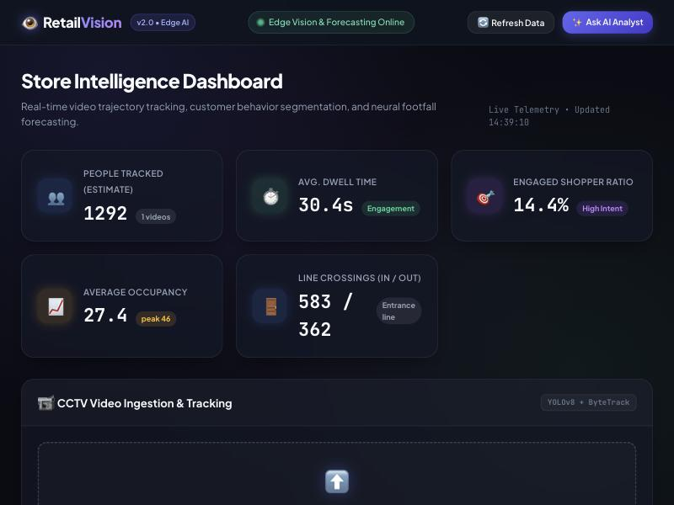
Frontend: what you see and where it comes from
KPI cards
/overview/
Upload, progress, summary
/analyze_video/, /jobs/
Counting-line canvas
/frame/, /lines/
Footfall + forecast chart
/customer_traffic/, /forecast/
Behaviour donut, zone grid
/segments/, /overview/
Analyst chat with SQL
/ask/
Plain JavaScript, Chart.js for charts. The page needs internet for Chart.js and fonts; everything else is local.
Notes:
Everything on the page is a plain HTML element updated by JavaScript from one of the API routes. The step badges are an animation, not live server progress.

Slide 15
What was measured
Public mall data
occupancy, detection
One entrance clip, one annotator
crossings, bags (n = 53)
12 unseen questions
analyst
30-minute soak
135 windows, 0 errors, memory +4.4%
Notes:
Say where each number comes from. Occupancy and detection use a public dataset with ground truth; the others are hand labels on one supplied clip, so they are indicative.

Slide 16
Honest limits
People tracked
Crossings
Staff vs customer
Overcounts in crowds (ID switches). Use occupancy and crossings.
Need a camera facing a door and a drawn line. About 70% precision.
Never validated. Switched off.
Forecast
Behaviour groups
Analyst
Needs days of history; under 9 hours it shows the flat average, and with no data, nothing.
Always three, names relative to one video.
A 1.5B model: about 90%. Always read the SQL it shows.
Notes:
Close on this slide when asked 'what does not work'. Each limit has a reason and a fix path.

Slide 17
From camera feed to decision, locally
8
core algorithms, each with a stated reason
84
automated tests
Detect, track, count, group, forecast and ask, with every number traceable and every limit stated.
0
external AI services
docs/HOW_IT_WORKS.md has the full written explanation
Notes:
Close with: eight core algorithms, each chosen for a measured reason, each with a stated limit. Offer the written document for detail.

