Slide 1
AIC
Arpita Shah
Vidushi Chitranshi
P. Abhinav
Pranav Magadi

Slide 2
PROBLEM STATEMENT
During the absorption of CO₂ in the canister, heat and moisture are generated. The canister temperature may rise ~37°C to ~40°C. This warm gas flows to the flow sensors of the breathing system, which are at a cooler temperature (consider operation theatre temperature 20°C). The vapor in the gas condenses in the breathing system and the inspiratory flow sensor during inspiration. Additionally, expired air from the patient is at 37°C (body temperature) and moisture condenses at the expiratory flow sensor during expiration phase. This causes a lot of water to accumulate in the breathing system. This hampers flow sensor accuracy and monitoring capability.

Slide 3
Reason for this problem
The moisture is produced mainly due to the reaction of the CO₂ with the soda lime in the CO₂ scavenging unit.
Since this moisture is at ~37°C to ~40°C when generated, it condenses later on in the system since it is at ~20°C, causing the problem.

Slide 4
Our Approach
We propose a system in which this problem is completely eliminated by substituting the existing carbon dioxide scavenging system with a Metal Organic Framework (MOF) designed to selectively remove CO₂.
This way, there will be no moisture generated in the system at all, and thus the condensation problem is reduced.
The reason we choose MOFs are because of their high selectivity and efficiency, as well as their capability of being regenerated. Their comparative advantages have been explained in the following slides.

Slide 5
Methods For CO2 Removal at current scale
Method | Wt% removal of CO2 | Selectivity for CO2 | Other effects | Cost
SodaLime | 26% | High | Generation of heat and moisture | Low
MOF | 35% | High | Instability to moisture | High
Zeolite | 9% | Medium | Adsorbs all other gases of similar size | Medium
Amine Scrubbing | 30% | High | Requires extreme operating conditions | High

Slide 6
Problems with the alternatives
Soda lime: High production of water
zeolites: less selectivity towards carbon dioxide
Amine scrubbing: extreme working conditions (not possible with anaesthesia machine)
MOFs: structure disintegration when in contact with water

Slide 7
MOFs: How They Work
MOFs are comprised of metal-containing nodes linked by organic ligand bridges and assembled principally through strong coordination bonds.
MOFs have geometrically and crystallographically well-defined framework structures and in most cases, these structures are robust enough to allow the removal of the included guest species resulting in permanent porosity.

Slide 8
MOFs
MOFs can be conceptually designed and synthesized based on how building blocks come together to form a network structure. As a result, the structures and properties of MOFs can be designed and systematically tuned by the judicious choice of building blocks.
This unique tunability allows us to modify MOFs pre- as well as post-synthesis for specific applications.
This very property is what makes MOFs an ideal separator for our system – it can be made absolutely selective towards CO2, not affecting the rest of the operation at all in terms of chemical makeup.

Slide 9
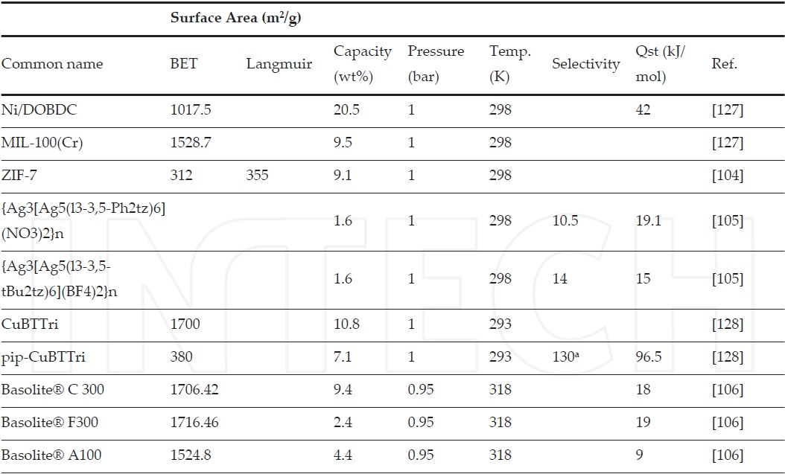
Selection of an MOF For the given operating conditions of ~1 atm and ~298k, we have the following data for MOFs. A more comlete table can be found at ref. no.[4].

Slide 10
Selection of an MOF
After referring to several sources, the Mg MOF 74 seems to the most suitable one due to the following reasons:
The rate of absorption is maximum for Mg MOF-74 at the temperature and pressure conditions suitable for the patients health that is 1.5 bar and 300K.
It does not interfere with the rest of the operation of the machine, i.e. does not give any products during adsorption other than heat.
Weight% absorption of carbon dioxide is maximum among its competitors. maximum CO2 uptake of about 41.3% (with the help of mixed ligand approach )
Selectivity of CO2 over Nitrogen, nitrous oxide, Oxygen, methane is high for the Mg-Mof-74
It does not interfere with the ongoing process of breathing ( does not insert any compound in the system )
It requires much less temperature than other alternatives to get recycled.

Slide 11
Recycling the MOF
Once the MOF gets saturated with the Carbon dioxide, it needs to get recycled. It can be done in two ways:
PRESSURE SWING:
According to the papers researched, the Mg MOF 74 membrane can be reversed and put through a high pressure stream to free the trapped CO2.
2. TEMPERATURE SWING:
The second method is to heat the saturated MOF. Since CO2 is attached to MOF through coordinate bond, it can be easily broken by providing thermal energy through slight heating (which will not affect its structure).

Slide 12
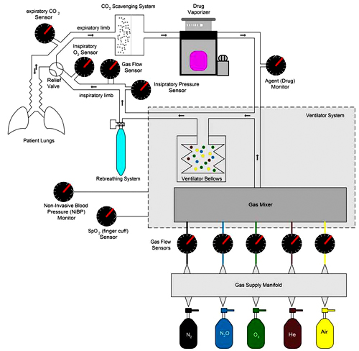
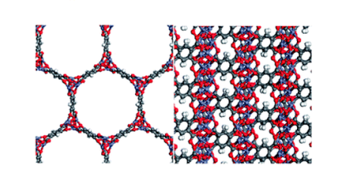
DESIGN PARAMETERS
mof
Propose new design of machine
f
MOF-74 analogs have 1-dimensional hexagonal channels approximately 1.1 nm in diameter

Slide 13
DESIGN PARAMETERS
Membrane-based gas separation is an attractive alternative to both of processes for a number of reasons.
1.Membrane separation is a passive separation and involves no moving parts, making it a far less energy consumptive process comparatively.
2.Membrane separation is a continuous process.
3.Membrane separation takes advantage of differences in diffusivity, thereby potentially achieving higher selectivity for a given separation.
4. Regeneration of CO2 is easier as we only have to slightly heat the Co2 or replace the membrane structure.

Slide 14
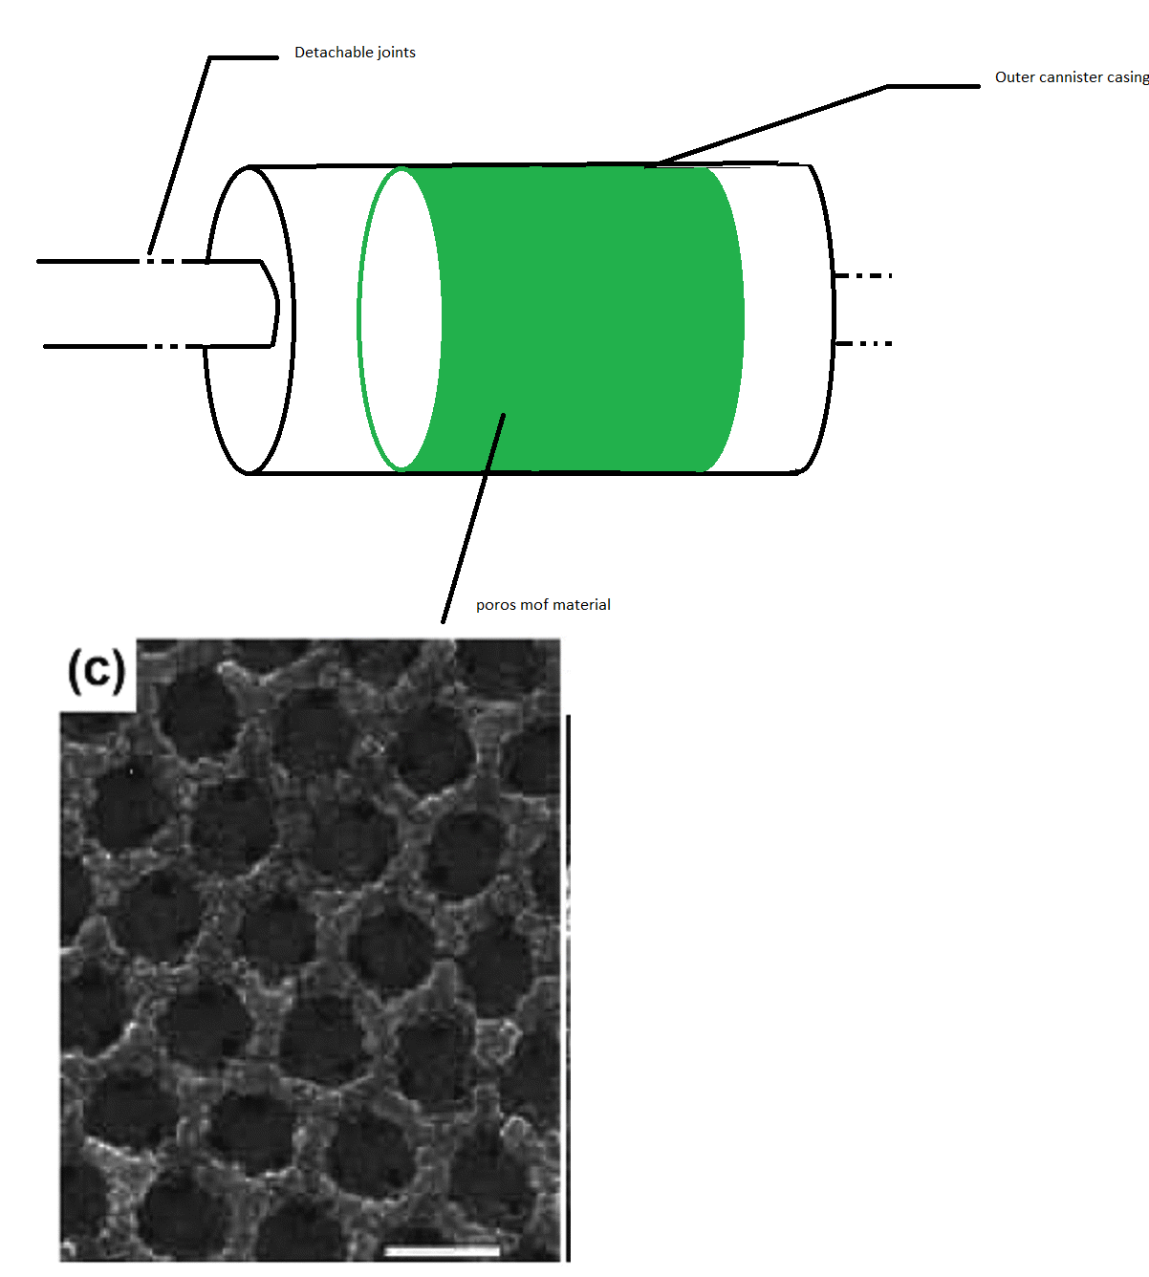
Structured packing to maximize surface area
Detachable cylinder to recycle mof
Outer casing made of suitable material

Slide 15
COST ANALYSIS
According to currently available methods of MOF synthesis, the large scale production of MOFs for commercial purposes is an extremely expensive affair, and is thus not feasible as of now.
However, it is definitely one the most promising carbon capture technologies existing.

Slide 16
Advantages
Environmentally friendly
Non toxic
High co2 uptake
Flexible

Slide 17
Major challenges with mof
There are two seriou

Slide 18
Disadvantages
High cost
New technology
intolerant to Moisture

Slide 19
References
[1] http://www.sciencedirect.com/science/article/pii/S0010854511000701
[2] D. Yuan, D. Zhao, D. Sun, H.C. Zhou
Angew. Chem., Int. Ed., 49 (2010), p. 5357
[3] Z.Q. Wang, S.M. Cohen
Chem. Soc. Rev., 38 (2009), p. 1315
[4] J. Klinowski, F.A. Almeida Paz, P. Silva, J. Rocha
Dalton Trans., 40 (2011), p. 321
[5] H. Furukawa, N. Ko, Y.B. Go, N. Aratani, S.B. Choi, E. Choi, A.O. Yazaydin, R.Q. Snurr, M. O’Keeffe, J. Kim, O.M. Yaghi
Science, 329 (2010), p. 424
[6] X.S. Wang, S.Q. Ma, P.M. Forster, D.Q. Yuan, J. Eckert, J.J. Lopez, B.J. Murphy, J.B. Parise, H.C. Zhou
Angew. Chem., Int. Ed., 47 (2008), p. 7263
[7] http://cdn.intechopen.com/pdfs-wm/49936.pdf
[8] U.S.E.I. Administration
International Energy Annual
[9] R.J. Kuppler, D.J. Timmons, Q.R. Fang, J.R. Li, T.A. Makal, M.D. Young, D.Q. Yuan, D. Zhao, W.J. Zhuang, H.C. Zhou
Coord. Chem. Rev., 253 (2009), p. 3042

