Slide 1

Personalized Movie Recommendation System
Capstone Three Final Presentation
Vidushi Raval | Data Science Career Track

Slide 2
Problem & Context
Streaming platforms overwhelm users with too many choices.
Users either spend too much time browsing or select suboptimal content.
Goal: Build a personalized recommendation system to predict user preferences.
Business Impact: Boost engagement, satisfaction, and retention.

Slide 3

Stakeholders & Success Metrics
Stakeholders:
Product Team: Enhance recommendation engine.
Data Science Team: Build scalable ML pipelines.
Marketing Team: Personalize campaigns.
End Users: Better discovery and satisfaction.
Success Metrics:
RMSE, MAE for accuracy.
Precision@K, Recall@K, NDCG for ranking quality.

Slide 4
Dataset
MovieLens 20M Dataset:
20M ratings, 138k users, 27k+ movies.
Fields: userId, movieId, rating, timestamp, title, genres, tags.
Rich metadata enables both collaborative and content-based methods.

Slide 5
Data Wrangling
Cleaned ratings and normalized metadata.
Merged ratings with movies dataset.
Handled sparsity: most movies/users have few ratings.
Feature Engineering: One-hot genres, TF-IDF vectors, standardized ratings, label encoding IDs.

Slide 6
Exploratory Data Analysis
Ratings skewed toward 3.0–5.0 (positive bias).
Most movies and users have few ratings → sparsity.
Drama, Comedy dominate in volume; Film-Noir, Documentary highest averages.
Popularity ≠ quality; hybrid methods needed.

Slide 7
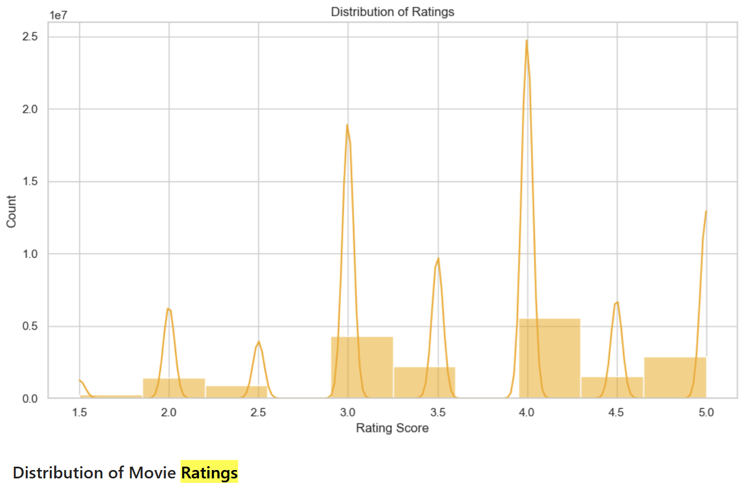
Distribution of Ratings

Slide 8
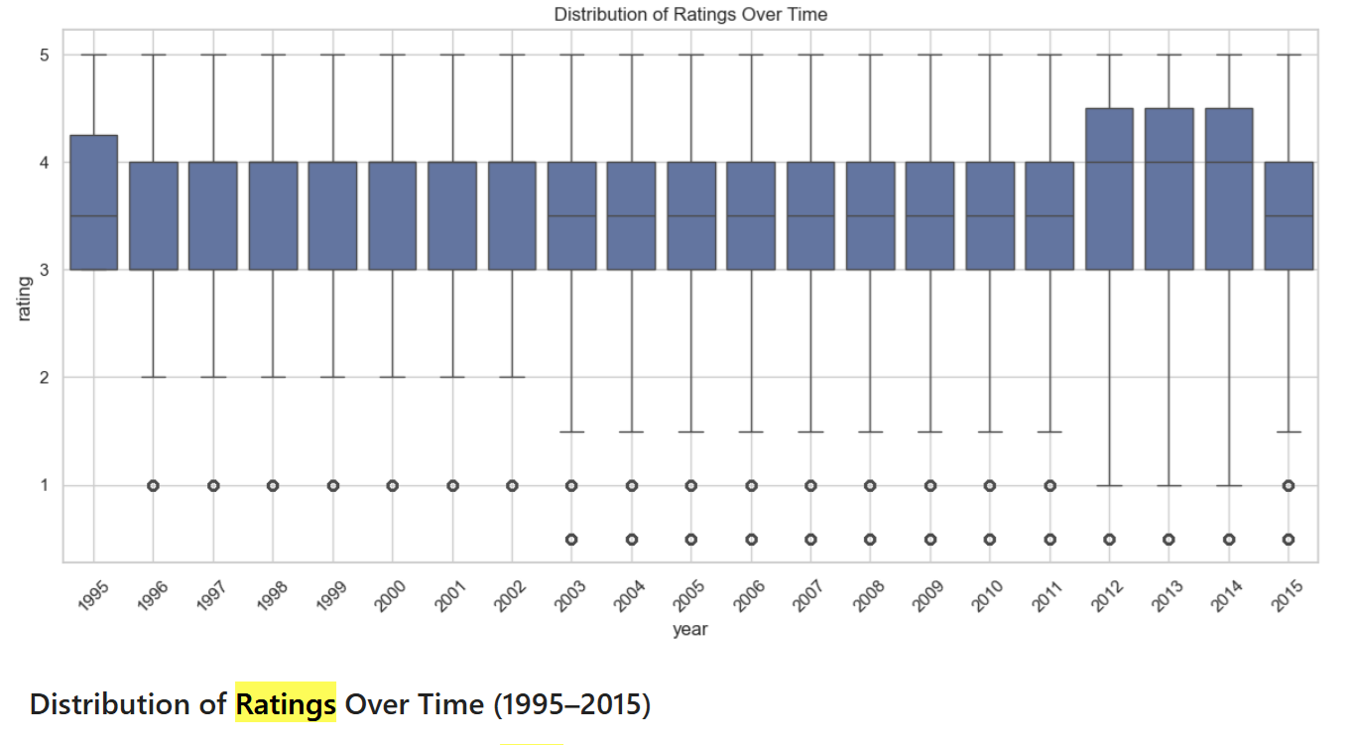
Distribution of Ratings Over Time

Slide 9
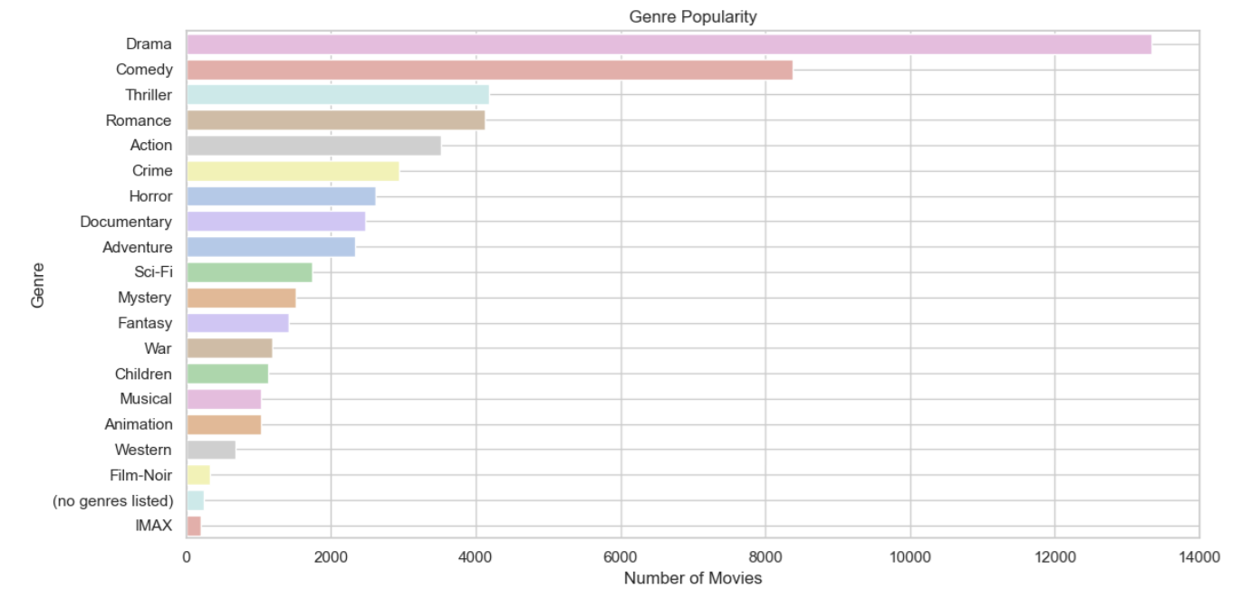
Genre Popularity

Slide 10
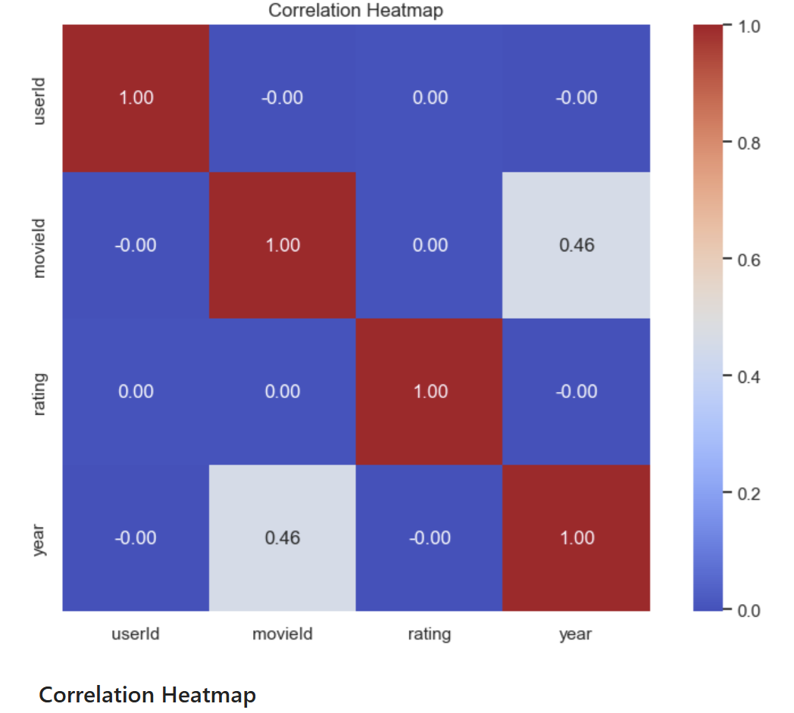
Correlation Heatmap

Slide 11
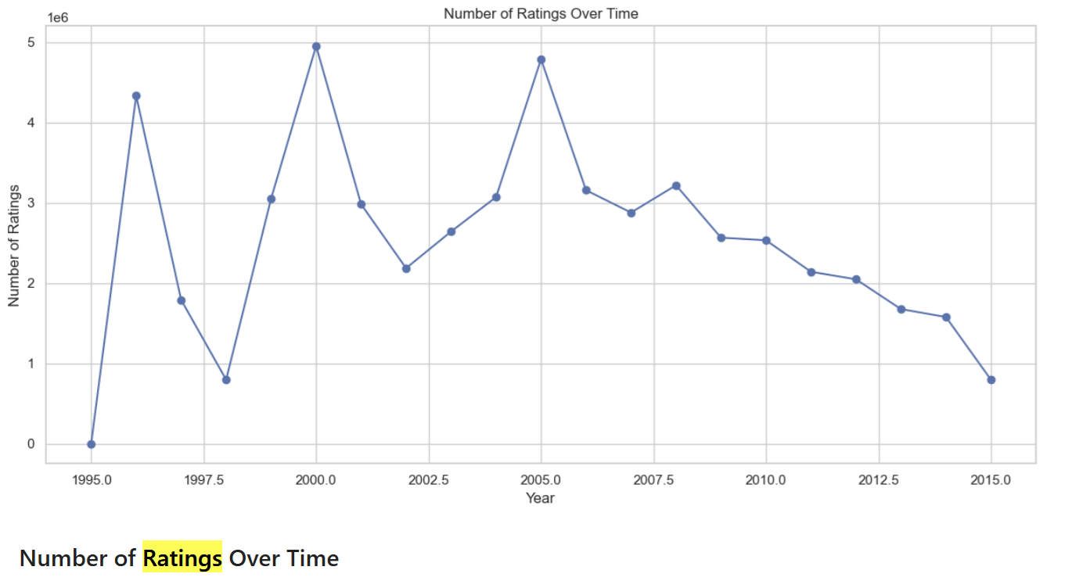
Number of Ratings Over Time

Slide 12
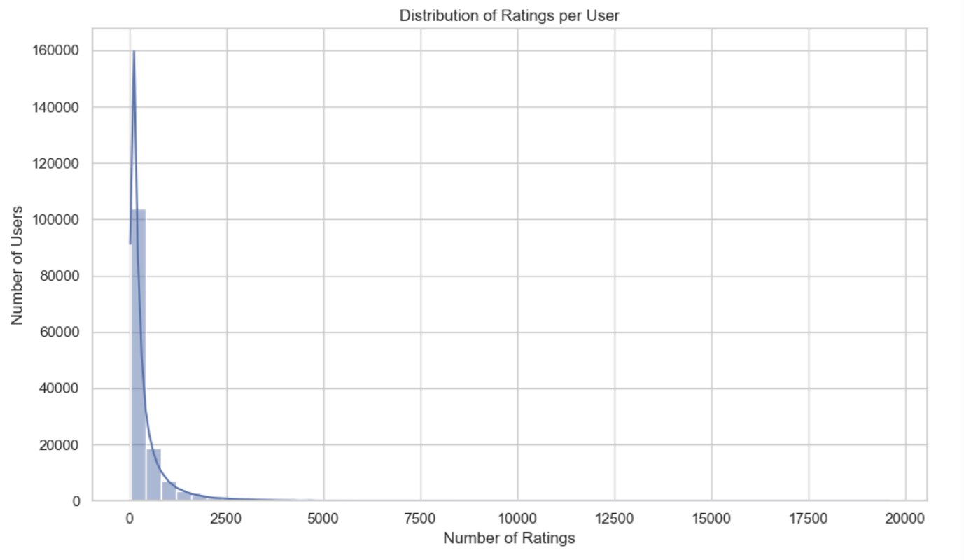
Distribution of Ratings per User

Slide 13

Modeling Approaches
1. Baseline Models:
Global/User/Movie averages.
2. Deep Learning (Neural CF):
Embeddings for userId/movieId, dense layers.
3. Hybrid Model:
Collaborative Filtering + Content (TF-IDF on genres).

Slide 14
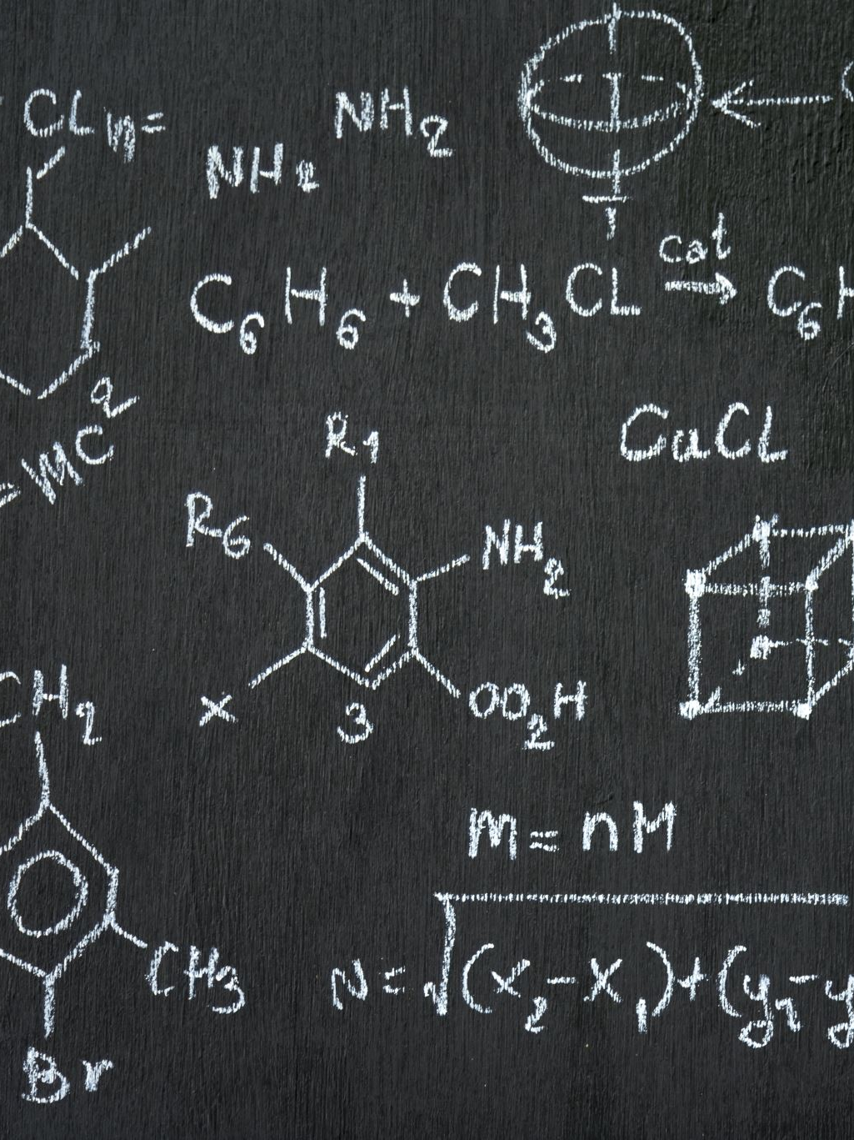
Model Performance
Baseline (Movie Average): RMSE ≈ 0.81, MAE ≈ 0.65.
Deep Learning: RMSE ≈ 0.78, MAE ≈ 0.61.
Hybrid: Similar accuracy + greater diversity in recommendations.
Overlap between Deep and Hybrid Top-10 = only 10% → complementary signals.

Slide 15
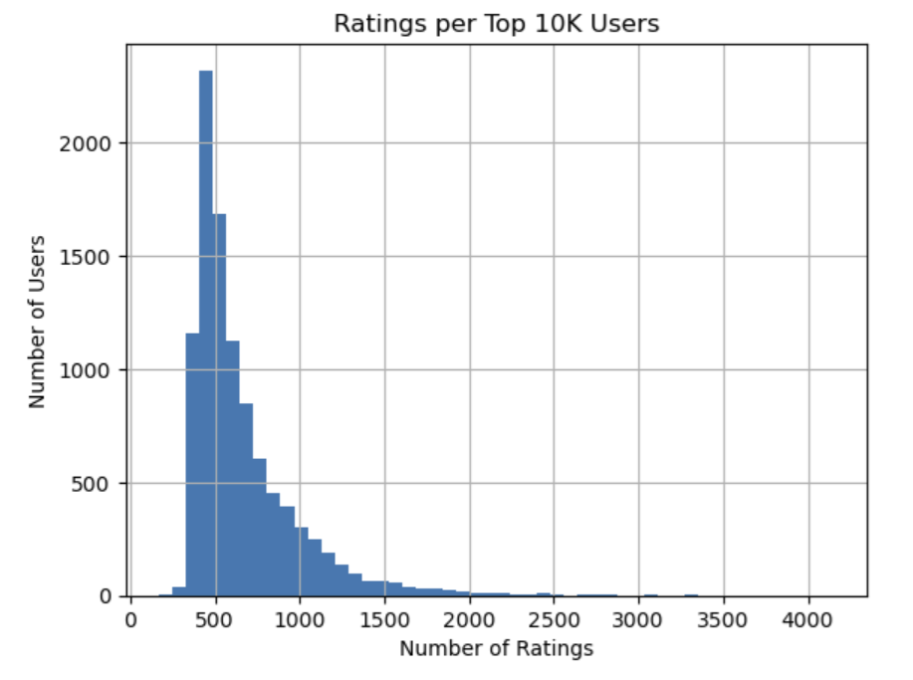
Ratings per Top 10K Users

Slide 16
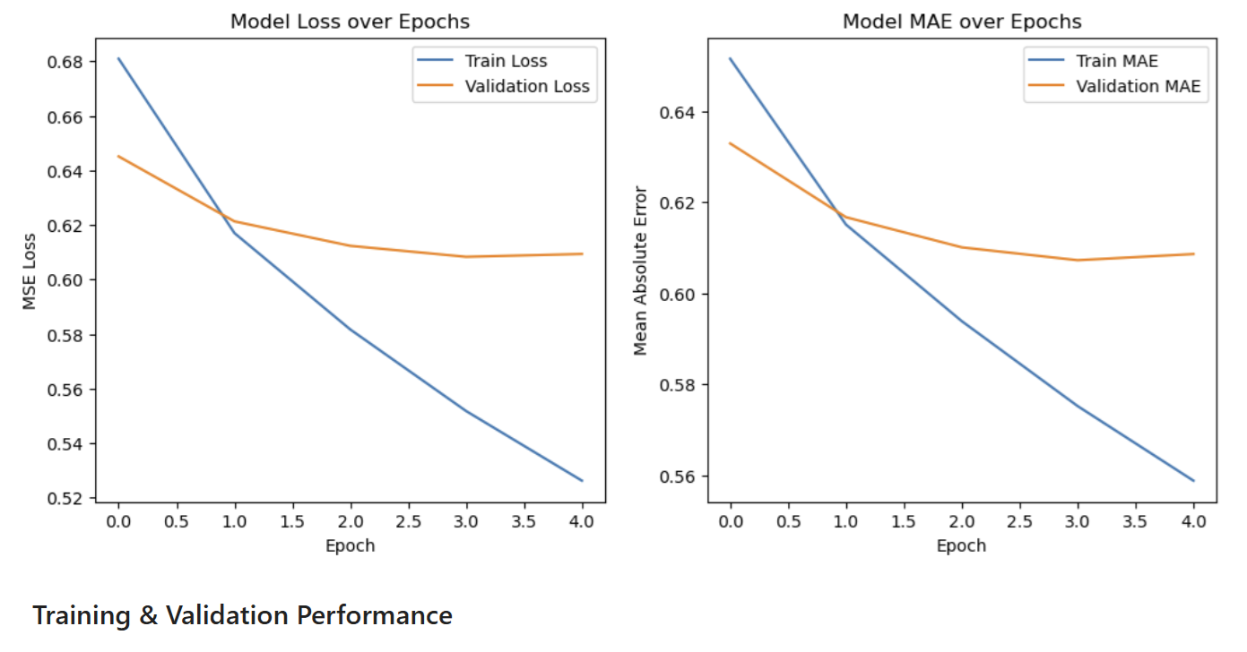
Model Training & Validation

Slide 17


Recommendation Examples
Deep Learning:
Focused on popular franchises (Matrix, LOTR).
Hybrid:
Added diversity (Intouchables, Crouching Tiger).
Insight: Deep Learning = accuracy; Hybrid = novelty & diversity.

Slide 18
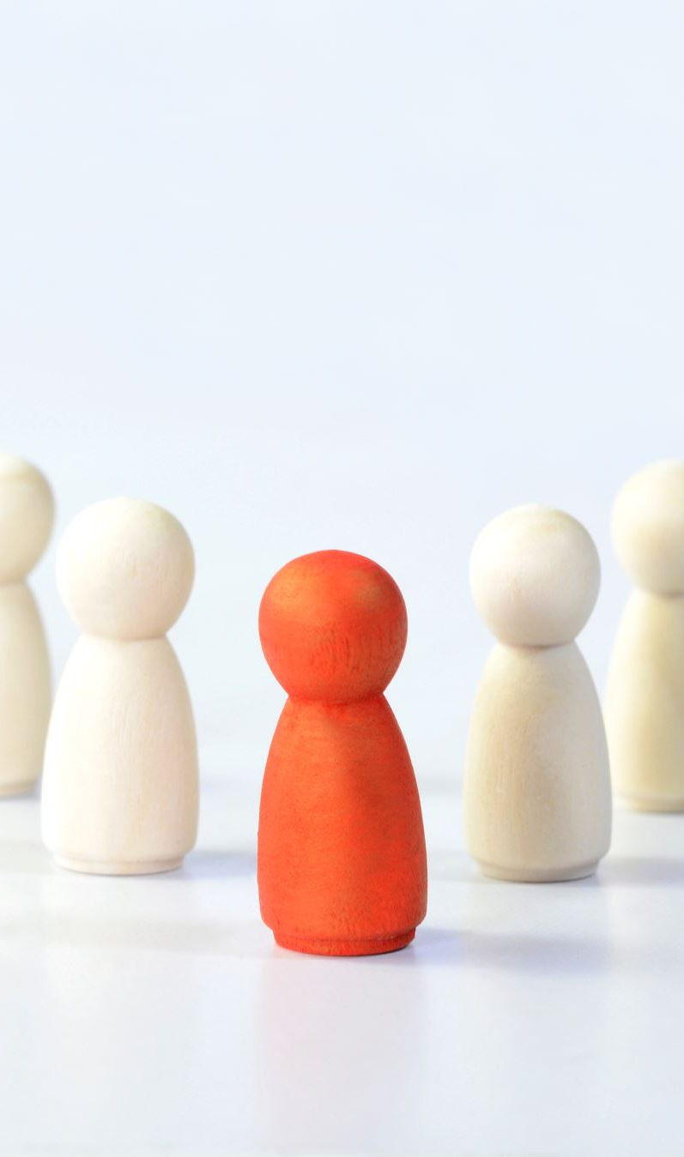
Recommendations & Business Value
Hybrid Model recommended as best choice.
Combines accuracy with diversity, avoids filter bubbles.
Better discovery for cold-start users.
Business Value: Increased engagement, retention, and satisfaction.

Slide 19
Future Work
Add temporal dynamics (preference evolution).
1
Use LLM-based embeddings (BERT, sentence transformers).
2
Deploy Hybrid Model via API/web app.
3
Explore re-ranking strategies balancing accuracy, novelty, and surprise.
4

Slide 20
THANK YOU!
Questions
-
Answers

