Slide 1
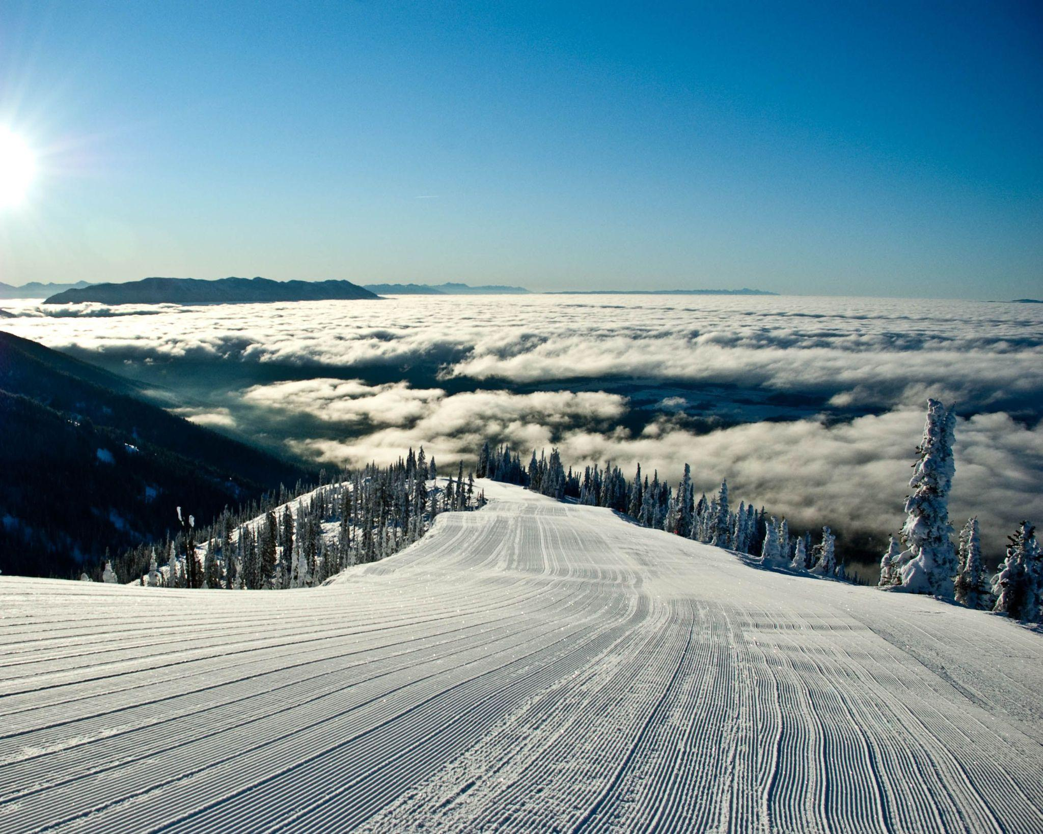
Big Mountain Ski Resort
Presented by:
Vidushi Raval
Data Science Fellow at Springboard
02.20.2025

Slide 2
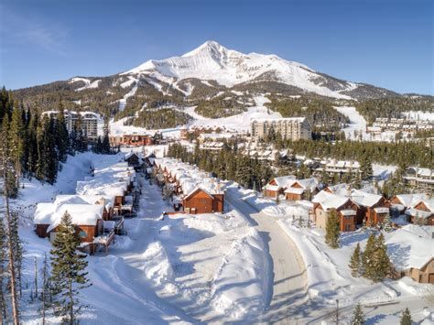
Big Mountain Ski Resort:
02.20.2025
Big Mountain ski Resort has access to 105 trails and every year about 350,000 people ski or snowboard at Big Mountain. This mountain serviced 11 lifts, 2 T-bars, and 1 magic carpet for novice skiers with the longest run is 3.3 miles (name = Hellre) in length.
The base elevation is 4,464 ft and the summit is 6,817 ft with a vertical drop of 2,353 ft.
The resort wanted to take data driven decisions on better value for their ticket price.
The resort has invested in new infrastructure but is unsure how to align this with their ticket pricing structure. This initiative is critical for ensuring that the resort can cover its operating costs and improve profitability, while also delivering a competitive advantage in the market.

Slide 3
Agenda:
Problem identification
Recommendation and key findings
Modeling results and analysis
Summary and conclusion
02.20.2025

Slide 4
Problem Identification:
02.20.2025
Big Mountain Resort seeks to optimize its ticket pricing strategy to increase revenue by at least 10% while maintaining visitor numbers and customer satisfaction by the end of the ski season.
The resort currently bases its pricing on market averages, which may not fully capture the value of its unique amenities, including a newly installed chairlift that added $1.54 million in operational costs.
To achieve this goal, data from 330 comparable resorts will be analyzed to identify the most influential factors affecting pricing and develop a data-driven pricing model that better reflects the resort’s value. The success of this initiative will be measured by improved revenue projections, competitive pricing alignment, and actionable recommendations for cost optimization.

Slide 5
Key Findings:
02.20.2025
Pricing Influences: Vertical drop, number of runs, and projected days open strongly impact pricing. Infrastructure like quad lifts and snow-making increases value.
Trends: California, Utah, and Nevada have the highest ticket prices. Night skiing boosts pricing in northern regions.
Competitive Analysis: Silverton Mountain Resort in Colorado commands higher prices due to a vast skiable area.

Slide 6
Recommendations For Big Mountain Resort:
02.20.2025
Adjust ticket pricing to reflect vertical drop and projected days open, which have the strongest impact on price.
Invest in infrastructure improvements, particularly fast quads, as they correlate with higher pricing.
Implement dynamic pricing strategies to adjust ticket prices based on demand, seasonality, and competitor pricing.

Slide 7
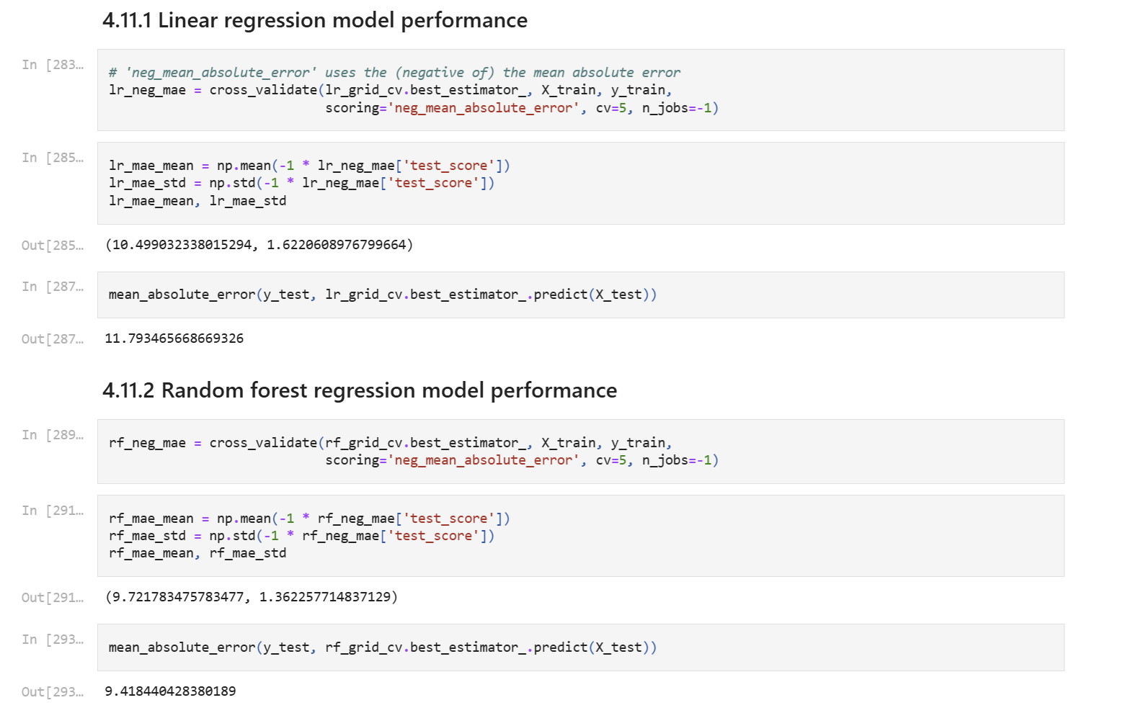
Modeling Results And Analysis:
02.20.2025
Linear Regression Model:
Explained over 80% of the variance on the train set and over 70% on the test set.

Slide 8
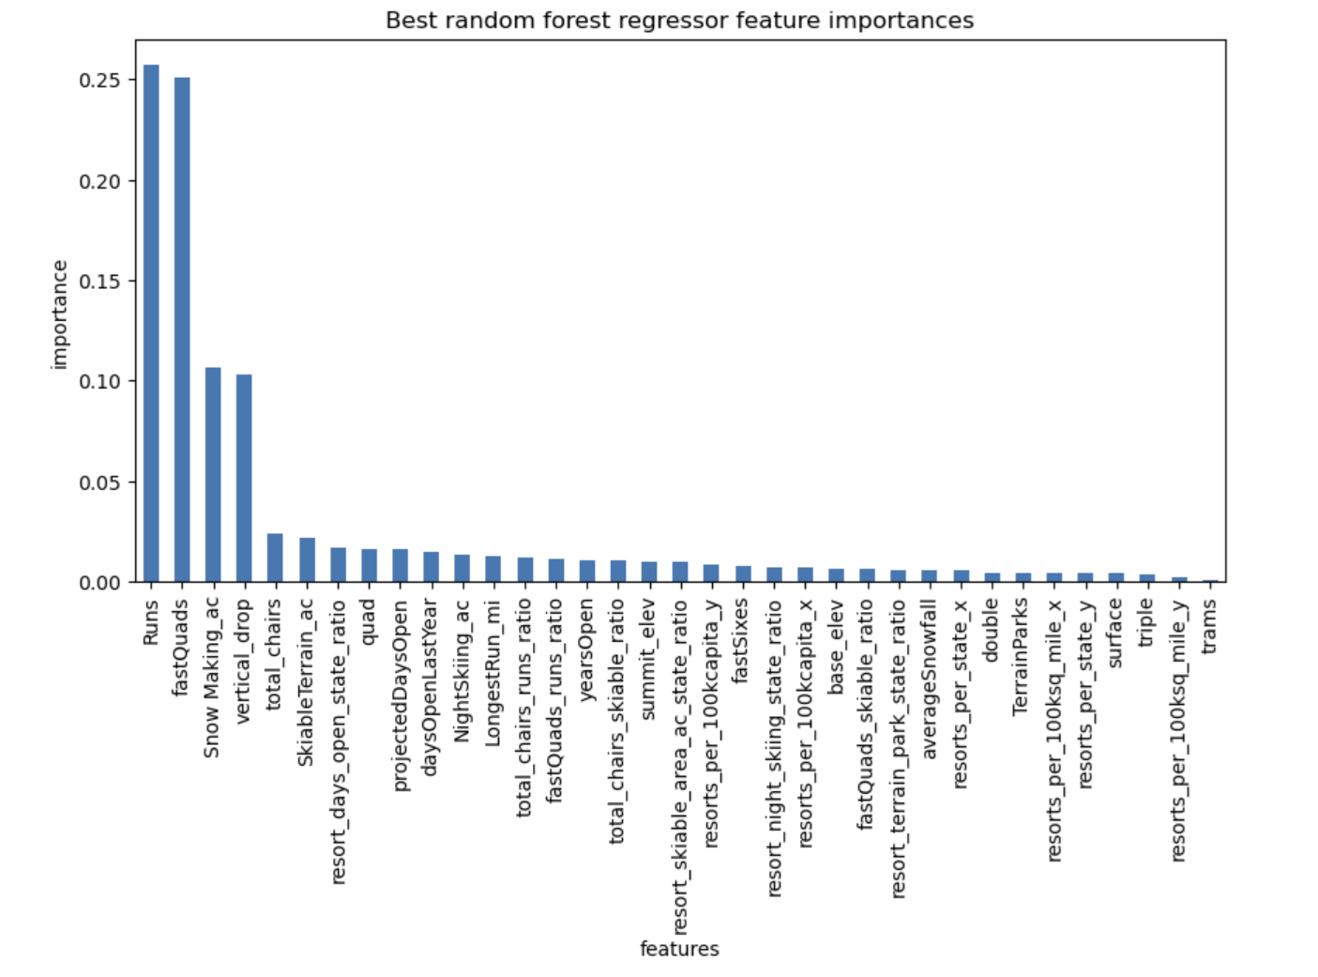
Modeling Results And Analysis:
02.20.2025
Random Forest Model:
Random Forest Model: Provided superior performance, with lower cross-validation mean absolute error and less variability.
Random Forest Model performed best, predicting ticket prices with high accuracy.
Figure: Bar Plot of the Random Forest Feature Importances

Slide 9
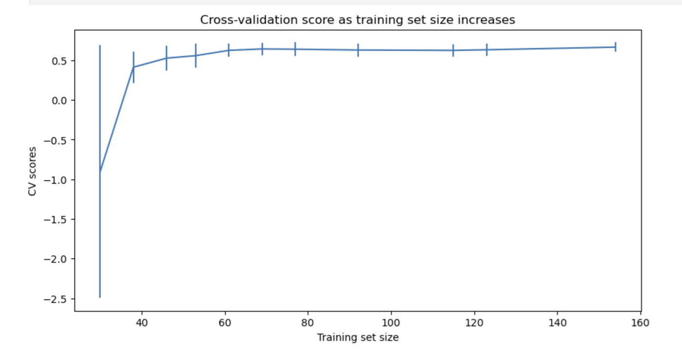
Modeling Results And Analysis:
02.20.2025
Cross-Validation Model:
Cross-validation confirmed model stability, suggesting pricing adjustments based on data-driven insights.
Cross-validation results showed that a Random Forest Regressor outperformed the Linear Regression model.
The model stabilized with a dataset size of approximately 40-50 samples, indicating that additional data would not significantly improve accuracy.
Figure: Cross validation score as training set size increases

Slide 10
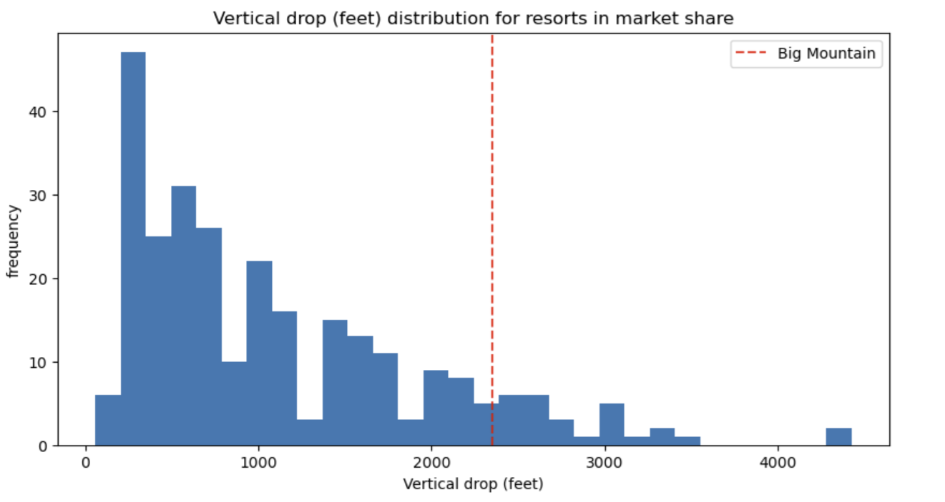
Modeling Results And Analysis:
02.20.2025
Big Mountain is doing well for vertical drop, but there are still quite a few resorts with a greater drop.
Vertical drop was the most significant predictor.
Figure: Vertical Drop (feet) Distribution For Resorts

Slide 11
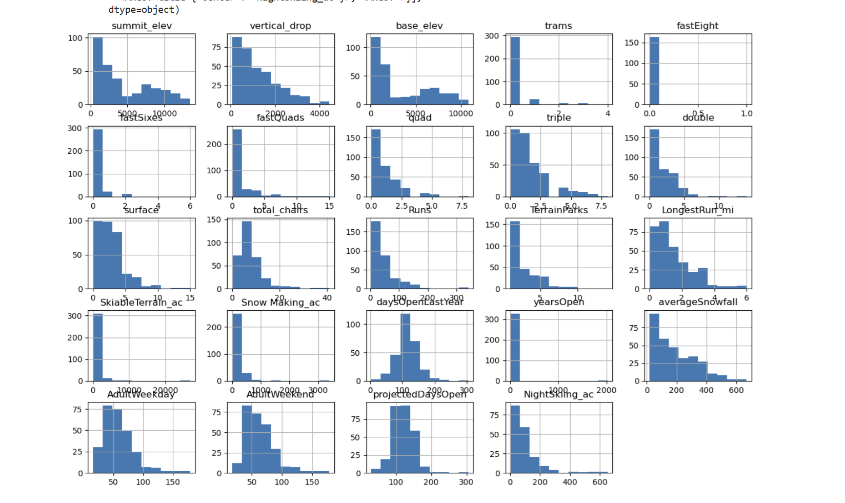
Distributions Of Feature Values:
02.20.2025
Features that have possible cause for concern about are:
SkiableTerrain_ac because values are clustered down the low end,
Snow Making_ac for the same reason,
fastEight because all but one value is 0 so it has very little variance, and half the values are missing,
fast Sixes raises an amber flag; it has more variability, but still mostly 0,
trams also may get an amber flag for the same reason,
years Open because most values are low but it has a maximum of 2019, which strongly suggests someone recorded the calendar year rather than number of years.
Figure: Distributions Of Feature Values

Slide 12
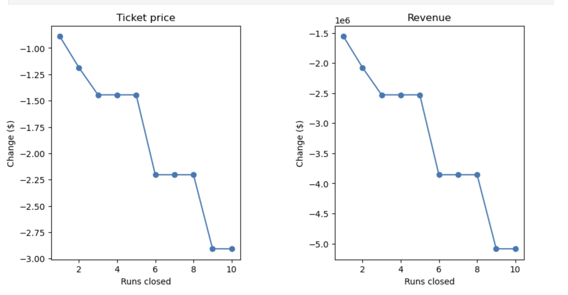
Summary and Conclusion:
The analysis of Big Mountain Resort's pricing strategy revealed that vertical drop, number of runs, and projected days open are key determinants of ticket pricing. The Random Forest model provided the best performance in predicting ticket prices, making it a suitable choice for guiding pricing decisions.
To optimize ticket pricing, Big Mountain Resort should:
Increase ticket prices to reflect key features influencing customer willingness to pay.
Focus on infrastructure improvements, particularly in high-speed lifts and snow-making capabilities.
Consider implementing dynamic pricing strategies to optimize revenue throughout the season.
02.20.2025
Figure: Two plots, side by side, for the predicted ticket price change (delta) for each condition (number of runs closed) in the scenario and the associated predicted revenue, change on the assumption that each of the expected visitors buys 5 tickets

Slide 13



The Team:
02.20.2025
Full Name: Jimmy Blackburn
Role: Director of Operations
Name: Alesha Eisen
Role: Database Manager
Name: Vidushi Raval
Role: Data Science Fellow

Slide 14
THANK
YOU!

