Slide 1
REGIONAL VEHICLE
SALES ANALYSIS
India | FY2019–FY2024
A Data Analytics Course Project
131.8M
28
5
6
Total Units Sold
States Covered
Vehicle Segments
Financial Years

Slide 2
Project Objective
8 structured business questions across 4 categories
Regional Demand
Segment & Mix
→ BQ1: Which states & regions lead in total sales volume?
→ BQ3: How does segment mix differ across regions?
→ BQ2: Which states are growing fastest — emerging markets?
→ BQ4: Which segments are growing / declining nationally?
EV & Fuel
OEM & Market
→ BQ5: Which states lead EV adoption FY2019–FY2024?
→ BQ7: Which OEMs dominate which regions & segments?
→ BQ6: How is the fuel-type mix (Petrol/CNG/EV) shifting?
→ BQ8: What recommendations for OEMs, dealers, policymakers?
Regional Vehicle Sales Analysis — India | FY2019–FY2024 | Data Analytics Project

Slide 3
Dataset Overview
Calibrated to SIAM FY2019–FY2024 national totals + VAHAN state-wise EV data
Segment
FY2019
FY2024
Growth
131.8M
Total Units Sold
Two-Wheeler
20.7M
17.9M
-13.6%
3,360
Passenger Car
3.3M
4.2M
+26.3%
Records × 10 Columns
Commercial Vehicle
0.85M
0.96M
+13.3%
18 OEMs
Manufacturers
Three-Wheeler
0.71M
1.01M
+42.7%
R²=0.978
Electric Vehicle
64K
1.62M
+2,430%
Forecast Model Fit
Regional Vehicle Sales Analysis — India | FY2019–FY2024 | Data Analytics Project

Slide 4
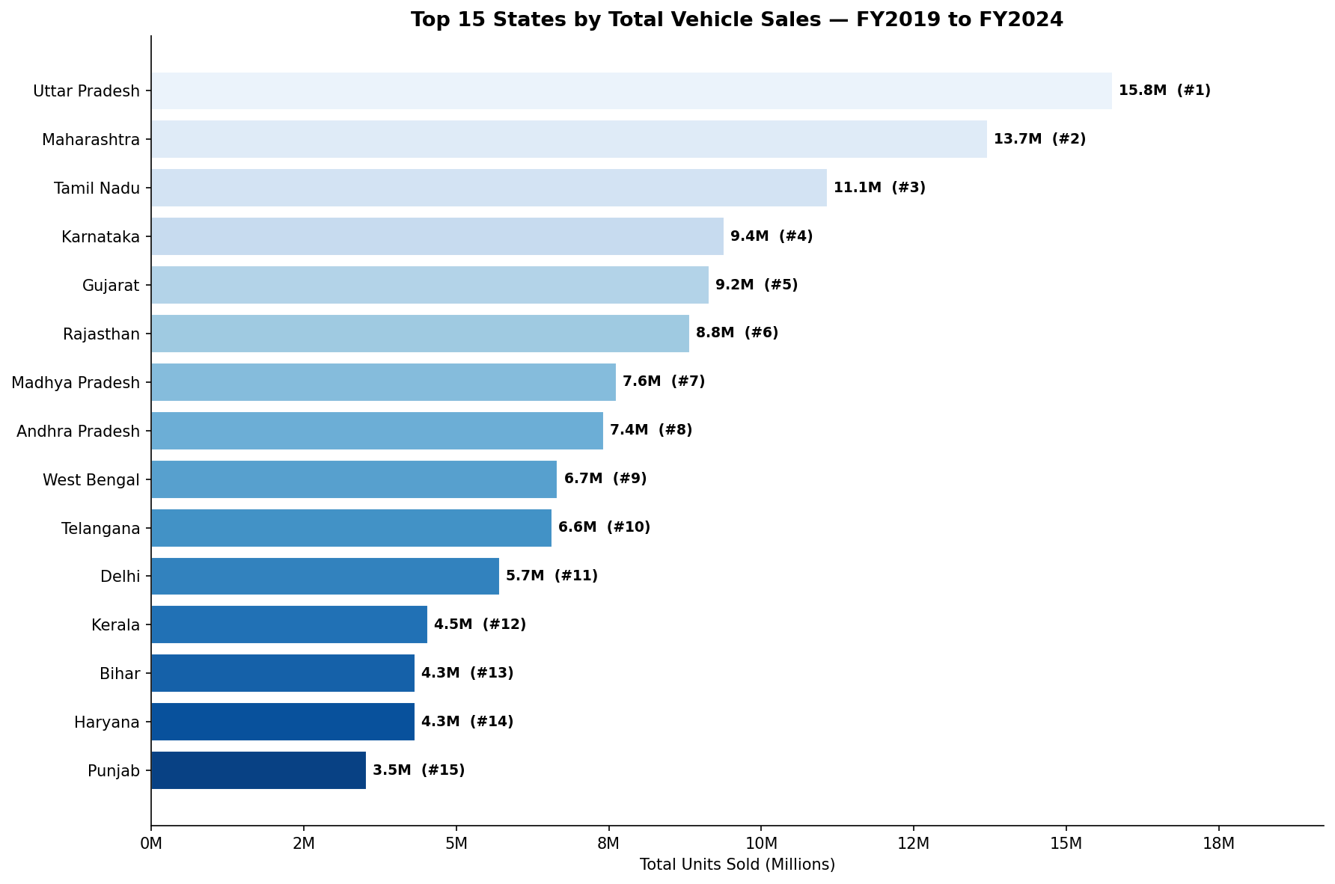
BQ1: Which Regions & States Lead in Sales?
FY2019–FY2024 cumulative volume — North dominates, South close behind
North
41.2M
31.2%
South
39.0M
29.6%
West
23.6M
17.9%
East
15.4M
11.7%
Central
9.7M
7.3%
Northeast
3.0M
2.3%
📍 UP alone = 15.8M units (12% of national)
Regional Vehicle Sales Analysis — India | FY2019–FY2024 | Data Analytics Project

Slide 5
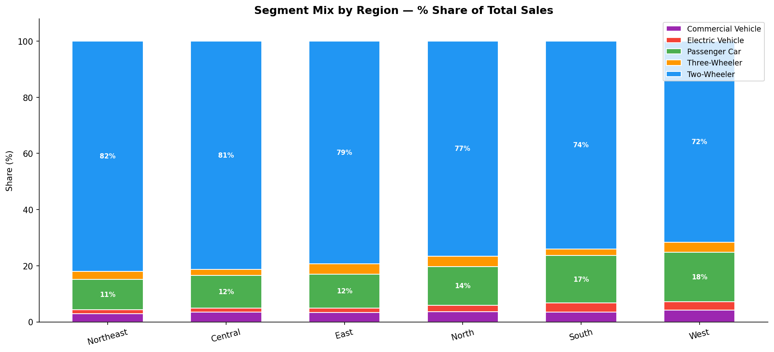
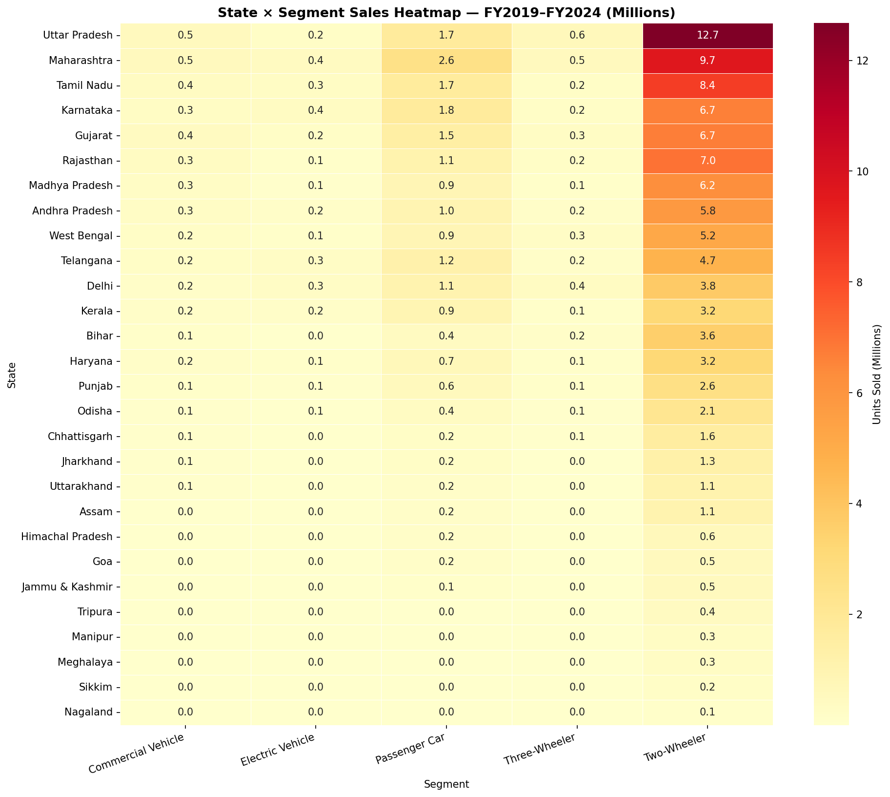
BQ3: How Does Segment Mix Differ Across Regions?
Two-Wheelers dominate everywhere — but South shows highest EV & PV penetration
💡 2W share: 72% West → 82% Northeast. South has highest EV & PV penetration.
Regional Vehicle Sales Analysis — India | FY2019–FY2024 | Data Analytics Project

Slide 6
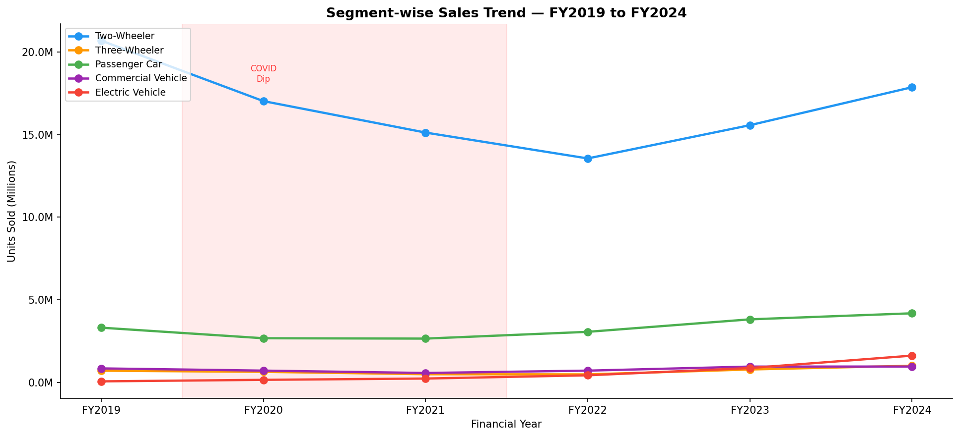
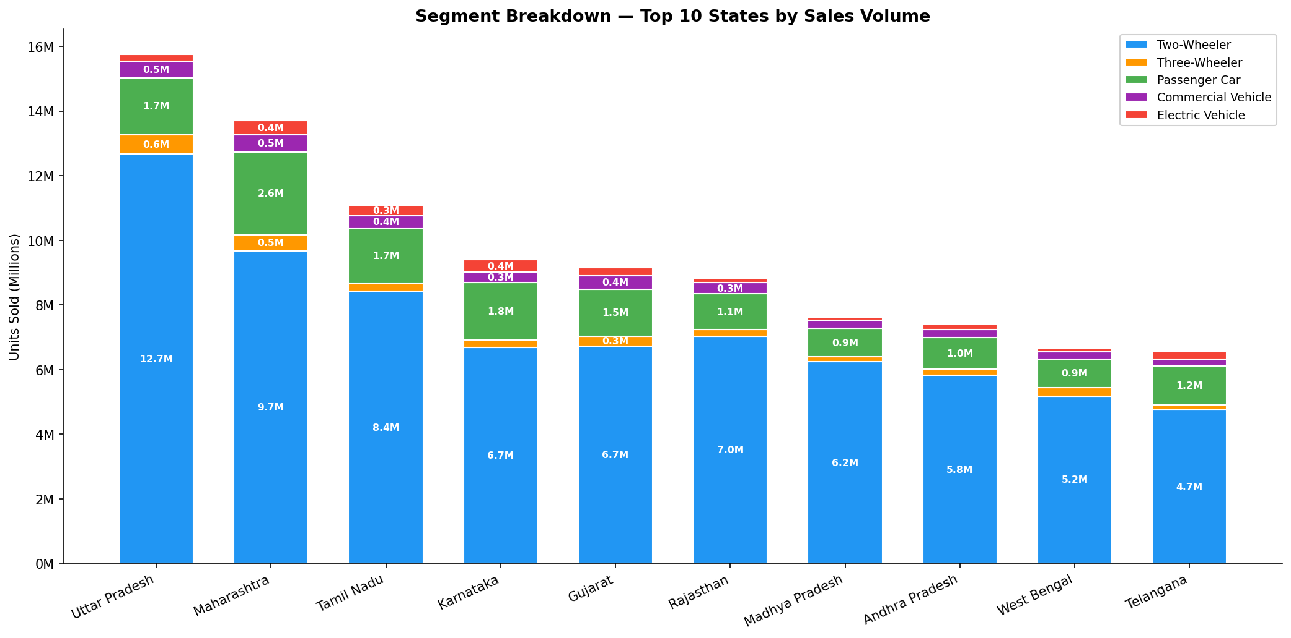
BQ4: Which Segments Are Growing vs Declining?
EV grew 2,430% — Two-Wheeler is the only declining segment
⚡ EV
+2,430%
🛺 3W
+42.7%
🚗 PV
+26.3%
🚛 CV
+13.3%
🛵 2W
-13.6%
Regional Vehicle Sales Analysis — India | FY2019–FY2024 | Data Analytics Project

Slide 7
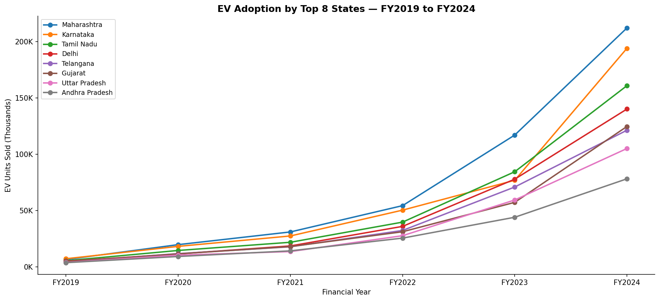
BQ5: The EV Revolution — Who's Leading?
64K → 1.62M units in 6 years | Maharashtra, Karnataka & Tamil Nadu lead
🥇 Maharashtra
212K
13.1%
🥈 Karnataka
194K
12.0%
🥉 Tamil Nadu
161K
9.9%
4. Delhi
140K
8.6%
5. Gujarat
125K
7.7%
🚀 National EV: 64K (FY2019) → 1.62M (FY2024) = +2,430% | MH CAGR = 103.8%
Regional Vehicle Sales Analysis — India | FY2019–FY2024 | Data Analytics Project

Slide 8
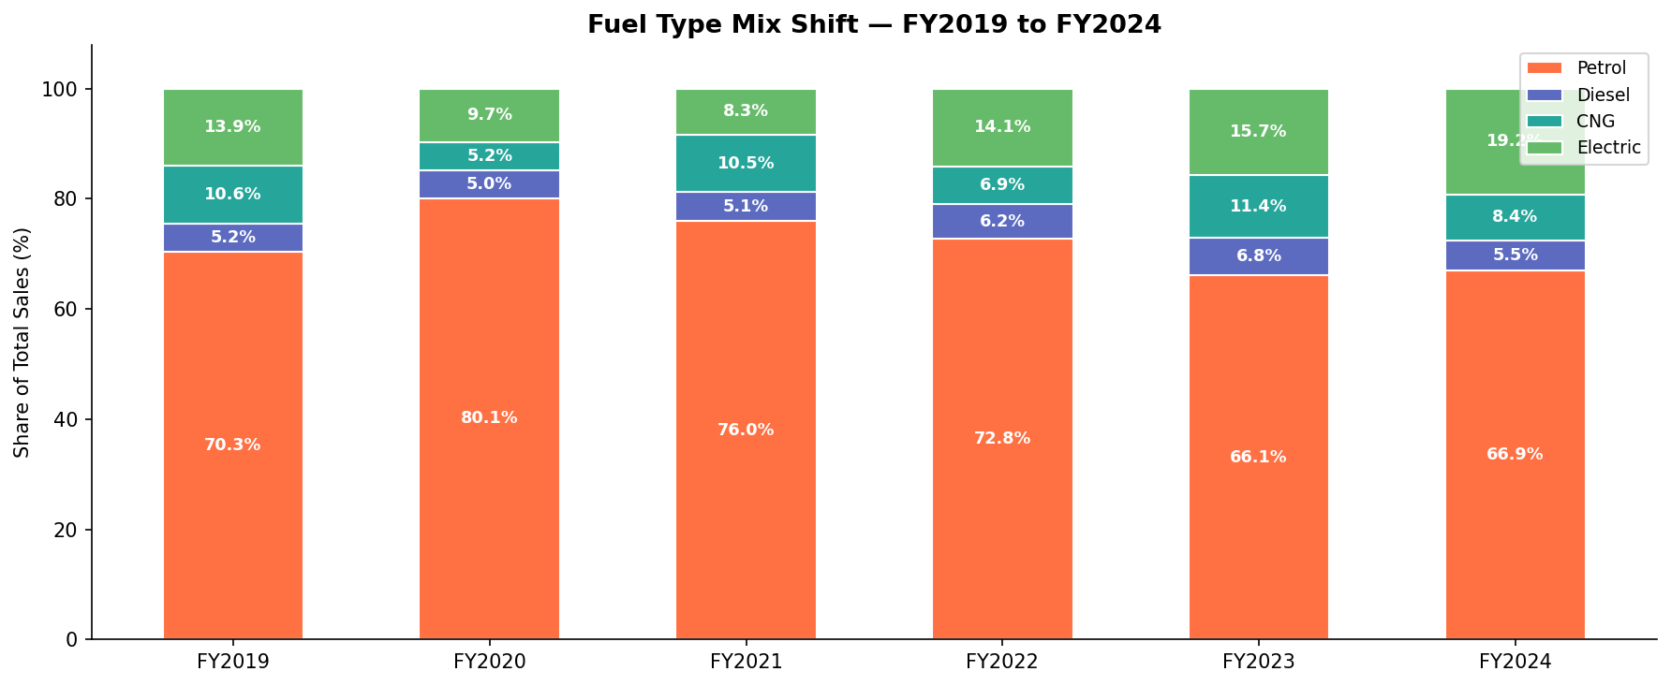
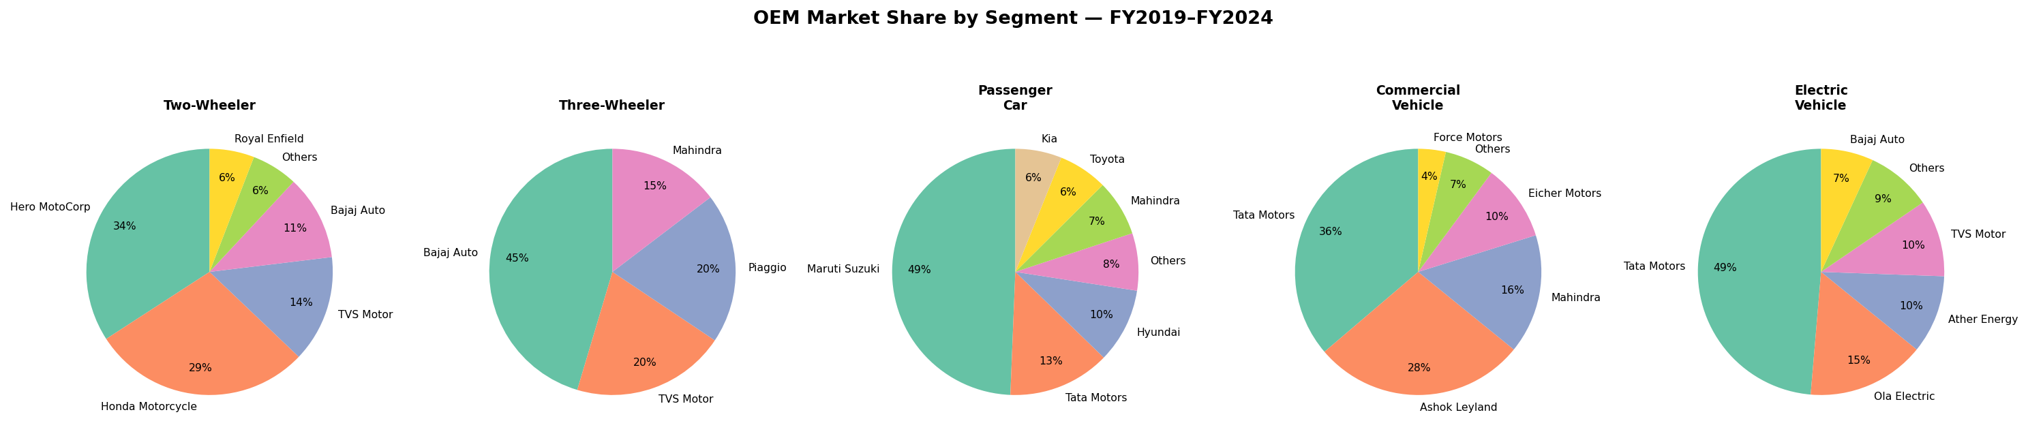
BQ6 & BQ7: Fuel Transition & OEM Dominance
Electric share +5.3pp | Tata leads EVs, Maruti leads PV, Hero leads 2W
Petrol
FY19: 70.3%
FY24: 66.9%
-3.4pp
Electric
FY19: 13.9%
FY24: 19.2%
+5.3pp
CNG
FY19: 10.6%
FY24: 8.4%
-2.2pp
Regional Vehicle Sales Analysis — India | FY2019–FY2024 | Data Analytics Project

Slide 9
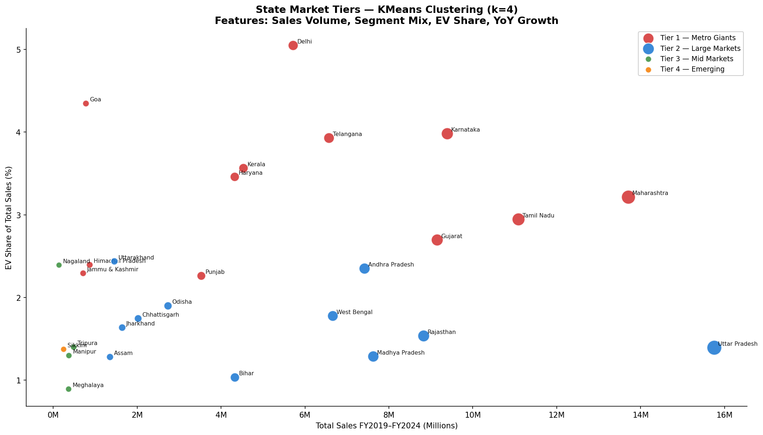
Advanced Analysis: State Market Tiers (KMeans Clustering)
k=4 clustering on sales volume, EV share, segment mix & YoY growth
Tier 1: Metro Giants
MH, KA, TN, DL, GJ…
→ Prioritize EV & premium
Tier 2: Large Markets
UP, RJ, MP, WB, Bihar…
→ Volume 2W + EV pilots
Tier 3: Mid Markets
Odisha, HP, J&K, Assam…
→ CNG + entry PV focus
Tier 4: Emerging
NE States, Sikkim
→ Brand building opportunity
Regional Vehicle Sales Analysis — India | FY2019–FY2024 | Data Analytics Project

Slide 10
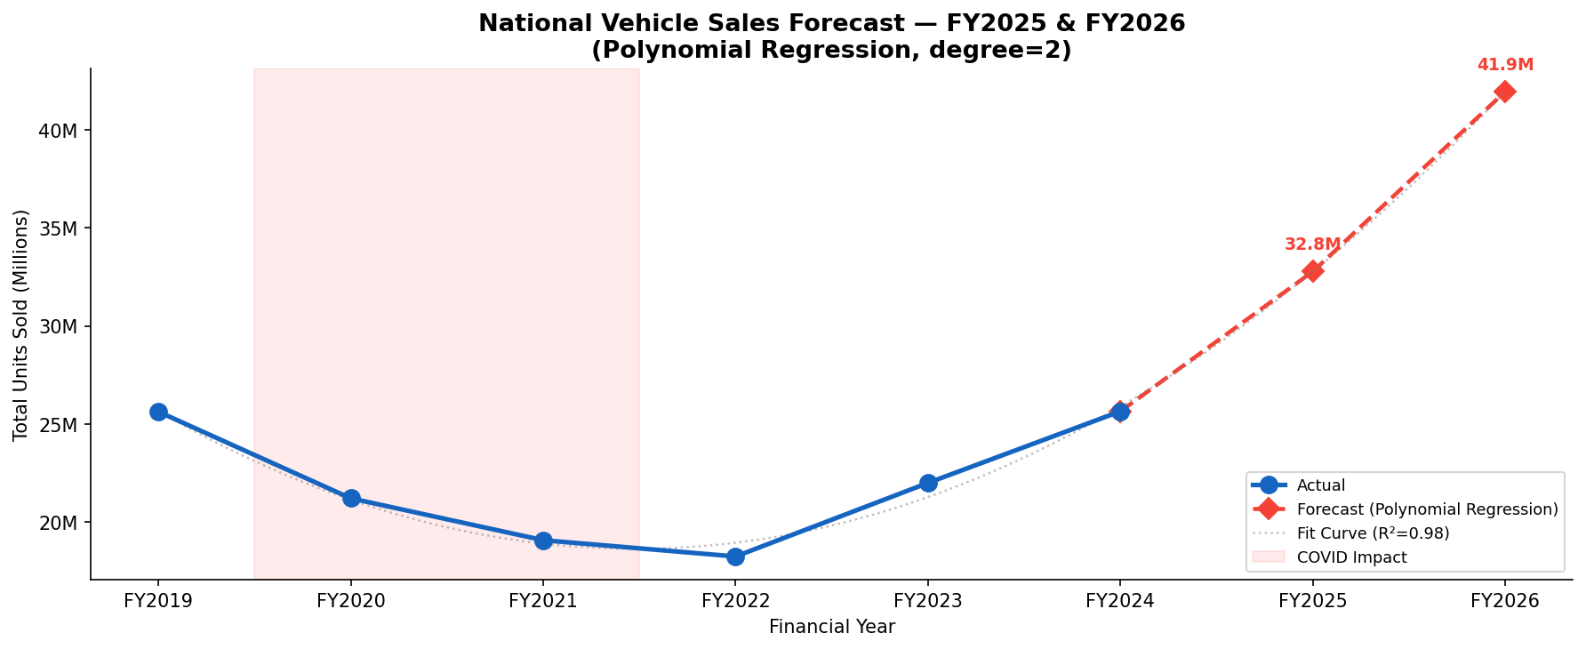
Sales Forecast: FY2025 & FY2026
Polynomial regression (degree=2) | R² = 0.978 | Captures COVID dip & recovery
FY2025
32.8M
Forecast
FY2026
41.9M
Forecast
📈 Strong post-COVID recovery momentum. EV acceleration is key upside risk beyond this forecast.
Regional Vehicle Sales Analysis — India | FY2019–FY2024 | Data Analytics Project

Slide 11
BQ8: Strategic Recommendations
Tailored insights for OEMs, Dealers, and Policymakers
🏭 OEMs
🏪 Dealers
🏛️ Policymakers
→ Launch EVs in Tier 1 markets first — MH, KA, TN, Delhi have the demand
→ South-state dealers: 25%+ showroom floor for EV models by FY2026
→ Concentrate charging infra spend in Tier 2 states (UP, RJ, MP, WB)
→ Build affordable EV 2W (sub ₹80K) for North India mass market
→ North/East dealers: stock CNG 3W & LCV variants alongside EV pilots
→ Targeted subsidies for EV 2W — addresses declining ICE 2W segment directly
→ Focus new SUV launches — fastest-growing PV sub-segment nationally
→ Pre-load inventory for Q3 (Oct–Dec) — consistently 31.3% of annual sales
→ NE state incentive programs to unlock high-growth emerging markets
Regional Vehicle Sales Analysis — India | FY2019–FY2024 | Data Analytics Project

Slide 12
Key Takeaways
⚡
EV is the defining story
64K → 1.62M units (+2,430%) in 6 years. EV strategy is no longer optional for any Indian OEM.
🗺️
North drives volume, South drives growth
North = 31.2% of sales (2W volume). South leads EV adoption & premium segments — strategic priority for OEMs.
🏆
Market is highly concentrated
Top 5 states = 50% of sales. Top 2 OEMs control 40% of volume. Real opportunity = Tier 2-3 states + EV infra.
Regional Vehicle Sales Analysis — India | Data Analytics Project | FY2019–FY2024

