Slide 1
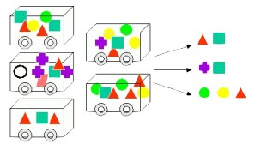
GROCERY STORE DATA
MARKET BASKET ANALYSIS
VIDYA V
PGPDSBA.O.2023 B

Slide 2
Sample 1
AGENDA
Analyze the grocery POS data to derive insights and identify patterns
Perform Market basket analysis to understand buying patterns
Develop marketing strategies and plan offers

Slide 3



Sample 2
EXECUTIVE SUMMARY
9
Months
1139
Orders
37
Products

Slide 4

UNIVARIATE ANALYSIS

Slide 5
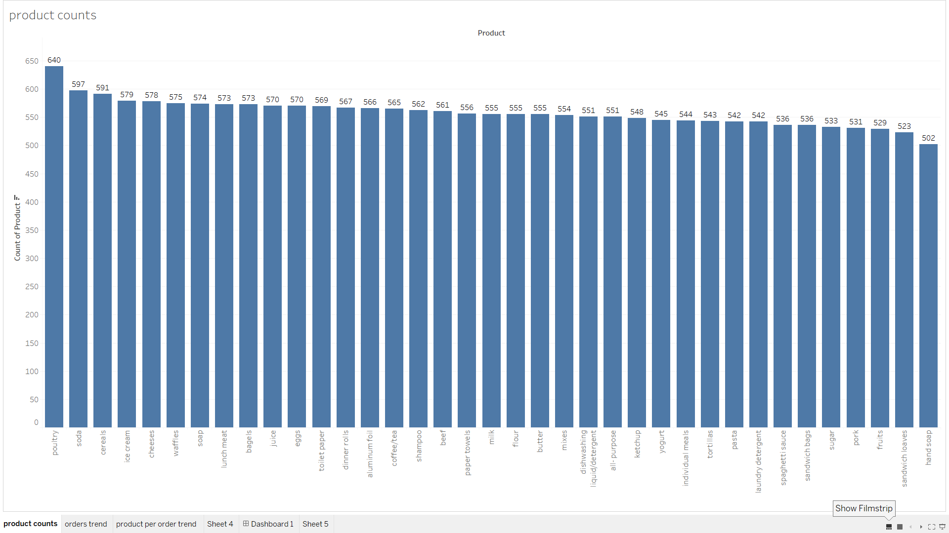

Slide 6
BIVARIATE ANALYSIS

Slide 7
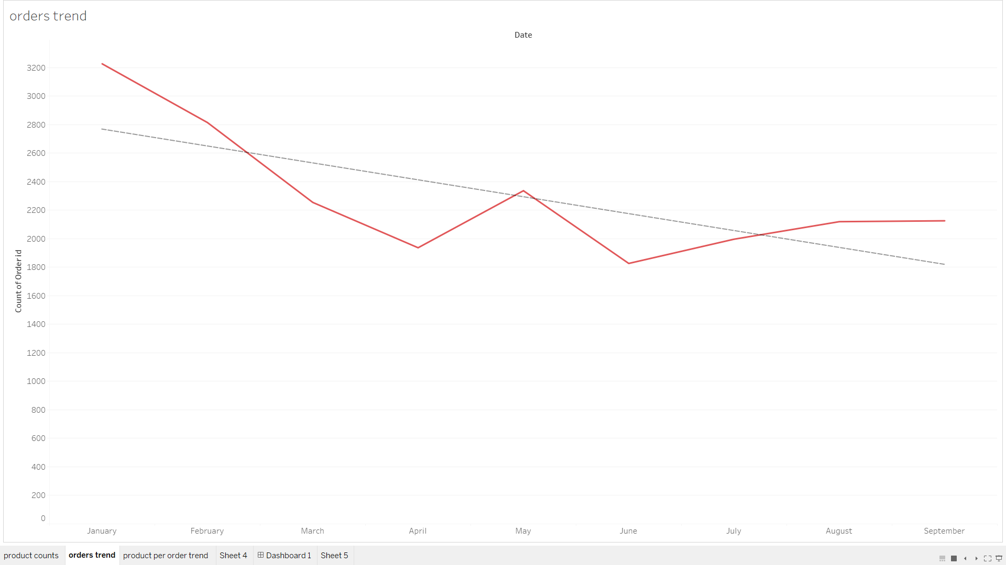

Slide 8
MULTIVARIATE ANALYSIS

Slide 9
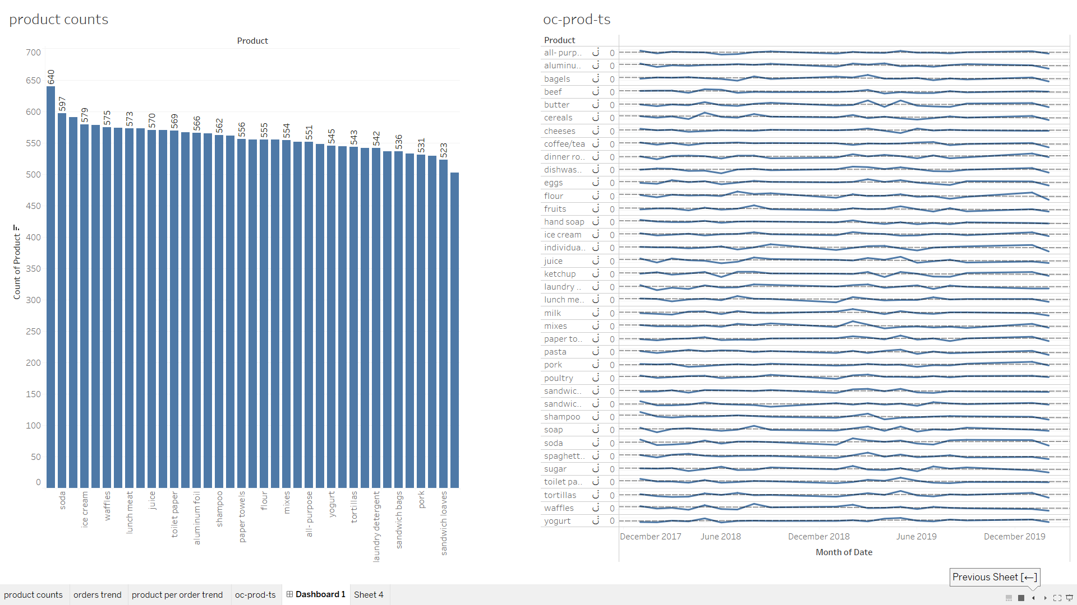

Slide 10
EDA OBSERVATIONS
Poultry is the most bought item- with a total purchase count of 640
Hand soap is the least bought item- with a purchase count of 502
The trend of order counts is decreasing- which might be a cause for concern
On individually inspecting the purchase trend of each product, for most of the products, the lowest purchase count was in June
After which there was a general increasing trend, followed by another decline in August
After August, most of the products have remained stagnant or have declined
Of the total 37 products, poultry, soda, dinner rolls, paper towels, yogurt, tortillas, pork, sandwich loaves are the only ones that show a positive increasing purchase trend
But none of the products have reached the purchase counts of that in January

Slide 11

MARKET BASKET ANALYSIS

Slide 12
MARKET BASKET ANALYSIS
Technique used identify associations between frequently bought products
Objective: To identify associations between the purchase of products to improve sales, product placements and develop marketing strategies
This is done by the association rule learner that uses various algorithms to identify the associations between products
Important metrics of association rule learner:
Support: Measure of the popularity of the antecedent. Ranges from 0-1. High support indicates a high probability of the antecedants .For the purpose of this project, the support value is assumed to be 0.01
Confidence: Measure of association between the consequent and the antecedent. Higher, the confidence more likely the consequent to be purchased. Assumed confidence value- 0.45
Lift: Measure of the strength of association between the antecedent and consequent

Slide 13
MARKET BASKET ANALYSIS
In the dataset given, there were duplicate values in the itemsets. In order to optimize the analysis, a separate kind of analysis was done to identify items that are frequently bought in multiples
Thus, two kinds of analysis was done:
To identify association between different products and to enable the suggestion of combo offers – association rule learner and filters
To identify the association of the product with itself in order to explore options of buy 1 get 1 kind of offers- groupby order and product and identify the mode of occurances

Slide 14
KNIME WORKFLOW- ASSOCIATION RULE LEARNER

Slide 15
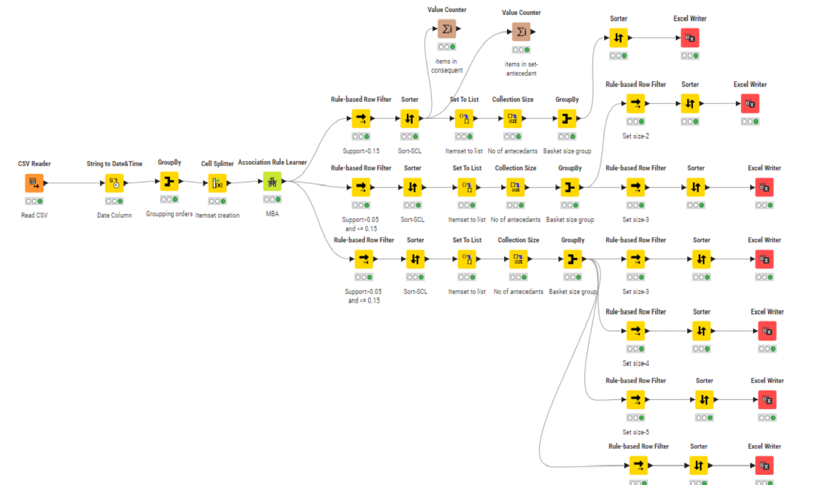

Slide 16
KNIME WORKFLOW- IDENTIFICATION OF SELF-ASSOCIATION

Slide 17
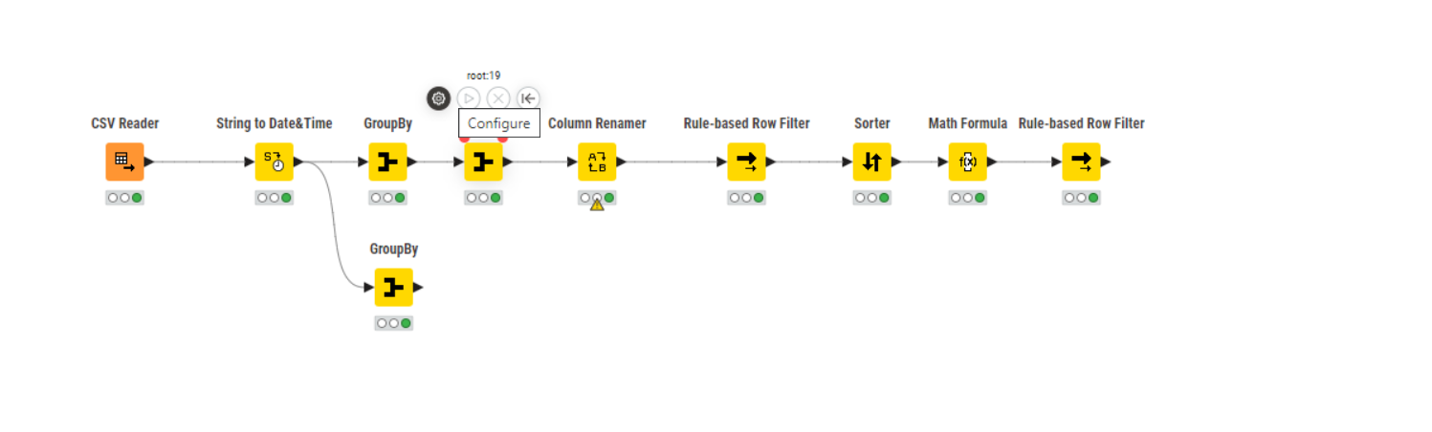

Slide 18
OBSERVATIONS- Associations
Itemset Size | Antecedants | Consequent | Support | Confidence | Lift
1 | Dinner Rolls | Poultry | 0.195 | 0.501 | 1.189
1 | Poultry | Dinner Rolls | 0.195 | 0.462 | 1.189
1 | Dishwashing Liquid/Detergent | Poultry | 0.187 | 0.482 | 1.144
1 | Eggs | Soda | 0.187 | 0.48 | 1.228
1 | Soda | Eggs | 0.187 | 0.479 | 1.228
2 | Spagetti Sauce, Poultry | Dinner Rolls | 0.099 | 0.579 | 1.49
2 | Spagetti Sauce, Dinner Rolls | Poultry | 0.099 | 0.577 | 1.368
2 | Dinner Rolls, Poultry | Spagetti Sauce | 0.099 | 0.509 | 1.364
3 | Eggs, ice Cream,pasta | paper towels | 0.055 | 0.649 | 1.791
3 | Eggs, ice Cream,paper towels | pasta | 0.055 | 0.643 | 1.731
3 | Paper towels, ice Cream,pasta | eggs | 0.055 | 0.630 | 1.616
3 | Eggs, paper towels,pasta | ice cream | 0.055 | 0.624 | 1.565
4 | poultry, fruits, toilet paper, sugar | cereals | 0.027 | 0.795 | 2.120
4 | cheeses, bagels, coffee/tea, sandwich bags | poultry | 0.027 | 0.795 | 2.007
4 | dinner rolls, hand soap, juice, sugar | dinner rolls | 0.027 | 0.795 | 1.886
4 | eggs, hand soap, pasta, individual meals | cheeses | 0.027 | 0.775 | 1.993
4 | bagels, cereals, coffee/tea, sandwich bags | paper towels | 0.027 | 0.775 | 1.984

Slide 19
OBSERVATIONS- Self associations
Product | usual purchase count | No of orders for the purchase count | Percentage of Total orders
flour | 2 | 105 | 9.218613
cereals | 2 | 99 | 8.691835
juice | 2 | 99 | 8.691835
poultry | 2 | 98 | 8.604039
soap | 2 | 98 | 8.604039

Slide 20
INFERENCES
The associations of itemset and consequents are tabulated in the previous slide
The more the number of items in set, less is the support
Dinner rolls and poultry has the highest support of 0.195 and poultry has the highest confidence as well
Juice, paper towels and yogurt are the most common antecedants in sets having support greater than 0.15
Poultry is the most common consequent in sets with support > 0.15
Flour is the product that is bought in multiple quantities most of the times

Slide 21
RECOMMENDATIONS

Slide 22
For items with high support and confidence, like dinner rolls and poultry, bundling them and selling them as a combo would help boost sales
For products like flour, cereals etc. that are mostly bought in multiple quantities in an order, buy 1 get 1 free offers can be considers
For items like hand soap, which have a very low purchase count, offering or increasing discounts is suggested

Slide 23
THANK YOU

