Slide 1
Cloud-Based Finance Tracker Web Application
Name: Vidwath Kumar Domain: Cloud Computing Institution: Shree Devi Institute of Technology

Slide 2
Contents
1. Abstract 2. Introduction 3. Objective 4. Problem Definition 5. Scope 6. Methodology 7. System Design 8. Implementation 9. Results 10. Conclusion

Slide 3
Abstract
This project focuses on developing and deploying a cloud-based finance tracking application using AWS EC2. The system allows users to record income and expenses, categorize transactions, and manage financial data efficiently. The backend is built using Node.js with MongoDB Atlas as the database, and the frontend uses HTML, CSS, and JavaScript. The application is deployed on the cloud, making it accessible from anywhere.

Slide 4
Introduction
Managing personal finances manually is difficult and error-prone. With the advancement of cloud computing, web applications can provide real-time access and data storage. This project demonstrates how cloud platforms like AWS can be used to deploy scalable and accessible applications.

Slide 5
Objective of the Study
• To develop a web-based finance tracker • To implement user authentication • To store data using cloud database (MongoDB Atlas) • To deploy the application on AWS EC2 • To provide global access to users

Slide 6
Problem Definition
Traditional methods of tracking expenses are inefficient and not accessible remotely. There is a need for a system that allows users to securely manage their finances from anywhere with real-time updates.

Slide 7
Scope of the Study
• Tracks income and expenses • User authentication system • Cloud deployment • Real-time data storage • Accessible via web browser

Slide 8
Literature Review
Various financial tracking systems exist, but many lack cloud deployment or real-time access. Studies show that cloud-based applications improve accessibility, scalability, and data security. This project combines web development with cloud computing for better efficiency.

Slide 9
Methodology
1. Requirement analysis 2. Frontend development (HTML, CSS, JS) 3. Backend development (Node.js, Express) 4. Database integration (MongoDB Atlas) 5. Cloud deployment (AWS EC2) 6. Testing and debugging

Slide 10
Experimental Setup
• Cloud Platform: AWS EC2 • Database: MongoDB Atlas • Development Tools: VS Code • Testing: Browser-based testing

Slide 11
Analysis and Interpretation
The system successfully handles user authentication and transaction management. Data is stored securely in MongoDB Atlas and retrieved efficiently. The application performs well under normal usage conditions.

Slide 12
Results / Findings
• Successful deployment on AWS • Real-time data storage • Secure login system • Accessible from any location

Slide 13
Consolidation Table
Feature | Status
Login System | Completed
Transaction | Completed
Database | Completed
Cloud Deploy | Completed

Slide 14
Discussion
The system demonstrates how cloud computing enables scalable and accessible applications. Challenges included configuring AWS and database connectivity, which were resolved successfully.

Slide 15
Proposed System
A cloud-hosted finance tracking system that allows users to manage financial data securely with real-time updates and global accessibility.

Slide 16
Feasibility Study
Technical: Uses widely available technologies
Economic: Low cost using free-tier AWS
Operational: Easy to use and maintain

Slide 17
Design / Workflow
User → Frontend → Backend (Node.js) → MongoDB Atlas

Slide 18
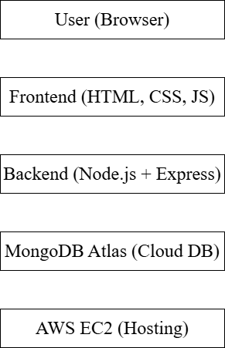
Diagrams
Architecture Diagram

Slide 19
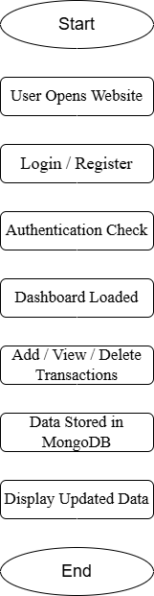
Flow Diagram

Slide 20
Methods and Techniques
• REST API • CRUD operations • Cloud deployment • Authentication system

Slide 21
Progress in Project
Phase 1: Development
Phase 2: Testing
Phase 3: Deployment
Phase 4: Finalization

Slide 22
Outcome / Results
A fully functional cloud-based finance tracker accessible via public IP with real-time database integration.

Slide 23
Conclusion
The project successfully demonstrates the deployment of a web application on AWS. It highlights the importance of cloud computing in modern application development and provides a scalable solution for financial tracking.

Slide 24
References
• AWS Documentation • MongoDB Atlas Docs • Node.js Documentation • Express.js Documentation

