Slide 1

SOCIALIZE APP
RNS INSTITUTE OF TECHNOLOGY
BENGALURU - 98
DEPARTMENT OF INFORMATION SCIENCE & ENGINEERING
Presentation on Internship
VIDYASHREE E
USN: 1RN18IS123
ENMAZ Engineering Services Pvt. Ltd.
Internal Guide
Mrs. KUSUMA R
Assistant Prof. Dept of ISE, RNSIT
External Guide
Mr. AKSHAY DR
Co-Founder & CEO, Enmaz Engineering Services Pvt. Ltd., Bangalore

Slide 2
AGENDA
Abstract
About the Company
Introduction
Requirements
System Design
Detailed Design
Implementation
Testing
Conclusion and Future Enhancements
References
Q & A
VIII Semester, Department of ISE, RNSIT
2021 - 2022

Slide 3
ABSTRACT
Flutter is an open-source cross-platform mobile application development SDK created by Google.
Dart is a programming language designed for client development, such as for the web and mobile apps.
Socialize is a social media app where the user can create his or her own account and creates a platform for engagement for people with common interests to associate together and build relationships.
Socialize application has a total of three screens on focus: the loading page, login and the home screen which displays the user profile.
VIII Semester, Department of ISE, RNSIT
2021 - 2022

Slide 4
ABOUT THE COMPANY
Enmaz is the IT services company registered under Govt. of India, Ministry of Micro, Small & Medium Enterprises.
Enmaz has a simple yet robust solution that helps any Industry/Factory digtise their work floor in no time.
The products offered will help in remote monitoring ,controlling and also analysing and machine parameter or process.
Their Mission is to empower their customers with necessary knowledge, skills and resources for them to succeed in their endeavours.
VIII Semester, Department of ISE, RNSIT
2021 - 2022

Slide 5
INTRODUCTION
Socialize is a social media app where the user can create his or her own account and creates a platform for engagement for people with common interests.
It is a cross platform application which is developed using Flutter .
This application focuses only on the basic front-end of the application and the flutter application is developed on Visual Studio by using Dart as the programming language .
The entire application is set to be made out of widgets , which describes the view of the application in a given state.
VIII Semester, Department of ISE, RNSIT
2021 - 2022

Slide 6
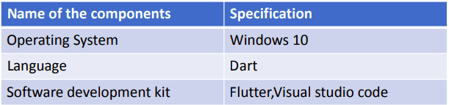
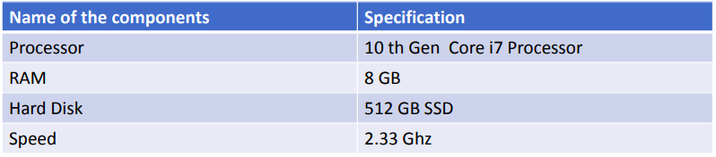
REQUIREMENTS
Software Requirement
Hardware Requirement
VIII Semester, Department of ISE, RNSIT
2021 - 2022

Slide 7
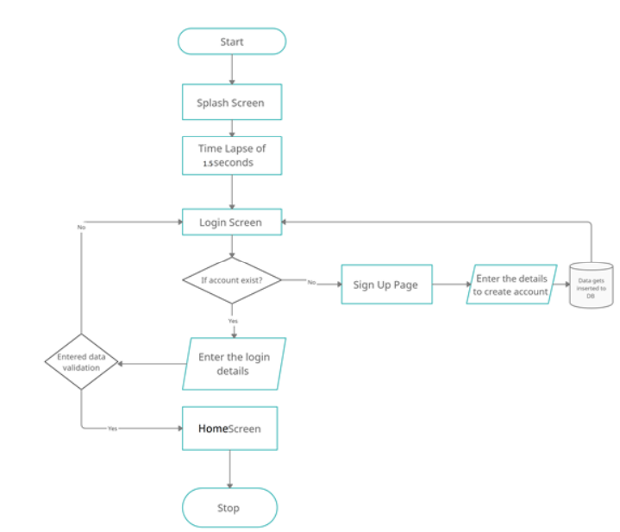
SYSTEM DESIGN
Figure : System Architecture
VIII Semester, Department of ISE, RNSIT
2021 - 2022

Slide 8
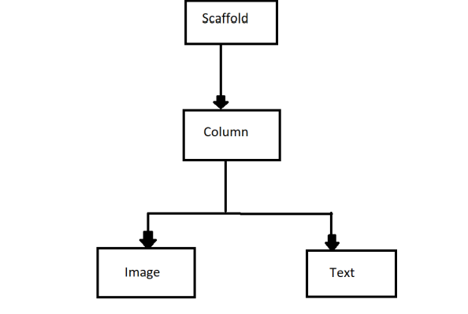
DETAILED DESIGN
Fig: Widget tree of Splash screen

Slide 9
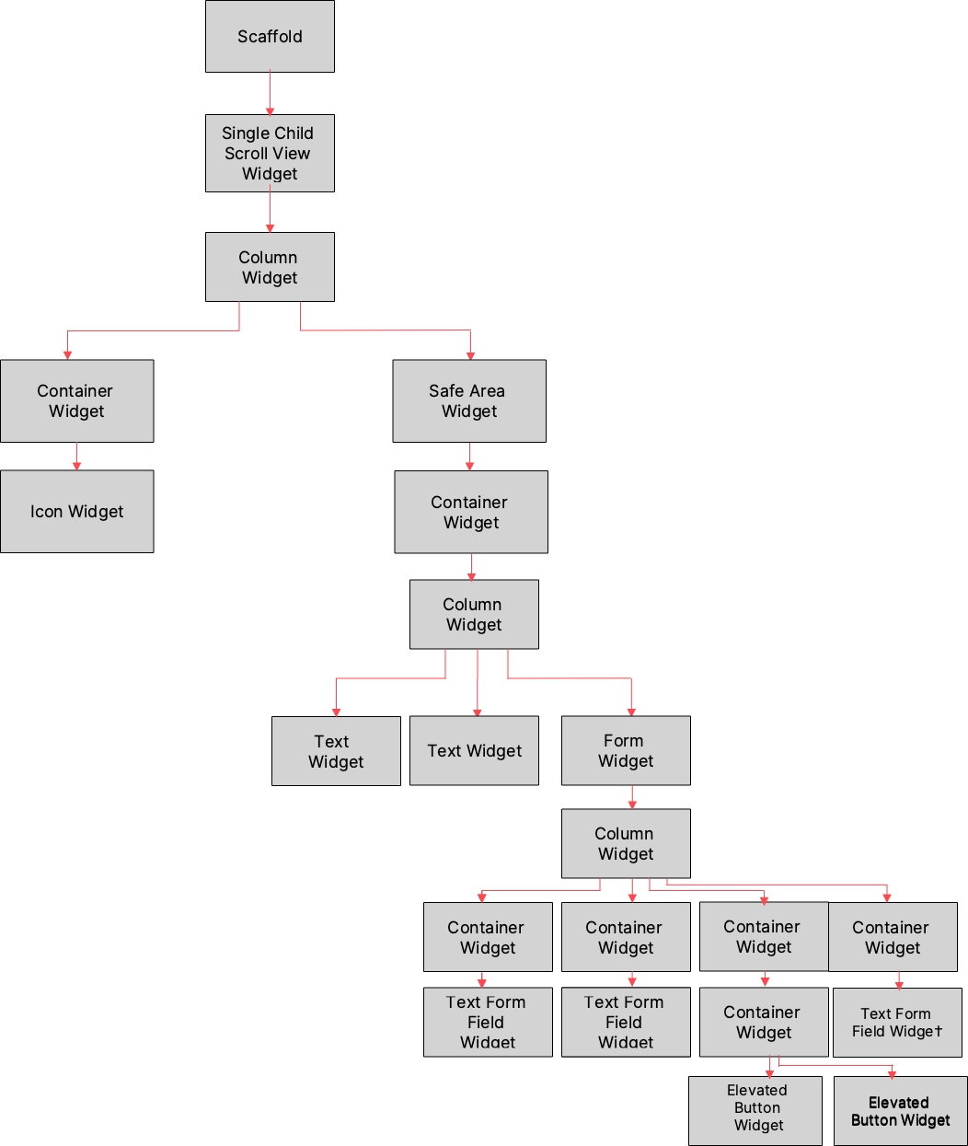
DETAILED DESIGN
Figure : Widget Tree For Login Screen
VIII Semester, Department of ISE, RNSIT
2021 - 2022

Slide 10
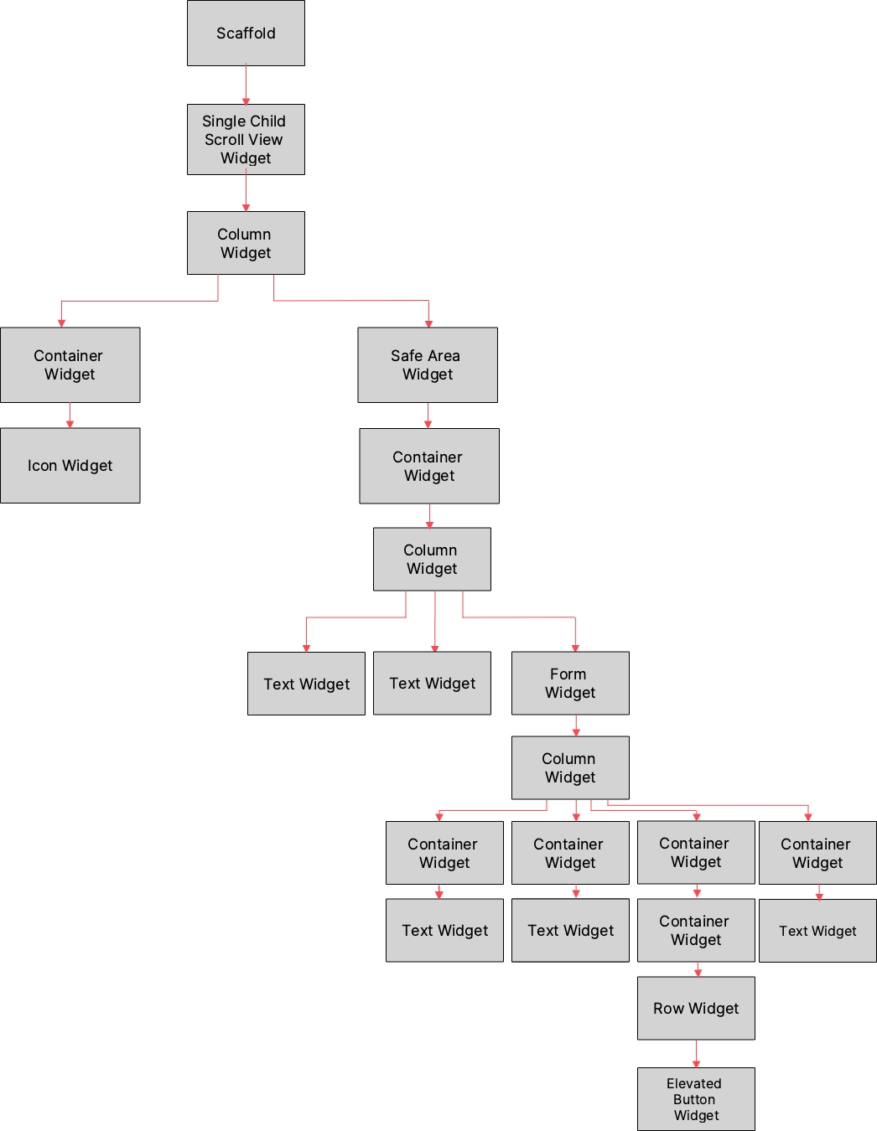
DETAILED DESIGN
Figure : Widget Tree For SignUp Screen
VIII Semester, Department of ISE, RNSIT
2021 - 2022

Slide 11
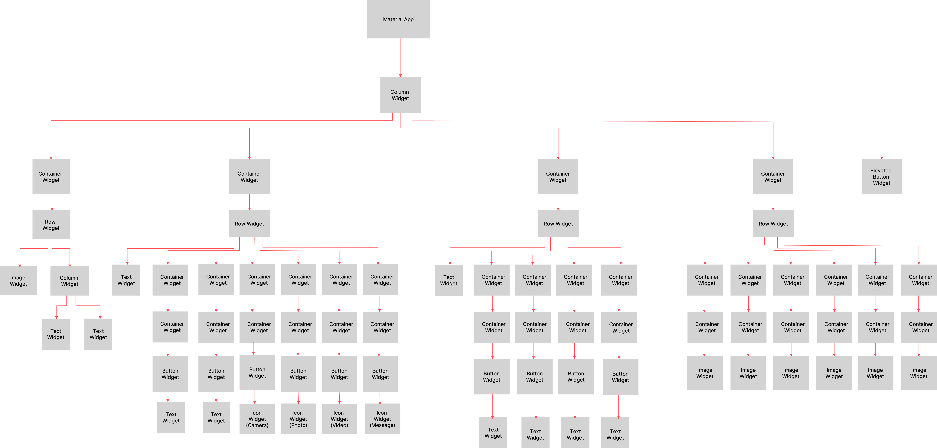
DETAILED DESIGN
Figure : Widget Tree For Home Screen
VIII Semester, Department of ISE, RNSIT
2021 - 2022

Slide 12
IMPLEMENTATION
PseudoCode for Database Connectivity
Future get database async{
if(_database!=null)
return _database;
_database=await _initiateDatabase();
return _database;
}
_initiateDatabase () async{
Directory directory=await getApplicationDocumentsDirectory();
String path=join(directory.path,_dbName);
return await openDatabase( path, version:_dbVersion, onCreate:_onCreate );
}
VIII Semester, Department of ISE, RNSIT
2021 - 2022

Slide 13
IMPLEMENTATION
Creating Table in the Database
Future? _onCreate(Database db, int version){
db.execute( '''
CREATE TABLE $_tableName(
$_columnUserName text not null,
$_columnEmail text not null,
$_columnPAssword text not null )
''' );
}
Inserting Data into Table
Future insert(Map row) async{
Database? db=await instance.database;
await db?.insert(_tableName,row);
}
VIII Semester, Department of ISE, RNSIT
2021 - 2022

Slide 14
IMPLEMENTATION
Route implementation
Route generateRoute(RouteSettings settings) {
User userL=new User(email: '', userName: '', password: '');
switch(settings.name) {
case HomeViewRoute:return MaterialPageRoute(builder: (context)=>Splash());
case LoginViewRoute: return MaterialPageRoute(builder: (context)=>LoginPage());
case SecondViewRoute: return MaterialPageRoute(builder: (context)=>SecondScreen(user:userL, userName: ‘',));
case SignupRoute:return MaterialPageRoute(builder:(context)=>SignUpPage());
default: return MaterialPageRoute(builder: (context)=>SecondScreen(user:userL, userName:'',));
}
}
VIII Semester, Department of ISE, RNSIT
2021 - 2022

Slide 15
IMPLEMENTATION
Validation for login
if (_formKey.currentState!.validate()) {
_formKey.currentState!.save();
bool response=await auth.authUser(userL);
if (response == true) {
//Navigator.pushNamed(context,SecondViewRoute);
Navigator.push( context, MaterialPageRoute( builder: (context) =>SecondScreen( userName:userL.userName, user:userL, ),
}
else
ScaffoldMessenger.of(context).showSnackBar(SnackBar(content: Text('Login Unsuccessful')));
VIII Semester, Department of ISE, RNSIT
2021 - 2022

Slide 16
IMPLEMENTATION
Splash Screen implementation
class _SplashState extends State {
@override
void initState(){
super.initState();
navigatetohome();
}
_navigatetohome() async {
await Future.delayed(Duration(milliseconds:1500),); Navigator.pushNamed(context,LoginViewRoute);
}
VIII Semester, Department of ISE, RNSIT
2021 - 2022

Slide 17
IMPLEMENTATION
Splash Screen implementation (contd..)
@override
Widget build(BuildContext context){
return Scaffold( body:Center( child:Column( mainAxisAlignment : MainAxisAlignment.center, children: [
Image.asset('assets/images/icon.png',fit: BoxFit.cover,),
Text("Ilcome to Socialize”,
style: TextStyle( fontSize: 24, fontIight: FontIight.bold),
), ],)
)
);
VIII Semester, Department of ISE, RNSIT
2021 - 2022

Slide 18
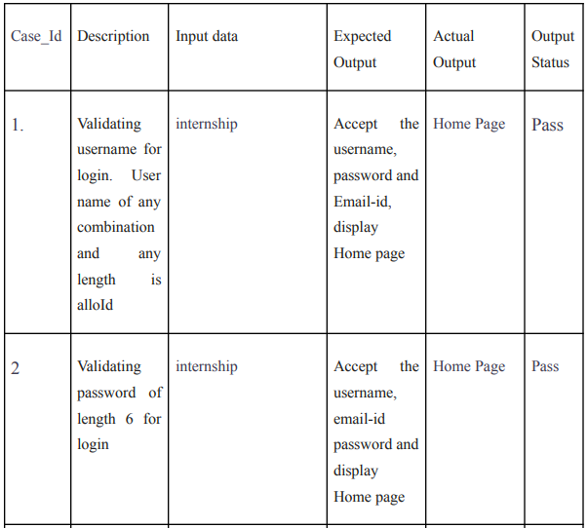
TESTING
Unit Testing: Unit testing is a level of software testing where individual units/ components of a software are tested.
VIII Semester, Department of ISE, RNSIT
2021 - 2022

Slide 19
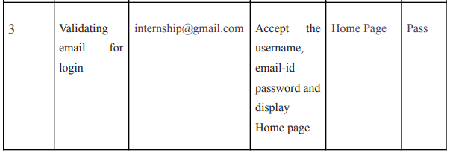
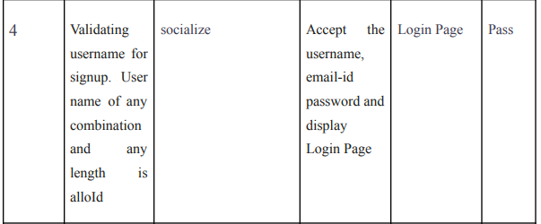
TESTING
(contd..)
VIII Semester, Department of ISE, RNSIT
2021 - 2022

Slide 20
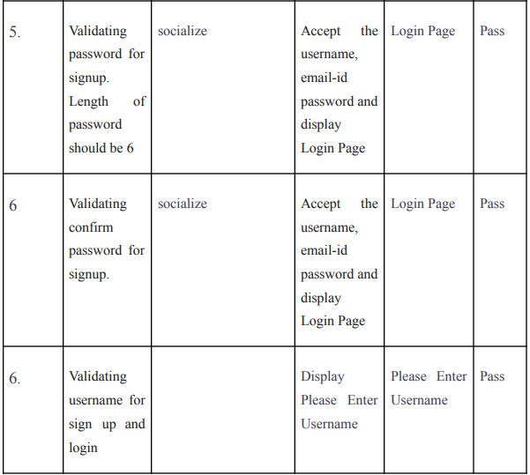
TESTING
(contd..)
VIII Semester, Department of ISE, RNSIT
2021 - 2022

Slide 21
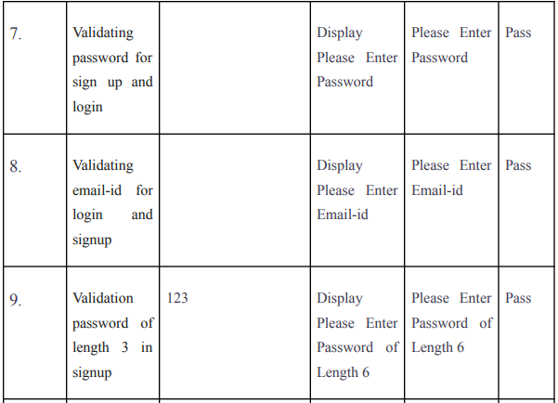
TESTING
(contd..)
VIII Semester, Department of ISE, RNSIT
2021 - 2022

Slide 22
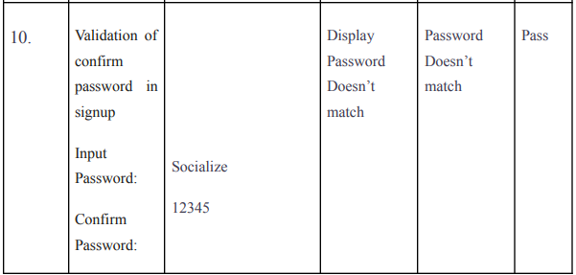
TESTING
(contd..)
VIII Semester, Department of ISE, RNSIT
2021 - 2022

Slide 23
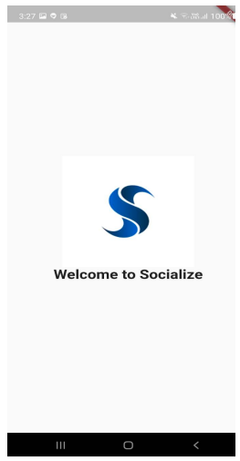
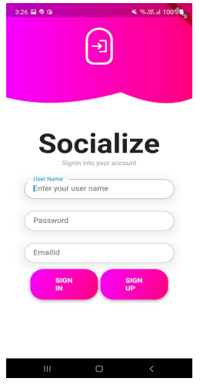
RESULTS
Fig: Splash Screen. Fig: Login Screen
VIII Semester, Department of ISE, RNSIT
2021 - 2022

Slide 24
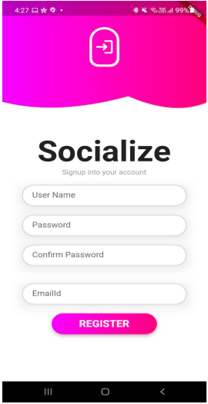
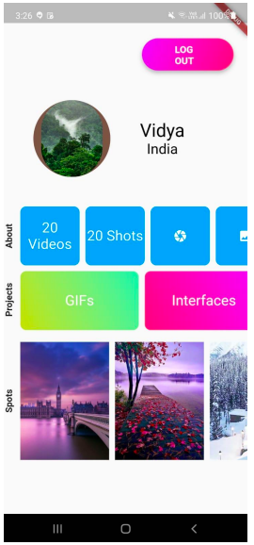
RESULTS
Fig: SignUp Page. Fig: Home Screen
VIII Semester, Department of ISE, RNSIT
2021 - 2022

Slide 25
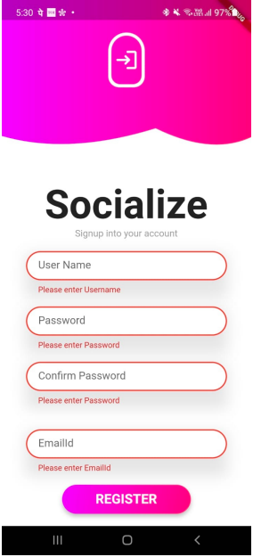
RESULTS
Fig: Validation Of Empty Inputs
VIII Semester, Department of ISE, RNSIT
2021 - 2022

Slide 26
CONCLUSIONS
Socialize, the online social media application is a 3 screen application .
The developed application focuses purely on the UI. The application performs basic validation of the user using the database.
It displays the user profile which consists of the user details such as images,number of shots and videos.
VIII Semester, Department of ISE, RNSIT
2021 - 2022

Slide 27
FUTURE ENHANCEMENTS
Forgot Password Screen can be implemented.
Home screen can be designed to have better interaction.
User profile consisting of ones details can be displayed.
User can add any number of photos.
Backend for this application can be developed.
VIII Semester, Department of ISE, RNSIT
2021 - 2022

Slide 28
REFERENCES
[1] https://flutter.dev/
[2] https://www.javatpoint.com/flutter
[3] https://www.geeksforgeeks.org/flutter-tutorial/
[4] https://medium.com/flutter
[5] https://stackoverflow.com/questions/tagged/flutter
VIII Semester, Department of ISE, RNSIT
2021 - 2022

Slide 29
THANK YOU
VIII Semester, Department of ISE, RNSIT
2021 - 2022

