Slide 1

SWE1010 - DIGITAL IMAGE PROCESSING
REVERSIBLE DATA HIDING (RDH)
SYSTEM USING QR-BASED ADAPTIVE EMBEDDING
23MIA1039 - VISHNU PRIYA A
23MIA1044 - PRAVESHIKA M
23MIA1176 - TARLANA VIDYA

Slide 2
PROBLEM STATEMENT
MOTIVATION
  This project presents a Reversible Data Hiding (RDH) System using QR-based Adaptive Embedding.
  In modern digital communication, data hiding techniques are essential for secure image transmission and copyright protection.
  However, most conventional watermarking approaches are irreversible, meaning that once data is embedded, the original image cannot be fully recovered.
  The proposed system addresses this limitation by introducing a reversible embedding mechanism that allows both the hidden data and the original image to be perfectly restored, thereby ensuring high security and maintaining image fidelity, especially in sensitive images such as Medical X-rays, CT-scans, etc

Slide 3
BASE PAPER
SUMMARY
The base model employs a simple Least Significant Bit (LSB) technique for data embedding, which offers an easy and direct approach to hide information within images. However, while effective for small payloads, this method often struggles to maintain image quality and robustness when handling larger data. The proposed QR-based reversible data hiding model builds upon this foundation by introducing region-based embedding and reversible recovery mechanisms. Unlike the basic LSB model, it ensures complete image restoration after extraction, achieving pixel-wise identical recovery with infinite PSNR and SSIM of 1.0000. Additionally, the use of a QR code as the payload enhances both embedding structure and data validity, as the code remains fully scannable post-embedding. This model achieves higher payload capacity (around 80,000 bits) and improved visual fidelity (PSNR = 17.37 dB, SSIM = 0.9576) without compromising reversibility, making it suitable not only for general images but also for sensitive applications such as medical imaging where accuracy and lossless reconstruction are crucial.

Slide 4


OVERVIEW
METHOD
STEP 5
The final embedded image is saved and displayed. You can see that visual quality remains nearly unchanged.
STEP 3
The image is divided into 8×8 blocks, and gradient values are used to find suitable low-complexity embedding regions.
STEP 1
Here, the system initializes and loads the input image for preprocessing.
STEP 6
The system retrieves the hidden bits and reconstructs both the QR code and the original image.
We observe that the recovered image is visually identical to the original confirming reversibility.
STEP 4
Based on local complexity, one or two bits per pixel are embedded, ensuring high capacity and minimal distortion. The visible QR is then inserted in the Region of Interest.
STEP 2
The secret message is
converted into a QR code,
which will be
embedded
inside the image.

Slide 5
METHODOLOGY
FLOW DIAGRAM
Step-by-step Workflow:
  Input Original Image – e.g., a grayscale or medical image.
  Generate QR Code – using url containing info or patient-related data.
  Select Embedding Regions – done by algorithm in adaptive basis - identify suitable pixel blocks for data embedding.
  Embed QR Bits using Algorithm – modify pixel values slightly to store QR bits.
  Output Embedded Image – image now securely carries hidden information.
  Extract and Recover – retrieve the QR code and restore the original image with zero loss.
  Validate QR Code – ensure it remains readable and accurate.

Slide 6
RESULTS AND
METRICS
Performance Metrics:
  PSNR (Original vs Embedded): 17.37 dB
  PSNR (Original vs Recovered): ∞ dB
  SSIM (Original vs Embedded): 0.9576
  SSIM (Original vs Recovered): 1.0000
  Recovery Accuracy: 100% (0 pixel differences)
  Embedding Capacity: 80,000 bits (≈9.77 KB) across 1182 regions
  QR Validity: Scannable and error-free
Observation:
The embedded image shows minimal visual distortion and the recovered image matches the original pixel-by-pixel. Even in high-detail images such as medical scans, the visual clarity and diagnostic quality are retained.

Slide 7
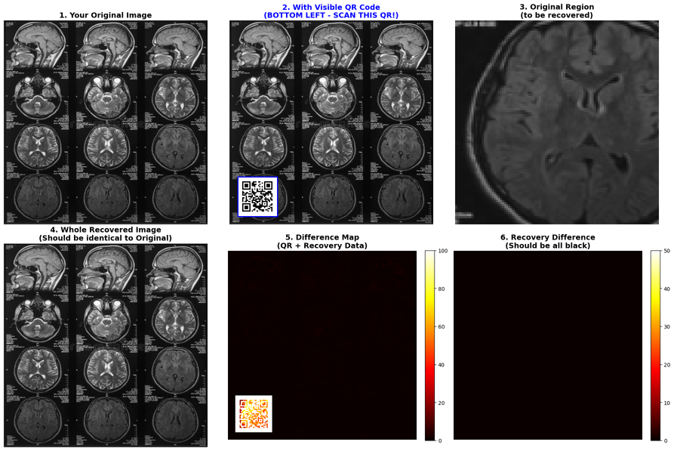
KEY RESULTS
and cONCLUSION
  THE PROPOSED REVERSIBLE QR-BASED SYSTEM ACHIEVES PERFECT RECOVERY WITH 100% ACCURACY AND 0 PIXEL LOSS.
  THE EMBEDDED IMAGE MAINTAINS PSNR = 17.37 DB AND SSIM = 0.9576, SHOWING MINIMAL VISUAL DISTORTION.
  THE RECOVERED IMAGE ATTAINS INFINITE PSNR AND SSIM = 1.0000, CONFIRMING LOSSLESS RECONSTRUCTION.
  A PAYLOAD OF 80,000 BITS (≈9.77 KB) IS EMBEDDED ACROSS 1182 REGIONS, ENSURING HIGH CAPACITY AND STRONG VISUAL FIDELITY.

Slide 8
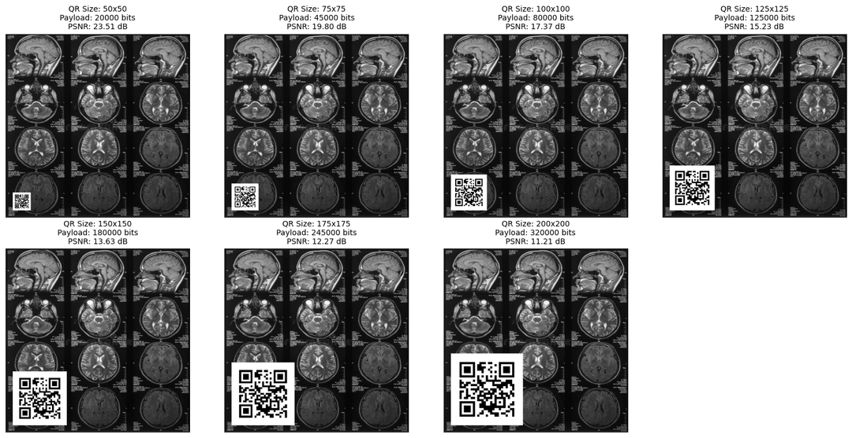
KEY RESULTS
and cONCLUSION
  AS THE QR SIZE INCREASES, THE EMBEDDED REGION BECOMES MORE VISUALLY DOMINANT, OCCUPYING A LARGER PORTION OF THE IMAGE.
  THE CORRESPONDING PSNR DECREASES STEADILY, CONFIRMING INCREASED EMBEDDING DISTORTION WITH HIGHER PAYLOADS.
  DESPITE THE LARGER QR INSERTIONS, STRUCTURAL DETAILS OF THE MEDICAL IMAGE REMAIN CLEARLY VISIBLE, PRESERVING DIAGNOSTIC USABILITY.
  THIS DEMONSTRATES A CLEAR TRADE-OFF BETWEEN EMBEDDING CAPACITY AND VISUAL QUALITY IN THE REVERSIBLE EMBEDDING PROCESS.

Slide 9
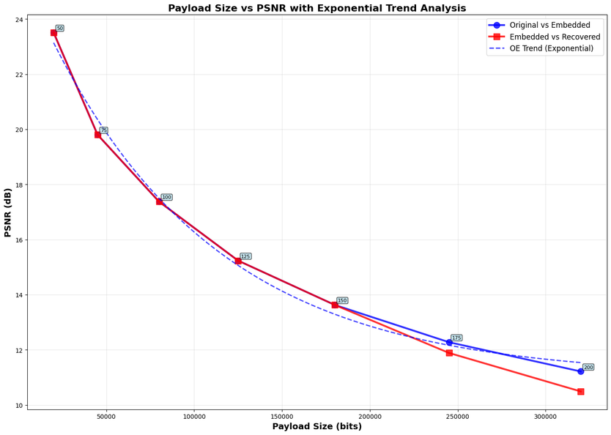
KEY RESULTS
and cONCLUSION
  AS THE QR PAYLOAD SIZE INCREASES, THE PSNR VALUES GRADUALLY DECREASE, INDICATING HIGHER DISTORTION DUE TO INCREASED EMBEDDING DENSITY.
  THE DROP IN PSNR FOLLOWS AN EXPONENTIAL DECAY TREND, AS LARGER PAYLOADS OCCUPY MORE PIXEL REGIONS.
  BOTH “ORIGINAL VS EMBEDDED” AND “EMBEDDED VS RECOVERED” CURVES SHOW CLOSELY ALIGNED TRENDS, CONFIRMING CONSISTENT EMBEDDING AND RECOVERY PERFORMANCE.
  DESPITE THE PSNR REDUCTION AT HIGHER PAYLOADS, THE RECOVERED IMAGE MAINTAINS STRUCTURAL INTEGRITY WITH MINIMAL PERCEPTUAL DEGRADATION.

Slide 10
KEY FINDINGS AND
FUTURE ENHANCEMENTS
KEY FINDINGS
  Achieved high embedding capacity with perfect recovery.
  Maintained excellent image quality (SSIM > 0.95).
  Ensured QR readability and data integrity post-embedding.
FUTURE ENHANCEMENTS
  Extend to color images and video frames.
  Use adaptive region selection for higher capacity.
  Add encryption and deep learning-based optimization for better security and payload efficiency.

Slide 11
THANK YOU

