Slide 1

Scheduling Simulator
By,
Jathin Sreenivas
Vineeth Bhat

Slide 2
Introduction
Scheduling is the decision on how the processes are assigned to run on available CPU(s).
The objective of this project is to design and implement a simulator for real-time scheduling algorithms and display the behavior of such algorithms based on predefined task set. The following algorithms will be simulated:
First In First Out (FIFO)
Shortest Job First
Earliest Deadline First (EDF)
Rate Monotonic scheduling
Deadline Monotonic scheduling
Least Slacktime First (LSF)

Slide 3
Features
The simulator includes the following:
Multiple forms of input(.txt, .csv, .xls and via on screen input)
Output in the form of graphical representation and numerical data
Option to choose the desired scheduling algorithm for simulation
Compare output of multiple algorithms
Technologies Used: Django Framework.

Slide 4
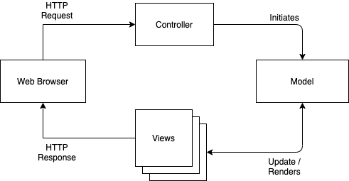
Design
The simulator design is based on the MVC architecture, i.e., the algorithms are decoupled from the UI so any further algorithms can be implemented without changing the structure.
Model: Defines the algorithms
Views: Graphical representation
Controller: Redirects the request to the model

Slide 5
Project Plan

Slide 6
Individual Roles
Project Elements | Member Contribution
Initial Phase | Team
Process Plan | Team
Design | Team
Implementation | Team
UI Design | Team
Testing | Team
Documentation | Team
We have adopted the Pair Programming software development technique.

