Slide 1

Scheduling Simulator
By,
Jathin Sreenivas
Vineeth Bhat

Slide 2
Introduction
Scheduling is the decision on how the processes are assigned to run on available CPU(s).
The objective of this project was to design and implement a simulator for real-time scheduling algorithms and display the behavior of such algorithms based on predefined task set. The following algorithms can be simulated:
Rate Monotonic scheduling
Earliest Deadline First (EDF)
First In First Out (FIFO)
Shortest Job First

Slide 3
Rate Monotonic scheduling (RMS): Considers the task with lowest execution time as highest priority task.
Earliest Deadline First (EDF): Task with the earliest deadline is executed first.
First In First Out (FIFO): Task that arrives first for execution will be given highest priority.
Shortest Job First (SJF): Task with least execution time is executed first unlike RMS there is no interruption for the task that is being executed.

Slide 4
Features
The simulator includes the following:
Can take input from .csv file and also through UI text fields.
Output in the form of graphical representation (bar and line graph).
Console to show the data that is executed, Utilization factor and various other details.
Option to choose the desired scheduling algorithm for comparison.

Slide 5
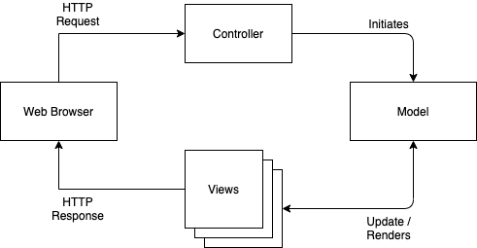
Design
The simulator design is based on the MVC architecture, i.e., the algorithms are decoupled from the UI so any further algorithms can be implemented without changing the structure.
Model: Defines the algorithms
Views: Graphical representation
Controller: Redirects the request to the model

Slide 6
Future Work
Including option to save the input to a .csv file.
Additional scheduling algorithms to be implemented.
References
Course materials from RTS, Prof. Dr. Matthias Deegener.

