Slide 1

Scheduling Simulator
By,
Jathin Sreenivas
Vineeth Bhat

Slide 2
Project Introduction
Scheduling is the decision on how the processes are assigned to run on available CPU(s). The objective of this project is to design and implement a simulator for real-time scheduling algorithms and display the behavior of such algorithms based on predefined task set. The following algorithms can be simulated: .....
V- model (Confirm with professor)

Slide 3
The simulator includes the following:
Multiple forms of input(.txt, .csv, .xls and via on screen input)
Output in the form of graphical representation and numerical data
Option to choose the desired scheduling algorithm for simulation
Compare output of multiple algorithms
Technologies Used: Django Framework.

Slide 4
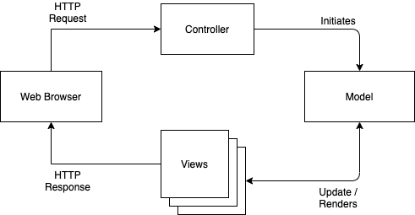
Design:
The simulator design is based on the MVC architecture, i.e., the algorithms are decoupled from the UI so any further algorithms can be implemented without changing the structure.
Model: Defines the algorithms
Views: Graphical representation
Controller: Redirects the request to the model

Slide 5
Project Plan
By intermediate project report Assignment:
Architecture Design completed
Framework Skeleton
2 algorithms
Basic UI
Next two weeks(23rd June):
Complete UI
Remaining 2 algorithms
Complete Project submission
By next stage:
Report

Slide 6
Project Plan

Slide 7
Individual Roles
Design and Architecture
Each 2 algorithms.
UI - Common split(Parallely)
Report(Based on what one has implemented)

