Slide 1

Project
“Face Recognition Attendance System”
Under the Guidance of
Prof. Ritviz Singh
Prof. Shiv Patel
Symbiosis Skills And Professional University, Pune
Data Associate-03 Batch
Sep 2023-Jan24
Presented by:- Mayur Borse
Vidya Lamkhade
Saurabh Pardeshi
Jayesh Erande

Slide 2
AGENDA
ABSTRACT
INTRODUCTION
PROBLEM STATEMENT
ALGORITHM
SYSTEM ARCHITECTURE
FUTURE SCOPE
SCRRENSHOTS
CONCLUSION

Slide 3
Abstract
The system's goal is to make the attendance marking process quick and easy because the teacher's in class is time consuming in monitoring the students while marking attendance and ensuring that no proxy attendance is marked.
To solve the problem efficiently, the system employs a machine approach that makes use of Python's OpenCV library.
The Haarcascade algorithm and the LBPH algorithm are used for face detection and recognition.
The system is designed to be sufficiently accurate in comparison to other systems.

Slide 4
INTRODUCTION
Normally the schoolteacher has to mark attendance of all students present in the class either before the times start of class or after the class or for both.
The project focuses on revolution the traditional methods of attendance tracking.
Introduces an innovative Face Recognition Attendance System as more efficient alternative.
Captures and processes facial data in real-time, ensuring instant and up-to-date attendance records.
Works smoothly with a central database to easily handle everyone’s information.

Slide 5
PROBLEM STATEMENT
This project seeks to address these challenges by introducing a Face Recognition Attendance System, aiming to provide a secure, efficient, and automated solution for attendance management in various settings.

Slide 6
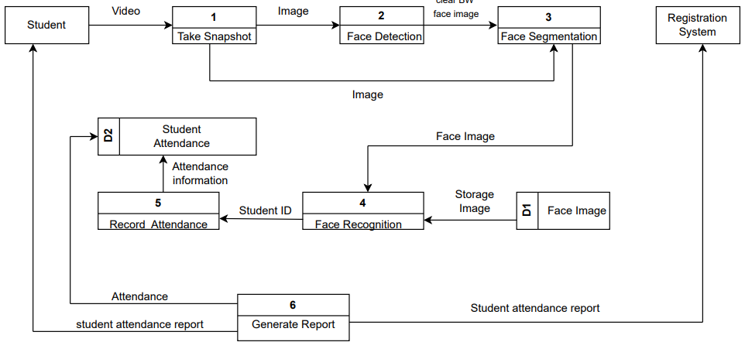
System Architecture

Slide 7
ALGORITHM
1)HaarCascade Algorithm:-
The HaarCascade algorithm requires a trained classifier to detect faces. Training involves providing the algorithm with positive samples (images containing faces) and negative samples (images without faces).
The algorithm learns to identify features that are characteristic of faces during this training phase.
2)LBPH Algorithm:-
The Local Binary Pattern Histogram (LBPH) algorithm is a texture-based method commonly used for facial feature extraction and recognition in computer vision applications.
Convert the input image to grayscale, as LBPH operates on intensity information.
Divide the image into a grid of cells. For each pixel in a cell, compare its intensity value with the intensities of its neighbors in a circular neighborhood. Assign a binary code (0 or 1) to each neighbor based on whether its intensity is greater or less than the central pixel's intensity.
Concatenate these binary codes to form an LBP pattern for each pixel in the cell.
.

Slide 8
Future Scope
1)Airport Security:-
Airport security checkpoint use facial recognition to scan passenger faces against terrorist and criminal databases; as well as employees who access more sensitive areas.
2) Hotels
Guests can easily log in using facial recognition, room entry verification, and employees use it as a quick way to clock in and out.
3) Retail
Retail chains are looking at facial recognition as a way to spot known shoplifters and provide a more personalized in-store experience for their customers.

Slide 9
CONCLUSION
In conclusion, the implementation of a face recognition attendance system offers a range of benefits and advancements in attendance tracking for various sectors. The utilization of facial recognition technology brings efficiency, accuracy, and convenience to the attendance management process. Through the analysis of facial features, the system can uniquely identify individuals, providing a reliable and secure means of recording attendance

Slide 10
Thank You ..

