Slide 1
DataSpark: Illuminating Insights for Global Electronics
- Vidya Sathiaseelan

Slide 2
Project Overview
As part of Global Electronics' data analytics team, conducting a comprehensive Exploratory Data Analysis (EDA) to uncover valuable insights from the company’s data. The goal is to provide actionable recommendations that can enhance customer satisfaction, optimize operations, and drive overall business growth.
Global Electronics, a leading retailer of consumer electronics, has provided with several datasets containing information about their customers, products, sales, stores, and currency exchange rates. The company seeks to leverage this data to better understand their business and identify areas for improvement.

Slide 3
Approach – Data Scrapping
Data Cleaning and Preparation
Check for missing values and handle them appropriately.
Convert data types where necessary (e.g., dates, numerical values).
Merge datasets where necessary for analysis (e.g., linking sales data with product and customer data).
Load Data
Insert the preprocessed data into an SQL database by creating relevant tables for each data source and using SQL INSERT statements to load the data.
Power BI Visualization
Connect SQL to Power BI/Tableau, import the data, and create interactive dashboards.

Slide 4
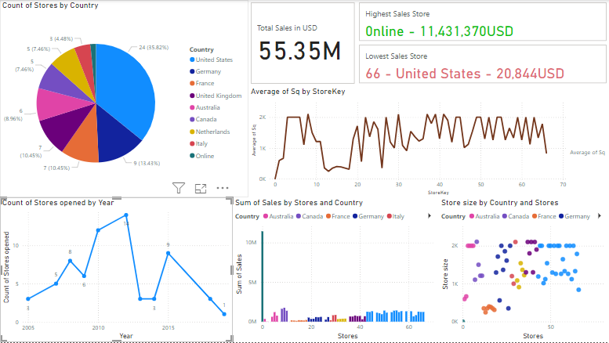
Store Analysis
Count of stores in each countries – To know the areas where the outlet has to be increased.
Count of stores opened per year – To know the growth of outlets yearly
Average area of each outlets opened – To know the capacity of storing the stocks
Sum of sales in each store (Country wise) – To know which store in which region has made the more sales
The Least and High performed stores in sales – To concentrate and encourage the performances
Store size by countries – To know the stock storage size in each country.
Total Sales in USD – To know the overall sales value in common currency type (USD)

Slide 5
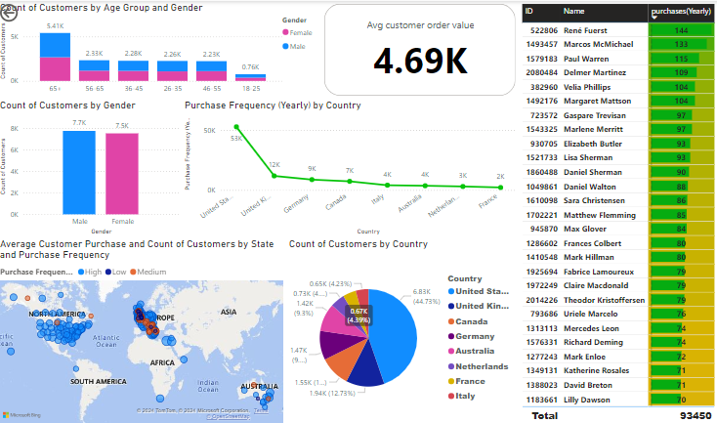
Customer analysis
Count of customers by gender – To know the number of female and male customers
Count of customers by gender and age group – To know which age group of customers are influenced by the products
Count of customers by country – To know the countries to be focused for attracting customers in those regions
Average customer sales, customer count and Purchase frequency(Country wise) – To study the purchase frequency in each country.
Table with yearly purchase frequency of each customer – To study the repeated customers.
Average of Total order values by customers

Slide 6

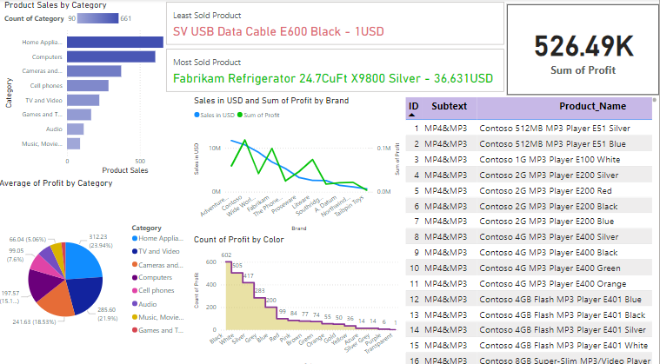
product analysis
Product sales by Category – To know the sales performance of each category.
Average profit by Category – To know the Average profit of each category of products.
Count of Profit by colour – To know which product colour attracts the customer the most.
Sales in USD and Sum of profit by Brands – To know the comparison of sales amount and profit gained by each Brand.
A table with each product and its profit.
Least and most sold products.
Sum of overall profit of the all the products.

Slide 7
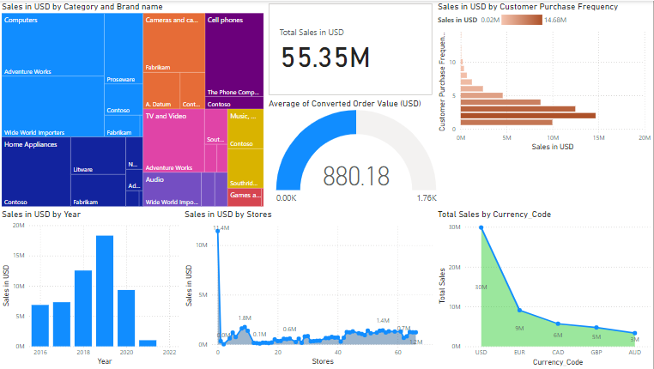
Sales analysis
Sales by Category and Brand – To know about the sales performance in each category and brand of products.
Sales in USD by Year – To know the yearly sales pattern.
Sales in USD by stores – To know the sales in each store.
Total Sales by Currency – To know the sales pattern for each currencies.
Sales in USD by Customer Purchase Frequency – To study the sales pattern in customer purchases.
Total Sales value in USD
Average sales made and Target value to be achieved.

Slide 8
Insights from the analysis
The below insights were obtained for Global Electronics from the analysis made from the given data sets to increase the turnover and customer base.
United States earns the most sales and also has the most customer base and hence have to concentrate on all the other states to increase the number of outlets and products to improve the customer base.
Male customers dominates the sales and hence to attract the female customers, offers and products should be launched.
Online store best performed in the sales but there is only one online store for whole products list and all the countries. Online stores must be increased to increase the customer size and sales performance.
Best performed colour in each product is Black. Hence Black production should be increased to fulfil the customers demand.
Home Appliances are in high demand so stocks must be maintained to avoid out of stock conditions.
Games and Toys products are performing well. If the product ranges are increased and offers are designed sales will be boomed in these areas.
Music and audio categories are least performing. So, reviewing the Brand and updating the manufacturer will help in increase of sales.

Slide 9
Learnings
Data Cleaning and Preprocessing
EDA, Python
Data Management using SQL
Power Bi

