Slide 1
Northwind Traders
- Vidya Sathiaseelan

Slide 2
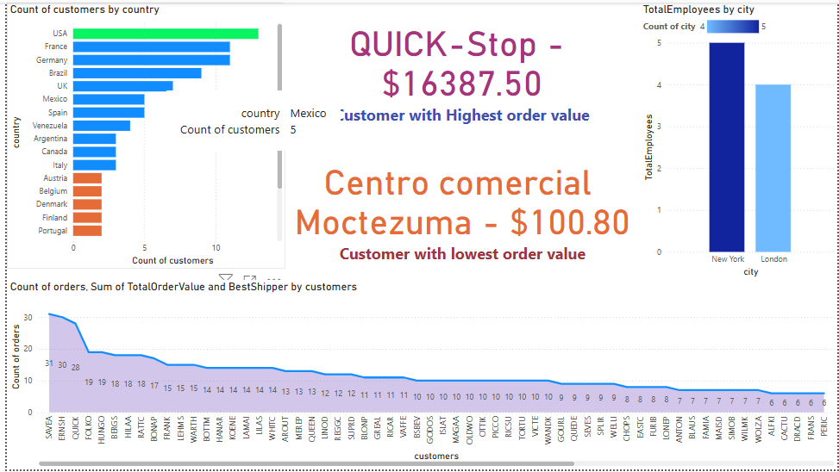
Customer and Employees
Highest base of customers are in USA
Have to concentrate to grow the customer base in other countries for sales growth
Have to get the feedback and maintain the service quality to retain the customer base.
Have to increase the employee base in other countries as only in USA and UK employees are present.
Increase in employee base will increase the higher performance in service provided to the customers.

Slide 3
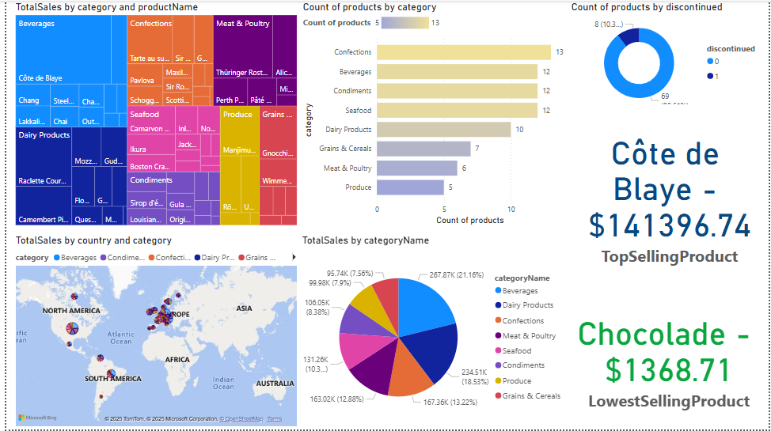
Products and categories
Beverages sells the most and Grains and cereals sells the most least.
Since grains and cereals are essential needs if the quality and types of products are increased the sales can also be increased.
importance to the factors that makes the sales low on some category and announcing some offers to the products that are not sold will increase the sales.
Maintaining the inventory stocks on the well performing products are also important.
If the discontinued items has some stocks left, clearance sale announcement would help in clearing the stocks.

Slide 4

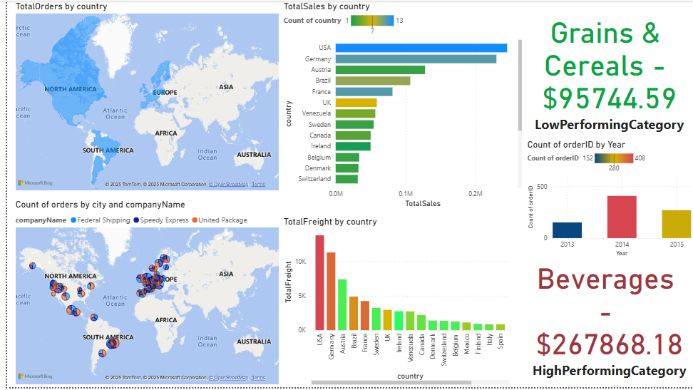
Orders and Order Items
USA and Germany performs well in the sales.
Poland is the least performing country have to increase the offers and bringing products suitable for those areas will increase the market in these areas.
Have to get feedback about the products and its quality which helps in finding out the lagging areas as the sales has been fallen from 2014.
Have to concentrate more on european countries as the sales and customer dense in low in these areas.

Slide 5
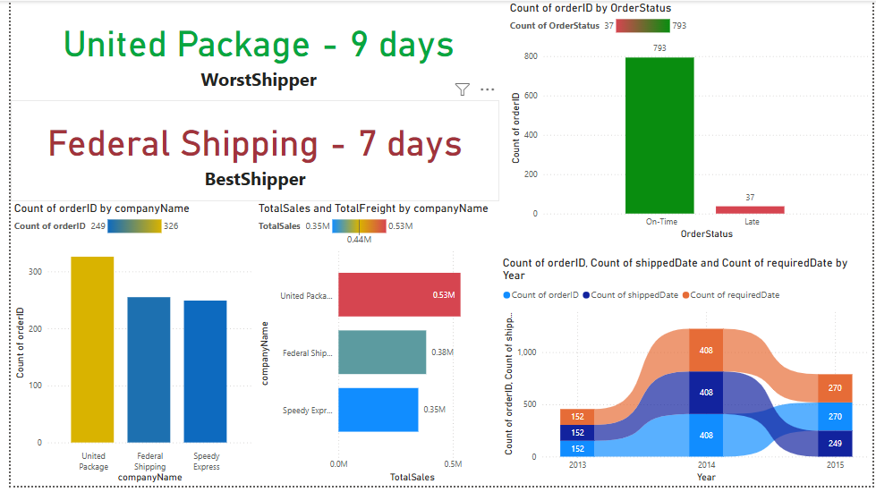
Shippers
United Package is performing well in shipping the orders.
Also have some delays in shipping the orders which may affect the sales
Constantly checking the shipping rates and tracking the performance is essential.

