Slide 1
Power Pulse: Household Energy Usage Forecast
- Vidya Sathiaseelan

Slide 2
Project Overview
In the modern world, energy management is a critical issue for both households and energy providers. Predicting energy consumption accurately enables better planning, cost reduction, and optimization of resources. The goal of this project is to develop a machine learning model that can predict household energy consumption based on historical data. Using this model, consumers can gain insights into their usage patterns, while energy providers can forecast demand more effectively.

Slide 3
Approach
Data understanding
Data Preprocessing:
Data type conversion
Null Value handling
Outlier identification and Treatment
Feature Engineering
Scaling
Model Building
X and Y split
Train and test split
Linear Regression – Sklearn and Statsmodel
Metrics Calculation
Visualization

Slide 4
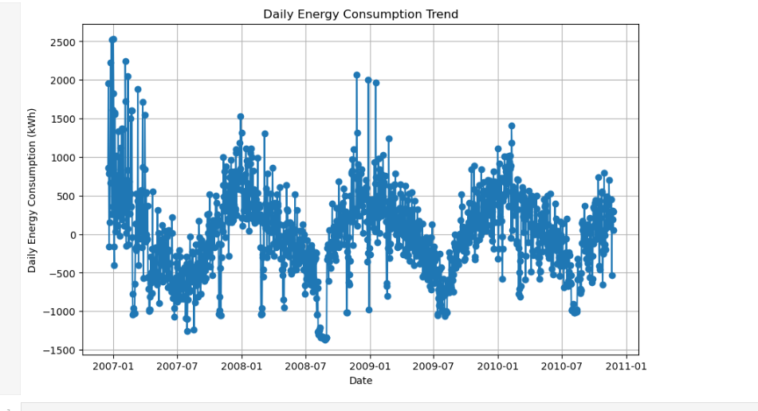
Daily Energy consumption Trend

Slide 5
Daily Energy consumption Trend
1. Seasonal Energy Consumption Patterns
Observation: There seem to be recurring peaks and troughs in energy usage that align with specific times of the year.
Actionable Insight: Households can prepare for seasons with higher energy demands (e.g., summer for air conditioning or winter for heating) by optimizing their energy use and ensuring appliances are energy-efficient.
2. Energy Spikes
Observation: There are significant spikes in energy consumption at certain times.
Actionable Insight: Households should investigate potential causes of these spikes (e.g., holidays, events, or malfunctioning appliances) and take steps to reduce energy waste by using timers, smart thermostats, or monitoring high-energy devices.
3. Negative Values
Observation: The plot shows negative values for energy consumption, which might indicate energy generation (e.g., through solar panels) or metering adjustments.
Actionable Insight: If households are generating excess energy, they could consider storing it in batteries or selling it back to the grid through net metering programs.

Slide 6
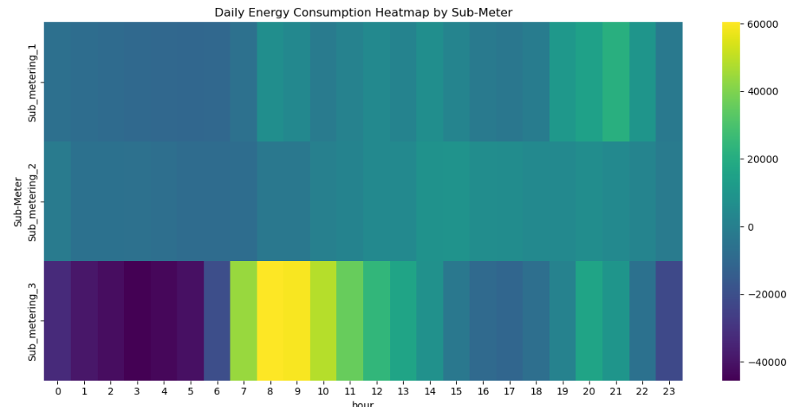
Daily Energy Consumption by Sub-meter

Slide 7
Daily Energy Consumption by Sub-meter
1. Opportunities for Energy Optimization
Morning Energy Demand (6 AM - 9 AM):
Water heater usage appears significant during this period. Households can reduce energy costs by:
Installing programmable water heaters to pre-heat water during off-peak hours.
Reducing shower durations or using energy-efficient water heaters.
Evening Energy Demand (6 PM - 9 PM):
High evening energy usage may indicate combined usage of multiple appliances. Households can:
Avoid simultaneous use of high-energy appliances (e.g., laundry and kitchen appliances) to reduce peak loads.
Adopt off-peak energy-saving habits if the electricity tariff is time-based.
2. Insights on Continuous Usage
Sub_metering_2 likely captures continuous refrigerator usage in the laundry room, which could benefit from:
Ensuring refrigerators are energy-efficient models.
Regular maintenance, such as cleaning coils and avoiding overstocking.
3. Unusual Patterns
The heatmap shows some negative energy values, which may indicate:
Errors in the dataset or measurement.
Calibration issues in the metering devices. These should be investigated to ensure accurate energy tracking.

Slide 8

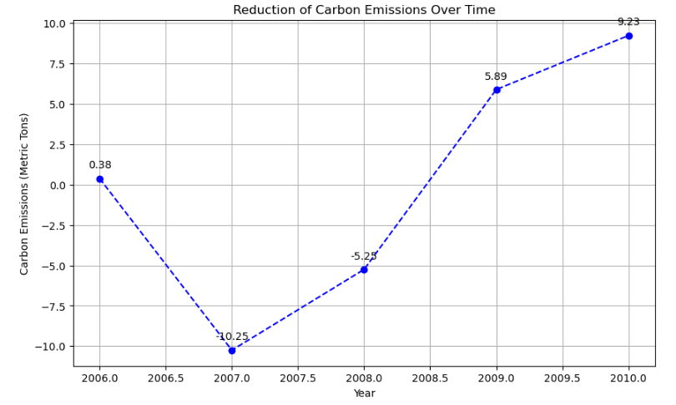
Reduction of carbon emission over time

Slide 9
Reduction of carbon emission over time
Actionable Recommendations for Reducing Carbon Footprints:
Encourage Renewable Energy Usage:
Incentivize the adoption of solar panels or wind energy to reduce dependence on carbon-intensive energy sources.
Energy Efficiency Programs:
Educate households about energy-efficient appliances and behavior changes, such as switching to LED lighting and reducing standby power usage.
Smart Load Management:
Promote smart home technologies and load management tools to optimize energy use during peak hours, reducing overall consumption.
Behavioral Changes:
Encourage sustainable practices, such as adjusting thermostat settings, reducing water heating usage, and unplugging unused devices.
Collaborate with Policymakers:
Work with governments to implement carbon taxation, subsidies for green technology, or stricter efficiency standards for buildings and appliances..

Slide 10
Insights from the analysis
Recommendations for Households:
Adopt Energy-Efficient Appliances: Upgrade to energy-saving appliances, particularly for the kitchen and water heating systems.
Behavioral Adjustments: Shift high-energy tasks to mid-day or off-peak periods to reduce costs.
Investigate Negative Values: Ensure that the metering system is functioning correctly to avoid misleading insights.
Recommendations for Providers:
Investigate the causes of anomalies (e.g., weather events, holidays, or outages).
Focus on tracking societal or technological changes (e.g., the adoption of renewable energy, electric vehicles, or energy-efficient appliances) that could alter consumption patterns over the long term.
Offer pricing incentives during low-demand periods to smooth out demand and reduce peak loads.
Segment customers based on usage patterns to tailor pricing and incentive strategies effectively.
Work with governments to implement carbon taxation, subsidies for green technology, or stricter efficiency standards for buildings and appliances.

Slide 11
Learnings
Data Preprocessing
Regression Modelling
Feature Engineering
Visualization
Python
Scikit-learn
Pandas
Matplotlib/Seaborn

