Slide 1
Redbus Data Scraping with Selenium & Dynamic Filtering using Streamlit
- Vidya Sathiaseelan

Slide 2
Project Overview
This project aims to learn about collecting, analyzing, and visualizing bus travel data. By utilizing Selenium for web scraping, this project automates the extraction of detailed information from Redbus, including bus routes, schedules, prices, and seat availability. By streamlining data collection and providing powerful tools for data-driven decision-making

Slide 3
Approach – Data Scrapping
Used Selenium for data scrapping in redbus webpage
Launched the Redbus website
Scrolled to RTC cards section and collected the route details for first 10 state and stored in a list
Launched all the route lists and searched for the government bus details [View Buses Button]
Scrolled to the end of the page which makes all the bus details available.
Scrapped all the bus details like Bus_Name, Bus_Type, Departing_Time, Duration, Reaching_Time, Price, Star_Rating, Seats_Available

Slide 4
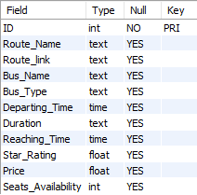
Approach – Data storing
Stored all the scrapped data into a .CSV file.
Created table called “BUS_ROUTES” inside the REDBUS database in MySQL with following description where ID column is auto increment primary key column.
Used Python – MySQL connection and transferred all the data in .CSV file to MySQL.

Slide 5
Approach – Data Analysis/filtering
Created a Streamlit application as shown in the picture for data analysis and filtering.
Connected the Streamlit application with MySQL and retrieved all the data from BUS_ROUTES table and stored in a dataframe df.
Used different kinds of elements for user interactive filtering.
Selectbox, Radio button, Slider, Time_input, Number_input, Pagination, Dataframe, image
Each elements filters the required data from the dataframe and consolidated data is displayed in a table format.

Slide 6
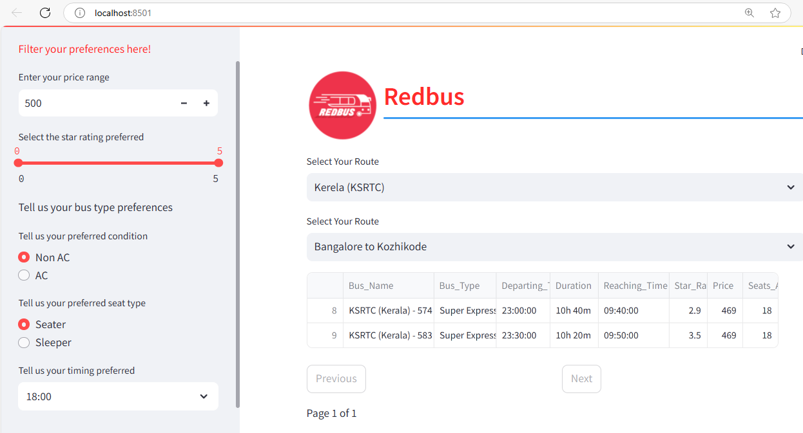
Created Streamlit Application

Slide 7
Learnings
Selenium installation, Webdrivers, waits, Elements, Locators, Finders, Interactions, Handling Exceptions.
Python – MySQL connection, pandas, pymysql, sotring collected data to .csv file, extracting data from .csv file and moving to SQL
SQL queries for filtering, alter, creation, selection.
Streamlit installation, application creation, text elements, Data elements, media elements, layouts and containers, Caching and state, connections.

