Slide 1
Real-Time Sentiment Analysis for Customer Feedback Using Neural Networks and Streamlit App
- Vidya Sathiaseelan

Slide 2
Project Overview
Develop a system that uses a Neural Network (NN) model to perform sentiment analysis on customer feedback provided through a web application. The application will allow users to input text (e.g., reviews, comments) into a webpage, click a “Analyze" button, and receive real-time sentiment predictions (positive, negative, or neutral). The backend will be powered by Streamlit, a lightweight Python framework for building interactive web applications

Slide 3
Approach – Data Scrapping
Used Selenium for data scrapping in IMDB webpage
Scrapped the movie review links for the trending IMBD movies
Launching the movie review pages one by one and scrapped all the needed details like, Review Title and Rating
Based on the Ratings provided, The reviews were classified into Positive, Neutral and Negative
This dataset was used further for model building.

Slide 4
Approach – Data preprocessing
Loaded the dataset with classes and pre-processed all the review text to be ready for model building by removing all the unnecessary punctuation marks, Html tags, urls, special characters and all the stop words.
Lemmatization was done using the NLTK.
Changed all the text to lowercase.
The “Sentiment” column was label encoded to 0 – negative, 1 – Neutral and 2 – Positive.
Then the “Review Title” column was defined as X and “Sentiment Label” was defined as Y

Slide 5
Approach – Building Models
Started building a model with bi directional LSTM. For which tokenizing and padding is done as a first step.
Then for a embedding layer, I used pretrained GLOVE model.
Then started training the model.
The model doesn’t gave the expected approach.
Then used SMOTE for balancing the dataset and tried the model training but the model performance was again low.
Now tried BERT and Distil BRET pre trained models. Model’s performance was good but predictions were done wrongly.

Slide 6
Approach - Data Augmentation
Data augmentation was done to handle the data imbalance in the dataset.
Positive class was higher than the negative and neutral classes.
Synonym augmentation and augment minority classes to match the majority class was performed and created a updated balanced dataset.
Used this dataset for bidirectional LSTM model which was finalized and the predictions where made as expected.

Slide 7
Model layers
Model contains the following layers
Embedding
Bidirectional LSTM(128)
Dropout
Bidirectional LSTM(64)
Dropout
Dense(Relu)
Dense(Sofmax)

Slide 8


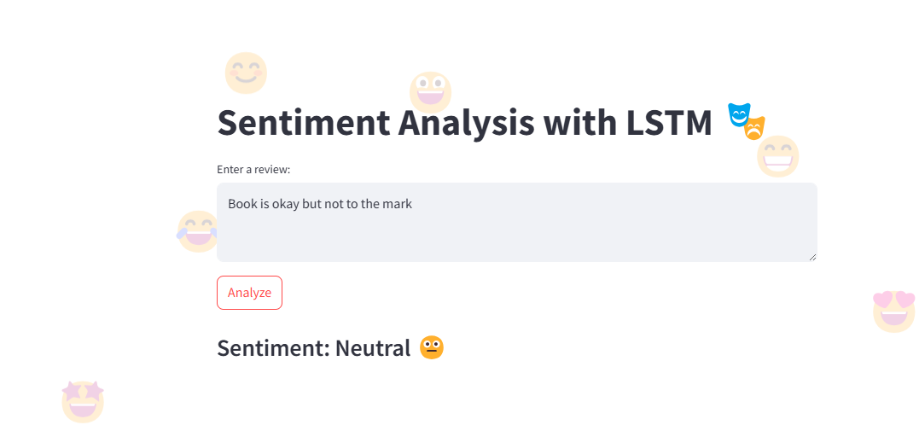
Streamlit app
A simple app was designed using streamlit.
The app is used to analyse the customer feedback and predict it whether it falls under positive, negative or neutral classes by connecting to model build.
The streamlit app was uploaded in streamlit community board for public use.

Slide 9
Learnings
Selenium installation, Webdrivers, waits, Elements, Locators, Finders, Interactions, Handling Exceptions.
Python – torch, Transformers, Numpy, Pandas, scikit-learn, NLTK, Augmentor
Streamlit installation, application creation, text elements, Data elements, media elements, layouts and containers, Caching and state, connections.

