Slide 1
23CSE373 - Computer Vision
Project Title
Dynamic Scene Graph Generation from Video
Using the VidOR dataset | Review 3
adult
holds
baby
on
table
beside
toy
VidOR parts 1-8 trained | 78-class pipeline

Slide 2
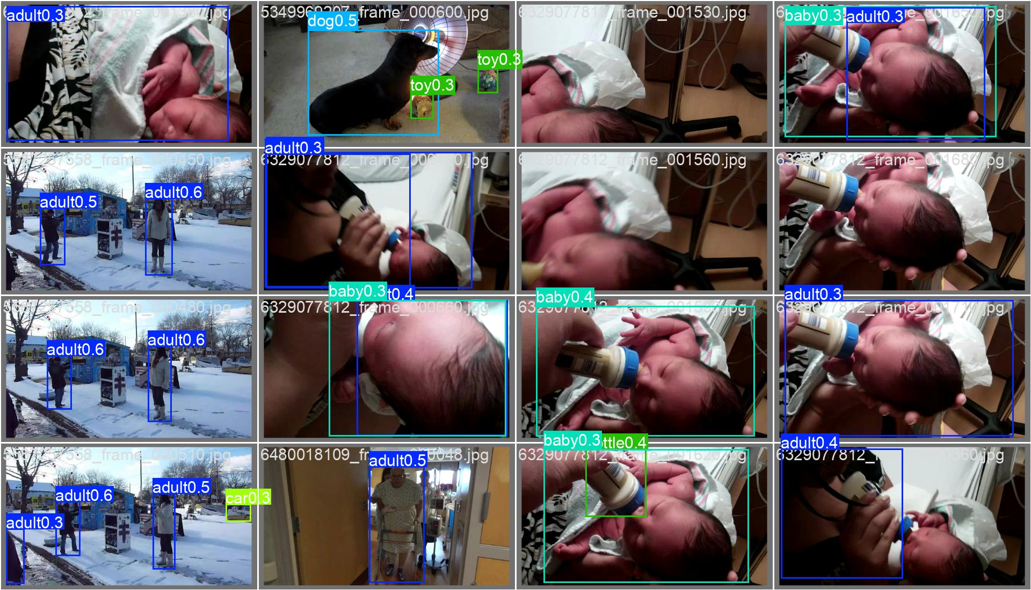
23CSE373 - Computer Vision
What is Dynamic Scene Graph Generation?
A scene graph describes a scene as objects (nodes) and relations (edges).
For video, the graph must follow each object through time.
Output for every frame: <subject, relation, object> triplets.
Built on VidOR with a YOLOv8s detector, tracking and relation prediction.
Real validation frames with detector output (run 3)
adult - holds - baby
baby - looks at - adult
adult - next to - baby
Example triplets (illustrative)

Slide 3
23CSE373 - Computer Vision
Objective
Relations as intervals
Generate a dynamic scene graph for video: detect objects, track them across frames and predict how they relate over time.
t0
t1
t2
t3
t4
adult - holds - baby
Problem Addressed
baby - near - adult
Per-frame scene graphs have no identity across frames, so relations flicker and temporal context is lost.
baby - looks at - toy
Approach
Detect with YOLOv8s, link boxes into tracks, build one graph per frame, connect graphs over time and predict relation labels.
Bars show how long each relation holds across frames.

Slide 4
23CSE373 - Computer Vision
Dataset Identification
VidOR is split into 8 parts, all now trained
Property | Value
Dataset | VidOR
Frame sampling | 1 fps
Training frames | 60,588
Validation frames | 3,594
New videos added | 750 (3 groups)
Object classes | 78
PART
1
earlier
PART
2
earlier
PART
3
earlier
PART
4
earlier
PART
5
earlier
PART
6
added now
PART
7
added now
PART
8
added now
Crimson = trained earlier | Grey = added for this review
Training frames = 33,277 earlier + 27,311 new. The validation set is unchanged, so results are comparable.

Slide 5
23CSE373 - Computer Vision
Pipeline: Eight Stages from Video to Scene Graph
1 preprocessing
clean and prepare frames
2 dataset
parse labels, sample at 1 fps
3 detection
YOLOv8s finds objects
4 tracking
link boxes into tracks
5 features
appearance and geometry
6 graph
one graph per frame
7 temporal
connect graphs over time
8 relations
predict predicate per pair
Trained and evaluated: detection, the relation model and the temporal LSTM/GRU models. Later stages consume the detector's boxes, so its quality sets the ceiling.

Slide 6
23CSE373 - Computer Vision
What the Dataset Export Contains
Folder / file | Contents
annotations | VidOR labels for train and validation
videos | Source clips
yolo_format | Frames and boxes in YOLO layout
tracks | Per-video object tracks
features | Extracted object features
relation_dataset | Object-pair relation samples
relation_dataset_corrected | Revised relation samples
dataset_manifest.json | Parts, fps and counts

Slide 7
23CSE373 - Computer Vision
Detector: YOLOv8s, Three Colab Runs and a Fine-tune
Setting | Value
Base model | yolov8s.pt, pretrained
Input size | 640 px
Epochs | 10 per run, 3 fine-tune
Optimizer | auto (AdamW)
Augmentation | mosaic, flip 0.5, HSV
Hardware | Colab GPU, then M3 Pro Mac
Run 1
weights saved
batch 16
Run 2
weights saved
batch 32
Run 3
best mAP50 0.263
batch 32
Fine-tune
from run 3, all parts
batch 16

Slide 8
23CSE373 - Computer Vision
Training Results: mAP Plateaus as Validation Loss Stays Flat
Training loss keeps falling while validation loss stays near 2.1, a sign of over-fitting. Full run: 10 epochs, about 79 minutes on one Colab GPU.

Slide 9
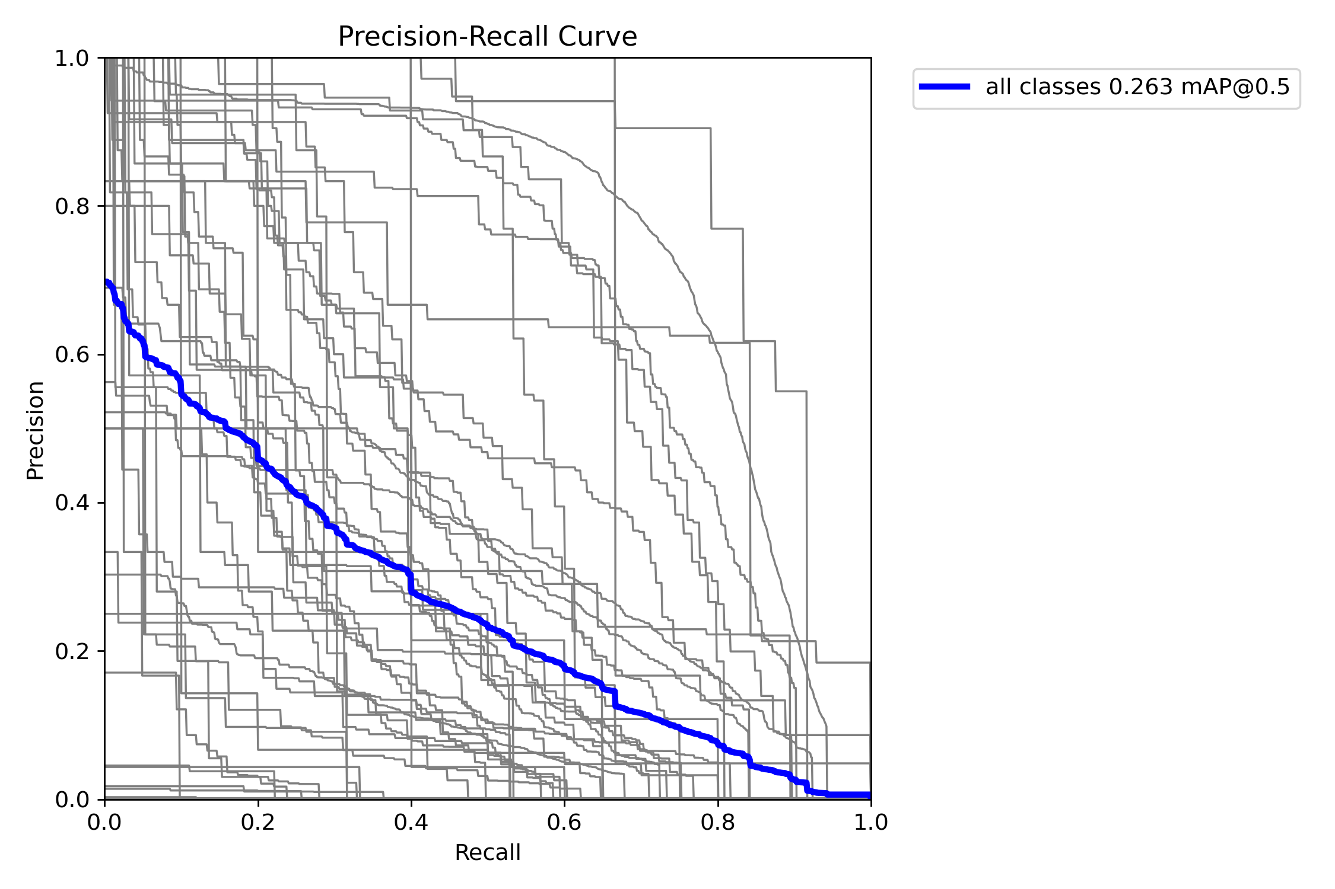
23CSE373 - Computer Vision
Result Metrics: Peak 0.263 mAP50 at Epoch 7
0.263
mAP50, best (epoch 7)
0.153
mAP50-95, best
0.363
precision, final epoch
0.251
recall, final epoch
Precision-recall curve: all classes (blue) and each class (grey).

Slide 10
23CSE373 - Computer Vision
Fine-tune on All Parts: Detector Results
 | P | R | mAP50 | mAP50-95
Baseline | 0.381 | 0.285 | 0.2635 | 0.1526
Epoch 1 | 0.410 | 0.235 | 0.2492 | 0.1471
Epoch 2 | 0.407 | 0.272 | 0.2556 | 0.1508
Epoch 3 | 0.331 | 0.303 | 0.2602 | 0.1548
27,311 new frames did not raise mAP50 (0.2635 to 0.2602). Recall rose, precision fell, and mAP50-95 is slightly higher. Validation classification loss improved from about 2.1 to 1.96. Each epoch took about 76 minutes on an M3 Pro.
Baseline = Colab run 3, scored on the same 3,594 validation images.

Slide 11
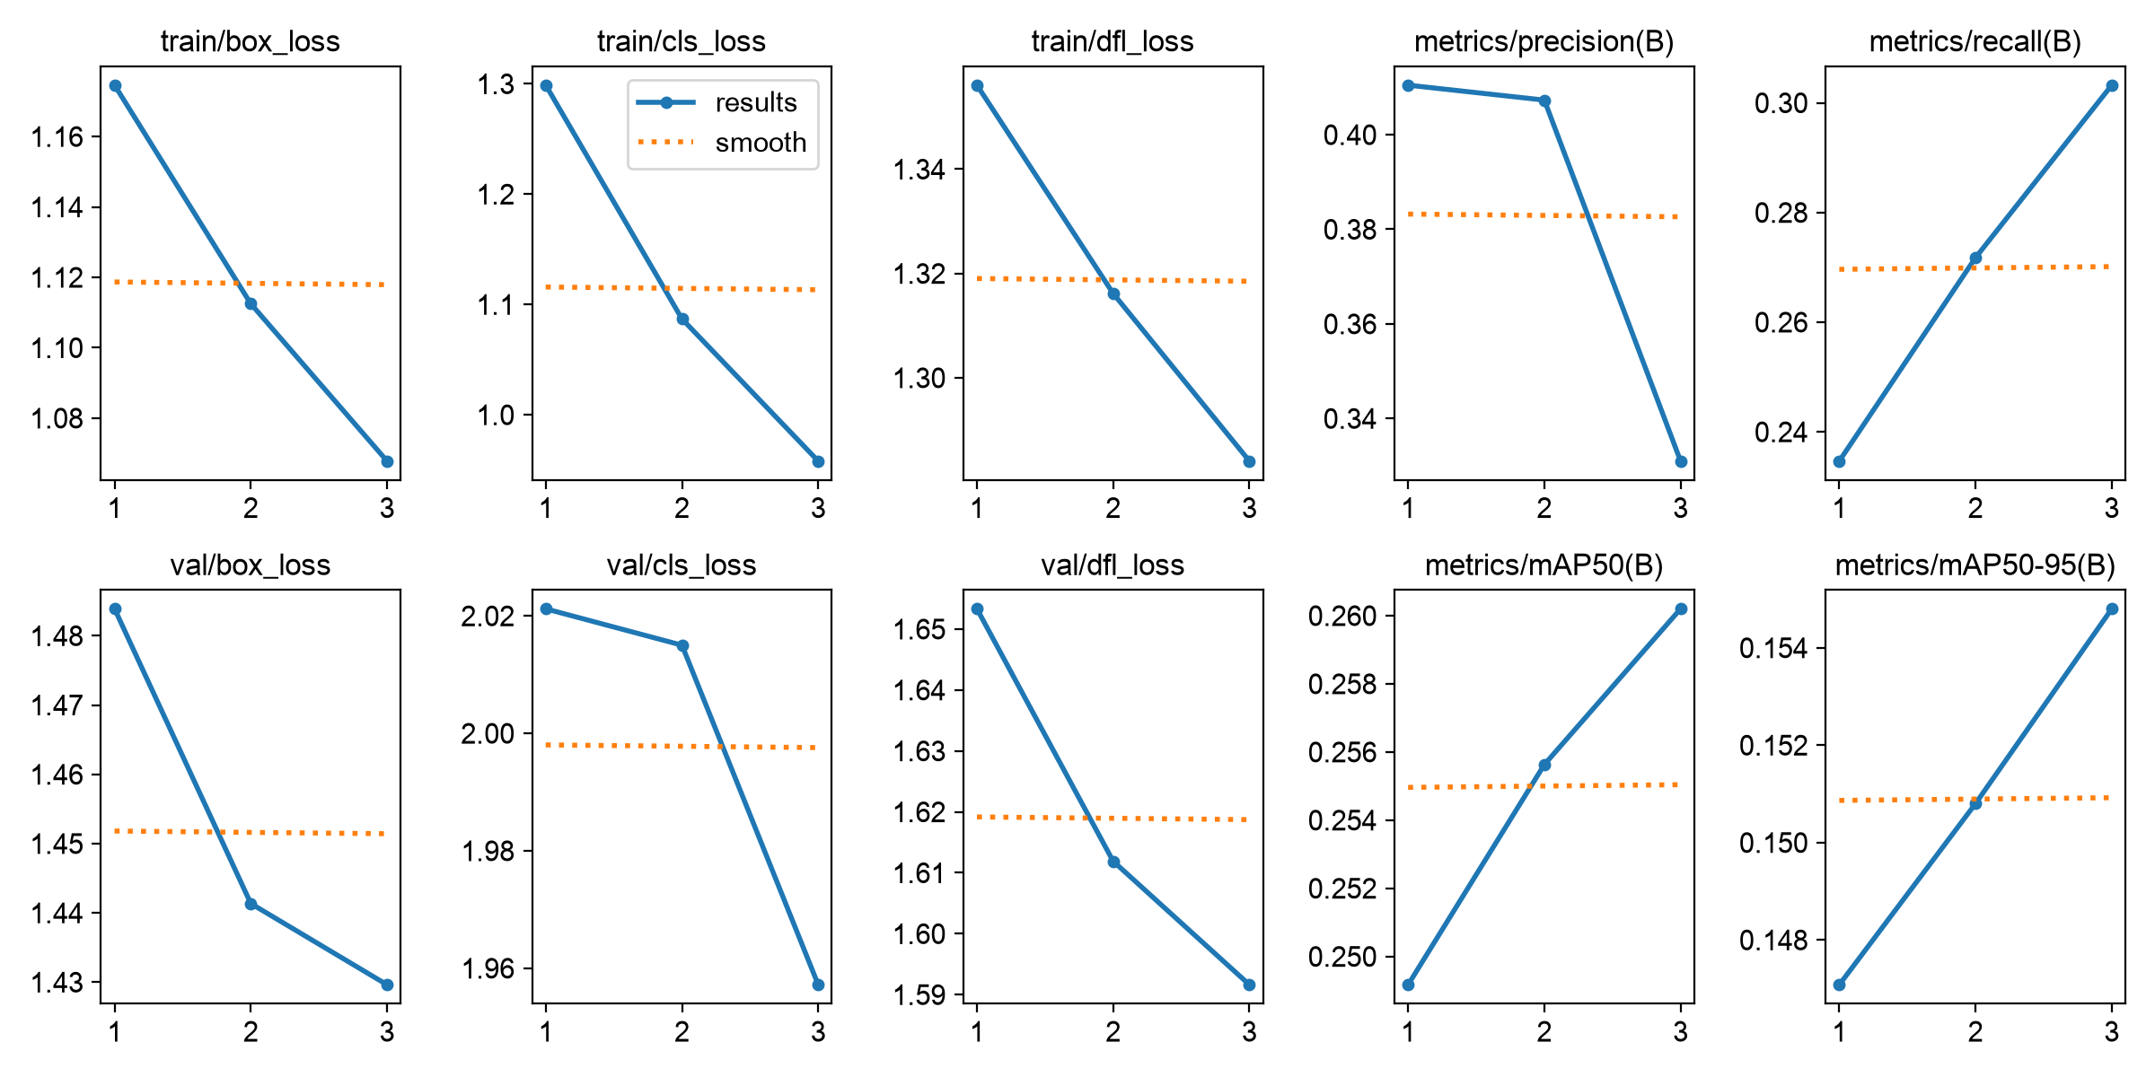
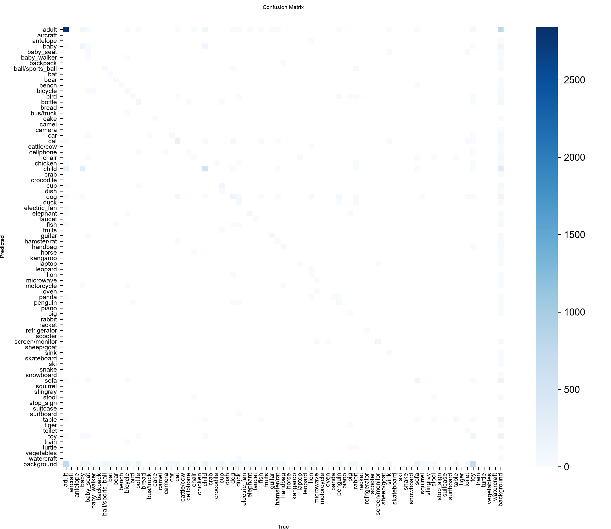
23CSE373 - Computer Vision
Fine-tune Training Graphs
Losses, precision, recall and mAP over the 3 fine-tune epochs.
Confusion matrix after fine-tuning.

Slide 12

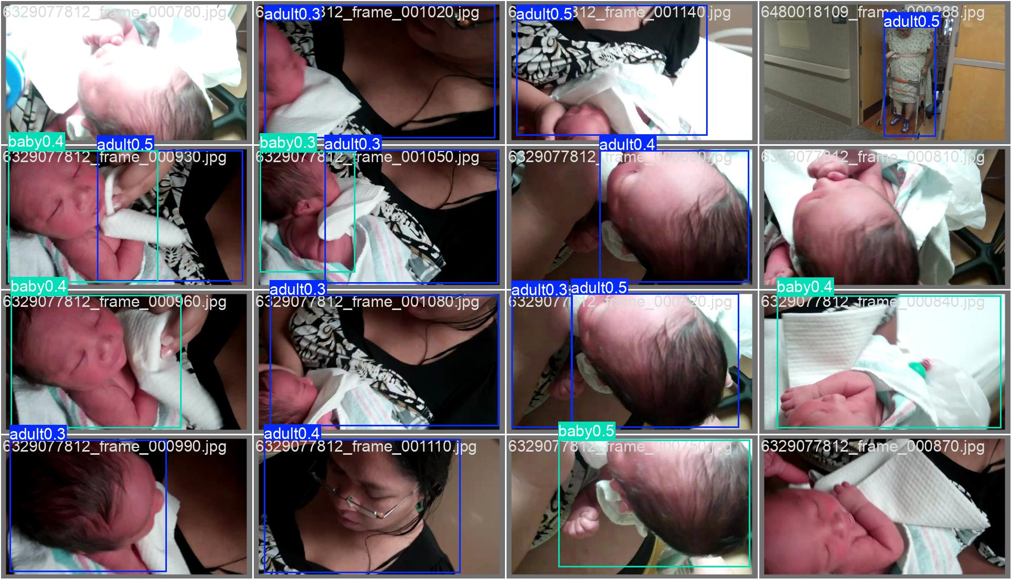
23CSE373 - Computer Vision
Error Analysis: Strong on Adults, Thin on Other Classes
Validation predictions: adult and baby are found, with confidence 0.3 to 0.5.
Confusion matrix: a dark adult cell, faint scatter elsewhere.

Slide 13
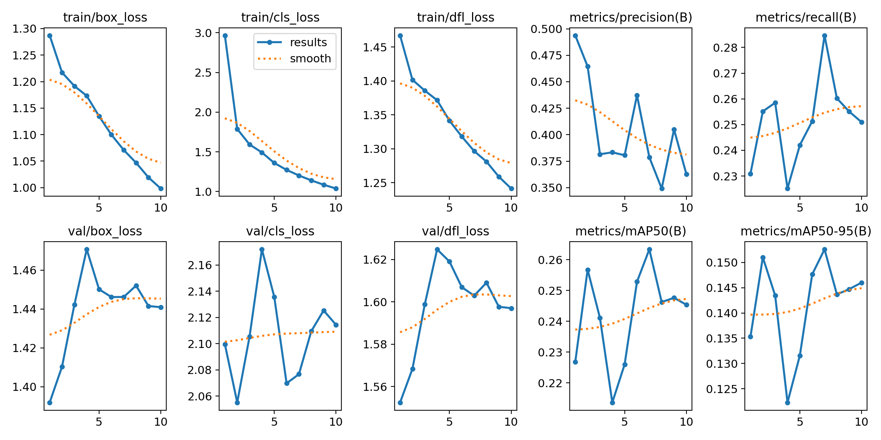
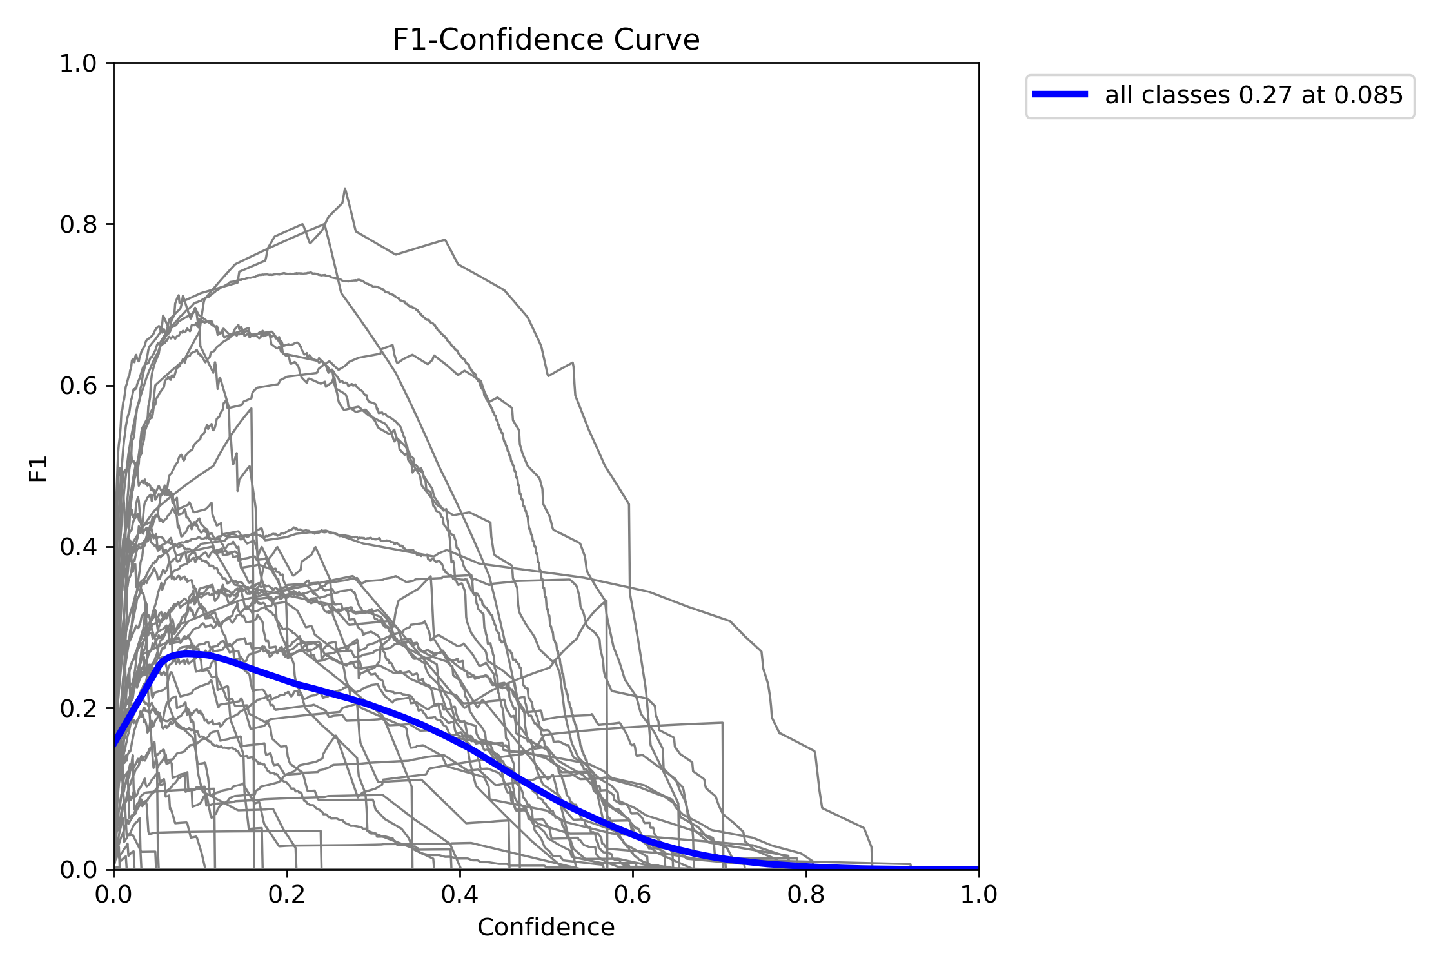
23CSE373 - Computer Vision
Training Graphs from the Run
F1 versus confidence threshold.
Losses, precision, recall and mAP over the 10 epochs.

Slide 14
23CSE373 - Computer Vision
Tracks Turn Per-Frame Boxes into a Temporal Graph
frame t
frame t+1
frame t+2
adult #1
adult #1
adult #1
holds
holds
baby #2
baby #2
baby #2
looks at
looks at
toy #3
toy #3
toy #3
Solid lines: relations inside a frame. Dashed lines: the same object linked through time.

Slide 15
23CSE373 - Computer Vision
Combining Old and New Training: 28 to 78 Classes
Old relation model
28 classes
Copy weights
by class name
Expanded model
78 classes, identical output
Fine-tune
old + new data
 | Old data | New data | Combined
Relation training pairs | 7,536 | 145,031 | 152,567
Temporal training sequences | 1,890 | 38,388 | 40,278
The expanded model gave exactly the same answers as the old one on the old validation set (accuracy 0.429, loss 1.758), so no knowledge was lost. 38 new videos (every 10th) were held out of training to test on unseen data.

Slide 16
23CSE373 - Computer Vision
Relation and Temporal Models: Before and After Fine-tuning
Model | Test set | Accuracy | Macro-F1 | Loss
Relation | old val | 0.429 -> 0.529 | 0.068 -> 0.077 | 1.758 -> 1.490
Relation | new videos | 0.303 -> 0.407 | 0.098 -> 0.124 | 2.264 -> 1.781
Temporal LSTM | old val | 0.645 -> 0.586 | 0.072 -> 0.099 | 1.317 -> 1.375
Temporal LSTM | new videos | 0.278 -> 0.372 | 0.026 -> 0.074 | 2.100 -> 1.891
Temporal GRU | old val | 0.576 -> 0.628 | 0.075 -> 0.113 | 1.510 -> 1.372
Temporal GRU | new videos | 0.281 -> 0.390 | 0.032 -> 0.063 | 2.284 -> 1.809
Every model improves on the unseen new videos; the old models had never seen most of the 78 classes.
The LSTM is slightly worse on the old validation set (accuracy 0.645 to 0.586); the GRU improves on both.
Scores are still low: macro-F1 is at most 0.13, because background pairs dominate the data.
Validation loss is best after 1 to 3 epochs, then rises (over-fitting), so early stopping chose the checkpoints.

Slide 17
23CSE373 - Computer Vision
Why Two Predicates Dominated the Graphs
Data: next_to and in_front_of are 72% of all positive labels; the rarest predicates have fewer than 30 samples.
Loss: v1 used an unweighted loss, so guessing the common classes pays off.
Checkpoints: v1 was chosen by validation loss, but macro-F1 on new videos was still rising (0.124 to 0.156 by epoch 5).
Result: v1 predicted only 11 of 32 predicates (the GRU only 4).

Slide 18
23CSE373 - Computer Vision
The Fix: Class-balanced Loss, Checkpoints by Macro-F1
Model | Test set | Macro-F1 | Accuracy | Predicates used | Top-2 share
Relation | new videos | 0.124 -> 0.189 | 0.407 -> 0.406 | 11 -> 23 | 74% -> 58%
Relation | old val | 0.084 -> 0.064 | 0.529 -> 0.314 | 8 -> 14 | 73% -> 53%
Temporal LSTM | new videos | 0.074 -> 0.145 | 0.372 -> 0.339 | 8 -> 17 | 95% -> 54%
Temporal LSTM | old val | 0.099 -> 0.059 | 0.586 -> 0.322 | 4 -> 10 | 92% -> 47%
Temporal GRU | new videos | 0.063 -> 0.172 | 0.390 -> 0.333 | 4 -> 22 | 99% -> 45%
Temporal GRU | old val | 0.113 -> 0.130 | 0.628 -> 0.396 | 3 -> 13 | 100% -> 49%
v2 = v1 retrained with loss weights proportional to 1/sqrt(frequency), capped at 12x, with the checkpoint chosen by macro-F1. Top-2 share = share of non-background predictions that are next_to or in_front_of.
On new videos every model gains macro-F1 and uses far more predicates; the GRU's top-2 share falls from 99% to 45%.
Cost: accuracy drops. On the small old validation set the result is mixed: relation worse, LSTM worse, GRU better.

Slide 19
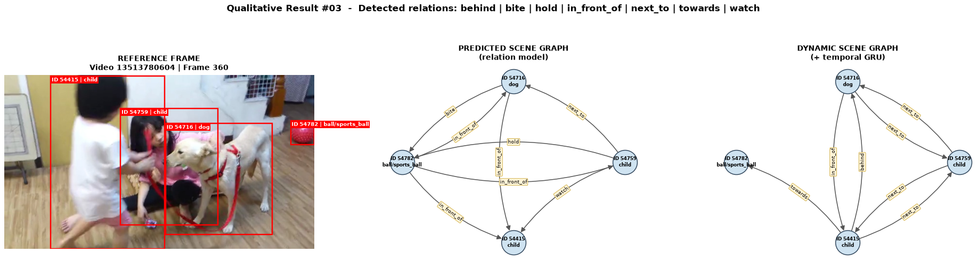
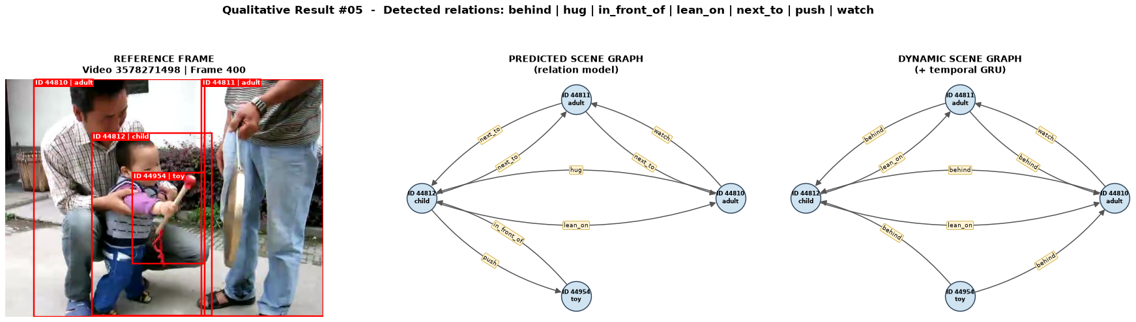
23CSE373 - Computer Vision
Dynamic Scene Graphs After the Fix (1/2)
Held-out new videos. Examples were picked for predicate variety, not at random.

Slide 20
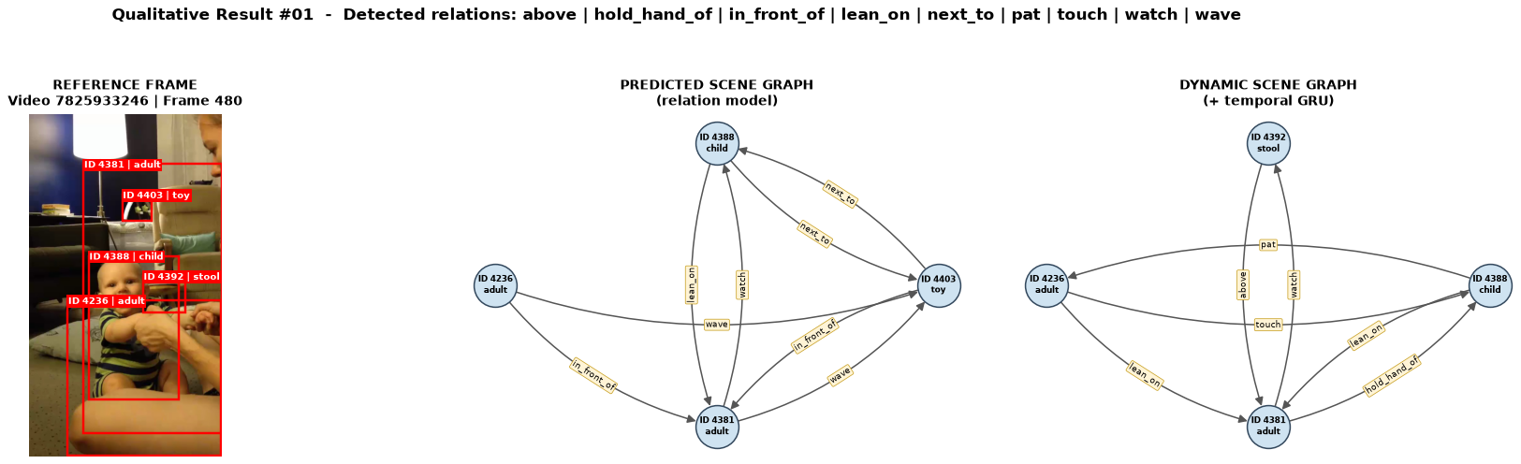
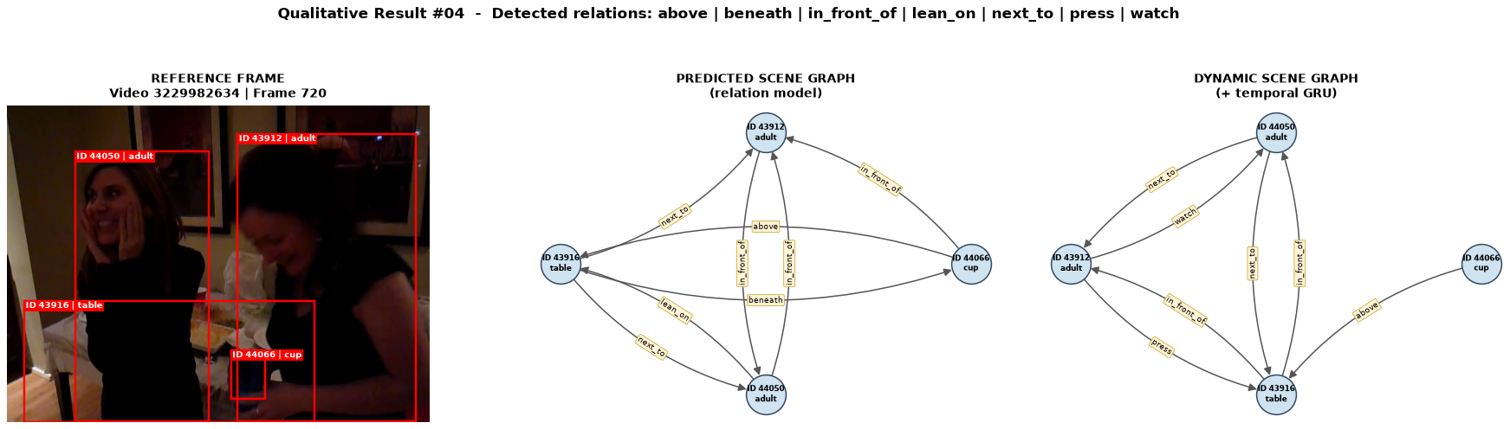
23CSE373 - Computer Vision
Dynamic Scene Graphs After the Fix (2/2)
Some relations are plausible (watch, hold, towards), others are wrong: scores remain low.

Slide 21
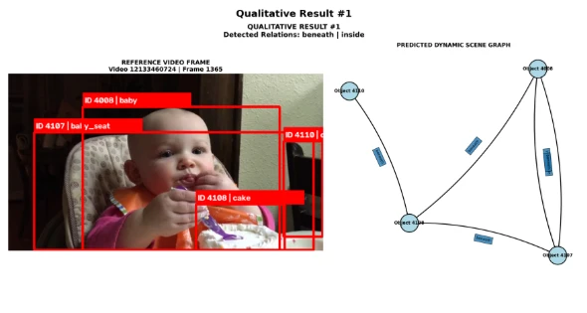
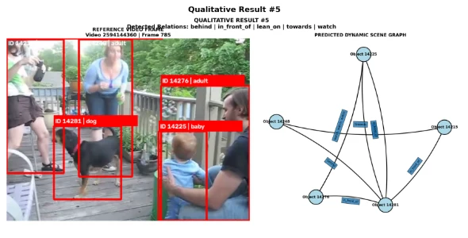
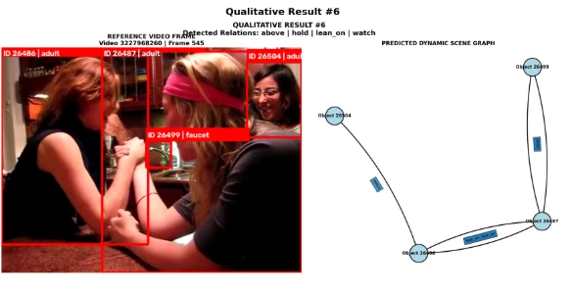
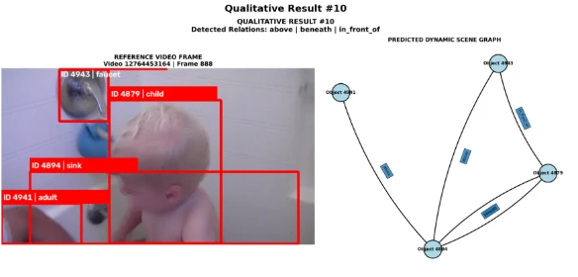
23CSE373 - Computer Vision
Qualitative Results: Frames and Predicted Graphs
Left of each panel: tracked, labelled objects. Right: predicted scene graph with relation labels.

Slide 22
23CSE373 - Computer Vision
Review 3: VidOR Training Progress
1
2
3
4
5
6
7
8
Parts 1-5 trained earlier
Parts 6-8 added now
Stage | Before (parts 1-5) | After (parts 6-8 added)
Detector mAP50 / mAP50-95 | 0.2635 / 0.1526 | 0.2602 / 0.1548
Detector recall | 0.285 | 0.303
Relation, new videos (acc / macro-F1) | 0.303 / 0.098 | 0.408 / 0.124
Temporal GRU, new videos (acc / macro-F1) | 0.281 / 0.032 | 0.390 / 0.063
Honest summary: more data did not raise detector mAP50. The relation and temporal models improved on unseen new videos, but scores remain low.

Slide 23
23CSE373 - Computer Vision
Challenges Faced
Next Review
Compute: limited GPU access, so the final fine-tune ran on a Mac (about 4 hours for 3 epochs).
Class mismatch: the pipeline had 28 classes, the detector 78. Fixed by expanding by class name.
Over-fitting: relation and temporal validation loss rises after 1 to 3 epochs.
Low scores: detector recall 0.30 and macro-F1 at most 0.13.
Run the full pipeline end to end and evaluate it.
Train the detector longer with a tuned learning rate.
Use a class-weighted relation loss to lift macro-F1.
Track and featurise every new video, not every second one.

