Slide 1
REVIEW 3 · VIDOR DATASET
Dynamic Scene Graph Generation from Video
person
holds
bottle
stands by
on
table
Detect objects, track them through time, and predict how they relate - frame by frame.
near
dog
5 of 8 VidOR parts complete · parts 6-8 training
illustrative scene graph
Notes:
Title. Project: dynamic scene graph generation on VidOR. Review 3 update: 5 of 8 dataset parts complete, parts 6-8 are training.

Slide 2
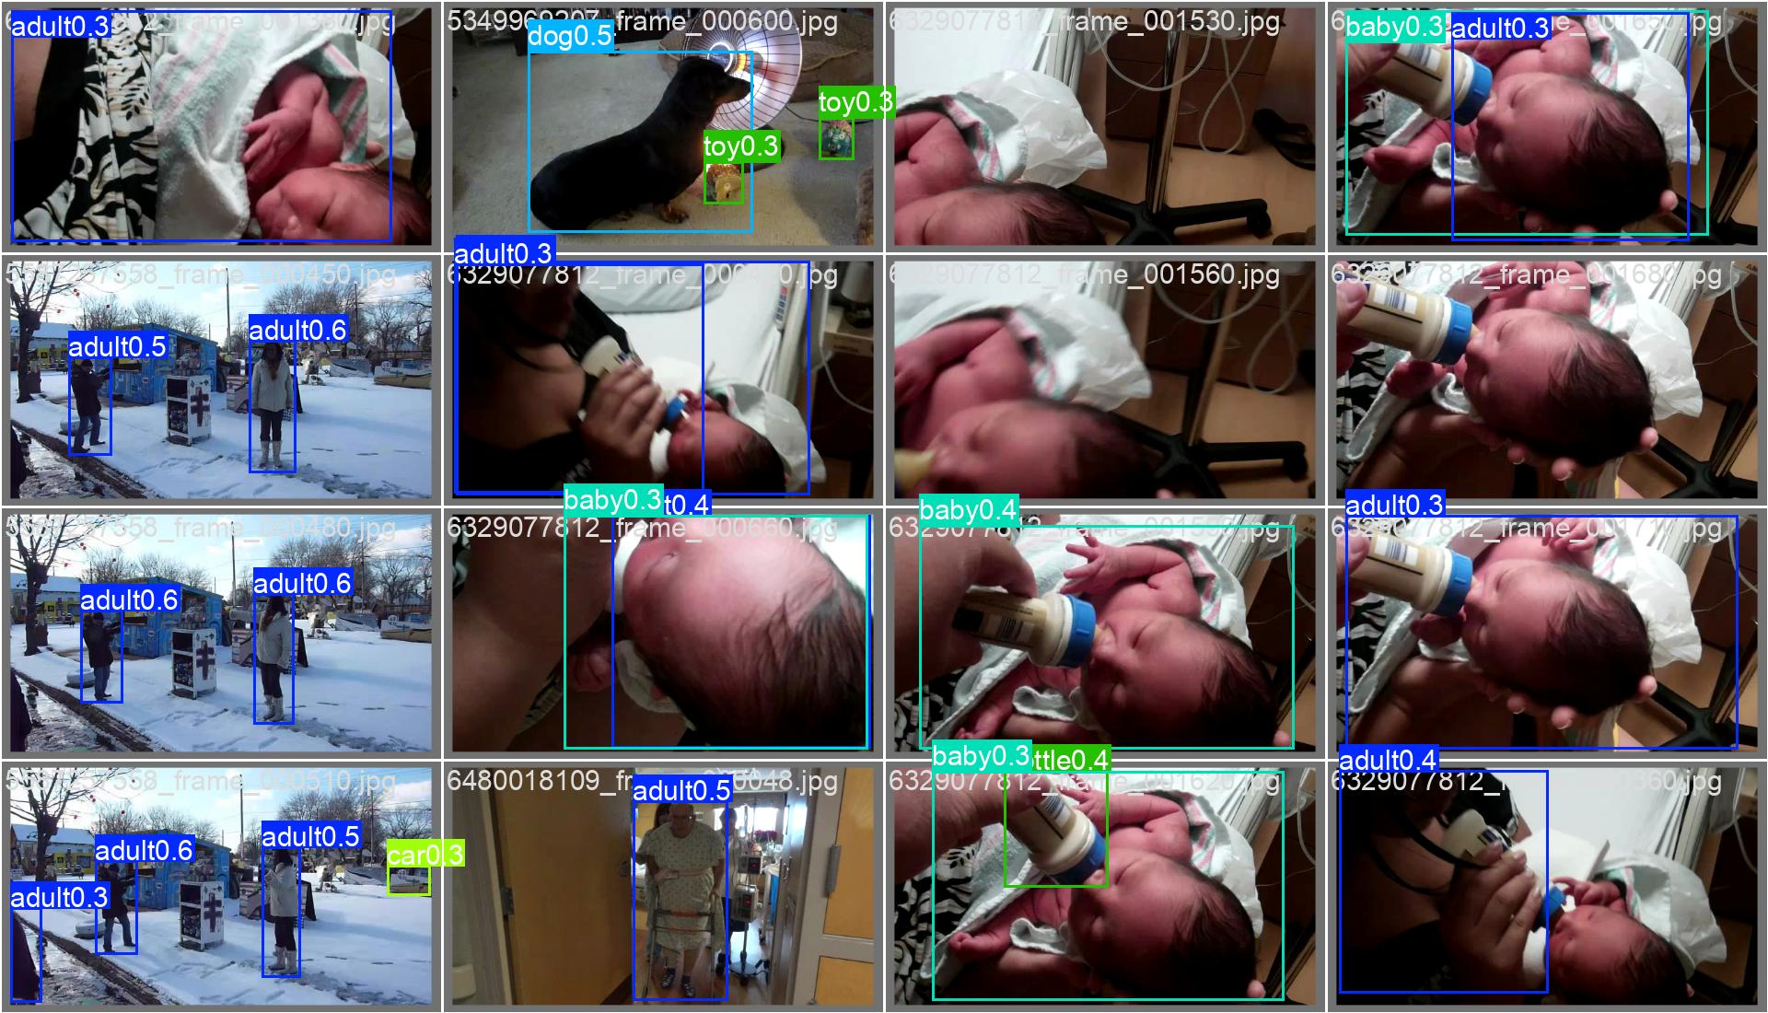
A video is a story of who does what to whom
01 · THE PROBLEM
OUTPUT PER FRAME (illustrative)
adult holds baby
baby looks at adult
adult next to baby
Real validation frames with detector output (run 3)
Doing this for every frame, with objects that keep their identity over time, is this project's task.
Notes:
Scene graph = objects as nodes, relations as edges. We want this for every moment of a video.

Slide 3
Per-frame graphs miss what changes over time
02 · WHY DYNAMIC
Static (per frame)
Dynamic (this project)
Each frame labelled on its own
No identity link between frames
Relations flicker on and off
Tracked objects keep one ID
Relations carry a start and an end
Context from neighbouring frames
RELATIONS AS INTERVALS
t0
t1
t2
t3
t4
person - holds - ball
dog - near - person
dog - looks at - ball
Notes:
A static scene graph treats each frame alone. A dynamic one keeps identities and records when relations start and stop.

Slide 4
VidOR comes in eight parts - five are trained
03 · DATA
1 fps
frame sampling rate
PART
PART
PART
PART
1
2
3
4
done
done
done
done
33,277
training frames (YOLO format)
PART
PART
PART
PART
3,594
validation frames
5
6
7
8
done
training
training
training
250
videos per part
Filled = complete · Dashed = in training
Counts from the last dataset export manifest.
Notes:
VidOR training set is split into 8 parts. Parts 1-5 are complete. Parts 6-8 are training now because GPU access was limited. Stats from dataset_manifest.json (export snapshot).

Slide 5
Eight stages from raw video to scene graph
04 · PIPELINE
1
2
3
4
5
6
7
8
preprocessing
dataset
detection
tracking
features
graph
temporal
relations
Clean and prepare frames
Parse VidOR labels, sample at 1 fps
YOLOv8s finds objects per frame
Link detections into tracks
Appearance and geometry per object
Build a graph for each frame
Connect graphs across time
Predict the predicate between pairs
Trained and evaluated so far: stage 3, detection
The remaining stages consume its boxes, so detector quality sets the ceiling.
Notes:
Stages mirror the src/ folder of the project.

Slide 6
What the dataset export contains
05 · DATA EXPORT
annotations
videos
VidOR labels for train and val
Source clips
yolo_format
tracks
Frames and boxes in YOLO layout
Per-video object tracks
features
relation_dataset
Extracted object features
Object-pair relation samples
relation_dataset_corrected
dataset_manifest.json
Revised relation samples
Parts, fps and counts
Notes:
dataset_export on Drive.

Slide 7
YOLOv8s fine-tuned in three runs
06 · DETECTOR
Base model
yolov8s.pt, pretrained
Run 1
weights saved
Input size
640 px
batch 16
Epochs
10 per run
Run 2
weights saved
Optimizer
auto, lr0 0.01
batch 32
Augmentation
mosaic, flip 0.5, HSV
Run 3
metrics + curves logged
Precision
mixed (AMP), Colab GPU
batch 32
Notes:
Config from args.yaml of each run. Only run 3 has saved metrics.

Slide 8
mAP stalls near 0.25 as validation loss stays flat
07 · RESULTS
Training loss keeps falling while validation loss stays near 2.1 - a sign of over-fitting. Full run: 10 epochs, about 79 minutes on one Colab GPU.
Notes:
Run 3, 10 epochs, from results.csv. Classification loss: train 2.97 to 1.04, validation 2.10 to 2.11.

Slide 9
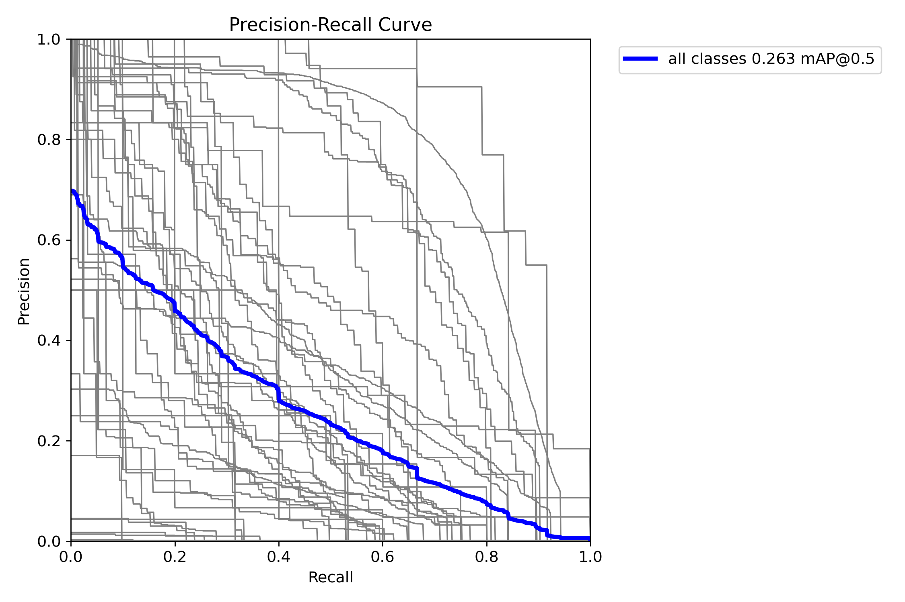
Peak 0.263 mAP50 at epoch 7
08 · RESULTS
0.263
0.153
mAP50, best (epoch 7)
mAP50-95, best (epoch 7)
0.363
0.251
precision, final epoch
recall, final epoch
Precision-recall for all classes (blue) and each class (grey). Precision falls steeply as recall rises.
Notes:
Best mAP values across 10 epochs; precision and recall are final-epoch values. PR curve image is from the run-3 folder.

Slide 10
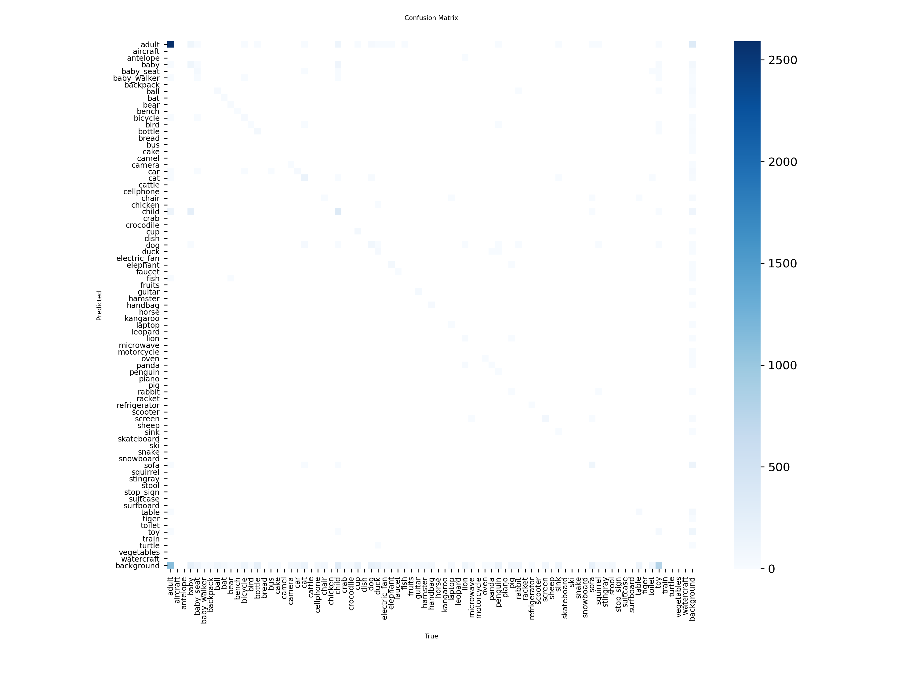
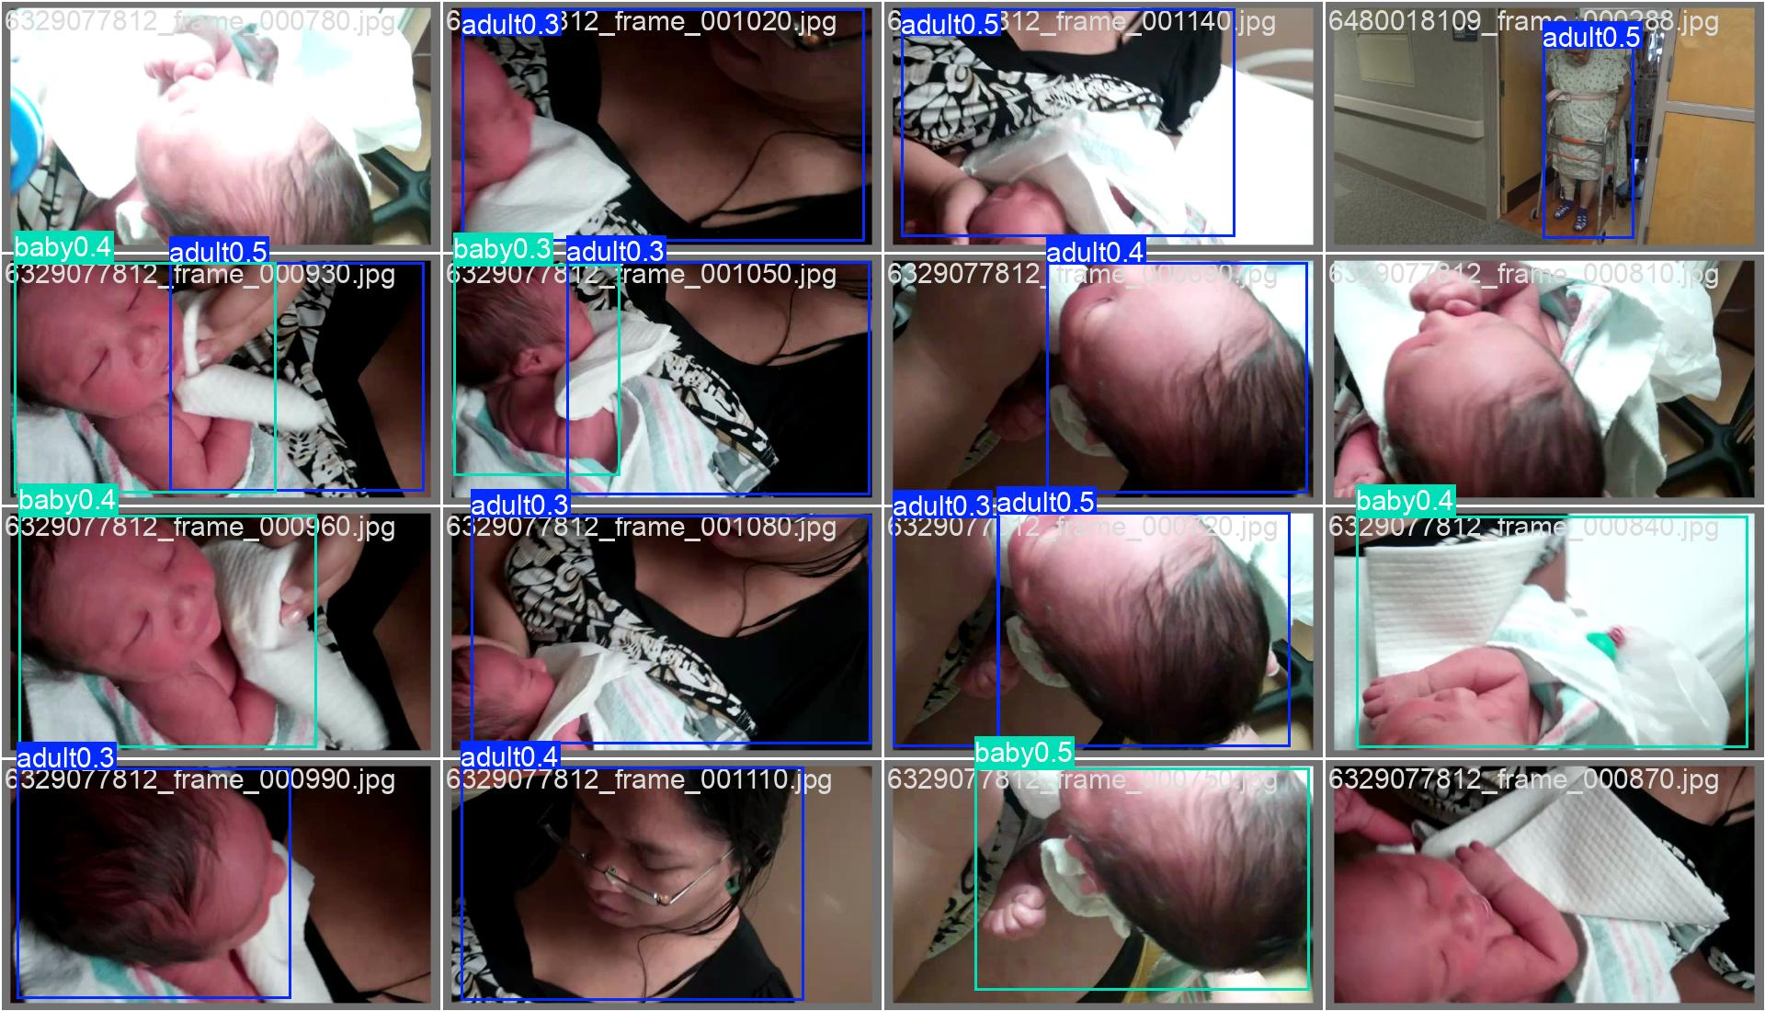
Strong on adults, thin on most other classes
09 · ERROR ANALYSIS
Confusion matrix: a dark adult cell, faint scatter everywhere else.
Validation predictions: adult and baby are found, but confidence stays at 0.3 to 0.5.
Notes:
Confusion matrix and validation predictions from the run-3 folder. The adult class dominates; many classes barely register. Predicted boxes on validation frames show adult and baby at confidence 0.3 to 0.5.

Slide 11
Tracks turn per-frame boxes into a temporal graph
10 · TEMPORAL GRAPH
frame t
frame t+1
frame t+2
person #1
person #1
person #1
holds
ball #2
ball #2
ball #2
looks at
dog #3
dog #3
dog #3
Solid edges: relations inside a frame. Dashed edges: the same object linked through time.
Notes:
Tracking assigns persistent IDs; graph and temporal modules connect nodes across frames.

Slide 12
Relation samples come from tracks and features
11 · RELATION DATA
annotations
relation_dataset
relation_dataset_corrected
predicate model
tracks
features
Two exports exist: the first relation set and a corrected version. The corrected one is the cleaner input for relation learning.
Notes:
Data flow inferred from the dataset_export folders.

Slide 13
What slowed us down and what we learned
12 · LESSONS
1
GPU access
2
Short runs
Limited Colab time capped how many parts we could train, so parts 6-8 waited.
Ten epochs per run is a small budget for 33k frames.
3
Over-fitting
4
Low recall
Validation loss stays flat while training loss falls.
The detector misses objects, which limits every later stage.
Notes:
GPU access limited the number of parts we could train before this review.

Slide 14
VidOR training: five of eight parts complete
REVIEW 3 · VIDOR PROGRESS
Parts
Status
Result
1 - 5
Complete
Detector: best mAP50 0.263, mAP50-95 0.153
5/8
6
Training
Pending evaluation
7
Training
Pending evaluation
parts complete
8
Training
Pending evaluation
Next in this review: parts 6-8 results, compared against the parts 1-5 baseline of 0.263 mAP50, go in as each run finishes.
Notes:
Review 3 slide. Parts 1-5 are complete and reported. Parts 6-8 are currently training; their results will be added after evaluation.

Slide 15
Finish the parts, then close the loop
13 · NEXT
1
2
3
4
Finish parts 6-8
Retrain on all eight
Longer runs
Run the full graph
Complete training and evaluate each part
Re-fit the detector with the full, more varied data
More epochs, watch validation loss for early stopping
Detection to tracking to temporal relations, end to end
Thank you
Notes:
Roadmap.

