Slide 1
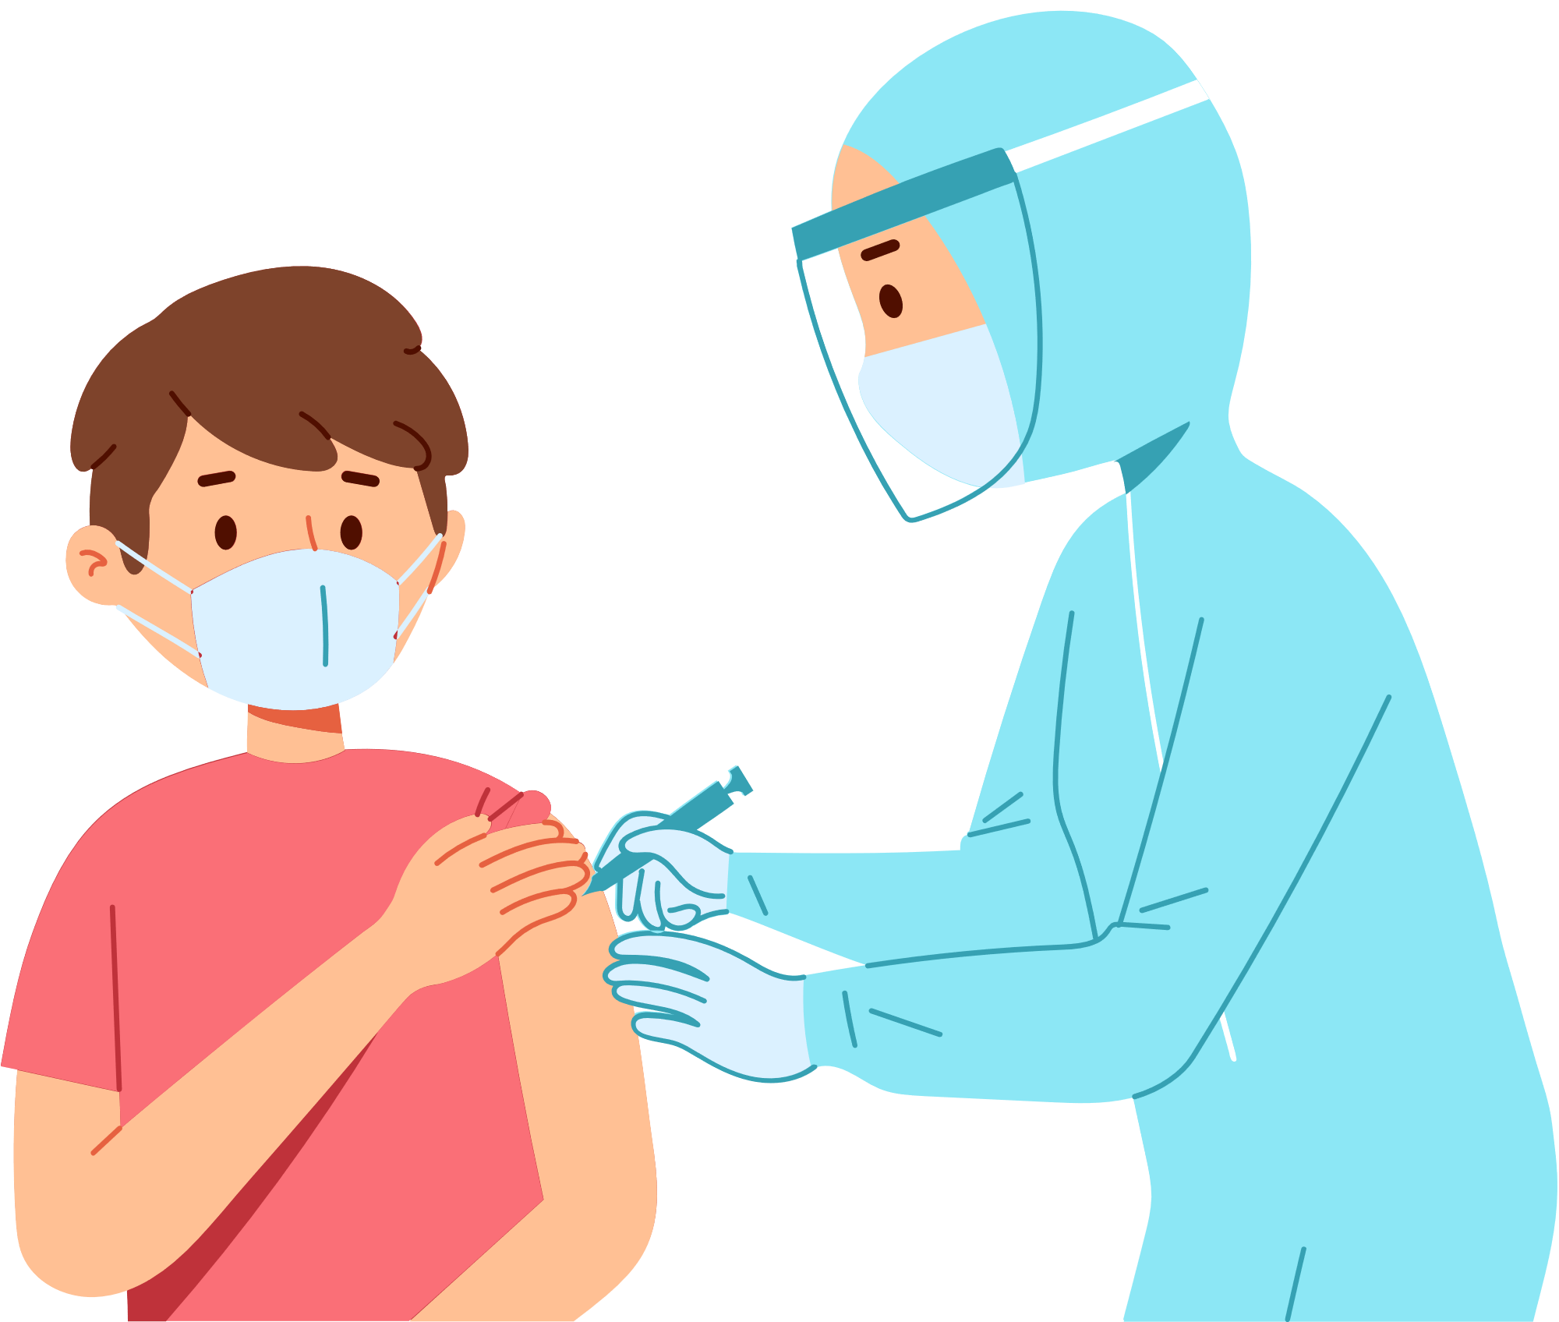



Team - TrojanHash

Slide 2

Team Members
- Bhargav Joshi
- Dikshita Kambri

Slide 3

Problem Statement
BookMydose is a web-based Application platform to connect users directly with nearby hospitals and facilitate the process of scheduling an appointment with the hospital to get vaccinated.

Slide 4










Tech Stack

Slide 5

Solution/Prototype
Using our platform, the user has to fill a registration form providing necessary details which will be shared to the hospital. Then, the user can choose from available date and time slots, & Register self with his details. Later, the user can visit the chosen hospital according to the scheduled appointment.

Slide 6

Why our platform?
Proper Management of Vaccine Distribution.
Database of all Registered people.
Reducing possible crowding at clinics/ hospitals when the vaccine becomes public.
On the admin side, a proper database of users and hospitals will be maintained to track the progress and maintain the records of vaccine distribution easily and efficiently.

Slide 7

Registration Stages
01
VISIT WEBSITE
02
CLICK ON BOOK
03
FILL THE DETAILS
04
BOOK SLOT
05
SUBMIT

Slide 8


Components
MANAGE
DB
REGISTRATION
ADMIN
DAHBOARD
USERS
DATABASE
HOSPITALS
LIST

Slide 9


