Slide 1

CAT Scan Localization Using Deep Learning
Presented by: Vidya Lekshmi

Slide 2

Table of contents
01
03
Dataset Description
Model Building
02
04
Neural networks
Results

Slide 3
01
Dataset Description

Slide 4
Context
The data was retrieved from a set of 53500
CT images from 74 different patients
This dataset consists of 384 features extracted from CT images.
The dataset also has a reference column which is a continuous numeric column which displays the relative location of the ct slice on the axial axis of the human body.
The class variable is numeric and denotes the relative location of the CT slice on the axial axis of the human body.

Slide 5
Field descriptions
patientId:
Each ID identifies a different patient
value[1-241]
Histogram describing bone structures
value[242 - 385]
Histogram describing air inclusions
386
Relative location of the image on the axial axis (class value).

Slide 6

Problem Statement
A CAT Scan is an X-ray image made using a form of tomography in which a computer controls the motion of the X-ray source and detectors, processes the data, and produces the image.
CT scans can detect bone and joint problems, like complex bone fractures and tumors.
In this project, a model is created to detect which part of the body the CAT Scan was taken, i.e., localization of the CAT scan.

Slide 7
Objective:
To create a neural network and find which part of the body the CAT Scan was taken.

Slide 8
02
Neural Network

Slide 9
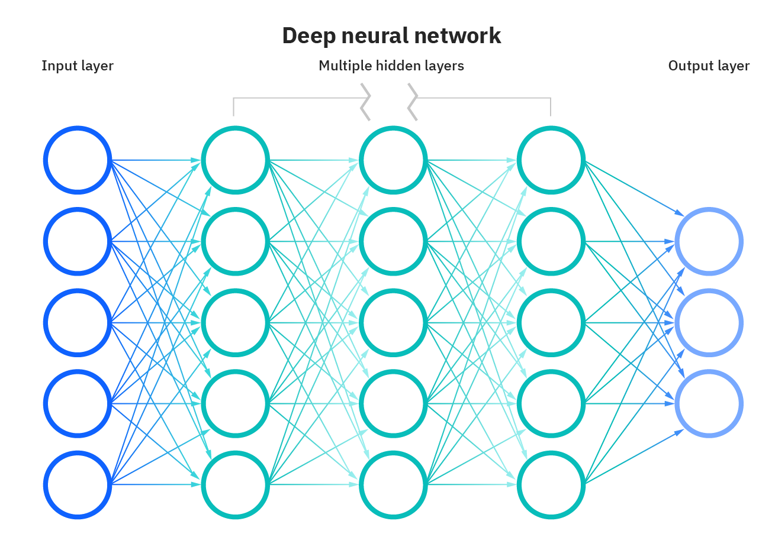

Slide 10
Neural Network
A neural network is a method in artificial intelligence that teaches computers to process data in a way that is inspired by the human brain. It is a type of machine learning process, called deep learning, that uses interconnected nodes or neurons in a layered structure that resembles the human brain. It creates an adaptive system that computers use to learn from their mistakes and improve continuously.

Slide 11
03
Model Building

Slide 12

Model Building
Each CT slice is described by two histograms. The first histogram describes the location of bone structures in the image, the second the location of air inclusions inside of the body. Both histograms are concatenated to form the final feature vector. Bins that are outside of the image are marked with the value -0.25.

Slide 13
04
Results

Slide 14
RMSE
R2 Score
The R2 score obtained was 0.99910
The RMSE score obtained was 0.67073
As you can see from the output above, our CAT Scan localization model gives an accuracy rate of almost 99%. This means that 99% of the time the model is able to make the correct prediction.

Slide 15

Thanks!
CREDITS: This presentation template was created by Slidesgo, including icons by Flaticon, and infographics & images by Freepik.

