Slide 1










Tech Stack
Data warehouse
Data marts
Data Source
Extract / Load
Staging
Transform
Visualisation
Version control
Testing
Data catalog

Slide 2
Data Architecture
Data Engineers
Data Analytics
Data Scientists
Orchestration (e.g. Azure)
Extract Load (ADF)
Transform (dbt)
Business Intelligence
Batch Data
Processing
Cleaning/Staging
(ADF)
Remove duplicate data
Data masking
Renaming variables
Data quality check
Aggregate
Tables
Core Data
(Data Lake)
Create Tables
Split Data
Notebooks
Data Sources
Web App
Log File
Database
Raw Dump
Raw Data
(Azure Blob)
Prejoined
Analytical
Tables
Event Data
Processing
Analytics Reports
View Creation
KPI Reporting
Realtime Data
Processing
Archived/Historical
Data
Machine Learning
Data Governance
Data Life Cycle
Data Security / Classification

Slide 3







CI / CD Workflow
Version Control Tool
CI / CD Tool
Datawarehouse
Manual changes
DB objects
Commit
SQL script
Workflow will run schema change and apply missing changes
Code_Challenge.sql
Create
Stages
Test branch
Pull Request
Approve
DB objects
SQL script
Workflow will run schema change and apply missing changes
Code_Challenge.sql
Stages
Master branch

Slide 4
Enable a cross-functional team to discover data assets within a datalake.
Cloud Provider: Microsoft Azure
Service Name: Azure Data Lake Storage Gen2
Data Lake Storage Gen2 supports the following authorization mechanisms
Shared Key authorization
Shared access signature (SAS) authorization
Role-based access control (Azure RBAC)
Access control lists (ACL)
Shared Key and SAS authorization grant access to a user (or application) without requiring them to have an identity in Azure Active Directory (Azure AD).
Azure RBAC and ACL both require the user (or application) to have an identity in Azure AD.
RBAC allows you grant "coarse-grain" access.
ACLs allows you grant "fine-grained" access

Slide 5
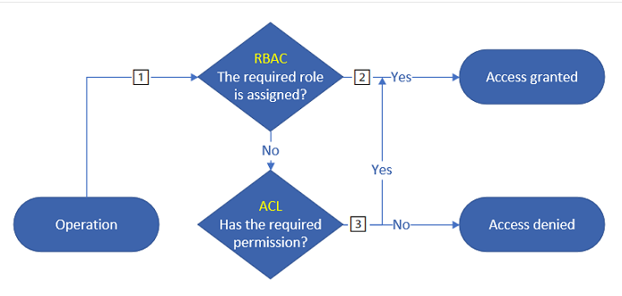
Enable a cross-functional team to discover data assets within a datalake (Cont.).
The system always evaluates Azure role assignments first, and if the assignment grants sufficient access permission, ACLs are ignored.
Security groups : always use Azure AD security groups as the assigned principal in an ACL entry. Avoid direct role assignment to individual users or service principals.

