Slide 1

Automotive Robotics
India Pvt. Ltd.
J1939 Protocol
Prepared By: Jeevan Kishore Kuruba
Presented By: Jeevan Kishore Kuruba
31/05/08
Property of Automotive Robotics India Pvt. Ltd.

Slide 2
INTRODUCTION
J1939 is a high speed communications network designed to support real-time closed loop control functions between ECUs which may be physically distributed throughout the vehicle.
The J1939 protocol comes from the international Society of Automotive Engineers (SAE) and works on the physical layer with CAN-highspeed (J1939 is built on CAN)
The SAE J1939 protocol was defined for use in commercial vehicles, but it is also used in ships, rail-bound vehicles, agricultural machinery and large generators.
31/05/08
Property of Automotive Robotics India Pvt. Ltd.

Slide 3
J1939 Overview
J1939 uses the CAN protocol which permits any ECU to transmit a message on the network when the bus is idle.
Collisions are avoided due to the arbitration process that occurs while the identifier is transmitted
Permits high priority messages to get through with low latency (delay) times because there is equal access on the network for any ECU
When multiple ECUs are simultaneously attempting to transmit, the highest priority message prevails.
The speed is nearly always 250 Kbit/s
31/05/08
Property of Automotive Robotics India Pvt. Ltd.

Slide 4
Message Format and Usage
J1939 provides a complete network definition using the 29 bit identifier (CAN Extended Frame) defined within the CAN protocol
J1939/21 enables 11 bit identifier (CAN Standard Frame) devices to be used within the same network, defining all messages as proprietary, permitting both device types to coexist without interference
The 11 bit identifier definition is not directly a part of J1939 but is included to assure that users of it can coexist on the same network without conflict.
31/05/08
Property of Automotive Robotics India Pvt. Ltd.

Slide 5
Message
A “message” is equivalent to one or more “CAN Data Frames” that have the same Parameter Group Number. For instance the information related to a single Parameter Group Number to be transferred on the bus may take several CAN data frames.
Messages defined by the J1939 standard are intended to be broadcast.
The data is transmitted on the network without a specific destination.
Any device can use the data without requiring additional request messages.
Allows future software revisions to easily accommodate new devices
When a message must be directed to a particular device, a specific destination address can be included within the message identifier.
31/05/08
Property of Automotive Robotics India Pvt. Ltd.

Slide 6
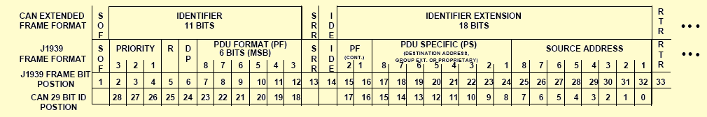
Message Format
The first 3 bits of the 29 bit identifier are used for determining message priority during the arbitration process.( A value of 000 has the highest priority)
The next bit of the identifier (R) is reserved. (The bit should be set to 0 for transmitted messages.)
The next set of 9 bits in the identifier is the Data Page (DP) bit and PDU Format (PF) field.(PDU stands for Protocol Data Unit )
31/05/08
Property of Automotive Robotics India Pvt. Ltd.

Slide 7
  The DP bit is used as a page selector.
  The PF field identifies one of two PDU formats able to be transmitted.
The SRR and IDE bits are entirely defined and controlled by CAN
The next 8 bits of the identifier are PDU Specific (PS), meaning that they are dependent on the value of the PF
The last 8 bits of the identifier contain the address of the ECU transmitting the message (Source Address)
31/05/08
Property of Automotive Robotics India Pvt. Ltd.

Slide 8
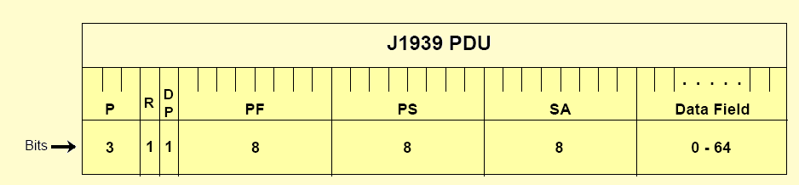
Protocol Data Unit (PDU)
In layered systems, a unit of data that is specified in a protocol of a given layer and that consists of protocol-control information of the given layer and possibly user data of that layer
The Applications and/or Network Layer provide a string of information that is assimilated into a protocol data unit.
It provides a framework for organizing the information that is key to each CAN Data Frame that will be sent.
There is only one PDU per CAN data frame
31/05/08
Property of Automotive Robotics India Pvt. Ltd.

Slide 9
It consist of seven fields.
  Priority, reserved, data page, PDU Format, PDU specific, source address, and data fields.
PRIORITY (P)
  These three bits are used to optimize message latency for transmission onto the bus only.
The priority of any message can be set from highest, 0 (000)2, to lowest, 7 (111)2.
RESERVED BIT (R)
  This bit is currently reserved for future use by the SAE.
31/05/08
Property of Automotive Robotics India Pvt. Ltd.

Slide 10
DATA PAGE (DP)
  The data page bit selects an auxiliary page of Parameter Group descriptions.
    Page 0 contains all the messages which are presently being defined.
    Page 1 provides additional expansion capacity for the future
PDU FORMAT (PF)
  The PDU Format is an 8-bit field that determines the PDU format and is one of the fields used to determine the Parameter Group Number assigned to the data field.
31/05/08
Property of Automotive Robotics India Pvt. Ltd.

Slide 11
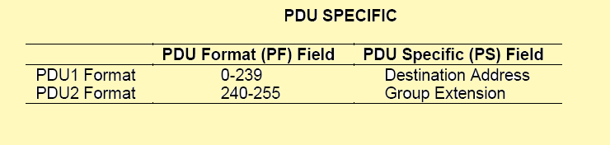
PARAMETER GROUP NUMBER (PGN)
Whenever it is necessary to identify a Parameter Group in the data field of a CAN data frame, it will be expressed in 24 bits.
The Parameter Group Number is a 24 bit value that has the following constituent components: Reserved bit, Data Page bit, PDU Format Field (8 bits), and Group Extension Field (8 bits).
31/05/08
Property of Automotive Robotics India Pvt. Ltd.

Slide 12
  Parameter Group Numbers will be used to identify or label commands, data, some requests, acknowledgments, and negative-acknowledgments.
  If there is more information than will fit in 8 data bytes then a multipacket message will need to be sent
  The definition of two proprietary Parameter Group Numbers has been established allowing both PDU1 and PDU2 formats to be used.
Multipacket Messages — A type of J1939 message which is used when more than one CAN data frame is required to transmit all data specific to a given Parameter Group Number. Each CAN data frame will have the same identifier but will contain different data in each packet.
31/05/08
Property of Automotive Robotics India Pvt. Ltd.

Slide 13
PDU SPECIFIC (PS)
  This is an 8-bit field and its definition depends on the PDU format.
    If the value of the PDU Format (PF) field is below 240, then the PDU specific field is a destination address.
    If the value of the PF field is 240 to 255, then the PDU Specific field contains a Group Extension (GE) value.
  Destination Address (DA)
    This field defines the specific address to which the message is being sent. (The global destination address (255) requires all devices to listen and respond accordingly as message recipients.)
31/05/08
Property of Automotive Robotics India Pvt. Ltd.

Slide 14
  Group Extension (GE)
    The Group Extension field, in conjunction with the four least significant bits of the PDU Format field provide for 4096 Parameter Groups per data page
    These 4096 Parameter Groups are only available using the PDU2 Format.
    240 Parameter Groups are provided in each data page for use only in the PDU1 Format.
    In total, 8672 Parameter Groups are available to be defined using the two data pages currently available.
31/05/08
Property of Automotive Robotics India Pvt. Ltd.

Slide 15
SOURCE ADDRESS (SA)
  The Source Address field is 8 bits long. There shall only be one device on the network with a given source address.
DATA FIELD
  Data from 0 to 8 Bytes
    When eight or less bytes of data are required for expressing a given Parameter Group then all 8 data bytes of the CAN data frame can be used.
  Data Up to 1785 Bytes
    When up to 1785 data bytes are needed to express a given Parameter Group the communication of this data is done in multiple CAN Data Frames.(the term multipacket is used to describe this type of Parameter Group Number)
31/05/08
Property of Automotive Robotics India Pvt. Ltd.

Slide 16
Addresses and NAME
Each ECU on the network will have at least one name and one address associated with it.
Each ECU must have a Unique NAME (64 bit)
Unique Address for each ECU within a specific network(8 bit)
The address of an ECU defines a specific communications source or destination for messages
The name includes identification of the primary function performed at that address
As many as 254 different ECUs of the same function can coexist on the network, each identified by their own address and name.
31/05/08
Property of Automotive Robotics India Pvt. Ltd.

Slide 17
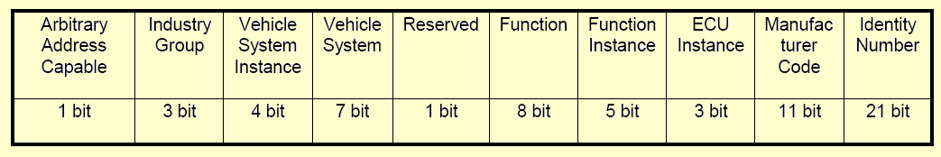
Structure of the Name
NAMEs identify the primary vehicle function or functions which an ECU performs and uniquely identify each ECU
But with a length of 64 bits, a NAME is inconvenient to use in normal communications. Therefore, once the network is fully initialized, each ECU utilizes an 8 bit address as its source identifier or “handle” to provide a way to uniquely access a given ECU on the network.
31/05/08
Property of Automotive Robotics India Pvt. Ltd.

Slide 18
Communication Methods
Three primary communication methods exist within J1939 and appropriate use of each type allows effective use of the available Parameter Group Numbers.
  Destination specific communications, using PDU1 (PF values 0 – 239)
  Broadcast Communications using PDU2 (PF values 240 - 255)
  Proprietary Communications using either PDU1 or PDU2 format
31/05/08
Property of Automotive Robotics India Pvt. Ltd.

Slide 19
Destination specific Parameter Group Numbers are needed where the message must be directed to one or another specific destination and not to both.
Broadcast Communications apply in several situations, including:
  Messages sent from a single or multiple sources to a single destination
  Messages sent from a single or multiple sources to multiple destinations
Broadcast Communications cannot be used where a message must be sent to one or another destination and not to both.
Proprietary communications, is provided by the use of two proprietary Parameter Group Numbers
31/05/08
Property of Automotive Robotics India Pvt. Ltd.

Slide 20
This allows for two functions.
  A specific source can send its proprietary message in a PDU2 type format (broadcast).
  It allows for situations where a service tool must direct its communication to a specific destination out of a possible group of ECUs.
Proprietary communications are useful in two situations:
  Where it is unnecessary to have standardized communications
  Where it is important to communicate proprietary information
31/05/08
Property of Automotive Robotics India Pvt. Ltd.

Slide 21
Transmitting Messages
To send a particular data item, a message must be constructed by properly filling each of these fields i.e. The 6 bit control field, a data field (which is typically 8 bytes), and CRC, ACK, and EOF fields
Parameter Groups which have more than eight bytes of data must be sent as multipacket messages
  The two ways of transmitting multi-packet messages:
1. Broadcast Announce Message
      All devices on the network will receive these messages
2. Connection Management
      Sent point to point between two devices
31/05/08
Property of Automotive Robotics India Pvt. Ltd.

Slide 22
Receiving Messages
There are various techniques (and chips) available for capturing selected messages off the network
  If a message is a destination specific request or command, the device must determine if the destination address matches an address claimed by the device. If there is a match, the receiving device must process the message and provide some type of acknowledgment.
  If a message is a global request, every device, even the originator, must process the request and respond if the data is available.
  If a message is broadcast, each device must determine if the content is of relevance or not.
31/05/08
Property of Automotive Robotics India Pvt. Ltd.

Slide 23
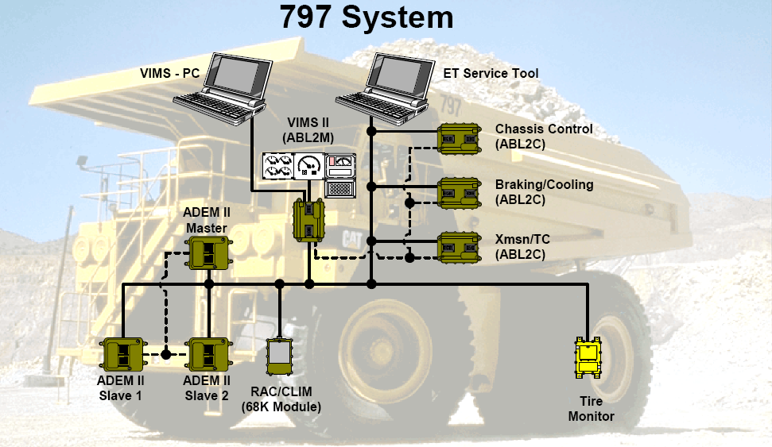

CAN (SAE J1939) Example: Caterpillar 797
+ 195 sensors and actuators
+ wireless data link
31/05/08
Property of Automotive Robotics India Pvt. Ltd.

Slide 24
Applications
It is a worldwide serial data bus communication standard for truck, bus, off-road, construction, and marine vehicle applications
It is a control and information data bus that supports critical safety-related systems and subsystems on heavy-duty tractors, trucks, converter dollies, and trailers
  Safety-critical systems currently in production that utilize (or have the potential to utilize) the J1939 network include engines, transmissions, drive slip control (subset of antilock brake systems), collision avoidance, and lane guidance systems.
One of the most important potential applications of the J1939 data bus will be the next generation of brake systems, known generically as electronically controlled brake systems (ECBS)
31/05/08
Property of Automotive Robotics India Pvt. Ltd.

