Slide 1
Python Programming Language
Name: Ahamad Shaik
Title: Python Training
Date:

Slide 2
Agenda
Introduction of Python
Data Types
Conditions and Loops
Modules and Functions
Oops
Exception handling
Files
UI Design development
ING

Slide 3
Introduction of Python
Python was developed by “Guido Van Rossum”.
Python is powerful programming language for general purpose programming.
Generally used for scripting purpose
Python is used for ''Automation of tasks'‘ by writing Scripts.
Python is used in embedded domain, medical domain, image processing, etc.
Python is a "compiled interpreted language".
Python provides high code readability by using techniques like ''Indentation''.
ING

Slide 4
Python Interaction
There are two ways to interact with Python
Immediate Mode (command line based).
Script Mode (GUI Based).
In python (>>>) and (…) indicates taking input.
(remaining all indicates output in python).
NOTE : for input and output python provides functions like input() and print().

Slide 5
Target code Generation Process
Python source file having extension(.py)
ex: “file_name.py”
source file compiled by compiler and Produces a file with (.pyc ) extension file. it's also called as compiled sourcefile.it contains intermediary code which is known as “BYTE CODE”.
ex: “file_name.pyc”
BYTE CODE will Processed by INTERPRETER and produces "TARGET CODE" file with an .pyo extension.
ex: “file_name.pyo”

Slide 7
Use source file
Write a 1st program Print Hello
Simply the program is
>>> print “ Hello World!”
OR
>>> print 'Hello World!'
After that save it as hello.py
.PY as Extension for Python

Slide 8
Inputs:
a = input(“Enter Data”)
a = raw_input(“Enter Data”)
Outputs:
print a, ‘\n’, type(a)
Code Comment:
#
New line:
\n

Slide 9
Data Types
Data Types in Python:1)Mutable 2)Immutable
Numbers
Lists
Tuple
Dictionary
Strings
Note : In python no need to define a variable as in like other programming languages (C/C++), and there is no data type for variable.

Slide 10
Numbers
int
long
float
complex
bool
Ex: var = 25
var = 12345678912
var = 1.2
var = 1j
var = True or False

Slide 11
List
List functionality is same as like linked list and it's representation is same as like array.
List is Mutable in nature.
In List insertion order is preserved and Duplicates are allowed.

Slide 12
List Rules
Using Square Brackets [] we can represent the elements in list.
We can access elements in the list by using index.
Unlike C python checks size bound strictly.
If it violates leads to "index error".
Backward traversing done through negative index of a list i.e. from -1 position.

Slide 13
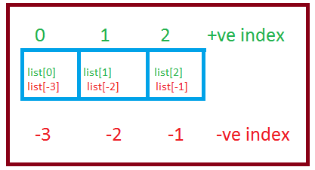

Slide 14
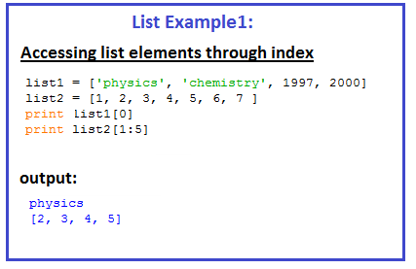
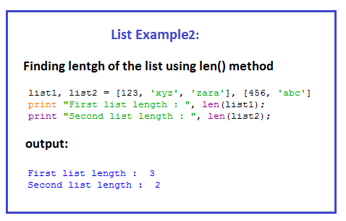

Slide 15
Tuple
Tuple is Immutable.
In the tuple elements can be mutable or immutable.
Using Parenthesis () we can represent the elements
in the tuple. Ex : tup = (5,2.5,"String",False).
Elements in the tuple can be access same as like list.

Slide 16
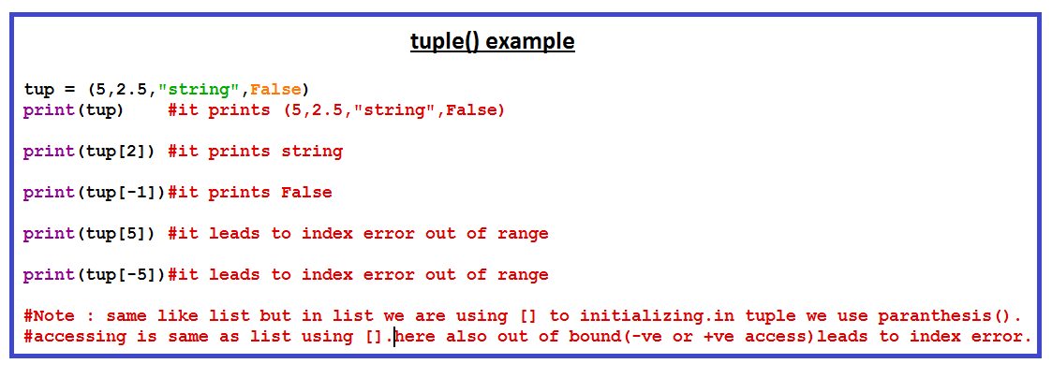

Slide 18
Dictionary
Dictionary is a collection of key value pairs.
Each key seperated by a colon (:)
Items are seperated by commas
Whole dictionary enclosed with curly braces
{'key': value } → ex : {'nine',9}.
key is immutable.
Value is mutable.
Duplicate key's and values are allowed but it will take latest one.

Slide 19
Programming Examples:
dict = {'Name': 'Zara', 'Age': 7, 'Class': 'First'}
print "dict['Name']: ", dict['Name']
dict['Age'] = 8; # update existing entry
print dict.keys()
print dict.items()
print dict.values()
Delete Dict:
del dict['Name']; # remove entry with key 'Name' dict.clear(); # remove all entries in dict
del dict ; # delete entire dictionary

Slide 20
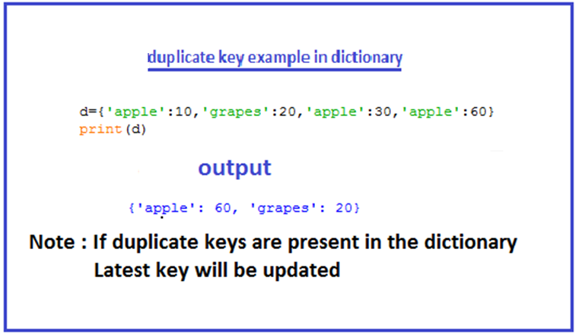

Slide 21
Strings
Strings can be represent by using single quotes or double quotes.
ex : "String" or 'string'.
In python we have multi line strings using triple quotes.
multi_line_string = """This is the 1st line.
This 2nd line.
This 3rd line. """
(or)
multi_line_string = '''This is the 1st line.
This second line.
This third line. '''

Slide 22
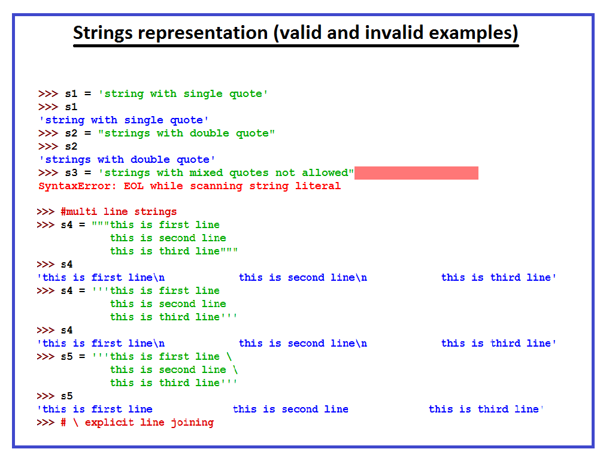

Slide 23
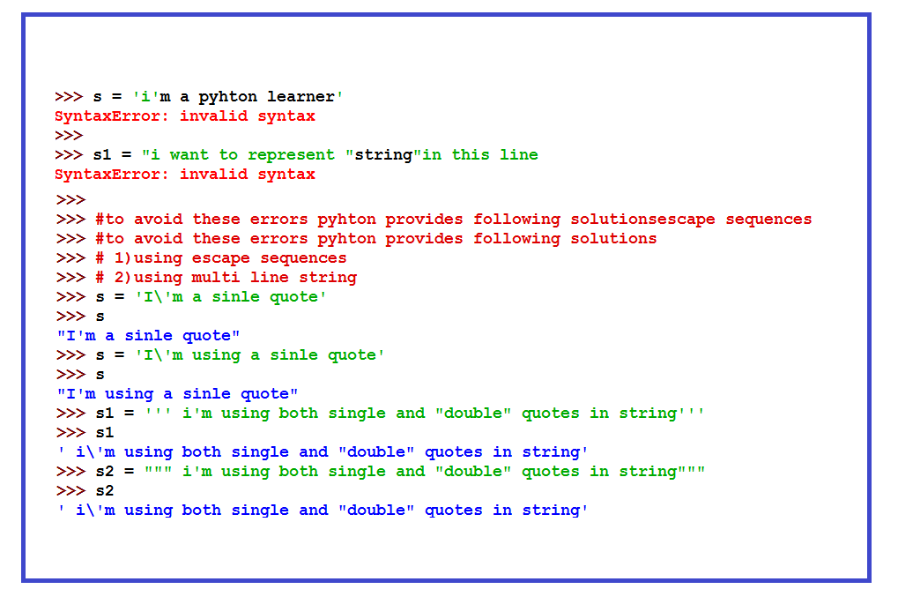

Slide 24
Operators
Arithmetic Operator
Relational Operator
Logical Operator
Bitwise Operator
Assignment Operator
Membership Operators
Identity Operators

Slide 25
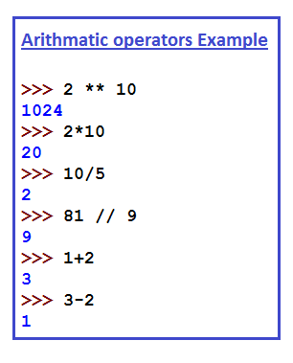
Arithmetic Operator
Exponent (**)
Multiplication (*)
Division (/)
Modulus (%)
Floor Division(//)
Addition (+)
Subtraction (-)

Slide 26
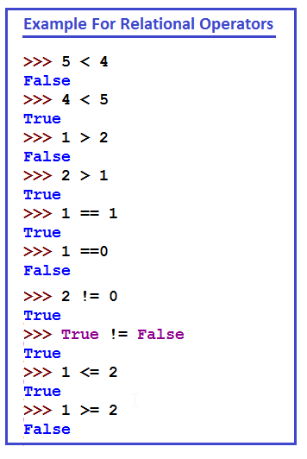
Relational Operator
Less Than (<)
Greater Than (>)
Equal to (==)
Not Equal to (!=)
Less than are Equal to (<=)
Greater than are Equal to (>=)
"The result of relational operator
is either True or False"

Slide 27
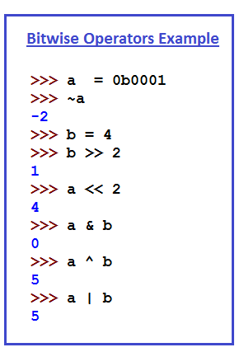
Bitwise Operator
Bitwise Tilde (~)
Bitwise Right shift (>>)
Bitwise Left shift (<<)
Bitwise AND (&)
Bitwise Exponent (^)
Bitwise OR (|)

Slide 28
Assignment Operator
Assignment ( = )
Compound Assignment
+=
-=
*=
/=
%=
//=
**=
&=

Slide 29
|=
^=
>>=
<<=
NOTE: Assigning more than one variable at a time possible in python.
Example : a, b= 5,6
a value is 5
b value is 6.

Slide 30
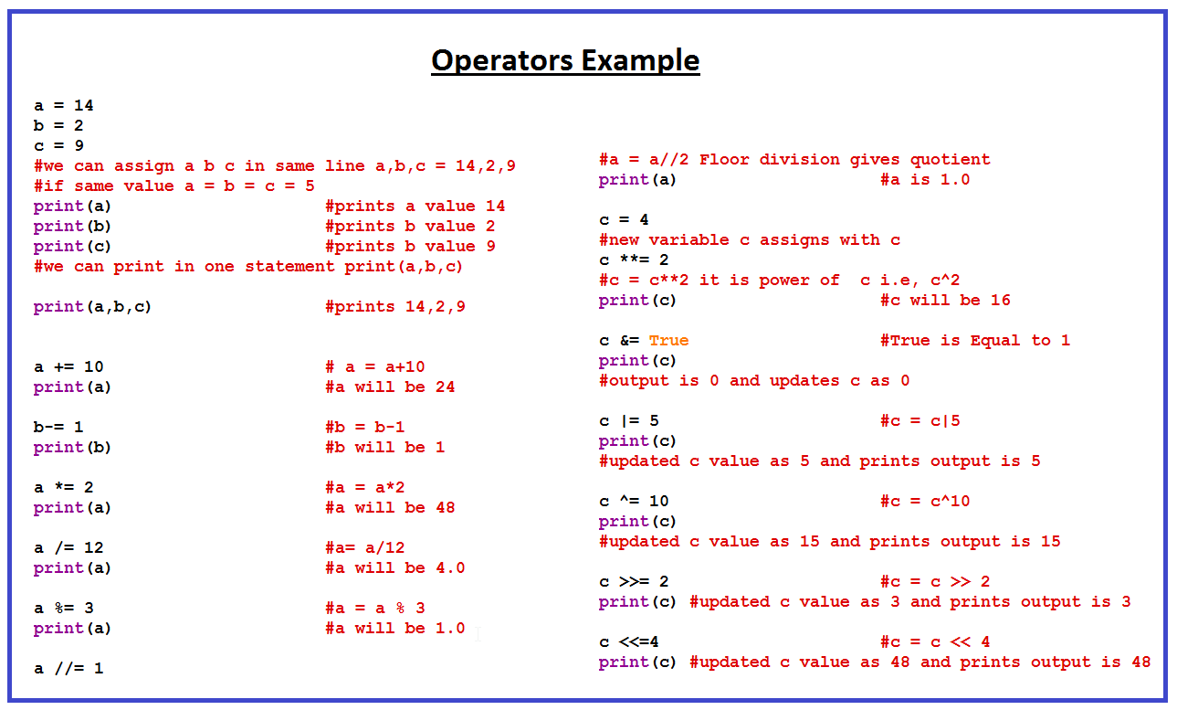

Slide 31
Membership Operator
in : Evaluates to true if it finds a variable in the specified sequence and false otherwise.
Not in : Evaluates to true if it does not finds a variable in the specified sequence and false otherwise.
Ex1: a = 10
b = 20
list = [1, 2, 3, 4, 5 ]
if ( a in list ):
print "Line 1 - a is available in the given list"
else:
print "Line 1 - a is not available in the given list"

Slide 32
Ex2: a = 10
b = 20
list = [1, 2, 3, 4, 5 ]
if ( b not in list ):
print "Line 1 - b is available in the given list"
else:
print "Line 1 - b is not available in the given list"

Slide 33
Identity Operator
is : Evaluates to true if the variables on either side of the operator point to the same object and false otherwise..
Is not : Evaluates to false if the variables on either side of the operator point to the same object and true otherwise.
Ex1: a = 10
b = 20
if ( a is b):
print “Both are same"
else:
print “Both are not same"

Slide 34
Ex2:
a = 10
b = 20
if ( a is not b ):
print “Both are not same"
else:
print “Both are same"

Slide 35
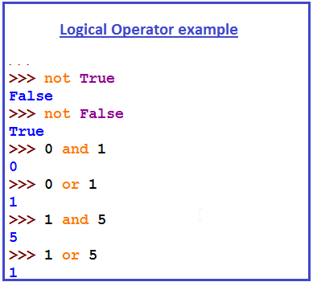
Logical Operator
Logical Not
Logical And
Logical Or
Note:
'Logical and', 'Logical or' are called as
short circuit operators.
i. In the case of AND if 1st argument
is Zero then the second statement is not executed,
ii. In the case of OR if 1st argument is not Zero then the.
second statement is not executed.

Slide 36
Flow Control
The order of execution of statements is called Flow Control
if
else
elif
while
for
NOTE : if ,elif ,else is a conditional statement, for and while are looping statements

Slide 37
if, else, elif Condition
if can be used to check condition.
If the condition is true control interpret the if body. it's false it comes through else or elif body's as follows.
There can be zero or more elif possible and else is followed by if, but else part is optional.
NOTE : In python if or any other block body identified by indentation (number of spaces), not like other languages hold block by brackets { }.

Slide 38
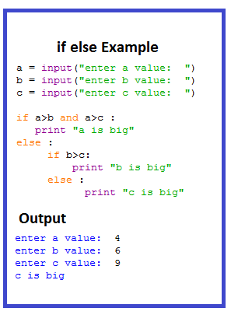
if else syntax and Example
if(test expression):
True statement
True statement
True statement
else:
False statement
False statement
False statement

Slide 39
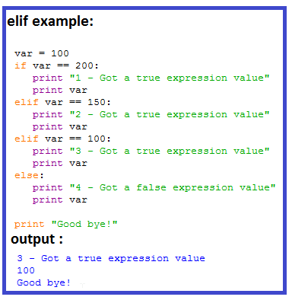
When ever if condition false then else body executes
When ever we require more than one if in a sequence with condition based elif is used.(also known as else if ladder).
There is no switch statement in python.

Slide 40
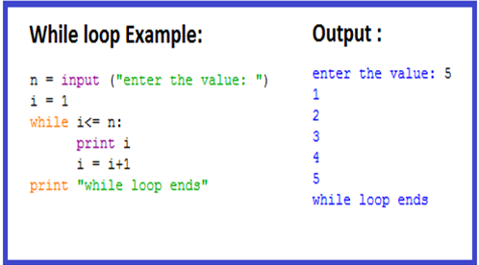
While Loop
Loops are used for iteration purpose.
while is one of the looping statement in python.
while syntax as follows:
while (iter_var):
stmts_in_while
updating_iter_var

Slide 41
Range Function
Range comes in 3 versions
range (end)
print (range(5))
‘end’ value should be positive value.
range (start , end)
start and end values either positive nor negative. start value should be less than end value.
print (range(5, 20))
print (range(-5, -2))

Slide 42
range(start , end, step)
Positive step:
print (range(10, 20, 1))
print (range(-10, -2, 2))
Negative step:
print (range(5, 0, -1))
print (range(-10, -20, -1))
NOTE: start and end values must be integer only

Slide 43
For loop
for is another looping statement in python.
for syntax as follows:
for iterating_variable in seq_range:
Ex:
1. For i in range(10)
print i
2. for letter in 'Python':
print 'Current Letter :', letter

Slide 44
Else with loop
for i in range(1,10):
if i%2==0:
print i, "is even"
else:
print i, "is odd"

Slide 45
Statements
Break: It terminates the current loop and resumes execution at the next statement, just like the traditional break statement in C
EX:
for letter in 'Python':
if letter == 'h':
break
print 'Current Letter :', letter

Slide 46
Continue: It returns the control to the beginning of the while loop.. The continue statement rejects all the remaining statements in the current iteration of the loop and moves the control back to the top of the loop.
EX:
for letter in 'Python':
if letter == 'h':
continue
print 'Current Letter :', letter

Slide 47
Pass: It is used when a statement is required syntactically but you do not want any command or code to execute, nothing happens when it executes.
EX:
for letter in 'Python':
if letter == 'h':
pass
print 'This is pass block'
print 'Current Letter :', letter

Slide 48
Functions
Functions are used to perform a specific task
Functions provides code readability.
Functions are useful for “Reusing” the code.
The code block within every function starts with a colon (:) and is indented
Syntax : def function_name([arg1],[arg2]) :
----------------------
[return object]
Note : def is a keyword followed by function_name()

Slide 49
Types of Functions
Functions with no arguments and no return value
Functions with no arguments and return value
Functions with arguments and no return value
Functions with arguments and return value
Functions with Default arguments
Functions with keywords as arguments
Packing arguments in function
Unpacking arguments in function
Lambda Expression

Slide 50
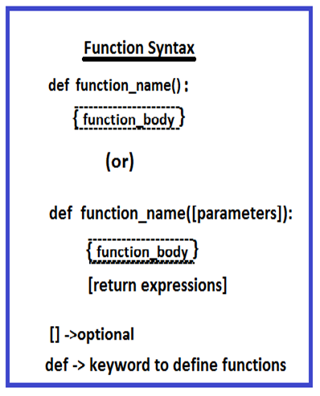
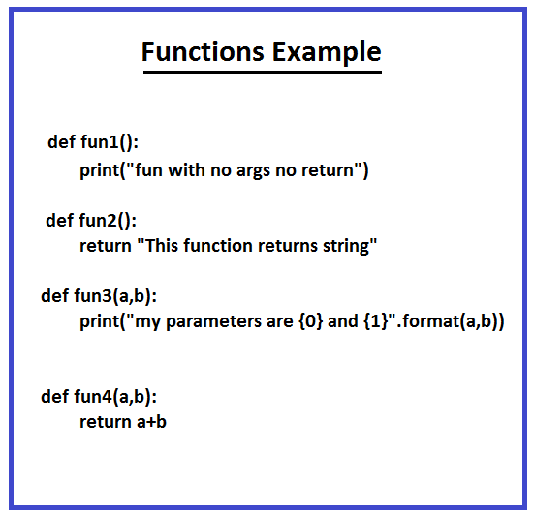

Slide 51
Default arguments
The most useful form is to specify a default value for one or more arguments. This creates a function that can be called with fewer arguments than it is defined to allow.
The default values are evaluated at the point of function definition in the defining scope.
NOTE: The default value is evaluated only once. This makes a difference when the default is a mutable object such as a list, dictionary, or instances of most classes.

Slide 52
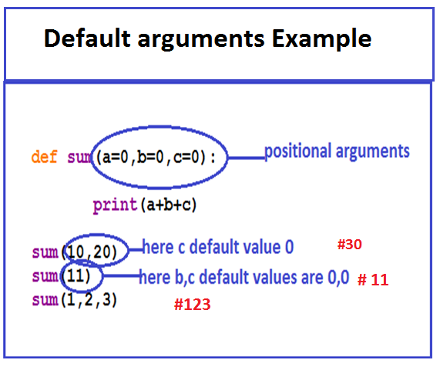
NOTE: The default value is evaluated only once. This makes a difference when the default is a mutable object such as a list, dictionary, or instances of most classes.

Slide 53
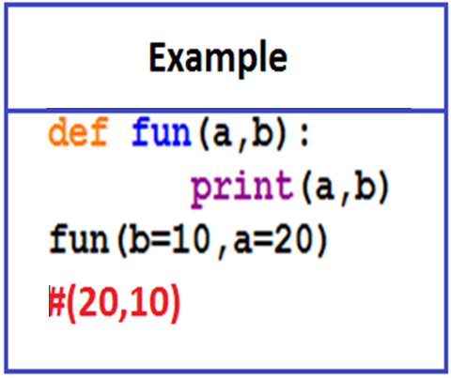
Keyword arguments
In keyword arguments we
can change the positional
arguments.

Slide 54
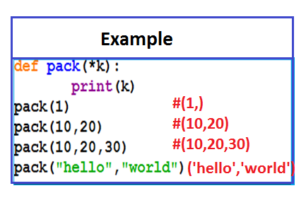
Packing arguments
For printing more parameters at at a time we are using packing arguments.
For packing the arguments ‘*’ symbol is used and it indicates it will take any number of variables.
In the argument list having only one argument then “ , ” will be appear at the end of argument.

Slide 55
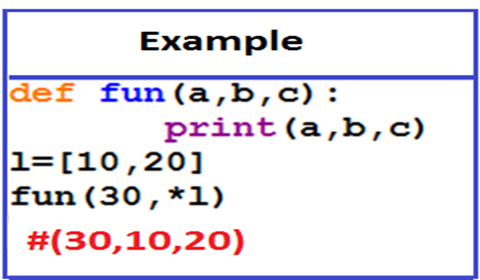
Unpacking arguments
when the arguments are already in a list or tuple but need to be unpacked for a function call requiring separate positional arguments for that we need to unpack the list.

Slide 56
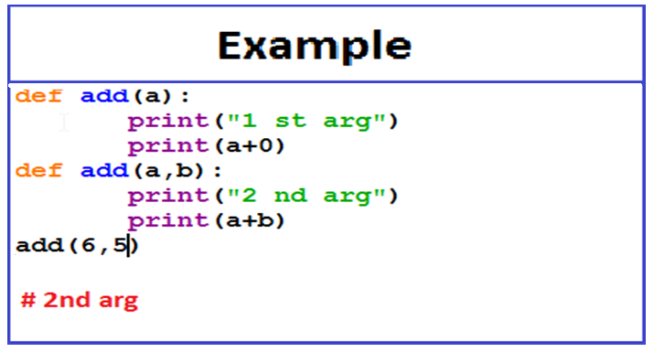
Function Overriding
If we are trying to do function over loading it will considered as function overriding.
Note: If the two functions having same name it will consider
'latest version'.

Slide 57
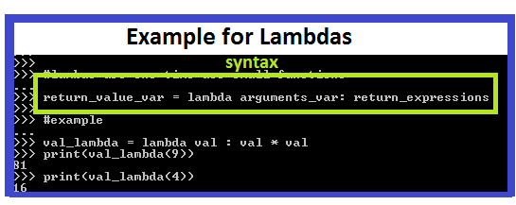
Lambdas
Lambda or Anonymous expressions also called as 'lambda forms'.
Lambda functions are simple one line functions.
Lambda functions are anonymous(i.e. no name functions).
created by using lambda keyword.
There is no return statement in lambda expression.

Slide 58
Import statement
Import in python is similar to Header file inclusion in C.
import is a keyword which is used to add modules or packages or functions to current working directory.
Modules contains set of functions.
Generally module is .py file.
Packages are set of Modules.
Packages may have Sub Packages also.
Importing done only at once.

Slide 59
Modules
Module is a group of scripts.
Modules gives flexibility to perform operations depends on attributes.
Modules are useful to perform tasks easily.
modules are executed only when ever it imports.
(i.e. by using import Keyword).

Slide 60
Import functionality
Import first search in current working directory, if not present it searches in system path.
It also searches the added depended path. We can append customized library path using sys.path variable.
Ex:
import sys
print sys.path
To append path:
sys.path.append("C:\\Users\\ashaik\\Desktop")

Slide 61
help(argument)function give Description of passing argument.
Example :
help(' modules ') gives list of available modules.
help(' time ') gives details about time modules.
To import the specific module in our code:
Ex:
import modulename

Slide 62
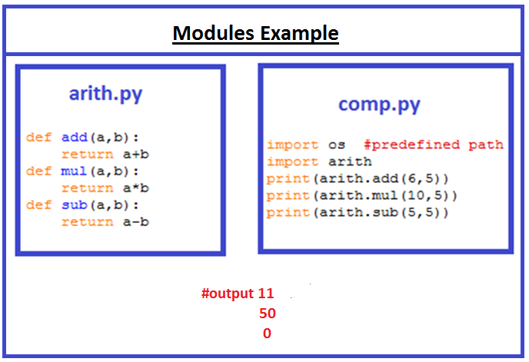

Slide 63
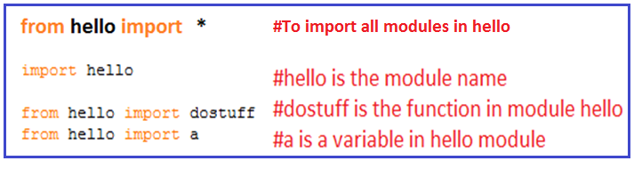
From import
There are three ways to import
By name of the functions
every thing in the module using *
every thing in the module using module_name

Slide 64
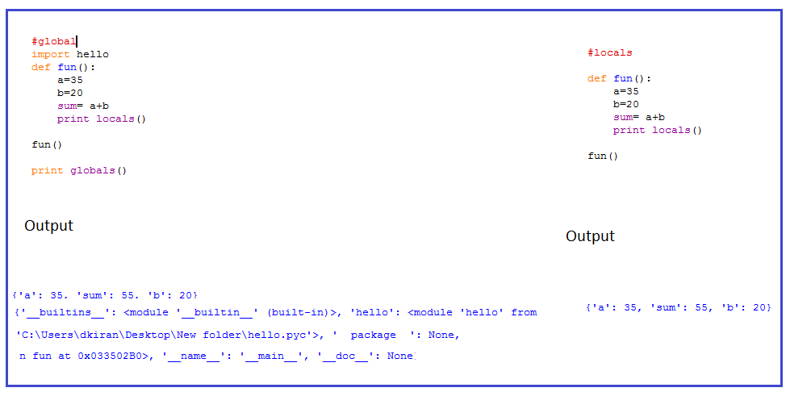
Global() and Local()

Slide 65
Import multiple files
We can access or import the modules from the different files
Ex: module1.py
def fun2():
print "func2“
hello.py
import module1
def fun():
print "Python"
Module2.py
import sys
sys.path.append("C:\\Users\\ashaik\\Desktop")
import hello
print hello.module1.fun2()

Slide 66
Import multiple files in single file and extract the modules from that file.
Ex: init.py
import hello
import test_1
import test_10
Module1.py
import init
init.hello.fun()
a = init.test_1.add(1,2)
print a

Slide 67
Oops
Terminology in OOPs
class
Object
Method
Abstraction
Inheritance
Polymorphism
Encapsulation
NOTE: oops principles such as abstraction, inheritance, polymorphism, encapsulation, provides flexibility to create our own Classes and Methods.

Slide 68
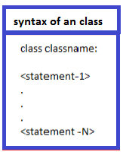
Class
Class is a logical entity (or) virtual representation of members .In simple words class is a template/Blueprint of an object.
Class members can be set of variables and functions.
Class describes the abstract characteristics of an Object.
By creating object we can
access variables & methods.

Slide 69
Object
Object is an entity it specifies behavior, identity.
Each object is having attributes and methods.
Object is an existence entity of an class, also called as instance of a class.
New object is created with class name followed by set of parentheses().
Here in this example newclass
is the object of Myclass.
Ex:
Class Myclass:
i = 10;
Ob = Myclass()

Slide 70
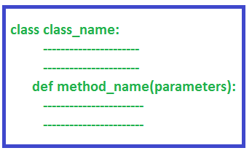
Method
Method is a function that is associated with an object .
In python method is not unique to class instants.
Each object inside the class is having methods .
We can Invoke the static
method by using classname.
Ex:classname.methodname()

Slide 71
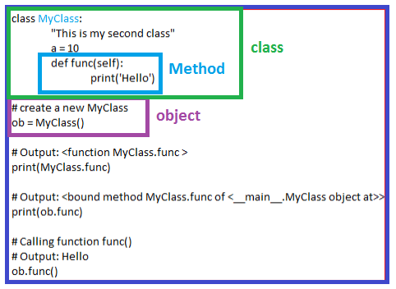

Slide 72
Constructor
Constructor is a function which is invoked automatically when an object is created.
In python constructors are created using "__init__" method
This method always take "self" as the first argument which is reference to the object being initialized. Other arguments can also be passed after "self".
The purpose of the constructor is to initialize the object
syntax for constructor:

Slide 73
Destructor
It is a function which is invoked automatically when an object is destroyed .
The purpose of this destructor is to perform the clean up operations like socket closing, file closing ,database closing, etc.

Slide 74
class Test:
def __init__(self):
self.l = [10,20,30]
self.x = 10
self.y = 20
def __del__(self):
print("Distructor")
## self.x
## self.y
## self.l
t1 = Test()
t1.fun()
del t1
##del t1.x
##print t1.x

Slide 75
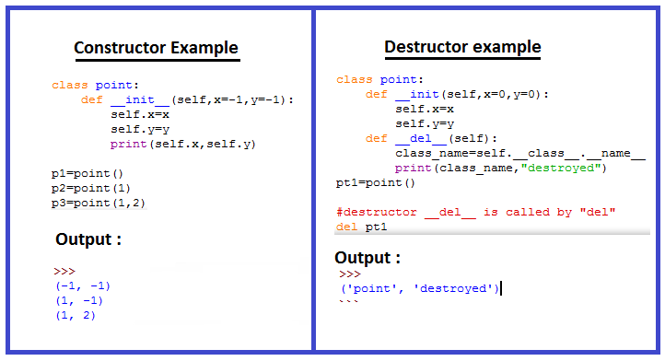

Slide 76
Abstraction
Hiding the internal data and show only functionalities.
For hiding any internal data double underscore ''__''
symbol is used.
Variables can be private which can be useful on many occasions. A private variable can only be changed within a class method and not outside of the class.
Accessing the hidden variable will leads to error.

Slide 77
EX:
class Test:
a = 10
__b = 20
def fun(self):
print(self.a + self.__b)
t1 = Test()
t1.fun()
print t1.a
print t1.__b

Slide 78
Encapsulation
Binding up of a data and functions into single unit is called Encapsulation.
Encapsulation restrict the accessing of private 'variables' and 'Functions' .
This is needed for prevent the data being modified accidently.

Slide 79
Ex:
class Test:
a = 10
def fun(self):
self.__Encap()
def __Encap(self):
self.b = 20
print self.b
print 'Encapsulation Method'
t1 = Test()
t1.fun()
##t1.__Encap() #not accesible from object.

Slide 80
Polymorphism
The term polymorphism refers to many forms.
It is the ability of an object to adapt the code to the type of data processing.
it helps us to define action regardless to type of an object.
In polymorphism we can call the same method name parameter and depending on the parameter it will perform different functionality.

Slide 81
Ex:
class Bear():
def sound(self):
print "Groarrr"
class Dog():
def sound(self):
print "Woof woof!"
def makeSound(animalType):
animalType.sound()
bearObj = Bear()
dogObj = Dog()
makeSound(bearObj)
makeSound(dogObj).

Slide 82
Inheritance
Accessing the properties from one class to another class
is known as Inheritance.
The new class is called derived (or child) class and the one from which it inherits is called the base (or parent) class.
Derived class can acquire properties of Base class but not vice versa.
Inheritance provides features like code reusability, method overriding .

Slide 83
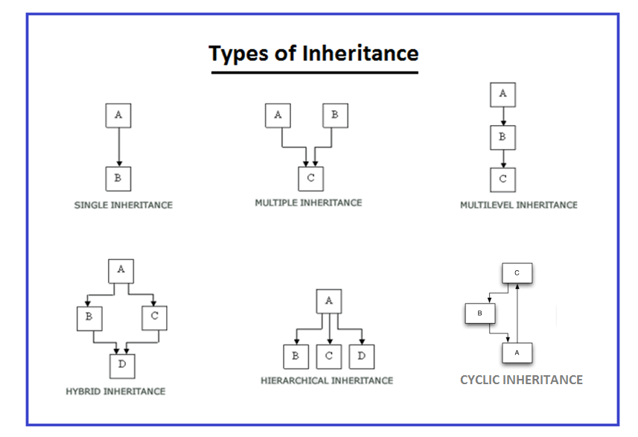

Slide 84
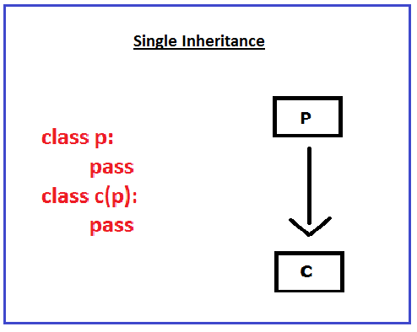

Slide 85
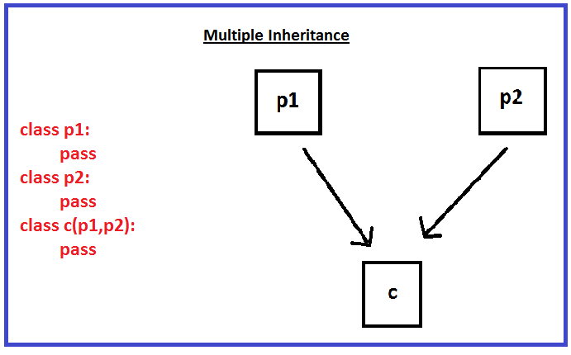

Slide 86
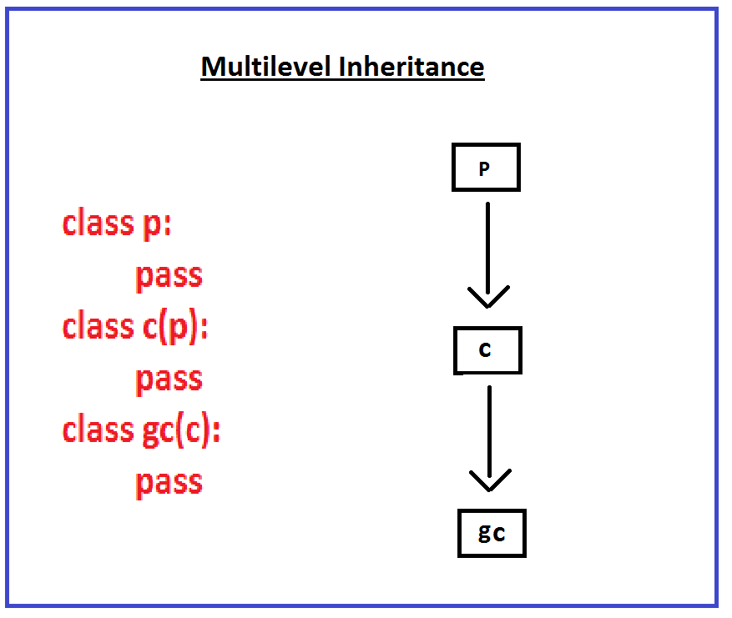

Slide 87
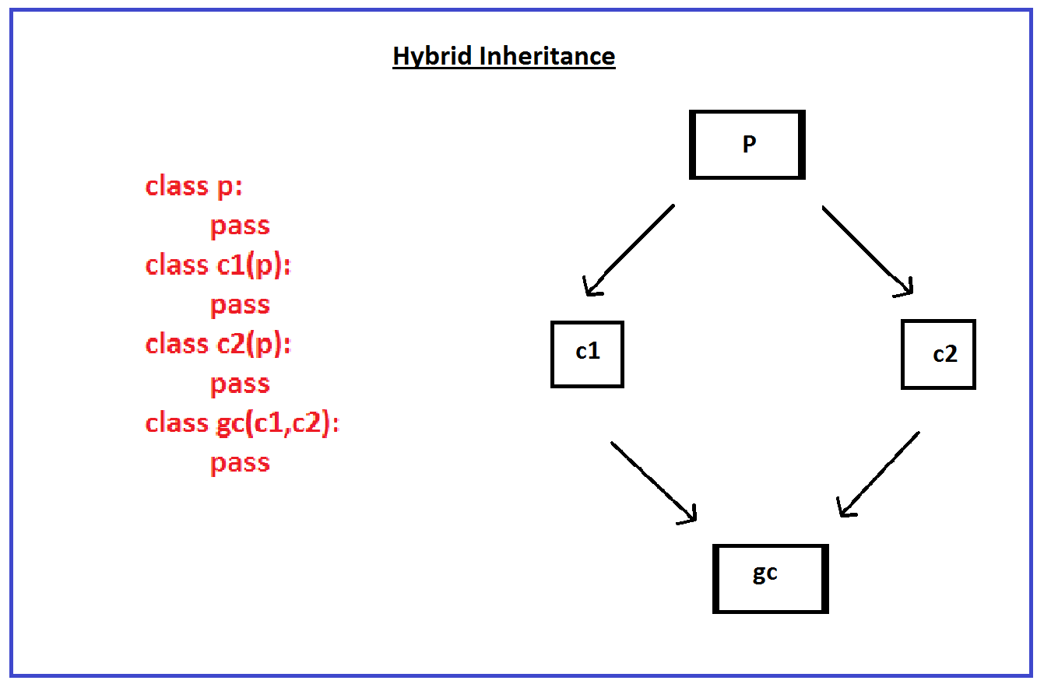

Slide 88
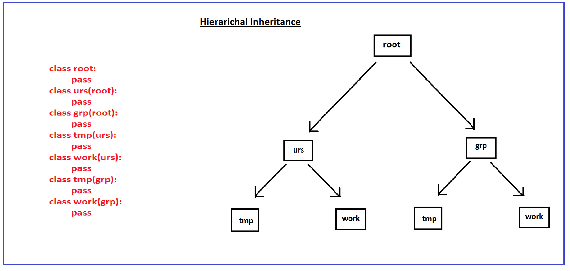

Slide 89
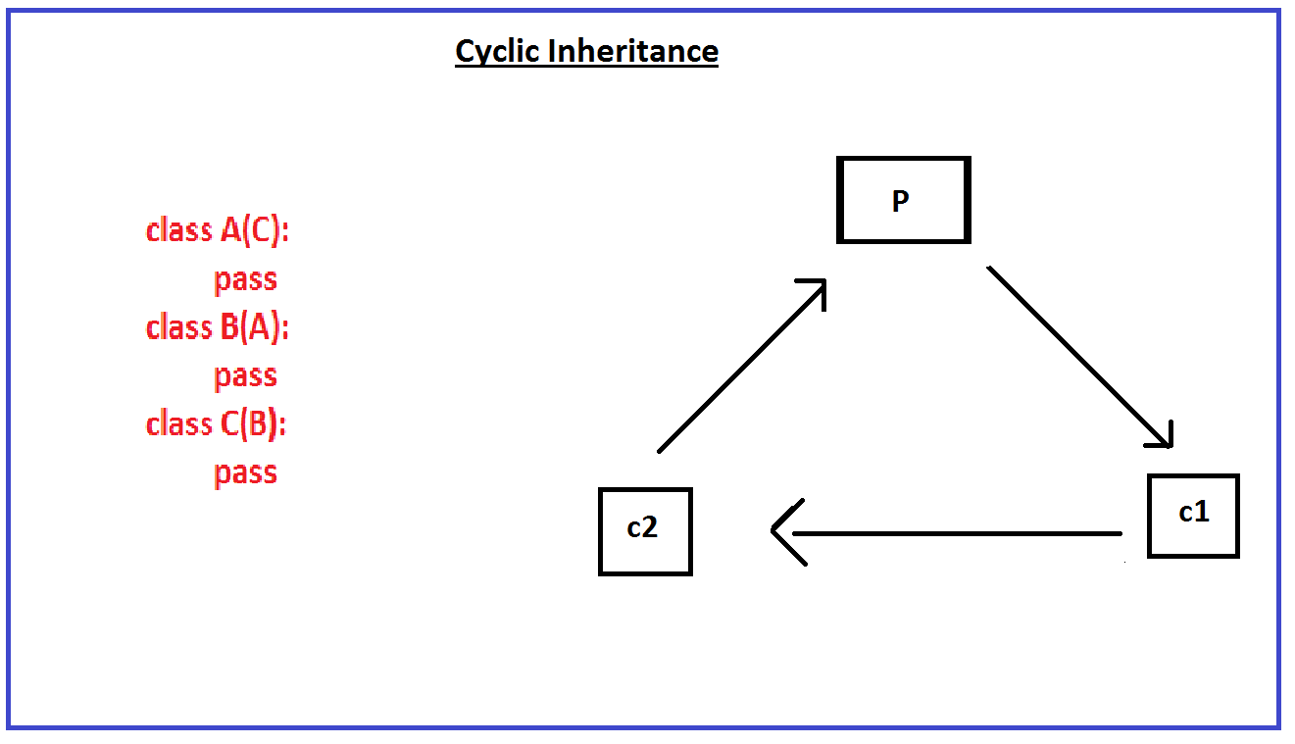

Slide 90
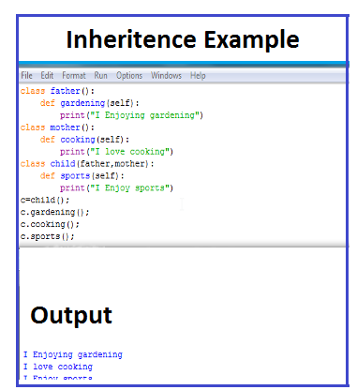

Slide 91
Dynamic Polymorphism
Function overriding is called “Dynamic Polymorphism”
Ex:
class ParentClass(object):
def test(self):
print 'Im in parent class'
class ChildClass(ParentClass):
def test(self):
super(ChildClass,self).test()
print "hi"
x = ChildClass()
x.test()

Slide 92
Exception Handling
An exception is an unwanted event, which occurs during the execution of a program that disrupts the normal flow of the program's instructions.
It provides an alternate way of providing grace full termination.
when an exception is occurred python interpreter is going to give following statements,
line at which exception is occurred
name of the exception
description of exception.

Slide 93
keywords to handle exceptions are
try
except
Finally
when we are using try we need except.
try syntax:
try:
risky code
except :
provides an alternate solution

Slide 94
try vs finally
finally block is always executed irrespective of whether an exception is handled or not
finally syntax :
finally:
cleaning code is used in finally block.
releasing the resources.
Note: for try we need either finally or except or both.
after except we can write finally.

Slide 95
Errors/Exception
which type of errors occur in python normally???
(after that how exception’s handled in python is follows)
zero division error : Divide with zero leads this.
keyboard interrupt error : aborting current execution.
type error : Invalid operations between
different types.
Io error : Invalid i/o operations leads this.
name error : undefined types leads this.

Slide 96
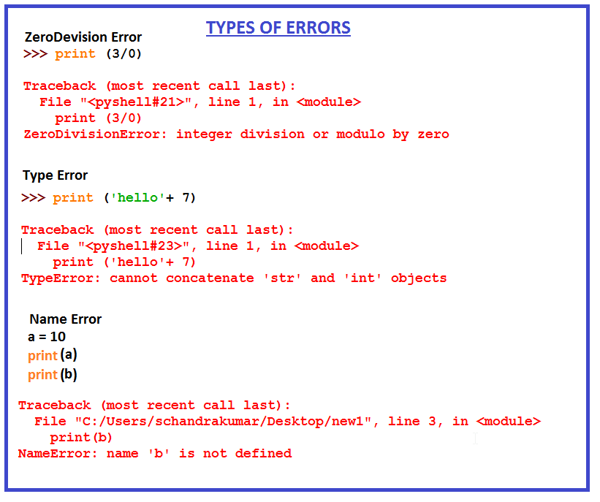

Slide 97
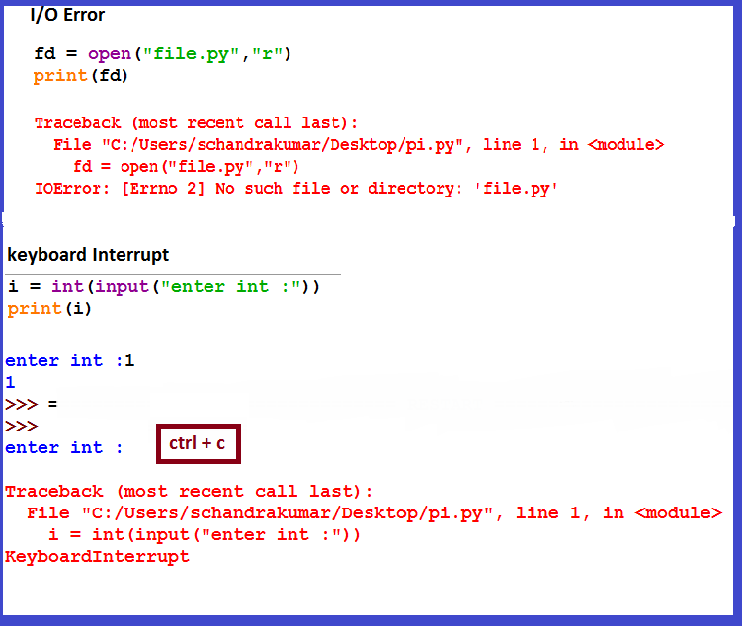

Slide 98
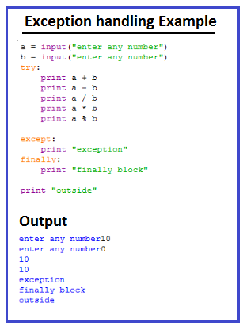

Slide 99
Files
Files are used to save data in local drive
(i.e. in non-volatile - memory).
File handling concept provides flexibility to create
new files (or) modify data in existing files using modes.
modes can be read(r) ,write (w),append (a),
readplus(r+),writeplus(w+)etc.

Slide 100
Create new file:
fo = open(filename, accessing mode)
fo = open("foo.txt", "w")
Write : To write data into file
fo.write( "Python is a programming language\n");
Read : To read the data from file
fo = open("foo.txt", “r")
str = fo.read(12);
print str
Position: To check the current position of file pointer
position = fo.tell();
seek: To reset the file position
position = fo.seek(0, 0);
close: To close the opened file
fo.close()

Slide 101
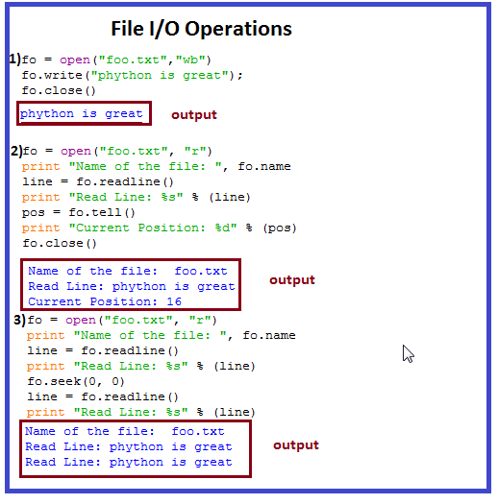

Slide 102
Read & Write in html
Create html file:
f = open('helloworld.html','w')
Write:
f.write("Hello Python!")
Read
f = open('helloworld.html','r')
fo = f.read()
print fo
f.close()

Slide 103
Read & Write in Excel
To Create Excel file we need to import the module openpyxl and Workbook
To create work book call the below module
book = Workbook()
To create work book shets call the below module
sheet = book.active
To write data into shets
sheet[‘A1’] = 10
sheet[‘A2’] = 20
To save the write
book.save("sample.xlsx")
To Read the data
book = openpyxl.load_workbook('sample.xlsx')
a1 = sheet['A1']
print(a1.value)
Reference: http://zetcode.com/articles/openpyxl/

Slide 104
Debugging
Debugging is a technique used to enhance the unexpected behavior in code or errors in code.
Generally we are having two types of debuggers those are i)Hardware Debuggers ii)Software Debuggers.
Now we are using software Debugger called PDB(python Debugger).

Slide 105
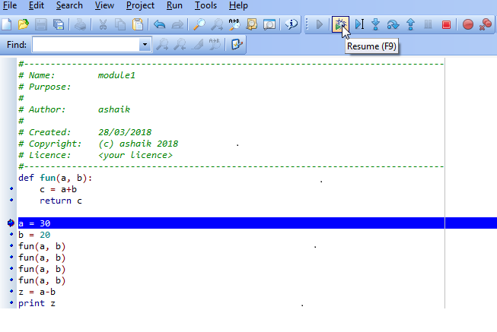
Debugging Process
Set the break point where you observed the issue or need to start debugging.
To enter into debug mode click F9 or debug button

Slide 106
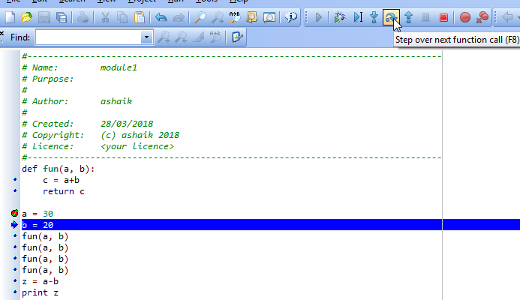
Click on the Step over next statements or F8 to go to next statements.

Slide 107
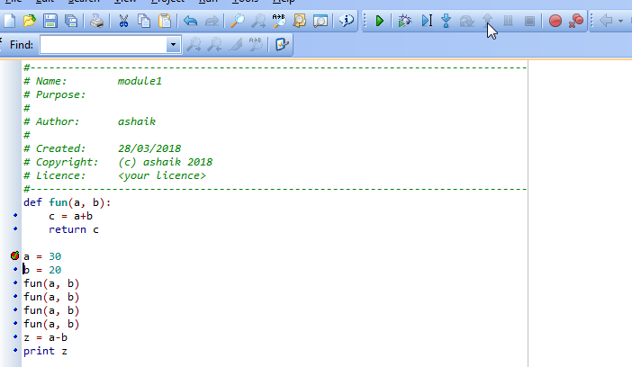
Click on step out or shift +F8 to go to next break point or come out from execution

Slide 108
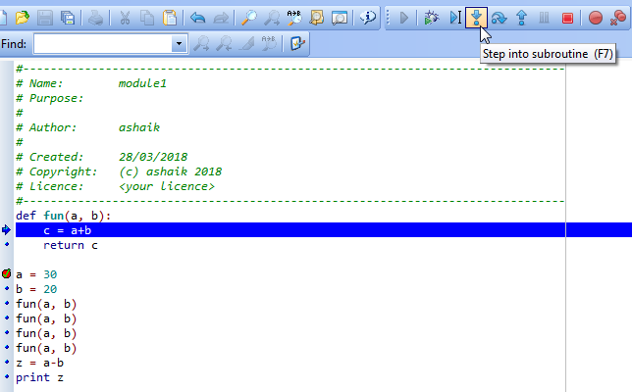
Click on step into subroutine or F7 to enter inside the function

Slide 109
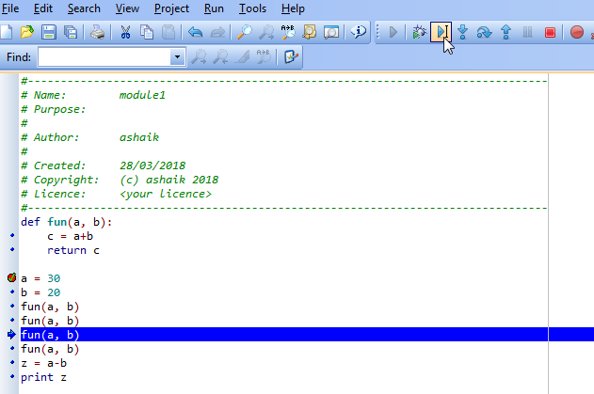
Click on Run to cursor or F4 to move debug point to cursor placed location

Slide 110
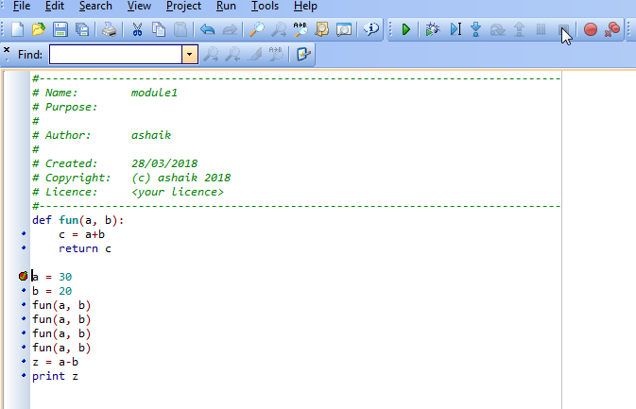
Click on Abort debugging or Alt+Shift+F9 to stop the debugging.

Slide 111
GUI Programming
Python provides various options for developing graphical user interfaces (GUIs). Most important are listed below:
1 ) Tkinter : Tkinter is the Python interface to the Tk GUI toolkit shipped with Python. We would look this option in this tutorial
2) wxPython : This is an open-source Python interface for wxWindows http://wxpython.org.
3) Jpython: JPython is a Python port for Java, which gives Python scripts seamless access to Java class libraries on the local machine ··http://www.jython.org.

Slide 112
Tkinter Programming
Tkinter is the standard GUI library for Python. Python when combined with Tkinter provides a fast and easy way to create GUI applications. Tkinter provides a powerful object-oriented interface to the Tk GUI toolkit.
• Import the Tkinter module.
· Create the GUI application main window.
· Add one or more of the above mentioned widgets to the GUI application.
· Enter the main event loop to take action against each event triggered by the user.

Slide 113
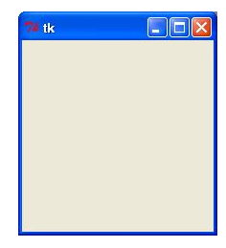
Example:
import Tkinter
top = Tkinter.Tk()
# Code to add widgets will go here...
top.mainloop()
O/p : GUI Like this

Slide 114
Tkinter Widgets
Tkinter provides various controls, such as buttons, labels, and text boxes, used in a GUI application.
These controls are commonly called widgets.
There are currently 18 types of widgets in Tkinter.
We present these widgets as well as a brief description in the following

Slide 115
Button The Button widget is used to display buttons in your application.
Canvas The Canvas widget is used to draw shapes, such as lines, ovals, polygons, and rectangles, in your application.
Checkbutton The Checkbutton widget is used to display a number of options as checkboxes. The user can select multiple options at a time.
Entry The Entry widget is used to display a single-line text field for accepting values from a user.
Frame The Frame widget is used as a container widget to organize other widgets.
Label The Label widget is used to provide a single-line caption for other widgets. It can also contain images.

Slide 116
Listbox The Listbox widget is used to provide a list of options to a user.
Menubutton The Menubutton widget is used to display menus in your application.
Menu The Menu widget is used to provide various commands to a user. These commands are contained inside Menubutton.
Message The Message widget is used to display multiline text fields for accepting values from a user.
Radiobutton The Radiobutton widget is used to display a number of options as radio buttons. The user can select only one option at a time.
Scale The Scale widget is used to provide a slider widget.
Scrollbar The Scrollbar widget is used to add scrolling capability to various widgets, such as list boxes.

Slide 117
Text The Text widget is used to display text in multiple lines.
Toplevel The Toplevel widget is used to provide a separate window container.
Spinbox The Spinbox widget is a variant of the standard Tkinter Entry widget, which can be used to select from a fixed number of values.
PanedWindow A PanedWindow is a container widget that may contain any number of panes, arranged horizontally or vertically.
LabelFrame A labelframe is a simple container widget. Its primary purpose is to act as a spacer or container for complex window layouts.
tkMessageBox This module is used to display message boxes in your applications.

Slide 118
Button
The Button widget is used to add buttons in a Python application. These buttons can display text or images that convey the purpose of the buttons. You can attach a function or a method to a button, which is called automatically when you click the button.
Syntax:
Here is the simple syntax to create this widget:
w = Button ( master, option=value, ... )
Parameters:
· master: This represents the parent window.
· options: Here is the list of most commonly used options for this widget. These options can be used as key-value pairs separated by commas.

Slide 119
Option Description
activebackground Background color when the button is under the cursor.
activeforeground Foreground color when the button is under the cursor.
bd Border width in pixels. Default is 2.
bg Normal background color.
command Function or method to be called when the button is clicked.
fg Normal foreground (text) color.
font Text font to be used for the button's label.
height Height of the button in text lines (for textual buttons) or pixels (for images).
image Image to be displayed on the button (instead of text).

Slide 120
Option Description
activebackground Background color when the button is under the cursor.
activeforeground Foreground color when the button is under the cursor.
bd Border width in pixels. Default is 2.
bg Normal background color.
command Function or method to be called when the button is clicked.
fg Normal foreground (text) color.
font Text font to be used for the button's label.
height Height of the button in text lines (for textual buttons) or pixels (for images).
image Image to be displayed on the button (instead of text).

Slide 121
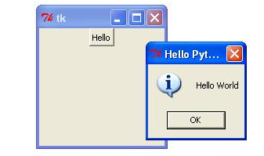
Example:
import Tkinter
import tkMessageBox
top = Tkinter.Tk()
def helloCallBack():
tkMessageBox.showinfo( "Hello Python", "Hello World")
B = Tkinter.Button(top, text ="Hello", command = helloCallBack)
B.pack()
top.mainloop()
O/P :

Slide 122
Checkbutton
The Checkbutton widget is used to display a number of options to a user
as toggle buttons. The user can then select one or more options by
clicking the button corresponding to each option.
You can also display images in place of text.
Syntax:
Here is the simple syntax to create this widget:
w = Checkbutton ( master, option, ... )
Parameters:
· master: This represents the parent window.
· options: Here is the list of most commonly used options for this widget. These options can be used as key-value pairs separated by commas

Slide 123

Example:
from Tkinter import *
import tkMessageBox
import Tkinter
top = Tkinter.Tk()
CheckVar1 = IntVar()
CheckVar2 = IntVar()
C1 = Checkbutton(top, text = "Music", variable = CheckVar1, onvalue = 1, offvalue = 0, height=5, width = 20)
C2 = Checkbutton(top, text = "Video", variable = CheckVar2, onvalue = 1, offvalue = 0, height=5, width = 20)
C1.pack()
C2.pack()
top.mainloop()

Slide 124
Menubutton
A menubutton is the part of a drop-down menu that stays on the screen all the time. Every menubutton is associated with a Menu widget that can display the choices for that menubutton when the user clicks on it.
Syntax:
Here is the simple syntax to create this widget:
w = Menubutton ( master, option, ... )
Parameters:
· master: This represents the parent window.
· options: Here is the list of most commonly used options for this widget. These options can be used as key-value pairs separated by commas.

Slide 125

Example:
from Tkinter import *
import tkMessageBox
import Tkinter
top = Tk()
mb= Menubutton ( top, text="condiments", relief=RAISED )
mb.grid() ; mb.menu = Menu ( mb, tearoff = 0 )
mb["menu"] = mb.menu
mayoVar = IntVar() ; ketchVar = IntVar()
mb.menu.add_checkbutton ( label="mayo", variable=mayoVar )
mb.menu.add_checkbutton ( label="ketchup", variable=ketchVar )
mb.pack()
top.mainloop()

Slide 126
Thank You!

