Slide 1
Clutter Suppression and Target Detection Using STAP in Airborne Radar
VIDYA SAGAR MUKTI
DRFT-2

Slide 2
LITERATURE SURVEY JULY
MODELLING OF FULL STAP AUG-SEP
MODELLING OF REDUCED RANK STAP OCT-NOV
PORT THE ALGORITMS IN ZYNQ DEVICES DEC-JAN

Slide 3
Introduction
Radar systems face challenges: clutter, jamming, moving target detection
Conventional methods: separate spatial and temporal processing
STAP: combines space and time adaptively for better detection

Slide 4
CONCEPT OF STAP
In airborne radar, you’ve got three main “bad guys”:
Ground clutter (big reflections from terrain, buildings, vegetation).
Jammers (strong, intentional interference from certain directions).
Noise (thermal noise in your receiver).
And one small “good guy”:
Target — possibly slow-moving, hidden under clutter returns.

Slide 5
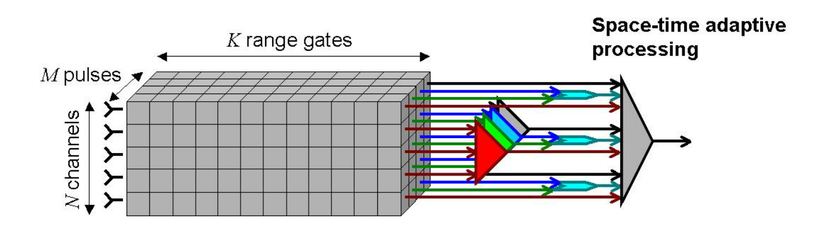
SPACE TIME ADAPTIVE PROCESSING
The radar transmits a coherent burst of M pulses at a constant PRF, For each PRI, K time samples are collected. Each time sample corresponds to a particular range. Thus, during each coherent pulse interval, the data collected consists of MNK samples.

Slide 6
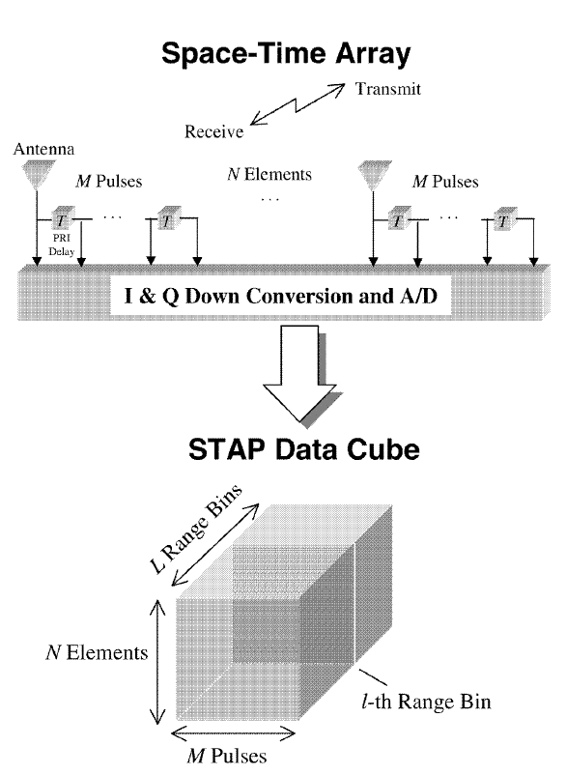
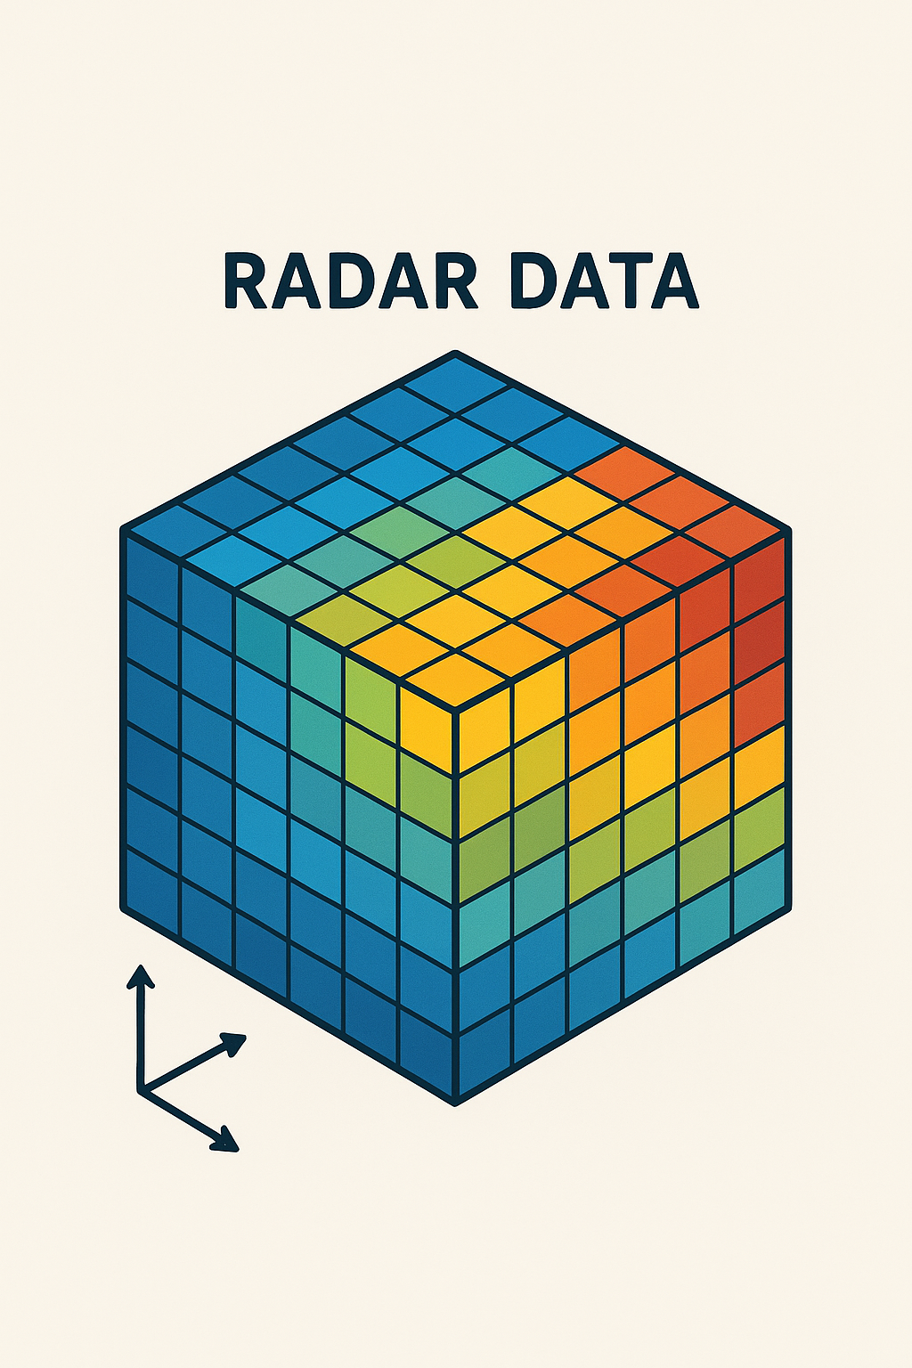

Slide 7
Mathematical Model
Radar data cube: Samples × Elements × Pulses
Received signal = Target + Clutter + Jammer + Noise
Space-time steering vector models target’s angle and Doppler shift

Slide 8
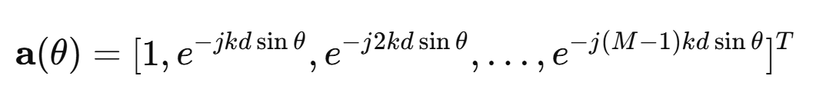
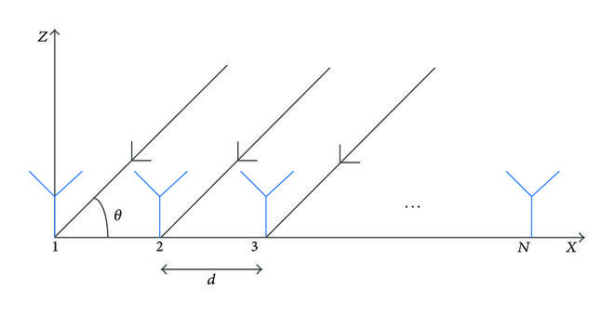

Spatial Steering Vector
Represents the phase shifts across array elements for a signal arriving from a specific angle.
For a uniform linear array (ULA):
where
M = number of elements
d = spacing between elements
wave number

Slide 9
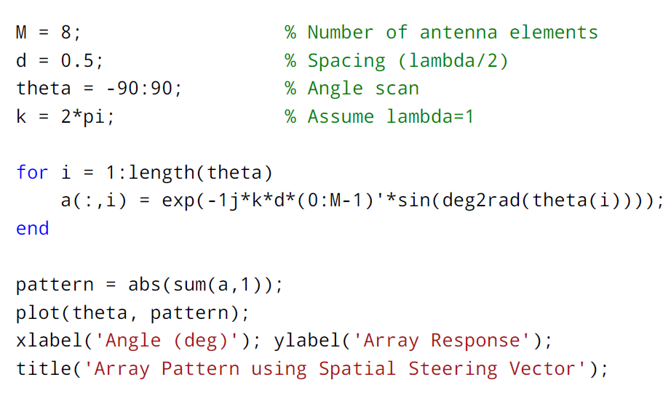
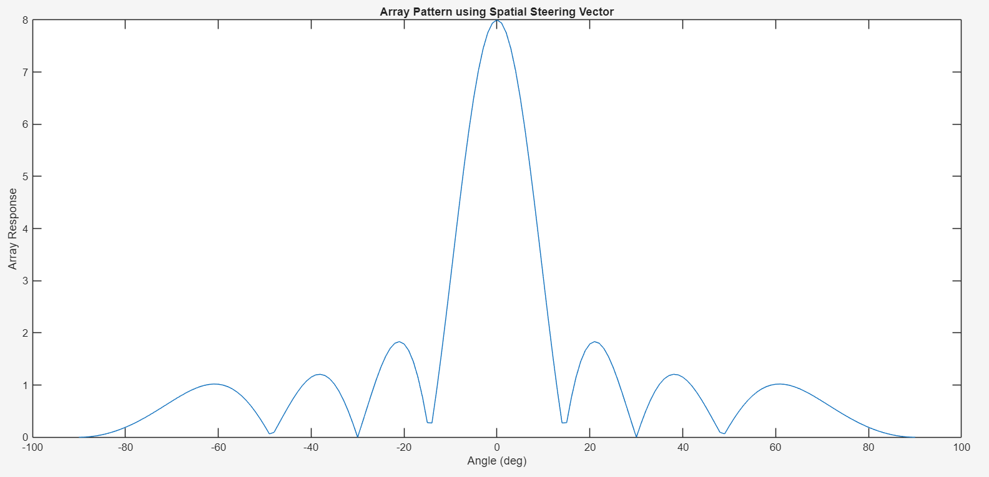

Slide 10

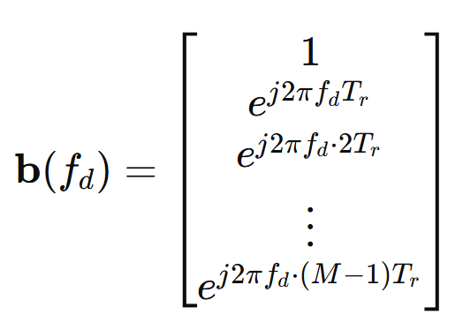
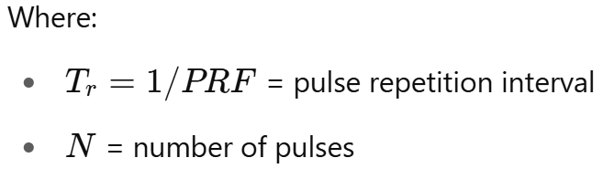
Temporal Steering Vector
Doppler Effect in Radar: A moving target causes frequency shift
For N pulses and Doppler frequency ​:

Slide 11


In Space-Time Adaptive Processing, the temporal steering vector is combined with the spatial steering vector to form a space-time steering vector:
a(θ) handles angle (spatial phase shifts across elements).
handles velocity (temporal phase shifts across pulses).
Together, STAP can focus on a specific angle and radial velocity simultaneously, rejecting clutter from other angle/velocity combinations.

Slide 12
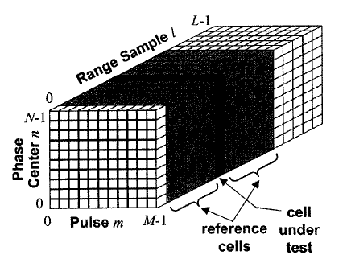
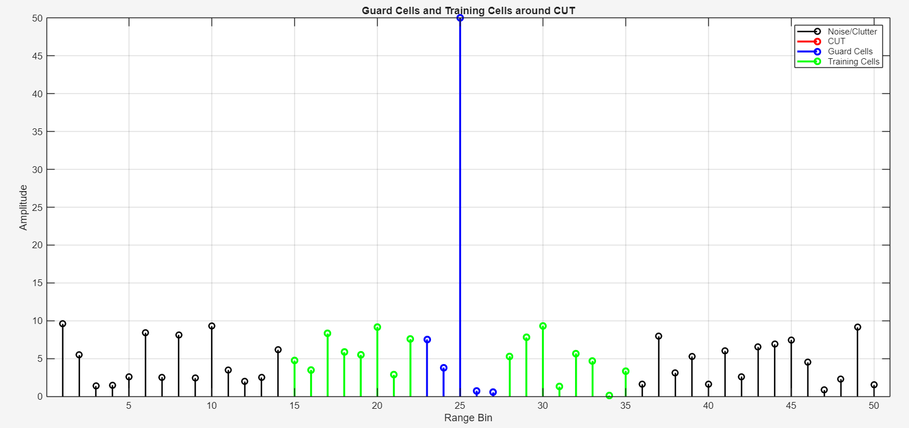
To evaluate a CUT (Cell Under test) : Guard cells: small band around the CUT (not used, to avoid target leakage). Reference cells: surrounding cells used to estimate noise/clutter level.

Slide 13

Covariance Matrix Formation
We first estimate the clutter + noise covariance matrix
Estimate interference covariance matrix R
Compute adaptive weights: w = R⁻¹s / (sᴴR⁻¹s)
Apply weights to suppress clutter/jamming while preserving target

Slide 14
MVDR Concept
Objective: Minimize output power due to clutter and noise
Constraint: Preserve gain in the desired target direction (distortionless response)
Achieved by solving an optimization problem:
Minimize wᴴ R w subject to wᴴ s = 1

Slide 15
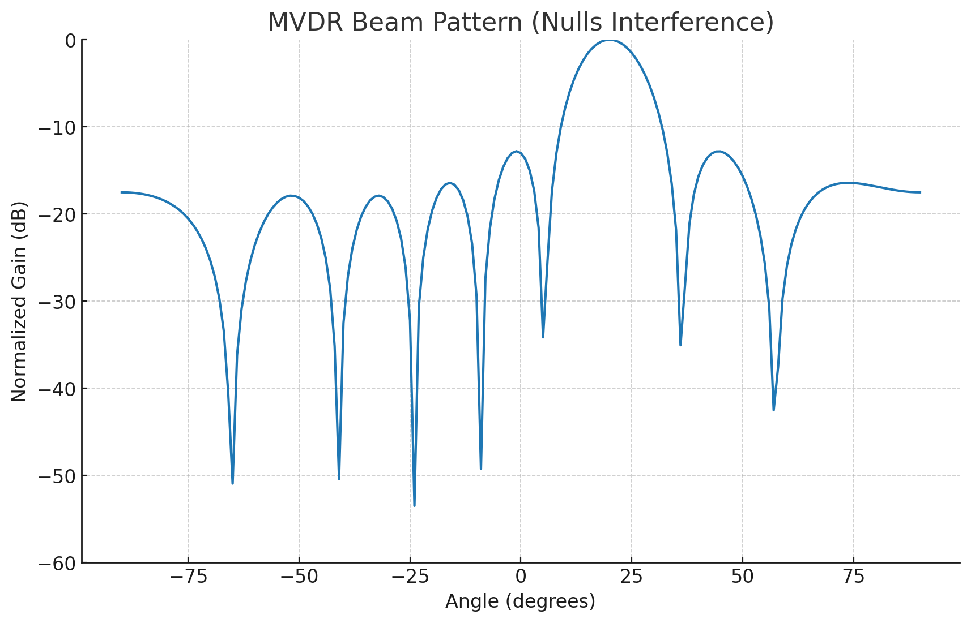
MVDR Solution
Closed-form solution for weight vector:
w = (R⁻¹ s) / (sᴴ R⁻¹ s)
R = interference covariance matrix
s = steering vector (target direction & Doppler)
Ensures unity gain for target, nulls interference adaptively
After forming the covariance matrix, MVDR computes adaptive weights that “shape” the beamformer to null clutter/jammers while keeping the target signal untouched.

Slide 16
Practical Implementations
Full-rank STAP: accurate but computationally expensive
Reduced-rank STAP: lower complexity (PCA, Krylov, MSWF)
Sample Matrix Inversion (SMI), Loaded SMI commonly used

Slide 17
Challenges
High computational complexity
Large training data requirement
Performance degrades in non-stationary clutter environments

Slide 18
References
Ward, J. (1994). Space-Time Adaptive Processing for Airborne Radar
Melvin, W. L., & Showman, G. A. (2006). An Approach to Knowledge-Aided Adaptive Radar
Klemm, R. (2002). Principles of Space-Time Adaptive Processing

