Slide 1
CSE7101-CapstoneProject Review-1
Al-enabled water well predictor
Batch Number: CSE_172
Under the Supervision of,
MR.Jerrin Joe Francis
Assistant Professor School of Computer Science and Engineering Presidency University
Roll Number | StudentName
20221CSE0411 20221CSE0408 20221CSE0565 | C.ChandBasha P.Abhisekhar Reddy Vidyasagar.M
Name of the program: Computer Science And Engineering Name of the HOD: Dr.Asif Mohammed
Name of the program project coordinator: DR.jayavadivel Ravi
Name of the school project coordinator: DR.Sampath A K ,DR.Geetha. A

Slide 2
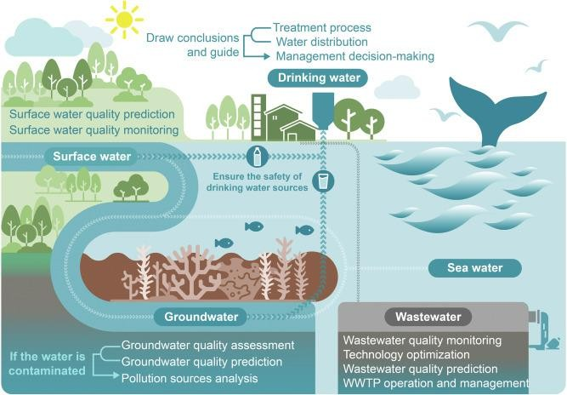
Ground water image

Slide 3
ProblemStatementNumber:
Organization:
Government agencies– toplan water project sin rural areas
Non-profit organizations(NGOs)– to help communities find clean water
Private companies–working in agriculture,construction, or water services
Local communities–to reduce the risk of drilling dry wells
These organizations can use the tool to make better decisions,savere sources,and improve access to water.
Category:Software
Problem Description:Many people waste time and money drilling waterwell sin the wrong places. It’s hard to know where to find water underground. Traditional methods often fail.
We need a better way to find the right spots to drill wells.
An AI-enabled tool can help by using data to predict the best places to find water, saving effort and improving success.

Slide 4
Content
ProblemStatement
Objectives
BackgroundandRelatedworkfortitleSelection
AnalysisofProblemStatement
InnovationorNovelContributions
Git-hubLink
TimelineoftheProject
References

Slide 5
ProblemStatement
Drilling a well is expensive and sometimes fails if no water is found.
Traditional method choose drilling spots are not always sreliable.
Failed drilling wastes money,time, and resources.
There is a need for as marter,data-driven way to find good well locations.
AI can help by analyzing past data to predict the best places to drill.
Many people, especially in rural areas,depend on wells for water.

Slide 6
Objectives
Predict the best locations to drill water wells using AI.
Increase the successrate of finding groundwater.
Reduce cost sand time wasted on failed drilling.
Help communities and planners make better water decisions.
Support sustainable use of groundwater resources.

Slide 7
BackgroundandRelatedworkfor titleSelection
Background
Many rural are as rely on waterwells for drinking and farming.
Drilling well sis expensive and sometimes fail water isn't found.
Traditional methods(likesurveys) are not always accurate.
AI can analyze large datasets(e.g., soil,rainfall, past welldata)to find better drilling spots.
Using AI can save money,reducefailures,and improve access to water.

Slide 8
BackgroundandRelatedworkfor titleSelection
Relatedwork
AI and machine learning are already use din agriculture and water management.
Remote sensing and GIS have been used to map groundwater from satellite data.
Studies in countries like India and Africa have used AI models (e.g.,Random Forest) to predict good well locations.
AI helps combine multiple factors like soil,elevation,and rainfall to make better predictions.
Some NGO sand global organization shave tested AI tools to improve water access in poor regions.

Slide 9
AnalysisofProblemStatement
Background:
Drilling wells to access groundwater is expensive and risky.
Traditional methods(likegeological surveys) aren't
always accurate.
Failedwells waste money and resources, especially in water-scarce regions.
TheChallenge:
Finding the rightplace to drill with a high chance of hitting water.
Predicting depth,water quality,and sustainability of the source.
.

Slide 10
AnalysisofProblemStatement
3.WhyAI?
AI can analyze huge datasets :soiltypes , satelliteimagery , rainfall , past drillingdata ,etc.
It finds patterns humans might miss.
It can make location-specificpredictions faster and cheaper.
4. Key Goals of the AI System:
Predict the best drilling locations.
Estimate the probability of success(e.g.,wateryield,depth).
Reduce costs and risks.
Help governments,NGOs, and farmers make better decisions

Slide 11
Innovation
AI-Based Prediction: Uses machine learning to predict the best locations for water wells, unlike traditional guess work or manual surveys.
Data-DrivenApproach:Combines various data sources(soil type, rainfall , elevation ,past well data,satellite images) to makes mart decisions.
Reduces Failure Risk:Increases the chance of finding water , reducing the number of failed and costly drilling attempts.
User-Friendly Tool: Can be built as a mobile or web app for easy use by field workers, farmers, NGOs, or local governments.
Customizable to Any Region:The system canadapt to different geographic areas by training it with local data.

Slide 12

GithubLink
https://github.com/VidyasagarM2004/ai-enabled-water-well-predictor.git
•

Slide 13







TimelineoftheProject(GanttChart)
Task RequirementAnalysis DataCollection DataPreprocessing ModelDevelopment Testing&Validation
Deployment& Reporting
W1–W3
W4–W5
W6–W7
W8–W9
W10–W13

Slide 14
References(IEEEPaperformat)
P.Z araf shanetal.,“Artificial Intelligence Hybrid Deep Learning Model for Ground water Level Prediction UsingMLP-ADAM,”ar Xiv preprint , Jul.292021.
M.L.Taccari etal.,“AttentionU-Netasas urrogate model for ground water prediction,”ar Xivpreprint,Apr.92022.
A.S.AliAli etal.,“An Overview of DeepLearning Application sin Groundwater Level Modeling: Bridging the Gap between Academic Research and Industry Applications,” Applied Computational Intelligence and Soft Computing, vol.2024,Art.ID9480522,Aug.14 2024.
A. Najafabadipour etal., “Application of Artificial Intelligence Techniques for the Determination of Groundwater Level UsingSpatio-Temporal Parameters ACS Omega, vol.7, no.12, pp.10751–10764, Mar.212022.
A.Khedrietal.,“Comparison study of artificial intelligence method for short term groundwater level prediction in the northeast Gachsaran unconfined
aquifer,” Water Supply, vol.20, no.3, pp.909–921, May2020.

Slide 15


