Slide 1
CSE7101-CapstoneProject Review-2
Al-enabled water well predictor
Batch Number: CSE_172
Under the Supervision of,
MR. Vinayak Raju Kage
Assistant Professor School of Computer Science and Engineering Presidency University
Roll Number | StudentName
20221CSE0411 20221CSE0408 20221CSE0565 | C.ChandBasha P.Abhisekhar Reddy Vidyasagar.M
Name of the program: Computer Science And Engineering Name of the HOD: Dr .Asif Mohammed
Name of the program project coordinator: DR .jayavadivel Ravi
Name of the school project coordinator: DR .Sampath A K ,DR .Geetha. A

Slide 2
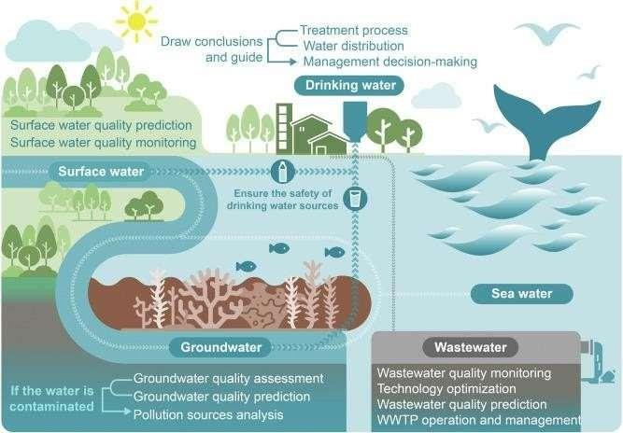
Ground water image

Slide 3
ProblemStatementNumber:
Organization:
Government agencies– to plan water project sin rural areas
Non-profit organizations(NGOs)– to help communities find clean water
Private companies–working in agriculture,construction, or water services
Local communities–to reduce the risk of drilling dry wells
These organizations can use the tool to make better decisions,savere sources,and improve access to water.
Category:Software
Problem Description:Many people waste time and money drilling waterwell sin the wrong places. It’s hard to know where to find water underground. Traditional methods often fail.
We need a better way to find the right spots to drill wells.
An AI-enabled tool can help by using data to predict the best places to find water, saving effort and improving success.

Slide 4
Content
Problem Statement
Objectives
Back ground and Related work for title Selection
Analysis of Problem Statement
Innovation or Novel Contributions
Git-hub Link
Timeline of the Project
References

Slide 5
Problem Statement
Drilling a well is expensive and sometimes fails if no water is found.
Traditional method choose drilling spots are not always sreliable.
Failed drilling wastes money ,time, and resources.
There is a need for as marter ,data-driven way to find good well locations.
AI can help by analyzing past data to predict the best places to drill.
Many people, especially in rural areas , depend on wells for water.

Slide 6
Objectives
Predict the best locations to drill water wells using AI.
Increase the success rate of finding groundwater.
Reduce cost sand time wasted on failed drilling.
Help communities and planners make better water decisions.
Support sustainable use of groundwater resources.

Slide 7
Background and Related work for title Selection
Background
Many rural are as rely on water wells for drinking and farming.
Drilling well sis expensive and sometimes fail water isn't found.
Traditional methods(like surveys) are not always accurate.
AI can analyze large datasets(e.g., soil ,rainfall, past well data)to find better drilling spots.
Using AI can save money ,reduce failures ,and improve access to water.

Slide 8
Background and Related work for title Selection
Related work
AI and machine learning are already use din agriculture and water management.
Remote sensing and GIS have been used to map groundwater from satellite data.
Studies in countries like India and Africa have used AI models (e.g., Random Forest) to predict good well locations.
AI helps combine multiple factors like soil,elevation,and rainfall to make better predictions.
Some NGO sand global organization shave tested AI tools to improve water access in poor regions.

Slide 9
Analysis of Problem Statement
Background:
  Drilling wells to access groundwater is expensive and risky.
  Traditional methods(like geological surveys) aren't
always accurate.
  Failed wells waste money and resources, especially in water-scarce regions.
The Challenge:
  Finding the right place to drill with a high chance of hitting water.
  Predicting depth ,water quality ,and sustainability
of the source.
.

Slide 10
Analysis of Problem Statement
3.WhyAI?
AI can analyze huge datasets :soiltypes , satelliteimagery , rainfall , past drilling data ,etc.
It finds patterns humans might miss.
It can make location-specific predictions faster and cheaper.
  4. Key Goals of the AI System:
Predict the best drilling locations.
Estimate the probability of success(e.g.,water yield,depth).
Reduce costs and risks.
Help governments ,NGOs, and farmers make better decisions

Slide 11
Innovation
AI-Based Prediction: Uses machine learning to predict the best locations for water wells, unlike traditional guess work or manual surveys.
Data-Driven Approach :Combines various data sources(soil type, rainfall , elevation ,past well data ,satellite images) to makes mart decisions.
Reduces Failure Risk :Increases the chance of finding water , reducing the number of failed and costly drilling attempts.
User-Friendly Tool: Can be built as a mobile or web app for easy use by field workers, farmers, NGOs, or local governments.
Customizable to Any Region: The system can adapt to different geographic areas by training it with local data.

Slide 12

GithubLink
https://github.com/VidyasagarM2004/ai-enabled-water-well-predictor.git
•

Slide 13
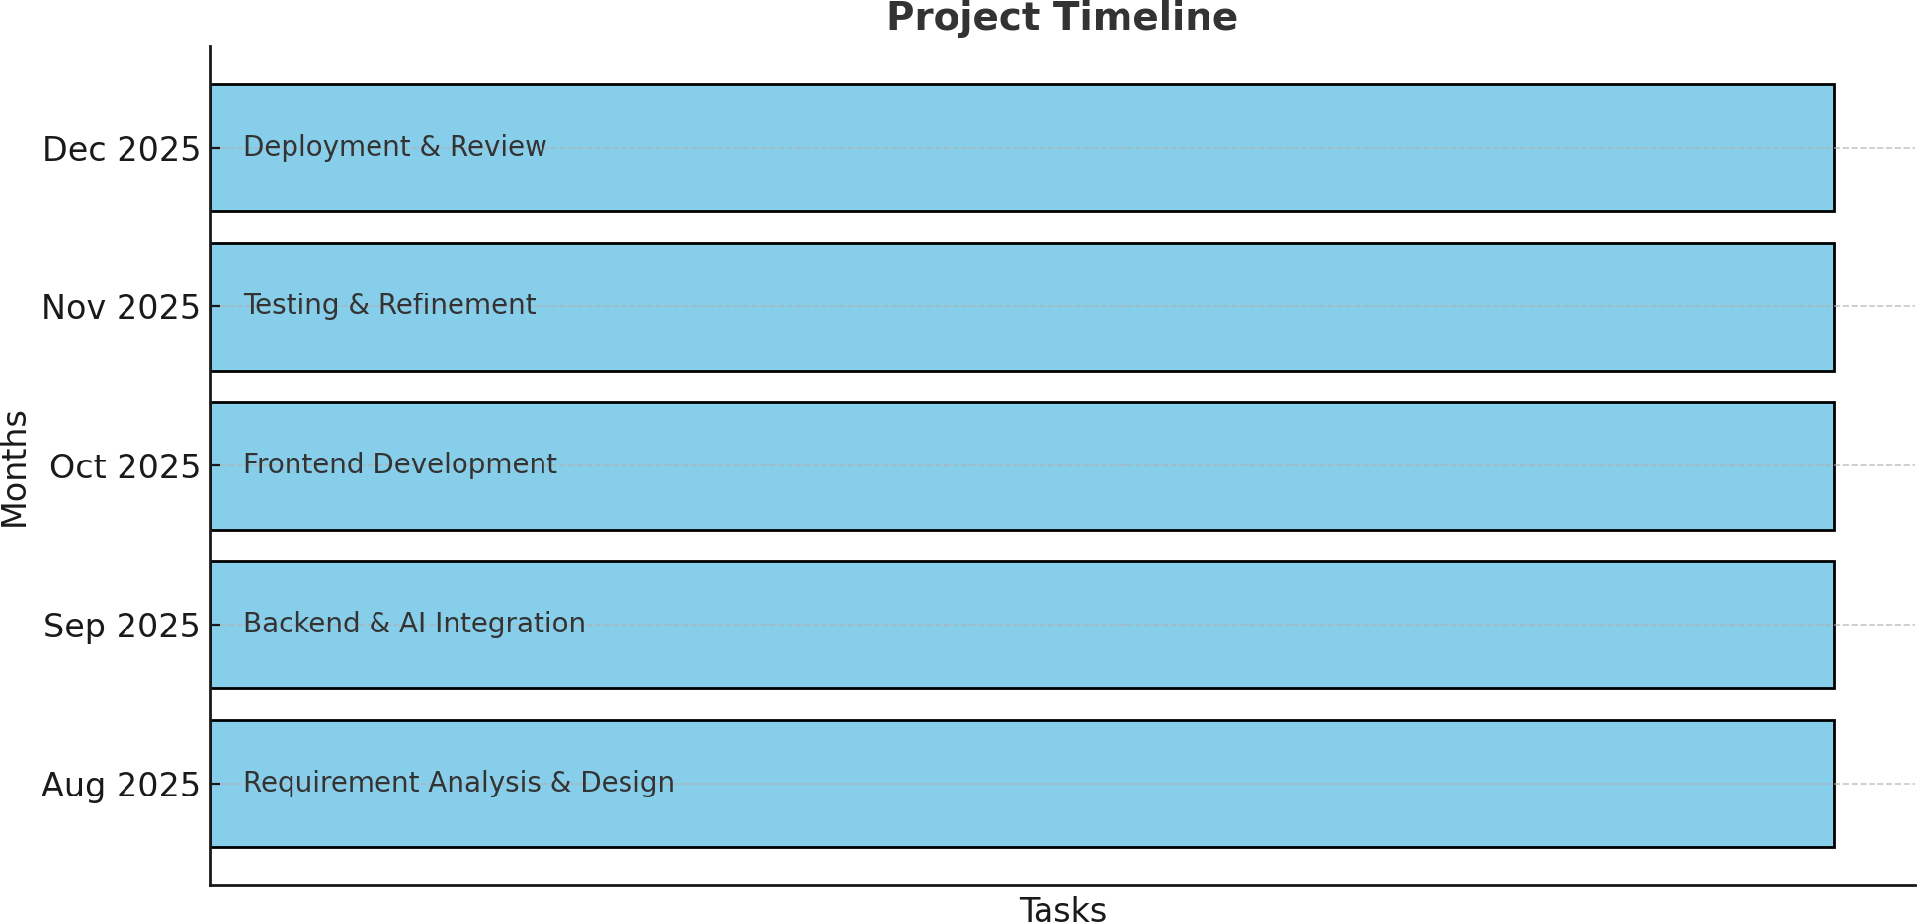
Timeline of the Project (Gantt Chart)

Slide 14
References(IEEEPaperformat)
P.Z araf shanetal.,“Artificial Intelligence Hybrid Deep Learning Model for Ground water Level Prediction Using MLP-ADAM,”ar Xiv preprint , Jul.292021.
M.L.Taccari etal.,“Attention U-Netasas urrogate model for ground water prediction,”ar Xivpreprint,Apr.92022.
A.S.AliAli etal.,“An Overview of Deep Learning Application sin Groundwater Level Modeling: Bridging the Gap between Academic Research and Industry Applications,” Applied Computational Intelligence and Soft Computing, vol.2024,Art.ID9480522,Aug.14 2024.
A. Najafabadipouretal., “Application of Artificial Intelligence Techniques for the Determination of Groundwater Level UsingSpatio-Temporal Parameters ACS Omega, vol.7, no.12, pp.10751–10764, Mar.212022.
A.Khedrietal.,“Comparison study of artificial intelligence method for short term groundwater level prediction in the northeast Gachsaran unconfined aquifer,” Water Supply, vol.20, no.3, pp.909–921, May2020.

Slide 15


