Slide 1
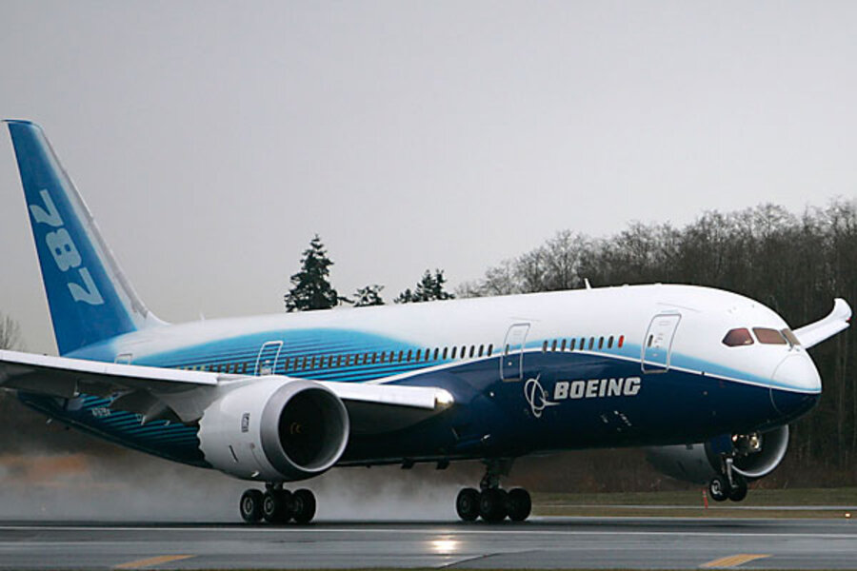
Group 17 - Halabaloo
We first read and store JSON files in a SQL database
We then query the database
Finally we present the data
By Kiran, Mohnish, Vidyut and Jeremy

