Slide 1
[
SECTION 2 · TAKE-HOME PROTOTYPE
Exam–Syllabus
Alignment Analyzer
Does this exam paper test what the syllabus says it should — and where do the marks actually fall?
Vienna Wong · O-Level History 2174, Specimen Paper 1 + Upper Secondary syllabus

Slide 2
THE BRIEF, IN ONE IDEA
The syllabus already contains the two structures the brief asks about
The brief asks for two analyses:
Alignment with objectives
maps to
→
Assessment Objectives
Does each question test the skills the syllabus names?
the skills — e.g. Interpret & Evaluate Sources
Balance of topic weightage
maps to
→
Content units
How are the marks spread across what's taught?
the topics — e.g. Dutch Indonesia 1870s–1920s
Extract both from the syllabus, map every question to them, then add up the marks. That framing is the whole architecture.
2

Slide 3
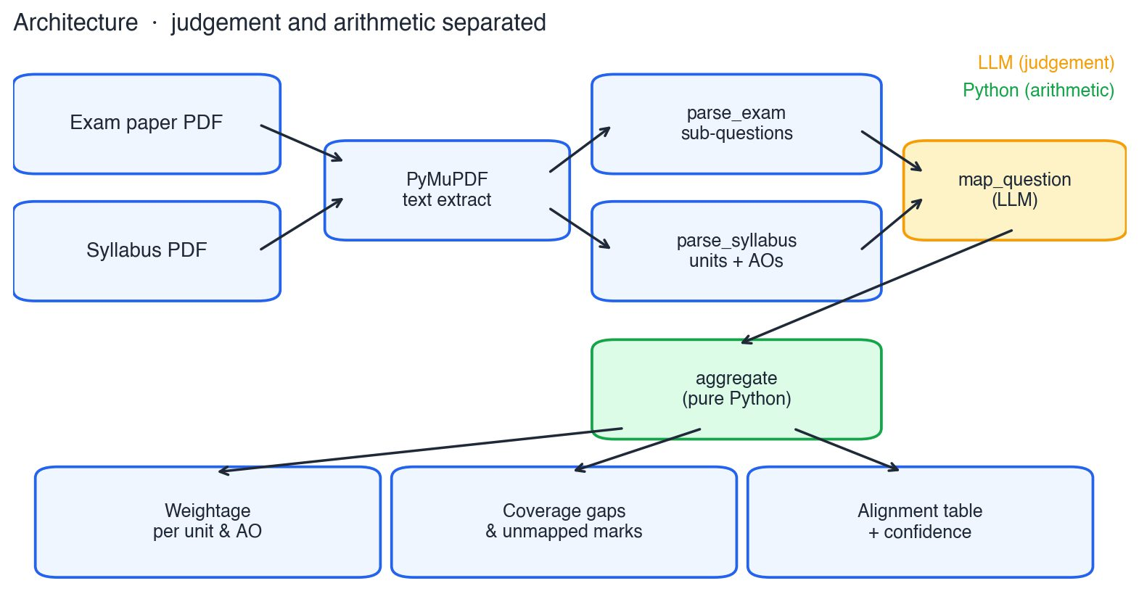
ARCHITECTURE
Judgement and arithmetic, deliberately separated
01
Sub-question is the unit
Q1 has parts (a)–(e), each with its own marks and skill. Aggregating at “Question 1” would erase the signal the tool exists to find.
02
LLM judges, Python counts
The model does the one genuinely hard step — mapping. Plain Python sums the marks. The numbers are reproducible, cheap, and never hallucinated.
3

Slide 4
TRUST BY DESIGN
Three choices that make an answer auditable, not just plausible
✓
▣
❝
Confidence + justification
Constrained outputs
Verbatim evidence
Every mapping carries a 0–1 confidence and a one-line reason. An unverifiable label becomes something a curriculum officer can check in seconds.
The model may only pick from the extracted unit / AO IDs, or the explicit “unmapped” sentinel. It cannot invent a category to hide uncertainty.
Each extracted unit and objective quotes the syllabus line it came from — so the rubric itself is traceable back to the source document.
These aren't decoration — they enable human-in-the-loop routing (low confidence → review) and the calibration analysis later in this deck.
4

Slide 5
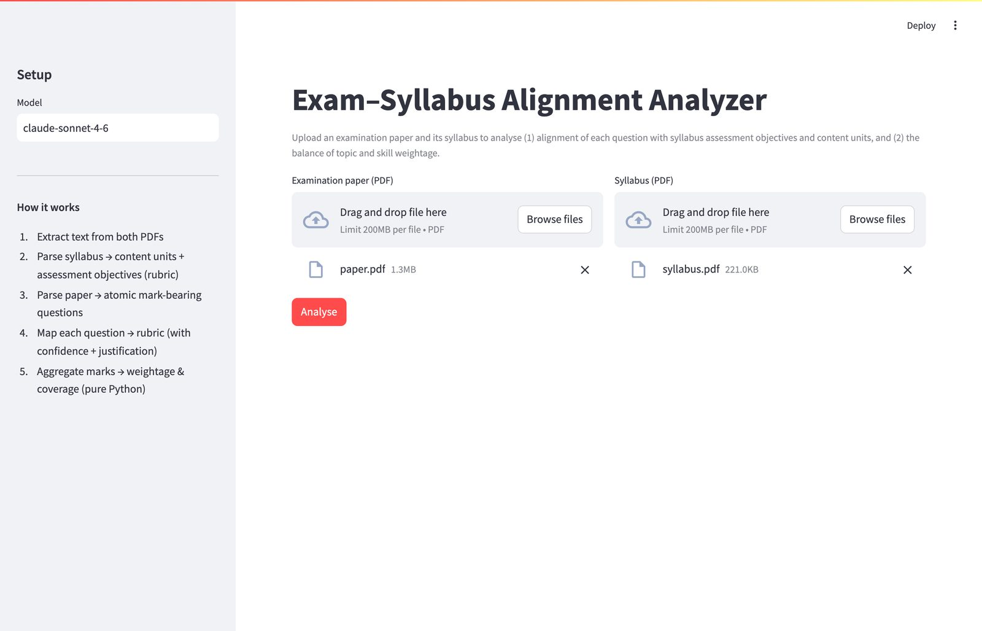
LIVE DEMO
One real run: 2174 Paper 1
1
Rubric extracted
17 content units + 3 AOs — the AOs match SEAB's published rubric word-for-word
2
9 sub-questions parsed
Q1a–Q1e source-based + Q2a/Q2b/Q3/Q4 essays · 70 marks total
3
Alignment table
each question's units, AOs, a confidence bar, and a justification
4
Weightage + gaps
WWII-Europe 25.7%; 10 of 17 units carry zero marks in this one paper
“Point at Q1c — confidence 0.40. The model is telling us itself that this one needs a human.”
5

Slide 6
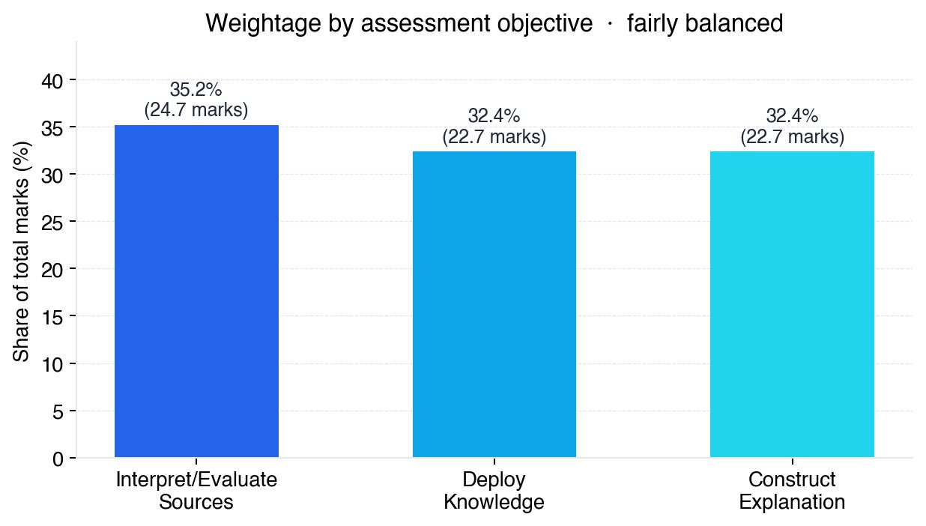
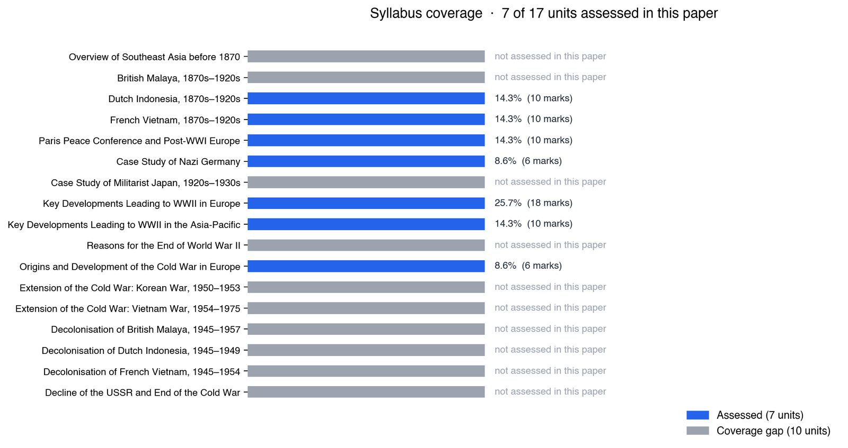
RESULT · THE TWO ANALYSES
Skills are balanced; one topic dominates
Across the three objectives the paper is even (35 / 32 / 32%).
But only 7 of 17 units appear — useful as a signal across years, not a verdict on one specimen paper.
6

Slide 7
EVALUATION METHOD
We measure agreement with a human — not “correctness”
Ground truth is itself uncertain. Trained markers disagree on which objective a question tests. So the metrics are built for multi-label answers, and the premise is agreement, not an oracle.
Content-unit overlap
AO micro P / R / F1
Unit is near single-label — any intersection of predicted and gold counts as agreement.
Objectives are multi-label; scored over every (question, objective) pair.
AO mean Jaccard
Confidence calibration
Per-question set overlap — penalises both misses and false positives.
Do higher-confidence calls actually agree more? This is what makes routing possible.
Gold set: 9 items, hand-labelled by me. Production would use multiple trained markers and report inter-annotator agreement (Krippendorff's α). The submission is about the method, which scales with labels.
7

Slide 8
RESULTS · HEADLINE
Where the model lands against the human labels
9
0.89
1.00
0.94
Items evaluated
Unit overlap accuracy
AO micro-precision
AO micro-F1
0.88
0.89
Precision is perfect.
Every objective the model assigns is one a human would assign too. All the error is in misses, not false positives — and that asymmetry is itself useful.
AO micro-recall
AO mean Jaccard
8

Slide 9
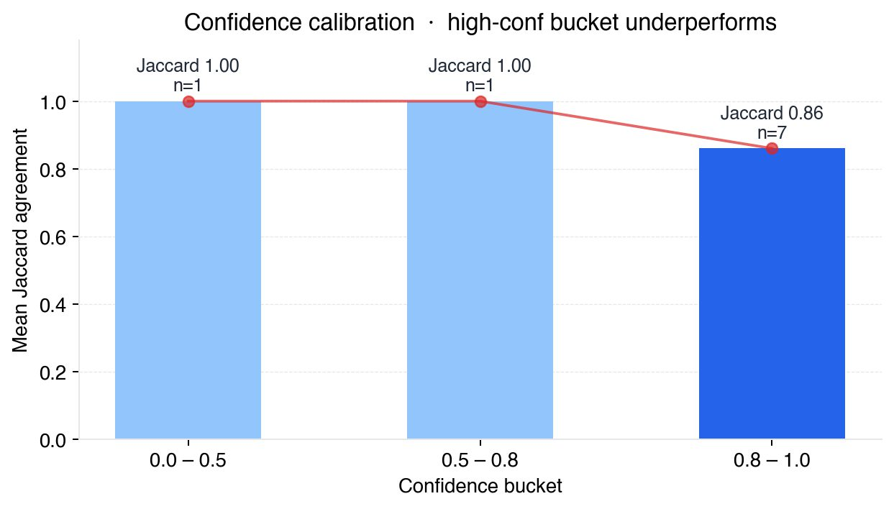
THE FINDING
Two opposite stories in one evaluation
Calibration working — Q1c
Picked the wrong unit (Cold War origins, not WWII-Europe) — but flagged itself at 0.40. A “confidence < 0.5 → review” rule catches it. The model is honest when it doesn't know.
Calibration failing — Q1a & Q1d
Both at 0.95 confidence, both missed Deploy Knowledge. “How useful is Source A as evidence of Hitler's foreign-policy ambitions?” — you can't judge utility without knowing the history. The model tagged source-skills only, confidently.
→ Overconfidence on a systematic blind spot — invisible from the weightage charts. The evaluation surfaced it.
9

Slide 10
LIMITATIONS & NEXT STEPS
What I'd fix first — and the honest caveats
In priority order
Stated before the panel does
1
Ingest the mark scheme
explicit AO weighting per question — the direct fix for the Q1a/Q1d miss
Born-digital PDFs only — scanned input is refused, not silently mangled (OCR out of scope).
Mark scheme not yet ingested — the single biggest accuracy lever.
Single-marker gold set (me) — needs trained markers + inter-annotator agreement.
One specimen paper — coverage gaps are only meaningful across several years.
Model: Claude Sonnet 4.6, free-tier-feasible — a larger model might close the recall gap, but I haven't measured it.
2
Multi-marker gold set + IAA
gives the metrics a meaningful floor: match human–human agreement
3
LLM-as-judge to scale labels
grow the eval set once anchored to humans; spot-check by sampling
4
Confidence-threshold routing
tune against the agreement floor; only below-threshold goes to review
5
Multi-year analysis
same pipeline across N years reveals syllabus drift and coverage gaps
10

Slide 11
METHOD I'D CARRY TO ANY SIMILAR PROBLEM
Five principles
01
Map analysis to structure
find the structure already in the source data before designing anything
02
Separate judgement from arithmetic
keep the LLM where uncertainty truly lives; plain code everywhere else
03
Smallest unit that keeps the signal
sub-question, not question
04
Constrain outputs, demand a reason
known categories only, with confidence + justification on every call
05
Treat ground truth as uncertain
measure agreement, design metrics for the multi-label reality
Thank you — happy to dig into the code, the eval, or a fresh problem.
11

