Slide 1
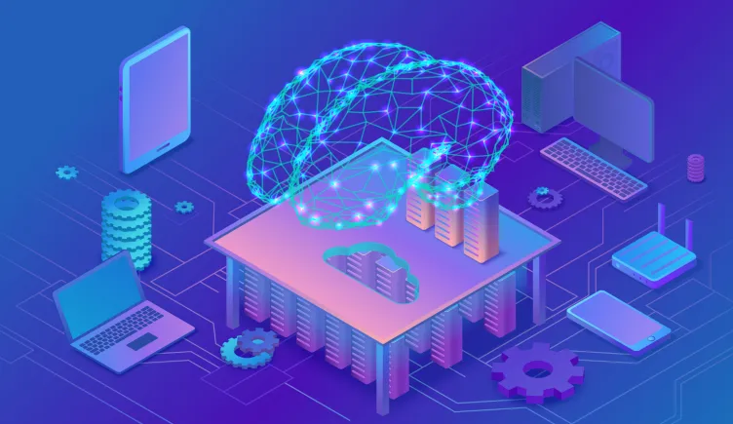
The Future of AI
AI is constantly changing our world. Here are just a few ways AI will influence our lives.
Viet NGUYEN -- 20006303

Slide 2
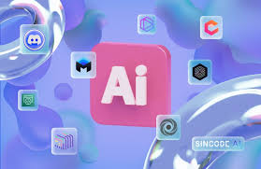
Introduce AI in 2024
Some AI models
The Advantage
The Risk of them / Disadvantage
Discuss

Slide 3






AI Models
- Text generator with NLP (Natural language processing)

Slide 4





Coding Support AI
Useful
Easy to use

Slide 5
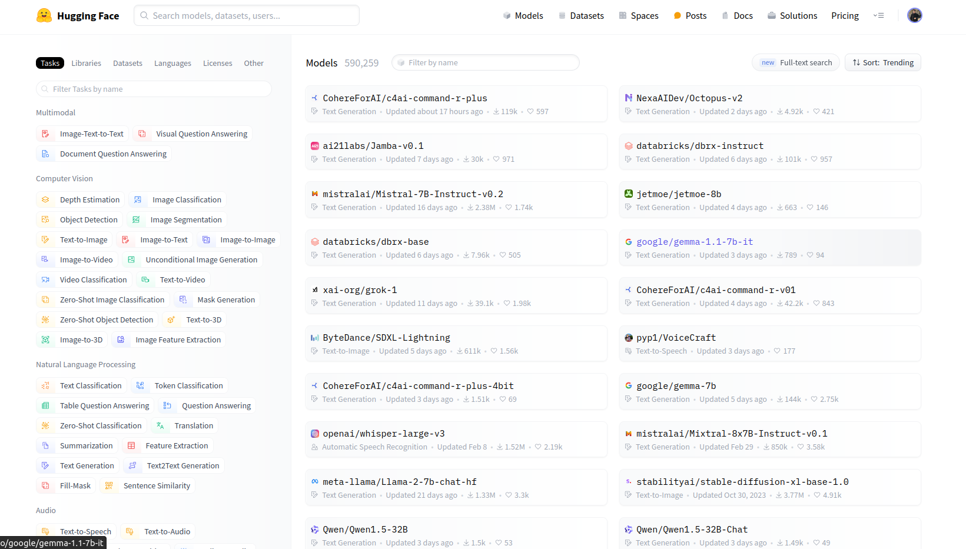
Introduce AI in 2024

Slide 6
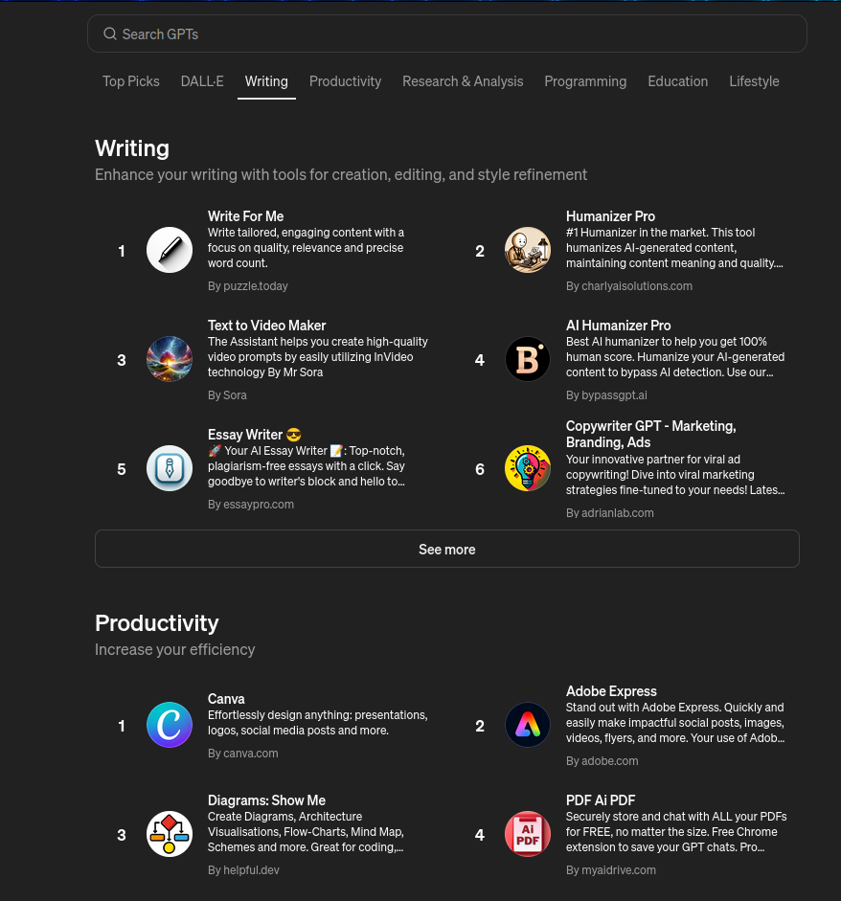
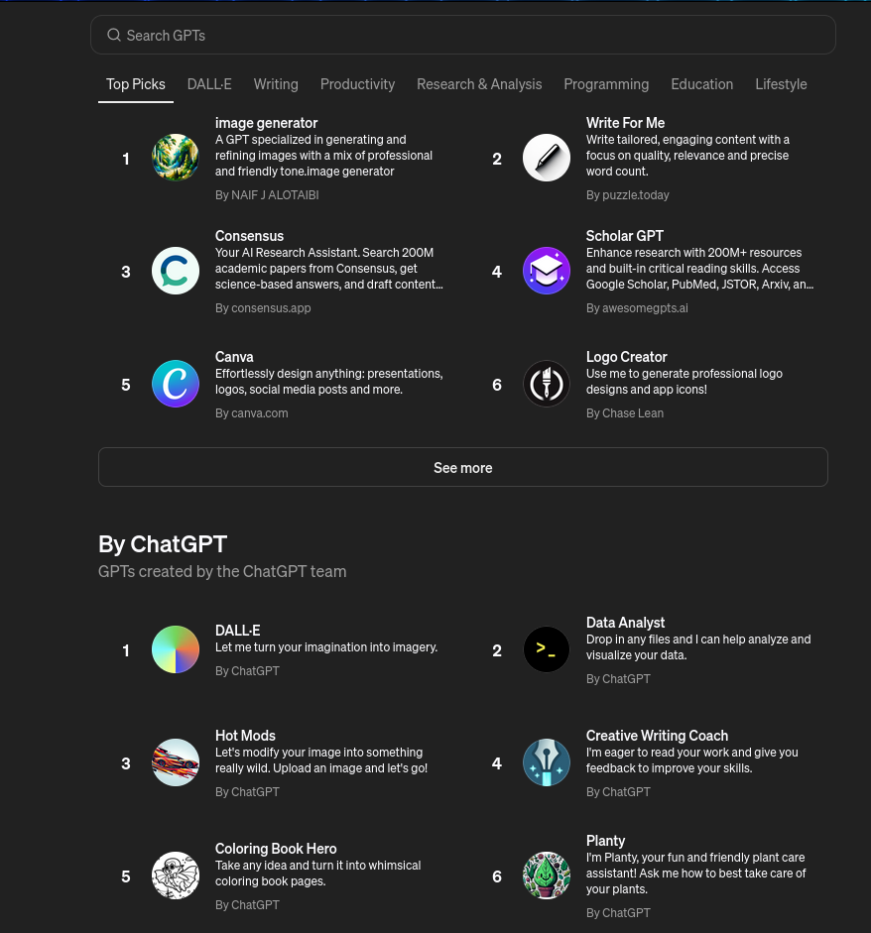
GPT Store

Slide 7
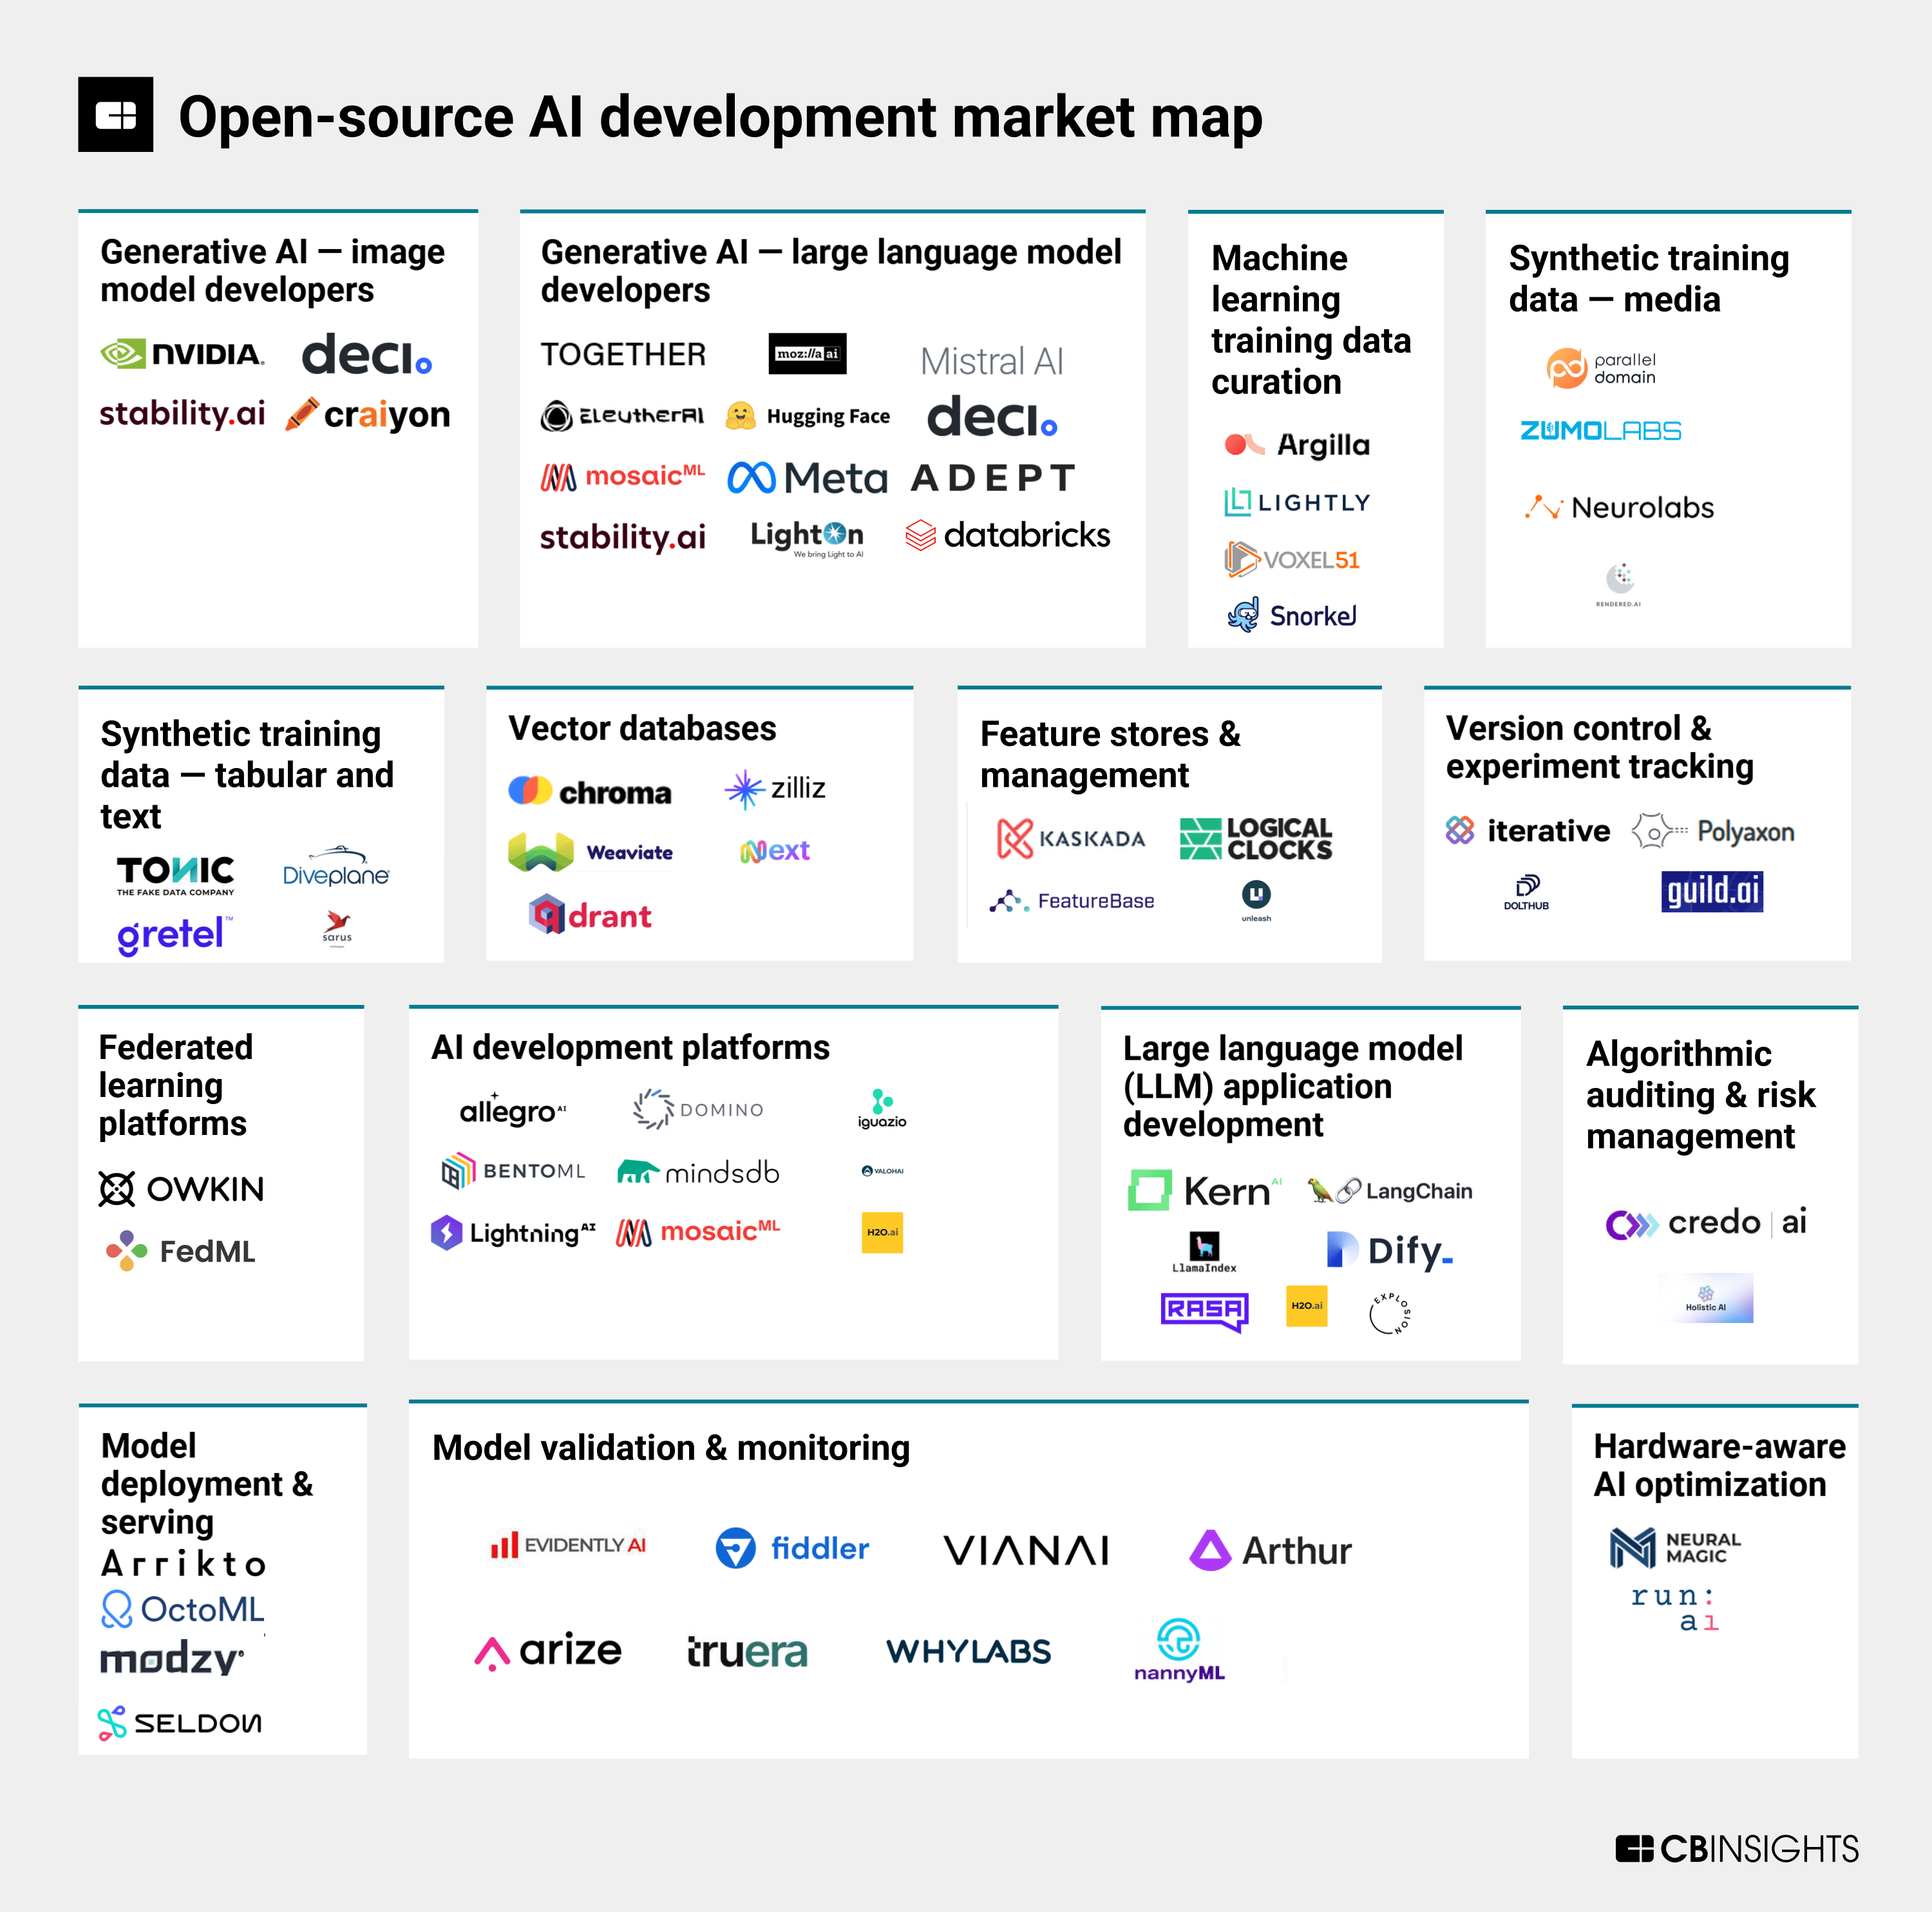
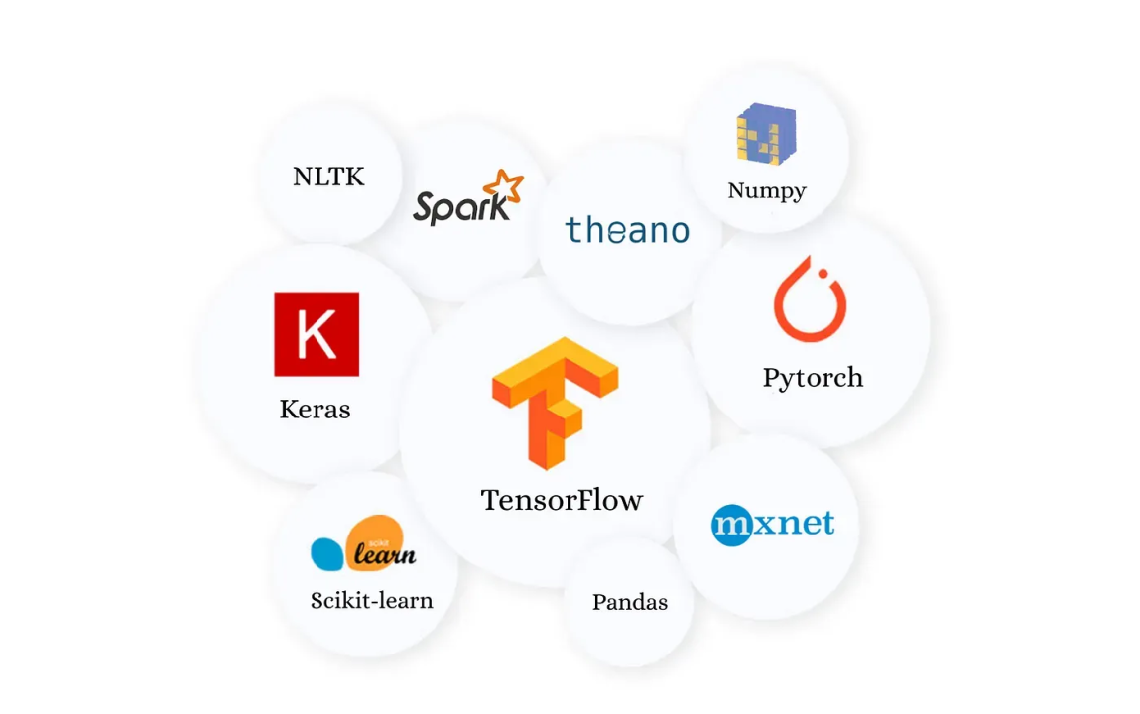
Open Source
Increasing impact of AI

Slide 8
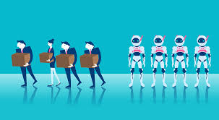
Disadvantage
Unemployment
Be dependent on AI
Security risk

Slide 9
Conclusion
The future of informatic and techinic are AI & Quantum Computer.

