Slide 1
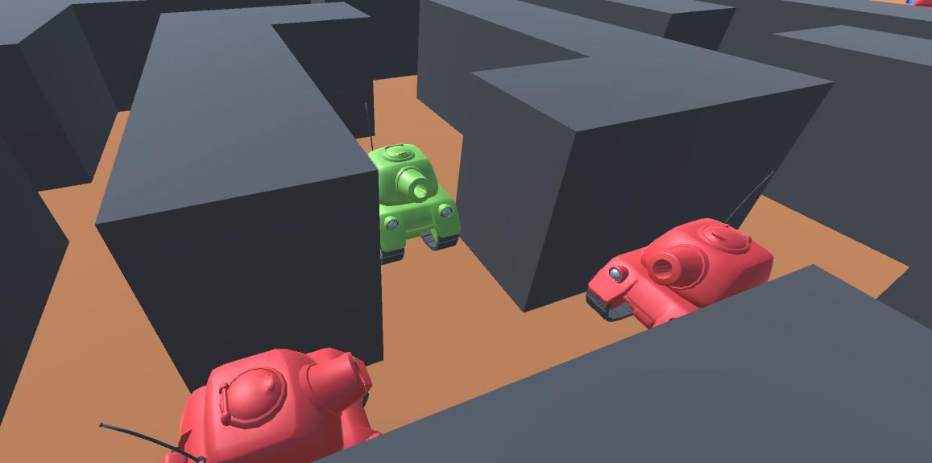
Big Mass
Viet Tran, Qusai Nejim

Slide 2
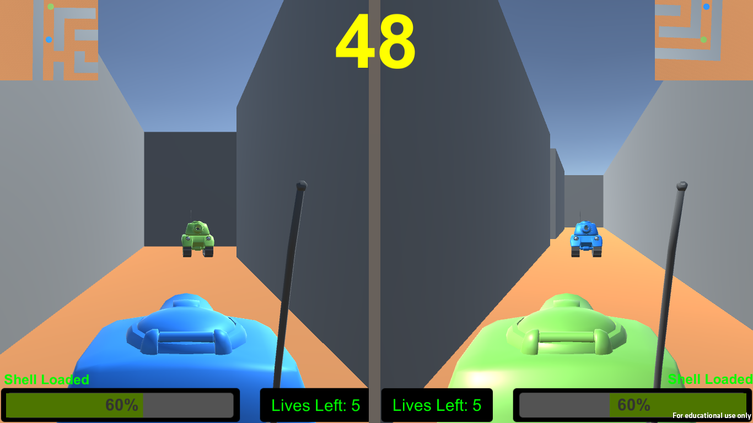
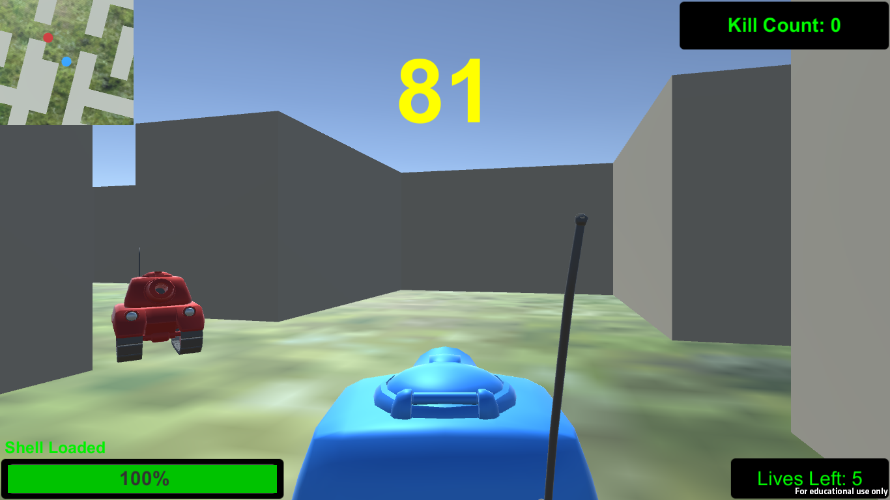
Overview
Big Mass is a third-person shooting game.
There are 4 stages with 2 modes in the game: multiplayer, single player.
Multiplayer: players fight each other until one of them runs out of lives or time’s up.
Single player: player destroys as many tanks as possible until they runs out of lives or time’s up.

Slide 3
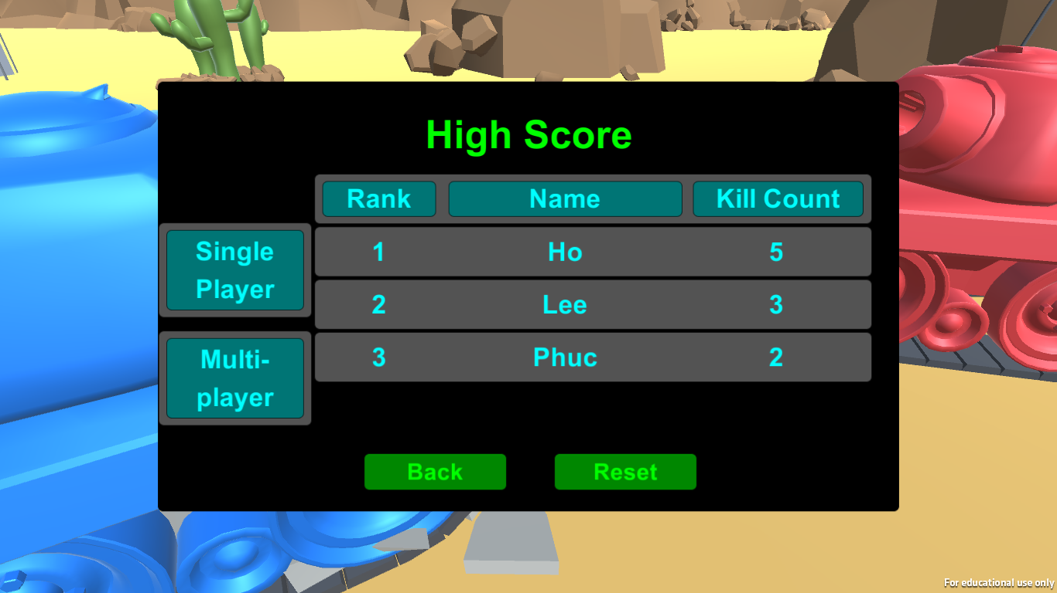
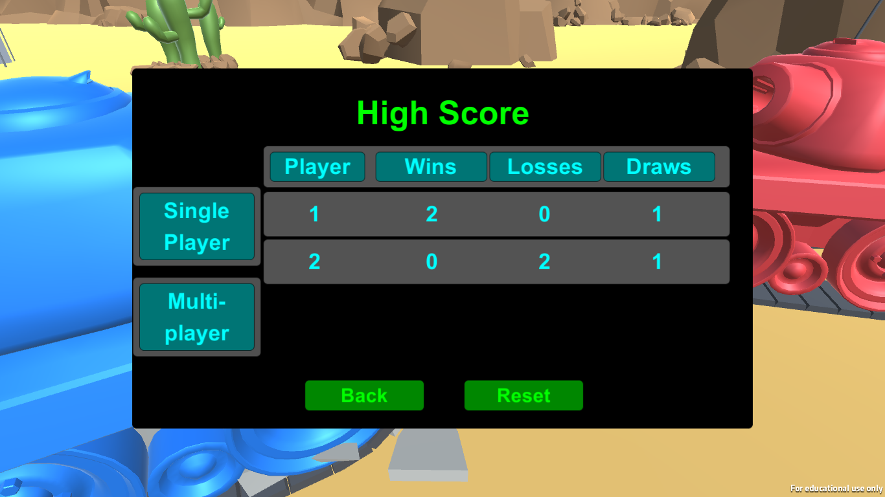
High score
After playing, players can see their records on the High Score section in the main menu
Single player mode only saves the player’s first three best records along with the name player gave.
Multiplayer mode saves all wins, losses and draws from both players.

Slide 4
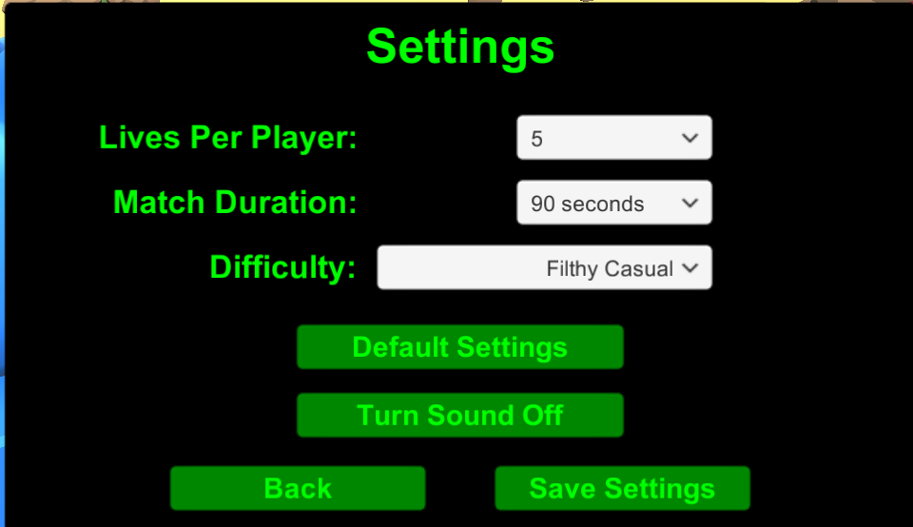
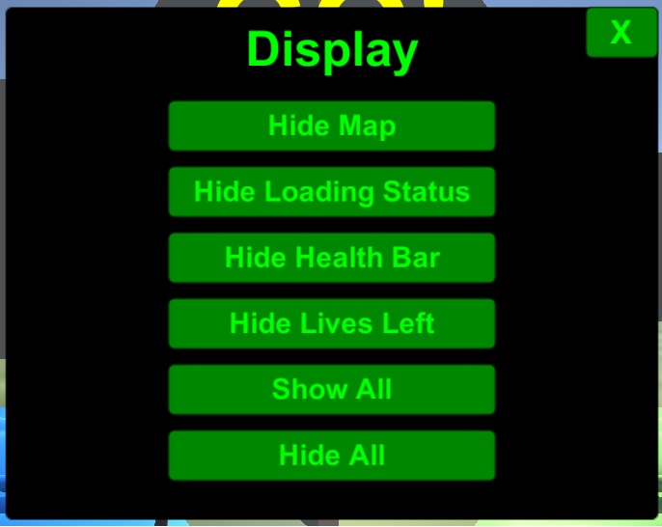
Extra features
Match settings: change how the match proceeds such as match duration, lives per player, difficulty (single player), mute.
Display settings: change what the player sees on the screen during the match such as health bar, map, lives left, etc.
Boxes: Randomly gives bonuses such as increase power, decrease loading time, healing.

Slide 5

How the game may distributed?
Platform: PC, Mac, Android.
Market: Google Play, Apple Store, Windows Store.
Target audience: people of all ages ( mostly focused on children from 10-15 years old).
Price: Free

Slide 6
Others
Software used:
Unity Game Engine
Blender
Language used:
C#
Things I didn’t made by myself:
Tank model
Bullet model
All the sound effects

Slide 7
Thank you for listening!

