Slide 1
Java Database Connectivity (JDBC)

Slide 2
JDBC provides a single interface for access to multiple databases
Java Application
JDBC
Sybase
Oracle
msQL
….

Slide 3
JDBC Component Interaction
DriverManager
Statement
ResultSet
creates
creates
access
Database

Slide 4
Steps to Connect to a Database
Import the necessary classes (java.sql.*)
Load the JDBC Driver
Identify the data source
Allocate a Connection object
Allocate a Statement object
Execute a query using the Statement object
Retrieve data from the returned ResultSet Object
Close the ResultSet
Close the Statement
Close the Connection

Slide 5
Defining some Terms
Driver manager – loads database drivers and manages the connections between the application and the driver
Driver– Translates API calls into operations for a specific data source
Connection – A session between an application and a driver
Statement – A SQL statement to perform a query or update operation.
MetaData – Information about returned data, the database and driver
Result Set – Logical set of columns and rows of data returned by executing a statement.

Slide 6
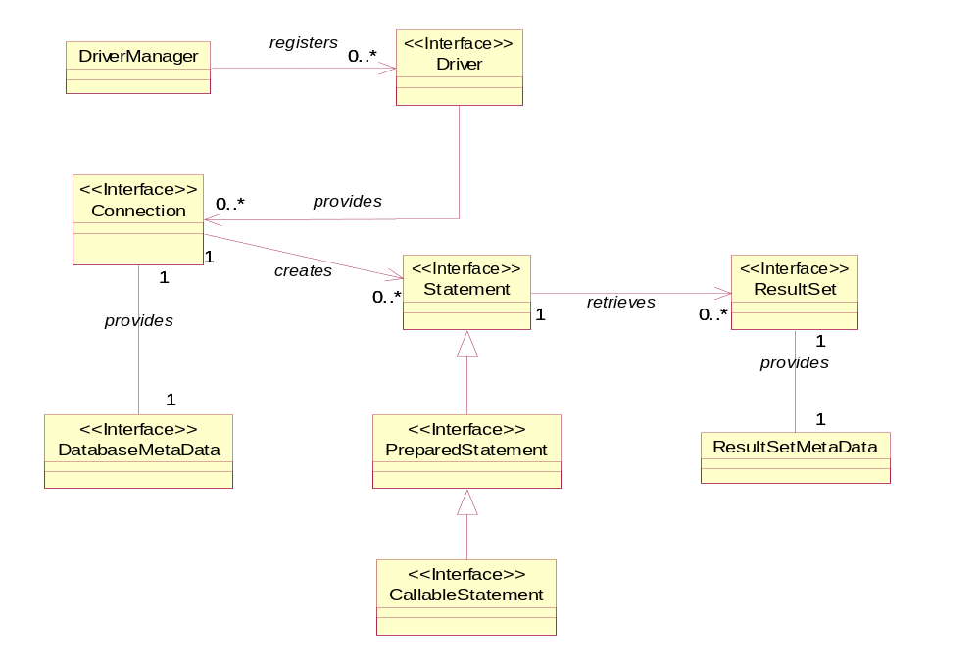

Slide 7
SQLServerDriver
Ms SQL
server
DB2Driver
getConnection(“jdbc:odbc:people”);
DriverManager
MySQL
server
MySQL JDBC Driver
Connection
JdbcOdbcDriver
Ms Access database
DriverManager queries JDBC Drivers to create Connection Object

Slide 8
Putting it into code (MS Access)
public class LookUp {
public static void main(String args[])throws SQLException, ClassNotFoundException {
String dbUrl = "jdbc:odbc:people";
// Load the Driver
Class.forName("sun.jdbc.odbc.JdbcOdbcDriver");
Connection c = DriverManager.getConnection(dbUrl);
Statement s = c.createStatement();
// SQL code
ResultSet r = s.executeQuery("SELECT Name,Email FROM people WHERE Email is null");
while(r.next()) {
System.out.println(r.getString("Name") + ": " + r.getString("Email"));
}
s.close(); // Also closes the Resultset
}
}

Slide 9
Putting it into code (MS SQL server)
public class LookUp {
public static void main(String args[])throws SQLException, ClassNotFoundException {
String userName = “abc”;
String password = “xyz”;
String dbUrl = "jdbc:sqlserver://server_name\\SQLEXPRESS;databaseName=MYDB";
// Load the Driver
Class.forName("com.microsoft.sqlserver.jdbc.SQLServerDriver");
Connection c = DriverManager.getConnection(dbUrl,userName,password);
Statement s = c.createStatement();
// SQL code
ResultSet r = s.executeQuery("SELECT Name,Email FROM people WHERE Email is null");
while(r.next()) {
System.out.println(r.getString("Name") + ": " + r.getString("Email"));
}
s.close(); // Also closes the Resultset
}
}

Slide 10
Putting it into code (MySQL server)
public class LookUp {
public static void main(String args[])throws SQLException, ClassNotFoundException {
String userName = “abc”;
String password = “xyz”;
String dbUrl = "jdbc:mysql://localhost:3306/book";
// Load the Driver
Class.forName("com.mysql.jdbc.Driver");
Connection c = DriverManager.getConnection(dbUrl,userName,password);
Statement s = c.createStatement();
// SQL code
ResultSet r = s.executeQuery("SELECT Name,Email FROM people WHERE Email is null");
while(r.next()) {
System.out.println(r.getString("Name") + ": " + r.getString("Email"));
}
s.close(); // Also closes the Resultset
}
}

Slide 11
Looking at the ResultSet object
The ResultSet returned by the
executeQuery() method is positioned
Before the first row of data
Alice Cooper alice@yahoo.com
James Stewart james@hotmail.com
Mat O’Reilly -
The initial call to the ResultSet next()
method sets the cursor to the first row.
Each subsequent call advances the
cursor of the ResultSet
Calls to data access methods getString()
Apply to the current row posirion

Slide 12
Intro to SQL
CREATE Statement
CREATE TABLE table_name (column_name column_type column_modifiers, …., …….)
CREATE TABLE musicians ( musician_id INT,
Last_name CHAR(40),
First_name CHAR(40),
Nickname CHAR(40))
not null, primary key, etc

Slide 13
INSERT Statement
INSERT INTO table_name (column_name ,…COLUMN_NAME)
VALUES (Value1, ……,Value2)
INSET INTO musicians ( musician_id , last_name, first_name, nickname),
VALUES(2, “Sinatra”, “Frank”, “blue eyes”
Note, you will have to repeat this step for each row

Slide 14
UPDATE Statement
UPDATE table_name
SET column_name = some value,…., …
WHERE column_name = some value
UPDATE albums
SET year = 1994
WHERE album_id = 4

Slide 15
DELETE Statement
DELETE FROM table_name
WHERE column_name = value
DELETE from albums
WHERE album_id = 4

Slide 16
SELECT Statement
SELECT column_name , ….. ,(column_name
FROM table_name
WHERE column_name = value
SELECT title
FROM albums
WHERE category = “rock”

Slide 17
PreparedStatements
Enables SQL statements to be created that are maintained in compiled form – executing more efficiently than statement objects.
Are more flexible than statement objects , because they can specify parameters

Slide 18
preparedStatement authorBooks = connection.prepareStatement( )
SELECT lastName, firstName, title
FROM authors
WHERE lastName = ? AND firstName = ? AND title = ?
authorBooks.setString(1, “Grant”);
authorBooks.setString(2,”Palmer”);
authorBooks.setString(3, “Java Programmers reference”);

Slide 19
Java Design Patterns

Slide 20
Some definitions of design patterns
“recurring solutions to design problems you see over and over”
“a set of rules describing how to accomplish certain tasks in the realm of software development”
“ a pattern addresses a recurring design problem that arises in specific design situations and presents solutions to it.

Slide 21
Why Design Patterns?
Helps to construct reliable software using proven architectures and accumulated industry experience.
Promote design and code reuse in future systems
Helps in identifying common mistakes and pitfalls that occur when building systems.
Helping to design systems independent of the language of implementation
Shortening the design phase in a software-development process

Slide 22
Model View Controller Architectural pattern
Controller
View
Data Model

Slide 23
Pattern Types
Describe techniques for instantiating objects (or groups)- eg., singleton pattern & factory pattern
Creational Patterns
Describes common ways to organize classes and objects in a system- eg., problems associated with class responsibilities
Structural Patterns
Provide stategies to model how objects collaborate with one another. Eg., observer pattern with listener objects
Behavioral Patterns

Slide 24
Gang-of-four 23 design patterns
Creational | Structural | Behavioral
Abstract Factory Builder Factory Method Prototype Singleton | Adapter Bridge Composite Decorator Façade Flyweight Proxy | Chain-of-Responsibility Command Iterator Interpreter Observer Mediator Memento State Strategy Template Method Visitor

Slide 25
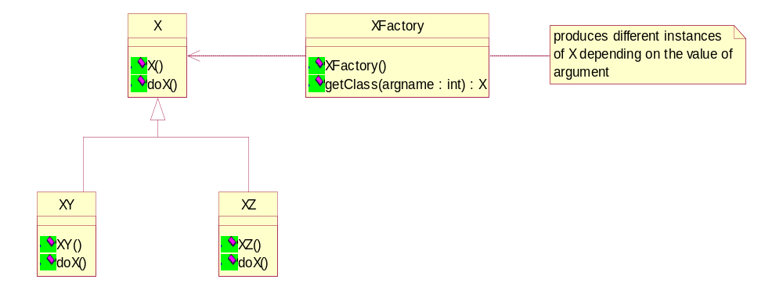
The Factory pattern
When to Use
A class can’t anticipate which kind of class of objects that it must create.
A class uses its subclasses to specify which objects it creates
You want to localize the knowledge of which class gets created

Slide 26
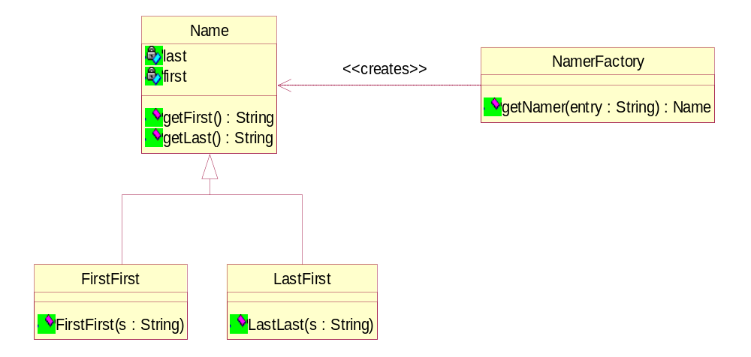
UML Diagram of Factory Pattern Classes

