Slide 1
Java Foundation Classes
AWT
Swing
Java 2D
Accessibility
JFC
Drag & Drop

Slide 5
Abstract Windowing Toolkit (AWT)
Contains numerous classes and methods that allow you to create and manage windows, fonts that run in a GUI environment.
Main purpose is to support applet windows, but can be used to create stand-alone window programs.

Slide 6
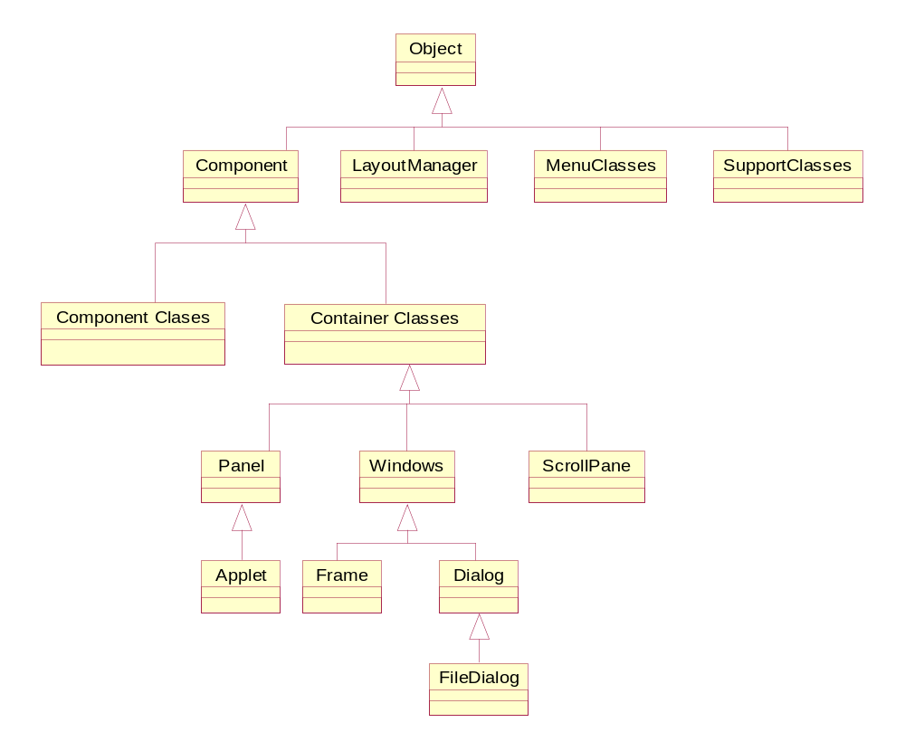
AWT Hierarchy

Slide 7
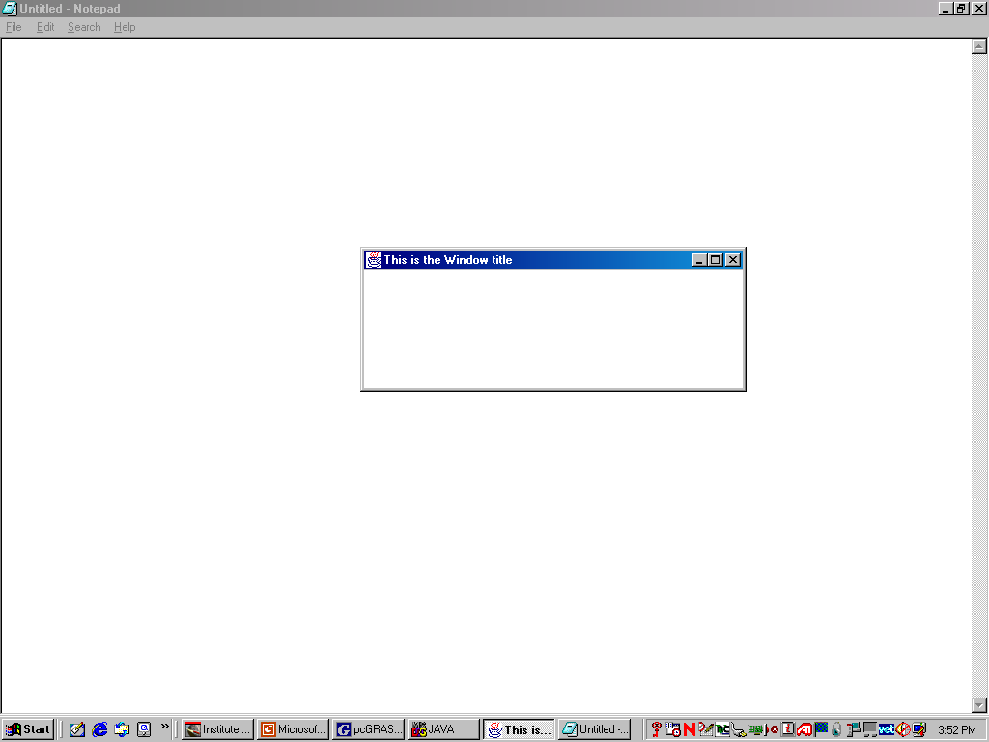
Creating a Window
x = 100
y=50
150
400
DrawWindow

Slide 8
Summary of Container Classes
Container
Description
Window
Defines a window with no title bar and no borders.Not usually used by itself
Frame
Has a title bar and can other other components to it. Its subclasses to create win
Dialog
Used to define a dialog box for the input of data
FileDialog
A dialog box specifically for selecting a file.
Panel
Used to contain and arrange other components. You cannot draw on a Panel
Applet
A base class for applets. You can draw in an Applet and add other components

Slide 9
Components that are not Containers
You can use the Canvas class in two ways. (1) As a base class for defining your own components (2) You can draw on this object
Button
Canvas
Scrollbar
CheckBox
Component
(abstract class)
Label
Choice
List
TextComponent
TextField
TextArea

Slide 10
Component Attributes
Position as (x,y) coordinates relative to its container object.
The name of the component as a String object
Its size is recorded as its width and height
Foreground and background colors when object is displayed.
The font used by the object when text is displayed
The cursor for the object – its appearance when over the object.
Whether the object is enabled or not.
Visibility of object on screen (drawn on screen)
Whether the object is ‘valid’ or not. For example you can make a Container object invalid by changing its contents.It will then need to be validated before it is displayed correctly.

Slide 11
The Size and Position of a Component
Method
Description
void setBounds(int x, int y ,
int width , int height )
Sets the position,width and height of the Component object
void setBounds( Rectangle
Rect )
Sets the position and size of the Component ojject to that of Rect argument
void setSize (Dimension d )
Sets width and height of Component object to values stored in object d
Dimension getSize( )
Returns current size of the Component object as a Dimension object
Point getLocation( )
Returns the position of the Component object as an object of type Point
Rectangle getBounds( )
Returns the position and size of the object as an object of type Rectangle
Toolkit getToolkit( )
Returns a Toolkit object that contains info about the environment your
Application is running, including screen size in pixels.
Window2

Slide 12
Accessibility API
“ Enables assistive technologies such as screen readers and Braille displays to get information from the user interface.”

Slide 13
Drag and Drop Support (Java 2 platform only)
“ Provides the ability to drag and drop between a Java application and a native application “

Slide 14
Java 2D API
“ Enables developers to easily incorporate high-quality 2D graphics, text, and images in applications and in applets”

Slide 15
Defining Color
Colors are represented in Java by objects of the class Color
You define a color value as a combination of the three primary colors, red, green and blue
You can specify the intensity of each primary color to be a value between 0 and 256, or 0.0 and 1.0.
Instead of creating color objects, you could use any of the 13 default color constants defined as static final variables.

Slide 16
Creating Color objects
Color color1 = new Color(int RED, int GREEN,int BLUE )
Color c1 = new Color(0,0,0); // Color black
Color c2 = new Color(255,255,255);//White
Color c3 = new Color(0,100,0); //Green

Slide 17
Color Constants in Java
white
lightGray
gray
darkGray
black
pink
orange
yellow
greeen
10. black
11. magenta
12. cyan
13. blue
aWindows.setBackground(Color.pink)

Slide 18
Frequently used Color methods
Method
Description
brighter( )
Brightens the color
darker( )
Darkens the color
getRed( )
Returns the intensity of specified color
equals(Color obj)
Returns true if colors are equal

Slide 19
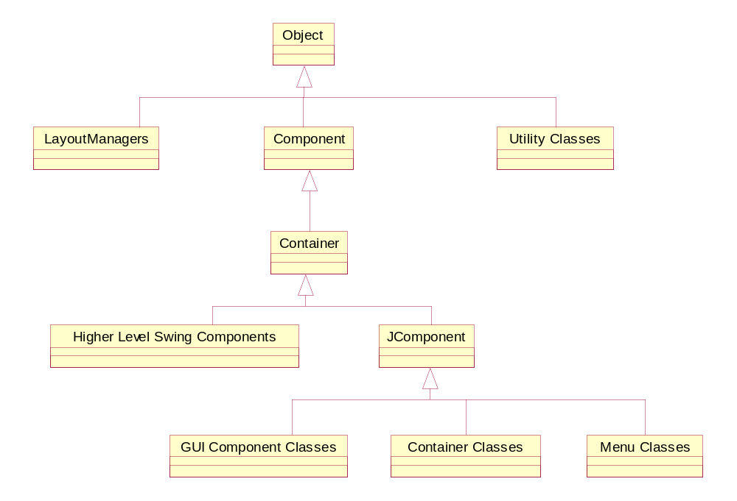
javax.swing

Slide 20
Swing features
Provides a number of new components including trees, tables and tooltips.
The containers defined in the javax.swing
package contains different layers or panes,on which components can be placed.
A new set of classes containing borders enables borders to be placed around components.
Swing components employ a model-view-controller(MVC) architecture that gives the components a great deal of flexibility in specifying the behaviour of the component.
Swing components are written entirely in java so their look and behaviour is not dependent on the runtime’s native environment.

Slide 21
MVC Architecture
UI Manager (Feeds the look and feel to component)
Is responsible for how the component is actually displayed on the screen. The appearance and width of the slider, the size and position of a button are examples.
Contains the quantitative aspects of the component. The minimum and maximum values of a JScrollBar or the list of objects contained in a JList would be examples of information encompassed by the model
View
( The look of the component)
Model
(Component Data)
Defines the manner that the components can be interacted with. The controller would define for instance, that clicking on a button is an acceptable way to intract with the button
Controller
( Deals with events making
changes to the model or view)
Component
UI Delegate

Slide 22
Using Top-Level Containers
A container is a special component that can hold other components
Swing provides three generally useful top-level container classes: JFrame, JDialog, and JApplet
To appear onscreen, every GUI component must be part of a containment hierarchy. Each containment hierarchy has a top-level container as its root.
Each top-level container has a content pane that, generally speaking, contains the visible components in that top-level container's GUI.
You can optionally add a menu bar to a top-level container. The menu bar is positioned within the top-level container, but outside the content pane.
Diagram for internal structure of Top Level container

Slide 23
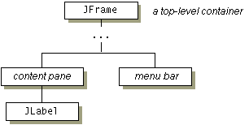
Containment Hierarchy
Each program that uses Swing components has at least one top-level container. This top-level container is the root of a containment hierarchy -- the hierarchy that contains all of the Swing components that appear inside the top-level container.
As a rule, a standalone application with a Swing-based GUI has at least one containment hierarchy with for example JFrame as its root.

Slide 24
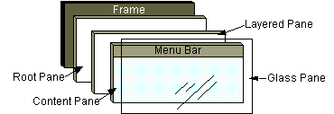
Internal Structure of a high level container
Container

Slide 25

Layered Pane
Manages the content pane and
menu bar and other components
Content pane
  The home for the root pane's container's menus. If the container has a menu bar, you generally use the container's setJMenuBar method to put the menu bar in the appropriate place.
  The container of the root pane's visible
  components,excluding the menu bar.
  Its default layout manager
  is the BorderLayout
  Hidden, by default. If you make the glass pane visible, then it's like a sheet of glass over all the other parts of the root pane. It's completely transparent unless you implement the glass pane's paint method so that it does something, and it intercepts input events for the root pane.
Glass Pane

Slide 26
JFrame Class
Public class Jframe extends Frame implements RootPaneContainer, WindowConstants,Accessible
Object
Component
Container
Window
Frame
JFrame
A top level window with a title bar, border and other platform specific buttons, such as minimize, maximize and close
Components are not added to the JFrame directly, but to one of the sub-panes of the JRootPane object associated with the JFrame object. Generally components are added to the content pane.
An error is thrown if an attempt is made to change the layout manager associated with the JFrame object. Such changes could be made to the content, layered,or glass panes.

Slide 27
JFrame Constructors
Method
Syntax
Jrame( )
public JFrame( )
public JFrame( String title)
public JFrame( GraphicsConfiguration gc)
public JFrame( String title, GraphicsConfiguration gc);
A GraphicsConfiguration object is provided to describe the chatracteristics of a graphics destination such as printer or monitor

Slide 28
Default Close Operations
Method
Syntax
getDefaultCloseOperation( )
public int getDefaultCloseOperation( )
setDefaultCloseOperation( )
Public void setDefaultCloseOperation( int operation)
DISPOSE_ON_CLOSE ( value =1)
DO_NOTHING_ON_CLOSE (value = 2)
EXIT_ON_CLOSE (value = 3)
HIDE_ON_CLOSE (value = 4) // Default value

Slide 29
Methods that return the JRoot sub-elements
Method
Syntax
getContentPane( )
public Container getContentPane( )
getGlassPane( )
public Component getGlassPane( )
getMenubar( )
public JMenuBar getMenuBar( )
getLayeredPane( )
public JLayeredPane getLayeredPane( )
getRootPane( )
public JRootPane getRootPane( )
See diagram for JFrame layers

Slide 30
Internal structure of a JFrame

Slide 31
Methods to set the JRootPane Sub-Elements
Method
Syntax
setContentPane( )
publicvoid setContentpane(Container contentpane )
setGlassPane( )
public void setGlassPane(Component glassPane )
setMenubar( )
public void setMenuBar(JMenuBar menuBar )
setLayeredPane( )
public void J setLayeredPane(JLayeredPane layeredPane )
See diagram for JFrame layers

Slide 32
How to Make Frames (Main Windows)
import javax.swing.*;
class FrameTest {
public static void main(String args[] {
  JFrame frame = new JFrame(“ My Frame”);// title
frame.setDefaultCloseOperation(JFrame.EXIT_ON_CLOSE);
frame.setSize(300,200);// set window size
frame.show();// or setVisible(true)
}
}
Diagram(A)- no GlassPane
Diagram(B) –with GlassPane
FrameTest

Slide 33
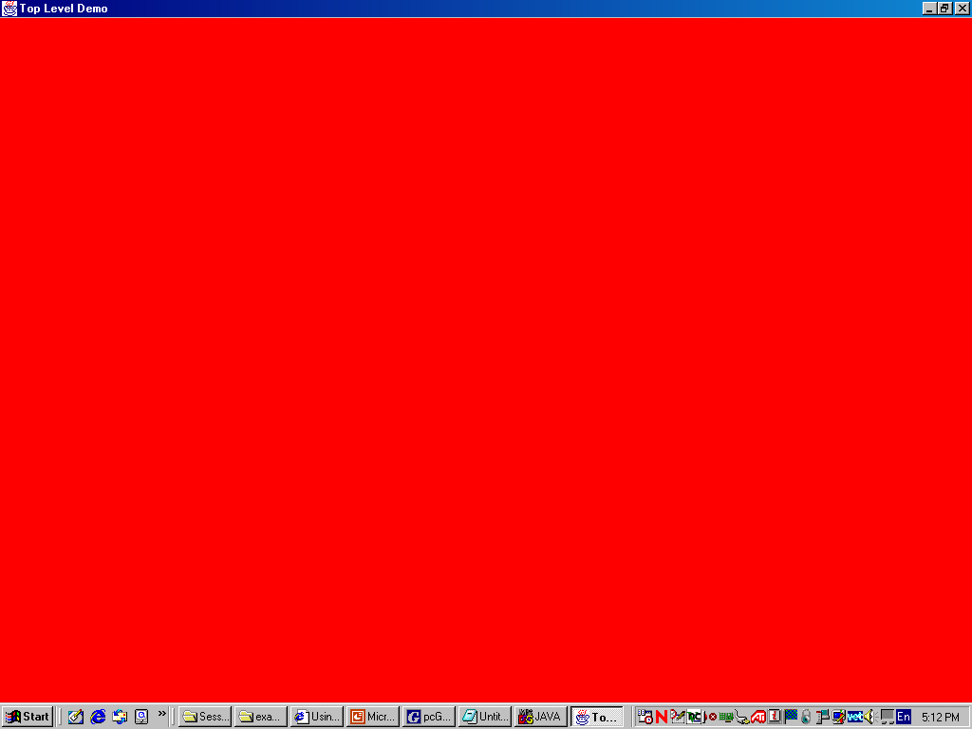
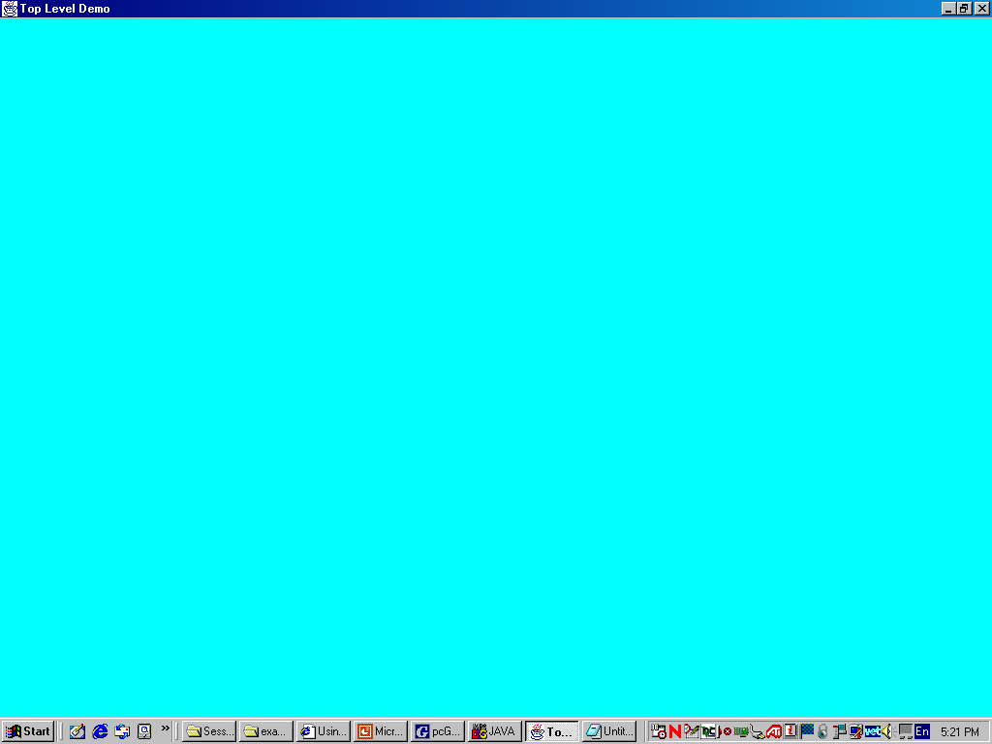
(A)
JRootPane
Content Pane
JRootPane
ContentPane
(B)
GlassPane

Slide 34
Frame Positioning
Screen width
Screen height
CentreFrame

Slide 35
Adding Components to a JFrame
Components are added to the Frames content pane
The content pane uses the BorderLayout Manager by default
Use the pack() to size the Frame instead of setSize(0 method.
The show() or setVisible() methods could be used to display Frame
Note
In Java Frames are really designed to be containers for components such as menu bars and other UI elements. It is not considered good programming practice to draw Strings directly onto a Frame.
FrameDemo

Slide 36
Using Intermediate Swing Containers
These are swing container objects that are not top-level containers.
Panel
Scroll Pane
Split Pane
Tabbed Pane
Tool Bar

Slide 37

Panel Object
The Jpanel class provides general-purpose containers for lightweight components. By default, panels don't paint anything except for their background; however, you can easily add borders to them and otherwise customize their painting.
They are often used to group components .A panel can use any layout manager . The content panes of top-level containers are often implemented as Jpanel instances

Slide 38

ScrollPane
A JScrollPane provides a scrollable view of a component. When screen real estate is limited, use a scroll pane to display a component that is large or one whose size can change dynamically. The scrollbars are added on automatically as required.

Slide 39
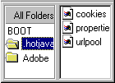
SplitPane
A JSplitPane displays two components, either side by side or one on top of the other. By dragging the divider that appears between the components, the user can specify how much of the split pane's total area goes to each component. You can divide screen space among three or more components by putting split panes inside of split panes.
Instead of adding the components of interest directly to a split pane, you often put each component into a scroll pane. You then put the scroll panes into the split pane. This allows the user to view any part of a component of interest, without requiring the component to take up a lot of screen space.

Slide 40
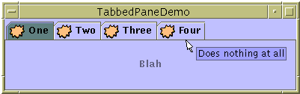
JTabbedPane
With the JTabbedPane class, you can have several components (usually panels) share the same space. The user chooses which component to view by selecting the tab corresponding to the desired component.

Slide 41

JToolBar
Holds a group of components(usually buttons) in a row or column, optionally allowing the user to drag the tool bar into different locations.

Slide 42
JPanel Class
Constructor
Purpose
JPanel()
JPanel(LayoutManager))
Create a panel. The LayoutManager parameter provides a layout manager for the new panel. By default, a panel uses a FlowLayout to lay out its components.
DrawingOnPanels
PanelButtons
Drawing a Rectangle
Placing Buttons

Slide 43
JDialog class
Object
Component
Container
Window
Dialog
JDialog
Is similar to the AWT Dialog object, and is a top level container
Components are not added directly to the JDialog but to one of the subpanes- generally the content pane
A JDialog object can be associated with a parent container, either a JFrame or another JDialog object
Does not support the EXIT_ON_CLOSE close operation, and the default close operation is HIDE_ON_CLOSE
TestDialog

Slide 44
How to make Dialogs
Using JDialog
class
Using
JOptionPane
class
Customized
Dialogs
Modal &
Non-Modal
Dialogs
Standard
Dialogs
Modal
Dialogs
only

Slide 45
The JOptionPane Class
Object
Component
Container
JComponent
JOptionPane
JOptionPane class provides a way to create common pop-up dialog boxes without having to build one from its individual components.
JOptionPane class has a series of constants to define the class property values. These are:
  MESSAGE TYPE
  OPTION TYPE
  INITIAL VALUE
  BOUND PROPERTIES

Slide 46
Creating Dialogs using JOptionPane class
Method 1
By creating objects of the JOptionPane class
Using one of its Constructors( ), and add this
Object to a JDialog or JInternalFrame object using
createDialog( ) or createInternalFrame( )
Method 2
Using one of the static methods of the JOptionPane
class

Slide 47
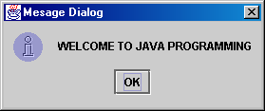
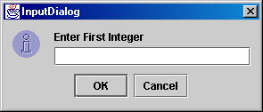
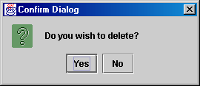
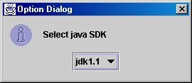
Dialogs using JOptionPane Class
There are four basic types of JOptionPane Dialogs
Displays information to the user that has a single OK button.
(see showMessageDialog ( ) )
Provides a way for the user to input data.It includes two
Buttons OK and Cancel.
(see showInputDialog( ) )
Asks the user to confirm some information.By default it has the Yes, No & Cancel buttons. This can be customized using the option type constants.( see showConfirmDialog( ) )
Displays data a user can select from and may contain any number of buttons.
( see showOptionDialog() )

Slide 48
JOptionPane Constructors
public JOptionPane( )
public JOptionPane(Object message)
public JOptionPane(Object message, int messageType)
public JOptionPane(Object message, int messageType, int optionType)
public JOptionPane(Object message, int messageType, int optionType, Icon icon)
public JOptionPane(Object message, int messageType, int optionType,Icon icon,Object[] options)
public JOptionPane(Object message, int messageType, int optionType, Icon icon,Object[ ] options
Object initialValue )
Code
Run
Exeercise

Slide 49
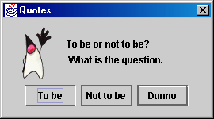
Exercise
Create the above dialog box by using an instance of the JOptionPane class

Slide 50
Using JOptionPane static display methods
These methods create temporary instances of JDialogObjects that contain JOptionPane objects. The input parameters are:
  parent – The parent container of the JOptionPane object. The dialog will be centered on the parent.
  message- A String or Icon that is placed inside the dialog.
  title- A String that appears in the title bar
  messageType- indicates the type of dialog to create.
  optionType- Determines the types of buttons that will be displayed. This parameter is only relevant for Confirm and Option dialogs
  icon- The Icon object that is displayed inside the dialog. Pasing null means the Icon will be determined based on the value of messageType. A messageType of PLAIN_MESSAGE means no icon is displayed.
  selectionValues- used only for input dialogs. It provides a set of values for the user to chose from. If the selectionValue is set to null, a TextField is displayed
  initialSelectionValue- which of the selectionValues is initially selected.
  options- This parameter is used for Option dialogs only. It allows for an arbitary number of buttons to be displayed. An array of Strings or Icons is usually passed.
  initialValue- specifies a default option from the options list.

Slide 51
showMessageDialog( ) method
public static void showMessageDialog( Component parent, Object message)
public static void showMessageDialog( Component parent, Object message,
String title, int messageType)
public static void showMessageDialog( Component parent, Object message,
String title, int messageType, Icon icon)

Slide 52
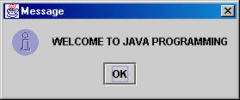
public static void showMessageDialog( Component parent, Object message)
JOptionPane.showMessageDialog(null, "WELCOME TO JAVA PROGRAMMING");

Slide 53
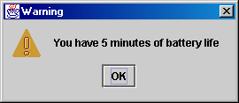
public static void showMessageDialog( Component parent, Object message,
String title, int messageType)
JOptionPane.showMessageDialog(null, "You have 5 minutes of battery life","Warning", JOptionPane.WARNING_MESSAGE);

Slide 54
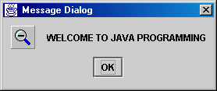
public static void showMessageDialog( Component parent, Object message,
String title, int messageType, Icon icon)
JOptionPane.showMessageDialog(null, "WELCOME TO JAVA PROGRAMMING"," Message Dialog",
JOptionPane.INFORMATION_MESSAGE, icon);

Slide 55
showInputDialog( ) method
public static String showInputDialog( Object message)
public static String showInputDialog( Component parent, Object message)
public static String showInputDialog( Component parent, Object message
String title, int messageType)
Public static Object showInputDialog( Component parent, Object message String title,int messageType,Icon,icon,Object[] selectionValues, Object selectionValue)

Slide 56
showConfirmDialog( ) method
public static int showConfirmDialog( Component parent, Object message)
public static int showConfirmDialog( Component parent, Object message
String title, int option Type)
public static int showConfirmDialog( Component parent, Object message
String title, int option Type,int messageType)
Public static int showConfirmDialog( Component parent, Object message
String title,int optionType, int messageType. Icon icon)

Slide 57
showOptionDialog( ) method
showOptionDialog( ) creates a JDialog object containing an option-style JOptionPane object and returns either YES_OPTION, NO_OPTION, CANCEL_OPTION, OK_OPTION or CLOSED_OPTION
public static int showOptionDialog( Component parent, Object message, String message,String title,int optionType,int messageType, Icon iconObject[] options, Object initialValue)

Slide 58
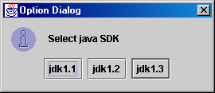
public static int showOptionDialog( Component parent, Object message, String message,String title,int optionType,int messageType, Icon iconObject[] options, Object initialValue)
OD
code

Slide 59




Message type constants
JOptionPane.ERROR_MESSAGE
JOptionPane.INFORMATION_MESSAGE
JOptionPane.QUESTION_MESSAGE
JOptionPane.WARNING_MESSAGE
JOptionPane.PLAIN_MESSAGE

Slide 60
Option type constants
Specifies the number and type of buttons places inside the JOptionPane object
JOptionPane.DEFAULT_OPTION
JOptionPane.OK_CANCEL_OPTION
JOptionPane.YES_NO_CANCEL_OPTION
JOptionPane.YES_NO_OPTION

Slide 61
Initial value constants
Specifies which selection is initially selected or which button has focus. The available options are:
JOptionPane.CANCEL_OPTION
JOptionPane.CLOSED_OPTION
JOptionPane.NO_OPTION
JOptionPane.OK_OPTION
JOptionPane.YES_OPTION
JOptionPane.UNINITIALIZED_VALUE

Slide 62
Bound properties constants
JOptionPane.INPUT_VALUE_PROPERTY
JOptionPane.VALUE_PROPERTY

Slide 63
Using Layout Managers
A LayoutManager is an object that is responsible for positioning and dimensioning of components contained inside a Container object
It does this automatically based on its own criteria
All layout managers implement one of the two interfaces defined in the java.awt package: (1) LayoutManager
(2) LayoutManager2.
Each container should be assigned only one layout manager, and no layout manager should be used to manage more than one container.
The BorderLayout is the default layout manager for every content pane.
The FlowLayout is the default layout manager for JPanel objects.

Slide 64
Layout Manager Hierarchy
Object
FlowLayout
GridLayout
BorderLayout
GridBagLayout
BoxLayout
CardLayout
LayoutManager
LayoutManager2

Slide 65

FlowLayout Manager
FlowLayout is the default layout manager for every JPanel. It simply lays out components from left to right, starting new rows if necessary.
public FlowLayout( )
public FlowLayout(int alignment )
public FlowLayout(int alignment,int hgap,int vgap)
FlowLayout.LEFT
FlowLayout.CENTER
FlowLayout.RIGHT
Specify spacing
between components
In pixels
run
code

Slide 66
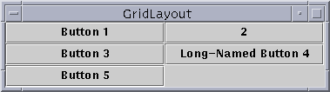
GridLayout Manager
The GridLayout manager arranges the components in rows and columns. Each grid in the layout has the same size, ie every component is of the same size. Components are added from left to right, top to bottom.
public GridLayout( )//one colums per component,only one row is used
public GridLayout(int rows,int columns)
public GridLayout(int rows,int columns,int hgap,int vgap)
run
code

Slide 67
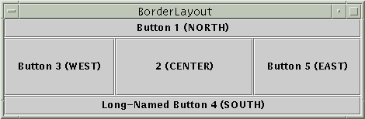
BorderLayout Manager
The BorderLayout class divides the Container into 5 regions, NORTH, SOUTH,EAST,WEST and CENTER.There can be only one component placed in any one region.
public BorderLayout()
public BorderLayout(int hgap,int vgap)
run
code

Slide 68
CardLayout Manager
Hidden Buttons
Button 1
Visible Button
A CardLayout object is a layout manager that stacks components like a deck of cards, with only one component visible at any single given time. Because this layout has a number of member functions, its desireable to instantiate an instance of it.
public CardLayout( )
constructors
public CardLayout(int hgap,int vgap)
Public void first(Container cont)
run
code
Methods to display components
public void last(Container cont)
public void next( Container cont)
public void previous(Container cont)
public void show(Container cont,String comName)

Slide 69
BoxLayout Manager
A BoxLayout object adds elements to a container either left-to-right (X axis), or top-to-bottom(Y axis).
A single constructor BoxLayout( Container target, int orientation) The orientation determines how components are laid out, either along the X-axis or Y-axis, and the following constants are used:
  BoxLayout.X_AXIS
  BoxLayout.Y_AXIS
Components are laid out according to their preferred sizes and they are not wrapped, even if the container does not provide enough space.Each components max size and X/Y alignment is respected.
The class Box which is a light weight container is often used to make using the BoxLayout manager easier. The Box class also supports the insertion of invisible blocks which are lightweight components with bounds but no view. These components are used as filler components.

Slide 70
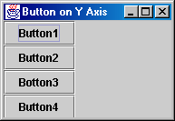
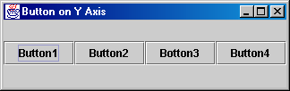
BoxLayout Examples
Y Axis
X Axis
X axis
code
Y axis
code

Slide 71
Using Invisible Components as Filler
Each component controlled by a box layout butts up against its neighboring components. If you want to have space between components, you can either add an empty border to one or both components, or insert invisible components to provide the space. You can create invisible components with the help of the Box class.
The Box class defines a nested class, Box.Filler that provides invisible components. The Box class provides convenience methods to help you create common kinds of filler. The following table gives details about creating invisible components with Box and Box.Filler.

Slide 72

Using Invisible Components as Filler
Type |  | Size constraints | Constraints
rigid area |  |  | Box.createRigidArea(size)
glue | horizontal |  | Box.createHorizontalGlue()
 | vertical |  | Box.createVerticalGlue()
custom.Box.Filler |  | (as specified) | new Box.Filler(minSize, prefSize, maxSize)

Slide 73


Rigid Area
  Use this when you want a fixed-size space between two components. For example, to put 5 pixels between two components in a left-to-right box, you can use this code:
  container.add(firstComponent); container.add(Box.createRigidArea(new Dimension(5,0))); container.add(secondComponent);

Slide 74


Using Glue
  Use this to specify where excess space in a layout should go. Think of it as semi-wet glue -- stretchy and expandable, yet taking up no space unless you pull apart the components that it's sticking to. For example, by putting horizontal glue between two components in a left-to-right box, you make any extra space go between those components, instead of to the right of all the components. Here's an example of making the space in a left-to-right box go between two components, instead of to the right of the components:
  container.add(firstComponent); container.add(Box.createHorizontalGlue()); container.add(secondComponent);

Slide 75

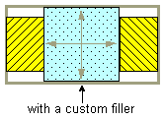
Custom Box.Filler
  Use this to specify a component with whatever minimum, preferred, and maximum sizes you want. For example, to create some filler in a left-to-right layout that puts at least 5 pixels between two components and ensures that the container has a minimum height of 100 pixels, you could use this code:
    container.add(firstComponent); Dimension minSize = new Dimension(5, 100); Dimension prefSize = new Dimension(5, 100); Dimension maxSize = new Dimension(Short.MAX_VALUE, 100); container.add(new Box.Filler(minSize, prefSize, maxSize)); container.add(secondComponent);

Slide 76
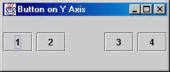
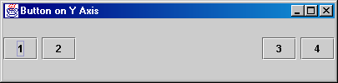
Using Invisible components as fillers
glue
Rigid Area( 5 pixels)
code

Slide 77
GridBagLayout Manager
Components are arranged in rectangular grids, but components are not necessarily the same size, and a component can occupy more than one grid position
Each component in GridbagLayout has its own set of constraints. These are defined by a GridBagConstraints object that is asociated with a component.
The GridBagConstraints object has 11 public instance variables that you can set to define the constaints of a component.
Unlike the FlowLayout, the GridBagLayout will allow components to be clipped by the edge of the managing container, and will not move child components down into a new row. See example

Slide 78
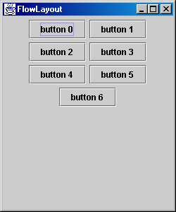

Slide 79
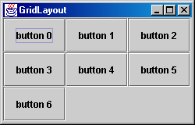

Slide 80
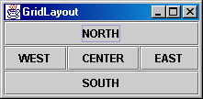
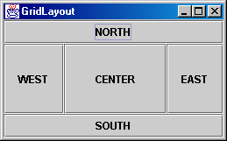

Slide 81
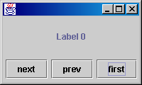

Slide 82
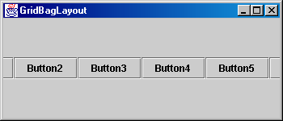
Example of components arranged using a GridBagLayout
Components are clipped if parent container cant accommodate them
code

Slide 83
GridBagConstraints Instance Variables
Type
Variable Name
Purpose
int
gridx
Determines the horizontal position of component in the container
int
gridy
Determines the vertical position of component in the container
int
gridwidth
Specifies the number of columns a component occupies(default =1)
int
gridheight
Specifies the number of rows occupied by component (default=1)
int
anchor
Where a component is positioned within its occupied cell(s)
int
fill
Determines how components expand across an array of cells it occupies. (default = GridBagConstraints.NONE // no expansion)
int
ipadx
The number of pixels the top & bottom edges of the component expands. ( default = 0);
int
ipady
The number of pixels the left and right edges of the component are to be expanded.(default =0)
Insets
insets
Defines the space between the edges of the component and the boundaries of the display area it occupies(default = insets(0,0,0,0))
double
weightx
Determines how space in the container is distributed between components in the horizontal direction, on resizing.(default= 0.0)
double
weighty
Determines how space in the container is distributed between components in the vertical direction, on resizing( default = 0.0)

Slide 84
GridBagConstraints Instance Variables
gridx=1 gridy=3
Grid cell 0,0
 |  |  | (4)
gridheight=1
 | (6) |  |  | (5)
 | gridheight=3
 |  |  |  | (15)
Space around component derived by Insets = new Insets(4,6,15,5)
gridwidth=2
Component 1
Component 2
gridwidth=2
gridx=2 gridy=4

Slide 85
Examples
Using the gridx, gridy, insets, ipadx and ipady constraints
Using the weightx and weighty constraints
Using the gridwidth and gridheight constraints
Using the anchor constraints
Using the fill constraints

Slide 86
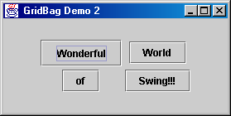
Using the gridx, gridy, insets, ipadx and ipady constraints
Code

Slide 87
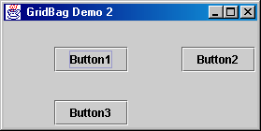
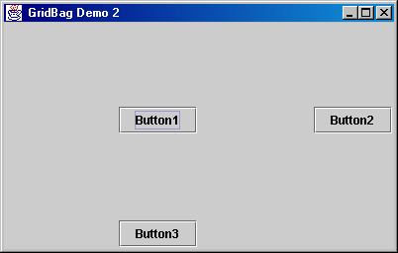
Using the weightx and weighty constraints
On Resizing Window
code

Slide 88

Using the gridwidth and gridheight constraints
code
EXAMPLE

Slide 89
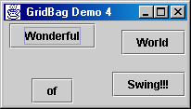
Using the anchor constraints
NORTH
EAST
SOUTH
GridBagConstraints.CENTER // default
GridBagConstraints.NORTH
GridBagConstraints.SOUTH
GridBagConstraints.EAST
GridBagConstraints.WEST
GridBagConstraints.NORTHEAST
GridBagConstraints.NORTHWEST
GridBagConstraints.SOUTHEAST
code
GridBagConstraints.SOUTHWEST

Slide 90
fill constraints
The most common reason for spanning multiple cells is that we want the component contained in that cell to occupy the enlarged space. To do this we use the gridwidth/gridheight condtaints as well as the fill constraint. The fill constraint can be assigned the following values:
GridBagConstraints.NONE
GridBagConstraints.HORIZONTAL
GridBagConstraints.VERTICAL
GridBagConstraints.BOTH

Slide 91
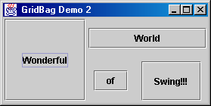
Using fill constraints
code

Slide 92
Swing GUI Components
Object
ButtonGroup
Component
ProgressMonitor
InputStream
Container
FilterInputStream
JComponent
ProgressMonitorInputStream
JComboBox
JList
JSlider
AbstractButton
JLabel
JScrollBar
JTextComponent
JButton
JToggleButton
JMenuItem
JEditPane
JTextArea
JTextField
JCheckBox
JRadioButton
JPassword

Slide 93
AbstractButton Class
The parent class for all Swing button components and many menu components as well. Because it is an abstract class its never instantiated.
Methods
ActionCommand Methods
Alignment Methods
doClick(0 method
Icon Methods
Mnemonic Methods

Slide 94
ActionCommand Methods
Every AbstractButton sub class object can have an action command String associated with it, that can be used to identify the button.
public String getActionCommand()
public String setActionCommand(String actionCommand)
run
code

Slide 95
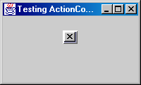
Button Object identified by String “close”

Slide 96
Alignment Methods
These methods return or set the horizontal or vertical alignment of the invoking AbstractButton subclass object.
public int getHorizontalAlignment()
public int getHorizontalTextPosition()
public int getVerticalAlignment()
public int getVerticalTextPosition()
public void setHorizontalAlignment(int horizAlign)
public void setHorizontalTextPosition(int horizAlign)throws IAE
public void setVerticalAlignment(int vertAlign)
public void setVerticalTextPosition(int vertAlign)

Slide 97
Alignment Constants
top
VA
center
Vertical Alignment Constants
HA
bottom
left
center
right
Horizontal Alignment Constants
SwingConstants.LEFT
SwingConstants.CENTER
SwingConstants.RIGHT
SwingConstants.TOP
SwingConstants.CENTER
SWingConstants.BOTTOM
default

Slide 98
JButton Class
Method
Syntax
JButton()
public JButton()
public JButton(Icon icon)
public JButton(String text)
public JButton(String text, Icon icon)

Slide 99
JCheckBox Class
Method
Syntax
JCheckBox()
public JCheckBox()
public JCheckBox(Icon I, boolean selected)
public JCheckBox(String text)
public JCheckBox(String text, boolean selected)
public JCheckBox(Icon i)
public JCheckBox(String text, Icon i)
public JCheckBox(String text, Icon I, boolean selected)

Slide 100
JComboBox Class
Method
Syntax
JComboBox
public JComboBox( )
public JComboBox(Object[] items )
public JComboBox(Vector items )
addItem()
public void addItem(Object o)
public void insertItemAt(Object o, int index)

Slide 101
JLabel Class
Method
Syntax
JLabel
public JLabel()
public JLabel(Icon image)
public JLabel(Icon image, int horizontalAlignment)
public JLabel(String text)
public JLabel(String text, int horizontalAlignment)
public JLabel(String text, Icon image, int horizontalAlignment)
SwingConstants.LEFT
SwingConstants.CENTER
SwingConstants.RIGHT

Slide 102
JTextField Class
Method
Syntax
JTextField
public JTextField( )
public JTextField(String text )
public JTextField(int columns )
public JTextField(String text, int columns )

Slide 103
JTextArea Class
Method
Syntax
JTextArea
public JTextArea( )
public JTextArea(int rows, int columns )
public JTextArea( String text)
public JTextArea(String text, int rows, int columns )

Slide 104
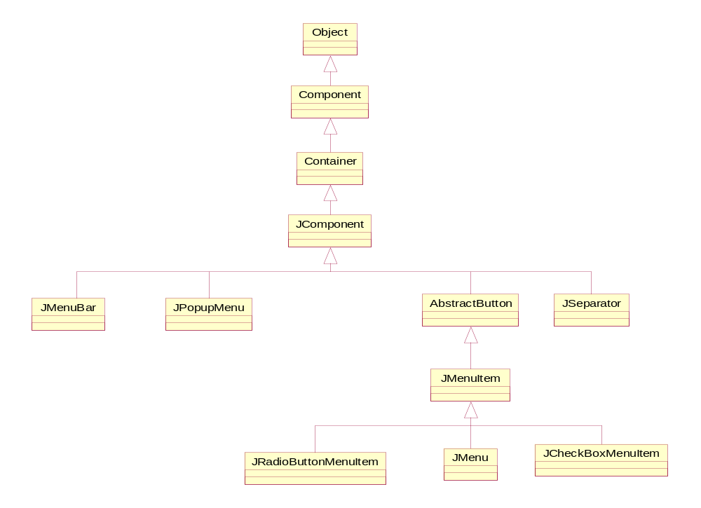
Menu Classes

Slide 105
JMenu Class
Represents a pull-down menu that can be placed in a container
Can contain JMenuItem, String, or Action objects
A Jmenu object can also contain other Jmenu objects, because it’s a JMenuItem object
A Jmenu object generates MenuEvent objects when it is selected, deselected, or removed from the screen

Slide 106
JMenu() Constructors
Method
Syntax
JMenu( )
public JMenu( )
public JMenu(Action act )
public JMenu(String name )
public JMenu(String name, boolean tearoff )
This property indicates whether the Jmenu object can be moved about the screen and is not currently implemented

Slide 107
add( ) , insert( ) Methods
Method
Syntax
add( )
public JMenuItem add(JMenuItem menuItem )
public JMenuItem add(String s )
public JMenuItem add(Action a )
public Component add(Component c )
public Component add(Component c, int index )
Method
Syntax
insert( )
public void insert(String s, int index )
public JMenuItem insert(JMenuItem jmi, int index )
public JMenuItem insert(Action a )
public JMenuItem add(Component c )

Slide 108
JMenuBar
Method
Syntax
JMenuBar( )
public JMenuBar( )
add( )
public JMenu add(Jmenu menu)

Slide 109
JMenuItem Class
Constructor
Syntax
JMenuItem( )
public JMenuItem( )
public JMenuItem(Icon icon)
public JMenuItem(String s )
public JMenuItem(String s, Icon icon))
public JMenuItem(String s, int mnemonic )
public JMenuItem add(Action action)

Slide 110
Handling Events
Keystrokes, Mouse Actions
Operating System
Java Library Classes
Events
Your Program
method
method
method
method

Slide 111
The Event Handling Process
Button click
public class MyButtonhandler implements
ActionListener {
//class members….
//Constructor…..
…….
button.addActionListsner(this);
…….
void actionPerformed(ActionEvent e) {
// Handle the event …..
}
}
OK
The listener object connects to the event source by calling addActionListener() of the source object
creates
ActionEvent
object
Passed to
Event Class

Slide 112
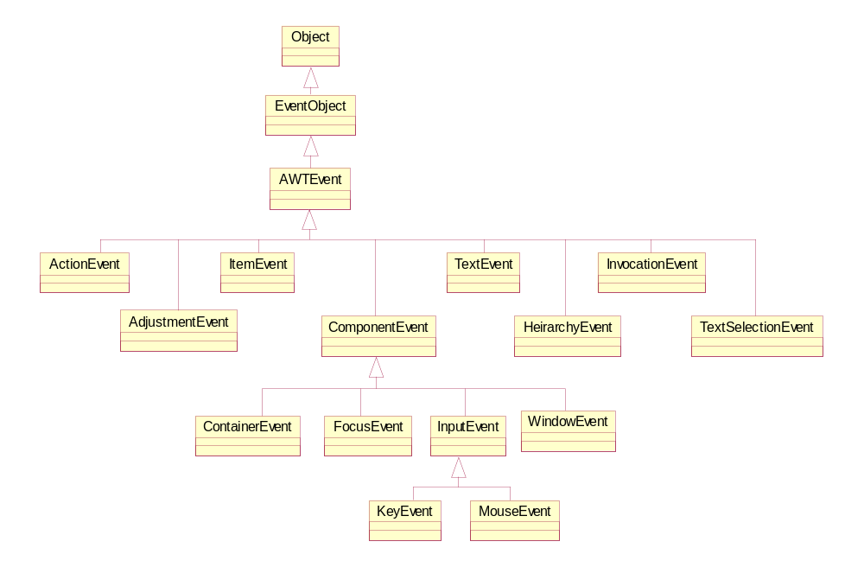
Event Class Hierarchy

Slide 113
EVENT CLASSES
LOW LEVEL
EVENT CLASSES
SEMANTIC
EVENTS
FocusEvent
ActionEvent
MouseEvent
TextEvent
KeyEvent
ItemEvent
WindowEvent
AdjustmentEvent
ContainerEvent

Slide 114
Low Level Event Classes
FocusEvent – Objects of this class are fired when a component gains or loses focus
MouseEvent– Objects are created when the mouse is moved,clicked or dragged
KeyEvent– Objects are when a key is pressed and/or released
WindowEvent– Objects are created when a window is opened, closed iconified, deiconified, activated or deactivated.
ContainerEvent– Objects are created when a container is added to or removed from a container

Slide 115
Semantic Event Classes
ActionEvent – is created when one of the following events takes place: 1. A button is pushed
2. A list item is double-clicked
3. A menu item is selected
4. A Return key is pressed in a text or password field.
ItemEvent – is created when one of the following events takes place: 1. Selecting an element from a JComboBox component
2. Selecting/de-selecting a JCheckBox, JRadioButton or JToggleButton
3. Single-clicking a List item
4. Toggling a JCheckBoxMenuItem, or JRadioButtonMenuItem on/off
TextEvent– is created when one of the following events takes place: . 1. The contents of a JTextField , JTextArea , JPassword change
TextSelectionEvent– is created when one of the following events takes place: The selected text of a JTextField , JTextArea , JPassword change (removed)
AdjustmentEvent– is created when one of the following events takes place: moving the slider on a scrollbar component.
return

Slide 116
Listener Interfaces
Listener Interfaces provide methods to receive and process events
A Listener Interface can have one or many methods which can be implemented.
A multiple method interfaces usually have an adapter class associated with them, saving time.
There are 3 ways to implement a listener interface:
1. The Component or Container class may itself implement the interface
2. The interface may be implemented in a separate class
3. It may be implemented as an Inner Class.

Slide 117
Low-Level Listener Interfaces
WindowListener
MouseListener
MouseMotionListener
KeyListener
FocusListener

Slide 118
WindowListener Methods
Provides methods for handling 7 types of WindowEvents
Method | Description
windowOpened(WindowEvent e) | Called the first time the window is opened
windowClosing(WindowEvent e) | Called when the system menu Close item or the windows close icon is selected.
windowClosed(WindowEvent e) | Called after a window has closed
windowActivated(WindowEvent e) | Called when the window is activated-by clicking on it for example.
windowDeactivated(WindowEvent e) | Called when a window is deactivated – by clicking on another window for example.
windowIconified(WindowEvent e) | called when a window is minimized and reduced to an icon
windowDeiconified(WindowEvent e) | Called when a window is maximized from an icon
TestWindowL

Slide 119
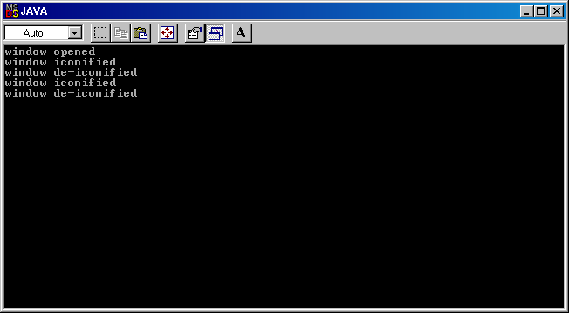
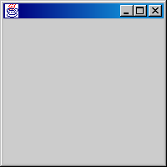

Slide 120
MouseListener Methods
Method | Description
mouseClicked(MouseEvent e) | Called when a mouse button is clicked on a component- the button is pressed and released
mousePressed(MouseEvent e) | Called when mouse button is pressed on a component
mouseReleased(MouseEvent e) | Called when a mouse button is released after being pressed down
mouseEntered(MouseEvent e) | Called when the mouse enters the area occupied by a component
mouseExited(MouseEvent e) | called when the mouse exits the area occupied by a component.
code1
run
code2

Slide 121
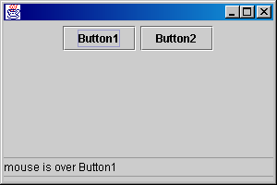
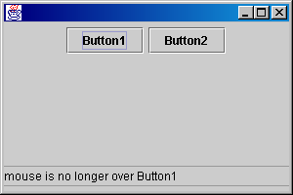

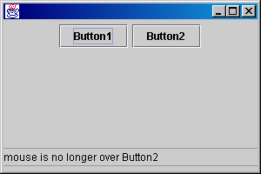

Slide 122
MouseMotionListener Methods
Method | Description
mouseMoved(MouseEvent e) | Called when the mouse is moved within a component
mouseDragged(MouseEvent e) | Called when the mouse is moved within a component while a mouse button is held down.
TestMML
run

Slide 123
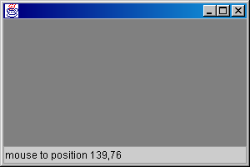
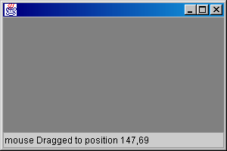
x = 139
x = 147
y = 69
y = 76

Slide 124
KeyListener
Method | Description
keyTyped(KeyEvent e) | Called when a key on the keyboard is pressed then released
keyPressed(KeyEvent e) | Called when the key on the keyboard is pressed
KeyReleased(KeyEvent e) | Called when the key on the keyboard is released
TestKL
run

Slide 125
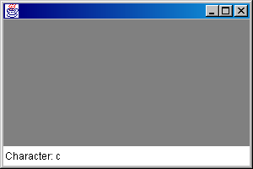

Slide 126
FocusListener Methods
Method | Description
focusGained(FocusEvent e) | Called when a component gains the keyboard focus
focusLost(FocusEvent e) | Called when a component loses the keyboard focus
TestFL
run

Slide 127
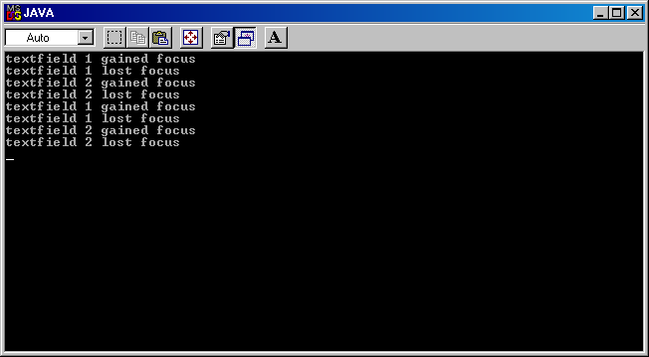
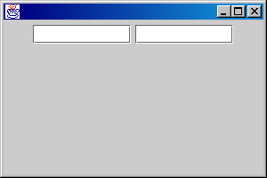

Slide 128
Semantic Event Listener Interfaces
InterFace
Method
ActionListener
void actionPerformed (ActionEvent e)
ListSelectionListener
void valueChanged(ListSelectionEvent e)
AdjustmentListener
void adjustmentValurChanged(AdjustmentEvent e)
TextListener
Not implemented by JText components
TextSelectionListener
This interface was present in JDK1.3 release Candidate1, but has
Removed from Release Candidate 2 onwards
peek

Slide 129
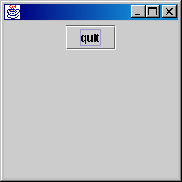
testAL

Slide 130

TestIL

Slide 131



TestADl

