Slide 1


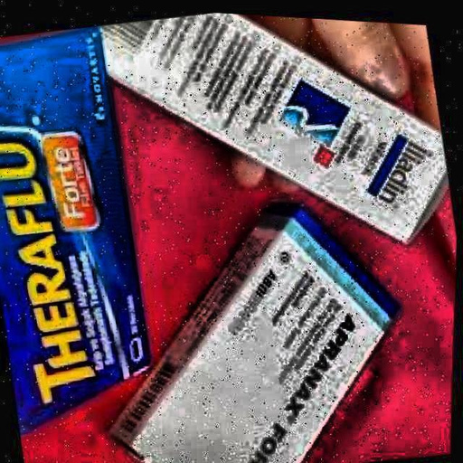
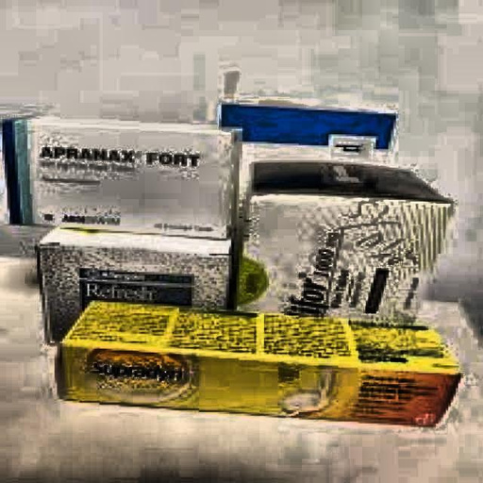
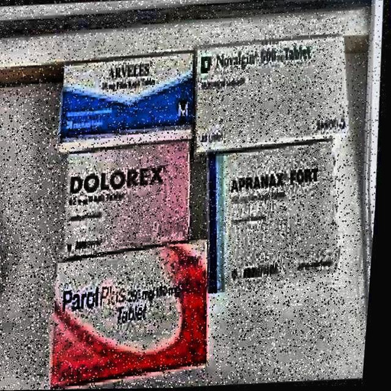
Object Detection for
Turkish Pharmaceutial Drug Dataset
Group 7
1

Slide 2



Agenda
Team Members
1
Introduction
Hoang Kim Huong - 22BA13158
Doan Ngoc Linh - 22BA13190
Dang Dinh Hoa - 23BI14169
Le Viet Hung - 23BI14182
Nguyen Gia Nam - 23BI14328
Nguyen Duc Thanh - 23BI14406
2
Data Overview
3
Methodology & Implementation
4
Evaluation
5
Conclusion
2

Slide 3


01. Introduction
Context
Object detection for pharmacy automation
Reduce human error in management
Improves operational efficiency
Challenges
Similar drug box shapes & sizes, packaging colors
Different angles
Difficulty in differentiating drug classes
RetinaNet + ConvNeXt-Tiny
Fully Convolutional One-Stage + ConvNeXt-Small
Proposed Approach
3
Notes:
4-stage pipeline: (1) image preprocessing, (2) text recognition using OCR, (3) structured information extraction in JSON format, and (4) a rule-based question answering chatbot

Slide 4
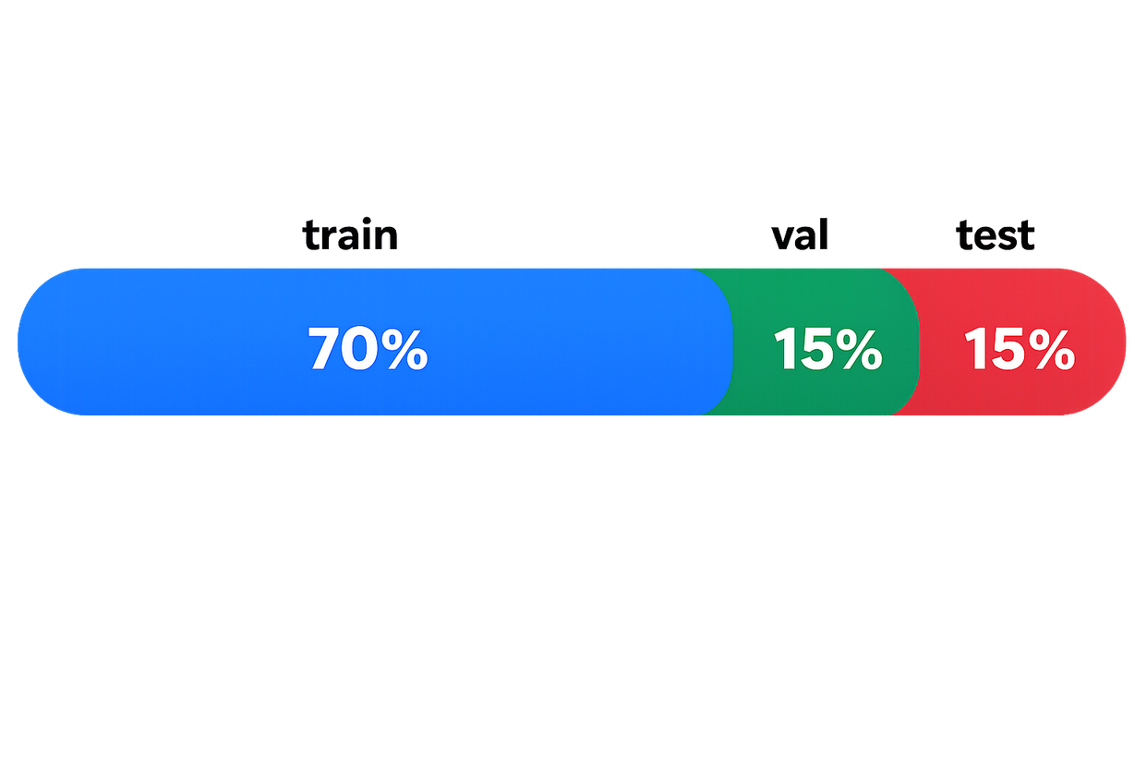
02. Data Overview
Dataset Overview
Dataset: Turkish Pharmaceutical Drug Dataset
Task: Drug box object detection
Format: YOLO-compatible annotations
Total images: 14,932
Image size: 640 × 640 (.jpg)
Classes: 12 drug categories
Drug Classes
aferin: Decongestant medication
apranax: Anti-inflammatory drug
arveles: Pain reliever
aspirin: Common pain reliever and blood thinner
dolorex: Pain medication
hametanKrem: Topical cream
hametanMerhem: Topical ointment
majezik: Pain reliever
metpamid: Anti-nausea medication
parol: Pain reliever
terbisil: Antifungal medication
unisom: Sleep aid medication
4

Slide 5


03. Methodology & Implementation
Data preprocessing
Input standardization
Convert images
→ RGB (3 channels)
Scale pixels [0–255] → [0–1]
Data cleaning
Clip boxes to image boundary
Remove invalid / tiny boxes
Validate class IDs
Annotation standardization
YOLO bbox + polygon labels
Convert all → bounding boxes
Eg: 0 0.27071744999999997 0 0.25350870625 0.08854474062499999 0.3339921703125 0.53257750625 1 0.47395911875 → x_min = 0; y_min = 0.25350870625; x_max = 0.53257750625; y_max = 1
Data Augmentation + Normalization
Geometric augmentation: Random horizontal flip (p = 0.5)
Normalization: ImageNet mean & standard deviation
5

Slide 6
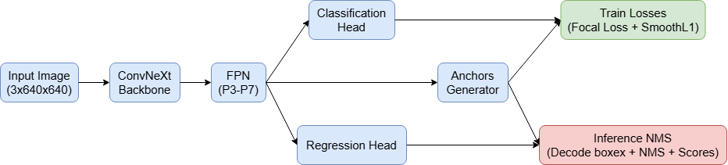
03. Methodology & Implementation
Architecture
(RetinaNet–ConvNeXt)
Training Losses
Classification:
Focal Loss
Handles class imbalance
Bounding box regression:
Smooth L1 Loss
Stabilizes box prediction
Inference NMS
Decode anchor offsets
→ bounding boxes
Compute confidence scores
Apply Non-Maximum Suppression (NMS)
Keep highest-score box
Remove overlapping boxes
Anchor Generator
Generate anchors: Multiple scales & aspect ratios
IoU-based assignment:
Positive: IoU ≥ 0.5
Negative: IoU < 0.4
Ignore: 0.4 ≤ IoU < 0.5
Backbone:
ConvNeXt-Tiny
Extract hierarchical features
Neck: Feature Pyramid Network (FPN)
Detection heads:
Classification head
Bounding box regression head
6

Slide 7
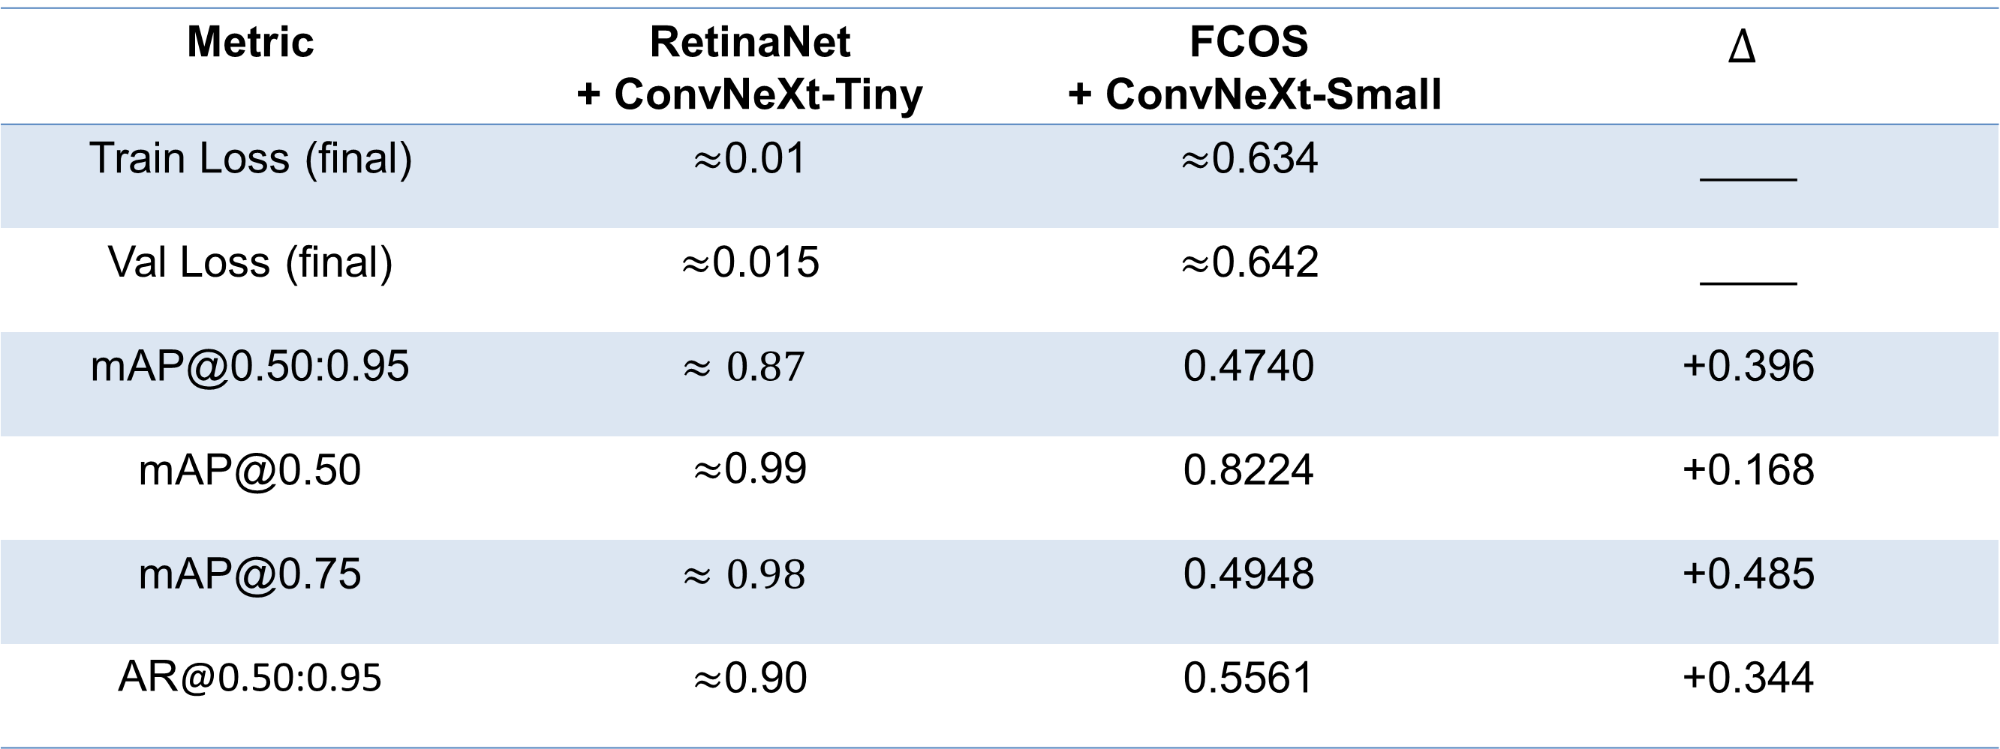
04. Evaluation
Metric | RetinaNet + ConvNeXt-Tiny | FCOS + ConvNeXt-Small | $$Δ$$
Train Loss (final) | $≈$0.01 | $≈$0.634 | ____
Val Loss (final) | $≈$0.015 | $≈$0.642 | ____
mAP@0.50:0.95 | $$≈0.87$$ | 0.4740 | +0.396
mAP@0.50 | $≈$0.99 | 0.8224 | +0.168
mAP@0.75 | $$≈0.98$$ | 0.4948 | +0.485
AR@0.50:0.95 | $≈$0.90 | 0.5561 | +0.344
Comparision of detection metric on test set (30 epochs)
7

Slide 8
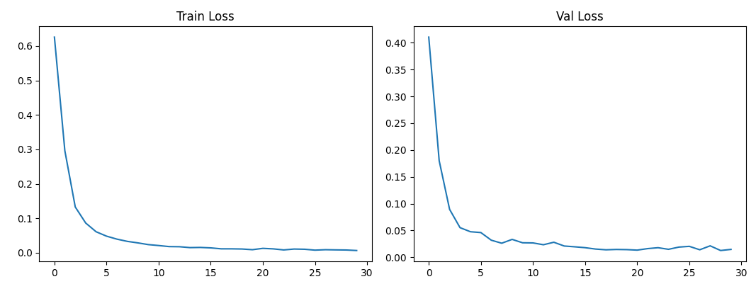
04. Evaluation
RetinaNet + ConvNeXt-Tiny training metrics
7

Slide 9
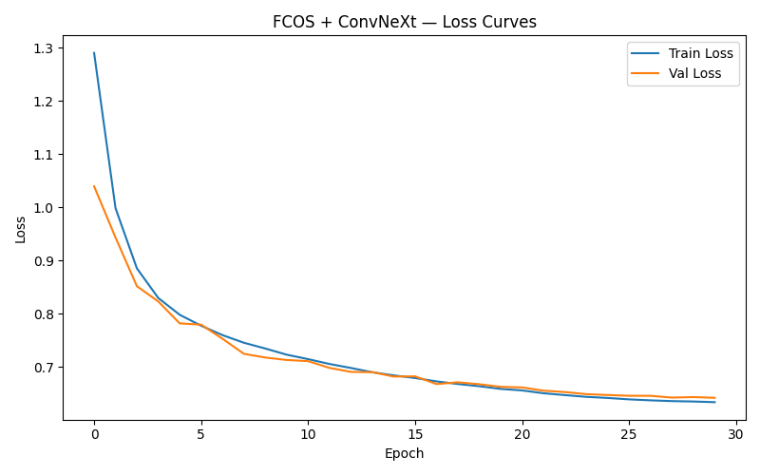
04. Evaluation
7

Slide 10
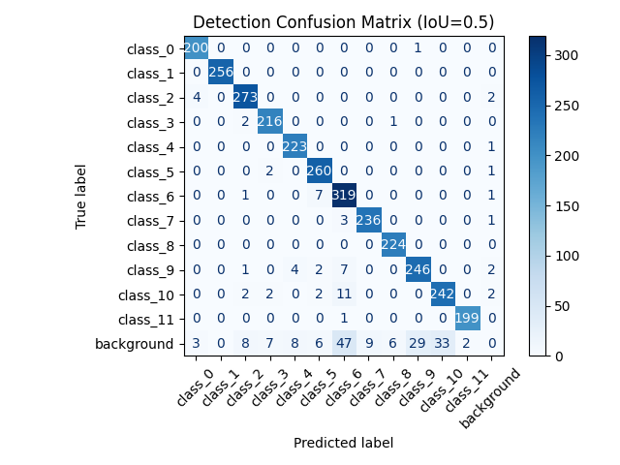
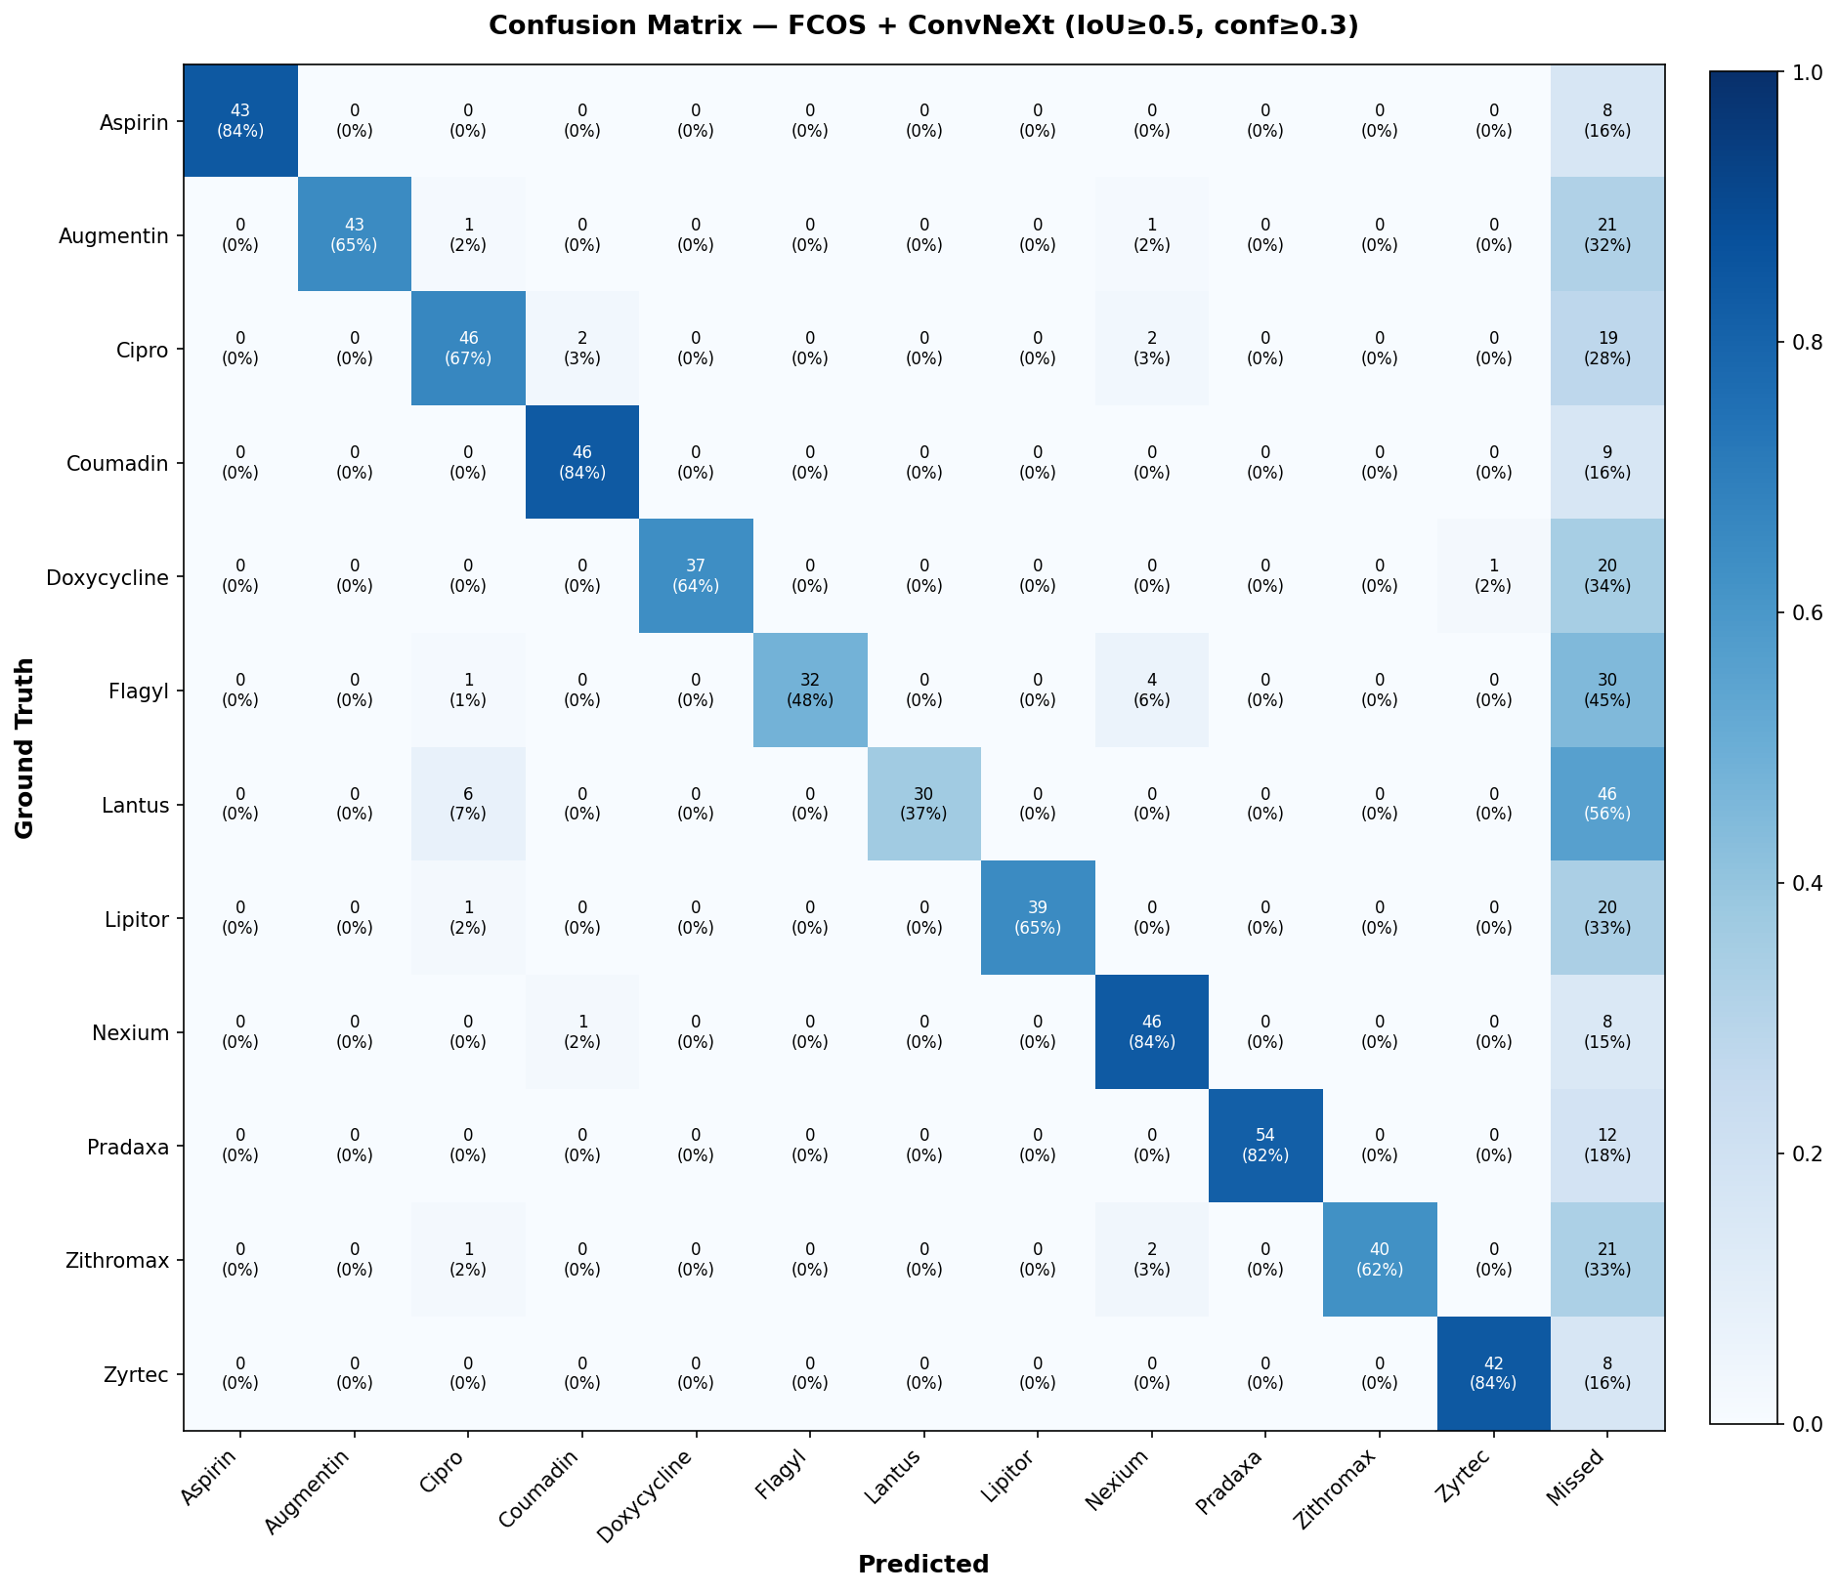
04. Evaluation
RetinaNet + ConvNeXt
8

Slide 11
05. Conclusion
Models Evaluated
FCOS + ConvNeXt-Small
mAP@0.50 ≈ 0.82
mAP@0.75 ≈ 0.49
RetinaNet + ConvNeXt-Tiny
mAP@0.50 ≈ 0.99
mAP@0.75 ≈ 0.98
Higher input resolution (640x640 vs 512x512)
Anchor-based regression
Easier optimization for consistent object sizes
Both models converged well
No significant overfitting
Future Work
Increase FCOS input resolution
Improve regression loss design
8

Slide 12


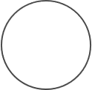







Thanks for
listening!
9

