Slide 1

NutriSnap
CSC10014 · MID-TERM PRESENTATION
Snap your meal. Know your nutrition. Build healthier habits.
University of Science, VNU-HCM · Faculty of Information Technology
Notes:
Good morning, teachers and everyone. We are team NutriSnap. I am Việt Huy, the team leader, and with me are Khôi Nguyên, Thành Đạt, Minh Đức, Phú Hiếu and Quốc Tuấn. NutriSnap is a mobile app that lets you snap a photo of your meal, know its nutrition, and build healthier daily habits.

Slide 2
Meet our team
NH
Nguyễn Hoàng Việt Huy
KN
Kiều Khôi Nguyên
LĐ
Lê Thành Đạt
25127060
25127107
25127293
Team leader
Member
Member
NĐ
Nguyễn Trần Minh Đức
LH
Lê Hoàng Phú Hiếu
HT
Hoàng Quốc Tuấn
25127300
25127049
25127543
Member
Member
Member
Notes:
Let me introduce our team. We have six members. I am Việt Huy, the team leader. With me are Khôi Nguyên, Thành Đạt, Minh Đức, Phú Hiếu and Quốc Tuấn. Together we designed the UI, wrote the functions and built the working prototype you will see today. A quick note on progress: the course asks for UI design, a function list, a use case diagram and a coding plan at this stage. We have done all of these, and we also have a working app on a real Android phone, so every screen in this presentation is a real screen.

Slide 3
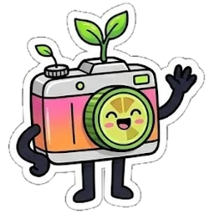
The story behind NutriSnap
TOPIC 01 · PRODUCT OVERVIEW
Who we are building for – and why
Notes:
Let us begin with Part one: the product, and the story behind it.

Slide 4
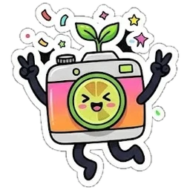


Meet Minh Anh – a story many students know
Day 1
Day 3
Day 5
“I will eat healthier this month!”
“Where is cơm tấm in this list?”
“This takes too long…”
Downloads a calorie app, full of motivation.
Searches every dish, guesses grams, types numbers.
Stops logging. The goal is forgotten.
Our mission
Make healthy tracking take seconds, not minutes – with Vietnamese food first and numbers you can trust.
Persona based on our own experience as students.
Notes:
Meet Minh Anh. She is a persona we created from our own experience as students. On day one she is motivated and wants to eat better on fifty thousand đồng a day. On day three she is tired of searching for every dish and guessing the grams. On day five she gives up. This happens to many of us. The problem is not motivation; the problem is that logging takes too long, local dishes like phở or cơm tấm are hard to find, and numbers from chatbots are not always trustworthy. So our mission is simple: make healthy tracking take seconds, not minutes.

Slide 5
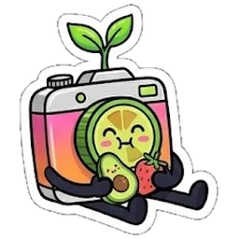

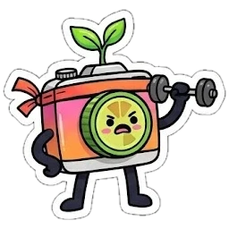
Who NutriSnap is designed for
The student
The office worker
The gym-goer
GOAL
GOAL
GOAL
Eat healthy on ~50,000 VND a day
Lose weight safely, without strict diets
Enough protein to build muscle
NUTRISNAP GIVES
NUTRISNAP GIVES
NUTRISNAP GIVES
Budget-aware dish suggestions, simple daily target
Safe weekly pace, weight trend, reminders
Macro targets, protein-rich food swaps
Notes:
NutriSnap is designed for three main groups. Students who want healthy food on a small budget. Office workers who want to lose weight safely. And gym-goers who need enough protein to build muscle. Each group has its own goal, so the app builds a personal plan for each person. In fact, our three demo accounts are exactly these three personas.

Slide 6
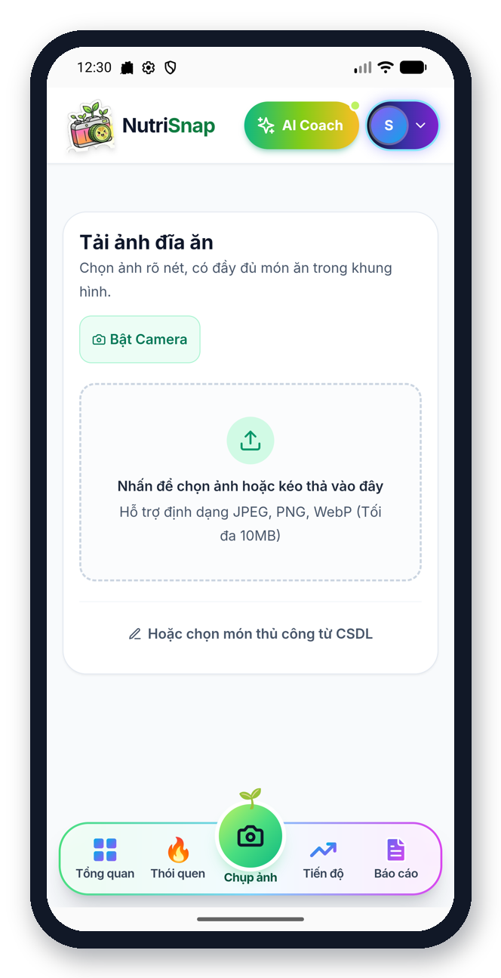
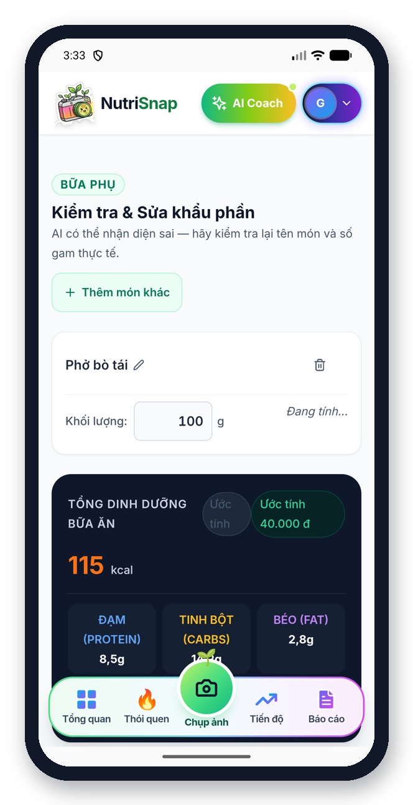
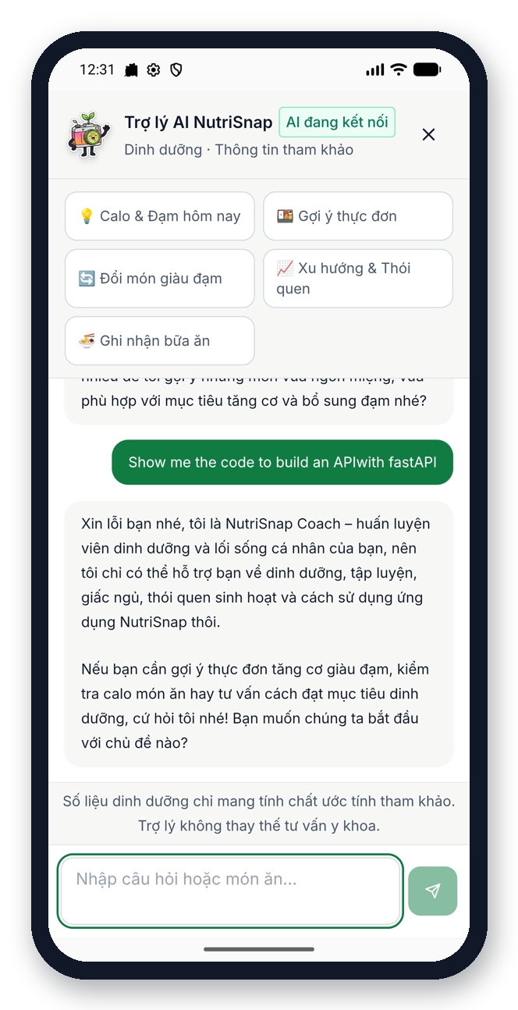
Meet NutriSnap: Snap → Confirm → Coach
1
2
3
Snap
Confirm
Coach
Take a photo – the app recognises the dishes
Check dishes and grams – nothing is saved before you agree
Ask anything – answers use your own data
One loop, every day: plan your goal → log your meal → see your progress → get coached.
Notes:
So what is NutriSnap? It is three simple steps. Snap: take a photo of your meal, and the app recognises the dishes. Confirm: you check the dishes and the grams, and nothing is saved before you agree. Coach: a friendly AI coach answers your questions using your own data. The screens here are from our real app.

Slide 7
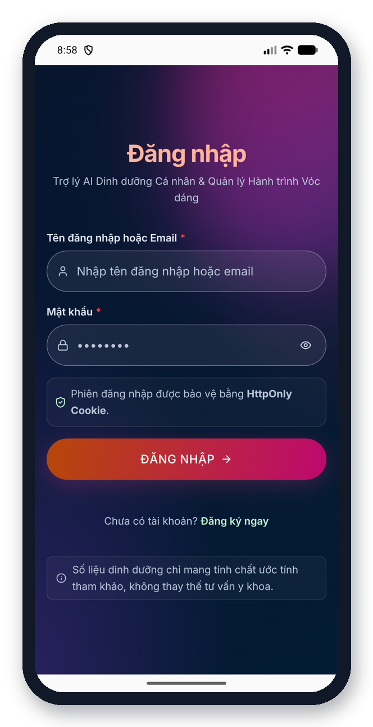
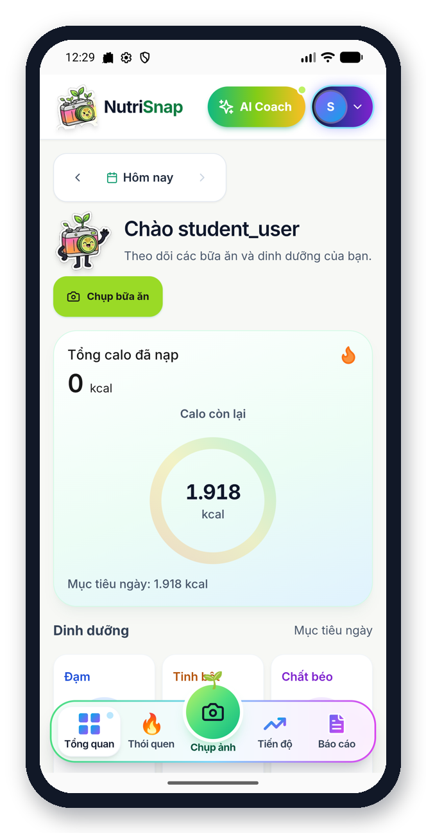
User flow: from opening the app to getting advice
1
Open & log in
2
Snap / log food
3
Confirm meal
4
See progress
5
Get advice
›
›
›
›
Personal goal ready
Photo or search
Check dishes & grams
Calories, macros, streak
Coach & food swaps
Notes:
Here is the user flow in five steps. One: the user opens the app and logs in, and their personal goal is ready. Two: they snap a photo of the meal or search a dish. Three: they confirm the dishes and the grams. Four: they see their progress – calories, macros and their streak. And five: they get advice from the AI coach or a healthier food swap. Then the loop starts again at the next meal.

Slide 8
Core features and their status
📸
📊
🎯
💬
Working
Working
Working
Working
Food logging
Nutrition & calories
Goals & profile
Suggestions
Photo or manual search
Daily ring + 3 macros
BMR, TDEE, safe pace
AI coach & food swaps
🔥
🔔
Working
Working
Habits & reports
Meal reminders
Streaks, badges, monthly PDF
Lock screen, with mascots
Notes:
These are our six core features, and all of them already work in our prototype: food logging by photo or manual search, nutrition and calorie tracking, goals and profile, suggestions from the AI coach and food swaps, habits and reports, and lock-screen meal reminders.

Slide 9
Where NutriSnap stands
TOPIC 02 · MARKET
Real user problems and how we are different
Notes:
Part two: the market, and where NutriSnap stands.

Slide 10
Target market and user problems
Target market
Young Vietnamese smartphone users
University students on a budget
Health-conscious people tracking daily food
People who eat mostly Vietnamese dishes
Numbers are confusing
Labels and calories are hard to understand
Manual logging is tiring
Search, guess, type – for every meal
Needs are unknown
Few people know their daily calorie or protein needs
Local food is missing
Mixed Vietnamese dishes are rare in global apps
Notes:
Our target market is young Vietnamese people who use their phones every day and care about health. They face four problems: nutrition numbers are hard to understand, manual tracking is inconvenient, they do not know their daily needs, and Vietnamese food is poorly covered by international apps.

Slide 11
How we compare
 | MyFitnessPal | YAZIO | Cronometer | NutriSnap
Main strength | Huge food database | Clean diet plans | Micronutrient detail | Photo + local data + coach
How you log | Search / barcode | Search / barcode | Search, detailed | Photo first, then confirm
Vietnamese dishes | User-added, varies | Limited | Limited | ~500 curated dishes
AI coach on your data | Limited | Limited | No | Yes, in Vietnamese & English
Price | Freemium | Freemium | Freemium | Free (student project)
Team assessment from public product descriptions – competitor features and prices may change.
Notes:
We compared NutriSnap with three popular apps: MyFitnessPal, YAZIO and Cronometer. They are strong products with big databases and nice plans, but logging is mostly search and barcode, Vietnamese dishes are limited, and many features are paid. This comparison is our team's own assessment based on public product descriptions.

Slide 12
Our positioning: what sets us apart
Fits Vietnamese food ↑
Photo-first, confirm-always
NutriSnap
Logging in seconds, but the user stays in control
Vietnamese + global data
~500 curated Vietnamese dishes plus 13,159 USDA foods
MyFitnessPal
YAZIO
A coach that knows you
Cronometer
Answers from your own goals and meals, stays on topic
Qualitative map by the team – not measured.
Low effort ← logging effort → High effort
Notes:
This map shows our positioning. Horizontally is how much effort logging takes; vertically is how well the app fits Vietnamese food. Most apps sit on the high-effort side. NutriSnap aims for the top-left corner: low effort and a strong local fit. Three things set us apart: photo-first logging with a confirm step, a curated Vietnamese food table together with USDA data, and a coach that understands your own goals.

Slide 13
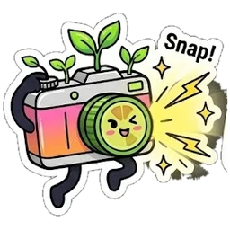
UI/UX and system plan
TOPIC 03 · ENGINEERING
Real screens, one design system, a clear path to code
Notes:
Part three is engineering. Here we focus on the UI and UX, the workflow, and our system plan.

Slide 14
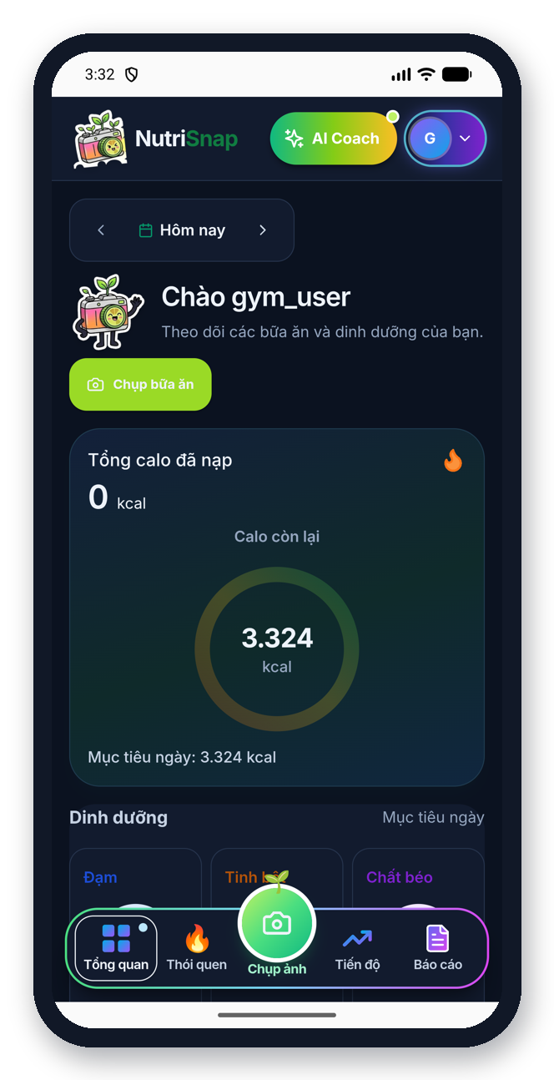
Design system and consistency
Colours
Primary green
Fresh lime
Warm accent
Info blue
Highlight
Ink / dark mode
Consistency rules
Same header and bottom bar on every screen
Raised camera button always in the centre
Rounded cards, big numbers, short labels
Light and dark mode share one layout
One friendly mascot in eight moods
Same screen,
light and dark
Notes:
First, consistency. Every screen uses the same design system. One fresh green as the main colour with warm accents, rounded cards, large readable numbers, and one raised camera button that is always in the same place. Our mascot, a little camera with a lime lens, appears in eight moods to guide and encourage the user. The app also has a full dark mode, and both themes use the same layout so users never feel lost.

Slide 15
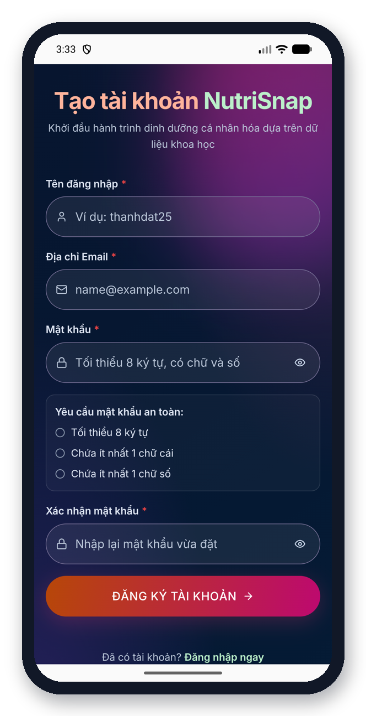
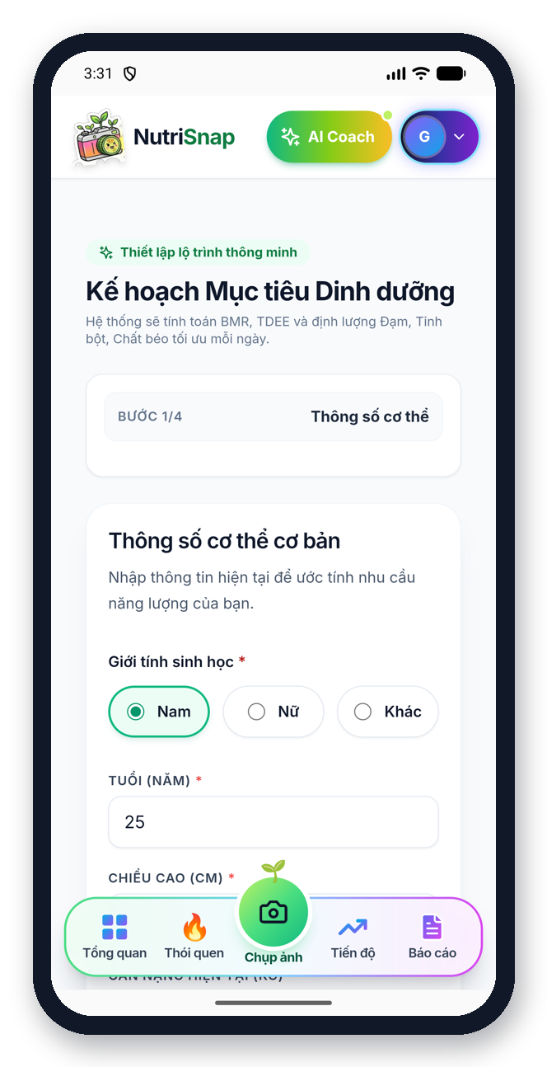
UI · Onboarding: sign up and set a personal goal
UX decisions
Login and register share one visual style
Live password checklist while typing
Goal wizard: 4 short steps, one topic each
Safe weekly pace shown before saving
Login
Register
Goal wizard · step 1/4
Notes:
This is onboarding. The login and register screens share the same style. Then the goal wizard asks for body data, the goal and activity level in four short steps, one question group per screen. At the end it shows a safe weekly pace, so users do not set extreme goals.

Slide 16
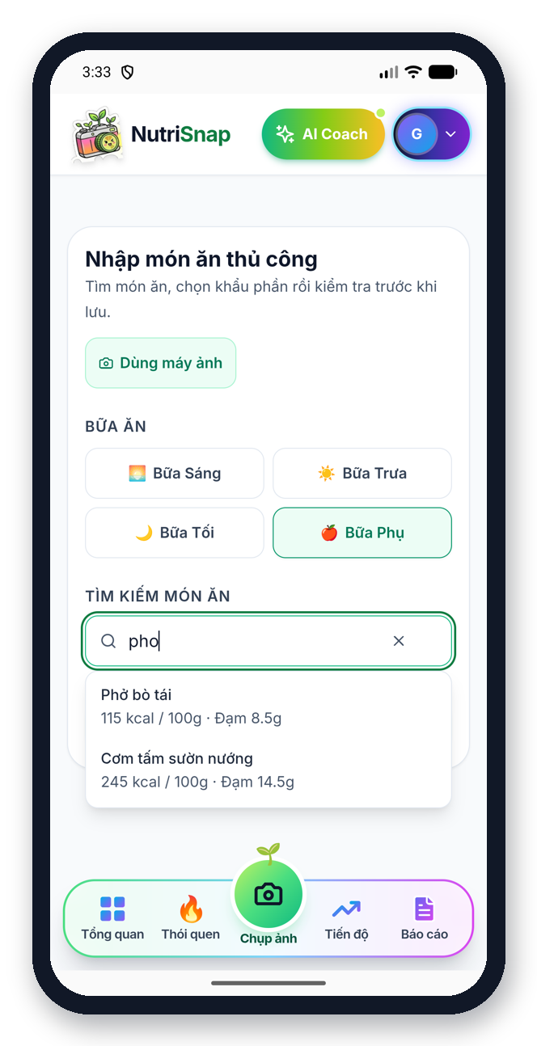
UI · Core loop: snap, search and confirm a meal
UX decisions
Two ways in: photo or manual search
Meal type chosen with one tap
Grams are editable; totals update
Non-food photo → “please retake”
Nothing saved until you confirm
Camera / upload
Manual search
Review & edit grams
Notes:
This is the core loop. From the camera screen the user can upload a photo or search a dish manually. The review screen shows each dish with its grams, which the user can edit, and the totals update right away. If the photo is not food, the app says: this is not a dish, please take the photo again, and returns to the camera.

Slide 17
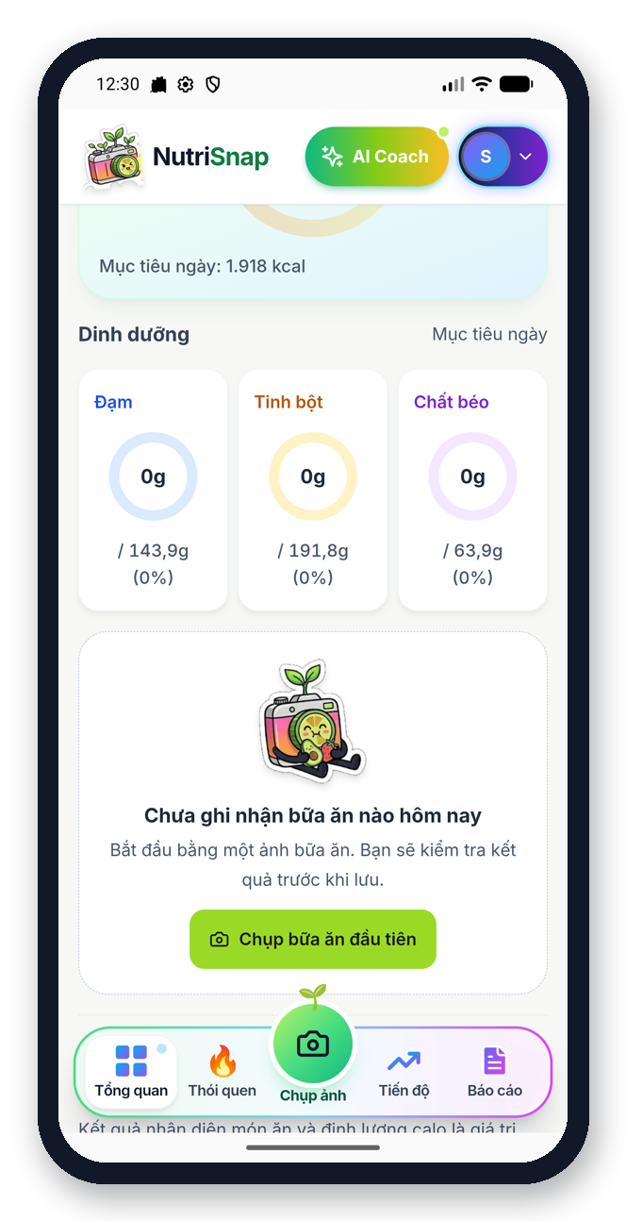
UI · Daily dashboard: today at a glance
UX decisions
One big number: calories left
Protein, carbs, fat as simple rings
Mascot greets and encourages
Friendly empty state with a clear next step
Calories ring
Macros & meals
Dark mode
Notes:
The dashboard is the home screen. It shows calories eaten and calories left in a big ring, then protein, carbs and fat. The mascot greets the user, and the same screen works in light and dark mode.

Slide 18
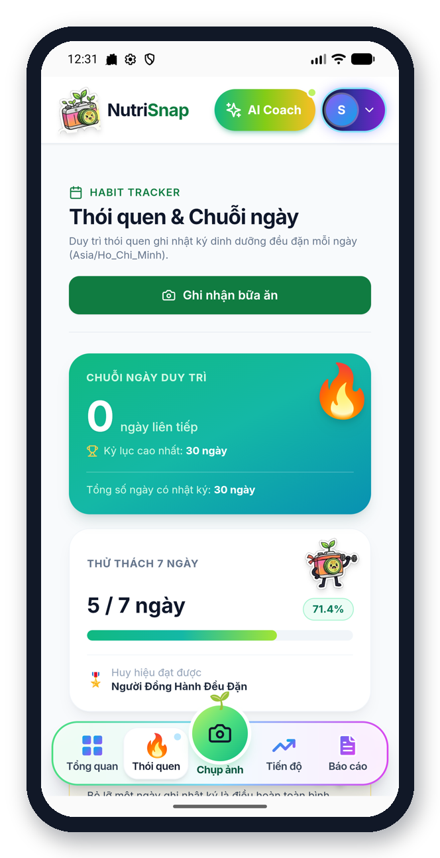
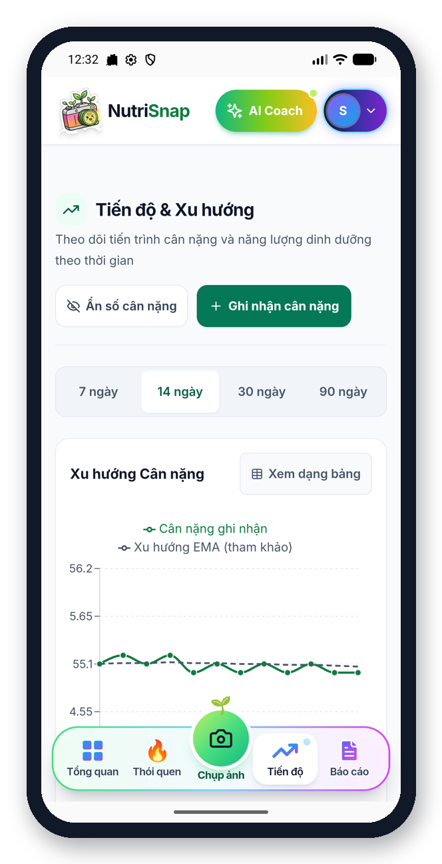
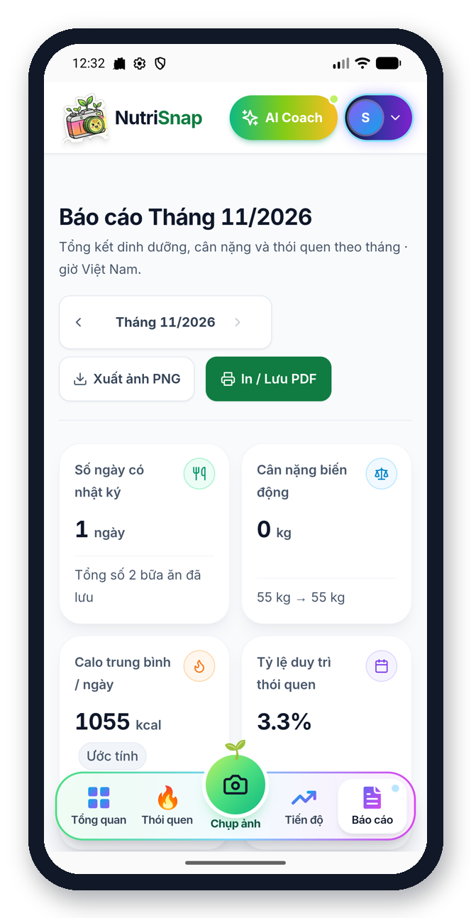
UI · Habits, progress and reports
UX decisions
Streak, 7-day challenge and badges
Trend over 7 / 14 / 30 / 90 days
Calm colours – no alarming red
Export report as PNG or PDF
Streaks & challenge
Weight trend
Monthly report
Notes:
For motivation and insights, the habit screen shows the streak, a seven-day challenge and badges. The progress screen shows the weight trend over seven to ninety days. The monthly report can be exported as an image or a PDF to share.

Slide 19
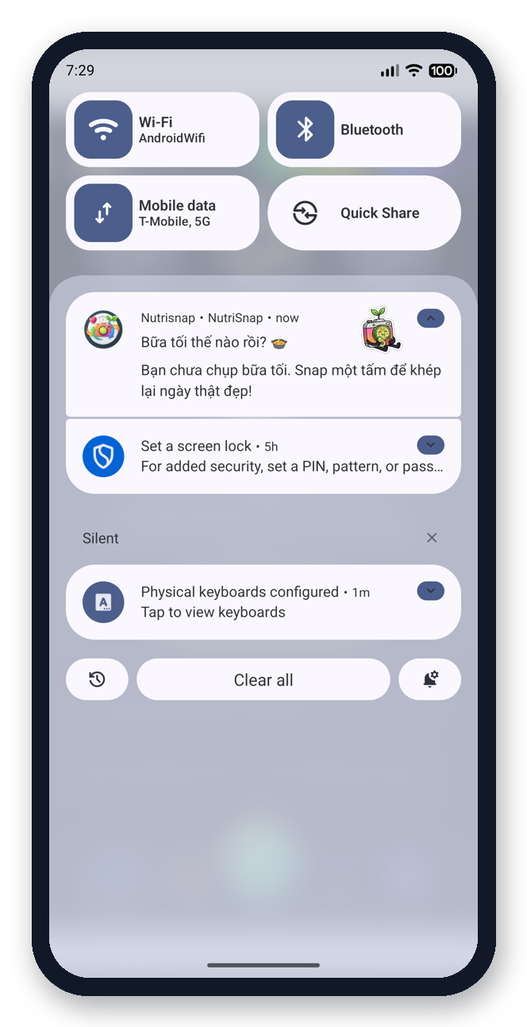
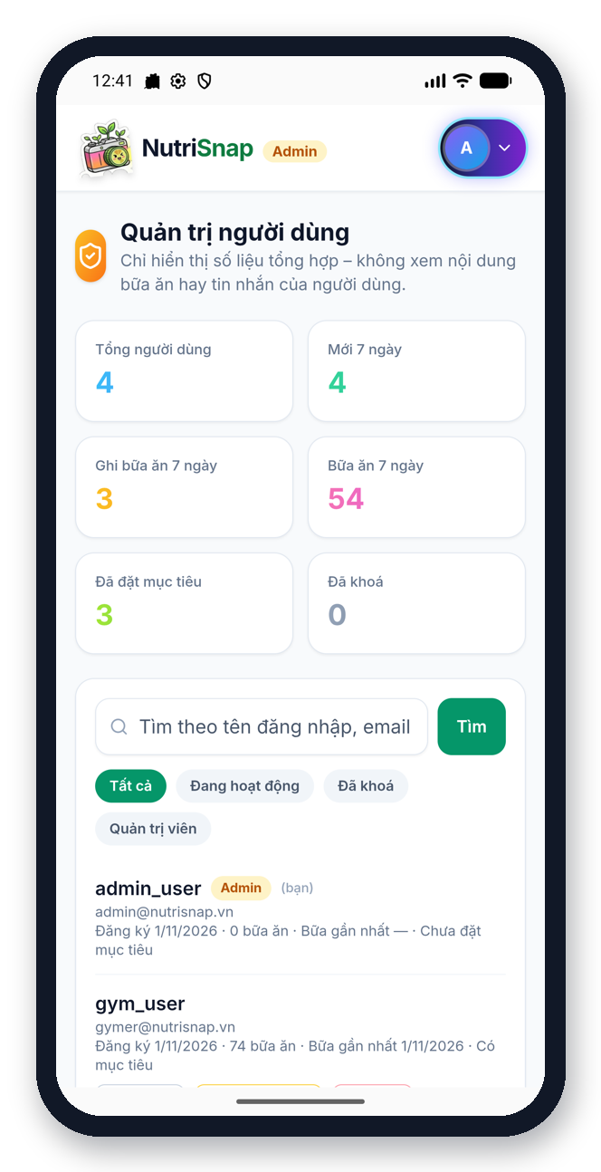
UI · AI coach, reminders and admin
UX decisions
Coach is one tap away in the header
Quick-question chips to start
Politely refuses off-topic requests
Reminders with mascots on the lock screen
Admin has its own separate panel
AI coach
Meal reminder
Admin panel
Notes:
The AI coach is always one tap away in the header. It answers in Vietnamese or English, and it politely refuses topics outside nutrition. Lock-screen reminders with mascots appear when a meal is missing. And for managing the app, an admin account has its own panel with user statistics and tools.

Slide 20
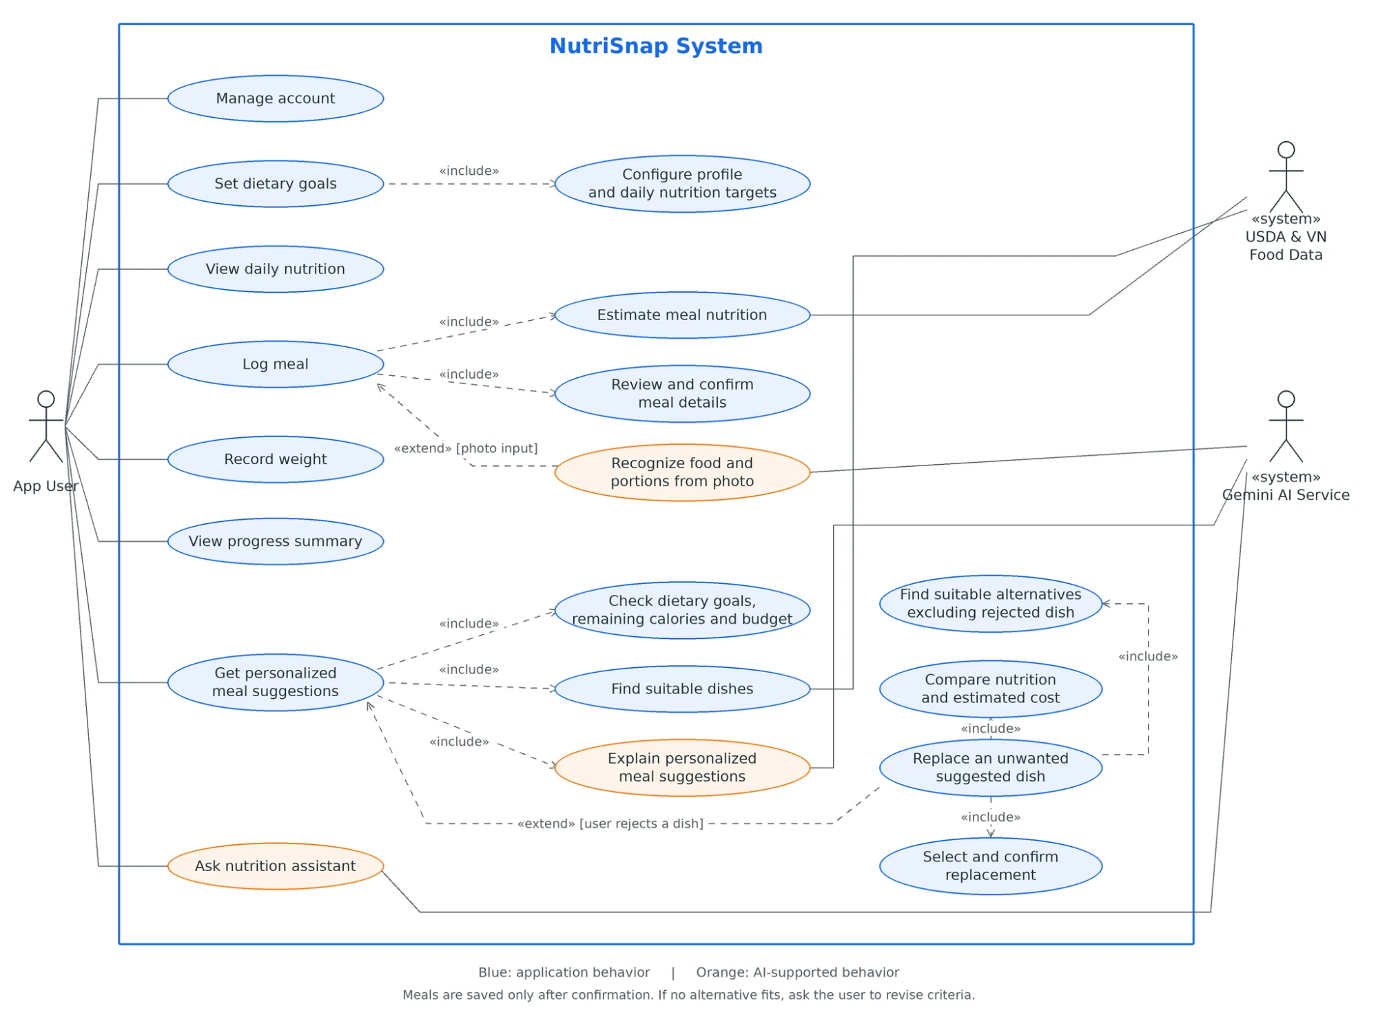
Workflow: function list and use case diagram
F1
Manage account
F2
Set dietary goals
F3
Log meal (photo / manual)
F4
Review & confirm meal
F5
View daily nutrition
F6
Record weight
F7
Habits & progress
F8
Monthly report
F9
Ask AI coach / swap food
F10
Meal reminders
Notes:
Here is our function list on the left and our use case diagram on the right. The user manages an account, sets goals, logs meals, records weight, views progress and asks the assistant. Logging a meal includes photo recognition and the confirm step. Each function plugs into the same daily loop: plan, log, review, improve.

Slide 21
Core pipelines: how the 3 key functions work
1 Snap to nutrition
Photo
Recognise dishes
Match food table
Calculate
Confirm & save
2 Personal goal planner
Body data
Energy needs
Calorie & macro target
Safe pace check
Daily plan
3 AI coach
Question
Read own data
Grounded answer
Safety check
Reply
Rule in every pipeline: the AI helps to understand – all numbers come from the food database.
Notes:
These are our three core pipelines. One: snap to nutrition – photo, recognise dishes, match them to our food tables, calculate, confirm, save. Two: the personal goal planner – body data, energy needs, a calorie and macro target, and a safe pace check. Three: the AI coach – the question, the user's own data, a grounded answer and a safety check. In all three, the AI helps to understand, but the numbers always come from the food database.

Slide 22
System architecture
⚙️ Backend server
🗄️ Database
📱 Mobile app
store / read
Cloud web service
Login & permissions
Rules + every calculation
Goals, reports, admin
Talks to AI and data
Users, goals, meals
Weights, chat history
Android app
Screens & charts
Camera, reminders
Shows server numbers
secure requests
🤖 Gemini AI
photo / text
Reads meal photos
Understands questions
Key rule
The AI understands. The database calculates.
🥗 Nutrition data
~500 VN dishes · USDA
Notes:
This is our system architecture. On the left is the mobile app. It sends secure requests to the backend server in the cloud. The server handles login, rules and every calculation. It stores and reads data in the database, sends photos and questions to the Gemini AI, and uses our nutrition data: about five hundred Vietnamese dishes and the USDA database. The key rule is simple: the AI understands, the database calculates.

Slide 23
System overview: how it all works
Frontend
Backend
Data
AI
Security
Mobile app (Android)
Server in the cloud
Where numbers come from
Understands, does not count
Your data stays yours
Shows screens and charts
Camera and reminders
Never calculates nutrition itself
Business rules and every calculation
Goal planner and nutrition engine
Reports, habits, admin
~500 Vietnamese dishes
USDA FoodData Central
Cloud database for user data
Reads meal photos
Understands questions
Answers grounded in user data
Protected login cookies
Each user sees only own data
Admin separated from users
Flow: app → secure request → server rules → food data + AI → result back to the app
Notes:
This is a brief overview of how the system works. The mobile app shows screens and collects input. The backend server handles the rules and every calculation. Data comes from a Vietnamese dish table and USDA FoodData Central and is stored in a cloud database. The AI only reads photos and questions. For security, login uses protected cookies, each person can only see their own data, and admins are separated from normal users.

Slide 24
How NutriSnap will grow – and thank you
Design
Build
Test
Improve
Release
UI, functions, use case
Working prototype
Real users & accuracy
Barcode, water tracker
Public Android app
Done
Done
Next
Next
Planned
Our coding approach
Small feature branches, reviewed before merging
Build each function end to end: screen → server → data
Keep one design system for every new screen
Test with real users after each step
Thank you!
Questions and feedback are welcome.
Notes:
Finally, how NutriSnap will grow. We build in small steps: design, build, test with users, and improve. Next we will apply your feedback, measure how accurate the recognition is, add a barcode scanner for packaged food and a water tracker, and prepare a public Android release. Thank you very much for listening. We are happy to answer your questions.

