Slide 1
School Feedback Management System
Group 11
Nguyen Viet Tu (Leader)
Hoang Quoc Viet
Tran Ho Minh Thuan
Supervisor: Nguyen Huy Hung

Slide 2
Overview
Introduction
Implementation & demonstration
Strengths & Challenges
1
2
3
Notes:
Còn 3 phần 1 2 4 thôi

Slide 3
1. Introduction
Introduction
Problem Definition
Proposed Solution

Slide 4

1.1 - Introduction

Slide 5
1.1 - Introduction
We develop a web application that allows school to create and manage feedbacks
Our target is to propose a solution for current feedback
management systems in Vietnam Universities and other
countries

Slide 6
1.2 - Problem Definition
Customize Feedback form:
Use same questions set for all lectures, courses, majors
Can’t question unique aspect of each course
(For example: Can’t question about accent of English lecturer)
Lack of usefulness and practicality (Can only ask same general
questions that used for all courses)
Hardly use for personal improvement
Can’t choose level of feedback survey
(Feedback for class, course, major, or department)
Can’t modify targets or conductors of Feedback

Slide 7
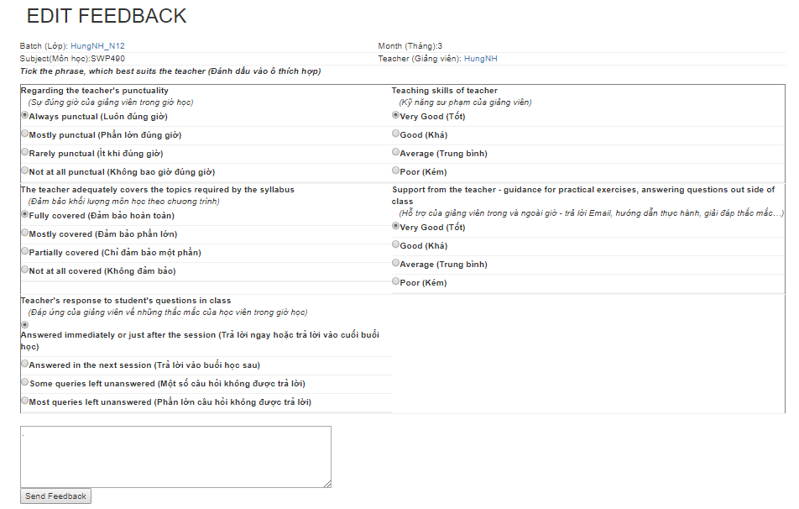
1.2 - Problem Definition
Conduct Feedback
- Edit answers

Slide 8
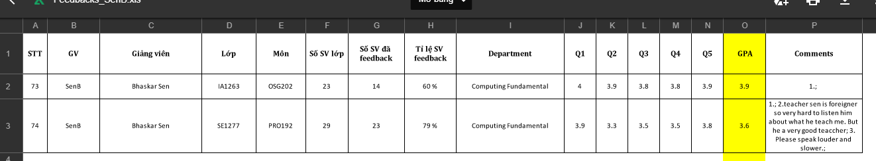
1.2 - Problem Definition
Analyze results and Report:
Can’t help directly visualize statistical results from feedback answers
Can’t compare results in the past to current
Don’t provide any suggestions to improve results in next times

Slide 9
1.3 - Proposed Solution
Our ideas to resolve the problem
Provide a drag-and-drop tool for user to create, design, and customize
feedback forms by dragging and dropping items
Analyze feedback results then provide reports and suggested improvementsbased on the results.
Include mobile app to conduct feedback

Slide 10
2. Implementation
&
Demonstration
System architectural design
Operation mechanisms

Slide 11
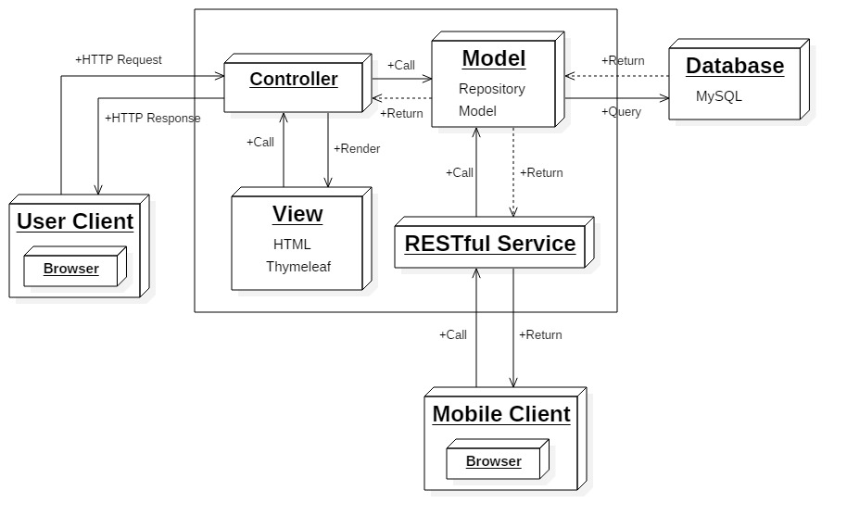
2.1 – System Architectural Design

Slide 12
2.2 – Operation mechanisms
2.2a Create feedback content
Old System | New System
Use 1 template for All Feedback | Create new blank or choose from many existed Template
Have no Criteria feature | Have Criteria feature
 | Create by Drag-n-Drop feature

Slide 13
2.2 – Operation mechanisms
2.2a Create feedback content
Feedback
id
point
referenceId
isTemplate
isPublished
createDate
startDate
endDate
feedbackName
feedbackDes
semesterId
typeId
majorId
courseId
clazzId
departmentId
Criteria
id
criteria
status
Question
id
type
questionContent
suggestion
isRequired
criteriaId
feedbackId
Option
id
isRequired
point
questionId

Slide 14
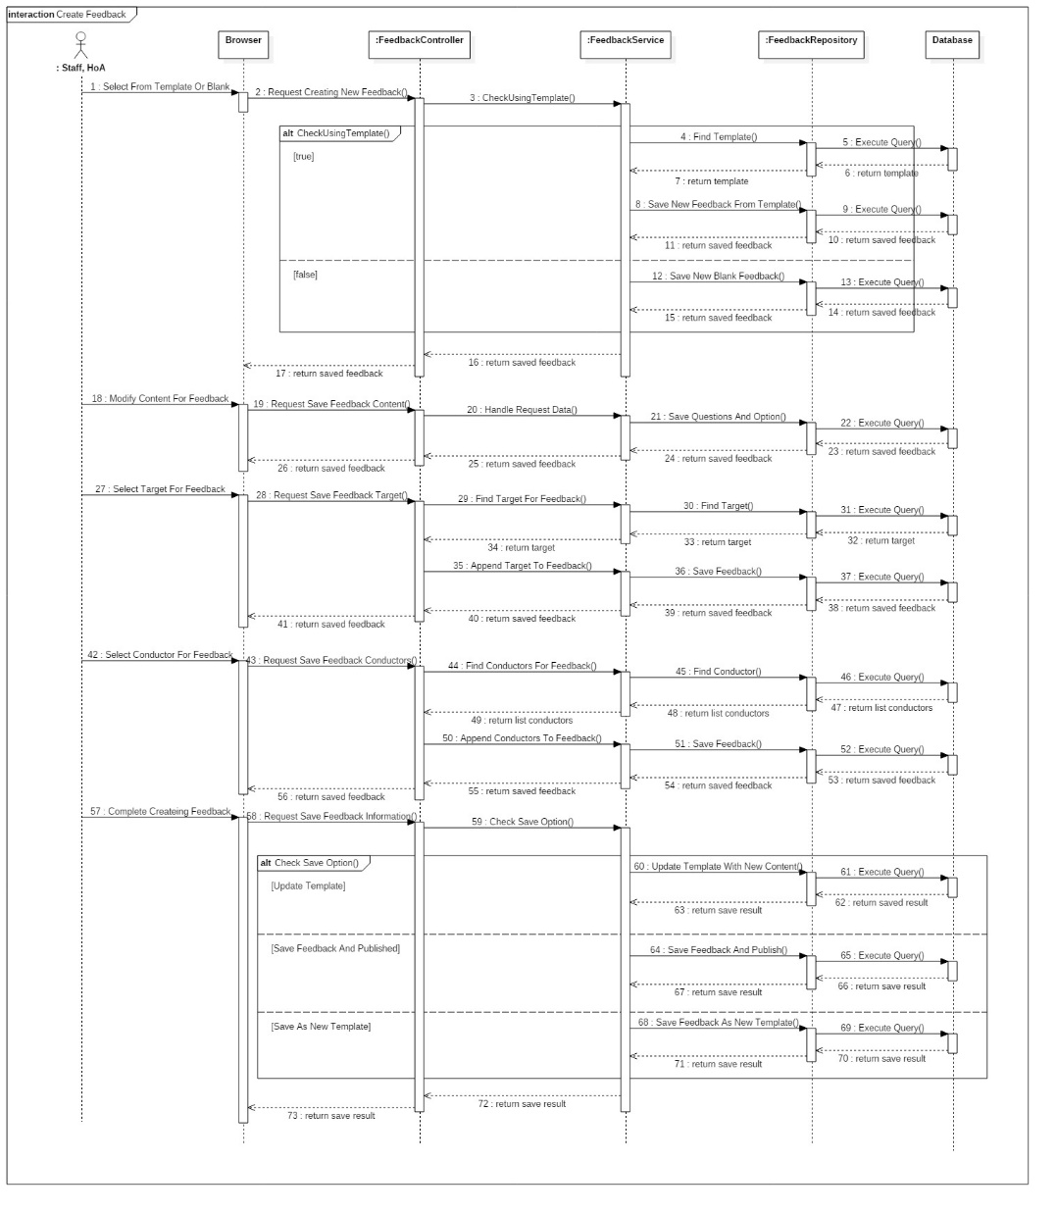
2.2 – Operation mechanisms
2.2a Create feedback content – from template or create blank

Slide 15
2.2 – Operation mechanisms
2.2b Modify other Feedback information
Old System | New System
Target of Feedback can be only Class | Target of Feedback can be a Class, Course, Major, or Department
No Suggested Improvement | Can set suggested improvement for each question
 | Set interval time for each Feedback
 | Can save Feedback as Template to re-use next time or create new
 | Choose suitable targets for each type of Feedback
 | Auto matching suitable conductors for each target

Slide 16
2.2 – Operation mechanisms
2.2b Modify other Feedback information – Auto matching Conductors to Target
User
id
username
email
password
roleId
departmentId
fullname
code
birth
status
majorId
Student_Clazz
userid
clazzId
Clazz
id
courseId
className
lecturerId
semesterId
Feedback
id
point
referenceId
isTemplate
isPublished
createDate
startDate
endDate
feedbackName
feedbackDes
semesterId
typeId
majorId
courseId
clazzId
departmentId
User_Feedback
userId
feedbackId
isConducted

Slide 17
2.2 – Operation mechanisms
2.2b Modify other Feedback information – Auto matching Conductors to Target

Slide 18
2.2 – Operation mechanisms
2.2b Modify other Feedback information – Auto matching Conductors to Target

Slide 19
2.2 – Operation mechanisms
2.2c Alert undone Feedback
Old System | New System
Force User to do Feedback or User can’t see other page | Alert a notification on website to remind user
 | Send email to notify user

Slide 20
2.2 – Operation mechanisms
2.2c Alert undone Feedback
Feedback
id
point
referenceId
isTemplate
isPublished
createDate
startDate
endDate
feedbackName
feedbackDes
semesterId
typeId
majorId
courseId
clazzId
departmentId
User_Feedback
userId
feedbackId
isConducted

Slide 21
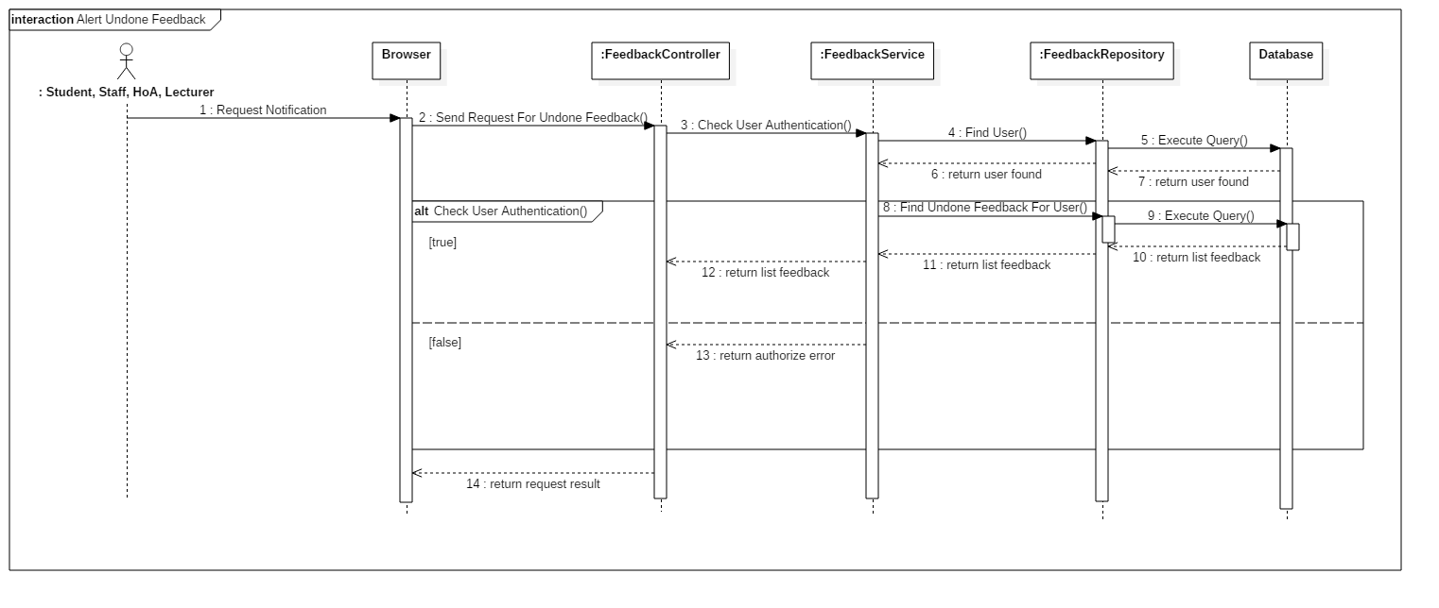
2.4 – Operation mechanisms
2.2c Alert undone Feedback – Send notification

Slide 22
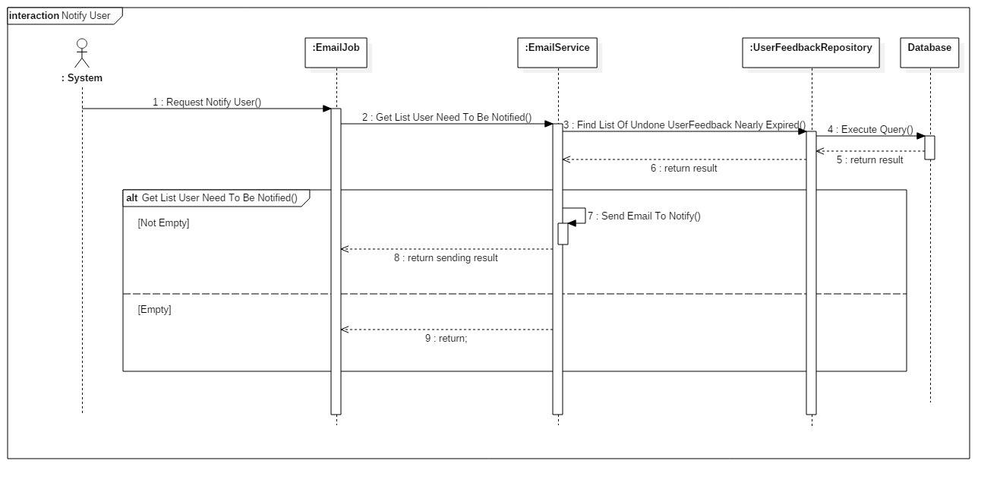
2.4 – Operation mechanisms
2.2c Alert undone Feedback – Send Email

Slide 23
2.2 – Operation mechanisms
2.2d Do Feedback
Old System | New System
Cannot edit answers | Allow users to edit answers as long as Feedback is still in available time range

Slide 24
2.2 – Operation mechanisms
2.2d Do Feedback
Feedback
id
point
referenceId
isTemplate
isPublished
createDate
startDate
endDate
feedbackName
feedbackDes
semesterId
typeId
majorId
courseId
clazzId
departmentId
Answer
id
answerContent
createDate
optionId
conductorId
User_Feedback
userId
feedbackId
isConducted
Question
id
type
questionContent
suggestion
isRequired
criteriaId
feedbackId
Option
id
isRequired
point
questionId

Slide 25
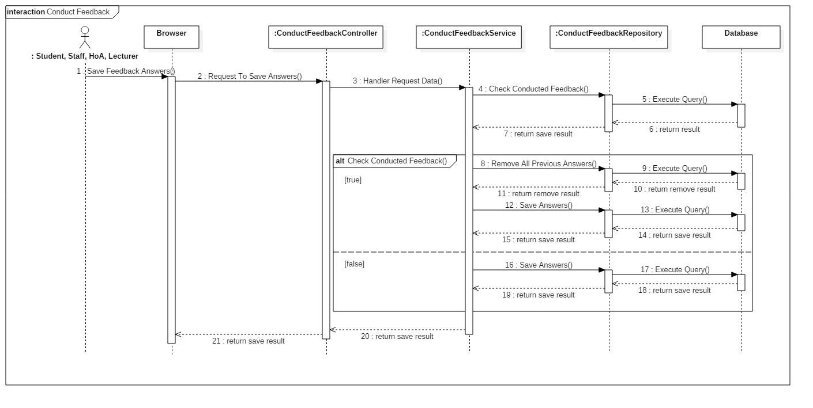
2.4 – Operation mechanisms
2.2d Do Feedback

Slide 26
2.2 – Operation mechanisms
2.2e Statistic and Generate Report
Old System | New System
Not compare average Feedback point through Semesters | Compare average Feedback points through Semesters
Only show total average point | Show average of each Criteria and total average point of the whole semester
Not show details information of each question that is replied | Show details information of each question: + Number of people answer + Pie chart shows percent of people choose each option

Slide 27
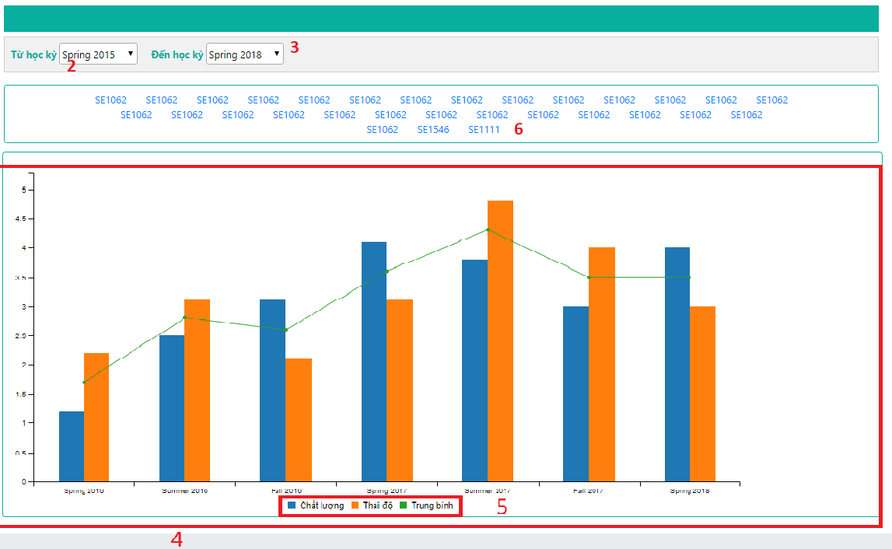
2.2 – Operation mechanisms
2.2e Statistic and Generate Report – Bar Chart
We have 2 types of Report Visualization:

Slide 28
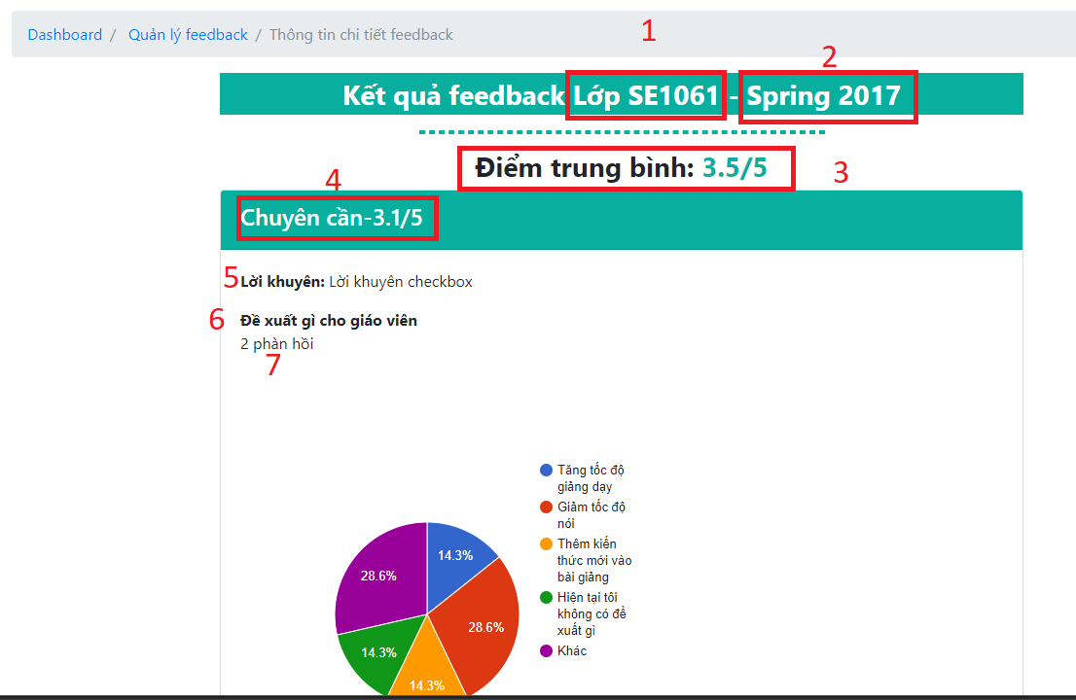
2.2 – Operation mechanisms
2.2e Statistic and Generate Report – Pie Chart

Slide 29
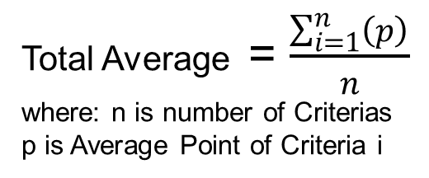
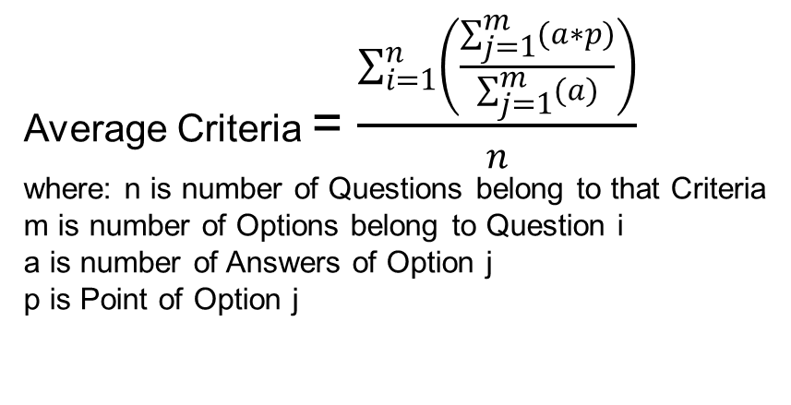
2.3 – Algorithms
- Each question has many Options. Each Options will have a specific point. When user chooses one answer, its point will be counted.
Average Criteria = $\frac{\sum_{i=1}^{n}{\left(\frac{\sum_{j=1}^{m}{(a∗p)}}{\sum_{j=1}^{m}{(a)}}\right)}}{n}$
where: n is number of Questions belong to that Criteria
m is number of Options belong to Question i
a is number of Answers of Option j
p is Point of Option j
Total Average = $\frac{\sum_{i=1}^{n}{\left(p\right)}}{n}$
where: n is number of Criterias
p is Average Point of Criteria i

Slide 30
2.2 – Operation mechanisms
2.2e Statistic and Generate Report – Pie Chart
Lecturer Nguyen Huy Hung, has 2 Java Web classes SE1061 and SE1063, in semester Spring 2018. His Feedback form for 2 those classes has the same questions set like this:
+ Question 1 – Criteria 1, Radio type question, has 2 Options:
Option 1 gives him 3 points
Option 2 gives him 5 points
+ Question 2 – Criteria 1, Checkbox type question, has 3 Options:
Option 1 gives him 5 points
Option 2 gives him 4 points
Option 3 gives him 2 points
+ Question 3 - Criteria 2, Radio type question, has 3 Options:
Option 1 gives him 4 points
Option 2 gives him 3 points
Option 3 gives him 2 points

Slide 31
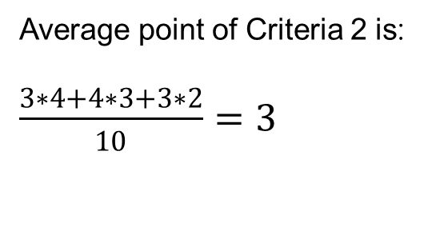
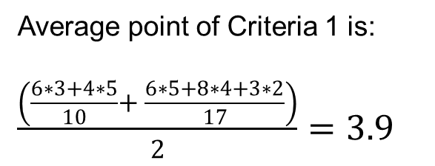
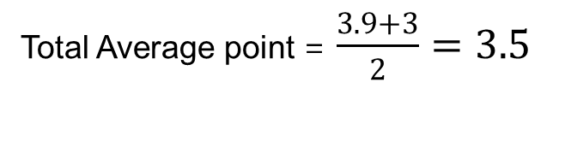
2.2 – Operation mechanisms
2.2e Statistic and Generate Report – Pie Chart
Now, there are 10 students in his 2 classes,
they give answers like this. The number
represent number of people chooses that
option:
Average point of Criteria 1 is:
$\frac{\left(\frac{6∗3+4∗5}{10}+ \frac{6∗5+8∗4+3∗2}{17}\right)}{2}=3.9$
 | Option 1 | Option 2 | Option 3
Question 1 | 6 | 4
Question 2 | 6 | 8 | 3
Question 3 | 3 | 4 | 3
Average point of Criteria 2 is:
$\frac{3∗4+4∗3+3∗2}{10}=3$
Total Average point = $\frac{3.9+3}{2}=3.5$

Slide 32
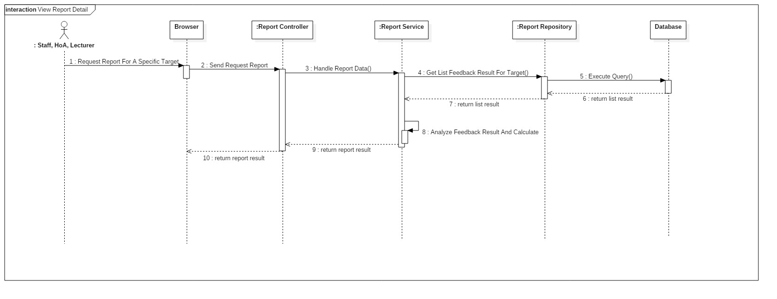
2.4 – Operation mechanisms
2.2e Statistic and Generate Report

Slide 33
3.
Strengths & Challenges
Strengths
Future plan
Challenges

Slide 34
4.1 - Strengths
More convenient, flexible way to design feedback form
and easier to apply for different objects
More directly visualize feedback results in report through different graphical charts

Slide 35
4.2 - Challenges
Staffs have to spend time to design feedback form
Still have to input suggested improvement manually

Slide 36
4.3 - Future plan
Current system is concentrated on core business flow. Therefore, some supporting features are restricted for the development team.
These features may be expanded in the future:
Analyze if users really spend time to do feedback
Analyze “Other comment” paragraph to see if it’s positive
or negative comment and count point

Slide 37

Thank you!

