Slide 1
Mosaicking Retinal Images: Segmentation
Viet Than
PI: Professor Ipek Oguz , Medical Image Computing Lab
In collaboration with Joe Malone and Professor Kenny Tao, Diagnostic Imaging and Image-Guided Interventions Lab
Notes:
Kenny and Joe

Slide 2
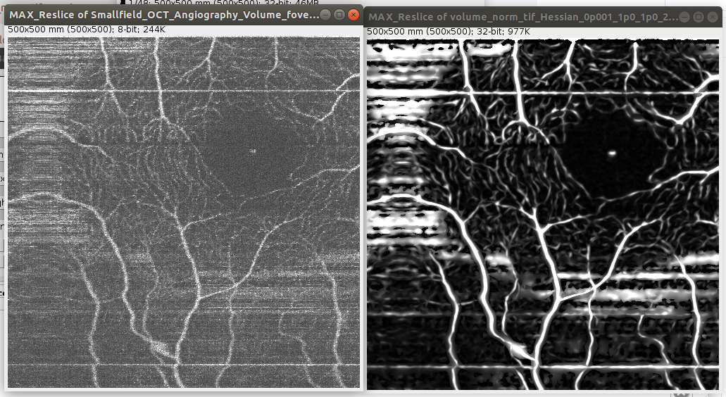
Input
Projection of OCT Volume Fovea Angiography
Output
Projection of input volume after Hessian/Frangi filter

Slide 3
Initial Problem:
OCT Angiography is a non-invasive tool to examine retina for early-stage diseases based on microvasculature.
However, there is a fundamental tradeoff between vascular resolution and image field of view (tldr: the higher the resolution, the smaller the “scope” of the image)
Vocabulary
Optical coherence tomography (OCT): Uses lightwaves to obtain 2D/3D scans at micrometer resolution for biological tissue
Angiography:
Visualizing/graphing of blood vessels
Retina:
The membrane covering the back of the eyeball responsible for collecting the light coming into your eye
Proposed solution:
Enhance the blood vessels (Segmentation)
Merge and combine into one (Registration)
THE GOAL:
Merge the two below pictures
Notes:
Image outut
Animate the process

Slide 4
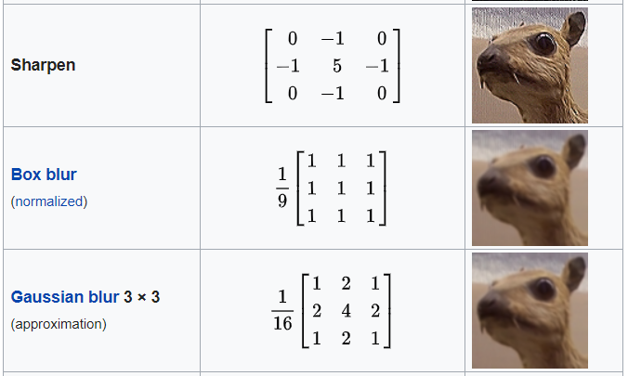
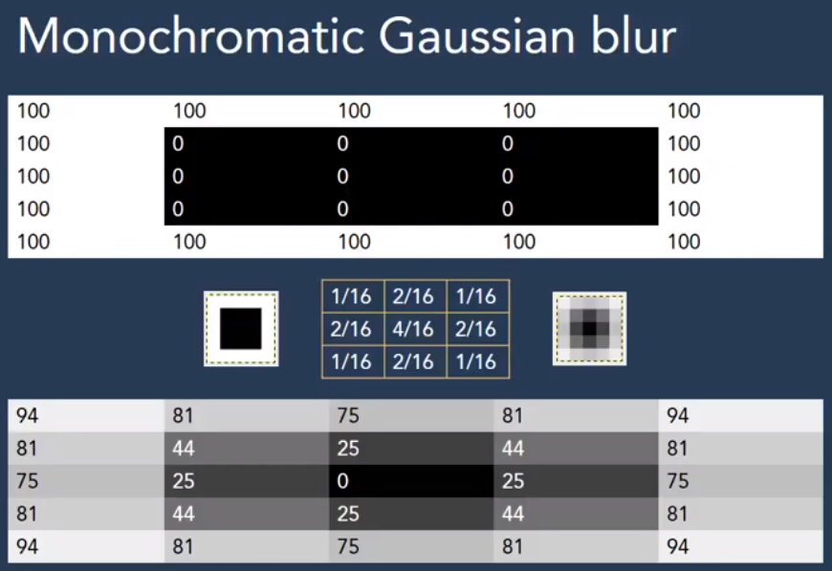
Taken from: Kernel (Image Processing), Wikipedia
Introduction to Image Processing
Doing a convolution between a kernel and an image
“Convolution is the process of adding each element of the image to its local neighbors, weighted by the kernel” – Kernel (Image Processing), Wikipedia
Taken from: Applications of Convolution in Image Processing Dhruv
https://www.youtube.com/watch?v=BQyMZ0caFbg
We are making a kernel that will allow us
to pick out vesselness features
Notes:
Animate the bottom half figure

Slide 5
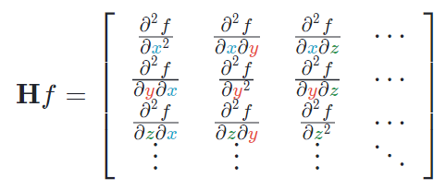
The Frangi Filter
Paper: “Multiscale vessel enhancement filtering”
A.F. Frangi, W.J. Niessen, K.L. Vincken, and M.A. Viergever. In Medical Image Computing and Computer-Assisted Intervention, pages 130–137, 1998.
“A common approach to analyze the local behavior of an image, L, is to consider its Taylor expansion in the neighborhood of point Xo”
We are only looking at the Hessian matrix, a square matrix of the second order partial derivative.

Slide 6

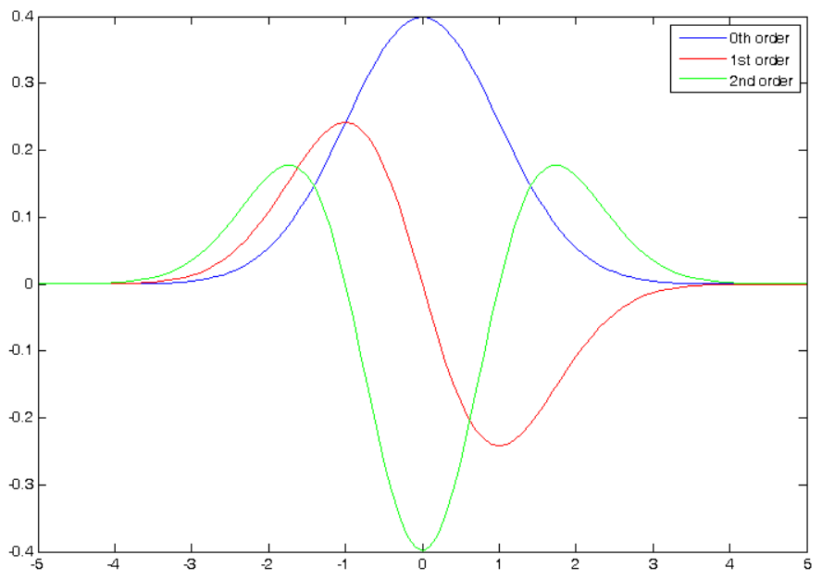
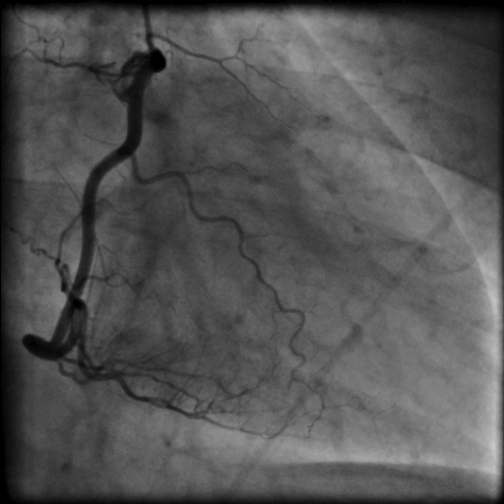
Scale
Image
Convolution
Gaussian (derivative)
Notes:
A vessel image as an example

Slide 7
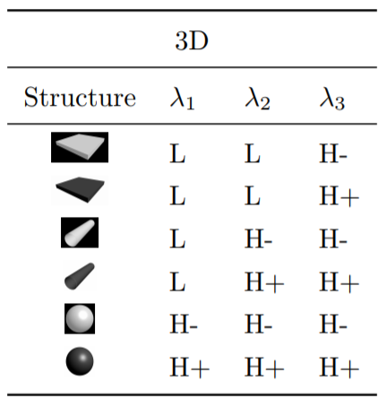
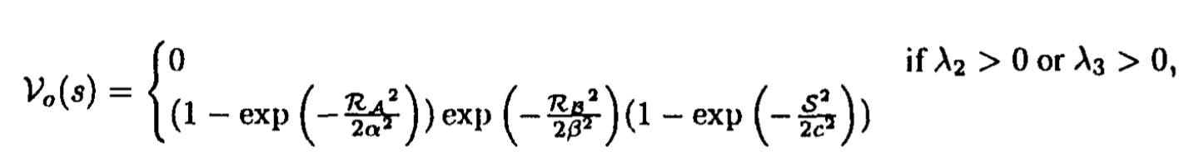
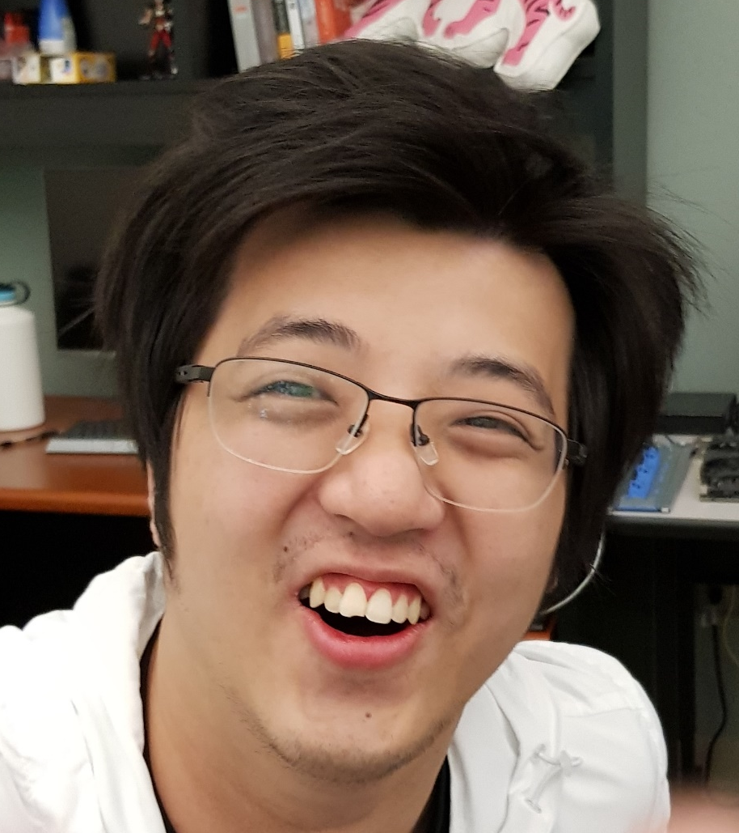
Eigenvalues
Every square matrix can decompose into “characteristic values” called eigenvalues and eigenvectors.
These values can be used to determine “shape” as eigenvectors always point toward the extrema
Method with Eigenvectors
Yipu “Barrett” Gao
September 4th
Notes:
Barret September 4th

Slide 8
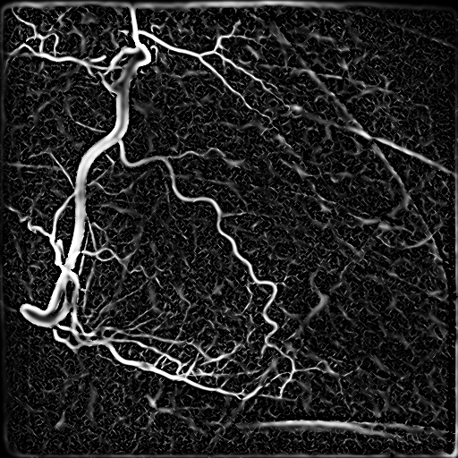
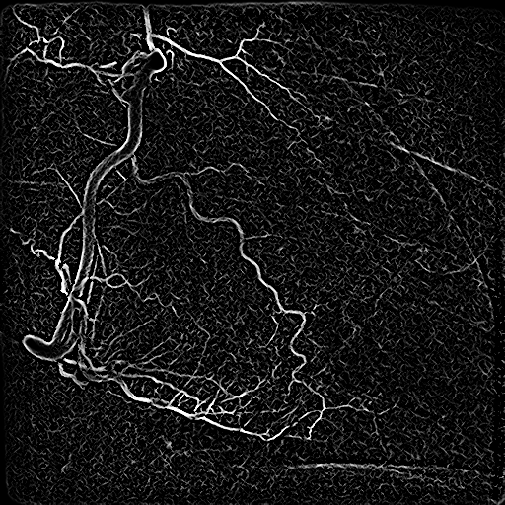
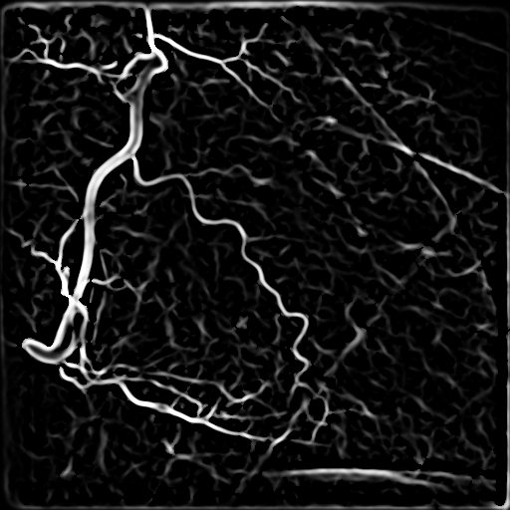
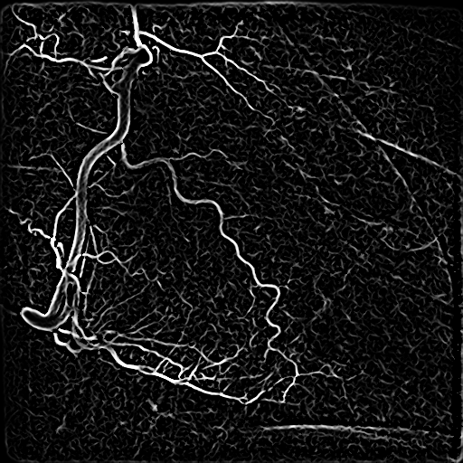

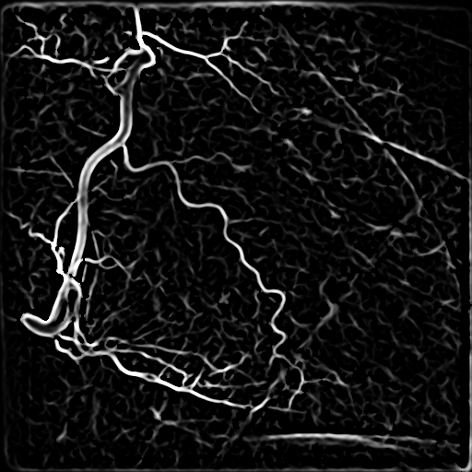
Correct For Scale
Scale
Result:
The maximum intensity at each location
Output
Input
Closeups at scale 0.5 (left), and 2.5 (right)
Scale = 0.5
1.0
1.5
2.0
2.5
Notes:
Put the equation so not to switch slides

Slide 9

ITK: Insight Segmentation and Registration Toolkit
C++ library
More efficient memory usage than MATLAB
Open-source
Readily available on ACCRE
Hessian filter already written
Host of functions for other processing capabilities

Slide 10
Input
Projection of OCT Volume Fovea Angiography
Output
Projection of input volume after Hessian/Frangi filter

Slide 11
New goals?
Providing a pipeline for cleaning and processing of handheld OCT
Evaluate usage for quantitative vasculature assessment
Future direction
Other Hessian-based vessel enhancing filters?
Enhance post-processing (thresholding, reduce artifacts etc.)
Combine/enhance for diffusion tensor imaging
Recreate/Repair “damaged” regions within OCT using a stochastic/random process

Slide 12
Acknowledgements
I give my thanks to:
Medical Image Computing Lab and Professor Ipek
Vanderbilt Institute for Surgery and Engineering
Diagnostic Imaging and Image-Guided Interventions Lab and Joe Malone and Professor Tao
And thank you, the audience.

