Slide 1
TIM KPI REPORT
2021 Dec

Slide 2

3. Innovation KPI
Index | Detail | Target | Actual | Comment | Mark
Document Control | ERI – order | 100% | 80%
 | TVP | 5% | 5%
Asset Management | 356 fee (Part & Printer Control): expand for MFE div. | 100% | 100%
VE | Apply for all group | 90% | 90% | Ele: 13-Oct PKE: 30-Nov Mec: 13-Dec
Checker Data Analyze | Visualize data & trend of Assy checker | 40% | 40%
Other | Deploy Engineering System to SSO | 80% | 80%
New
New

Slide 3
3. Innovation KPI
3. 1 ERI
WI : 10 step ~ Coding time: 5 months
1.PE
Issue
2.PE
Check
3.PE
Approve
4.PQA
check
5.PQA
approve
6.Responsible check
7.Responsible
approve
8.Distribute
9.Verify
check
10.Verify
approve
ERI : 19 step ~ Coding time: 4 months
type Order Part:
9. PPD/PDC1/CIS
Issue PO
10. PUR-PIC
Approve NPIS
11. IV Date
= Finish
= Delivery Part
1.PE
Issue
2.PE
Check
3.PE
Approve
4.PPD/PDC1/CIS
Confirm charging
5.PUR-PIC
Confirm
6.PUR
Check
7.PUR
Approve
8. PPD/PDC1/CIS
Export format PO
type Assembly:
1.PE
Issue
2.PE
Check
3.PE
Approve
4.Responsible check
5.Responsible
approve
6.Distribute
7.Verify
check
8.Verify
approve

Slide 4
3. Innovation KPI
3. 1 ERI
WI : 10 step ~ Coding time: 5 months
PE
issue
PE
check
PE
approve
PQA
check
PQA approve
Responsible check
Responsilble approve
Verify check
Verify approve
Distribute
01
02
03
04
05
06
07
08
09
10
ERI : 19 step ~ Coding time: 4 months
type Order Part:
PPD/CIS confirm charging
PUR approve NPIS
IV Date =
Finish
PE
issue
PE
check
PE
approve
PUR confirm
PUR approve
PPD/CIS export PO
PPD/CIS issue PO
PUR check
01
02
03
04
05
06
07
08
09
10
11
type Assembly:
PE
issue
PE
check
PE
approve
Responsible check
Responsilble approve
Verify check
Verify approve
Distribute
01
02
03
04
05
06
07
08

Slide 5

3. Innovation KPI
3. 1 ERI
Ways to reduce time !
2
1
Common function
1
2
Request user clear step before code
3
3
hhhhhh

Slide 6

3. Innovation KPI
3. 1 ERI
Way to reduce time!
Use Common function
Request user clear step before code

Slide 7

3. Innovation KPI
3. 2 TVP
What ‘s TVP ?
Trial Verification Plan before mass production
Purpose: To verify quality of the first shipment for new condition part(s)/unit(s).
Why need build TVP system?

Slide 8

3. Innovation KPI
3. 2 TVP
Concept:
Dept | No.TVP | Paper.TVP | Total
PE | 903 | *1 | 903
PQA | 903 | *1 | 903
ASSY | 903 | *2 | 1806
Total |  |  | 3612
Est: |  |  | 4000
Reduce paper
All progress from issue to finish PO (10 step)
Follow PO
Quatity and time product receive.
Where to product delivery?
Reason of lose, lack or borken
Avoid the wrong delivery
Follow Progress apply in Line

Slide 9
3. Innovation KPI
3. 2 TVP
Progress Manual:
2.PE
Check
4.Tim record excel file + release to PQA
1.PE
Issue
3.PE
Approve
5.PQA record
6. PQA input information
7. PQA check
8. PQA approve
9. Transfer to PDC1
10. PDC1 delivery to PIC
11. PDC1 scan and send email to related dept
12. PUR confirm
13. PDC1 issue PO
14. PDC1 check PO
15. PUR approve PO
16. PDC1 input plan
17. PDC1 approve plan
18. PDC1 send to all related dept
19. PDC1 transfer to PQA
20. PDC2 supply part
21. Inhouse dept make part/ unit/ machine
22. PQA received + record
23. PQA input judgment
24. PQA check
25. PQA approve
26. Transfer to TIM
27. TIM record, scan and mail
Progress System: (reduce 10 step)
2.PE
Check
4.Tim record excel file + release to PQA
1.PE
Issue
3.PE
Approve
5.PQA record
6. PQA input information
7. PQA check
8. PQA approve
9. Transfer to PDC1
10. PDC1 delivery to PIC
11. PDC1 scan and send email to related dept
12. PUR confirm
13. PDC1 issue PO
14. PDC1 check PO
15. PUR approve PO
16. PDC1 input plan
17. PDC1 approve plan
18. PDC1 send to all related dept
19. PDC1 transfer to PQA
20. PDC2 supply part
21. Inhouse dept make part/ unit/ machine
22. PQA received + record
23. PQA input judgment
24. PQA check
25. PQA approve
26. Transfer to TIM
27. TIM record, scan and mail

Slide 10
3. Innovation KPI
3. 2 TVP
4 slide - TVP là gì
Tại sao xây dựng hệ thống TVP: thời gian close TVP hiện tai là ba nhiêu, các vấn dê gặp phải : cấp nhầm hang ….
Concept :
Giảm giấy
Follow PO
Follow Progress apply in Line : hang về , đi đâu về đau số lượn bao nhiêu. Mất hỏng thiếu hang do dâu, ko cấp nhầm hang
EIMS point: cut giam bao nhieu gio , bao nhieu step, human

Slide 11
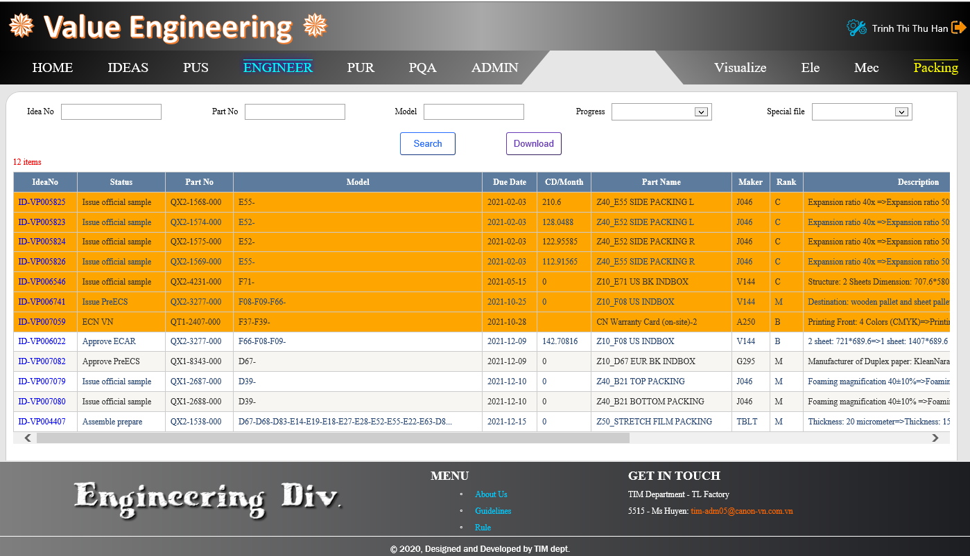
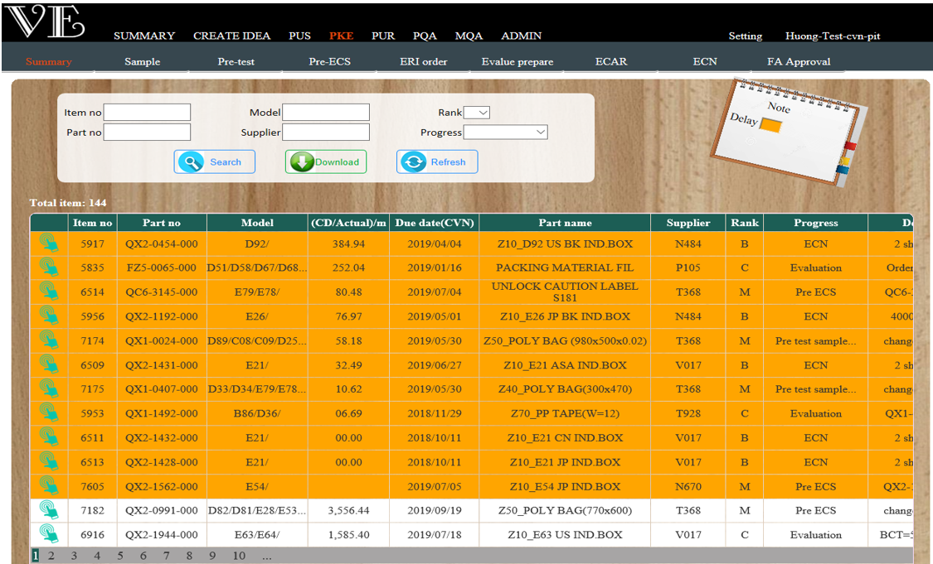

3. Innovation KPI
3. 1 VE SYSTEM
Mec
Ele
Packing
Old interface
New Interface
Before
Separate management by each group
Many menu in 1 interface-> difficult for user using
Can not overview VE for all factory
After
All group Mec-Ele-Packing using common system
Divide menu by Dept. & control by Status -> easy for user using
Can overview VE for both factory TL-TS

Slide 12
3. Innovation KPI
3. 1 VE SYSTEM – Improve Code
Before
Each interface, each coding page
Repeat code, Take long time to code
Difficult when upgrade system -> Maybe errors
After
Using common file for common interface
Only code for different content
Easy to modify

Slide 13
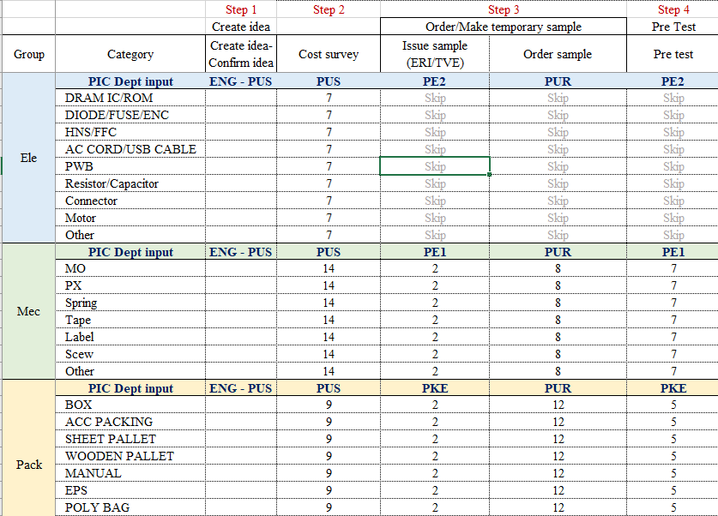
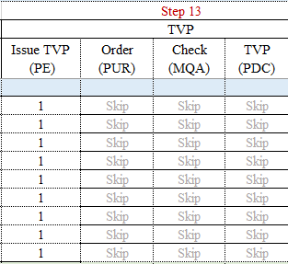
3. Innovation KPI
3. 1 VE SYSTEM – Improve JOB
Add more step to control
Confirm Cost survey: store all ideas before send to PUS cost survey
Add step for TVP control progress
ERI system
TVP system
Mar-2022
Automation link all steps of ERI, TVP
finish

Slide 14
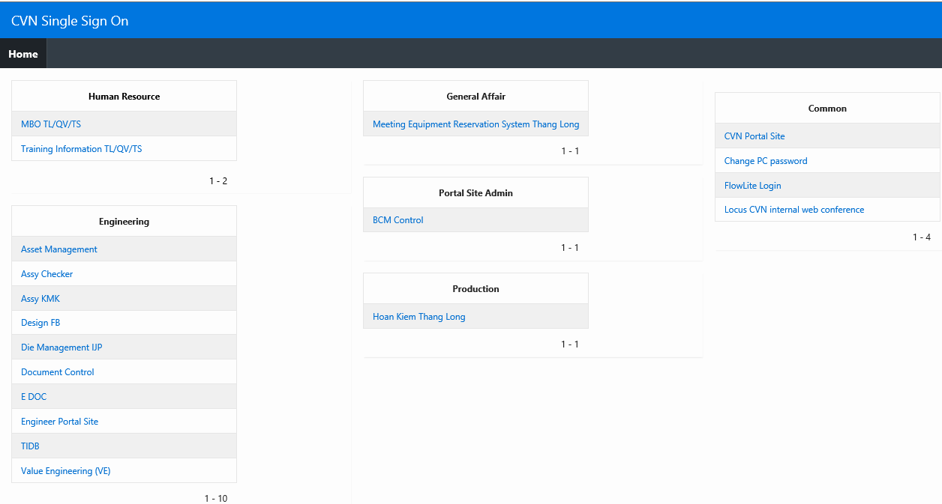
3. Innovation KPI
3. 2 Single Sign On - SSO
2019
2020
2021
1 account
/ 1 system
1 common account
/ all system
1 SSO account
/ all system
User must:
Remember many account
Login many time, each time each account
User:
Only use 1 account
But must login many time for multi system
User:
Login only 1 time/day for all system in SSO
8/10 Systems of
ENG Div.
deployed on SSO

Slide 15

3. Innovation KPI
3. 3 Checker Data Visualize
Current method
New method
Go to line copy data
Data can lost by replace PC
Analysis by excel
Can not visual any time
Checker
JIG NETWORK
Data warehouse
Data filter
Effect to Operator/ production
Not match real situation
Spend time so much
No predict trouble
No see status of chronic problem
CVN VENG Data warehouse
OPR/.Worst item analysis
Predict problem forecast
Chronic problem analysis
Data visualization

Slide 16
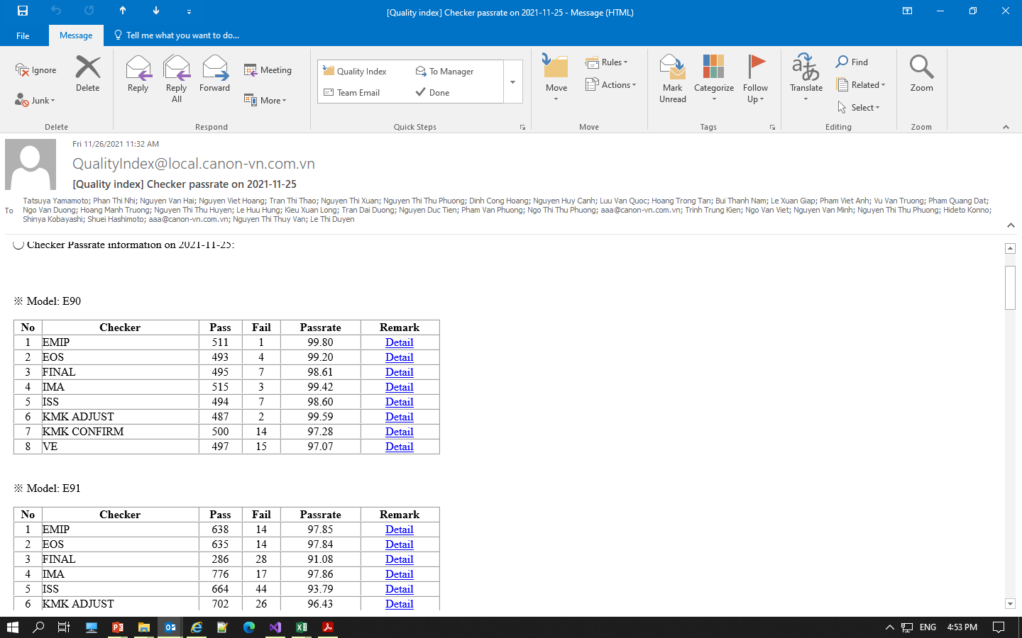
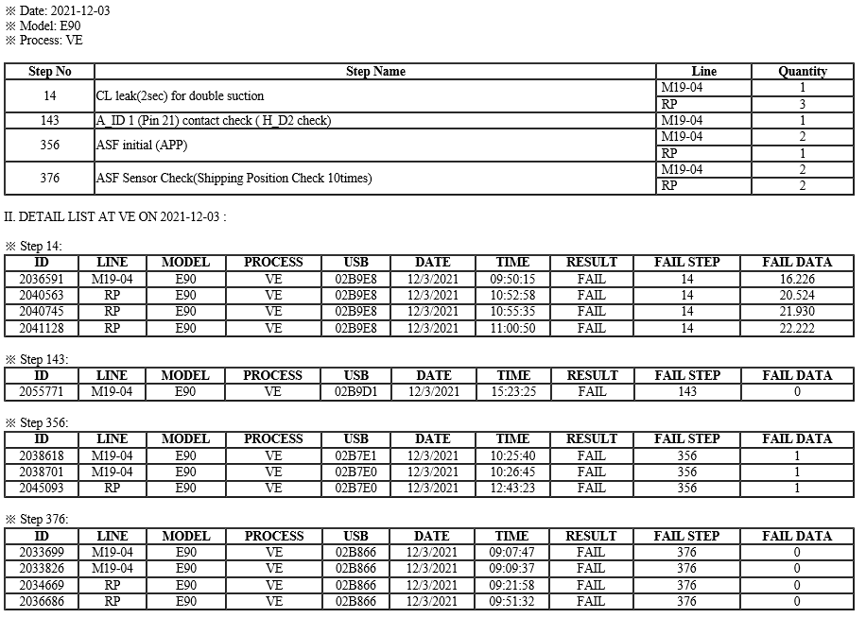
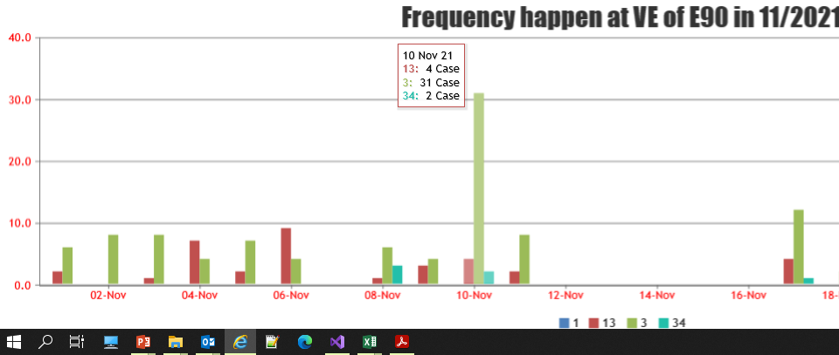
3. Innovation KPI
3. 3 Checker Data Visualize
RESULT
Monitoring
Pass rate of each model/checker
Monitoring
Detail which step NG, quantity, frequency happen

Slide 17
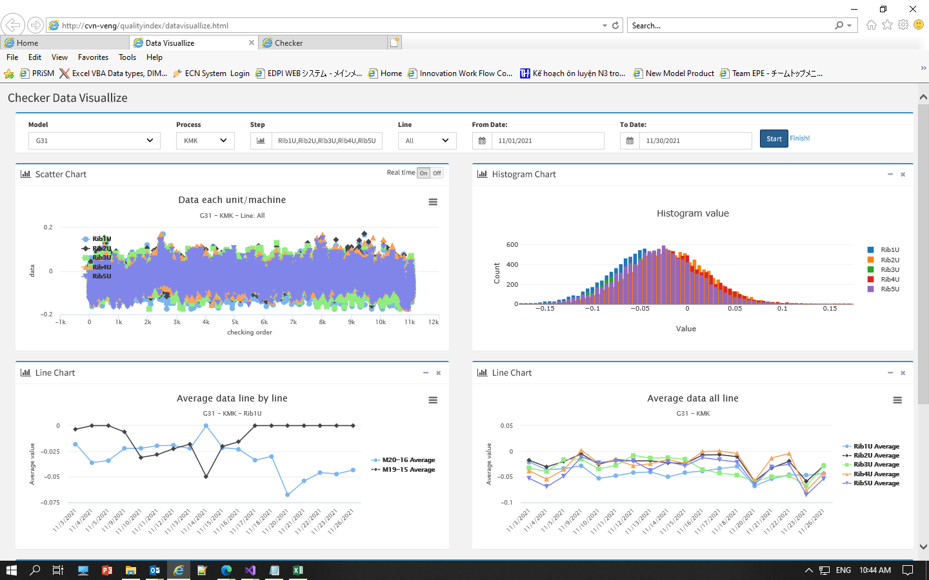
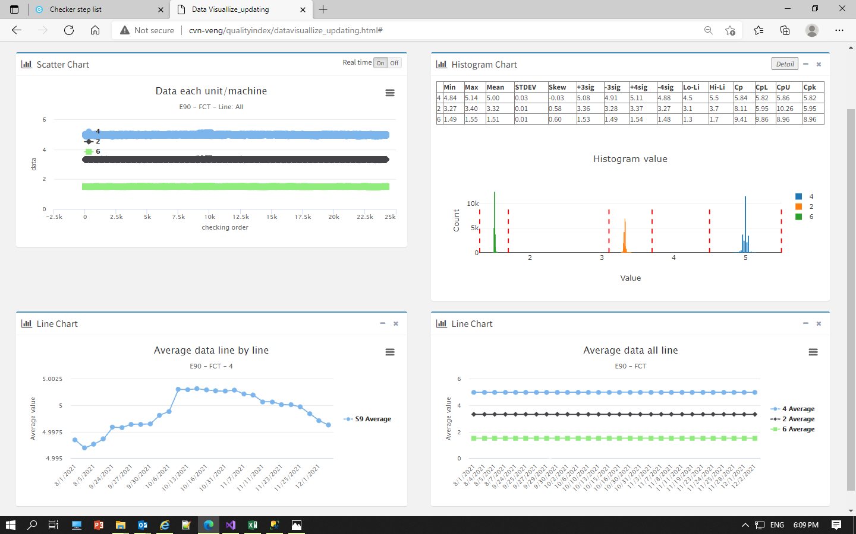
3. Innovation KPI
3. 3 Checker Data Visualize
RESULT
Scatter chart of each step/ each unit
KMK CF: Done
FCT: Done

Slide 18
3. Innovation KPI
3. 3 Checker Data Visualize
RESULT
Line chart for Average data each step/ compare between line
KMK CF Data
FCT Data

Slide 19
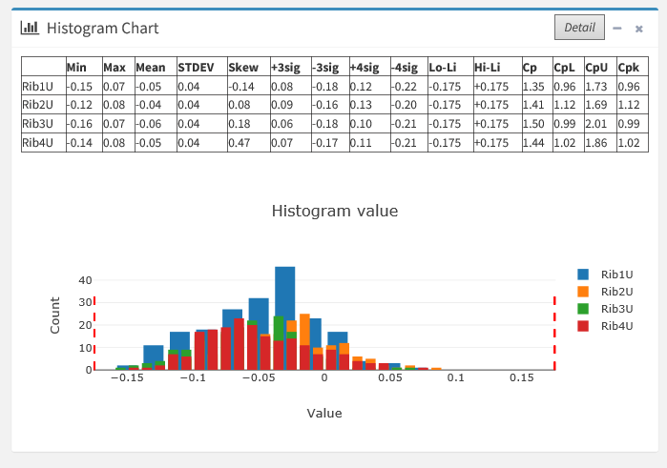
3. Innovation KPI
3. 3 Checker Data Visualize
RESULT
histogram chart for analysis data
KMK CF checker
FCT checker

Slide 20
3. Innovation KPI
3. 3 Checker Data Visualize
NEXT PLAN
2021
2022
Oct | Nov | Dec | Jan | Feb | Mar | Apr
KMK, FCT checker
22A PSU Final checker
Other ASSY checker

Slide 21
Thanks for attention

