Slide 1
1

Slide 2
CONTENTS
Introduction
Design Specifications
DAC Theory
Design Procedure
Result
Conclusion & Future works
*
2

Slide 3
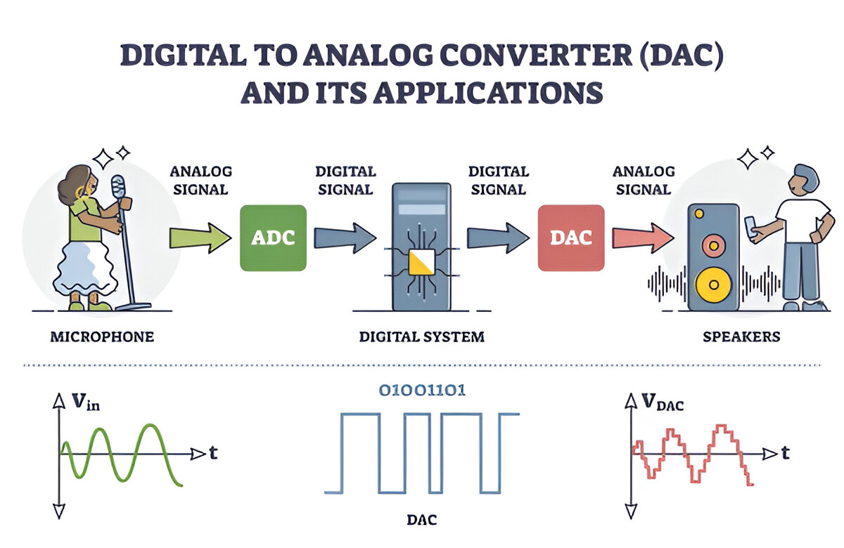
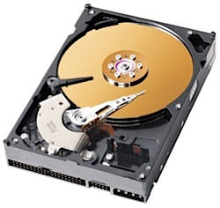
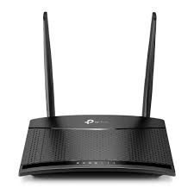

1. Introduction
Data converter is found in applications ranging from high-end computing systems to smart mobile devices
DAC and ADC is the main part of data converter
DAC convert the digital code input to analog output to connect to the real world
• Applications:
• Storage media
• Audio
• Mobile phone
• Routers
3

Slide 4
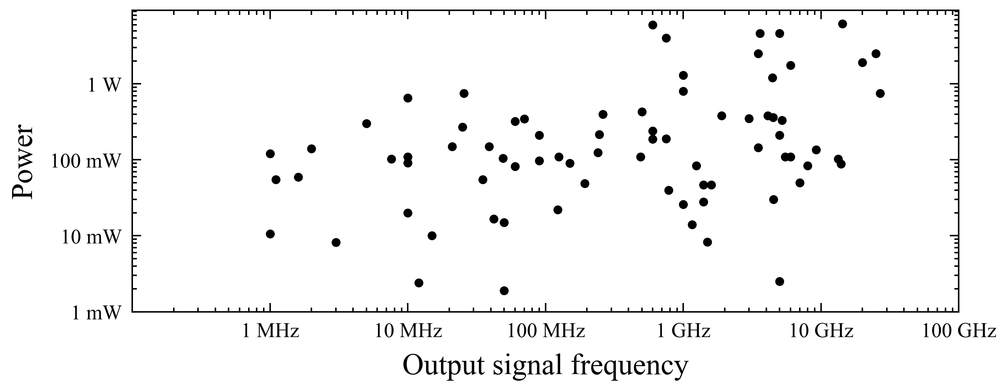
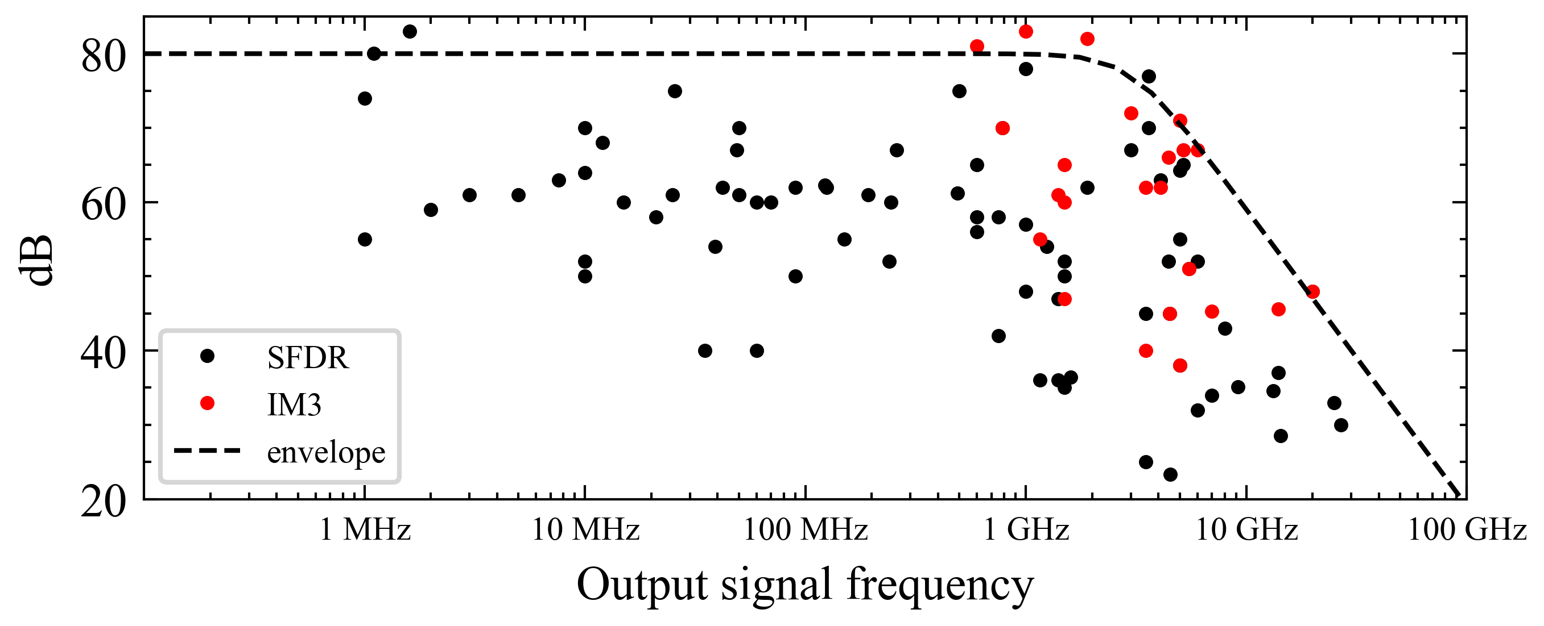
State of the art DAC
Higher Power, Higher Speed
Higher speed, lower SFDR
P. Caragiulo, C. Daigle, and B. Murmann, DAC Performance Survey 1996-2020,” [Online]. Available: https://github.com/pietro-caragiulo/survey-DAC
4

Slide 5
State of the art DAC
 | [20] | [21] | [6] | [22]
Year | 1999 | 2006 | 2010 | 2021
Technology | 0.5µm | 180nm | 65nm | 7nm
Resolution | 12 | 10 | 12 | 8
Power Dissipation (mW) | 140 | 216 | 188 | 308
Sampling Rate (MSPS) | 200 | 250 | 2,900 | 97,000
SFDR (dB) | 70 | 62.3 | 56 | 40.76
[6]C. -H. Lin et al., "A 12 bit 2.9 GS/s DAC With IM3 ≪− 60 dBc Beyond 1 GHz in 65 nm CMOS," in IEEE Journal of Solid-State Circuits, vol. 44, no. 12, pp. 3285-3293, Dec. 2009.
[20] A. Van den Bosch et al., "A 12 bit 200 MHz low glitch CMOS D/A converter," Proceedings of the IEEE 1998 Custom Integrated Circuits Conference (Cat. No.98CH36143), Santa Clara, CA, USA, 1998.
[21] J. Deveugele and M. Steyaert, "A 10b 250MS/s binary-weighted current-steering DAC," 2004 IEEE International Solid-State Circuits Conference (IEEE Cat. No.04CH37519), San Francisco, CA, USA, 2004.
[22] R. L. Nguyen et al., "8.6 A Highly Reconfigurable 40-97GS/s DAC and ADC with 40GHz AFE Bandwidth and Sub-35fJ/conv-step for 400Gb/s Coherent Optical Applications in 7nm FinFET," 2021 IEEE International Solid-State Circuits Conference (ISSCC), San Francisco, CA, USA, 2021.
5

Slide 6
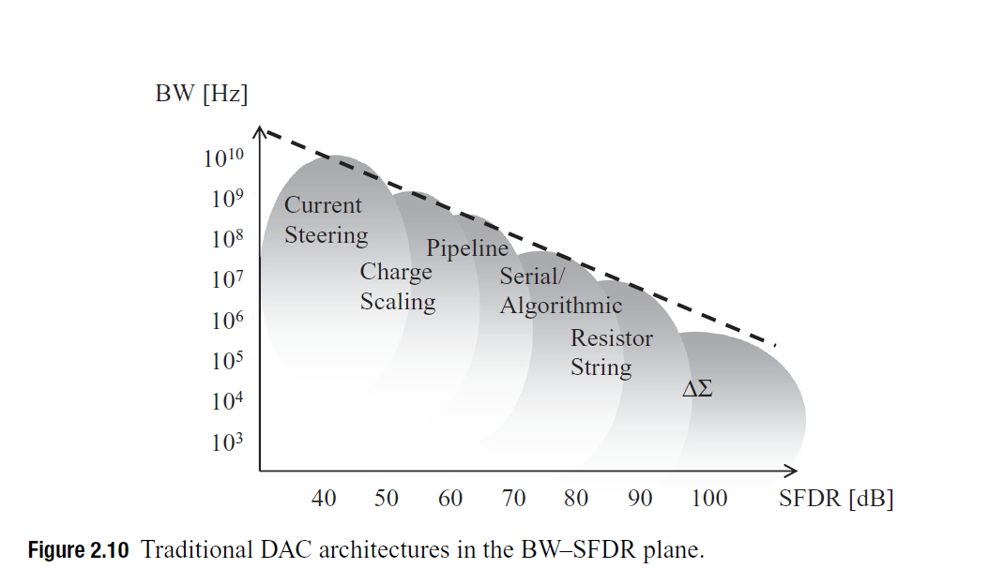
Trending DAC topologies
[2] G. Manganaro, Advance Data Converters. Cambridge University Press, 2012.
6

Slide 7
2. Design Specifications
DESIGN PARAMETERS |  | SPECIFICATIONS
VDD |  | 1.2V
Technology |  | 65nm
Resolution |  | 12
Fsamp |  | 500MS/s
SFDR |  | 70dB@250MHz
ENOB |  | 11
Power |  | 60mW
PVT | Process | 5 case of MOS
 | Temperature | -20˚C to 125˚C
7

Slide 8
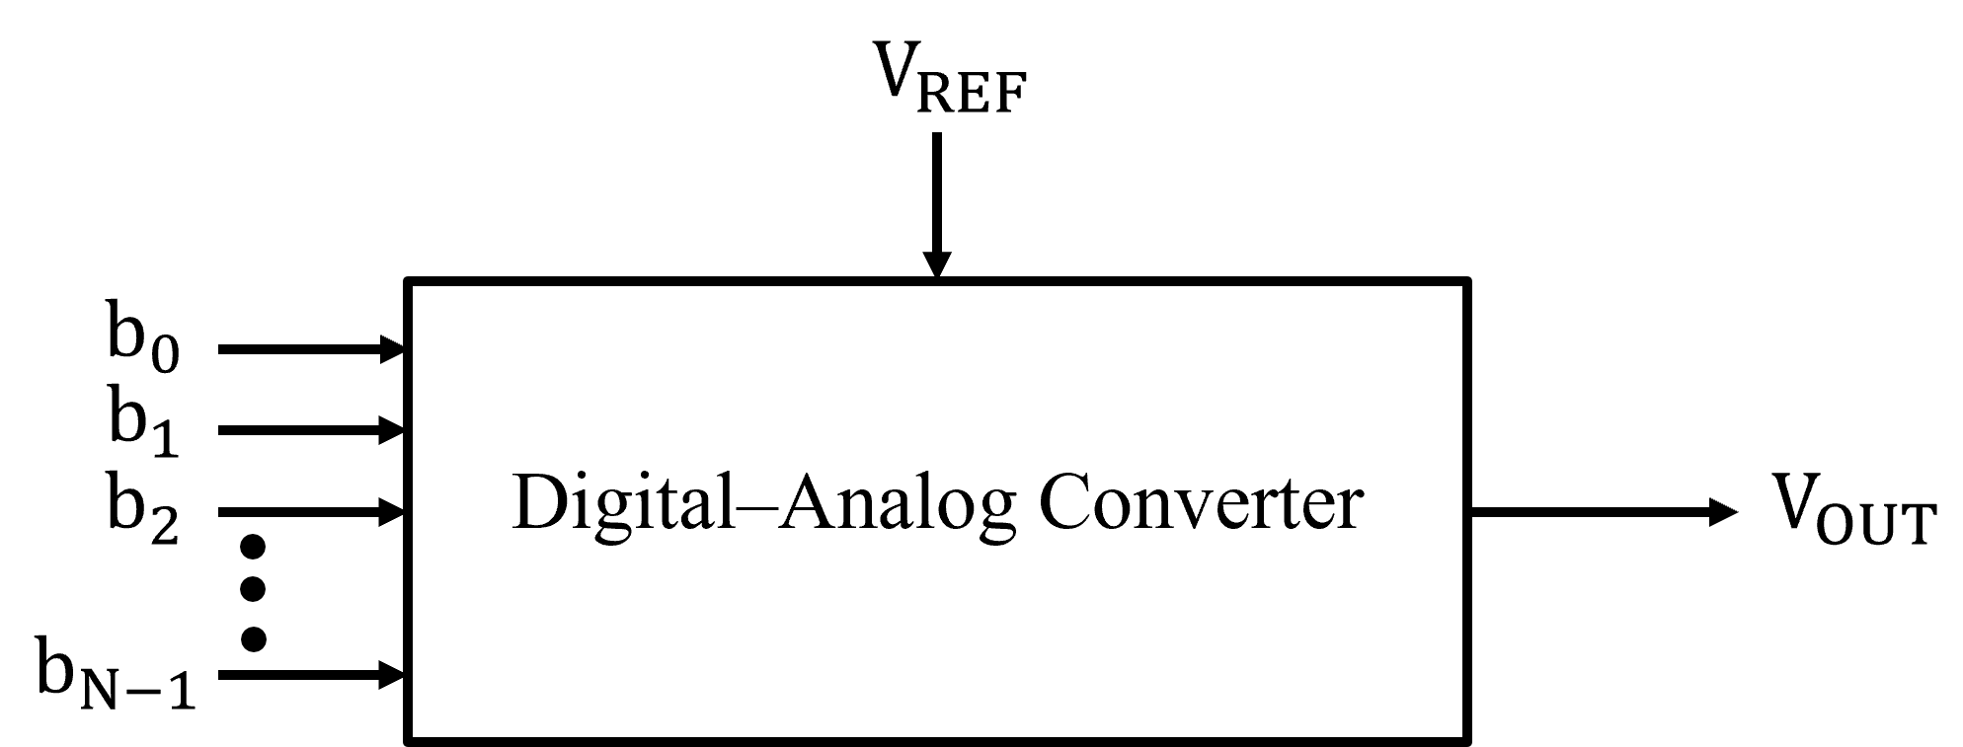


3. DAC Theory
$$\begin{aligned}&LSB=\frac{V_{REF}}{2^{N}}\#\end{aligned}$$
$$\begin{aligned}&Fullscale\left(FS\right)=V_{REF}−LSB=V_{REF}\left(1−\frac{1}{2^{N}}\right)\#\end{aligned}$$
N is the total number of bits of the digital word
8

Slide 9
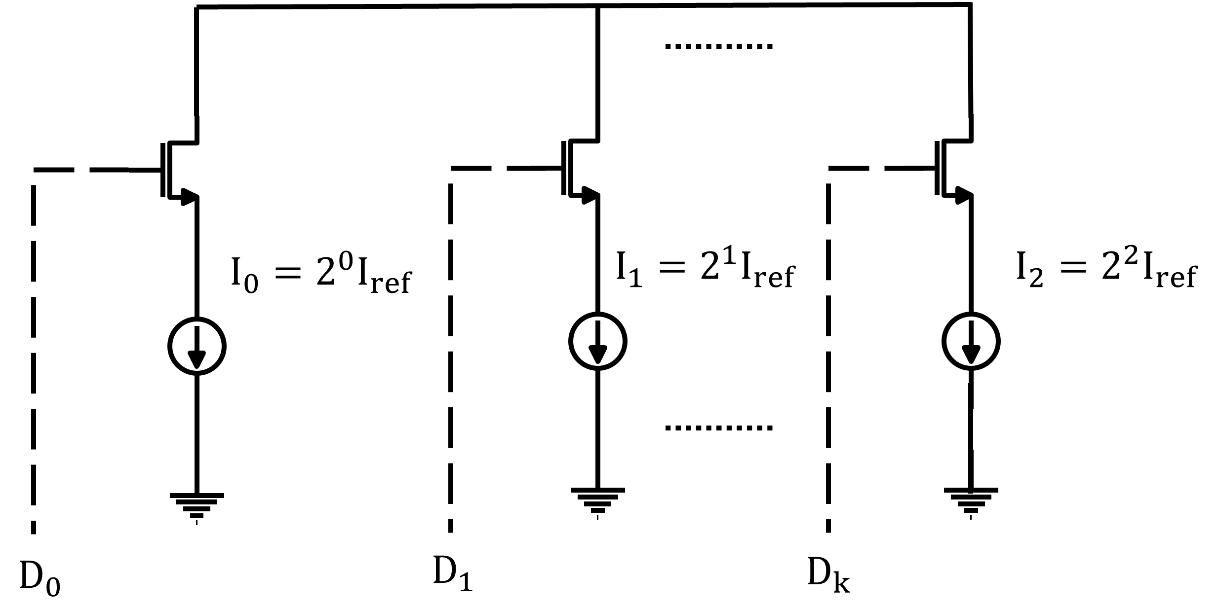
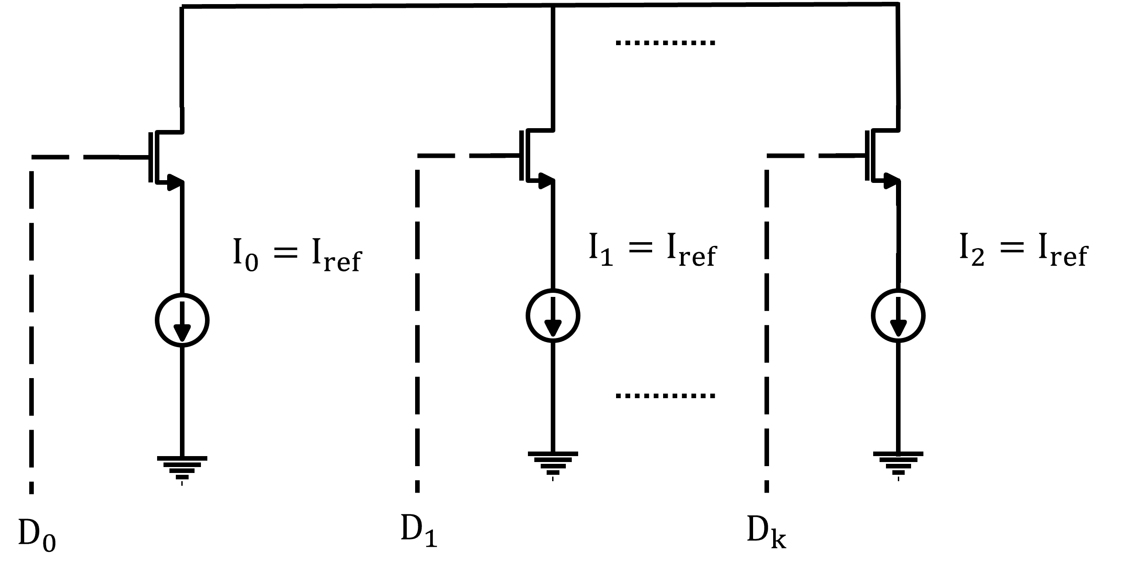
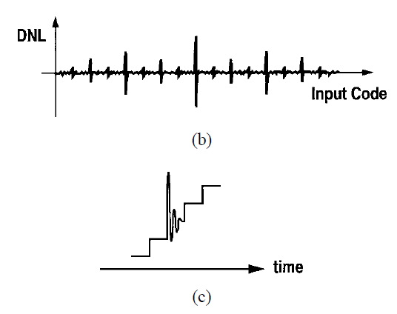
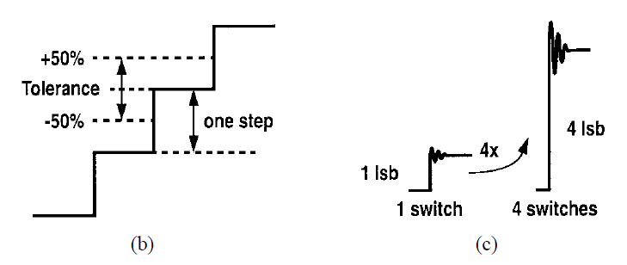
Binary weighted and Thermometer Current Steering DAC
Feature | Binary-Weighted DAC | Thermometer-Coded DAC
Complexity | Simple | Need decoder
Monotonicity | Not guaranteed | Guaranteed
Glitches at Mid-Code | Severe | Minimal
Best Use Case | Low-precision (<8-bit) | High-precision (> 8 bits)
binary-weighted
Thermometer
Matching and glitch advantages of a thermometer-coded DAC.
Matching and glitch problems of a binary-weighted DAC.
[12] Chi-Hung Lin and K. Bult, "A 10-b, 500-MSample/s CMOS DAC in 0.6 mm/sup 2/," in IEEE Journal of Solid-State Circuits, vol. 33, no. 12, pp. 1948-1958, Dec. 1998
9

Slide 10
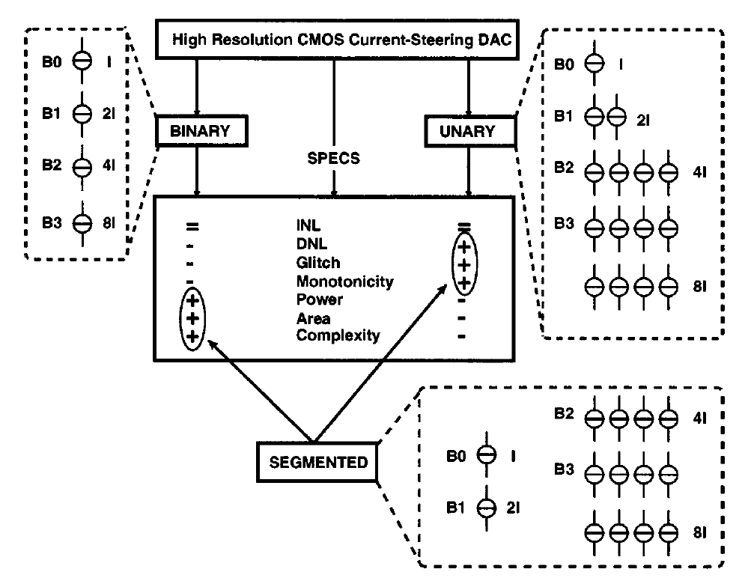
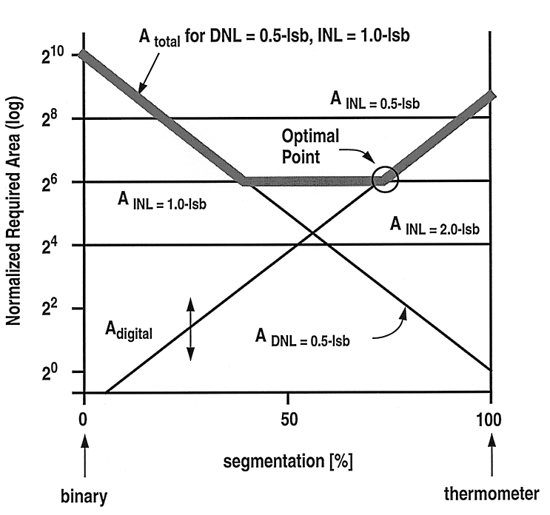
Segmentation current steering
Comprehensive overview of the specifications of unary, binary, and segmented implementations.
Normalized required area versus percentage of segmentation.
[15] A. van den Bosch, M. A. F. Borremans, M. S. J. Steyaert and W. Sansen, "A 10-bit 1-GSample/s Nyquist current-steering CMOS D/A converter," in IEEE Journal of Solid-State Circuits, vol. 36, no. 3, pp. 315-324, March 2001
[12] Chi-Hung Lin and K. Bult, "A 10-b, 500-MSample/s CMOS DAC in 0.6 mm/sup 2/," in IEEE Journal of Solid-State Circuits, vol. 33, no. 12, pp. 1948-1958, Dec. 1998
10

Slide 11
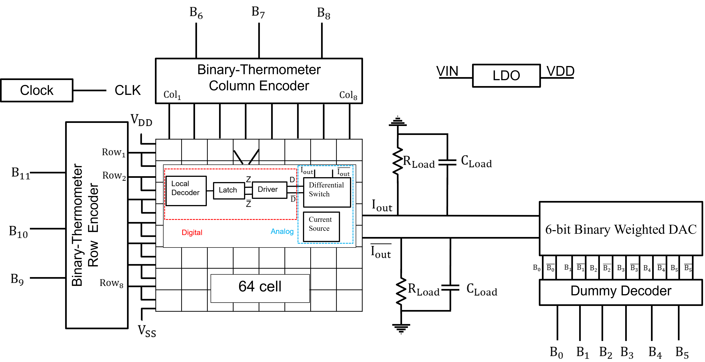
4. Design Procedure – DAC Implementation
11

Slide 12
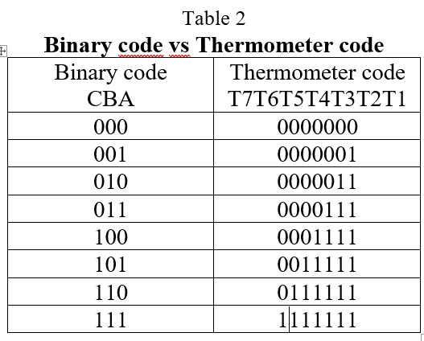
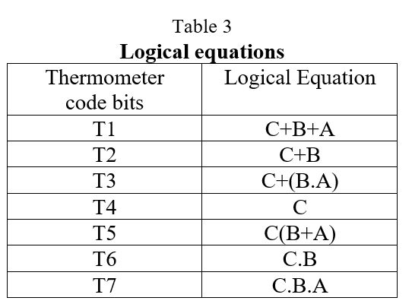
Thermometer Encoder
12

Slide 13
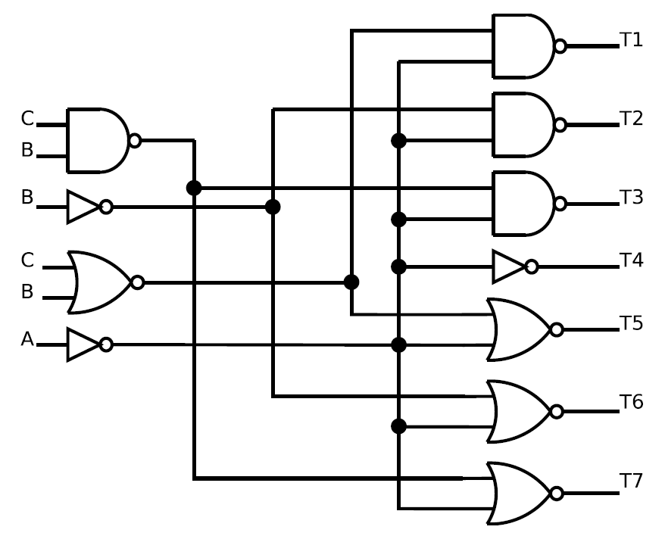
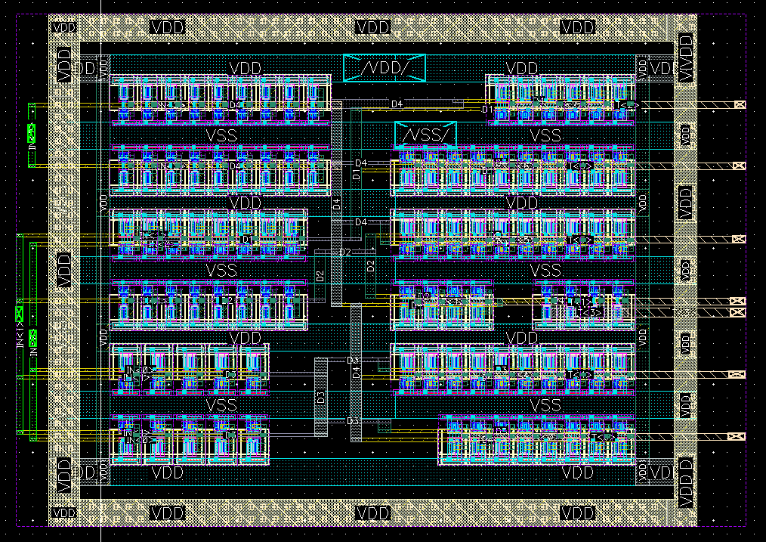
Thermometer Encoder – Schematic and Layout
13

Slide 14
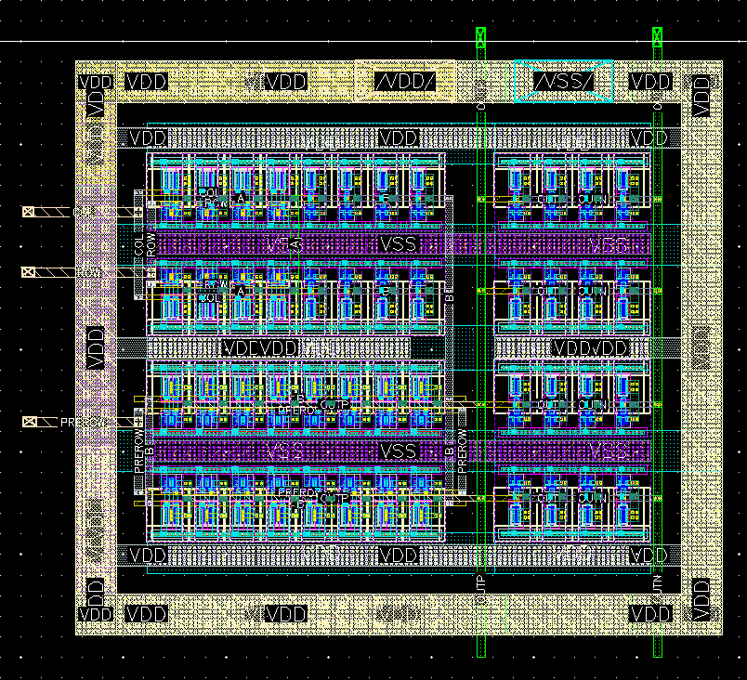
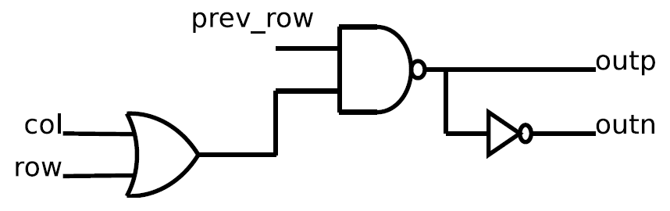
Local Decoder
Used to check whether the previous cell is turned on.
If so, the next cell is enabled
14

Slide 15
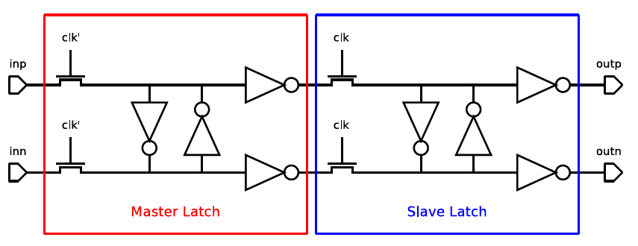
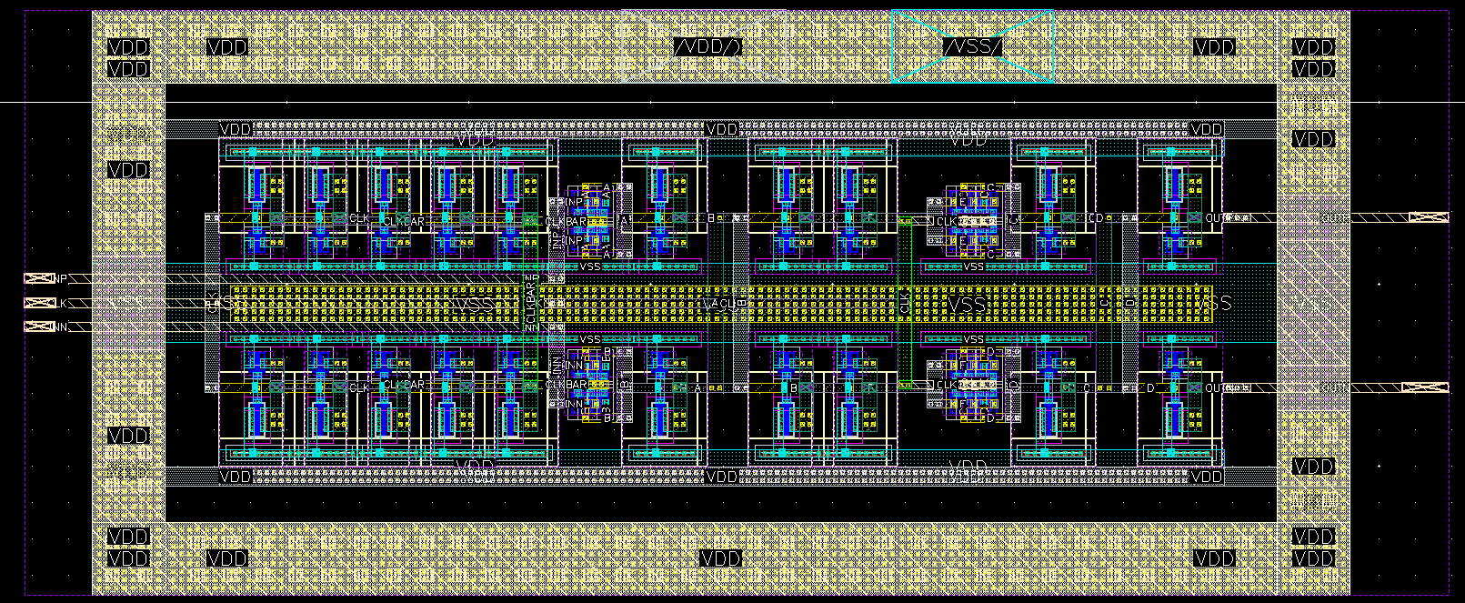
Latch
The latch synchronizes input signals, ensuring all switches in the current cell activate at the same time.
15

Slide 16
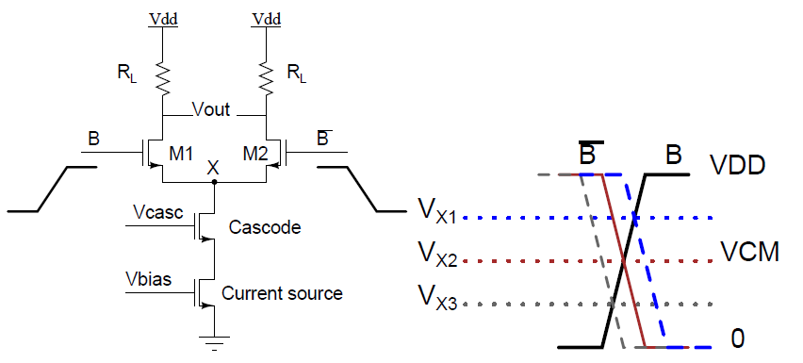
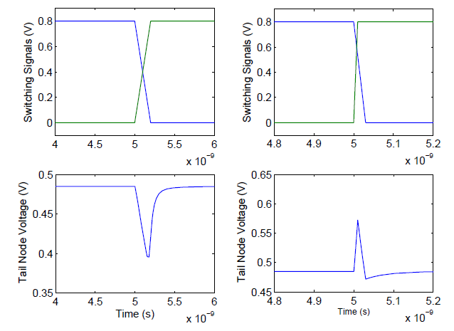
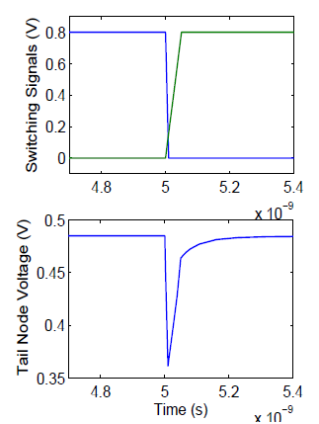
Current cell issue
Current cell with switch signal transition
=> Use driver to level-shift switch signals instead of just aligning timing
16

Slide 17
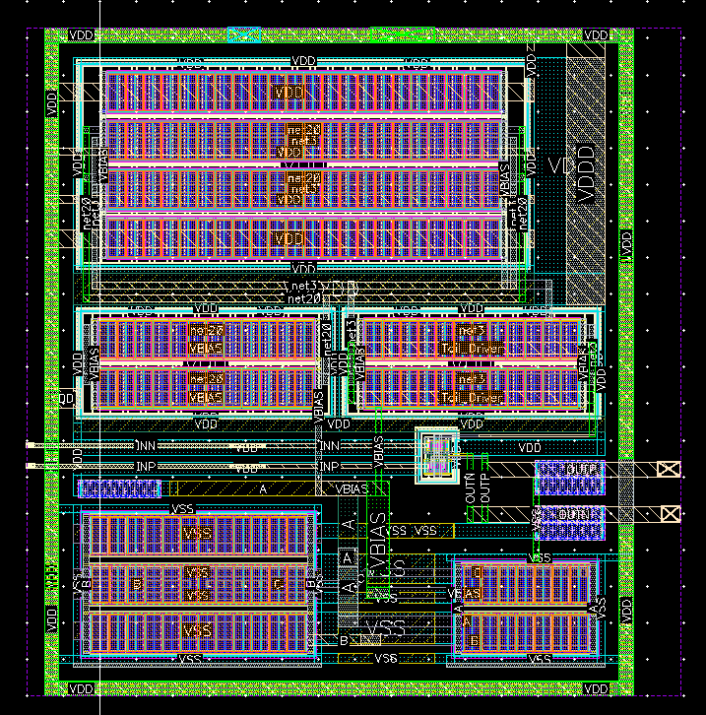
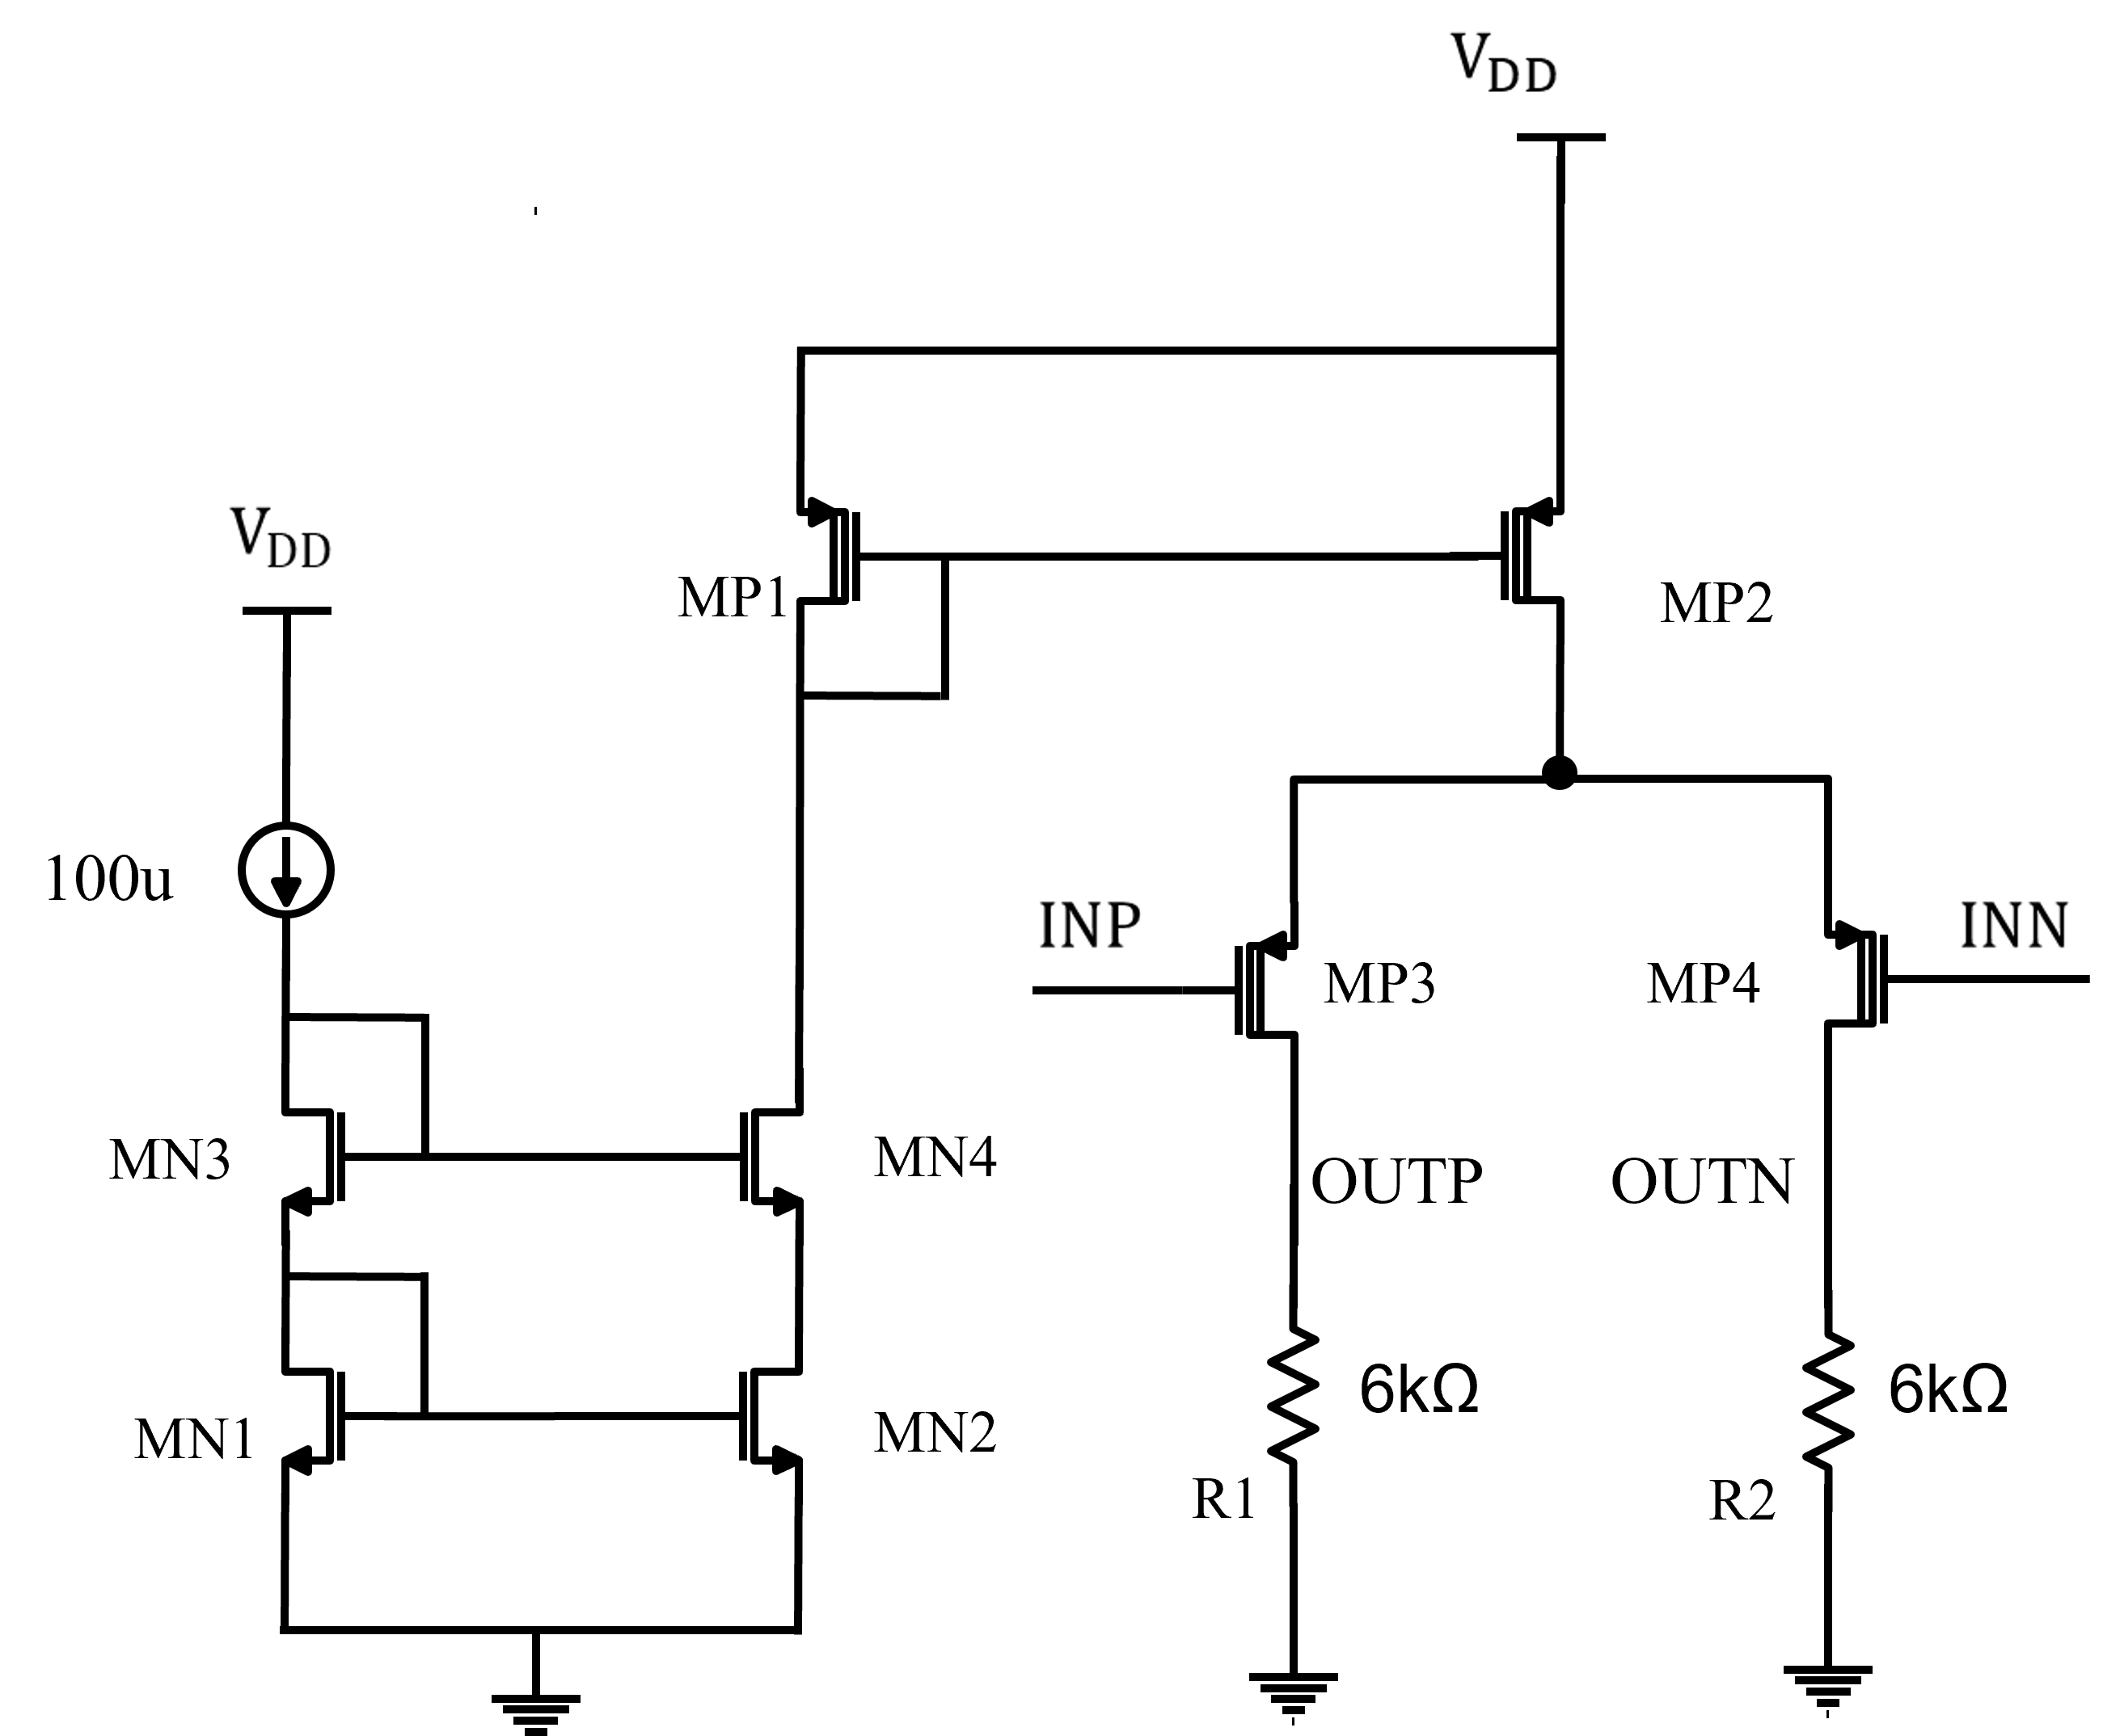
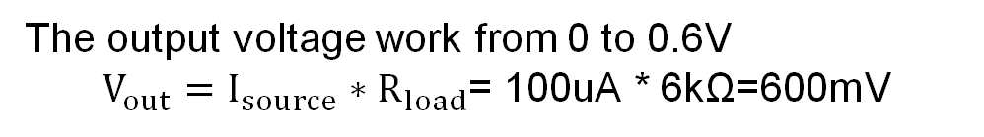
Driver - Schematic
The output voltage work from 0 to 0.6V
$V_{out}=I_{source}∗R_{load}$= 100uA * 6kΩ=600mV
17

Slide 18
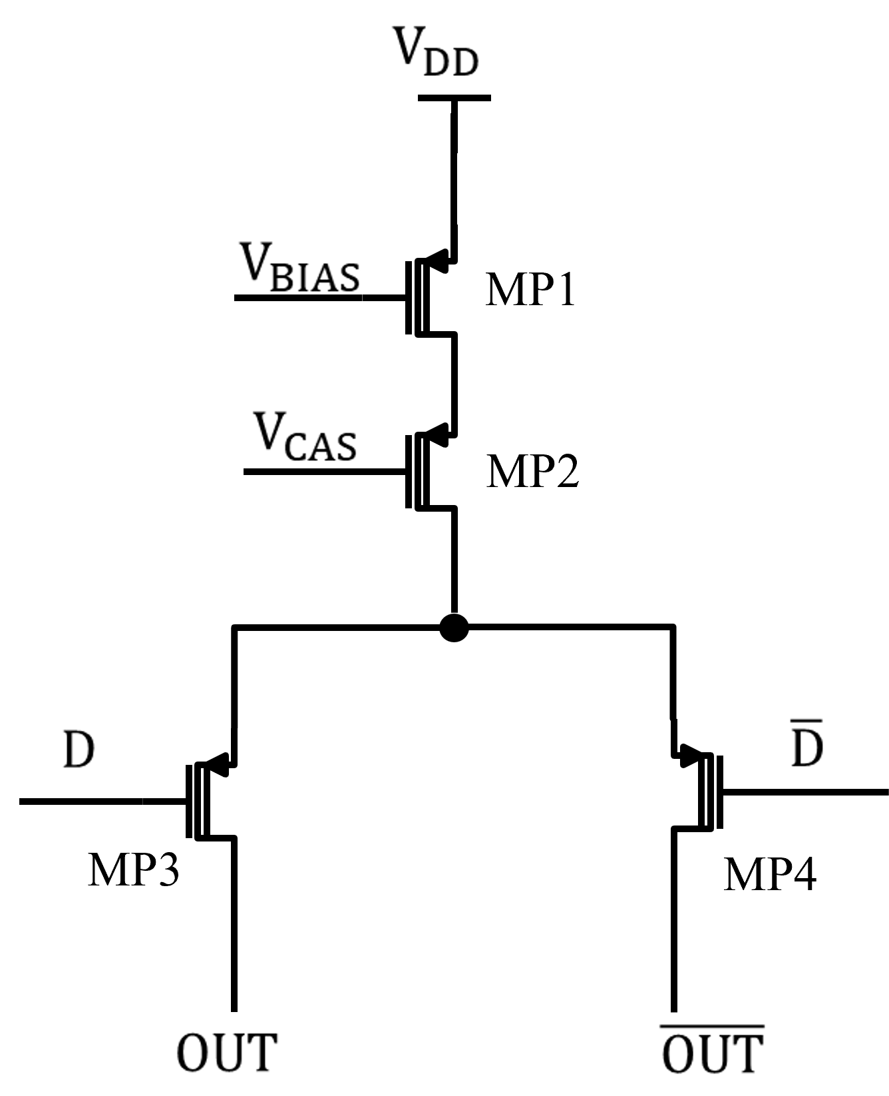
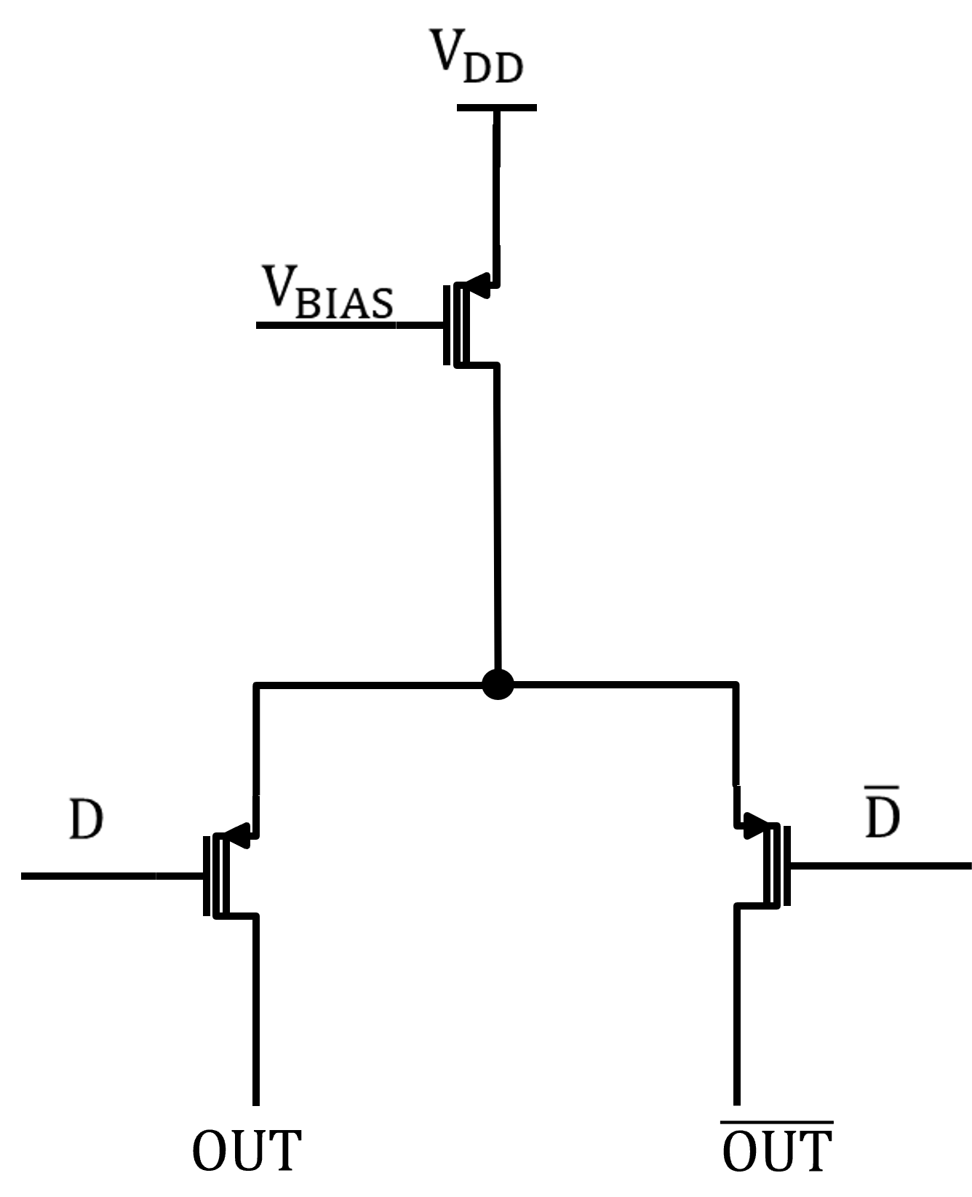
Current Cell – Design
MP1
More output impedance
Better ENOB
Lower glitch
Lower output swing
MP3
MP2
Basic Cell
Cascode current source Cell
18

Slide 19

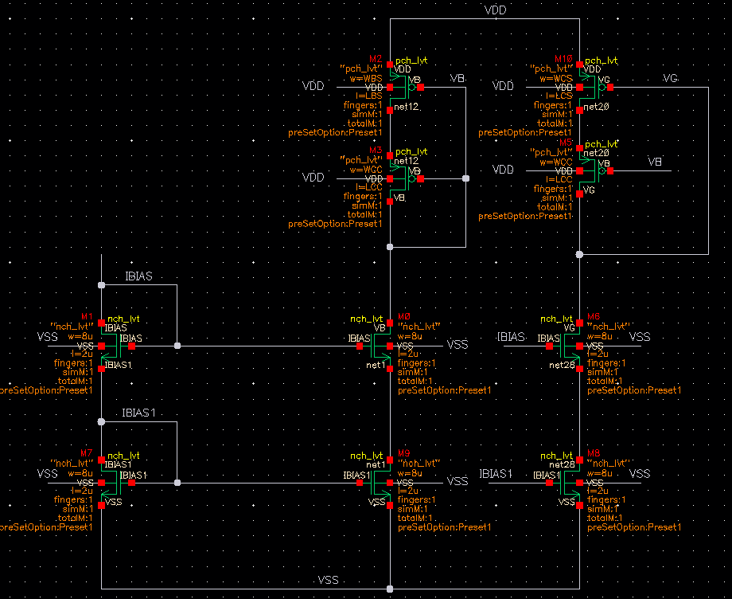









Current Cell Design – Final result
W = 10u
L = 2u
$$V_{BIAS}$$
W = 400n
L = 1u
$$V_{CAS}$$
W = 5.2u
L = 400n
Cascode current source
W = 150n
L = 60n
Cascode switch
W = 150n
L = 60n
Biasing Circuit
19

Slide 20
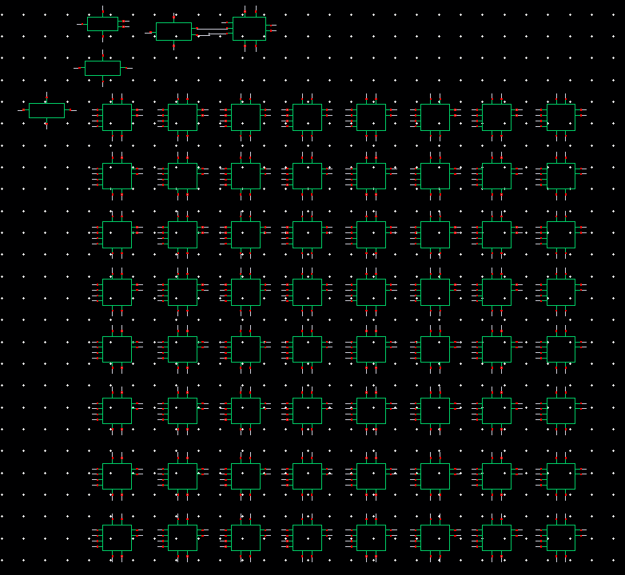
Full circuit
Current Biasing
Binary weighted cell
Dummy Decoder
Binary to thermo Decoder
Thermometer cell

Slide 21
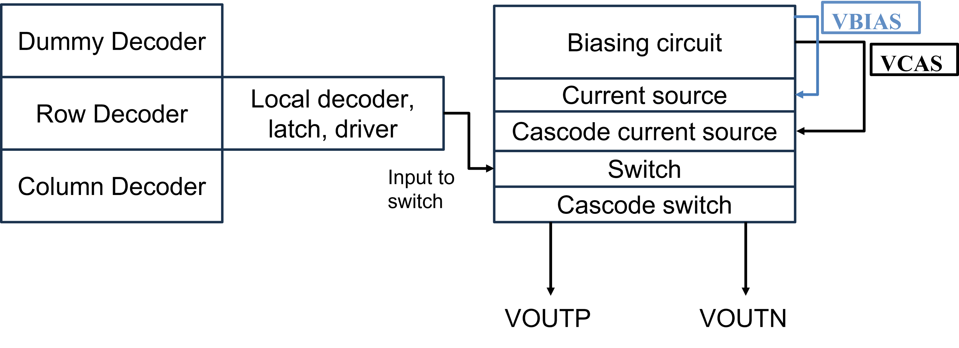
Layout - Floorplanning

Slide 22
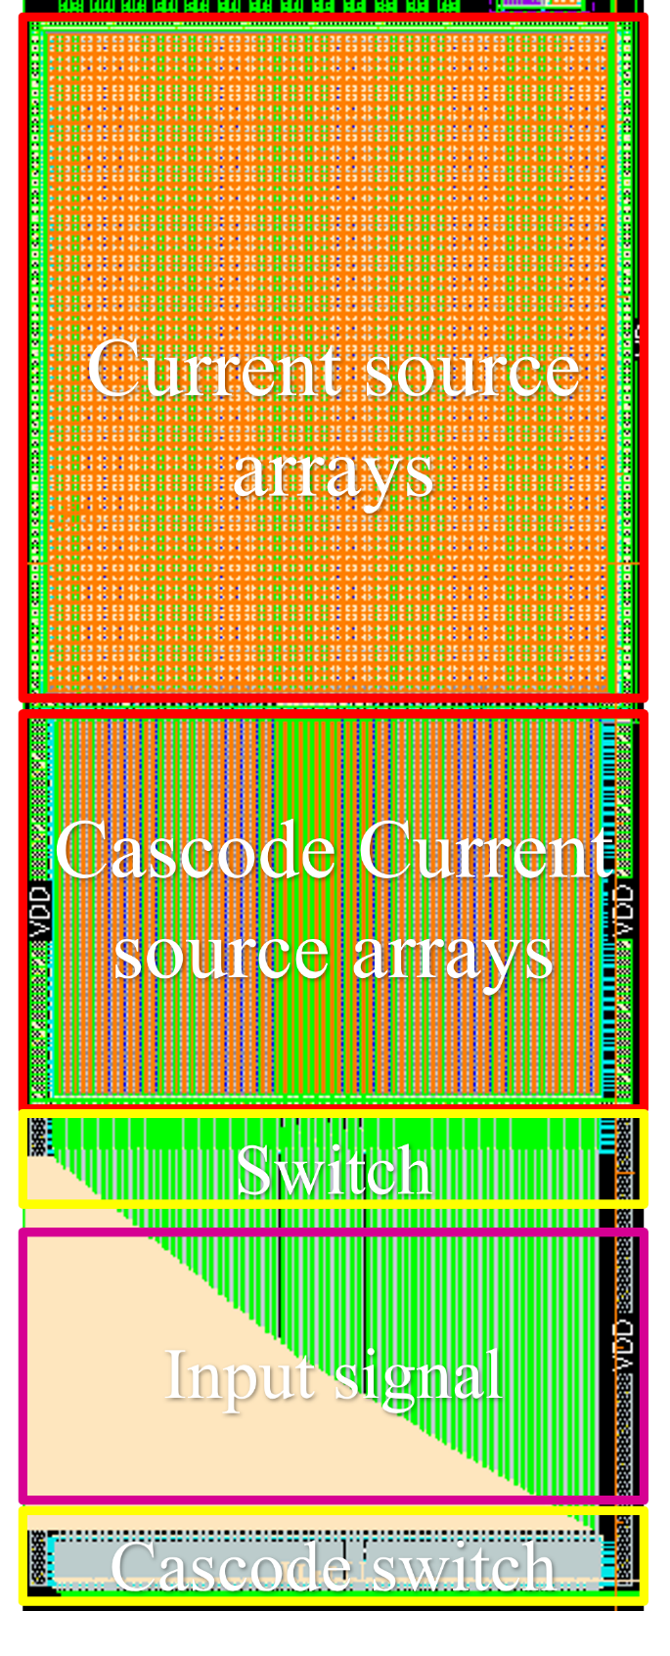
Layout – Current source arrays

Slide 23
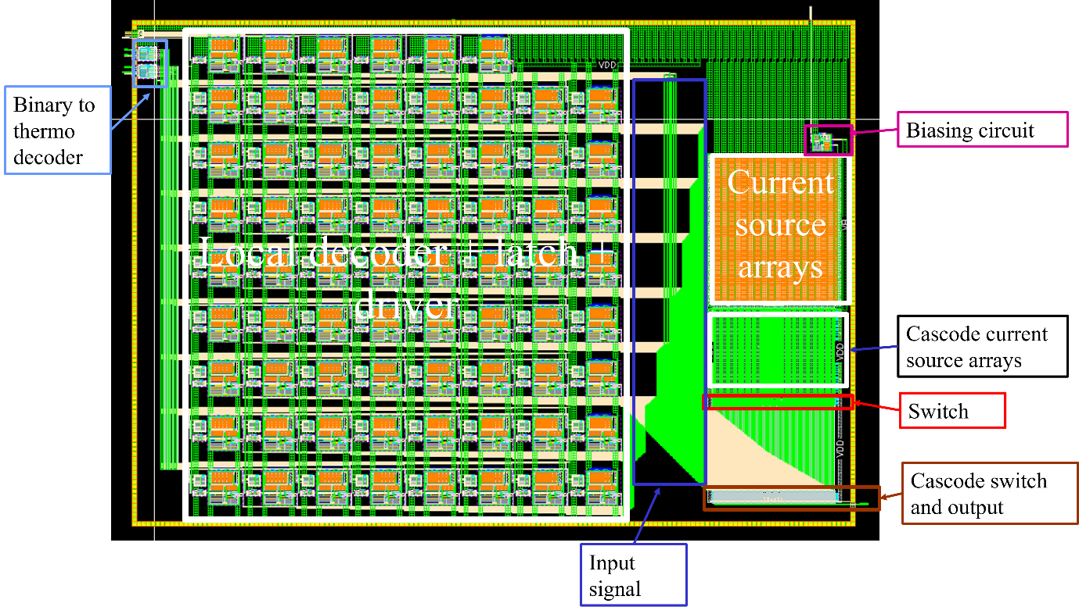
Layout – Full DAC
Area: 1.84 x 1.3 mm²

Slide 24
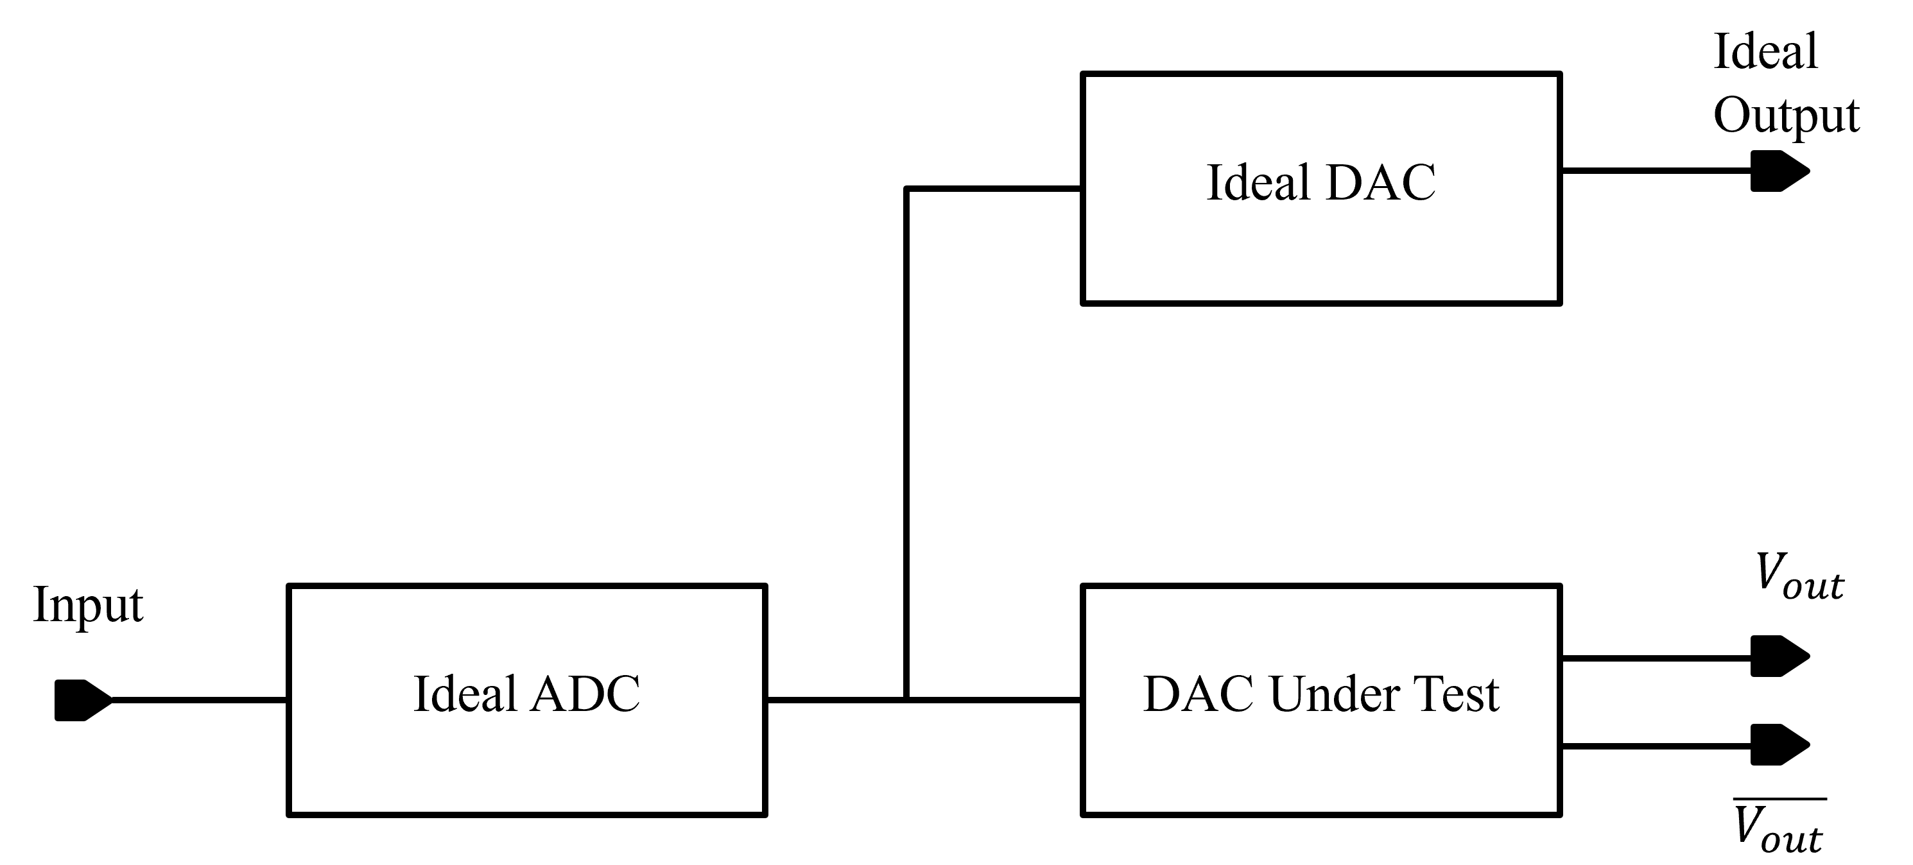
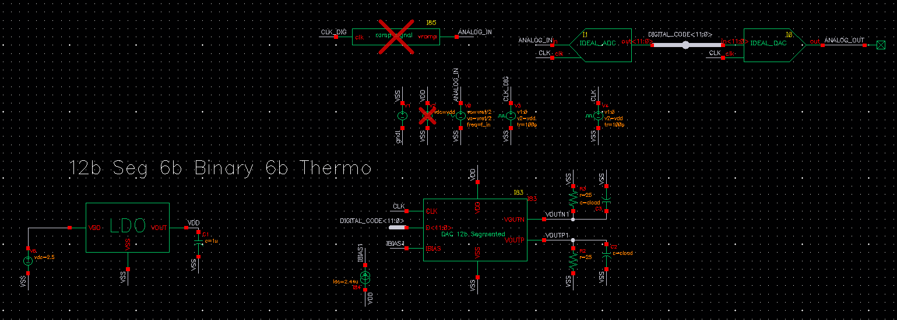
5. Result - Testbench
Ramp Signal

Slide 25
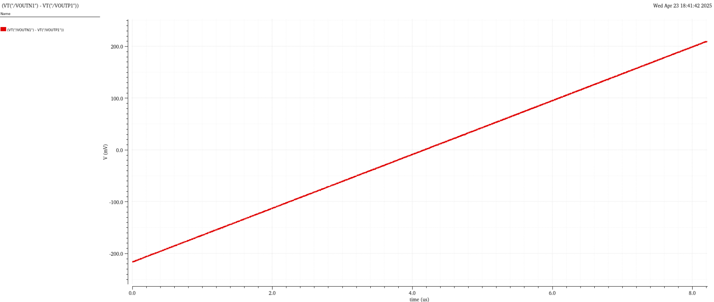
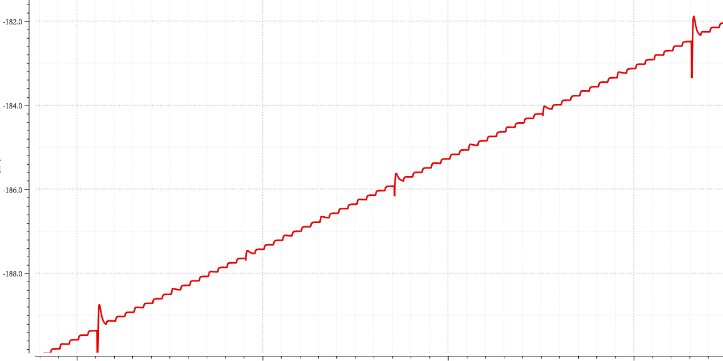
Static Performance
Using ramp signal to ADC to find DNL and INL

Slide 26
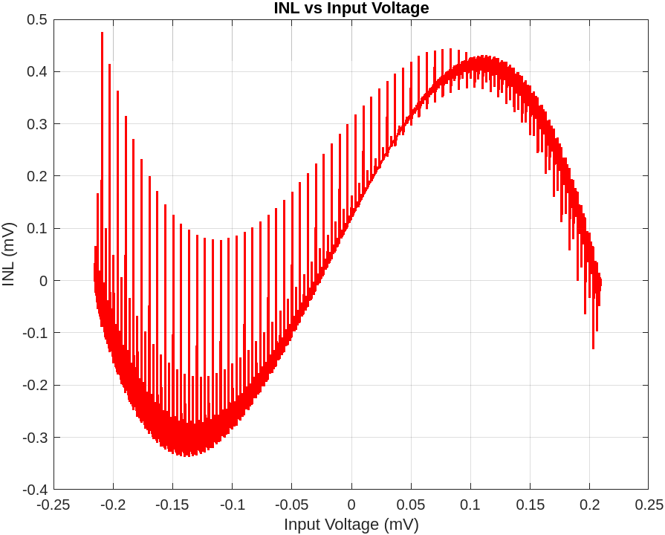
INL Result
Worst-case INL = 0.5LSB

Slide 27
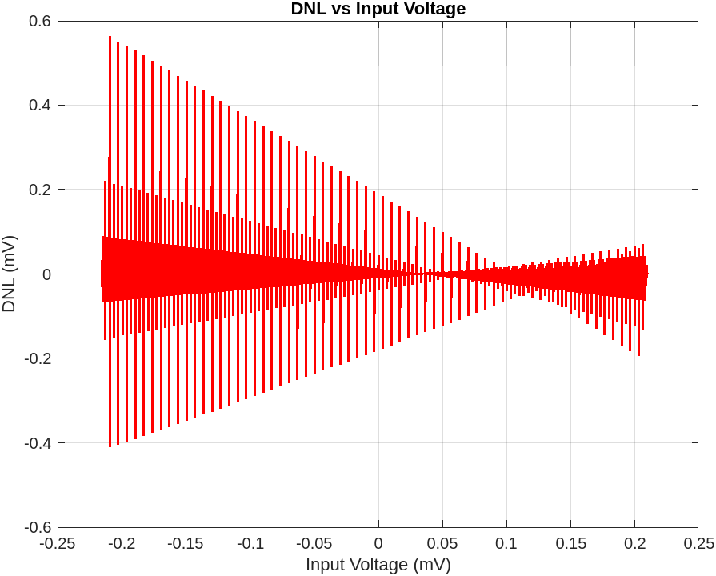
DNL Result
Worst-case DNL = 0.6LSB

Slide 28
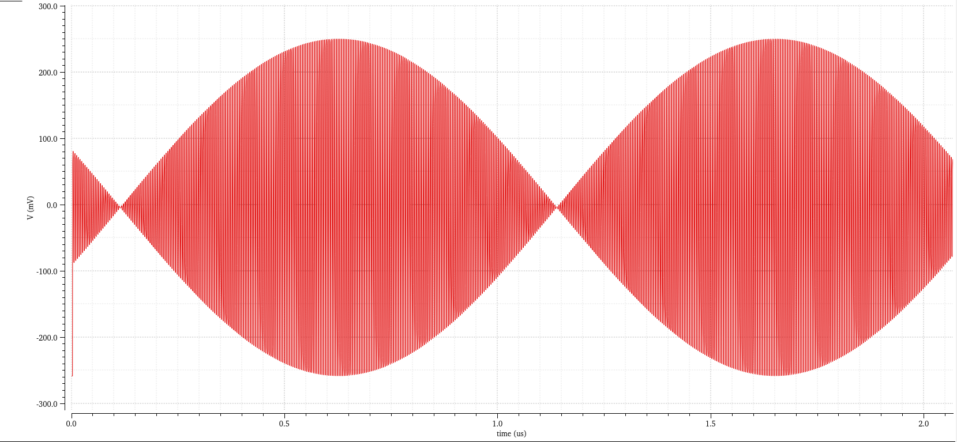
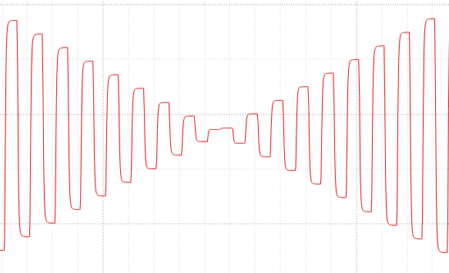
Dynamic Result
1024 samples, fin = 249.5MHz, Fsamp = 500MHz, include 4G noise transient

Slide 29
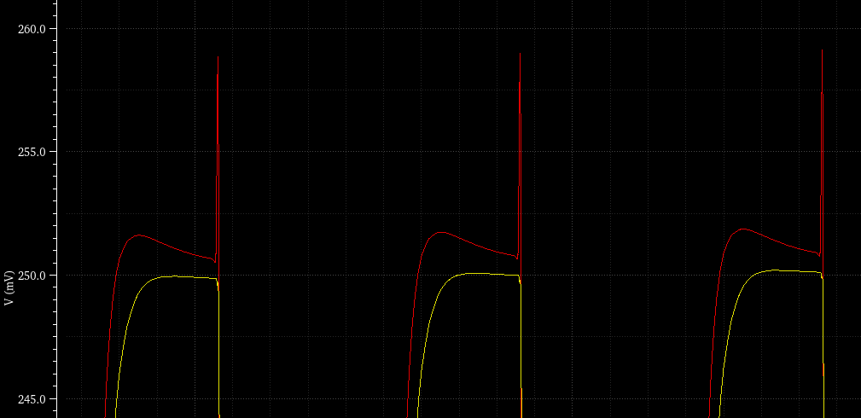


Comparison current cell
Cascode current source cell
Cascode current source cell
Cascode current source and cascode switch cell
Cascode current source and cascode switch cell
=> Use cascode switch to minimize glitch, increase ENOB

Slide 30
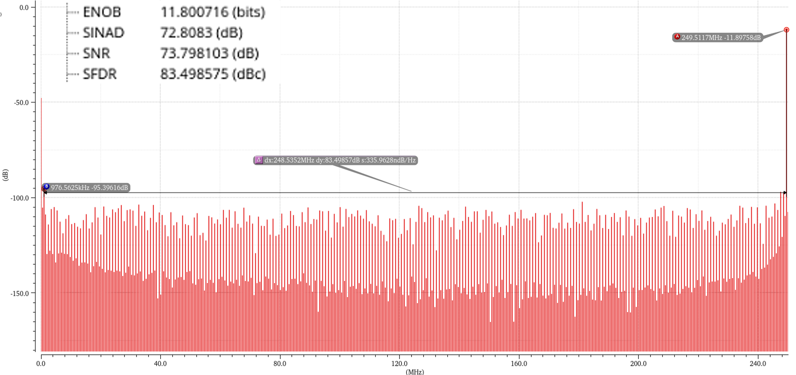
Spectrum Result
Spectrum with 249.5 MHz signal with and 500 MHz clock

Slide 31
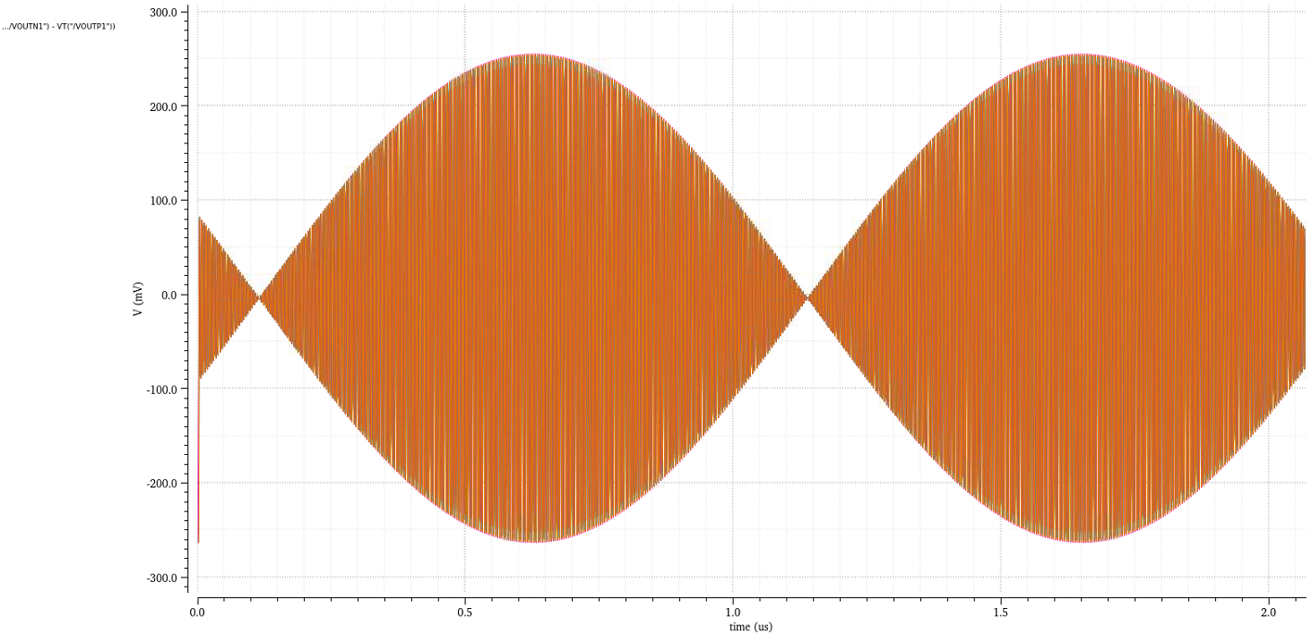
PVT result

Slide 32
PVT result
 | Min | Max | Typical | Post sim @TT | Post sim @100MSPS
Power Dissipation (mW) | 32.47 | 47.12 | 40 | 47.3 | 37.16
DNL (LSB) | 0.3 | 0.6 | 0.5 | - | -
INL (LSB) | 0.2 | 0.5 | 0.4 | - | -
SFDR (dB) | 68.72 | 85 | 83.5 | 30.7 | 67.4
ENOB | 10.6 | 11.8 | 11.8 | 4.56 | 10.17

Slide 33
Comparison
 | [6] | [11] | [19] | This Work
Technology | 65nm | 65nm | 90nm | 65nm
Resolution | 12 | 12 | 12 | 12
Power Dissipation (mW) | 188 | 30 | 128 | 40
DNL (LSB) | 0.3 | 0.23 | 0.5 | 0.6
INL (LSB) | 0.5 | 0.4 | 1.2 | 0.4
Update Rate (MS/s) | 2900 | 300 | 1250 | 500
SFDR (dB) | > 66 | 75.98 | 66 | 83.5
Bandwidth (MHz) | 300 | 30 | 625 | 250
ENOB | 10.67 | - | 10.67 | 11.8

Slide 34
Conclusion & Future work
Project Overview: Designed a 12-bit DAC 500MSPS in 65nm CMOS.
Achieved 11.8-bit ENOB at 500 MSPS (schematic), and 10.17-bit at 100 MSPS (post-layout).
Low power consumption: 41mW total.
High linearity: DNL = 0.6 LSB, INL = 0.5 LSB.
Robust across PVT corners.
Applied techniques:
+ Cascode current source
+ Cascode switch.
+ 3 to 7 bits binary to thermometer decoder.
Future Work
Layout optimization to improve post-layout performance → tape-out ready.
Add digital calibration (e.g., DEM) for higher accuracy and speed.
Explore system-level integration:
→ Use in optical transceivers for high-speed data center applications.

Slide 35
THANK YOU
35

Slide 36
Reference
[2] G. Manganaro, Advance Data Converters. Cambridge University Press, 2012..
[4] P. Caragiulo, C. Daigle, and B. Murmann, DAC Performance Survey 1996-2020,” [Online]. Available: https://github.com/pietro-caragiulo/survey-DAC.
[6] C. -H. Lin et al., "A 12 bit 2.9 GS/s DAC With IM3 ≪− 60 dBc Beyond 1 GHz in 65 nm CMOS," in IEEE Journal of Solid-State Circuits, vol. 44, no. 12, pp. 3285-3293, Dec. 2009.
[11] G. M. Hong, Shih-Hsuan Hsu, Yan-Hua Peng, Alvin Hsin-Hung Chen, Yi-Ti Wang and Hsin-Hung Lu, "A 10-bit 300MHz 0.1mm2 triple-channel current-steering DAC 75.98dB SFDR in 65nm," 2008 IEEE International Symposium on VLSI Design, Automation and Test (VLSI-DAT), Hsinchu, 2008.
[19] Wei-Hsin Tseng, Chi-Wei Fan, and Jieh-Tsorng Wu. A 12-bit 1.25-gs/s dac in 90 nm cmos with 70 db sfdr up to 500 mhz. Solid-State Circuits, IEEE Journal of, 46(12):2845–2856, 2011.
[20] A. Van den Bosch et al., "A 12 bit 200 MHz low glitch CMOS D/A converter," Proceedings of the IEEE 1998 Custom Integrated Circuits Conference (Cat. No.98CH36143), Santa Clara, CA, USA, 1998.
[21] J. Deveugele and M. Steyaert, "A 10b 250MS/s binary-weighted current-steering DAC," 2004 IEEE International Solid-State Circuits Conference (IEEE Cat. No.04CH37519), San Francisco, CA, USA, 2004.
[22] R. L. Nguyen et al., "8.6 A Highly Reconfigurable 40-97GS/s DAC and ADC with 40GHz AFE Bandwidth and Sub-35fJ/conv-step for 400Gb/s Coherent Optical Applications in 7nm FinFET," 2021 IEEE International Solid-State Circuits Conference (ISSCC), San Francisco, CA, USA, 2021.

Slide 37
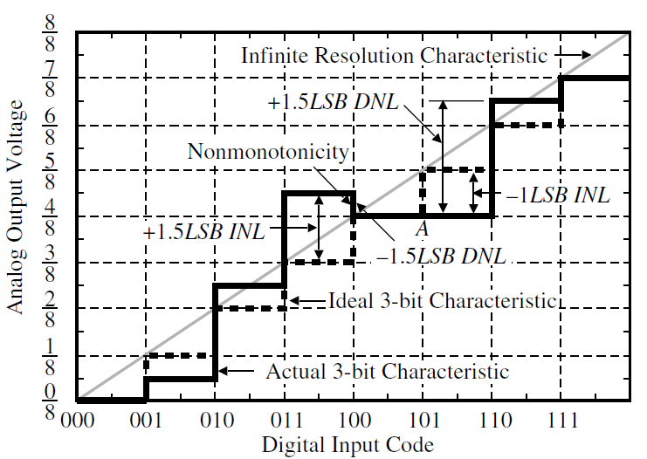
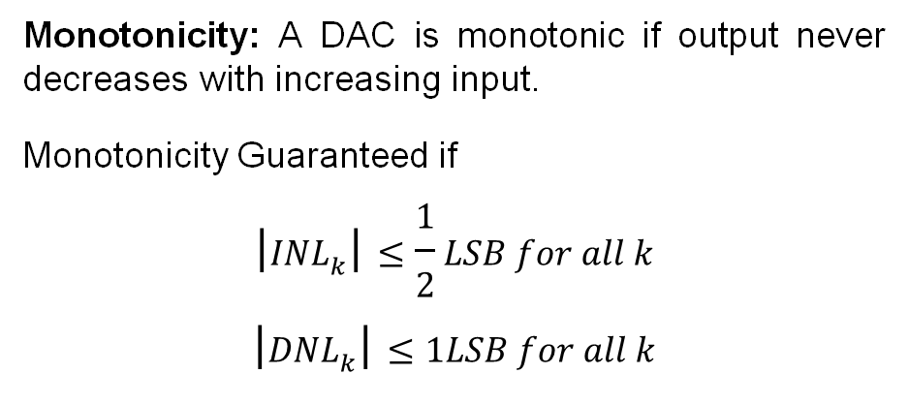
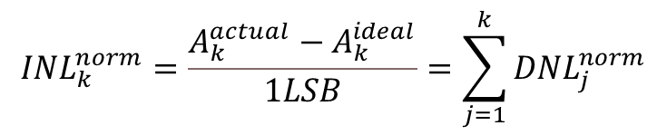
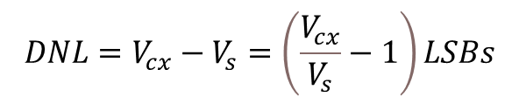
Static Characteristics of DACs
Differential nonlinearity (DNL) is a measure of the separation between adjacent levels measured at each vertical jump
$$\begin{aligned}&DNL=V_{cx}−V_{s}=\left(\frac{V_{cx}}{V_{s}}−1\right)LSBs\#\end{aligned}$$
Integral Nonlinearity (INL) is deviation of actual output from ideal output across full range
$${INL}_{k}^{norm}=\frac{A_{k}^{actual}−A_{k}^{ideal}}{1LSB}=\sum_{j=1}^{k}{{DNL}_{j}^{norm}}$$
Monotonicity: A DAC is monotonic if output never decreases with increasing input.
Monotonicity Guaranteed if
$$\begin{aligned}\left|{INL}_{k}\right|≤\frac{1}{2}LSB for all k\#\end{aligned}$$
$$\begin{aligned}\left|{DNL}_{k}\right|≤1LSB for all k\#\end{aligned}$$
37

Slide 38


Dynamic Characteristics of DACs
Time Domain Characteristics:
• Settling Time: Time to stabilize output after a step input.
• Glitch: Spurious spikes due to code transitions.
• Clock Feedthrough: Capacitive coupling of clock signals to output.
Frequency Domain Characteristics:
• SNR: Signal-to-noise ratio like the quantization noise and the noise produced by the components in the circuit, excluding harmonics.
$${SNR}_{dB}=6.02N+1.76dB$$
• SFDR: Ratio of signal power to highest spur.
$$SFDR\left(dBc\right)=10log\left(\frac{Signal Power}{Largest spur power}\right)$$
• ENOB: Effective resolution based on SNR or SFDR.
$$ENOB=\frac{{SFDR}_{dB}−1.76}{6.02}=\frac{{SNR}_{dB}−1.76}{6.02}$$
Dynamic performances of a DAC (a) Time domain response
(b) Frequency domain measure
38

Slide 39

DAC architectures
39

Slide 40

Application DAC
A. Khairi et al., "Beyond 200-Gb/s PAM4 ADC and DAC-Based Transceiver for Wireline and Linear Optics Applications," in IEEE Open Journal of the Solid-State Circuits Society, vol. 4, pp. 265-276, 2024,

Slide 41











Current Cell – Current source design
To calculate the sizing for cell better, we need to know the $A_{vth}$ and $A_{β}$, this parameters depend on technology, and we will use monte carlo to find it. Monte Carlo simulations are carried out for 100 runs each for various WL values
$$V_{DD}$$
$$V_{BIAS}$$
$$V_{CAS}$$
$$D$$
$$\overline{D}$$
$$OUT$$
$$\overline{OUT}$$
41

Slide 42

Current Cell – Current source design
The values for Avt and Ab are estimated to be 3.3mV$μ$m and 10% $μ$m
42

Slide 43

Current Cell – Current source design
In order to maintain an INL $≤$0.5 LSB, $\frac{σI}{I}$ is defined as
$$\frac{σI}{I}≤\frac{1}{2C\sqrt{2^{n}}}$$
Where C = inv norm(0.5 $±$ yield/2). To maintain a high yield, the value of C was chosen to equal 3$σ$
$\frac{σI}{I}≤\frac{1}{2∗3\sqrt{2^{12}}}=0.26$%
$${WL}_{min}=\frac{1}{2 {(0.26\%)}^{2}}\left[{10\%}^{2}+\frac{4∗({3.3∗{10}^{−3})}^{2}}{{\left(0.2\right)}^{2}}\right]=820um^2$$
$$I_{Fullscale}=10mA$$
$$→I_{LSB}=\frac{10}{2^{12}}=2.44uA$$
Choosing Vov = 0.2V, so (W/L) = 4
=> L 14.32um, W = 57.28um
43

Slide 44

Current Source Design – Output impedance
The current cell output resistance influences the INL by approximately
INL = $\frac{NR_{L}}{4r_{o}}$
The required current cell output impedance for a given SFDR is
$$R_{unit}≥R_{L}∗{10}^{\frac{6\left(N−2\right)+SFDR}{20}}$$
For this design, with 70 dB SFDR, 12 bit and 25Ω load resistance the minimum required current cell output resistance is calculated to be 100 MΩ.
44

Slide 45

Current Steering DAC
Current Steering DAC
Generates output current by summing contributions from active current sources.
Current is steered to output nodes—not just switched off—to maintain stable biasing.
Supports binary, unary, or segmented input coding
a)
Output Configurations
Single-ended: Used in low-frequency/control systems.
Differential: Preferred in modern systems for better noise immunity and distortion suppression.
Key Features
Output impedance = parallel of active current cells.
Differential outputs cancel even-order harmonics and reduce common-mode noise.
Compact area, high-speed operation.
b)
Current Steering architecture with two types of implementation a) The Binary Implementation and b) The Unary Implementation.
45

Slide 46

Thermometer Encoder – Schematic Cadence
Wp = 600nm
FingerP = 8
Wn = 200n
FingerN = 8
Wp = 600nm
FingerP = 8
Wn = 200n
FingerN = 8
Wp = 600nm
FingerP = 2
Wn = 200n
FingerN = 2
Wp = 600nm
FingerP = 6
Wn = 200n
FingerN = 6
Wp = 600nm
FingerP = 8
Wn = 200n
FingerN = 8
Wp = 600nm
FingerP = 4
Wn = 200n
FingerN = 4
Wp = 600nm
FingerP = 10
Wn = 200n
FingerN = 10
Wp = 600nm
FingerP = 10
Wn = 200n
FingerN = 10
Wp = 600nm
FingerP = 18
Wn = 200n
FingerN = 18
Wp = 600nm
FingerP = 10
Wn = 200n
FingerN = 10
Wp = 600nm
FingerP = 10
Wn = 200n
FingerN = 10
46

Slide 47

Thermometer Encoder - Result
A
B
C
T7
T6
T5
T4
T3
T1
T2
T1
47

Slide 48

Local Decoder
Wp = 600nm
FingerP = 16
Wn = 200n
FingerN = 16
Wp = 600nm
FingerP = 8
Wn = 200n
FingerN = 8
Wp = 600nm
FingerP = 16
Wn = 200n
FingerN = 16
Wp = 600nm
FingerP = 8
Wn = 200n
FingerN = 8
48

Slide 49

Local Decoder - Testbench
VDD, VSS
Input B2T
49

Slide 50

Local Decoder - Result
ROW
COL
OUTN
OUTP
PRE ROW
50

Slide 51

Latch – Schematic
Wp = 200nm
FingerP = 10
Wn = 200n
FingerN = 10
Wn = 200n
FingerN = 6
Wp = 200nm
FingerP = 4
Wn = 200n
FingerN = 2
Wn = 200n
FingerN = 8
Wp = 200nm
FingerP = 1
Wn = 200n
FingerN = 1
Wp = 200nm
FingerP = 1
Wn = 200n
FingerN = 1
51

Slide 52

Latch – Result
OUTN local decoder
OUTP local decoder
CLK
OUTN latch
OUTP latch
52

Slide 53

Driver – Result
INN
INP
OUTN
OUTP
53

Slide 54

Result – Post simulation

Slide 55


Result – Post simulation @100MSPS

Slide 56

General system of Optical communication system – DSP based

Slide 57


Appendix
A 12 bit 2.9 GS/s DAC With IM3 < - 60 dBc
Beyond 1 GHz in 65 nm CMOS
A 2 GS/s 14-bit current-steering DAC in 65 nm CMOS technology for wireless transmitter

Slide 58


Appendix
Voltage scaling DAC
This DAC uses 2^{N} equal resistors to divide the reference voltage into 2^{N} levels. Digital input controls switches to select one of these voltage levels as output. The output voltage is given by:
$$V_{out}=\frac{k}{2^{N}−1}V_{ref}​$$
It is simple and monotonic but not practical for high resolutions (N > 8) due to large area and delay.
An output buffer is needed to drive the load and reduce distortion at high frequencies.
Resistor String DAC

Slide 59


Appendix
Binary weighted resistor and R-2R resistor ladder – Current scaling
Binary weighted resistor DAC architecture
R-2R resistor ladder DAC architecture
Binary weighted resistor
Uses N resistors weighted by bit significance
Analog output is the sum of bit-controlled currents.
Requires low output impedance, so a buffer/amplifier is used for accurate current-to-voltage conversion.
Sensitive to resistor matching, especially for high-bit resolutions.
R-2R Ladder DAC
Uses only two resistor values: R and 2R, simplifying layout and improving matching.
Offers smaller area, better accuracy, and lower power than binary-weighted DACs.
Sensitive to switch resistance mismatch, limiting resolution.
Bandwidth of output buffer often limits speed → best for low-cost, low-resolution applications.
$$V_{out}=R.I_{OUT}​$$

Slide 60

Appendix
Capacitor DAC
Uses capacitors instead of resistors to generate analog output.
If all capacitors are equal, input is encoded in thermometer code; for binary input, binary-weighted capacitors are used.
Active bits switch their capacitors from GND to Vref, and output voltage is set by total charge redistribution.
Advantage: No continuous current flow → low power consumption.
Resilient to timing jitter: total charge stays constant despite small delays.
Main limitation: Capacitor mismatch causes non-linearity.
Common in pipeline ADCs and SAR ADCs.

