Slide 1
Design LDO in 65nm technology

Slide 2
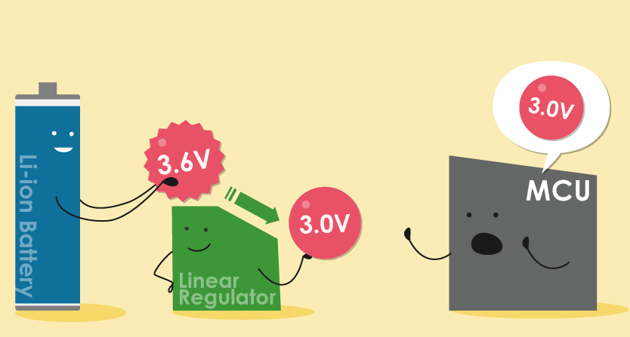
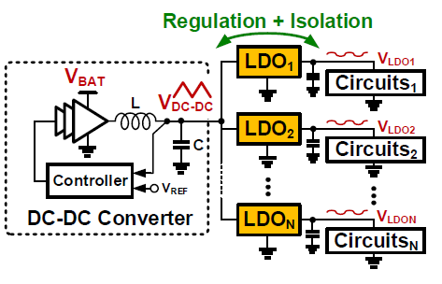
LDO Applications
Challenges in Power Supply:
Voltage fluctuations, noise, and transient disturbances.
Role of Voltage Regulators:
Ensure stable and precise voltage output.
Why LDO Regulators Matter:
Ideal for low-voltage IC applications.
Operate efficiently with minimal heat generation.
Maintain stability during rapid load transitions.

Slide 3
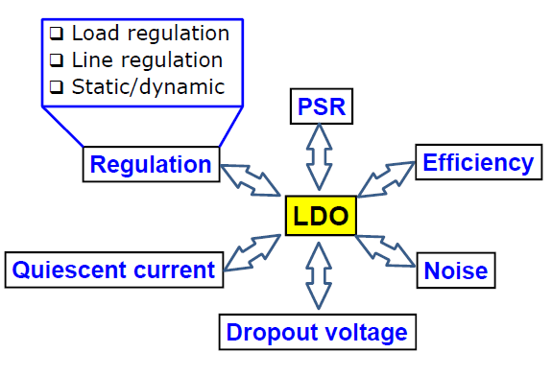
LDO Specifications
Purpose:
Stabilize output voltage by suppressing noise and ripple from DC-DC converters.
Key Specifications:
    Power Supply Rejection Ratio (PSRR): Ensures effective noise suppression.
    Low Quiescent Current: Minimizes power consumption in low-voltage applications.
    Low Dropout Voltage: Enables efficient operation at low input voltages.
    Load and Line Regulation: Maintains performance under varying conditions.
Applications:
Ideal for integration into high-speed systems (e.g., ADCs).

Slide 4
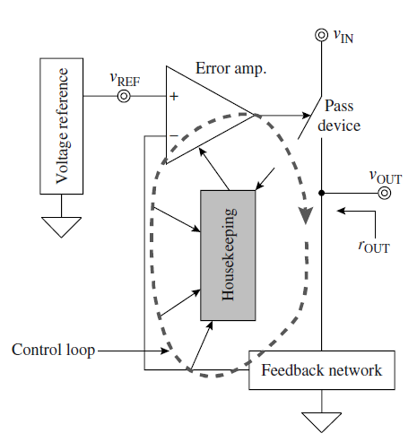
LDO Operation
Voltage Reference:
  Provides a stable DC bias voltage, resistant to noise and temperature fluctuations.
Control Loop:
  Error Amplifier: Detects discrepancies and generates corrective signals.
  Feedback Network: Monitors output voltage.
  Pass Device: Supplies load current from unregulated to regulated output.
Housekeeping Circuits:
Ensure safe and reliable operation with protection against:
  Overcurrent, overvoltage, overtemperature, short circuits, and ESD.

Slide 5
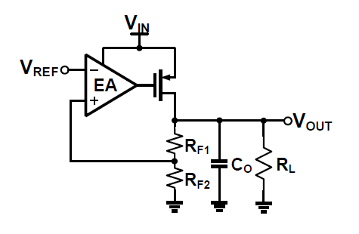
LDO Topology

Slide 6
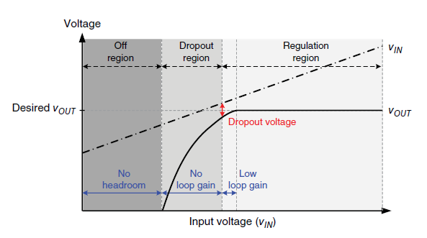
Dropout Voltage
VIN-VOUT at which VOUT is no longer regulated
Dropout voltage depends on pass device/load current
Dropout voltage is in the range of 0.1 to 0.5V

Slide 7
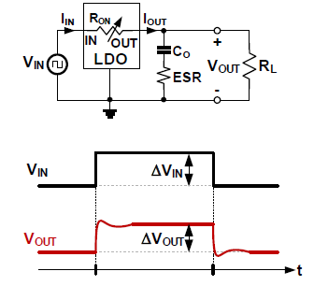
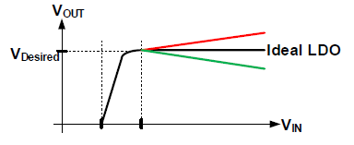
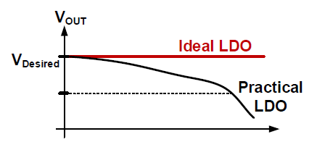
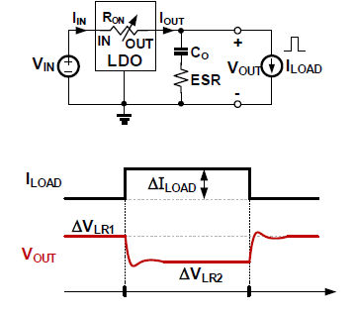


Line/Load Regulation and Transient Response
Line regulation = $\frac{∆V_{OUT}}{{∆V}_{IN}}$
Line Regulation
Line Transient Response
Load regulation = $\frac{∆V_{OUT}}{{∆I}_{OUT}}$
Load Regulation
Load Transient Response

Slide 8
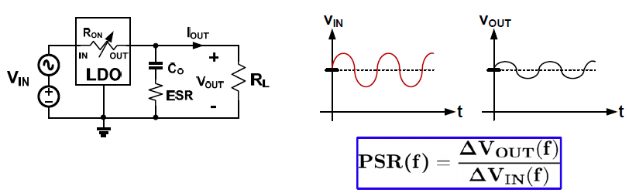
Power Supply Rejection
Regulator’s ability to reject VOUT variations due to changes in VIN
Similar to line regulation BUT measured vs. frequency
Similar to line transient BUT measured for “small signal” variations

Slide 9
Specification of OpAmp
DESIGN PARAMETERS |  | SPECIFICATIONS
VDD |  | 1.2V
Output mode |  | Single ended
Gain |  | > 60dB
Pharse Margin (PM) |  | > 60 degree
CMRR |  | > 60dB
Unity gain bandwidth |  | > 80MHz
Power consumption |  | < 1mW
Slew rate |  | 40V/us
Cap load |  | 1pF
ICMR |  | 0.6 - 1
PVT | Process | 5 process of MOS
 | Voltage | 1.08V-1.32V
 | Temperature | -40˚C to 125˚C

Slide 10
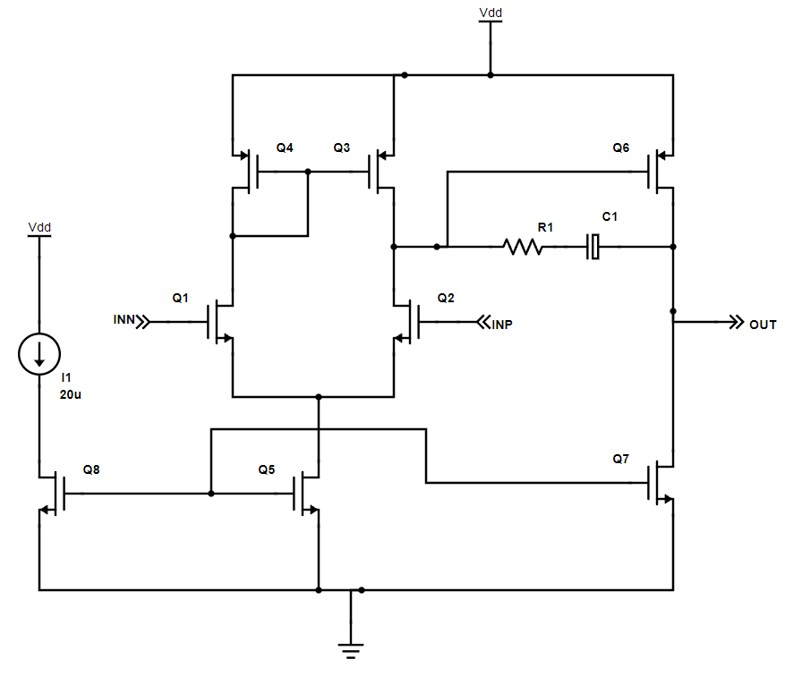
Schematic with sizing of OpAmp
W=4u
L=1u
W=104u
L=1u
2k
700f
W=10u
L=1u
W=6u
L=1u
W=6u
L=1u
W=78u
L=1u

Slide 11
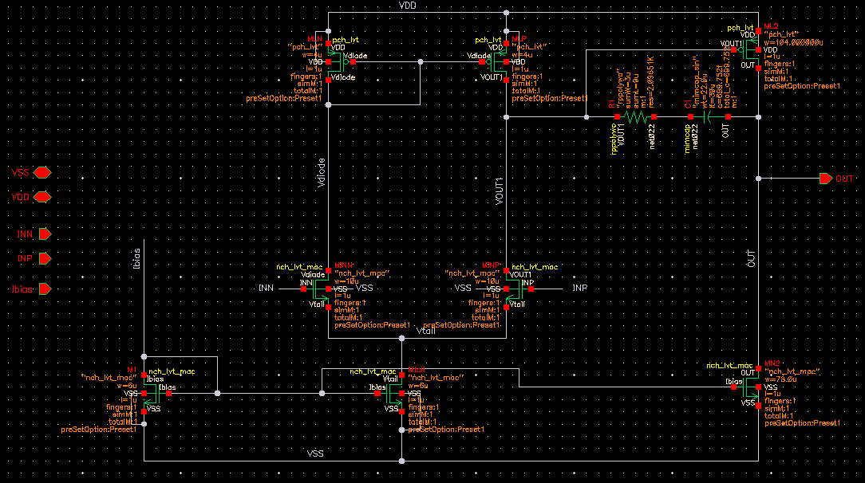
Schematic in Cadence

Slide 12
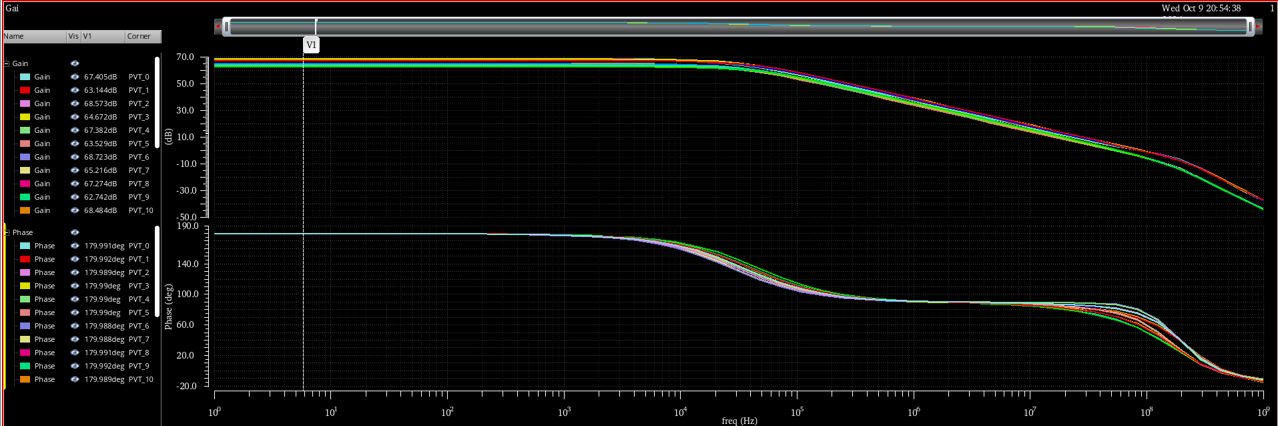
Open loop Gain

Slide 13
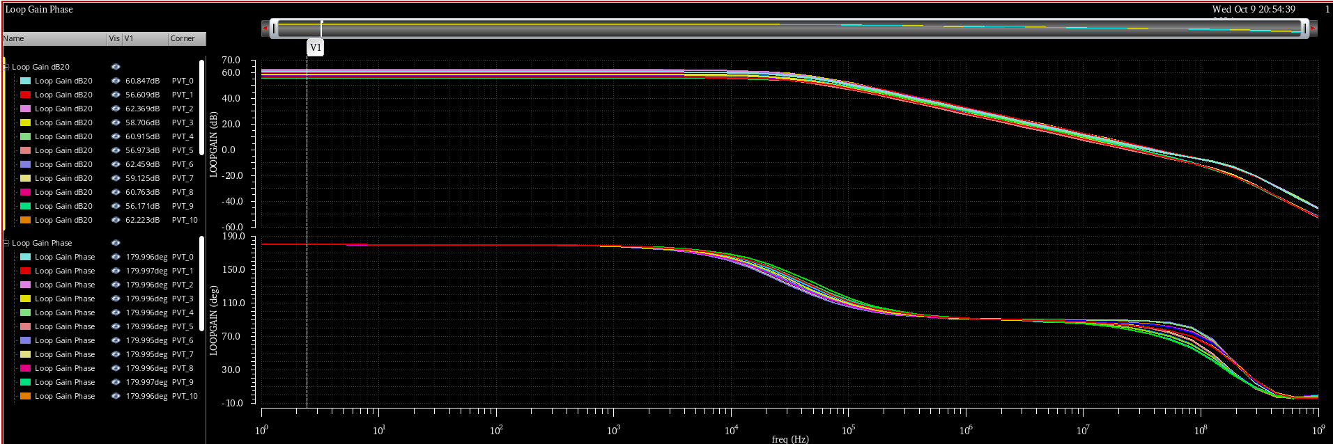
Closed loop Gain

Slide 14
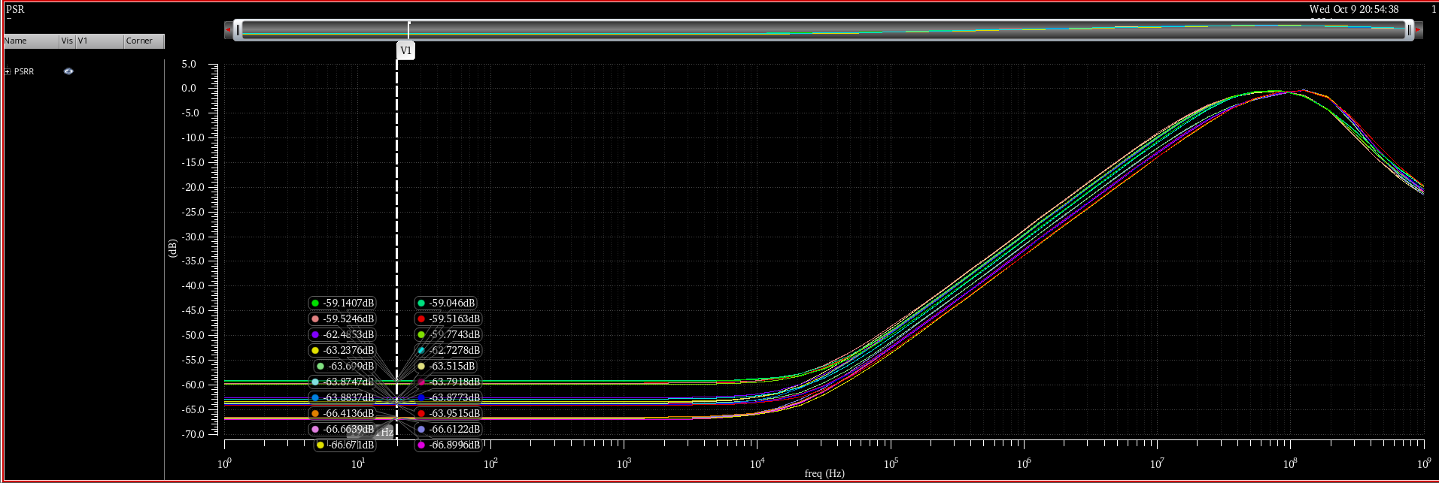
PSRR

Slide 15
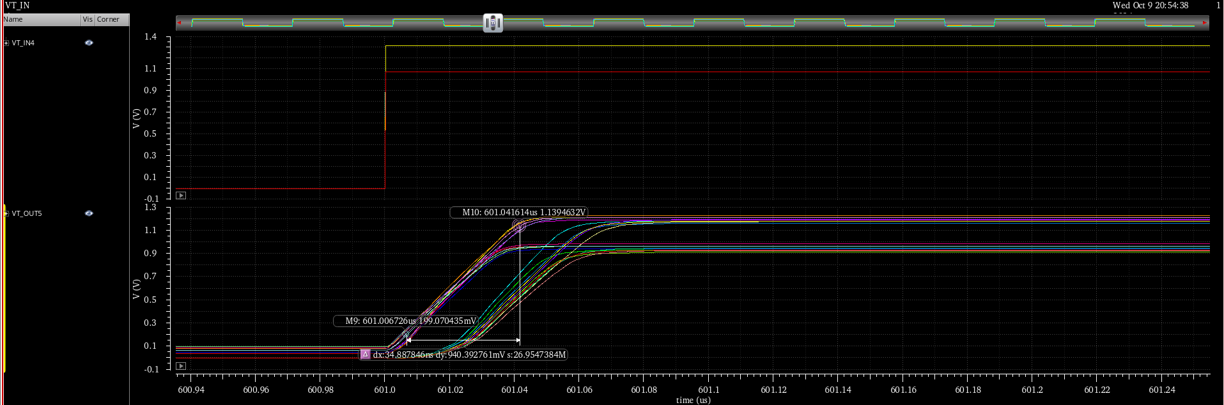
Slew rate

Slide 16
Results
Design specification |  | Min | Max | Typical | Test condition
Opened-loop gain |  | 62.64dB | 68.72dB | 67.04dB | In CM = 0.6
CMRR (single-ended) |  | 89.35 dB | 102.05dB | 69.88
Slew rate |  | 15.11V/uS | 31.15V/uS | 27V/uS
Unity gain BW | 1p | 52.75MHz | 96.73MHz | 74.32MHz
Phase Margin | 1p | 66.02 deg | 79.2 deg | 73.09 degree
Closed-loop gain |  | 56.17dB | 62.49dB | 60.75dB
ICMR |  | - | - | 0.5V to 1V | TTNN corner

Slide 17
Specification of LDO
DESIGN PARAMETERS |  | SPECIFICATIONS
VDD |  | 1.2V
Output Voltage |  | 0.75V
Dropout Voltage |  | 0.2V
Output current |  | 10uA - 1mA
PSRR |  | > 50dB
Phase margin |  | >60 degree
Cap load |  | 1pF
PVT | Process | 5 process of MOS
 | Voltage | 1.08V-1.32V
 | Temperature | -40˚C to 125˚C

Slide 18
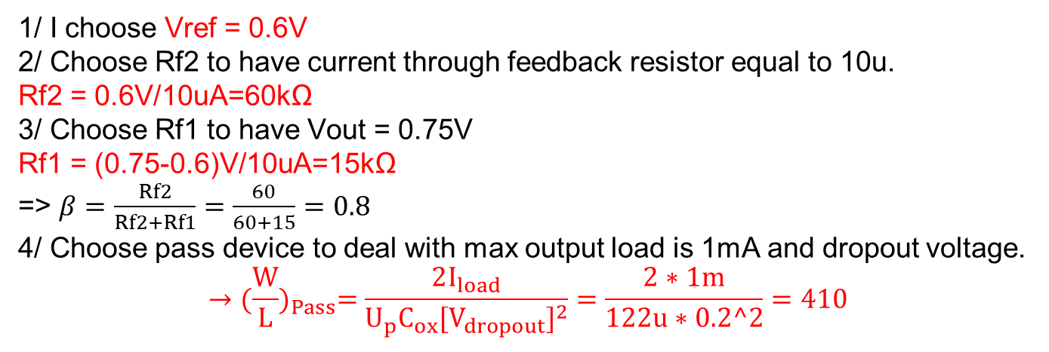
Design Procedure
1/ I choose Vref = 0.6V
2/ Choose Rf2 to have current through feedback resistor equal to 10u.
Rf2 = 0.6V/10uA=60kΩ
3/ Choose Rf1 to have Vout = 0.75V
Rf1 = (0.75-0.6)V/10uA=15kΩ
=> $β=\frac{Rf2}{Rf2+Rf1}=\frac{60}{60+15}=0.8$
4/ Choose pass device to deal with max output load is 1mA and dropout voltage.
$${→(\frac{W}{L})}_{Pass}=\frac{2I_{load}}{U_{p}C_{ox}{[V_{dropout}]}^{2}}=\frac{2∗1m}{122u∗0.2^2}=410$$

Slide 19
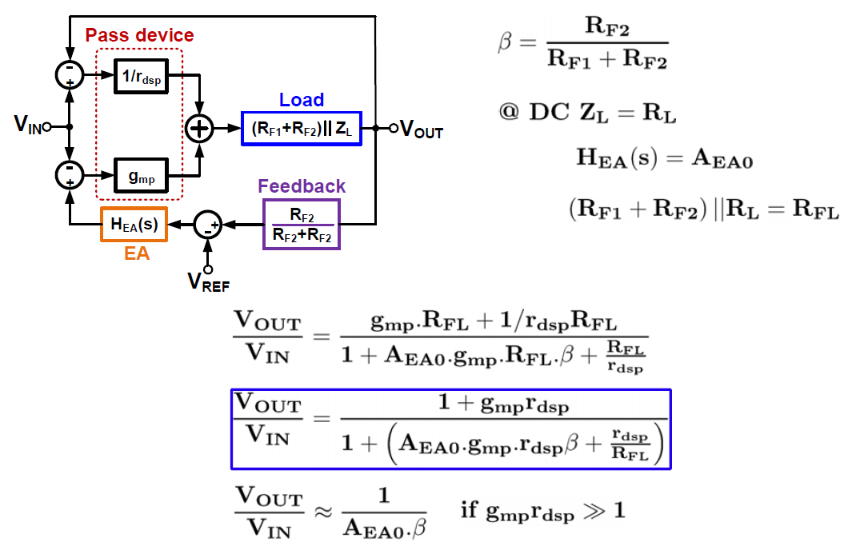
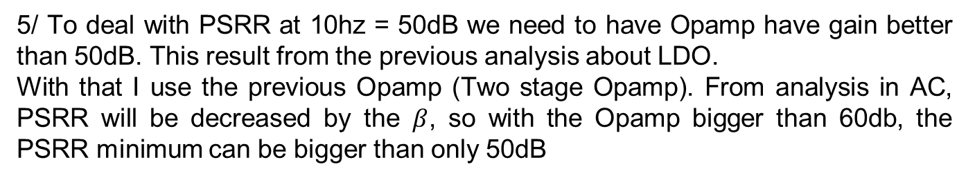
Design Procedure
5/ To deal with PSRR at 10hz = 50dB we need to have Opamp have gain better than 50dB. This result from the previous analysis about LDO.
With that I use the previous Opamp (Two stage Opamp). From analysis in AC, PSRR will be decreased by the $β$, so with the Opamp bigger than 60db, the PSRR minimum can be bigger than only 50dB

Slide 20
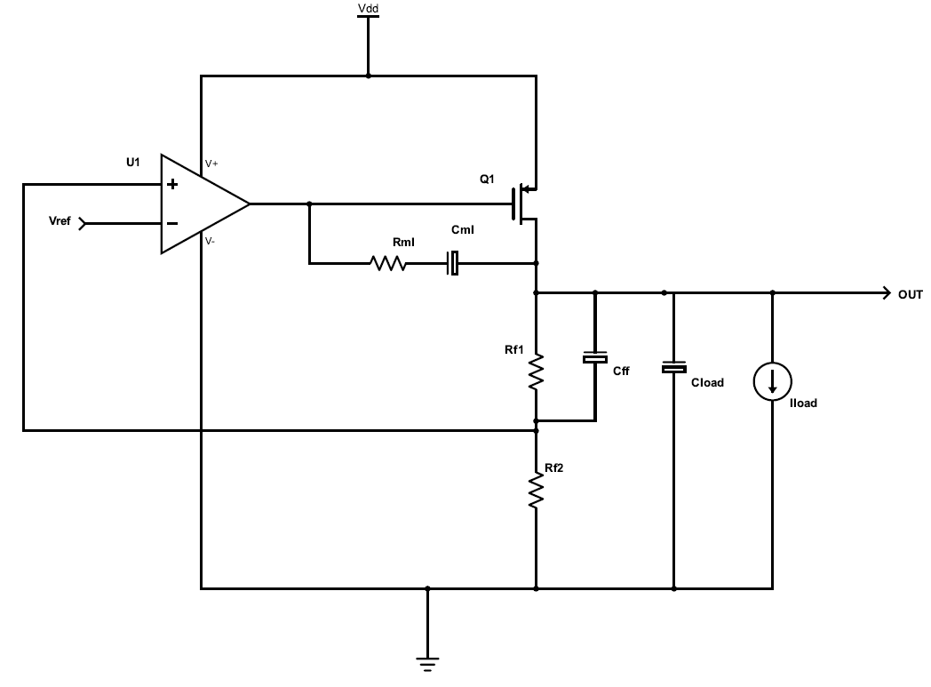
Design Procedure
6/ To deal with the Phase margin to have better than 60 degree, We use the RC miller and feed foward C to compensate and deal with that problem.

Slide 21
Schematic with sizing
W=4u
L=1u
W=208u
L=1u
W=10u
L=1u
W=6u
L=1u
W=6u
L=1u
W=78u
L=1u
W=28um
L=60nm
5.24KΩ
48.74pF
1pF
15kΩ
619.26fF
60kΩ

Slide 22
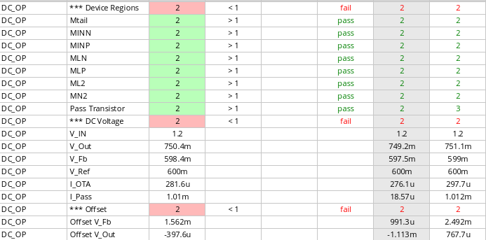
DC Operating point in PVT

Slide 23
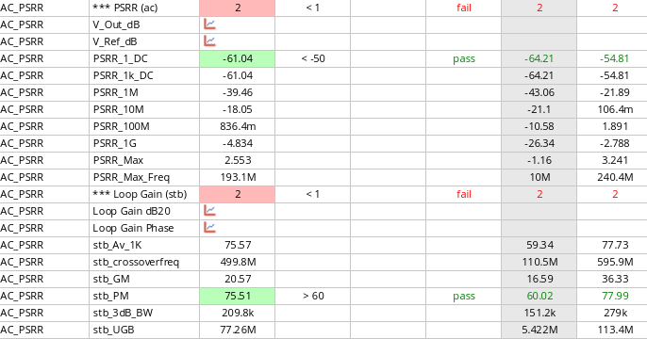
AC in PVT

Slide 24
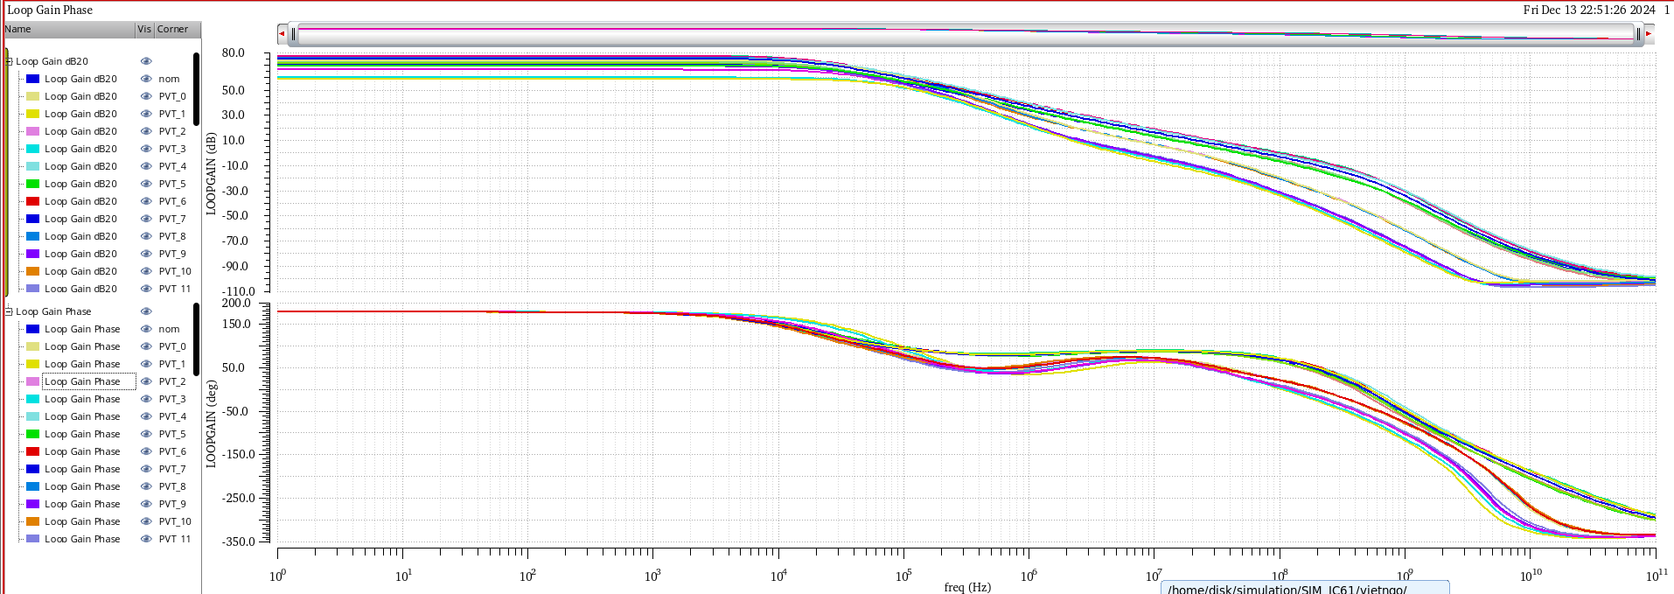
Loop gain and Phase in PVT

Slide 25
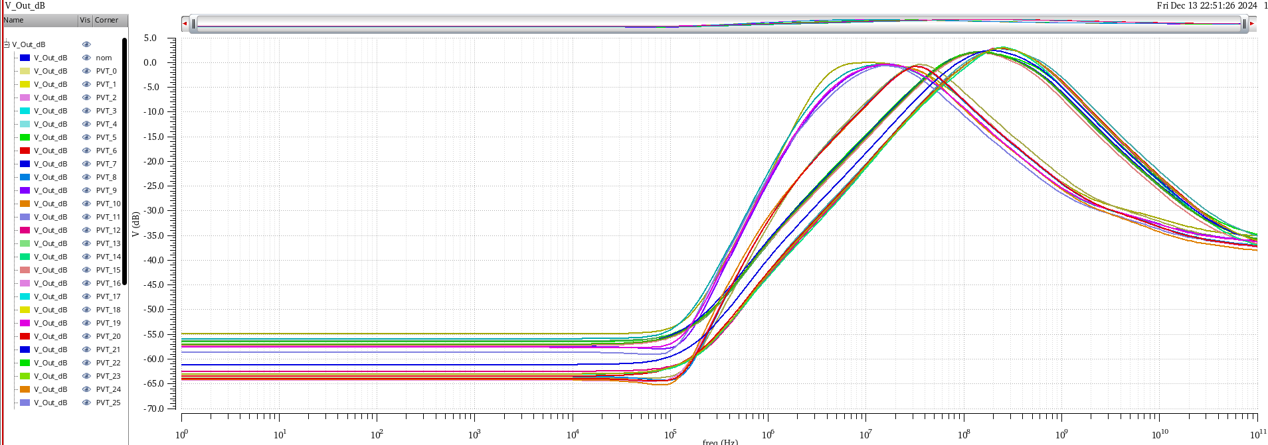
PSRR in PVT

Slide 26
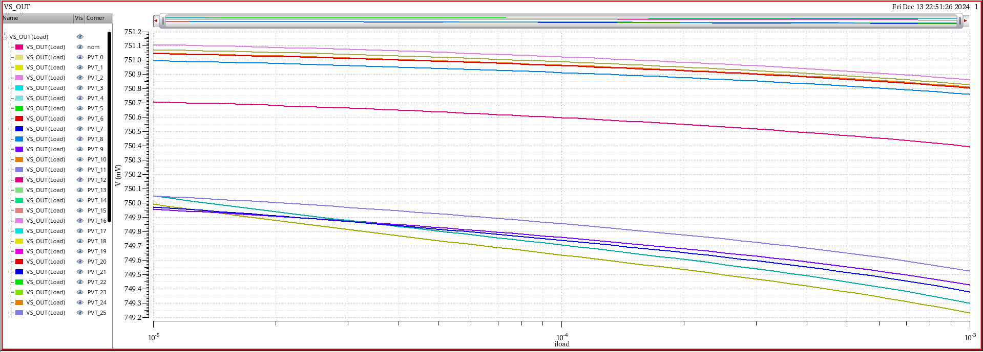
Load regulation in PVT

Slide 27
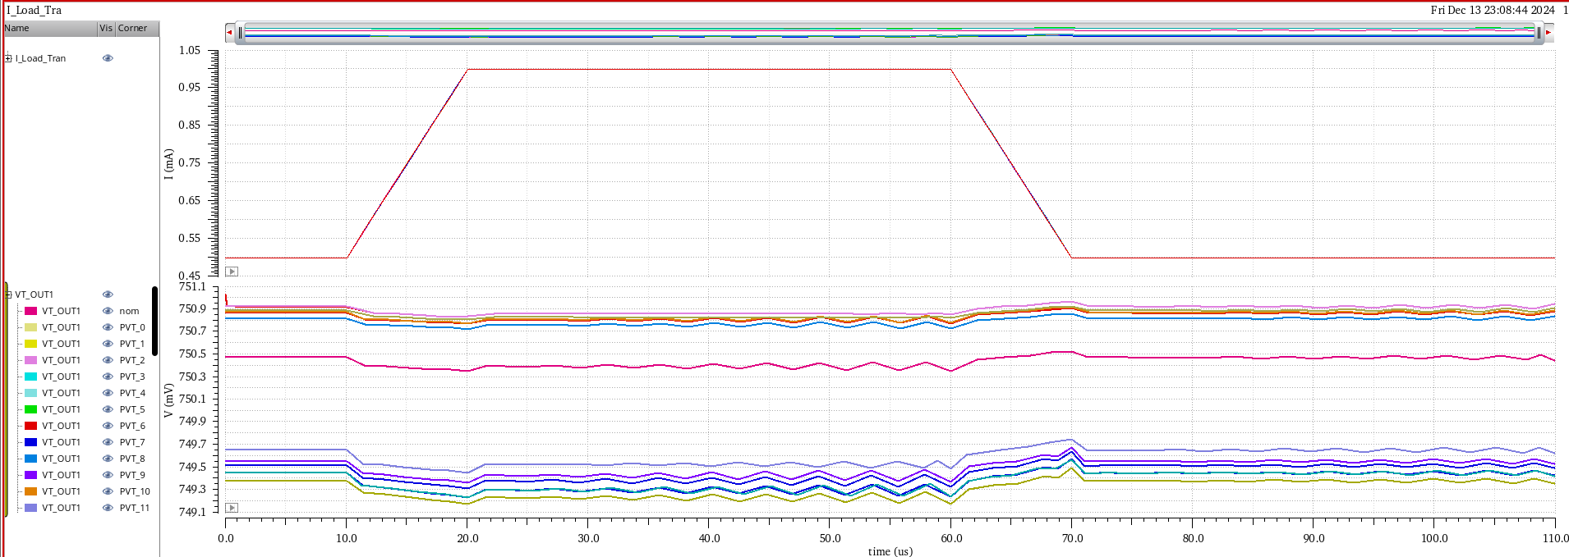
Load Transient Response in PVT

Slide 28
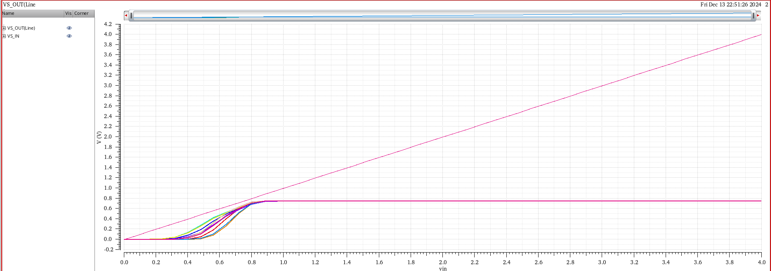
Line regulation in PVT

Slide 29
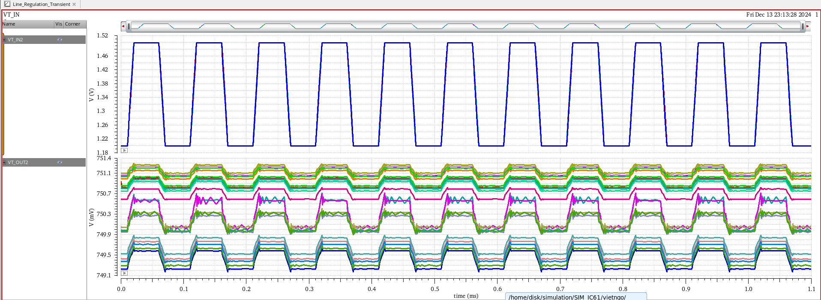
Line Transient Response in PVT

Slide 30
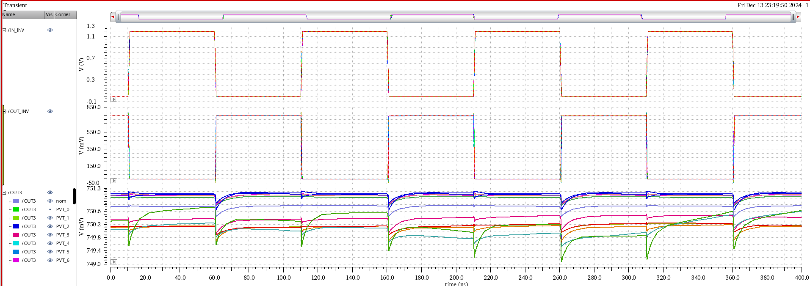
Transient Response with inverter in PVT

Slide 31
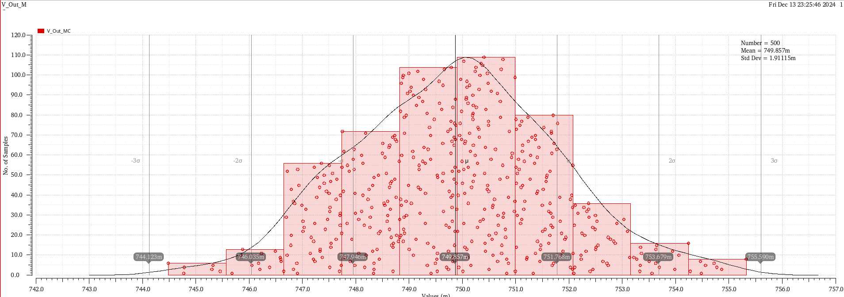
Monte Carlo VOUT LDO
VOUT 500 samples, temperature: 85, IloadL 500uA, VDD = 1.2V
Mean = 749,857mV
Std Dev = 1.9115mV
3* Std Dev = 5.7345mV

Slide 32
Reference
[1] Low Dropout Regulators, Pavan Kumar Hanumolu University of Illinois, Urbana-Champaign, P. Hanumolu CICC 2015
[2] Chen, K. (2016). Power Management techniques for integrated circuit design. https://doi.org/10.1002/9781118896846
[3] Gabriel Alfonso Rincon-Mora B.S. M.S. Ph.D. (1970, January 1). Analog IC design with low-dropout regulators. McGraw-Hill Education - Access Engineering. https://www.accessengineeringlibrary.com/content/book/9780071826631?implicit-login=true
[4] Y. Zhao, H. Quan, T. Zhang and J. Xiang, "A High-Performance LDO with Temperature-Coefficient Calibration," ITAIC, 2020.
[5] Robert J. Milliken; Jose Silva-Martinez; Edgar Sanchez-Sinencio, "Full On-Chip CMOS Low-Dropout Voltage Regulator," IEEE Transactions on Circuits and Systems I: Regular Papers, vol. 54, no. 9, pp. 1879 - 1890, 2007.
[10] "LDLN015 -150 mA - ultra low noise - high PSRR linear voltage regulator IC – ST32".

Slide 33
Thank you for watching

Slide 34
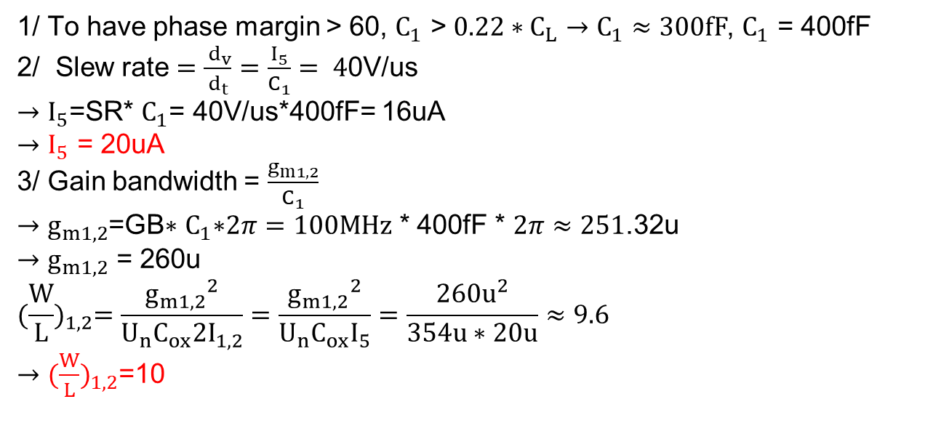
Apependix
Design Procedure OpAmp
1/ To have phase margin > 60, $C_{1}$ > ${0.22∗C}_{L}→C_{1}≈300fF$, $C_{1}$ = 400fF
  2/ Slew rate $=\frac{{ d}_{v}}{d_{t}}=\frac{I_{5}}{C_{1}}= 4$0V/us
              $→$ $I_{5}$=SR* $C_{1}$= 40V/us*400fF= 16uA
              $→$ $I_{5}$ = 20uA
3/ Gain bandwidth = $\frac{g_{m1,2}}{C_{1}}$
$→$ $g_{m1,2}$=GB$∗$ $C_{1}\text{∗}2π=100MHz$ * 400fF * $2π≈251$.32u
$→$ $g_{m1,2}$ = 260u
$${(\frac{W}{L})}_{1,2}=\frac{{g_{m1,2}}^{2}}{U_{n}C_{ox}2I_{1,2}}=\frac{{g_{m1,2}}^{2}}{U_{n}C_{ox}I_{5}}=\frac{{260u}^{2}}{354u∗20u}≈9.6$$
$→$ ${(\frac{W}{L})}_{1,2}$=10

Slide 35
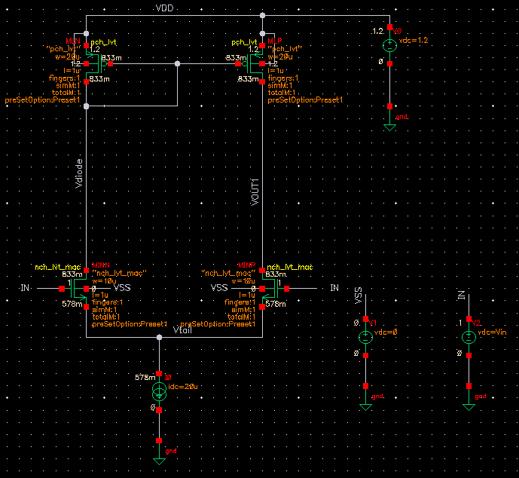


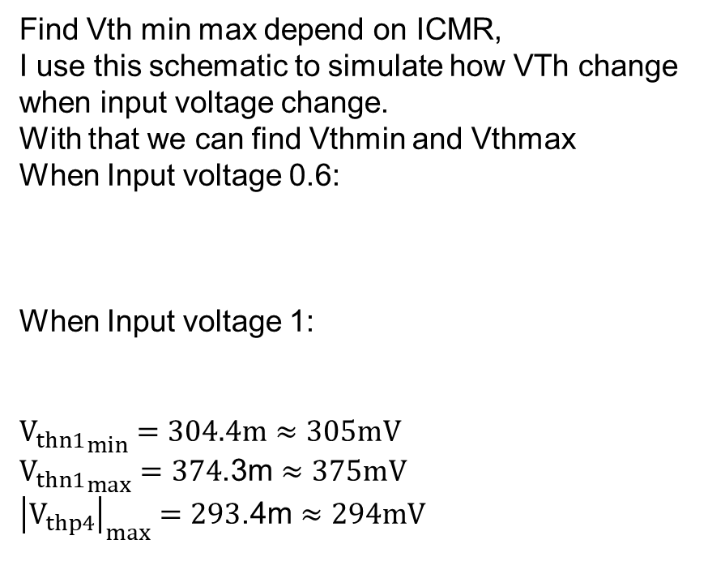
Apependix
Design Procedure OpAmp
Find Vth min max depend on ICMR,
I use this schematic to simulate how VTh change when input voltage change.
With that we can find Vthmin and Vthmax
When Input voltage 0.6:
When Input voltage 1:
$${V_{thn1}}_{min}=304.4m≈305mV$$
${V_{thn1}}_{max}=374$.3m $≈375mV$
${\left|V_{thp4}\right|}_{max}=293$.4m $≈294mV$

Slide 36
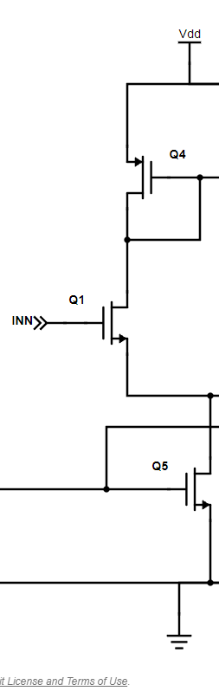
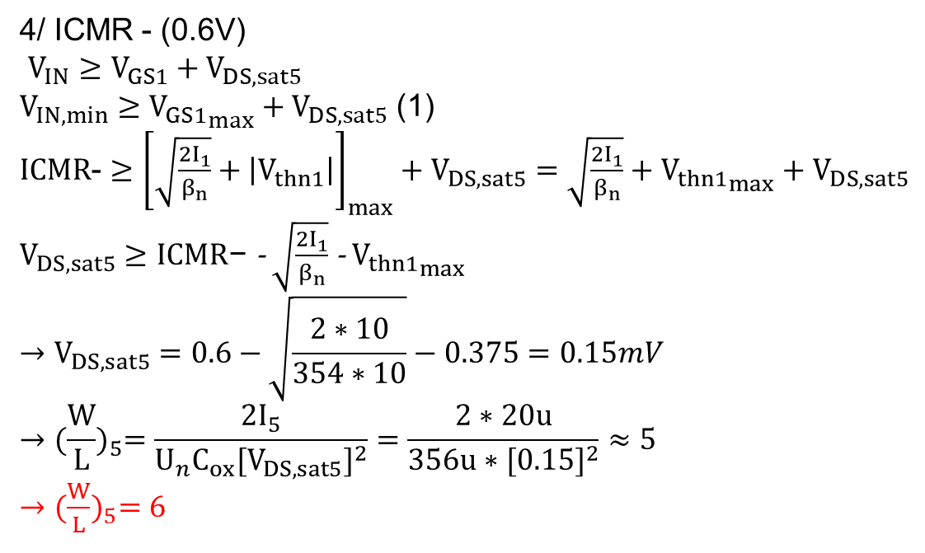
Apependix
Design Procedure OpAmp
4/ ICMR - (0.6V)
$V_{IN}≥V_{GS1}+V_{DS,sat5}$
$V_{IN,min}≥{V_{GS1}}_{max}+V_{DS,sat5}$ (1)
$ICMR$- $≥$ ${\left[\sqrt{\frac{2I_{1}}{β_{n}}}+\left|V_{thn1}\right|\right]}_{max}+V_{DS,sat5}=\sqrt{\frac{2I_{1}}{β_{n}}}+{V_{thn1}}_{max}+$ $V_{DS,sat5}$
$V_{DS,sat5}≥ICMR\text{−}$- $\sqrt{\frac{2I_{1}}{β_{n}}}$ - ${V_{thn1}}_{max}$
$$→V_{DS,sat5}=0.6−\sqrt{\frac{2∗10}{354∗10}}−0.375=0.15mV$$
$${→(\frac{W}{L})}_{5}=\frac{2I_{5}}{U_{n}C_{ox}{[V_{DS,sat5}]}^{2}}=\frac{2∗20u}{356u∗{[0.15]}^{2}}≈5$$
${→(\frac{W}{L})}_{5}=6$

Slide 37
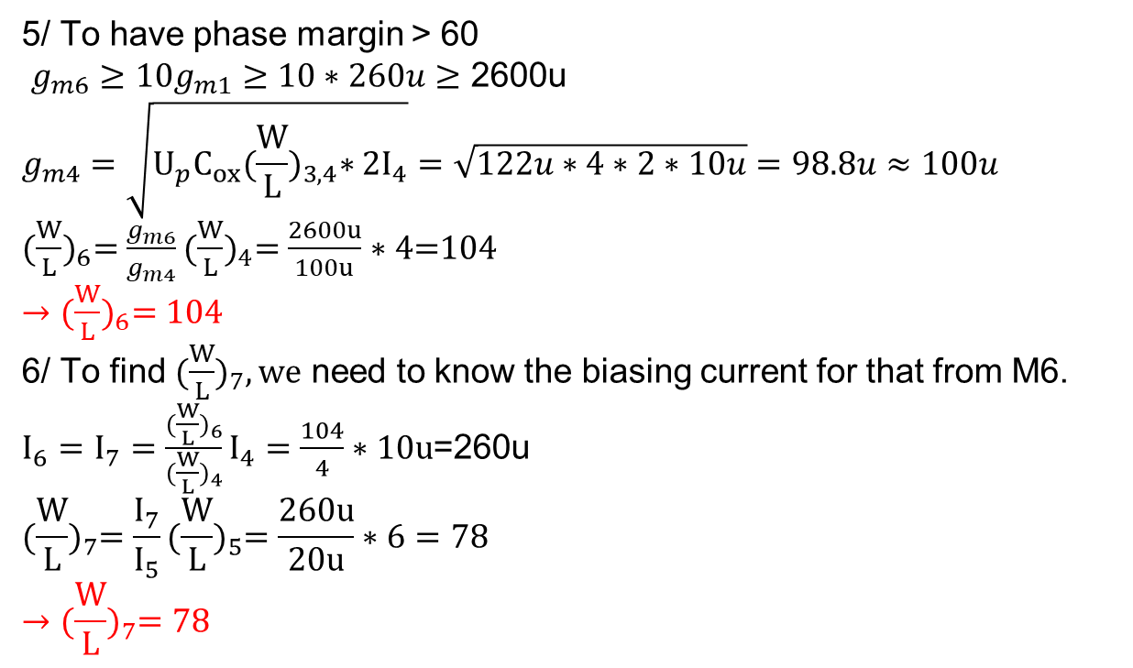
Apependix
Design Procedure OpAmp
5/ To have phase margin > 60
$g_{m6}≥{10g}_{m1}$ $≥10∗260u$ $≥$ 2600u
$$g_{m4}=\sqrt{U_{p}C_{ox}{(\frac{W}{L})}_{3,4}∗2I_{4}}=\sqrt{122u∗4∗2∗10u}=98.8u≈100u$$
${(\frac{W}{L})}_{6}=\frac{g_{m6}}{g_{m4}}{(\frac{W}{L})}_{4}=\frac{2600u}{100u}∗4$=104
${→(\frac{W}{L})}_{6}=104$
6/ To find ${(\frac{W}{L})}_{7}, we$ need to know the biasing current for that from M6.
$I_{6}=I_{7}=\frac{{(\frac{W}{L})}_{6}}{{(\frac{W}{L})}_{4}}I_{4}=\frac{104}{4}∗10u$=260u
$${(\frac{W}{L})}_{7}=\frac{I_{7}}{I_{5}}{(\frac{W}{L})}_{5}=\frac{260u}{20u}∗6=78$$
$${→(\frac{W}{L})}_{7}=78$$

Slide 38
Apependix
Design Procedure OpAmp
5/ To have phase margin > 60
$g_{m6}≥{10g}_{m1}$ $≥10∗260u$ $≥$ 2600u
$$g_{m4}=\sqrt{U_{p}C_{ox}{(\frac{W}{L})}_{3,4}∗2I_{4}}=\sqrt{122u∗4∗2∗10u}=98.8u≈100u$$
${(\frac{W}{L})}_{6}=\frac{g_{m6}}{g_{m4}}{(\frac{W}{L})}_{4}=\frac{2600u}{100u}∗4$=104
${→(\frac{W}{L})}_{6}=104$
6/ To find ${(\frac{W}{L})}_{7}, we$ need to know the biasing current for that from M6.
$I_{6}=I_{7}=\frac{{(\frac{W}{L})}_{6}}{{(\frac{W}{L})}_{4}}I_{4}=\frac{104}{4}∗10u$=260u
$${(\frac{W}{L})}_{7}=\frac{I_{7}}{I_{5}}{(\frac{W}{L})}_{5}=\frac{260u}{20u}∗6=78$$
$${→(\frac{W}{L})}_{7}=78$$

Slide 39
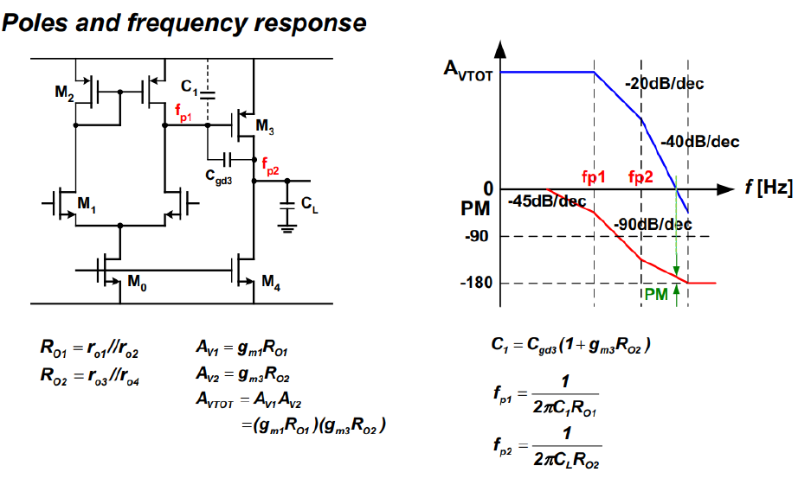
Apependix
OpAmp Frequency Response

Slide 40
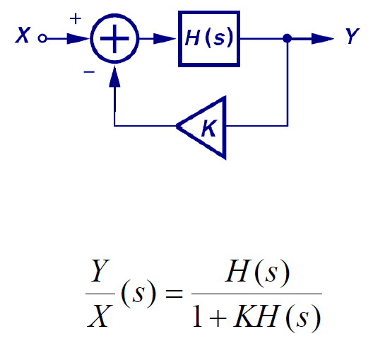
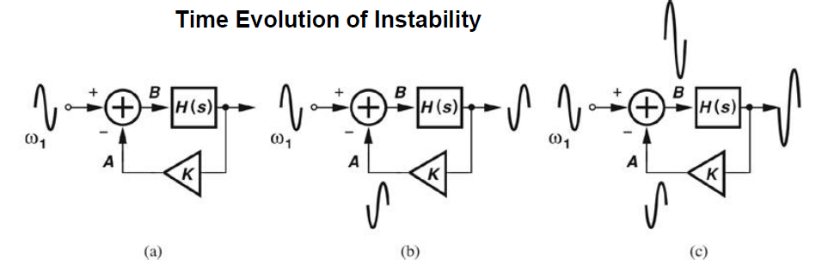
OpAmp Stability
Substitute jω for s.
If for a certain ω1, KH(jω1) reaches -1, the closed loop gain becomes infinite.
This implies for a very small input signal at ω1, the output can be very large.
Thus the system becomes unstable.
Notes:
Negative feedback use to stable output. It means that if output increase ky increase, x is stable, so after that vx-ky decrease. It multiple with Hs so it decrease y.
If phase shift 180, vx-ky increase, output increase, and it will increase infinitely

Slide 41
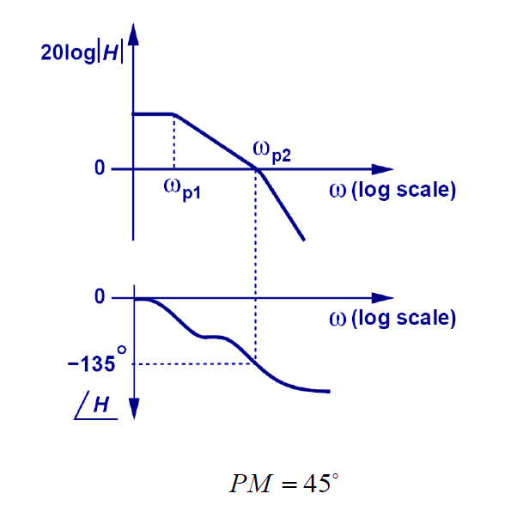
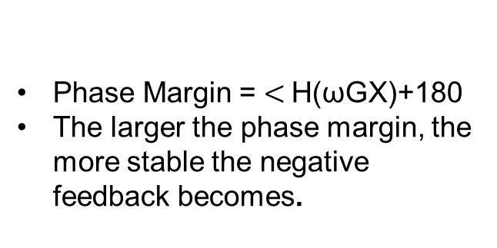
Phase Margin
Phase Margin = $<$H(ωGX)+180
The larger the phase margin, the more stable the negative feedback becomes.
Notes:
Negative feedback use to stable output. It means that if output increase ky increase, x is stable, so after that vx-ky decrease. It multiple with Hs so it decrease y.
If phase shift 180, vx-ky increase, output increase, and it will increase infinitely

Slide 42
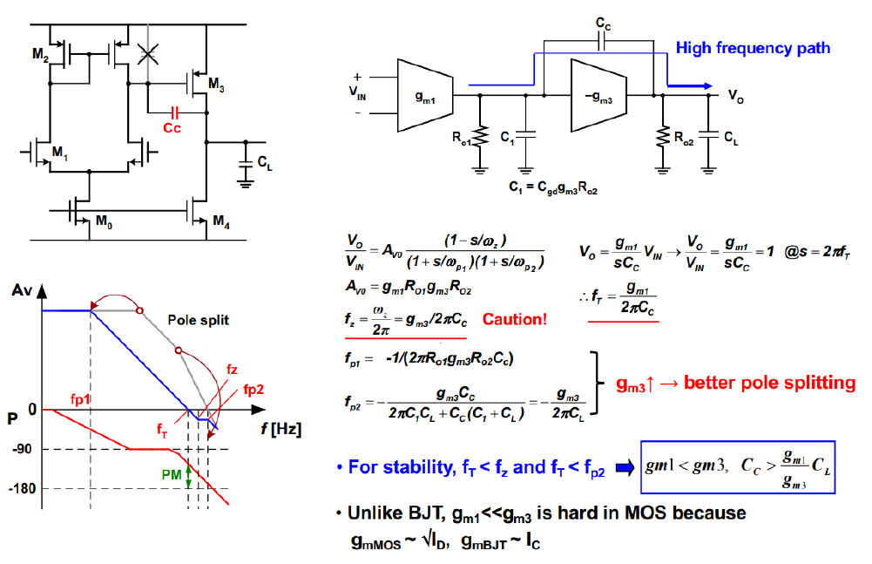
Frequency miller compensation of Two-Stage Amplifier

Slide 43
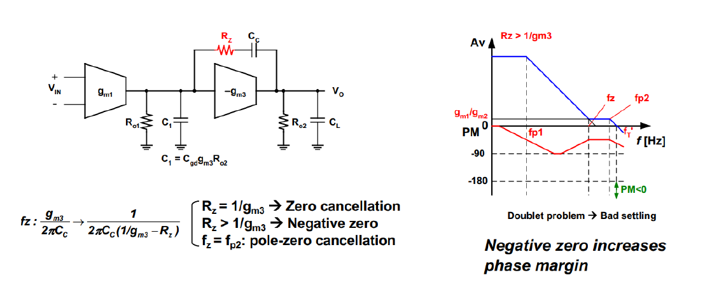
Zero Cancellation by Rz

Slide 44
Design Flow

Slide 45
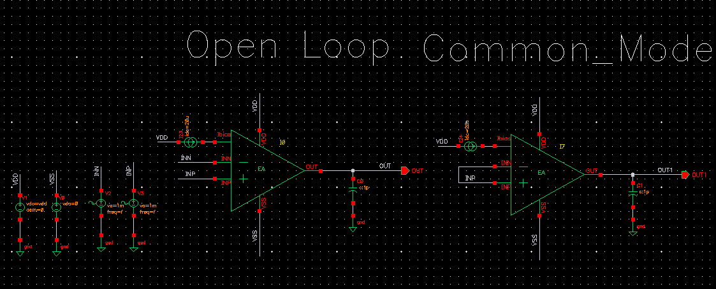
Testbench in Cadence

Slide 46
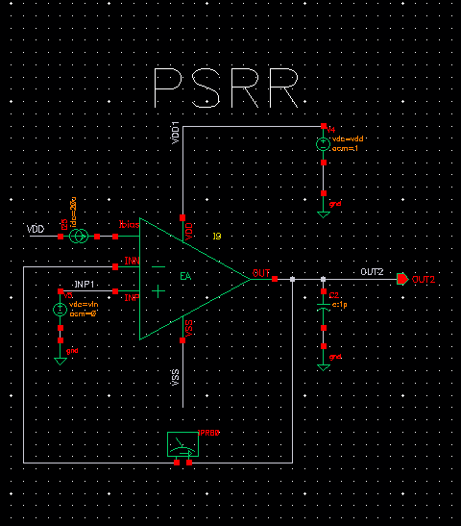
Testbench in Cadence

Slide 47
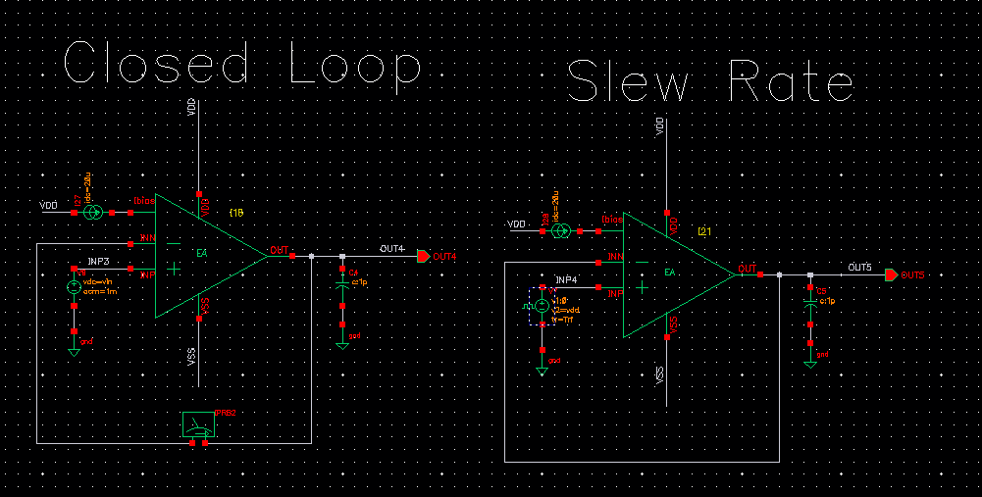
Testbench in Cadence

Slide 48
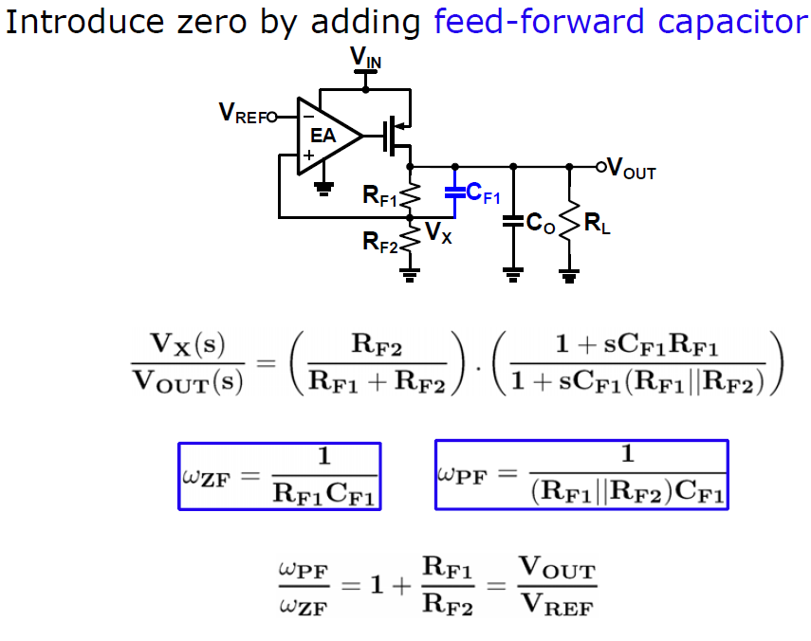
Design Flow

Slide 49
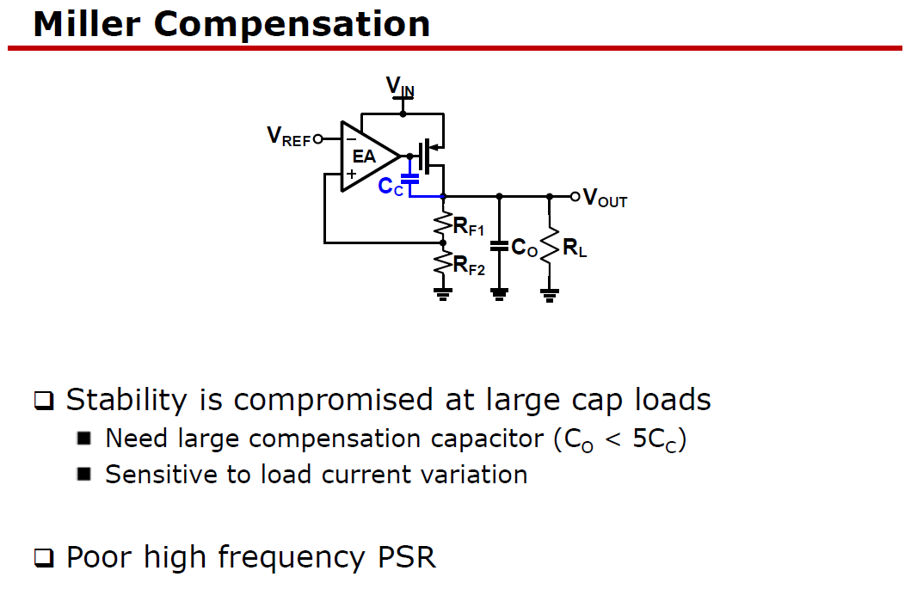

Slide 50
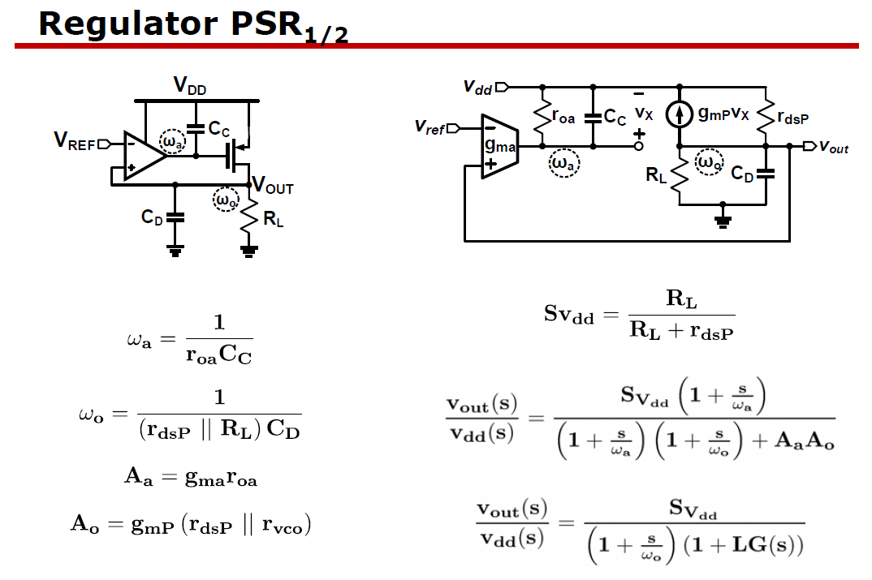

Slide 51


Slide 52


Slide 53

Testbench DC and AC in Cadence

Slide 54

Testbench Load regulation and Transient Response in Cadence

Slide 55

Testbench Line regulation and Transient Response in Cadence

Slide 56

Testbench Transient with Inverter in Cadence

Slide 57
Results
Design specification | [4] | [5] | [6] | Current work
Dropout voltage(mV) | 250 | 200 | 86-180 | 200
Output current(mA) | 200 | 50 | 150 | 1
PSRR(dB) | -40 | -60 | -90 | -50
Output capacitor(F) | 0.4n | 0-100p | 0.47u | 1p
Proccess | CMOS 65nm | CMOS 0.35u | N/A | CMOS 65nm

