Slide 1

Sorting Demonstration
Presentation begins

Slide 2
Team members
Phan Thái Việt - 20204895
Lê Thành Vinh - 20200668
Đoàn Ngọc Vinh - 20204935
Đinh Công Vũ - 20204896

Slide 3
Problem
Design
Visualize three sorting algorithms: MergeSort, CountingSort, RadixSort
An UI sorting visualizer

Slide 4
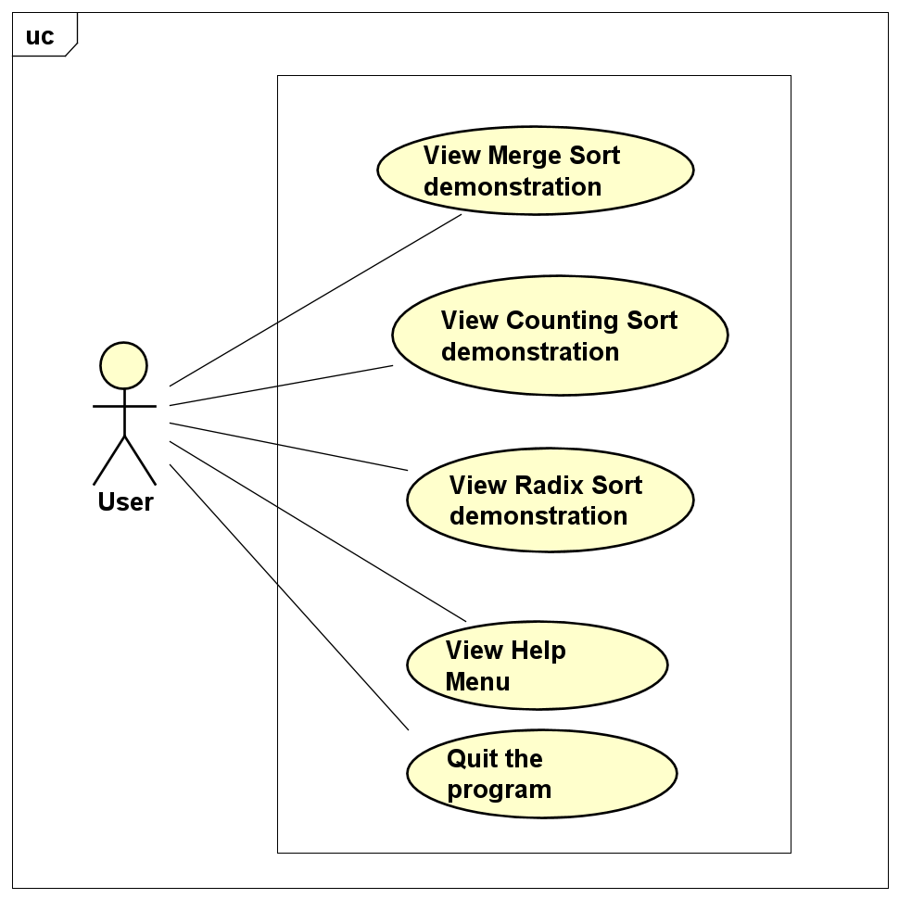
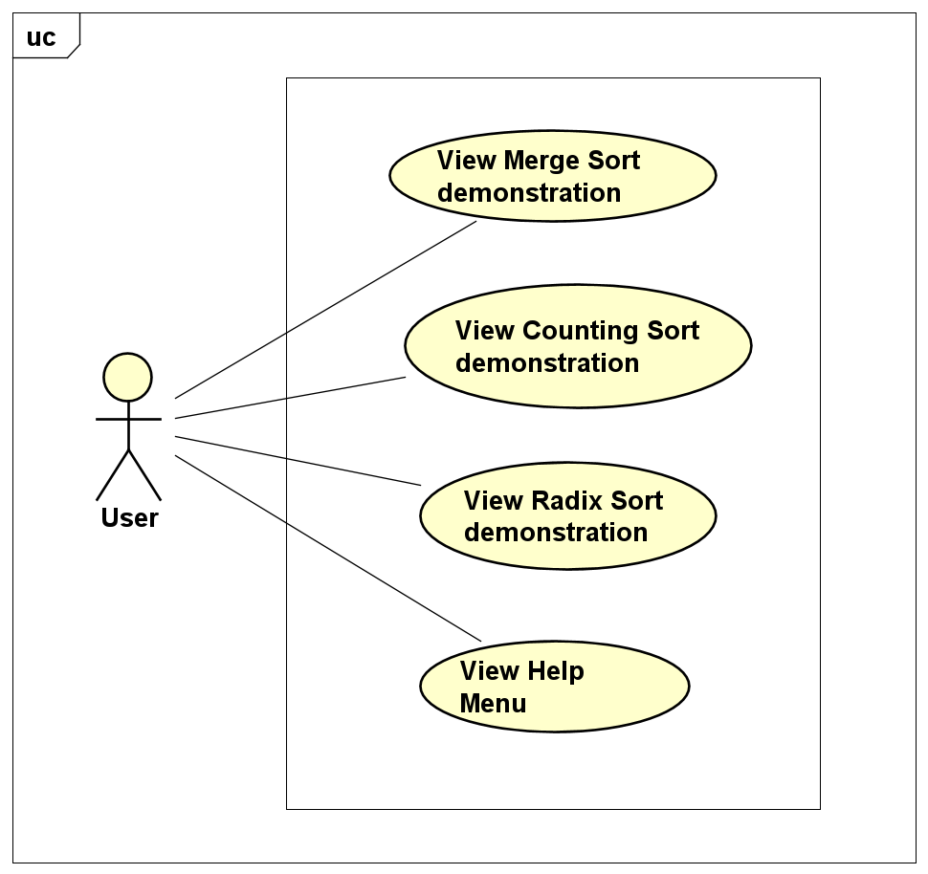

USE CASE DIAGRAM
User can choose to view one of the three counting algorithms
User can choose to view the help menu
User can choose to quit the program

Slide 5
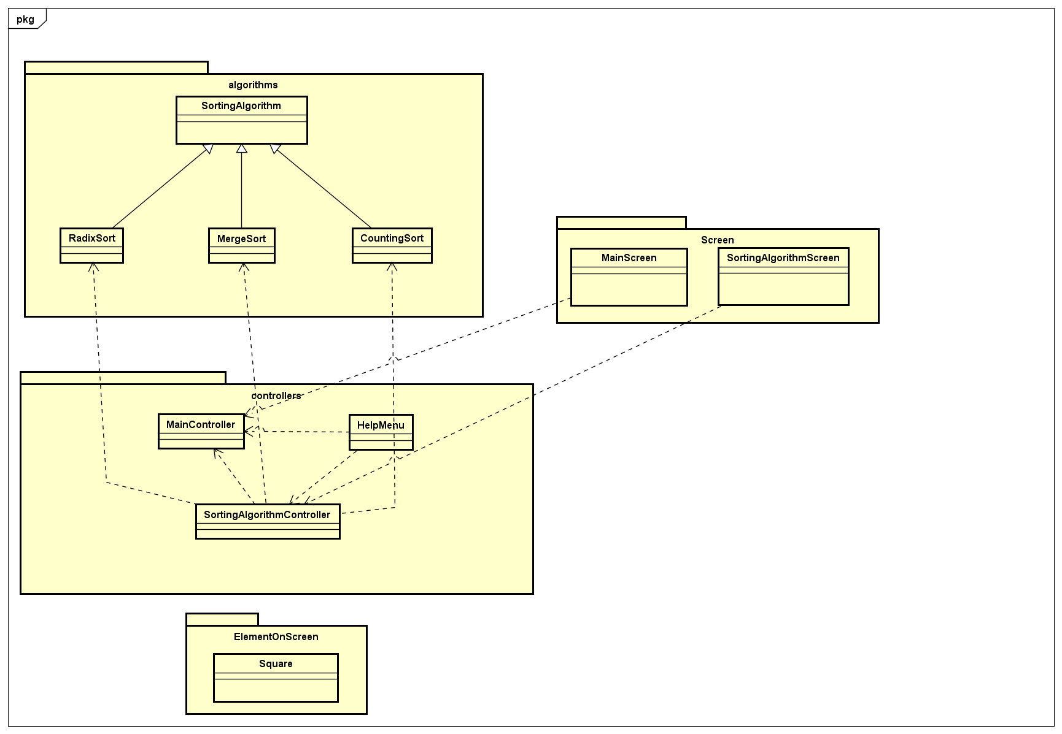
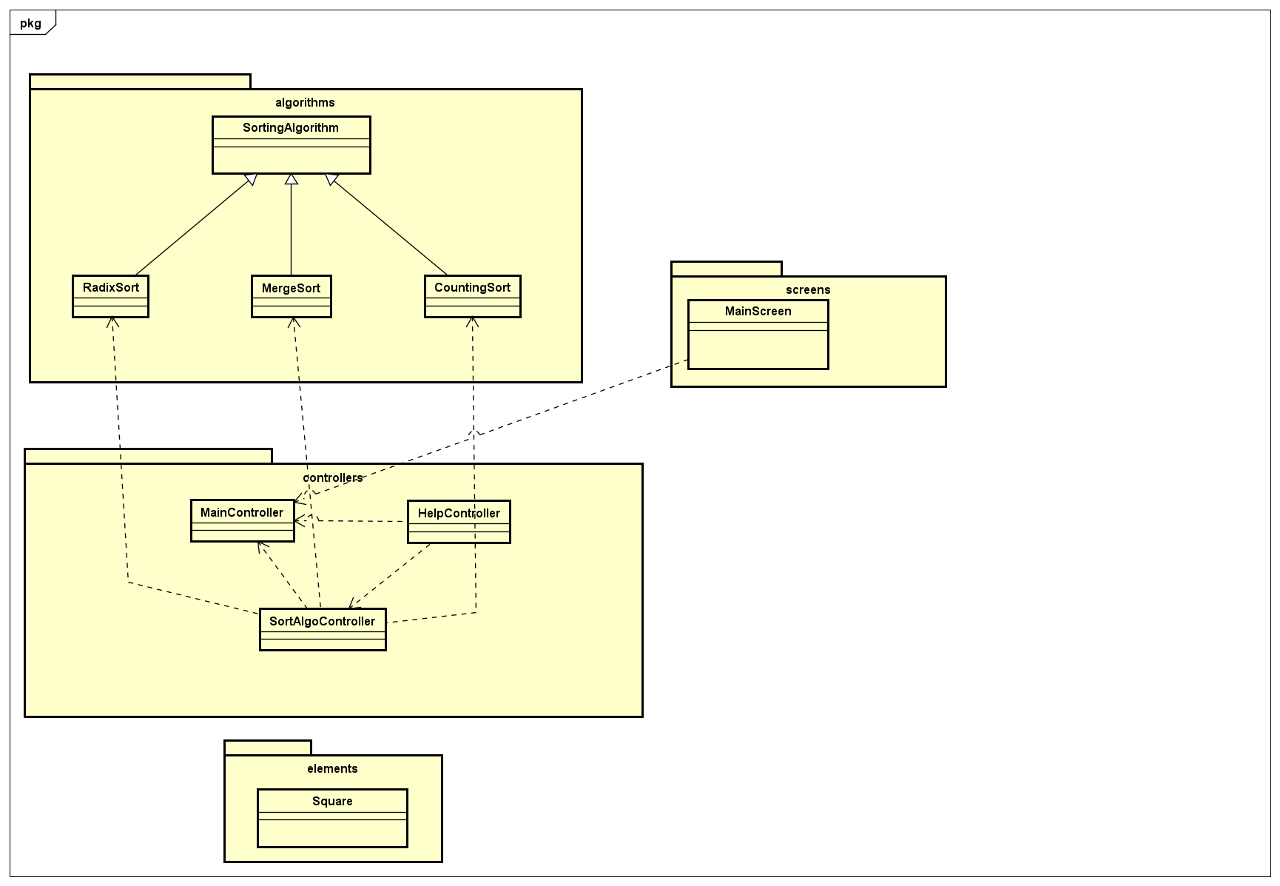
GENERAL CLASS DIAGRAM
‘algorithms’ package : Store 3 algorithms with abstract class SortingAlgorithm
‘controllers’ package : Store the two controller and the helpmenu controller
‘Screen’ package : Store the screen of the program
‘ElemenOnScreen’ package : store the class ‘square’

Slide 6
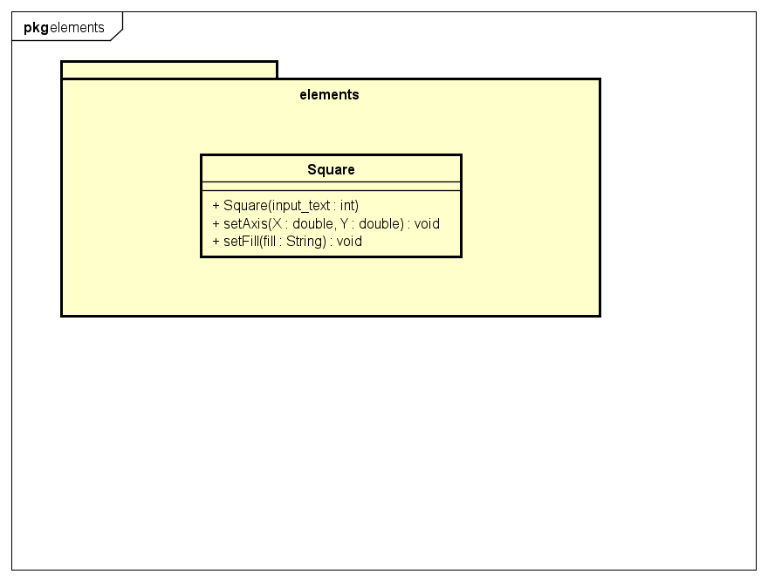
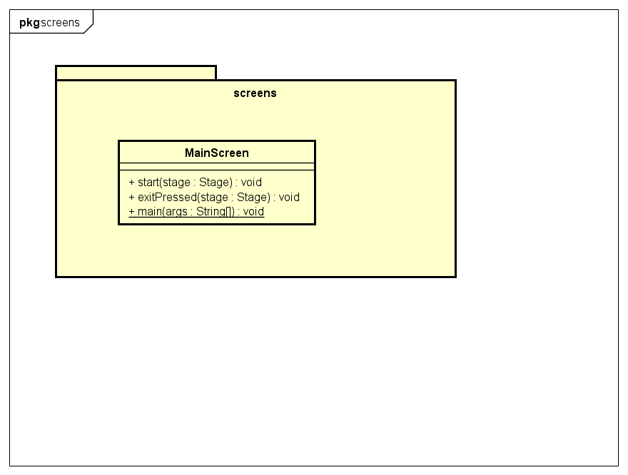
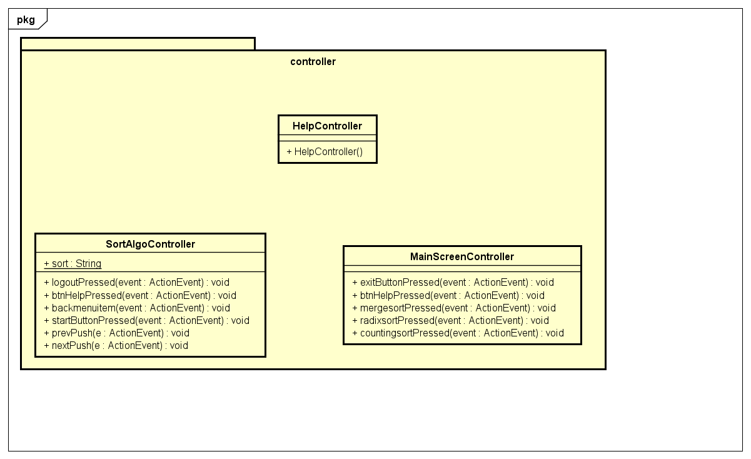
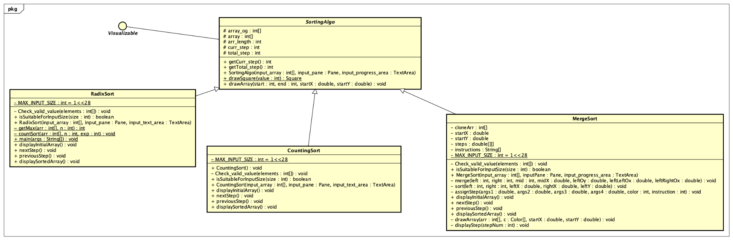
02
CONSULTING PROPOSAL
Sorting algorithm package

Slide 7
02
CONSULTING PROPOSAL
Controller package

Slide 8
02
CONSULTING PROPOSAL
Elements package

Slide 9
02
CONSULTING PROPOSAL
Screens package

Slide 10
OOP Technique
An abstract class sorting algorithm, the 3 algorithms inherit it.
Encapsulated methods and attributes in classes, avoid direct access from users.

Slide 11
~
Sorting Demonstration
link….

