Slide 1
PAGE REPLACEMENT ALGORITHM
Operating System

Slide 2

GROUP 15
Phan Thai Viet - 20204895
Nguyen Hung Anh - 20200028
Nguyen Huu Tuan Duy - 20204907
Hoang Gia Nguyen - 20204889

Slide 3
TABLE OF CONTENTS.
01 | Introduction
02 | Page Replacement algorithm
03 | GUI implementation

Slide 4
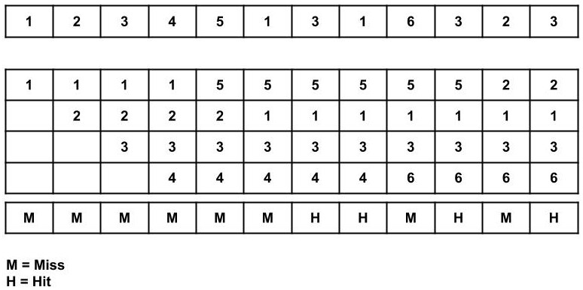
1. Introduction
A page replacement algorithm is needed to decide which page needs to be replaced when a new page comes in
Function: Reduce the frequency of disk accesses and improve system performance

Slide 5
2. Page Replacement Algorithm

Slide 6
2.1. FIFO
FIFO is a simple page replacement algorithm that maintains a queue of all pages in physical memory
Advantages:
Simple to implement and understand
Require minimal overhead
Disadvantage:
Can lead to poor performance in specific scenario
Lack of consideration for the frequency of page access

Slide 7
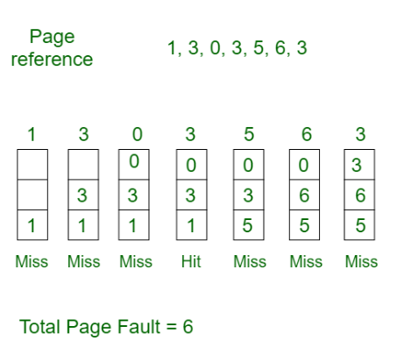

Slide 8
2.2. LRU
LRU is a popular page replacement algorithm that selects the page that has not been used for the longest period of time for replacement
Advantages:
Prioritize frequently used pages, leading to better
Relatively simple to understand and implement
Disadvantage:
The implementation can be more complex and difficult to optimize for large-scale systems

Slide 9
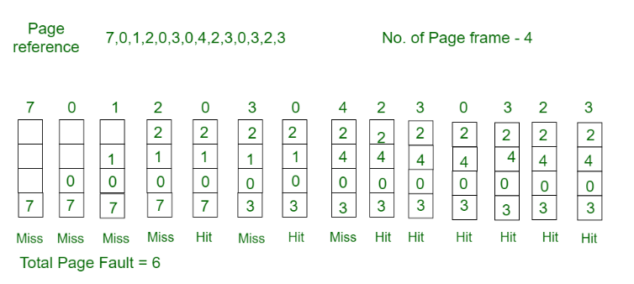

Slide 10
2.3. OPR
The OPR algorithm is an idealized approach to page replacement in which the page that will not be used for the longest time in the future is selected for eviction
Advantages:
Selects the page that will result in the fewest number of page faults
OPR has relatively low overhead compared to other page replacement algorithms
Disadvantage:
Requires perfect knowledge of the future page access pattern

Slide 11
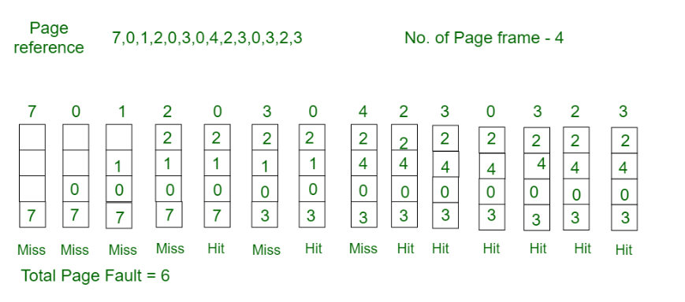

Slide 12
3. GUI implementation

Slide 13
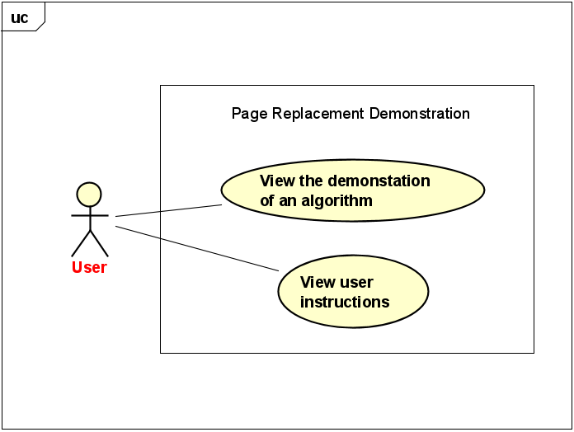
3.1. Usecase Diagram
Includes the following actors:
The system, which provides the GUI and runs the page replacement algorithms
The user, who interacts with the GUI

Slide 14
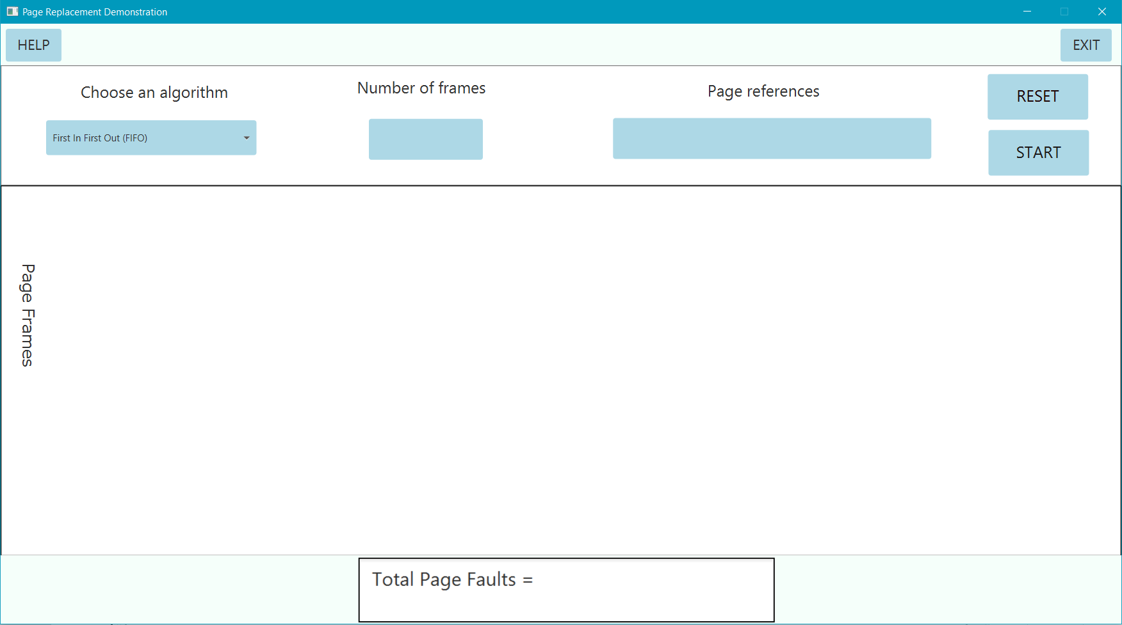

Slide 15
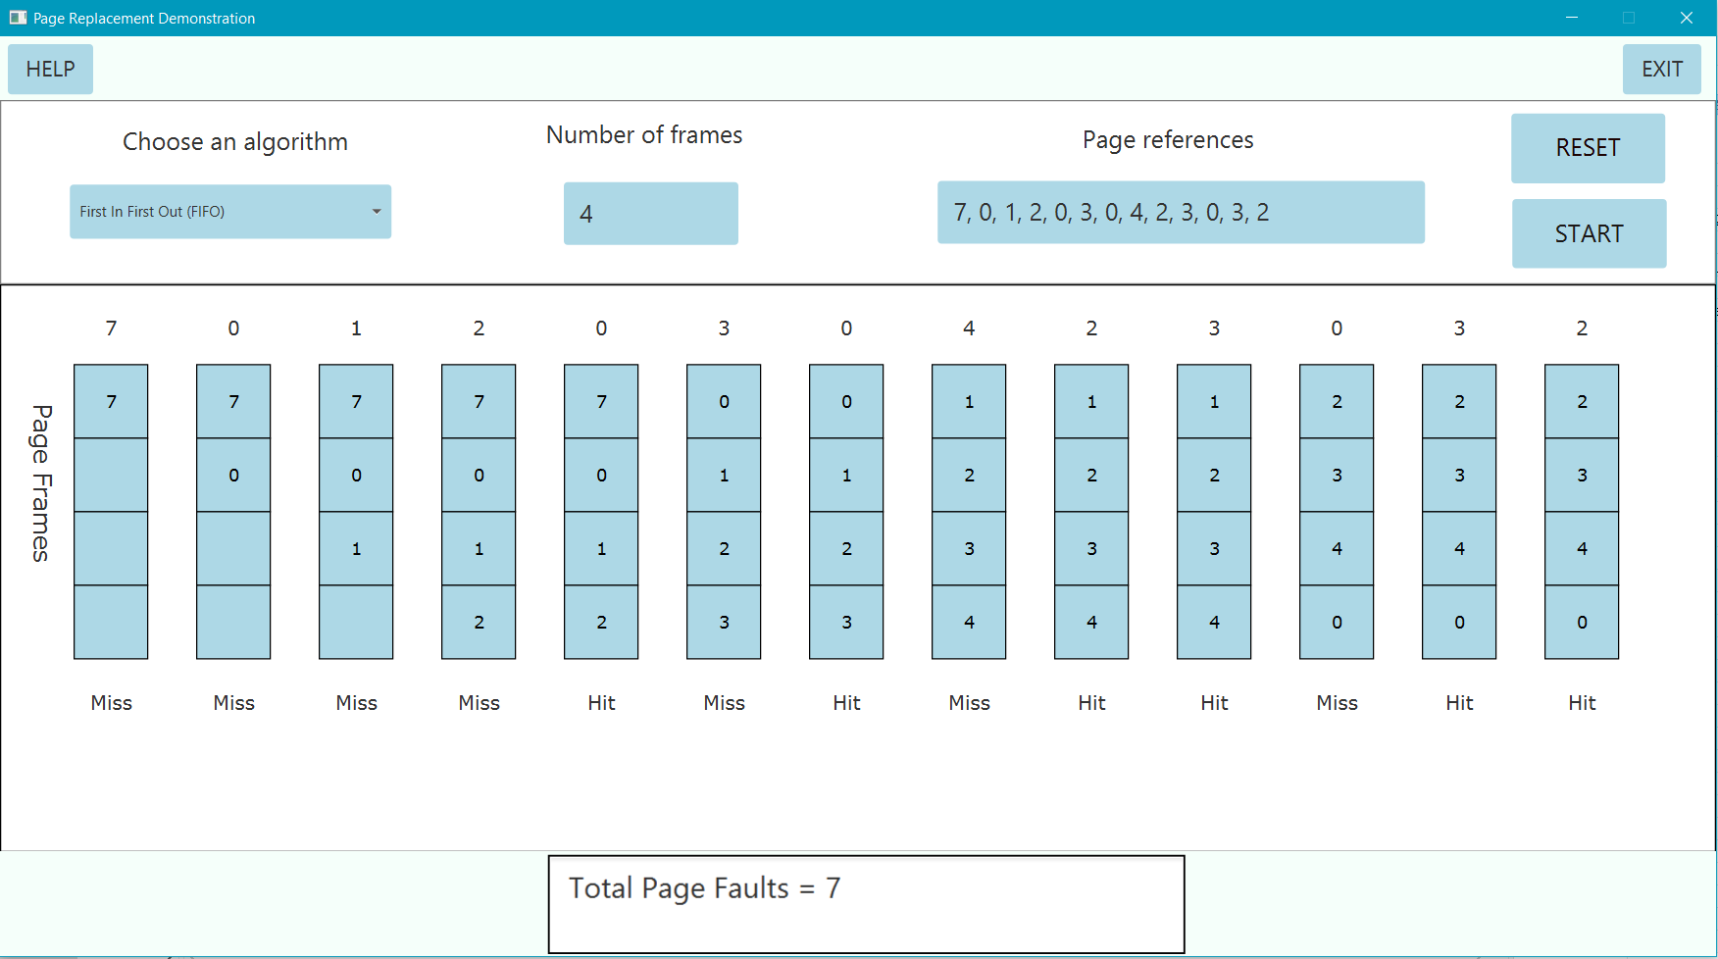

Slide 16
THANK YOU!
Do you have any questions?

