Slide 1
Machine Learning Course
Dog Breed Images Classification
Vu Tran 94607

Slide 2
Introduction
Developing an algorithm that could be used as part of mobile or application to identify Dog images ,human faces. If a dog is detected , it will provide an estimate of the dog's breed.If a human is detected , it will provide an estimate of accuracy.
I

Slide 3
Outline Steps
import Datasets
Detect humans
Detect dogs
Use a CNN to Classify Dog Breeds (using pre-trained RESNET 50)
Create a CNN to Classify Dog Breeds (from Scratch)
Create a CNN to Classify Dog Breeds (using Transfer Learning)
Write Algorithm
Test our Algorithm
I

Slide 4
Implementation
Assess the Human Face Detector
Detect Dogs
Pre-process the Data
Rescaling the images by dividing every pixel in every image by 255.

Slide 5
DataSet
Dogs Dataset:
Training DataSet 6680 samples
Validation Dataset 126 samples
Test Dataset 836 Dog images
Human Dataset:
13233 total human images

Slide 6
Detect Humans
Open CV with pre-trained face detectors
Before using any of the face detectors, it is standard procedure to convert the images to grayscale. The detectMultiScale function executes the classifier stored in face_cascade and takes the grayscale image as a parameter.

Slide 7
Detect Dogs
Pre-trained RESNET 50
ImageNet weights

Slide 8
Detect Dogs
Pre-trained RESNET 50
ImageNet weights

Slide 9
Build The Model From Scratch
Rescaling the images by dividing every pixel in every image by 255.
Classes are slightly imbalanced
CNN is created with 3 max pooling layers to reduce model parameters
with filters 16 ,32 ,64 stride is 2.
All layers has the same Relu activation functions.

Slide 10
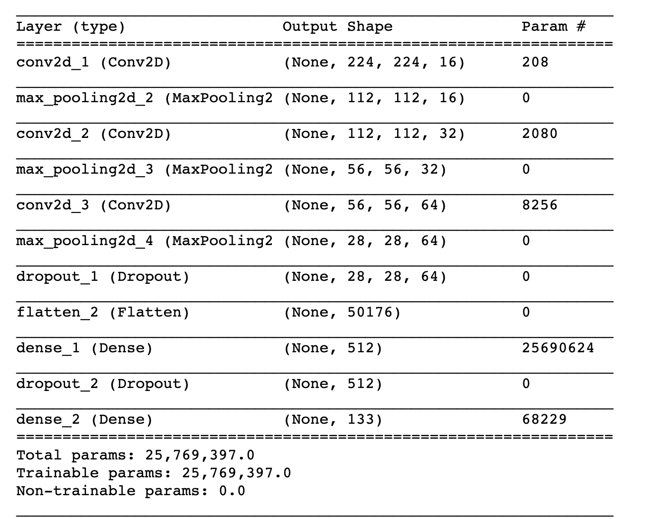
Model Summary

Slide 11
Pre-trained CNN pre-trained VGG-16 model
Saving times
Transfer learning

Slide 12
Summary
The model with pre-trained VGG 16 provides the best accuracy
By using Image Augmentation.
Accuracy could be improved if we provide more data for training (More Breeds can be added).

